Slide 1



Project Name:
School and University Partnership for Peer Communities of learners
(SUP4PCL)
Project Number:
573660-EPP-1-2016-1-EG-EPPKA2-CBHE-JP (2016-2516/001-001)
Work Package 1.3:Development of Materials
December 11th – 13th , 2017
Ain Shams University Cairo, Egypt
This project has been funded with support from the European Commission. This publication [communication] reflects the views only of the author, and the Commission cannot be held responsible for any use which may be made of the information contained therein

Slide 2

This project has been funded with support from the European Commission. This publication [communication] reflects the views only of the author, and the Commission cannot be held responsible for any use which may be made of the information contained therein

Slide 3
Meeting in October 3rd ,this meeting was held to discuss travel arrangements and divide the teams and select leader for each school.
This project has been funded with support from the European Commission. This publication [communication] reflects the views only of the author, and the Commission cannot be held responsible for any use which may be made of the information contained therein

Slide 4
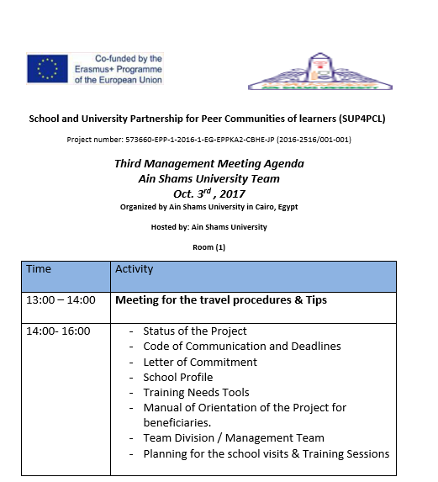
agenda
This project has been funded with support from the European Commission. This publication [communication] reflects the views only of the author, and the Commission cannot be held responsible for any use which may be made of the information contained therein

Slide 5
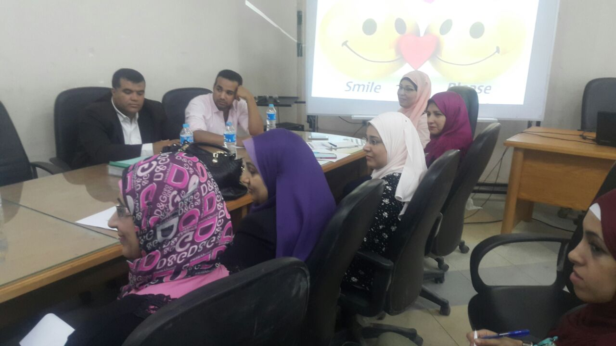
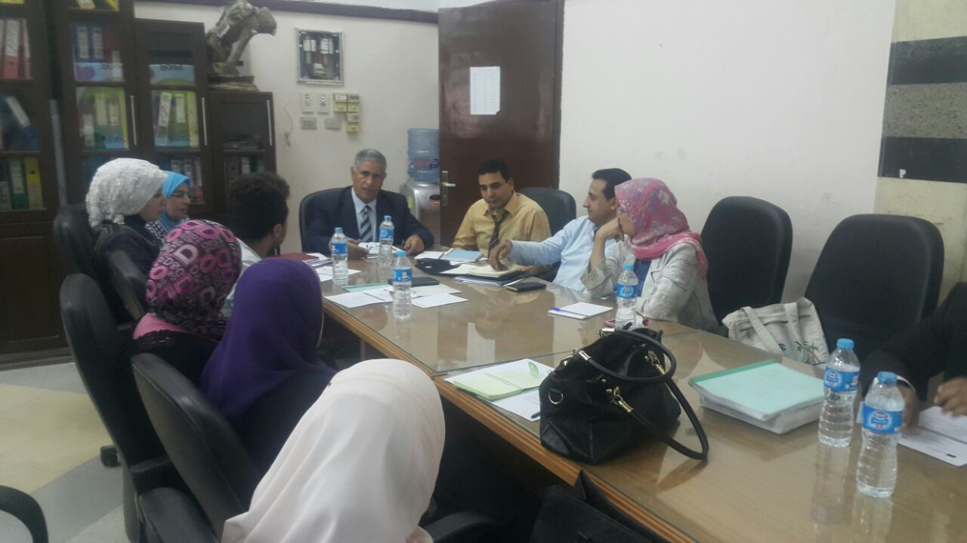
This project has been funded with support from the European Commission. This publication [communication] reflects the views only of the author, and the Commission cannot be held responsible for any use which may be made of the information contained therein

Slide 6
Main points of meeting
Discussions were held about the travel procedures and tips were given by dr. Zeinab and dr. Rasha for the group who will be travelling.
Planning for school visits :
Arranging ( event ) orientation day and ceremony in October 30 for launching of the project and inviting the participants and the principles of schools in the ministry of education.
Arrange action research workshops for all project participants on October 31 and November 1st.
Action research workshops will be planned and executed by dr. Dina Saber and Mr. Mahmoud Hggag.
This project has been funded with support from the European Commission. This publication [communication] reflects the views only of the author, and the Commission cannot be held responsible for any use which may be made of the information contained therein

Slide 7
Main points of meeting
school profile , training needs tool collected
Another tool were suggested to be designed which is for directors
Blog designed for the project for documentaand will be edited to be in the final form.tion of all details
Team leaders selected, 5 leaders for the 5 participant schools.
team leaders are : Dr.Mohamed Abdo - Dr.Yasser - Dr.Dina - Dr.Hanan - Dr.Sally
Leader School
This project has been funded with support from the European Commission. This publication [communication] reflects the views only of the author, and the Commission cannot be held responsible for any use which may be made of the information contained therein

Slide 8

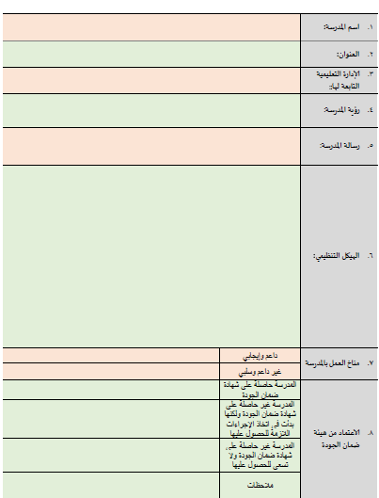
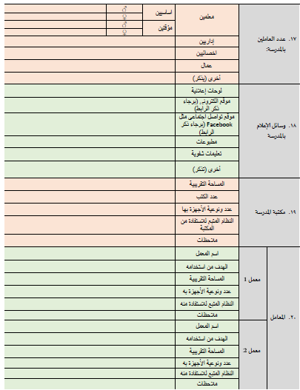
This project has been funded with support from the European Commission. This publication [communication] reflects the views only of the author, and the Commission cannot be held responsible for any use which may be made of the information contained therein

Slide 9

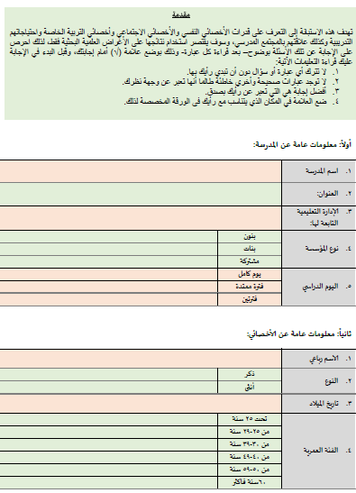
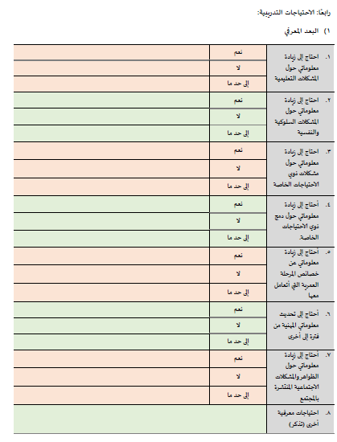
This project has been funded with support from the European Commission. This publication [communication] reflects the views only of the author, and the Commission cannot be held responsible for any use which may be made of the information contained therein

Slide 10

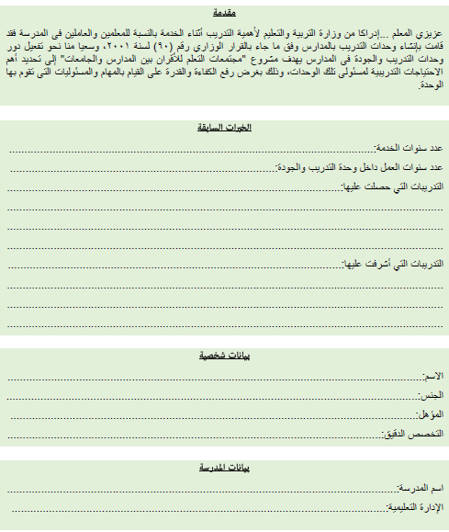
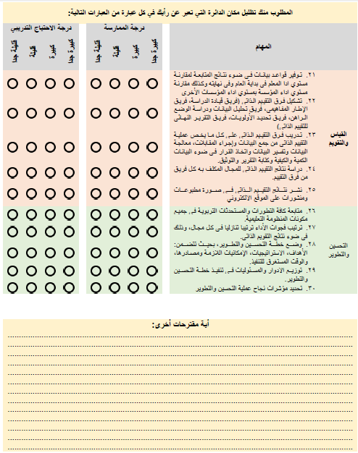
This project has been funded with support from the European Commission. This publication [communication] reflects the views only of the author, and the Commission cannot be held responsible for any use which may be made of the information contained therein

Slide 11

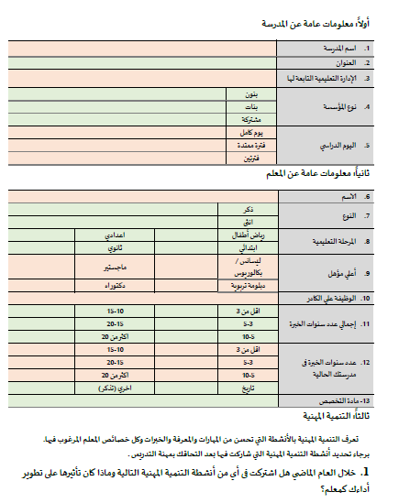
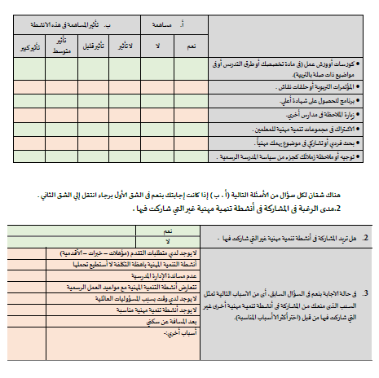
This project has been funded with support from the European Commission. This publication [communication] reflects the views only of the author, and the Commission cannot be held responsible for any use which may be made of the information contained therein

Slide 12
Main points of meeting
school profile , training needs tool collected
Another tool were suggested to be designed which is for directors
Blog designed for the project for documentaand will be edited to be in the final form.tion of all details
Team leaders selected, 5 leaders for the 5 participant schools.
team leaders are : Dr.Mohamed Abdo - Dr.Yasser - Dr.Dina - Dr.Hanan - Dr.Sally
Leader School
This project has been funded with support from the European Commission. This publication [communication] reflects the views only of the author, and the Commission cannot be held responsible for any use which may be made of the information contained therein

Slide 13
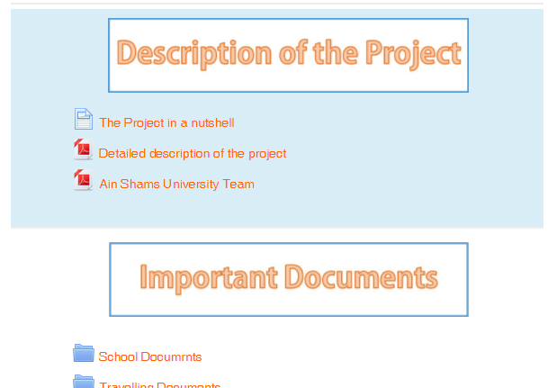
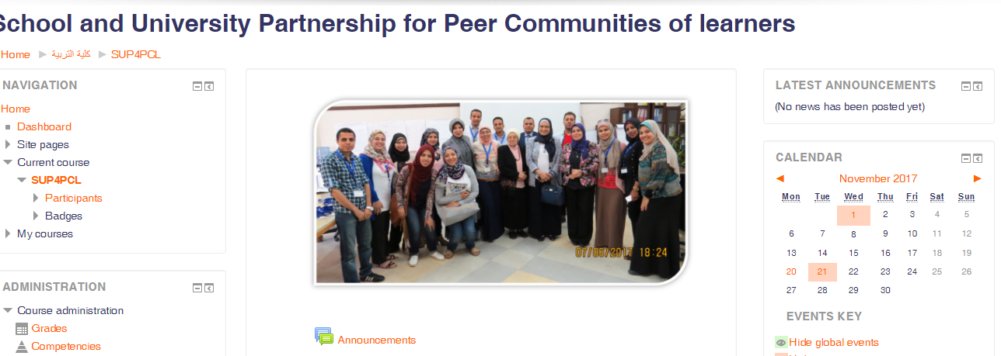
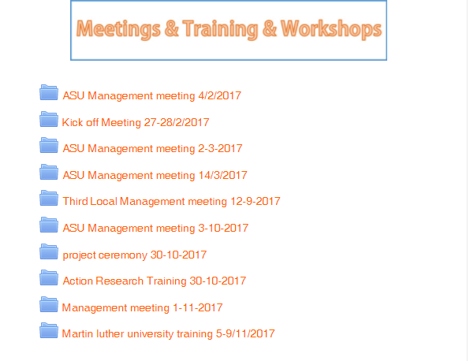
Blog:
This project has been funded with support from the European Commission. This publication [communication] reflects the views only of the author, and the Commission cannot be held responsible for any use which may be made of the information contained therein

Slide 14
Main points of meeting
school profile , training needs tool collected
Another tool were suggested to be designed which is for directors
Blog designed for the project for documentaand will be edited to be in the final form.tion of all details
Team leaders selected, 5 leaders for the 5 participant schools.
team leaders are : Dr.Mohamed Abdo - Dr.Yasser - Dr.Dina - Dr.Hanan - Dr.Sally
Leader School
This project has been funded with support from the European Commission. This publication [communication] reflects the views only of the author, and the Commission cannot be held responsible for any use which may be made of the information contained therein

Slide 15
Criteria for selecting school leaders
Highly committed
Well knowledge with ethnographic studies and documentation
Strong relation with school ( either by action research or practicum)
Personal communication
Team work skills
This project has been funded with support from the European Commission. This publication [communication] reflects the views only of the author, and the Commission cannot be held responsible for any use which may be made of the information contained therein

Slide 16
what have been done ? Next
Manual introduced
Event was organized
Plans were put by the school leaders
Final step : Application of tools
This project has been funded with support from the European Commission. This publication [communication] reflects the views only of the author, and the Commission cannot be held responsible for any use which may be made of the information contained therein

Slide 17
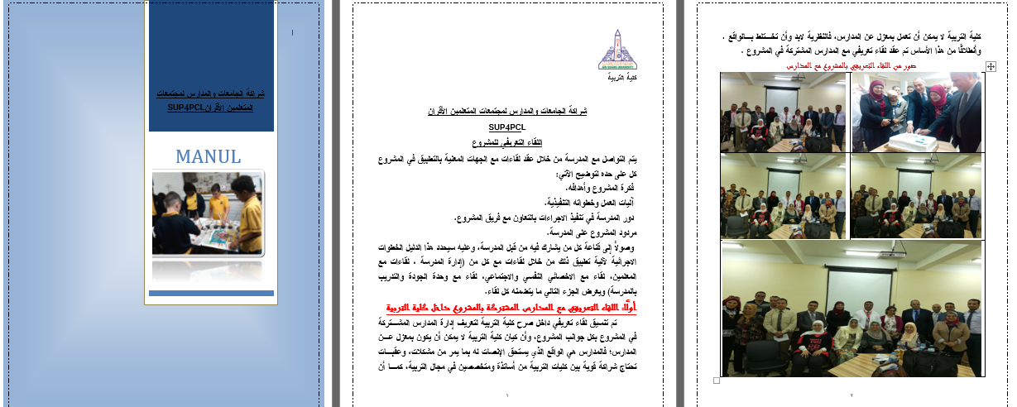
This project has been funded with support from the European Commission. This publication [communication] reflects the views only of the author, and the Commission cannot be held responsible for any use which may be made of the information contained therein

Slide 18
what have been done ? Next
Manual introduced
Event was organized
Plans were put by the school leaders
Final step : Application of tools
This project has been funded with support from the European Commission. This publication [communication] reflects the views only of the author, and the Commission cannot be held responsible for any use which may be made of the information contained therein

Slide 19

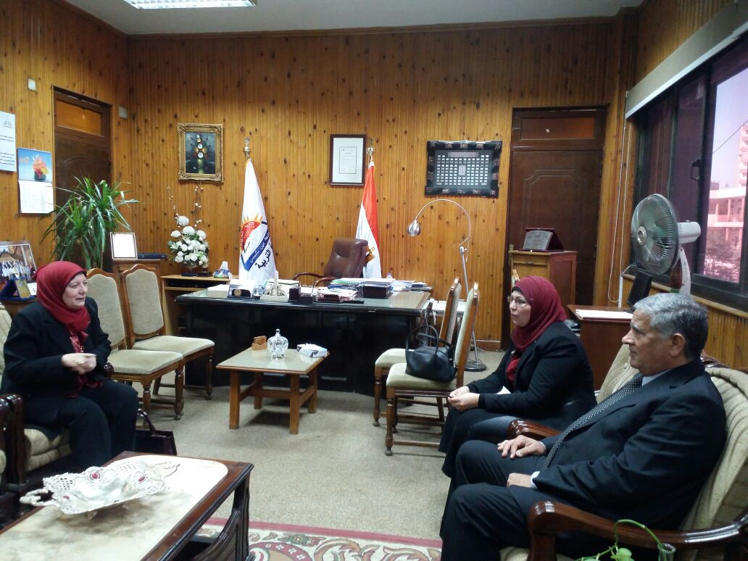
This project has been funded with support from the European Commission. This publication [communication] reflects the views only of the author, and the Commission cannot be held responsible for any use which may be made of the information contained therein

Slide 20
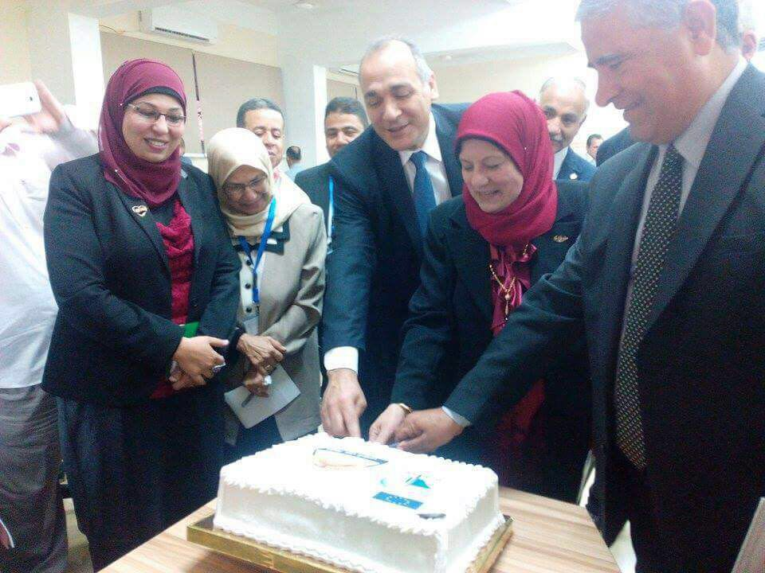
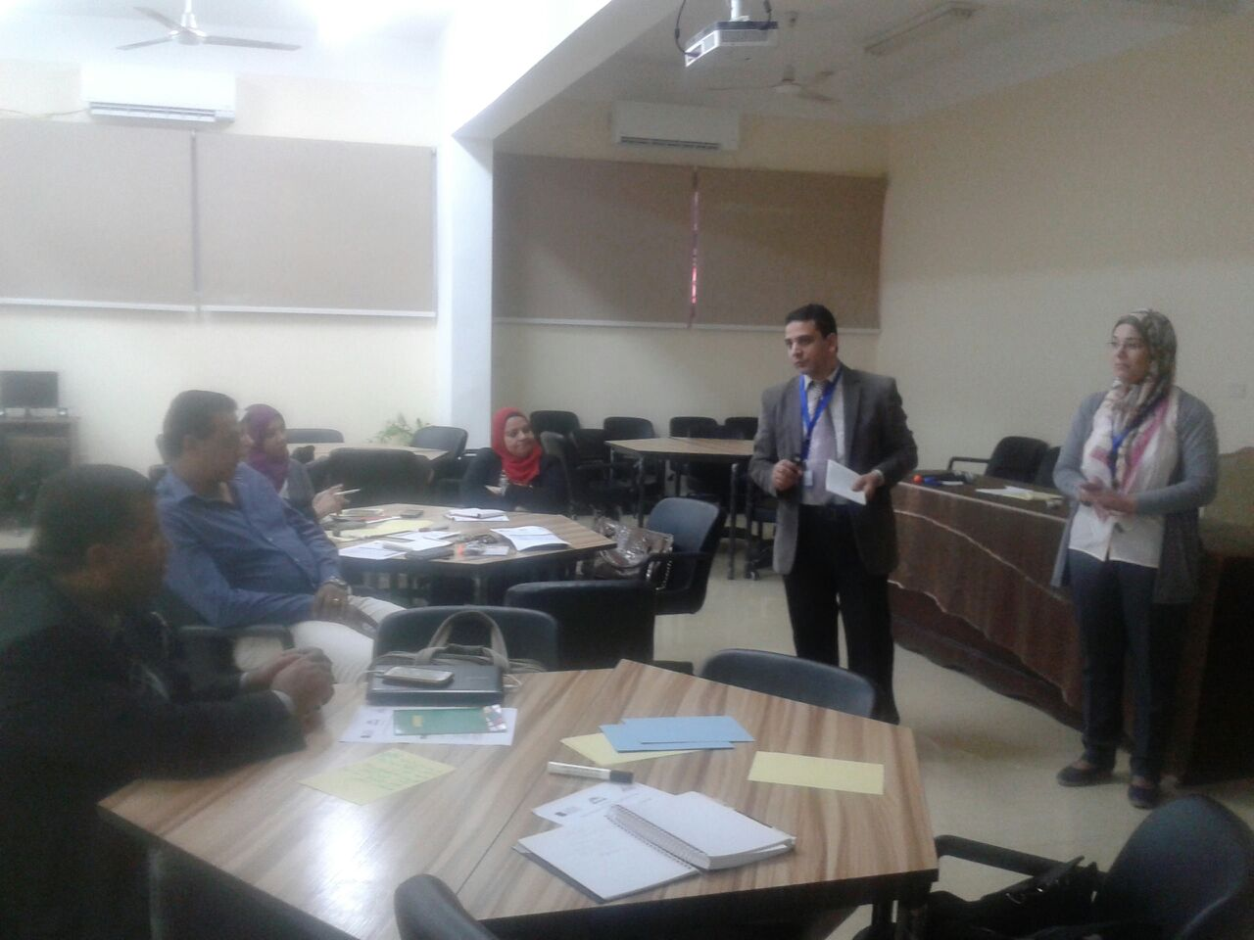
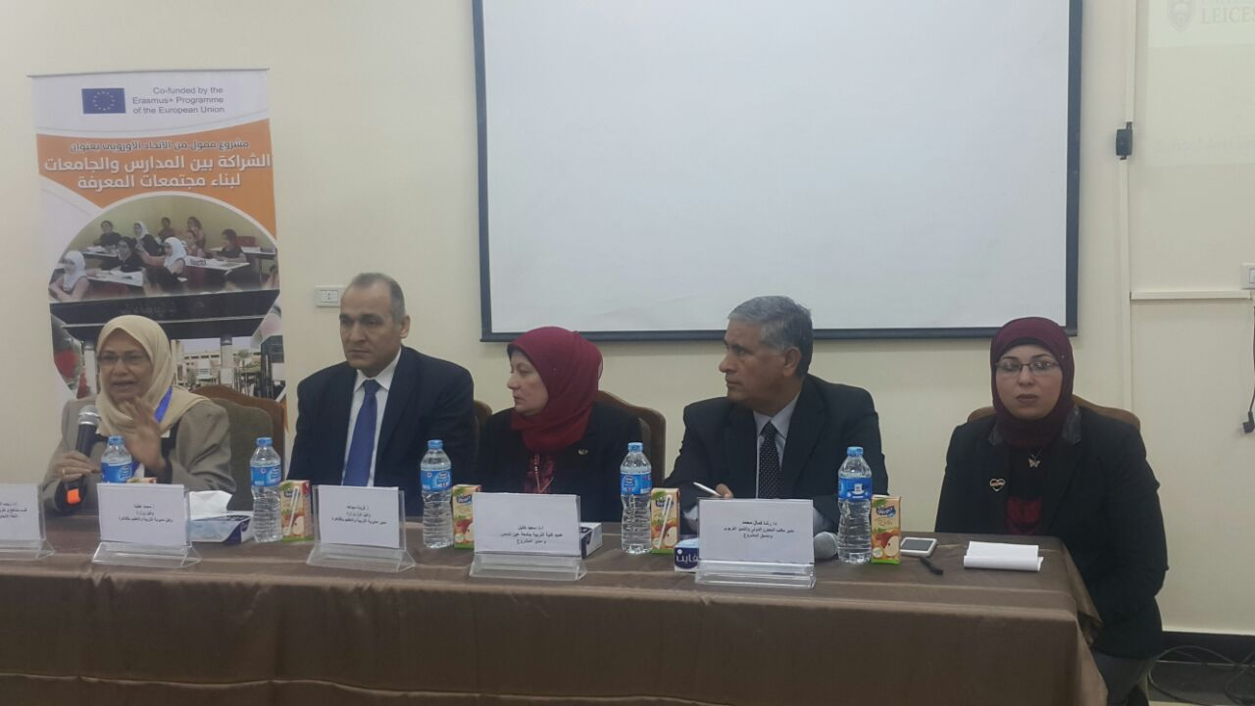
This project has been funded with support from the European Commission. This publication [communication] reflects the views only of the author, and the Commission cannot be held responsible for any use which may be made of the information contained therein

Slide 21
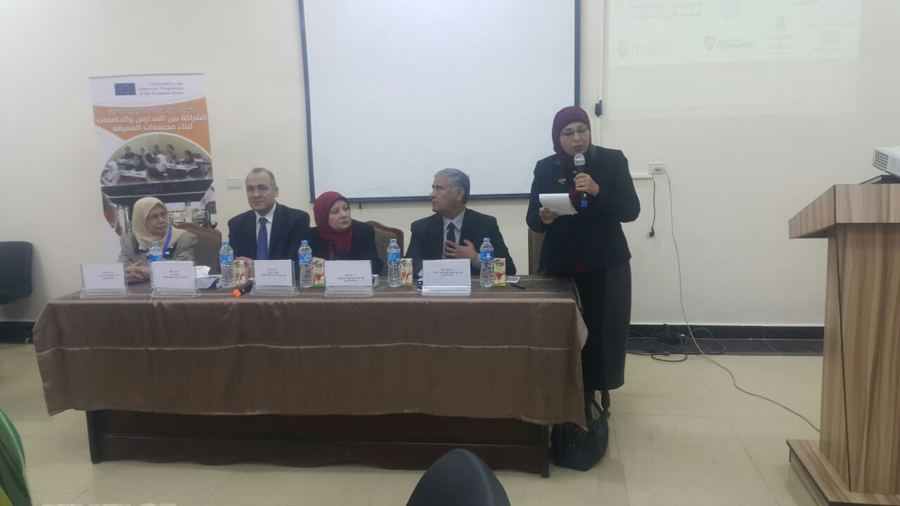
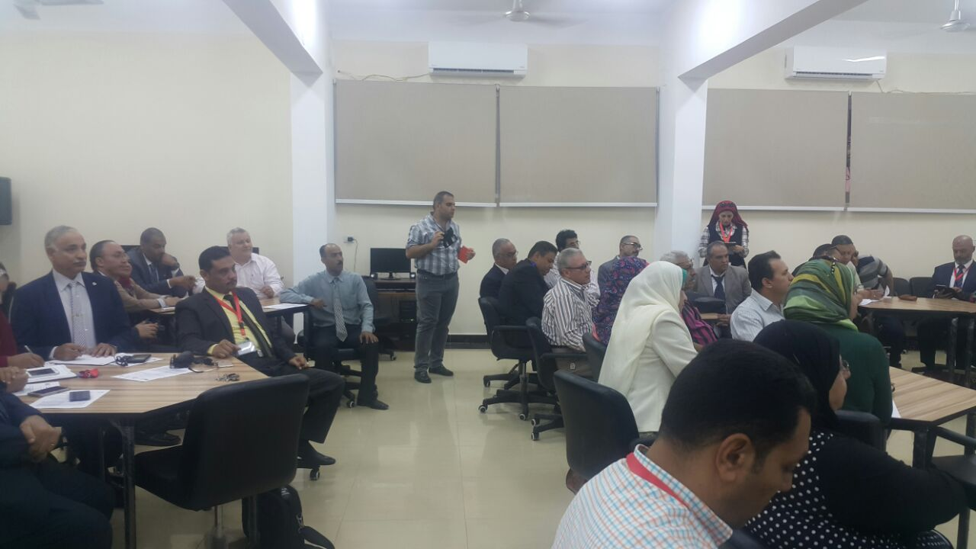
This project has been funded with support from the European Commission. This publication [communication] reflects the views only of the author, and the Commission cannot be held responsible for any use which may be made of the information contained therein

Slide 22
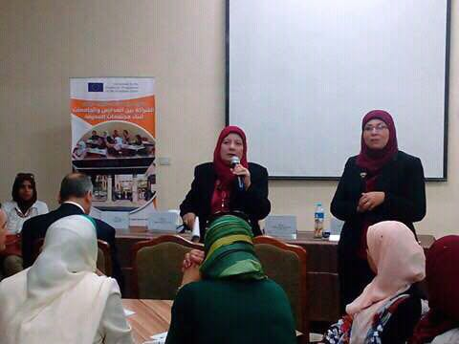
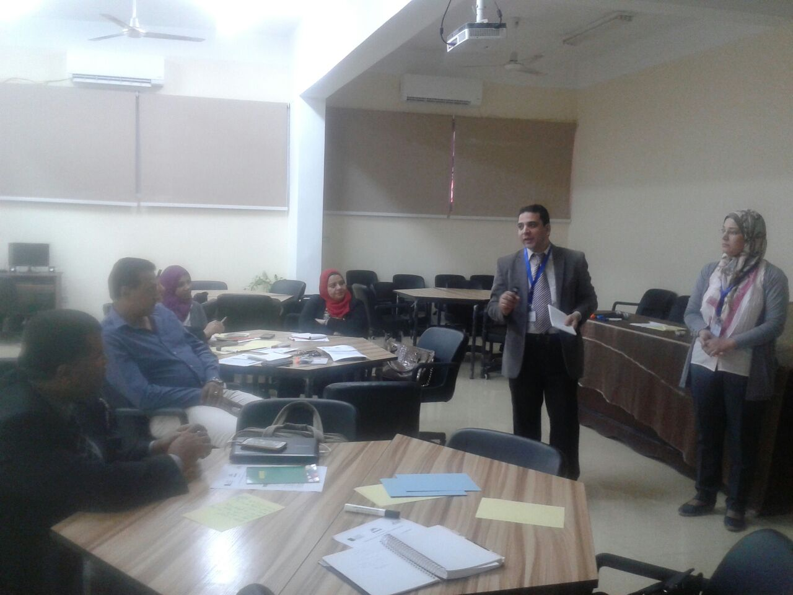
This project has been funded with support from the European Commission. This publication [communication] reflects the views only of the author, and the Commission cannot be held responsible for any use which may be made of the information contained therein

Slide 23

This project has been funded with support from the European Commission. This publication [communication] reflects the views only of the author, and the Commission cannot be held responsible for any use which may be made of the information contained therein

Slide 24

This project has been funded with support from the European Commission. This publication [communication] reflects the views only of the author, and the Commission cannot be held responsible for any use which may be made of the information contained therein

Slide 25

This project has been funded with support from the European Commission. This publication [communication] reflects the views only of the author, and the Commission cannot be held responsible for any use which may be made of the information contained therein

Slide 26
what have been done ? Next
Manual introduced
Event was organized
Plans were put by the school leaders
Final step : Application of tools
This project has been funded with support from the European Commission. This publication [communication] reflects the views only of the author, and the Commission cannot be held responsible for any use which may be made of the information contained therein

Slide 27
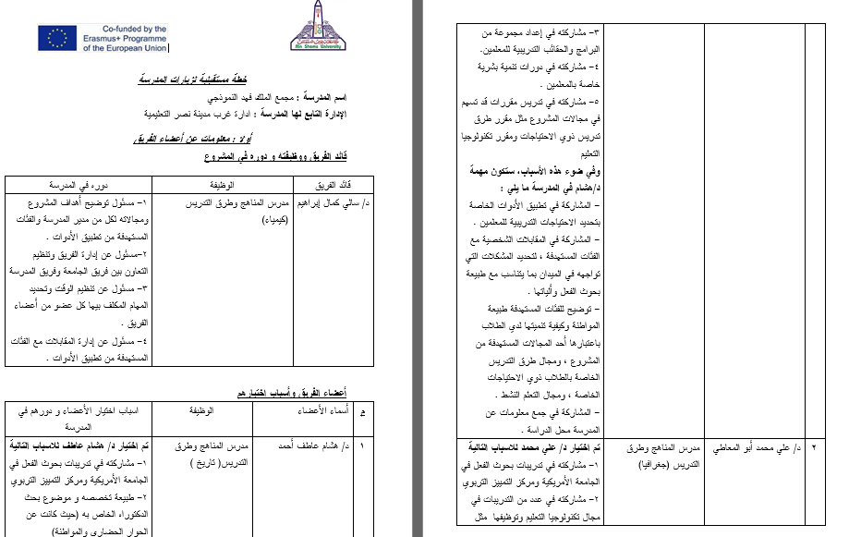
This project has been funded with support from the European Commission. This publication [communication] reflects the views only of the author, and the Commission cannot be held responsible for any use which may be made of the information contained therein

Slide 28
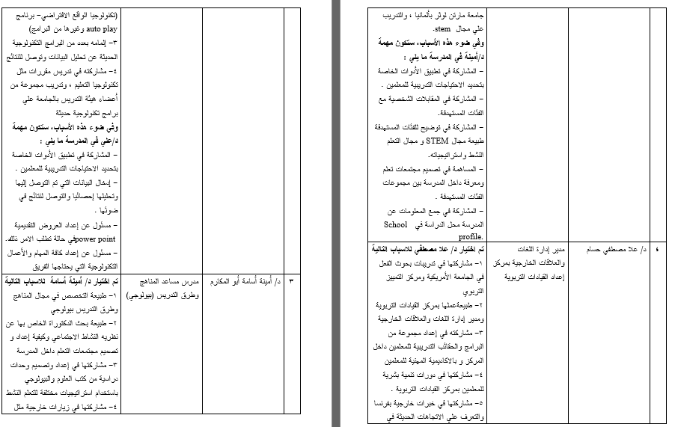
This project has been funded with support from the European Commission. This publication [communication] reflects the views only of the author, and the Commission cannot be held responsible for any use which may be made of the information contained therein

Slide 29
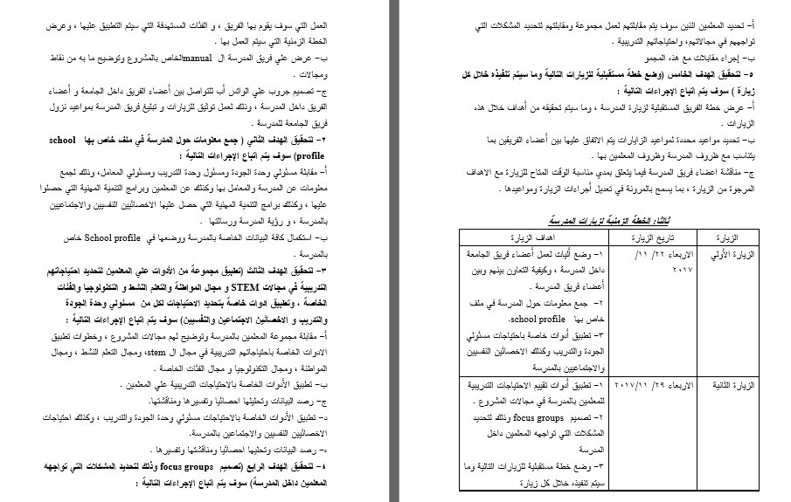
This project has been funded with support from the European Commission. This publication [communication] reflects the views only of the author, and the Commission cannot be held responsible for any use which may be made of the information contained therein

Slide 30
ASU Visit to the European universities and Schools
Comparison between the three visits
This project has been funded with support from the European Commission. This publication [communication] reflects the views only of the author, and the Commission cannot be held responsible for any use which may be made of the information contained therein

Slide 31
Inclusion/special needs/ learning disabilities | School placement | Mentoring | STEM | PLC
 |  | mentoring is a structured process for supporting professional learners through significant career transition. Concerning ITE, all trainee teachers have a mentor (classroom teacher) who is trained by university staff to be a mentor. The mentor gives advice and help for novice and untrained teachers. The outcome of this process is to improve the students’ performance inside schools. |  | Learning communities through active blended leaning | University of northampton
This project has been funded with support from the European Commission. This publication [communication] reflects the views only of the author, and the Commission cannot be held responsible for any use which may be made of the information contained therein

Slide 32
Inclusion/special needs/ learning disabilities | School placement | Mentoring | STEM | PLC
They have sections in school s for inclusion that contains a resource room for special educational needs and disability (SEND) students. This section helps Low achievers, students with ADHD, physically handicapped, dyslexics, and autism spectrum disorders. They have plans for those students and |  |  |  | Lesson Study which is a classroom-based, collaborative mode of professional learning. a lesson study cycle will involve small groups of teachers collaboratively planning a ‘research lesson’ which one teaches while other members of the team observe. In schools Schools collaborate together to help each other as a kind of forming PCL. Schools collaborate with universities as university staff in Leicester university helps them in PD for teachers and solving students’ problems. Teachers hold regular meetings (once a week) outside the school to develop their performance and solve their problems. | University of Leicester
This project has been funded with support from the European Commission. This publication [communication] reflects the views only of the author, and the Commission cannot be held responsible for any use which may be made of the information contained therein

Slide 33
Inclusion/special needs/ learning disabilities | School placement | Mentoring | STEM | PLC
 | It takes place : - 2nd year placement takes place in the Spring semester of Year 2 when student teachers participate in a School Placement of eight weeks. - 4th year placement takes place in the Autumn semester of Year 4 when student teachers participate in a School Placement of ten weeks. The school placement is organised by the School Placement Office. Undergraduate student teachers normally fill out school placement school option forms at least 6 months before school placements |  |  | Online courses Using technology in teacher education: employing student podcast to support the University of Limerick’s graduate attributes. It shed light on the definition of embedded podcasts and its benefits for university students. Then we had a training on a computer program classed “Corel Video studio x8”. | University of Limerick
This project has been funded with support from the European Commission. This publication [communication] reflects the views only of the author, and the Commission cannot be held responsible for any use which may be made of the information contained therein

Slide 34
Inclusion/special needs/ learning disabilities | School placement | Mentoring | STEM | PLC
 | 3 stages: The Orientation School Placement: This is done during the first semester for 2 weeks in which student teachers are placed in schools to observe teaching. When they come to the university they reflect on what they observed with their instructors. Teaching Practice Placements at School I: From the fourth semester and for four weeks pre-service teachers teach ten lessons and observe another 10 for each of the two specializations Teaching Practice Placements at School Ii : For 4 weeks during the fifth semester, student teachers observe 15 lessons and observe an equal number in each of the two specializations | Mentoring is indirect way through school placement process. | They don't name it STEM education but they practice its principals. They call it MINTegration (MINT stands for STEM in German). Since Germany hosts many refugees (800,000 in 2015), learning German is essential. This project is aMobile Science Lab that moves from school to school, offers one week courses and focuses on human health (Hygenic behavior, Healthy nutrition, Drug prevention and Sexual education).Students are evaluated and every student learned German vocabulary & connections. They practiced their German skills and improved it. They also enjoyed the project week and learned content in STEM. | Forming PLC in schools is officially decreed by the Ministry of Education | University of Martin luthur
This project has been funded with support from the European Commission. This publication [communication] reflects the views only of the author, and the Commission cannot be held responsible for any use which may be made of the information contained therein

Slide 35
Benefits of the visits
Projects : ( example)
Martin Luthur University
projects financed by the Higher Education Pact of the government to improve the education of teacher trainees from now till 2020.
These three projects are:
Project "Working against Doubts": This project deals with doubts or concerns that student teachers might have concerning their studies or while working as teachers.
This project has been funded with support from the European Commission. This publication [communication] reflects the views only of the author, and the Commission cannot be held responsible for any use which may be made of the information contained therein

Slide 36
Benefits of the visits
Projects : ( example)
Martin Luthur University
Project "Digitization of Teacher Training": The purpose of this project is two-fold: To develop courses for students and teachers at the university to enhance digital competence of current and future teachers and create awareness for students' ability to learn with the help of digital media
This project has been funded with support from the European Commission. This publication [communication] reflects the views only of the author, and the Commission cannot be held responsible for any use which may be made of the information contained therein

Slide 37
PLC
The MoE to adopt PLC's as a viable strategy for CPD in Egyptian schools. If there is support from decision makers, leaders and middle leaders for this strategy, it will be effective in improving teachers' performance and consequently student learning.
Using Pre-lesson planning and post-lesson evaluation meetings in Egyptian schools can provide discursive opportunities for detailed planning and in-depth reflection about the quality of teaching and learning. The collaboration in lesson study can help teachers to develop a sense of collective efficacy.
Case- based studies and reflections
This project has been funded with support from the European Commission. This publication [communication] reflects the views only of the author, and the Commission cannot be held responsible for any use which may be made of the information contained therein

Slide 38
Mentoring
Training cooperating teachers to mentor student teachers as well as other newly-qualified teachers in their schools.
Close cooperation between university and schools.
The role of mentorship and reflection in TPD.
This project has been funded with support from the European Commission. This publication [communication] reflects the views only of the author, and the Commission cannot be held responsible for any use which may be made of the information contained therein

Slide 39
Challenges we are facing
Time line must be changed or adjusted
Language barrier.
Exams at universities and schools.
This project has been funded with support from the European Commission. This publication [communication] reflects the views only of the author, and the Commission cannot be held responsible for any use which may be made of the information contained therein

Slide 40

This project has been funded with support from the European Commission. This publication [communication] reflects the views only of the author, and the Commission cannot be held responsible for any use which may be made of the information contained therein

