Slide 1


School and University Partnership for Peer Communities of Learners )SUP4PCL(
Project Number : 573660-EPP-1-2016-1-EG-EPPKA2-CBHE-JP (2016-2516/001-001)
Developing materials workshop
Alexandria- 6th-9th December 2017

Slide 2
Content
Gaining Access to Schools : Context and Challenges
Schools visits
Teachers’ needs assessment:
Goal
Participants
Methodology & Tools
Procedures
Initial Outcomes
Insights
Challenges
Next Steps

Slide 3
Gaining Access to Schools: Context & Challenges
First round of correspondences between FOE & MOE Directorate: January- September 2017
Attempt failed to have a Protocol signed between AU & the MOE Directorate in Alexandria
Memorandum of understanding : MOHE & MOE & AUC Middle East Studies institute
New round of correspondences between FOE & MOE Directorate: September- October 2017

Slide 4
Gaining Access to Schools: Context & Challenges
Visit from AU team representatives to the MOE Directorate, Community Participation manager: Monday 2nd October, 2017
Gaining Verbal consent to access schools
AU team first INFORMAL Visits to schools: 23-26 October, 2017
More challenges (official documents in schools, more documents required by the MOE Directorate, processing official letters at the FOE, etc.)

Slide 5
Gaining Access to Schools: Context & Challenges
Using all possible formal & informal channels of communications with the MOE Directorate (formal letters, phone calls, WhatsApp)

Slide 6
Schools’ Visits
A comprehensive & shared plan for schools’ visits till the end of December 2017 (mid-term exams).
Plan outlines:
  Goals of visits
  Teams assigned to each school
  Schedule for schools weekly visits
  Expected outcomes
  Sharing outcomes & next steps

Slide 7
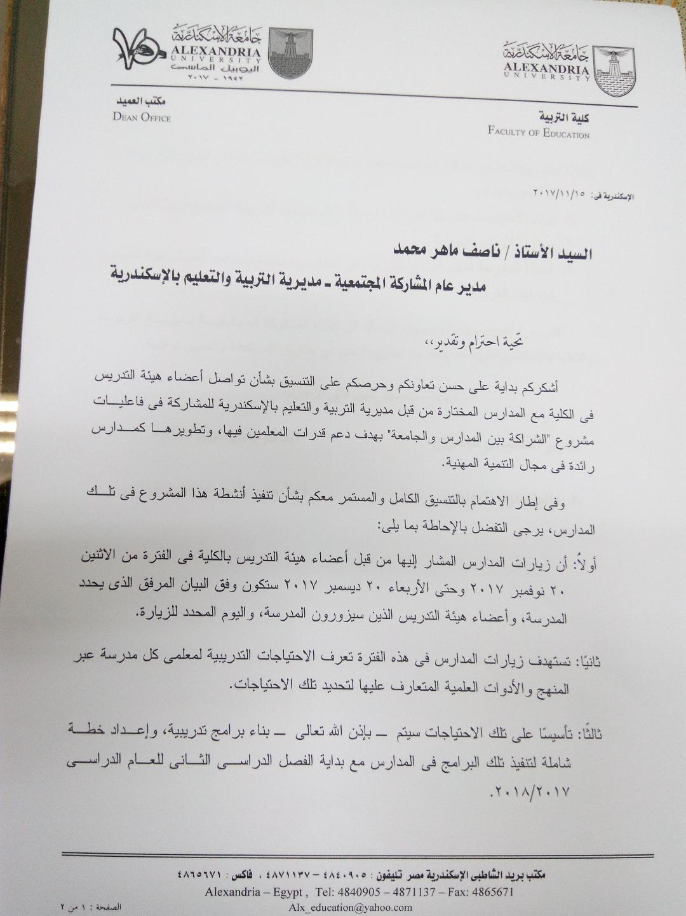
Schools’ Visits: Progress

Slide 8
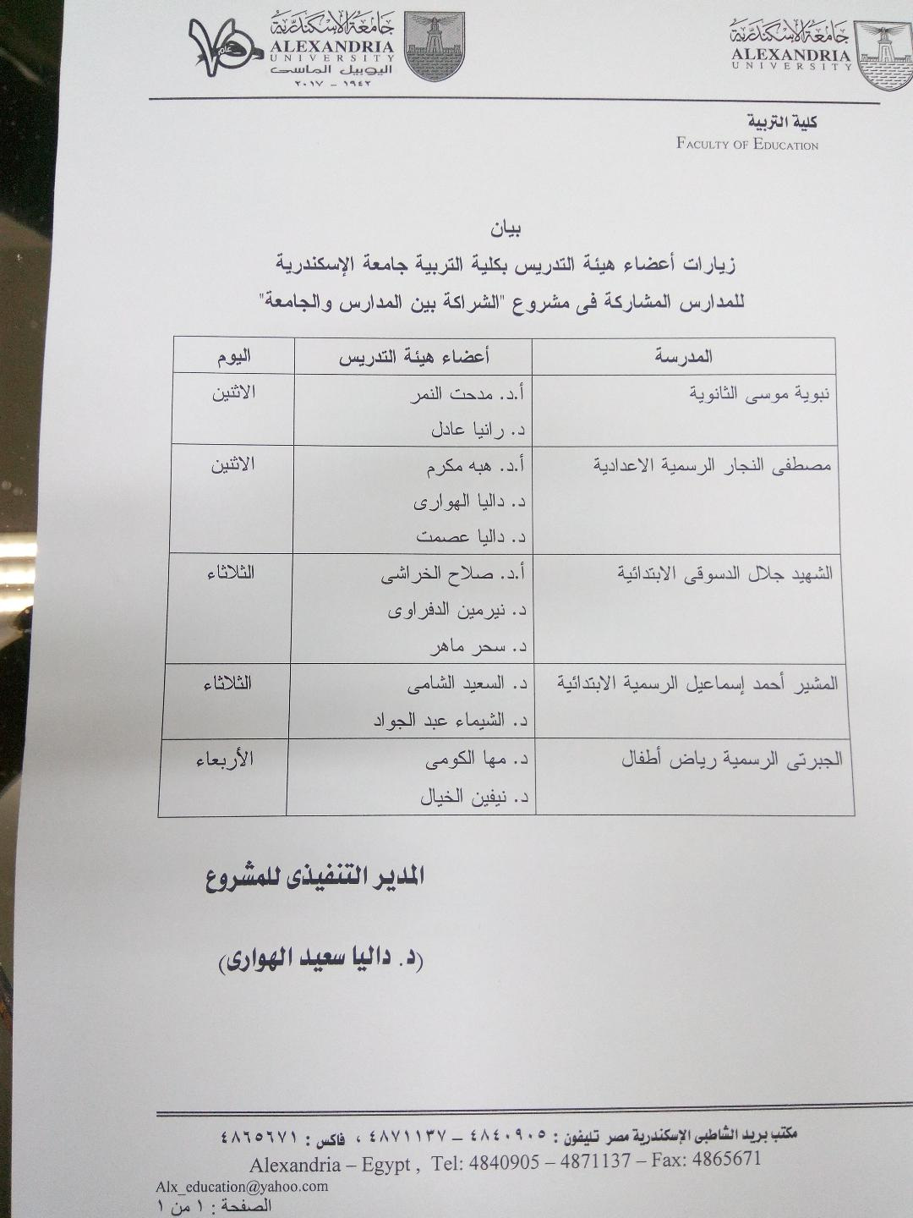
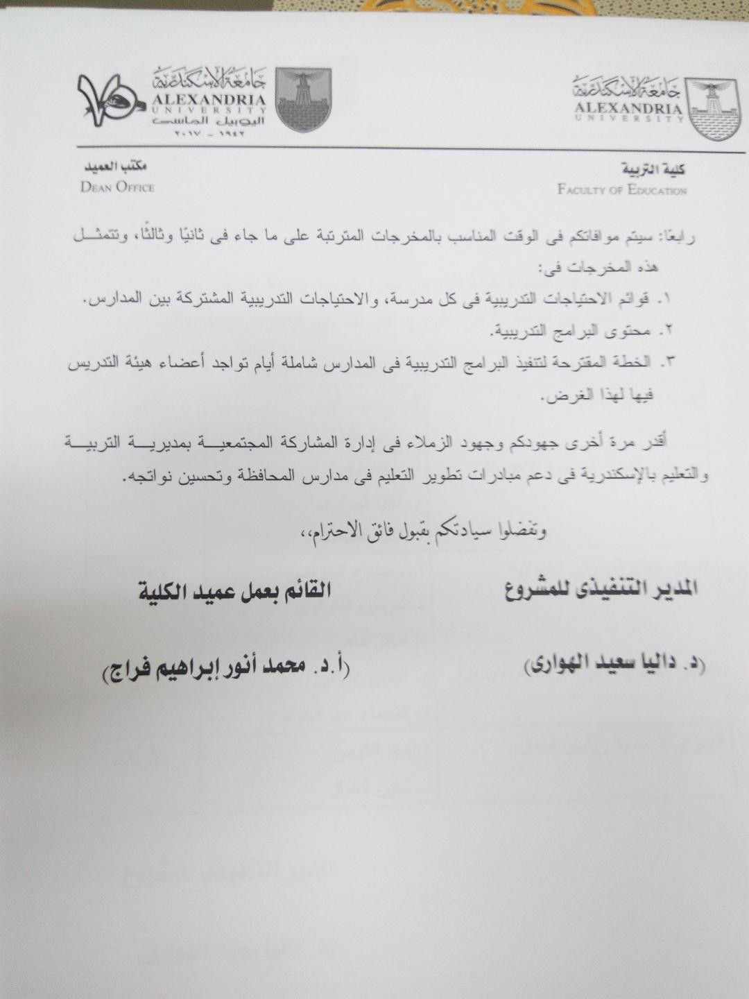
Schools’ Visits: Progress

Slide 9
Schools’ Visits
Schools have a comprehensive understanding of the project (meetings with school heads, Quality assurance teams & subject leads & teachers)
Building trust (formal & informal dialogue)
Planning meetings with different stakeholders (e.g. students & parents)
Planning classroom observations

Slide 10
Schools’ Visits
Weekly individual school visit report
Schools’ profiles completed
Identifying possible areas to be the focus for the ethnographic study
Starting the needs assessment process

Slide 11
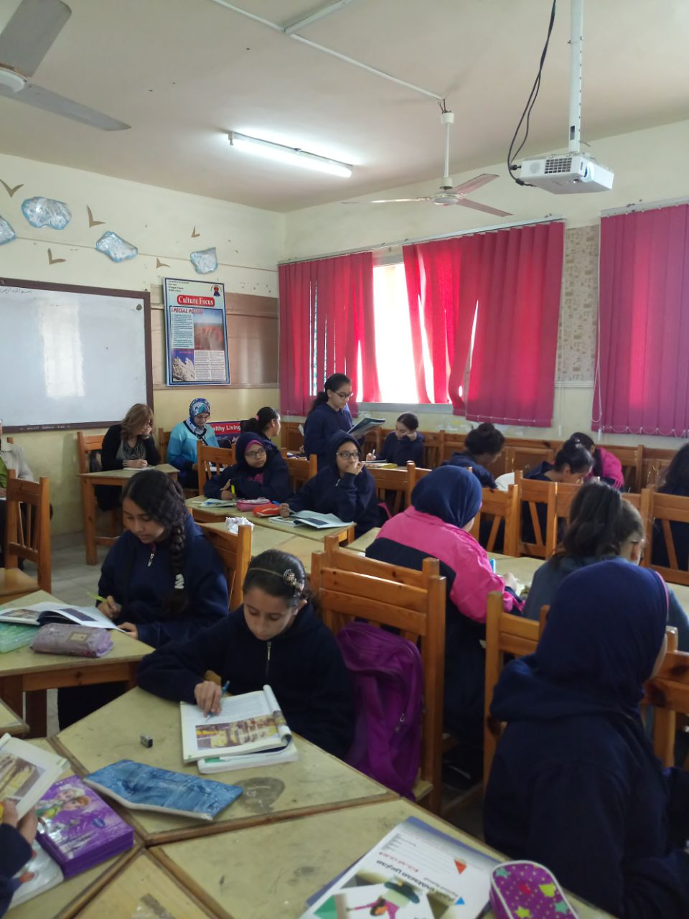

Slide 12
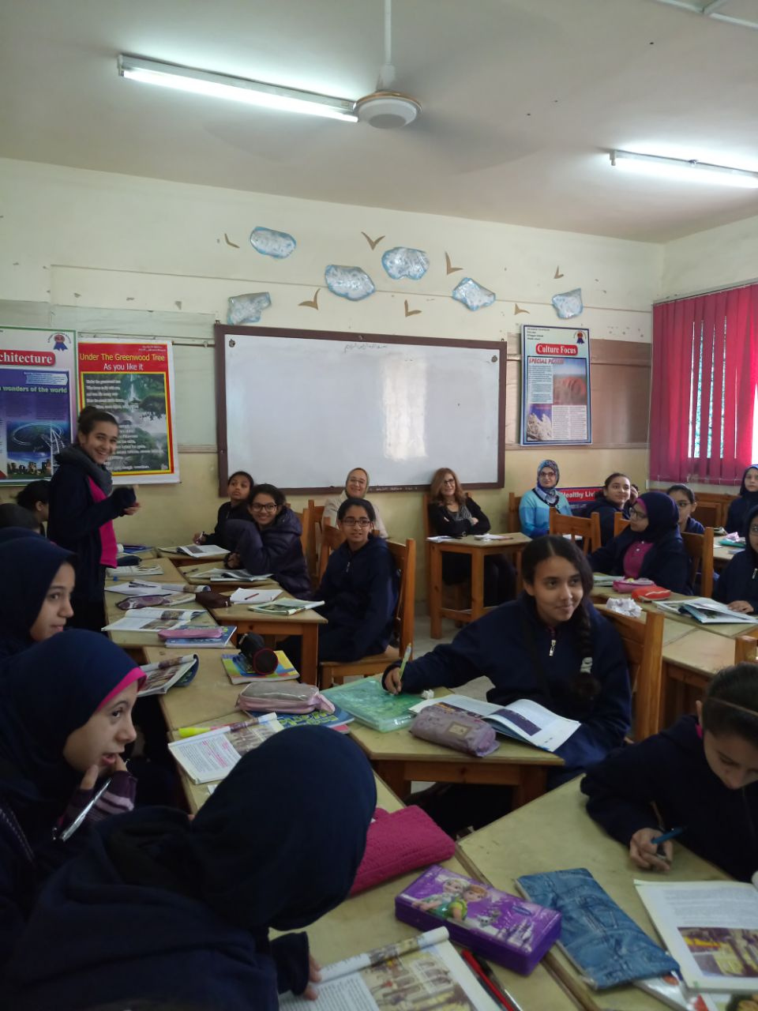

Slide 13
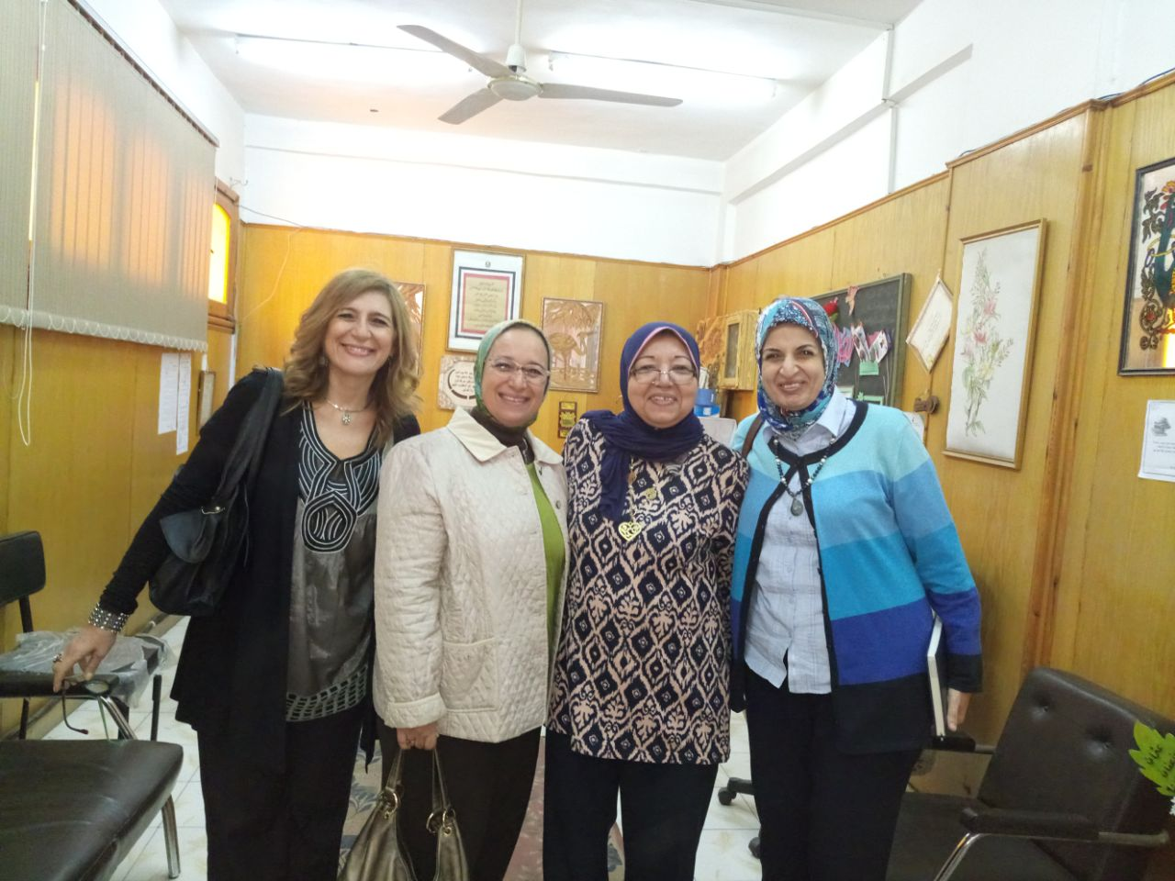

Slide 14
Teachers’ needs assessment
Goal
Identifying the professional needs of the teachers in each of the five schools as a prerequisite for building the PD programmes meeting these needs.

Slide 15
Teachers’ needs assessment
Participants
All Subject leads & teachers
Quality assurance units heads

Slide 16
Teachers’ needs assessment
Methodology & Tools
Mixed method
Delphi Technique
Tools
Questionnaires
Focus group
Interviews

Slide 17
Teachers’ needs assessment
Procedures
Awareness raising (AU team & Participants)
Design of first tool (Delphi technique- phase one- Open questionnaire)
Administering first tool (F2F- online)
Analysis of data + project goals
Design of second tool (Delphi technique- phase two- closed / open questionnaire)
Administering second tool (4-6 December)

Slide 18
Tools

Slide 19
Tools: Phase 2

Slide 20
Teachers’ needs assessment
Initial Outcomes
Active learning strategies
STEM education
Teaching for developing thinking and problem solving skills
Designing activities for students with special needs
Effective communication skills

Slide 21
Teachers’ needs assessment
Initial Outcomes
Building PLCs
Mentors’ professional responsibilities
School partnership for PD purposes

Slide 22
Insights
Varying …
Schools’ culture
Levels of accepting change
Awareness among teachers
Resources at schools
Levels of support from schools heads

Slide 23
Challenges
Time
Paper work
End-of-term exams (Schools & University)
Flow of information
Coordination with other universities
Building a strong & sustainable co-operative relationship with MOE

Slide 24
Next Steps
Focus group & individual interviews
Finalization of needs assessment
Prioritization of needs
Building training programmes
Making decisions
  Time
  Mode
  Use of available resources (e.g. websites)
  Etc.

Slide 25
Next Steps
Identifying mentors & mentees in each school
Developing mentorship plans in coordination with quality assurance teams in schools.
Producing five schools’ baseline studies
Identifying the focus & scope of schools’ ethnographic studies
Selecting AU mentors teams

Slide 26
Thank You
AU Team

