Slide 2
Researching PLC

Slide 3
PLAN
Learning about you!
Group analysis of the existing research tools
Plenary discussion of analysis outcomes

Slide 4
LEVELS OF PLC
Pupils communities
Pupil/Teacher communities
Teacher communities
Teacher/AINSU community
AINSU community
AINSU/UL community

Slide 5
LEARNING ABOUT YOU
What is your idea of PLC?
What is your vision about learning from your colleagues? Does this happen in your everyday experience? How does this happen? What is missing? What would promote the process?
How do you imagine the learning relationship with external experts (Europe)? What do you expect from it?

Slide 6
ANALYSIS TOPICS
Are the questions/indicators appropriate to research PLCs at the four different levels? Which are (in)appropriate for what level? What important indicators are missing?
What are the core indicators for the different levels? Are there differences?
What would be the different forms of evidence you could collect in schools in relation to the indicators? What methods/approaches could to collect this evidence (e.g., questionnaire, interview, focus group) and what are the advantages and disadvantages of each approach?

Slide 7
FURTHER DISCUSSION TOPICS
What are the possible weaknesses of these tools?
What are the possible barriers to effective data collection?
What do you plan to do with the data you collect?
How will it inform your future work with schools?

Slide 8
HOMEWORK
Let’s try the quantitative tool!
PERSONAL CODE:
S (for AINSU)
MOTHER’S DAY OF BIRTH (XX)
MOTHER’S MONTH OF BIRTH (XX)
MOTHER’S YEAR OF BIRTH (XX)
NUMBER OF SIBLINGS (XX)
Francesco:
ASU
26
03
40
01
Francesco: S26034001

Slide 9
HOMEWORK
Let’s check existing STEM materials!
ESTABLISH PROJECT MATERIALS
Renewable Energy
http://www.establish-fp7.eu/resources/units/renewable-energy.html
Cosmetics
http://www.establish-fp7.eu/resources/units/cosmetics.html

Slide 10
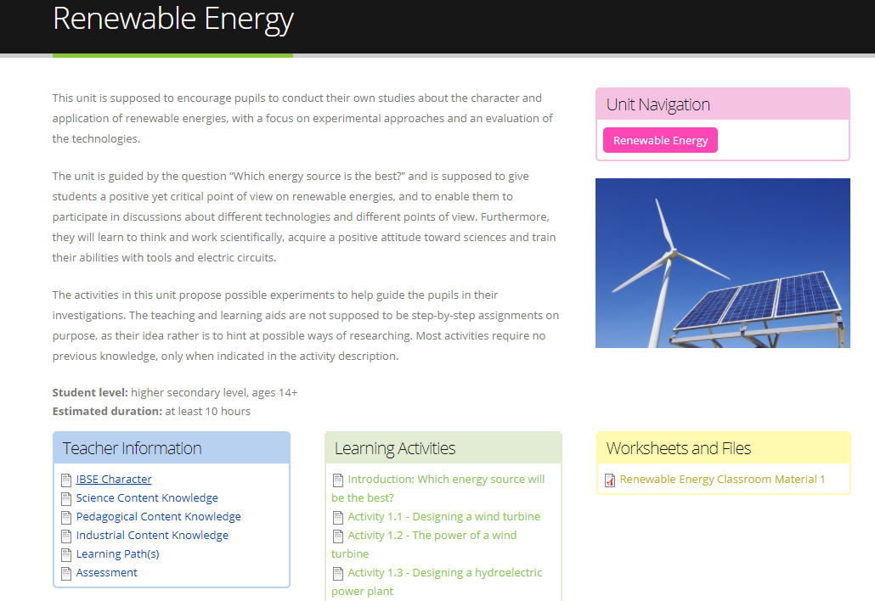

Slide 11
Key literature
Lave, J., & Wenger, E. (1991). Situated Learning: Legitimate Peripheral Participation. Cambridge: Cambridge University Press.
Brown, J. S., & Duguid, P. (1991). Organizational learning and communities-of-practice: Toward a unified view of working, learning, and innovation. Organization Science, 2 (1), 40–57.
Wenger, E. (1998). Communities of practice: learning, meaning, and identity. Cambridge University Press.
Wenger, E., McDermott, R., & Snyder, W. (2002). Cultivating communities of practice: a guide to managing knowledge. Harvard Business School Press.

Slide 12
Definitions
“Communities of practice are groups of people who share a concern, a set of problems, or a passion about a topic, and who deepen their knowledge and expertise in this area by interacting on an ongoing basis”
(Wenger et al, 2002, p. 4)
“Communities of practice are formed by people who engage in a process of collective learning in a shared domain of human endeavor.”
(Wenger, 2006, p. 1)
“An effective professional learning community has the capacity to promote and sustain the learning of all professionals in the school community with the collective purpose of enhancing pupil learning.”
(Bolam et al, 2005, p. iii)

Slide 13
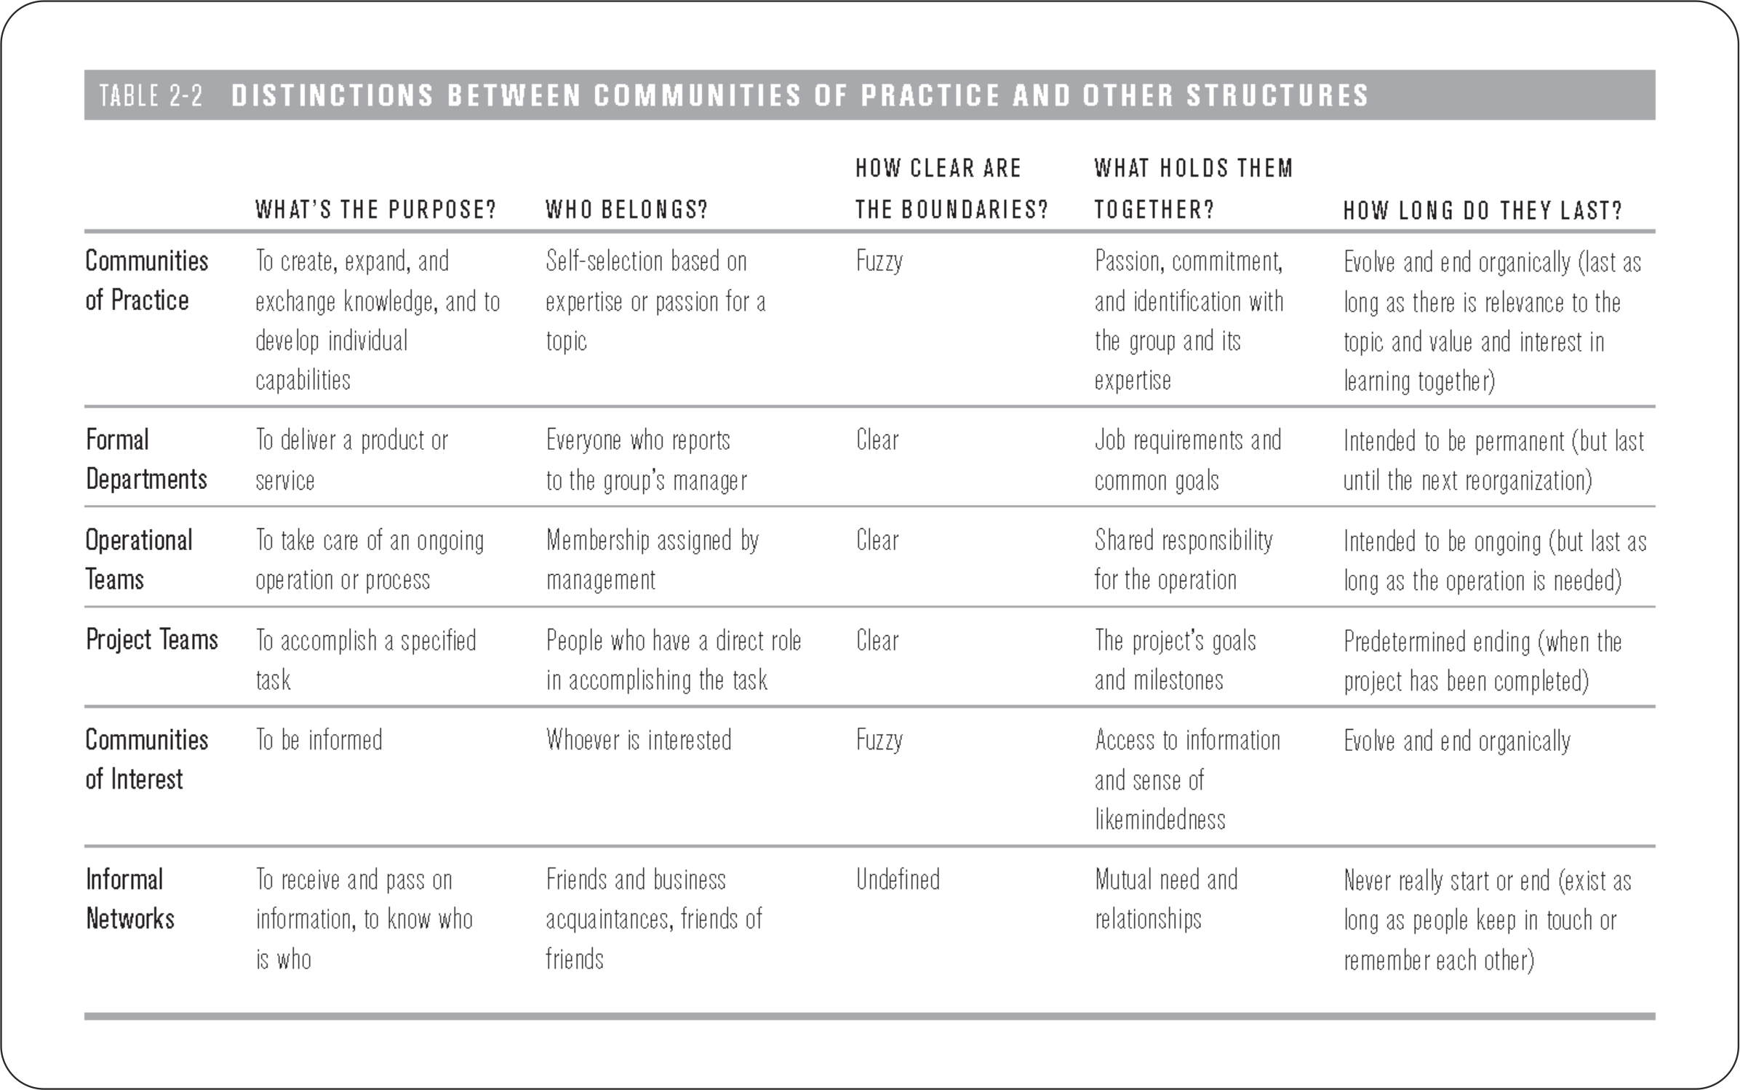
(Wenger et al, 2002)

Slide 14
“A community of practice can be viewed as a social learning system. Arising out of learning, it exhibits many characteristics of systems more generally:
emergent structure
complex relationships
self-organization
dynamic boundaries
ongoing negotiation of identity and cultural meaning.”
(Wenger, 2010, p. 179-80)

Slide 15
A working definition?
“The project’s working definition offers a practical basis for staff in schools wishing to promote an effective PLC. In so doing, they should take account of the issues associated with the components of that definition (…) in particular, relate the definition to their own context.”
(Bolam et al, 2005, p. i)
Bolan et al. (2005) suggest that it is very necessary “to make explicit use of the idea of a PLC, and the terminology, and to seek a shared understanding of it in order to promote and sustain a PLC.” (p. vii)
And that “each school staff will probably need to formulate its own working definition of a PLC.” (Ib.)
(Situated character of professional learning)
(Bolam et al, 2005)

Slide 16
Grossman, Wineburg and Woolworth’s (2001) model for the formation of teacher professional community has four dimensions
formation of group identity and norms of interaction
understanding difference/navigating fault lines;
negotiating tension
taking communal responsibility for individuals’ growth.
These four dimensions point to a necessity for teachers to find a common language with which to create a collective vision for their work.

Slide 17
Wenger (1998) identifies four components that define meaningful Communities of Practice
Making meaning from experiences
Actively engage in practice as part of a team toward community goals
Community is best characterized by groups working together in addition to a social component
Identity is positive, continuous and full engagement by all

Slide 18
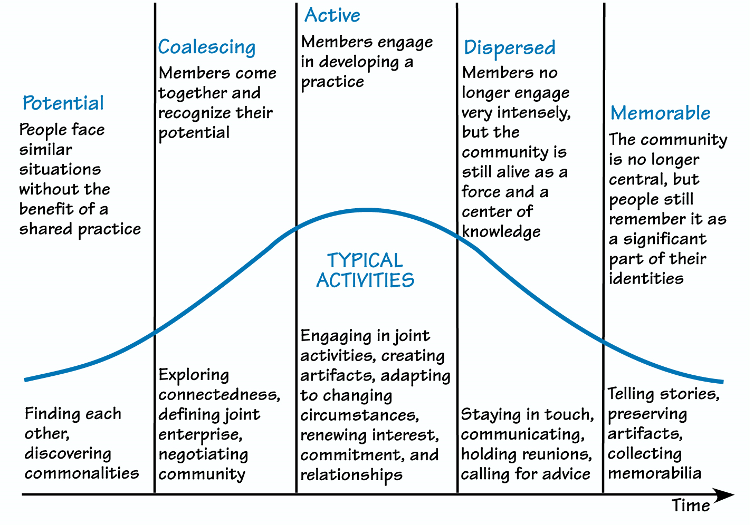
Developmental stages of Community of Practice

Slide 20
Bolam et al. (2005) identify 12 dimensions of PLC development
1. Shared values and vision
2. Collective responsibility for pupils’ learning
3. Collaboration focused on learning
4. Professional learning: individual and collective
5. Reflective professional enquiry
6. Openness, networks and partnerships
7. Inclusive membership
8. Mutual trust, respect and support
9. Optimising resources and structures to promote the PLC
10. Promoting professional learning: individual and collective
11. Evaluating and sustaining the PLC
12. Leading and managing the PLC

Slide 21
POSSIBLE INDICATORS
• Taking needs into account
• Taking opinions into account
• Managing conflict
• Valuing difference
• Availability of tools for effective collaboration
- online platform for sharing digital media
- physical repository for documents, literature and teaching materials
- online communication tools (email, forum, chat, blog)
• Availability of space and time resources
• Respondent’s disposition to collaborate w colleagues
• Colleagues disposition to collaborate
• ...

Slide 22

DISCLAIMER
This project has been funded with support from the European Commission. This publication [communication] reflects the views only of the author, and the Commission cannot be held responsible for any use which may be made of the information contained therein.

