Slide 1
IBSE
STEM
Teachers´
workshops

Slide 2
EU-FP7 founded ESTABLISH project
Levels of Inquiry
1. Interactive discussion /
Interactive demonstration
2. Guided discovery
3. Guided inquiry
4. Bounded inquiry
5. Open inquiry
Teacher‘s
Guidance
Student‘s
Participation &
Independence
Banchi, H. & Bell, R. (2008)
Wenning, C. J. (2005)

Slide 3

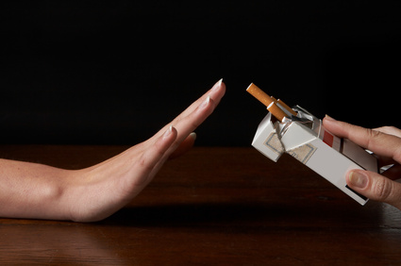
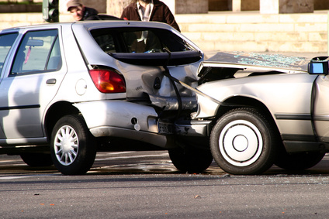
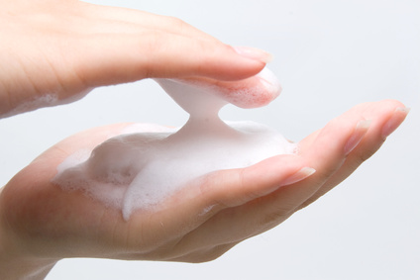

Requirements of the tasks
Relevance
For Sciences
For the students
Context orientation
Context of the dayly life of students
Vivid context which enables research
Open for inquiry
As seen before

Slide 4
Web resources from EU programmes
PARSEL-Project
http://icaseonline.net/parsel/www.parsel.uni-kiel.de/cms/indexafd1.html?id=modules
ESTABLISH-Project
http://www.establish-fp7.eu/resources/units.html

Slide 5
Examples of tasks
Analyse and assess the exemplary materials in terms of usability in your context
Renewable Energy
http://www.establish-fp7.eu/resources/units/renewable-energy.html
Cosmetics
http://www.establish-fp7.eu/resources/units/cosmetics.html

Slide 6
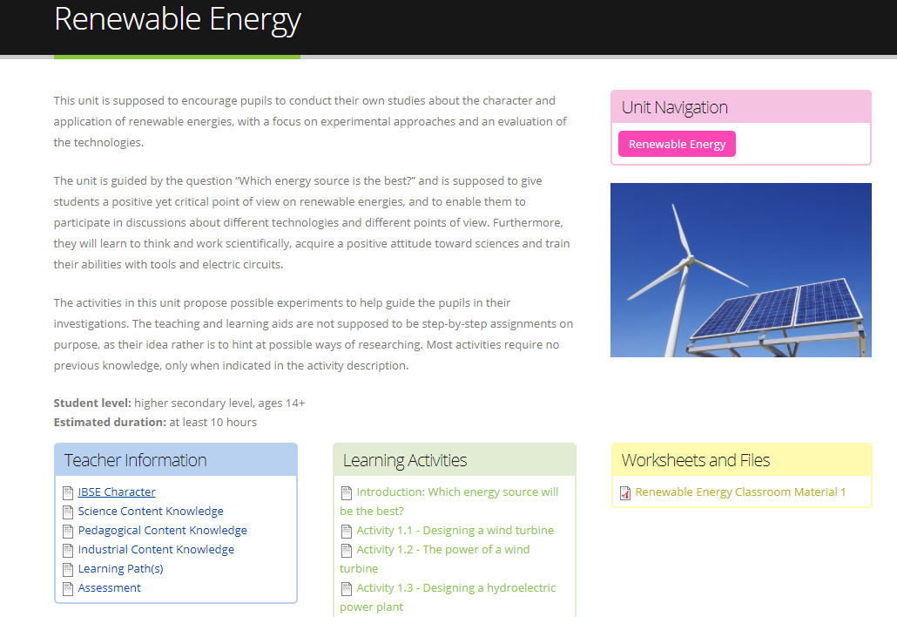

Slide 7
Worksheet: Which energy source will be the best?
Energy is one of the very important and expensive goods of today’s society; it is used for heating and to power every electric device. The world’s most utilised energy sources are fossil fuels such as coal, natural gas and petroleum, a resource which is only available in limited supply. The same applies to fuels for nuclear power, uranium and plutonium, which additionally burden us with the problems of safely depositing the nuclear waste, a problem we still have no viable long-term solution for.
Which source of energy will therefore be the best in the future?
1. Form a committee and try to work out an answer to this main question.
2. Develop criteria to guide your further investigations.
3. Use your findings to prepare for a panel discussion at the end of the project, where you present your results and your answer to the main question.
4. Discuss your answer with other groups and comment on their answers to arrive at a common solution.

Slide 8
Examples of tasks
Analyse and assess the exemplary materials in terms of usability in your context
Renewable Energy
http://www.establish-fp7.eu/resources/units/renewable-energy.html
Cosmetics
http://www.establish-fp7.eu/resources/units/cosmetics.html

Slide 9
EXPECTATIONS AND NEEDS
What kind of materials?
(Lesson scripts, information about disciplinary content, experimental procedures…)
How prescriptive vs. flexible?
Do you have preferred themes?
(e.g., from the EG curriculum)
How will you use the materials?

