Slide 1
What supports and hinders ‘deep change’
How can we support teachers through change

Slide 2
Desired Learning Outcomes
We will explore the concept of ‘deep change’ and the factors that support/hinder this
We will reflect on and explore the emotional and personal dimension of change
We will problematize the concept of ‘resistance’

Slide 3
Reflective task 1
Identify a time you were faced with change.
How did this change come about – voluntary or enforced? What impact did this have on you?
Consider your initial response to this change? Feelings, emotions, reactions etc
Did you implement the change with ease and welcome it or did you struggle with it and resist it? Why?

Slide 4
Deep versus surface change
Practice
Beliefs and Values
Content
Fullan, M. (2003)

Slide 5
Reflective task 2
Have you ever experienced ‘deep change’:
Describe the change briefly
Support your argument that it was ‘deep change’
Consider the factors that were in place that supported ‘deep change’

Slide 6
Reflective task 3
Have you ever experienced ‘surface change’:
Describe the change briefly
Support your argument that it was ‘surface change’
Consider the factors that created ‘surface change’

Slide 7
Difficulty of achievement ‘deep change’

Slide 8

‘Few educational innovations make it past the school room door permanently’ (Cuban 1990 cited in Marsh, 2003, pp.195)
Notes:
Have a read through those quotes for a second
So we see what we are up against. The education system is slow to change and when change is introduced it reacts to it by changing as little as possible. I particularly like the last quote there!

Slide 9

‘Changing schools is like punching a pillow. They absorb innovative thrusts and soon resume their original shape’ (Boyd, 1988 cited in Marsh, 1997, p.175)
Notes:
Have a read through those quotes for a second
So we see what we are up against. The education system is slow to change and when change is introduced it reacts to it by changing as little as possible. I particularly like the last quote there!
Education can deviate only in the direction and to the extent that society allows…….Whatever the season, education is a frozen institution’ (House)
Schools are icebergs that never melt
Resistant to deep change
Ruddock speaks of schools as an institution frozen in time, and that ‘thawing’ is a necessary precondition of school improvement
Society encourages schools to remain the same

Slide 10

‘Whatever the season, education is a frozen institution’ (House)

Slide 11
Some key considerations

Slide 12
Personal nature of change
Emotions and ‘resistance’

Slide 13
Goodson’s Three Phases of Change
Phase 3: Personal Change: begins with an inner change to beliefs
Phase 2: External change
Phase 1: Internal Change
Notes:
‘When teachers detach their identity projects, their ‘hearts and minds’ from school, change is unlikely to be successful’ (Goodson, 2001, p.55).
Reforms that seek to by-pass teachers…will not succeed’ (Kirk and MacDonald, 2001, p.552)
Any attempt to ‘teacher-proof reforms’ are likely to result in failure (Mac Donald 2003, p.140).

Slide 14
Emotions of change
While generally accepted, Spillane et al. (2002) argue that teacher emotions during the change process is ‘‘overlooked and understudied’’
Zembylas (2003): ‘‘invisible aspects of emotional work’’ (p. 113)
Notes:
Zembylas (2005) argues ‘‘teacher emotion is the product of cultural, social and political relations’’ (p. 4) and claims that what is missing from theory is an examination of how emotions are embedded in power relations inherent in education practices and relationships.
Hochschild’s (1993) argues that teaching is a profession that calls for emotional sensitivity and teachers learn to manage and suppress their true feelings in order to display behaviours which ﬁt with organisational expectations.
http://instructionalleadership.ie/images/Becky_SaundersThe_role_of_teacher_emotions_in_change.pdf

Slide 15

Emotions of change
Hochschild’s (1993) argues that teaching is a profession that calls for emotional sensitivity and teachers learn to manage and suppress their true feelings in order to display behaviours which ﬁt with organisational expectations.
Notes:
Teachers will experience feelings of discomfort, loss and bereavement when faced with change (Hargreaves, 1998; Handal & Herrington, 2003), even when such changes benefit them. It is unlikely that teachers will change their practices unless their beliefs and values are altered (Handal & Herrington, 2003). Goodson (2001) stresses that the personal dimension of change must be acknowledged, for ‘when teachers detach their identity projects, their ‘hearts and minds’ from school, change is unlikely to be successful’ (ibid, p.55).
emotional and personal dimensions of change, experienced by teachers, frequently remain ignored (Hargreaves, 1998)

Slide 16
Machiavelli on change
There is nothing more difficult to carry out,
nor more doubtful of success, nor more
dangerous to conduct, than to initiate a new
order of things. For the reformer has enemies
in all who profit by the old order and only
lukewarm defenders in all those who profit by
the new order (The Prince, 1519)

Slide 17
Concept of ‘Resistance’
‘Resistance’ is a normal, nature and expected reaction when faced with change and is strongly linked with emotions
‘Resistance’ needs to be framed as natural responses to transition
Feelings of discomfort, fear, loss and bereavement – even when changes benefit them (Handal & Herrington, 2003)

Slide 18
Misunderstood Resistance
‘Resistance’ places blame elsewhere and can hide underlying issues/problems i.e. required skills
Not always negative: productive and supportive ‘resistance’
Often a result of historical/political issues: knee jerk reaction/experience change as fads
Sometimes a change submitted with ease is concerning: shows that actually the change hasn’t been taken on board at all (Fullan, 2010)
Notes:
" Dur ing transitions from a familiar to a new state of affairs, individuals must normally confront the loss of the old and commit themselves to the new, unlearn old be liefs and behaviors and learn new ones, and move from anxiousness and uncertainty to stabilization and coherence. Any significant change involves a period of intense personal and organizational learn ing and problem solving. People need sup ports for such work, not displays of im patience.
Blaming "resistance" for the slow pace of reform also keeps us from understand ing that individuals and groups faced with something new need to assess the change for its genuine possibilities and for how it bears on their self-interest. From com puters across the curriculum, to main streaming, to portfolio assessments, to a radical change in the time schedule, sig nificant changes normally require extra effort during the transitional stage. More over, there's little certainty about the kinds of outcomes that may ensue for stu dents and teachers (and less assurance that they will be any better than the sta tus quo). These are legitimate issues that deserve careful attention. Many reform initiatives are ill-con ceived, and many others are fads. The most authentic response to such efforts is resistance. Nevertheless, when resis tance is misunderstood, we are immedi ately set on a self-defeating path. Refram ing the legitimate basis of most forms of resistance will allow us to get a more productive start and to isolate the real problems of improvement.

Slide 19
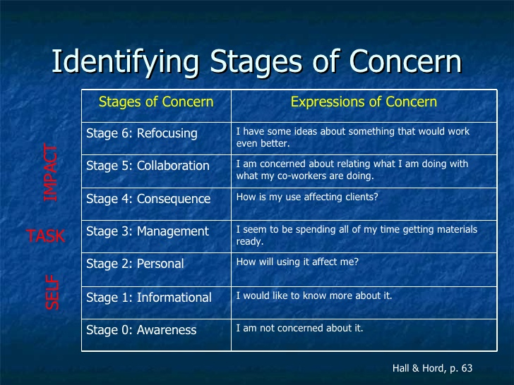
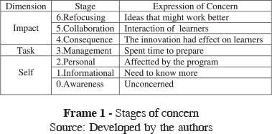
Hords Stages of Concern

Slide 20
How can we support teachers emotionally and encourage them to move to higher stages?

Slide 21
To think about
Schools may have volunteered but did teachers?
Why did schools/teachers become involved? What are their motivations and how will this impact on their engagement?
Incentives, prestige, resources
What voice/power/control will teachers have in the project?
Notes:
Fullan: people more likely to adopt change if it adds resources without expecting much of them

Slide 22
People make/adapt their own meaning

Slide 23
Tubulawa (1998, p.265) argues that ‘teachers are thinking beings who attach meaning to their actions and, as such, are capable of subverting planned change’.

Slide 24
Teachers alter reforms
To bring them in line with their pre-existing and deeply embedded beliefs and values (Curtner-Smith, 1999, p.92)
Teachers ability to ‘refract…….change is substantial’ (Goodson, 2001, p.54)
Reforms are ‘recreated’ rather than ‘implemented’ by teachers: results in ‘apparent slippage between conception and practice; (Mac Donald, 2003, p.141)
Notes:
Teachers can therefore adapt and alter externally mandated reforms in order to bring them in line with their own pre-existing and deeply embedded beliefs and values (Curtner-Smith, 1999, p.92). As change is such a personal process, teachers capacity ‘to refract externally mandated change is substantial’ (Goodson, 2001, p.54). Vulliamy et al. (1997) argues that reforms are recreated rather than implemented by teachers in schools, which can result in an ‘apparent slippage between conception and practice’ (Mac Donald, 2003, p.141).
must be interpreted, or decoded, and then translated, or recoded, before becoming practice (Beckert, 1999; Sannino, 2009; Ball, Maguire, & Braun, 2012).

Slide 25
To think about
What are teachers and schools current understanding of the purpose of the project?
Does everyone have a similar understanding?
Who says ‘our’ understanding is the most relevant/what is needed?
The purpose/focus may (should) change as the project develops: how can we develop/ensure a ‘shared meaning of change’ (Fullan, 2010)?

Slide 26
What lessons can we take from this for our project?

Slide 27
Key Lessons

Slide 28
Fullan’s 8 basic lessons for change
1- You can’t mandate what matters 2- Change is a journey not a blueprint 3- Problems are our friends 4- Vision and strategic planning come later 5- Individualism and collectivism must have equal power 6- Neither centralisation nor decentralisation works 7- Connection with the wider environment is critical for success 8- Every person is a change agent

Slide 29
Reference list
Prochaska, James O.; DiClemente, Carlo C. Trans theoretical therapy: Toward a more integrative model of change. Psychotherapy: Theory, Research & Practice, Vol 19(3), 1982, 276-288. http://dx.doi.org/10.1037/h0088437
Fullan (2007) The New Meaning of Educational Change. New York: Routledge.
Huberman, M (1988) Professional life cycle of teachers. Teacher careers and schools improvement. Journal of Curriculum Studies, 20/2

