Slide 1
Education for Sustainable Development
Core concepts and ideas

Slide 2


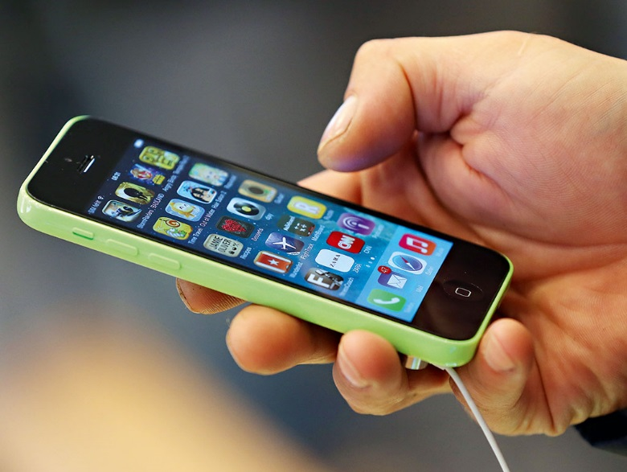
1. What is Development?
Question
How can our interpretation of ‘Development’ differ?

Slide 3
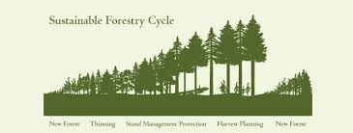
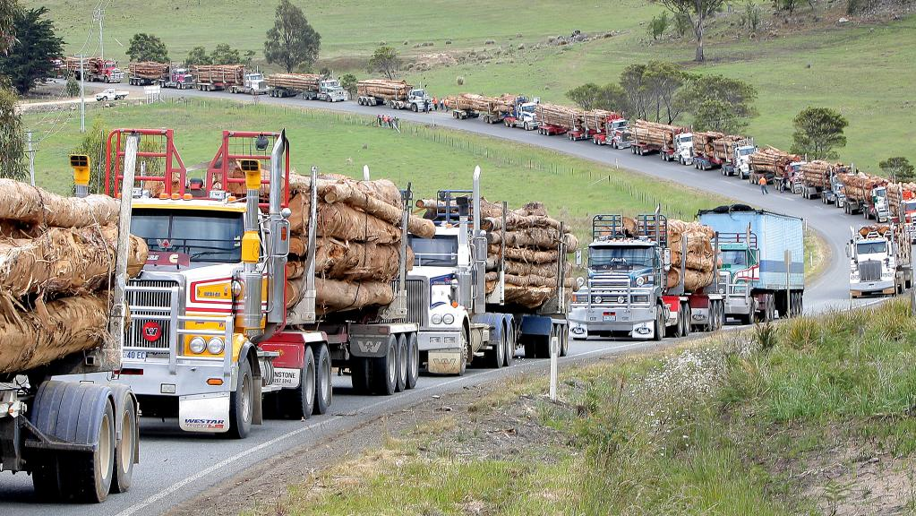
What is Development?

Slide 4
1. What is Development?
Quality Education
Freedom for all
Social Supports
Production & Consumption
Political Stability
Food Security
Peace & Security
Energy Security
Good Infrastructure
Stable Economy
Opportunity for all
Employment Opportunities
Water, Sanitation
Health Services

Slide 5
2. What is ‘Sustainable Development’?
“Development that meets the needs of the present without compromising the ability of future generations to meet their own needs”
World Commission on Environment and Development, 1987

Slide 6
2. What is ‘Sustainable Development’?
A Brief History
1972 – UN Conference on Human Environment (Stockholm) & EE
1974 – UN Declaration on the New International Economic Order
1975 - Belgrade Charter produced a framework for Environmental Education
1977 – Tiblisi Declaration
1980 - World Conservation Strategy
1987 – The World Commission on the Environment and Development
& Our Common Future
1992 – UN Conference on Environment and Development (UNCED),
or Earth Summit (Rio de Janeiro) & Agenda 21
2002 - World Summit on Sustainable Development (WSSD) in J’burg
2006 – UN Decade of Education for Sustainable Development & MDGs
2015 – UN Global Action Plan (& SDGs)
Notes:
Sustainable development is the vision for a better world in which environmental, social and economic considerations are balanced.

Slide 7
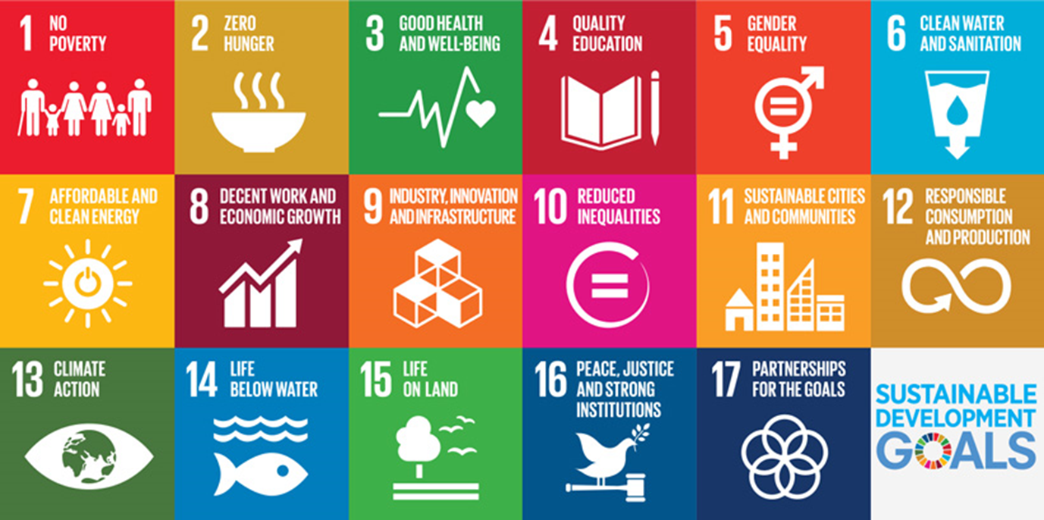
2. What is ‘Sustainable Development’?
United Nations Sustainable Development Goals (2015 - 2030)
Notes:
Agreed by the 193 Member States of the UN, the new agenda, Transforming Our World: 2030 Agenda for Sustainable Development, consists of a Declaration, 17 Sustainable Development Goals and 169 targets.
The principle of universality has been widely characterised as a foundational value of the goals. Universality implies that the issues exist in all countries, that the principles, standards and values are applicable to all people in all countries, and that there is significant interconnectedness of national and global development challenges, and therefore universal commitments to address them (UNEP, 2015).
The UN Decade of Education for Sustainable ran from 2005 -2014, this has now been replaced by the UN Global Action Programme
The Sustainable Development Goals acknowledge the important role of global citizenship education
including development education in building the conditions for a more peaceful, fair and sustainable world
under Target 4.7, which calls on countries to
“ensure that all learners acquire the knowledge and skills needed to promote sustainable development,
including, among others, through education for sustainable development and sustainable lifestyles,
human rights, gender equality, promotion of a culture of peace and nonviolence, global citizenship and
appreciation of cultural diversity and of culture’s contribution to sustainable development.’

Slide 8
3. Education for Sustainable Development
SDG Goal 4.7
“By 2030, ensure that all learners acquire the knowledge and skills needed to promote sustainable development, including, among others, through education for sustainable development and sustainable lifestyles, human rights, gender equality, promotion of a culture of peace and non-violence, global citizenship and appreciation of cultural diversity and of culture’s contribution to sustainable development”
(United Nations, 2015)

Slide 9
ESD
ESD was first described in Chapter 36 of Agenda 21 (1992) from Rio
four major thrusts
(1) improve basic education
(2) reorient existing education to address sustainable development
(3) develop public understanding, awareness, and
(4) training

Slide 10
Education for Sustainable Development
Education for Sustainable Development (ESD) is an approach to education that supports the learner to critically examine pertinent issues from a variety of perspectives and work towards identifying how change at individual, societal and global levels can bring about a fairer, more equal and more sustainable world.
Knowledge
…of interlinked social, economic & environmental issues
Skills
Critical thinking
Media literacy
Problem Solving
Systems Thinking
Communication
Attitudes
Agency
Empathy
Responsibility
Notes:
ESD is a ‘new vision of education’
…empower people of all ages to assume responsibility for creating a sustainable future
…reorienting education systems, policies and practices to enable the learner to address issues of sustainability and make clear decisions for action that are culturally appropriate and locally relevant
… Implemented using a‘strengths’ model

Slide 11

Head
Heart
Feet

Slide 12
Essential ESD skills UNESCO Bangkok
Envisioning – being able to imagine a better future
Critical thinking and reflection – learning to question our current belief systems and to recognize the assumptions underlying our knowledge, perspective and opinions
Systemic thinking – acknowledging complexities and looking for links and synergies when trying to find solutions to problems
Building partnerships – promoting dialogue and learning to work together
Participation in decision-making – empowering people
Notes:
… is the lead agency in promoting education for sustainable development (UN DESD)
‘…while sustainable development involves the natural sciences, policy and economics, it is primarily a matter of culture; it is concerned with the values people cherish and the ways in which we perceive our relationship with others and with the natural world’
UNESCO (2002)

Slide 13
3. Education for Sustainable Development
…ESD is about understanding the interdependencies and interconnectivities that exist within the world, and using this to address problems such as poverty, wasteful consumption, environmental degradation, population growth, gender inequality etc.
What interdependencies and interconnectivities?
Food we consume
Technology we use
Clothes we wear
Fuel/energy we depend on
Waste we produce
Norms that we maintain
Natural environment in which we live

Slide 14
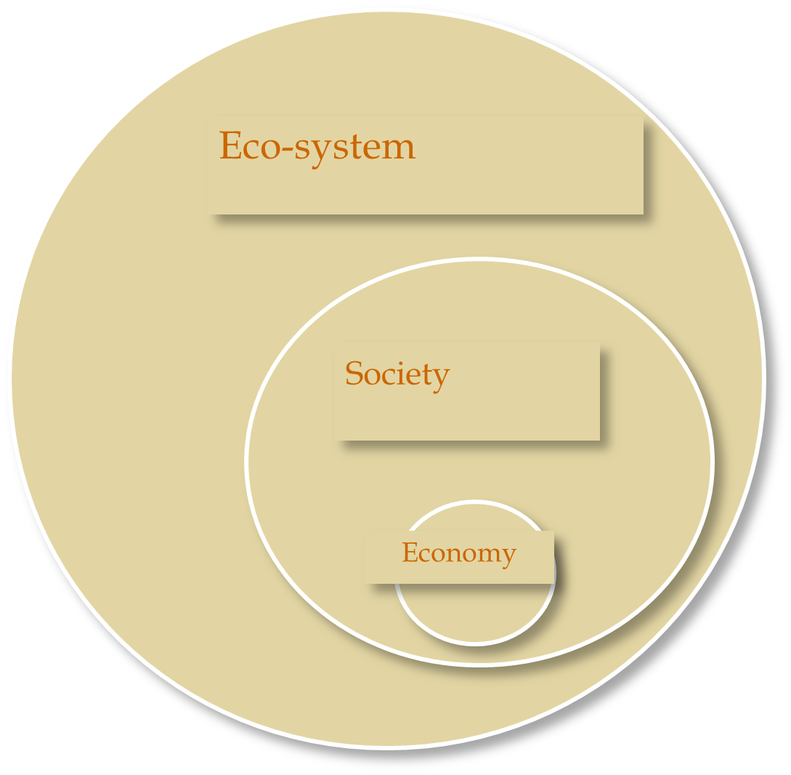
Rejects 3 equal interdependent and mutually reinforcing pillars
Sterling, 2002
Environment
Economy
Society
Notes:
Social: addressing poverty, racism, human rights, peace
Environment: protecting and managing the natural resource base
Economic: changing unsustainable patterns of production and consumption, unfair trade issuse
Environmental: climate change, natural disasters, pollution, erosion
Social: social and cultural inequality, gender, racism, war and conflict
Economic: income inequality, poverty, unemployment, migration
Maintains economic global development by balancing the three pillars of sustainability
(1) Social- wellbeing and overall quality of life
(2) Environmental- impacts of development
(3) Economic- advantages and costs
Social: addressing poverty, racism, human rights, peace
Environment: protecting and managing the natural resource base
Economic: changing unsustainable patterns of production and consumption, unfair trade issuse
Environmental: climate change, natural disasters, pollution, erosion
Social: social and cultural inequality, gender, racism, war and conflict
Economic: income inequality, poverty, unemployment, migration

Slide 15
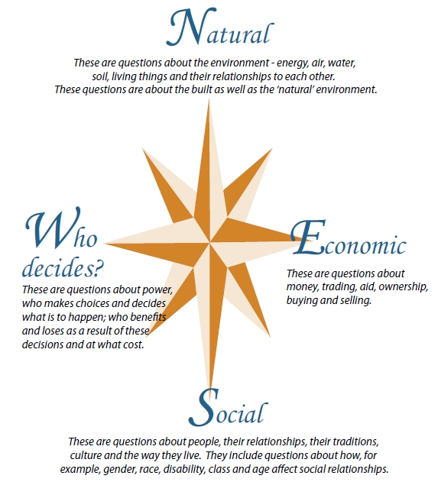
The Development Compass Rose, TIDE Global Learning, UK

Slide 16
Task
Identify topics/areas within Egyptian schools that are relevant to ESD?
Identify the interdependencies and interconnectivities that exist between these topics
What pedagogical approaches would support ESD?
Notes:
Explore this from a local, national and global perspectives

Slide 18
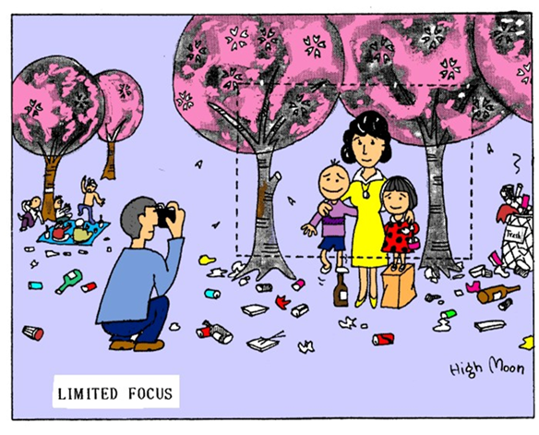
It’s not about teaching more, but about teaching differently
Tormey
Notes:
Not about finding out the ‘one truth’. Holistic approach
It’s about questioning things that we take for granted… critical and creative thinking
The process is as important as
the end … active participation
in learning
Global / local
Economic, social, environmental perspectives
Interdisciplinary perspectives
Holistic approaches

Slide 19
Global Citizenship

Slide 20
Global citizenship
Global citizenship education is an umbrella term for education that….
builds a sense of belonging to a common humanity and fosters respect for all. It plays a critical role in equipping learners with the necessary knowledge, competencies and values to take informed decisions and assume active roles locally, nationally and globally
The development of responsible, active and contributing global citizens.
Notes:
https://www.developmenteducationreview.com/issue/issue-6/perspective-relationship-between-development-education-and-education-sustainable

Slide 21
Global Citizenship
The world faces global challenges, which require global solutions……It requires transforming the way people think and act. Education must fully assume its central role in helping people to forge more just, peaceful, tolerant and inclusive societies. It is not enough for education to produce individuals who can read, write and count. Education must be transformative and bring shared values to life. It must cultivate an active care for the world and for those with whom we share it. Education must also be relevant in answering the big questions of the day. It must give people the understanding, skills and values they need to cooperate in resolving the interconnected challenges of the 21st century’ (GEFI, http://www.unesco.org/new/en/gefi/priorities/global-citizenship/ )
Notes:
These interconnected global challenges call for far-reaching changes in how we think and act for the dignity of fellow human beings. Barriers to global citizenship Legacy of the current education system. Schools have traditionally prepared people to pass exams, proceed to the next level and graduate into the workplace. We now face the much greater challenge of raising global citizens. Promoting respect and responsibility across cultures, countries and regions has not been at the centre of education. Global citizenship is just taking root and changing traditional ways of doing things always brings about resistance. This entails changing the way education is organized— making content more relevant to contemporary life and global challenges, introducing innovative and participatory teaching and learning styles. We must rethink the purpose of education and prepare students for life, not exams alone.
Outmoded curricula and learning materials. Reviews from around the world find that today’s curricula and textbooks often reinforce stereotypes, exacerbate social divisions, and foster fear and resentment of other groups or nationalities. Rarely are curricula developed through a participatory process that embraces excluded and marginalized groups. But change is possible when educators adopt a vision of ethical global citizenship. Lessons from India and Ghana, for example, show that explicitly teaching good citizenship as a subject can have powerful results with more empowered and ethical students emerging. Deeply entrenched beliefs take time to change. But young people are open to new perspectives, and schools are ideally positioned to convey them.
Lack of teacher capacity. Broad teacher development reforms are needed to ensure the uptake of new citizenship skills. If we want to transform the way students learn, we must also help teachers expand their own skills and outlooks. Are they comfortable with a curriculum that dwells explicitly on global citizenship? Can they teach traditional subjects in ways that exemplify non-discrimination and positive support to the disadvantaged? Many teachers lack the training, confidence and classroom resources to meet these challenges without support and instruction. We owe it to them, and our children, to provide it.
Teachers must both be comfortable with the content of what they are teaching but also model it in their teaching practice. This means on-going teacher development and participatory learning techniques are important to ensure teachers feel comfortable teaching about global citizenship explicitly. Teachers can help build ideas and habits of non-discrimination and positive support to the disadvantaged through the way they conduct their teaching of literacy, numeracy and other subjects.
Inadequate focus on values. The values of peace, human rights, respect, cultural diversity and justice are often not embodied in the ethos of schools. Instead of empowering students to learn and thrive, schools often replicate social inequalities and reinforce social pathologies by tolerating bullying and gender-based violence and subjecting children to physical and psychological punishment. Young people learn much from schools, but what they learn is not only in their lessons. Teachers and administrators must learn to model the skills we want students to develop, such as good environmental practices, participatory decision-making, and the control and prevention of violence through reporting policies and clear codes of conduct. Lack of leadership on Global Citizenship. To create a generation that values the common good, we must understand how young people see the world today—and our schools must find ways to foster a broader vision. Goals and targets should be set around 21st century skills and regularly assessed to measure progress.
Open discussion of tolerance and human rights can be politically sensitive, but it is critical if we want to overcome divisions and expand the prospects for peace and prosperity. Success will require support from a wide range of stakeholders, including the highest levels of government.

Slide 22
Global Citizenship
“a global citizen is someone who identifies with being part of an emerging world community and whose actions contribute to building this community’s values and practices.” (Israel, 2012)
“It is a way of living that recognises our world is an increasingly complex web of connections and interdependencies. One in which our choices and actions may have repercussions for people and communities locally, nationally or internationally” (IDEAS for Global Citizenship).

Slide 23
A Global Citizen is someone who:
is aware of the wider world and has a sense of their own role as a world citizen
respects and values diversity
has an understanding of how the world works
is outraged by social injustice
participates in the community at a range of levels, from the local to the global
is willing to act to make the world a more equitable and sustainable place
takes responsibility for their actions.

Slide 24
Global Citizenship

Slide 26
Task
Lets return to our task on ESD (content, topics, pedagogical approaches)
What additions/changes would you make to this chart in terms of Global Citizenship? How do you perceive the relationship between ESD and Global Citizenship?

