Slide 1
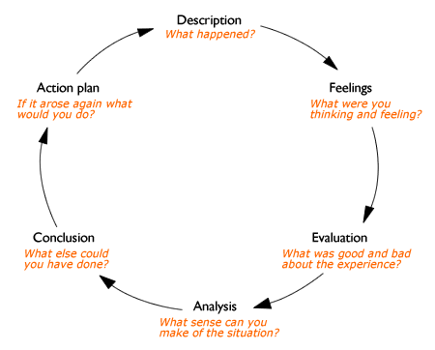
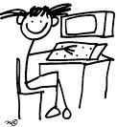
Gibb’s model of reflection (1988)
Being a reflective teacher

Slide 2
Gibb’s model of reflection (1988)
1.STOP!
2.Know the steps before and after so secure in the ability to be flexible in teaching needs.
3.Be Confident to do changes
4.Continue to build skills professional and not showing panic.
1.Wrong pitch of the lesson so children became disengaged
Stopped and drew class together to change teaching/pitch
Panic! Felt losing control! Unsure what to do...
Need to ensure LI?SC are fit for purpose.
Need to build in flexibility and see acknowledging is important.
I realised within the input.
Children's learning was not moved on.
Felt my panic developed into a lack control which undermined me as the teacher.

Slide 3
Gibb’s model of reflection (1988)
1.

Slide 4
Gibb’s model of reflection (1988)
1.

