Slide 1
Critical Reflection
Why bother with a model……
A framework of reflection can help to guide you through the process
A reflective model will help you to identify what you have learned from the experience and how this relates to the theory/knowledge that you have been taught or researched
Notes:
You will notice that both of the assignments have the phrase critical reflection, so this part of the presentation will focus on providing you with a starting point for finding out about this concept – which is considered to be a key aspect of being a teacher. We will be thinking about you personally critically reflecting on your own learning but we will also suggest that there is power in reflecting with others, collaborative reflection and you may find information from Roger Greenaway who has lots of ideas to support reflective practice - google.

Slide 2
Reflection
‘Experience itself is actually not the “greatest teacher,” for we do not learn as much from experience as we learn from reflecting on that experience.’
(Farrell, 2004 ,page 7)

Slide 3
Formal Models of Reflection

Slide 4
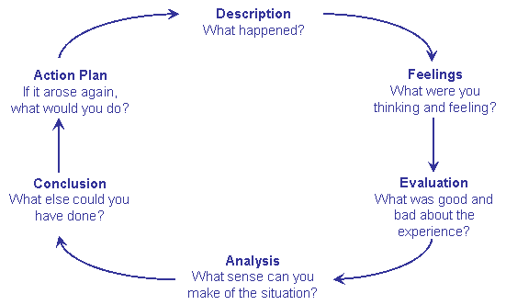
Gibbs’s Model (1988)
Notes:
This model starts with the idea that something happened or something was heard or read, it was a concrete experience. Gibbs suggested that the first part of reflection is to describe the event, and then to consider how you felt about it, consider what you were thinking and feeling. The next part of the model considers that you need to then unpick what was good and bad about the event, you are being to select aspects of the event and evaluating the impact of this. The next section is about making sense of your evaluation, if something is good or bad, then you need to say why do you feel that, what is making you feel that way. This part of the model suggests that you need to compare your personal feelings and evaluations with other sources of knowledge, different perspectives. As you move into the next stage of the model, you think what could you have done as well, or differently in response to the event. This may be because you decide something needs to be changed so the final part of the model is planning what to do if the same or similar event occurred again.

Slide 5
Kolb’s learning cycle model adapted to relate to ‘reflective practice’ (Crawford 2006)
Concrete experience
Reflective observation
Abstract conceptualisation
Active Experimentation
Notes:
This model, is another model to support the systematic way that you can critically reflect on an event.
Concrete experience
Could be any practice/management experience
Reflective observation
Reflecting back on the experience - writing down immediate thoughts
Concerns, ideas, asking yourself how? Why? What was happening?
Discussion with colleagues
Abstract conceptualisation
Consult theories/ research/ policy/ practice standards/ explore possible explanations using theory/models.
Link theory to practice
Analyse experience in the light of theory/models
Experimentation
What have you learnt?
What might you do differently in future?
What are your plans for testing out new practice?

Slide 6
A further model Ryde (2007) cited in Reed, M. and Canning, N. (2010)
Thinking about strengths
Can I recognise things I did well?
What am I most proud of?
Thinking about feelings
How do I feel about what I have done?
Were my instincts rights?
Did my actions support my values or beliefs?
Re-integrated thinking
Were there more than one possible solution/action I could have taken?
Can I identify their strengths and weaknesses
Insight thinking
What does this experience tell me?
Can I learn from this?
Above and beyond thinking
How would others view my actions?
Would they see things differently?

Slide 7
Process of Reflecting
In professional development, reflection is a process, rather a state of being or a way of thinking.
Some ways you might hear these referred to are:
Reflective practice
Reflective learning
Reflection on action
Reflection in action
Meta-reflection
Schon, 1987
Notes:
Reflective practice – being open to critical evaluation of your own practice to promote continuous improvement
Reflective learning – learning that requires you to stop and think continually about its relevance or application
Reflection on action - thinking about what you have done after the event (Schon, 1987)
Reflection in action – modifying your actions as you go along to take account of changing circumstances (Schon, 1987)
Meta reflection – to reflect upon reflection

Slide 8
Stages of Learning Model
Unconscious incompetence
Conscious incompetence
Conscious competence
Unconscious competence
not hierarchical.
Fifth stage – awareness to pass on a skill or knowledge (Alan Chapman (2009), called reflective competence (Davie Baume)

Slide 9
Impact of reflection
Improvement in confidence
Improvement in competence
Impact on your knowledge, skills, understanding (ongoing development)
Impact on your teaching (ongoing practice)
Impact on the progress made by children

Slide 10
References
Bolton, G. (2010) Reflective practice. 3rd edition. London: Sage.
Farrell, T. (2004) Reflective practice in action. 80 reflection breaks for busy teachers. Sage. London.
Gibbs, G. (1988) Learning by doing: A guide to teaching and learning methods. Further Education Unit, Oxford Brookes: University, Oxford.
Johns, C. (2006) Engaging reflection in practice: a narrative approach. Blackwell Press : Oxford
Redmond, B (2006) Developing reflective practice in health and social services. Aldershot: Ashgate.
Reed, M. and Canning, N. (2010) Reflective practice in the early years. London: Sage
Schon, D. ( 1983) The reflective practitioner; How professionals think in action. Aldershot: Ashgate Publishing

