Slide 1
Projects to develope modern teaching skills
projects are financed by the Higher Education Pact of the government
in addition to general education to improve the education of teacher trainees
at the moment three different projects until 2020
their purpose is to support students in different fields of studies
the three projects are:
- building capacity in the field of voice, body, attitude
- work against doubts concerning their studies or working as a teacher
- digitization of teacher training and digital competence of future teachers

Slide 2
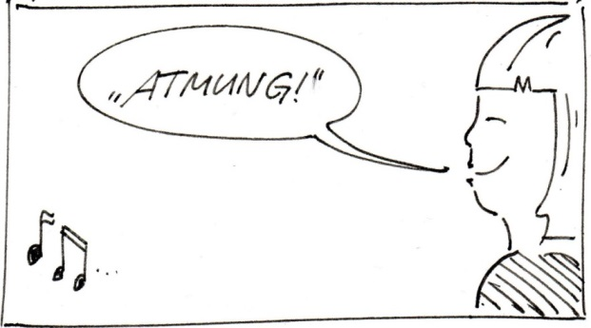
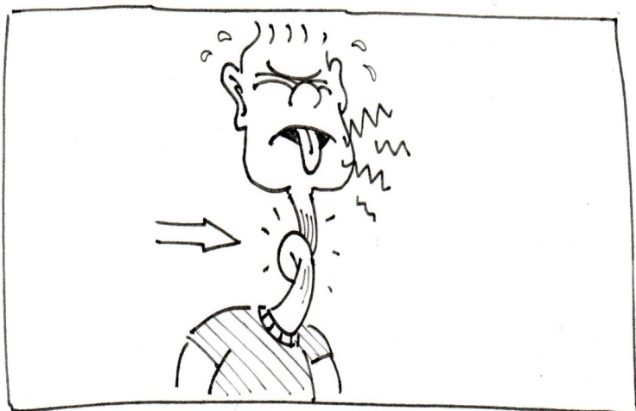
Project „Voice, Body, Attitude“
Production of films and online lectures concerning the purposeful use of voice, body and attitude in the classroom.

Slide 3
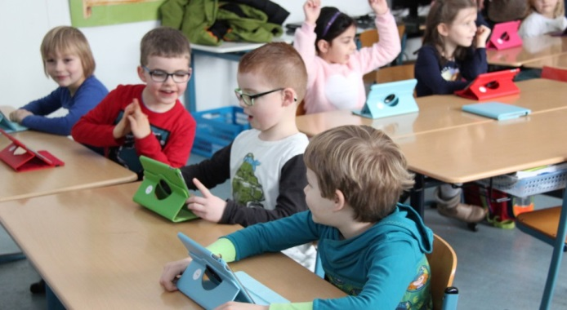

Project „Digitization of Teacher Training“
develop a concept for the digitization of teacher training
develop courses for students and teachers at the university to enhance digital competence of current and future teachers
using modern technology students learn how to use laptops, smartphones in class and create awareness for children’s ability to learn with the help of digital media

