Slide 1
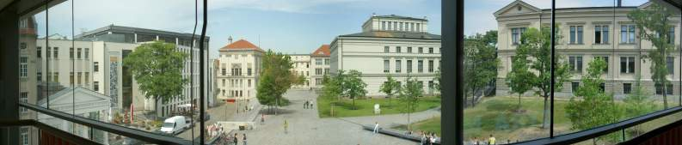
Teacher Training
at Martin-Luther-University
Halle-Wittenberg

Slide 2
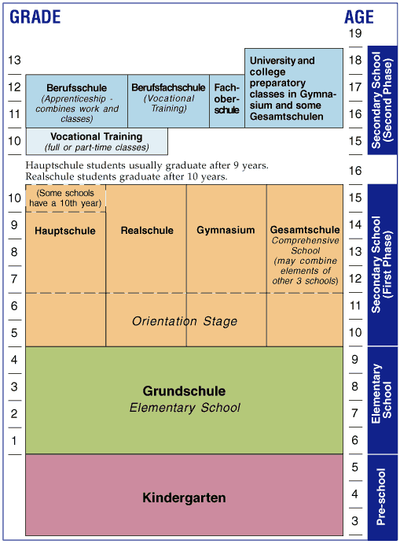
Education
System in Germany

Slide 3

Teacher-Training Centre (ZLB)
The teacher-training centre is responsable for the coordination of all teacher training activities at MLU and serves as a central contact point for students of the teaching profession.

Slide 4
Stages of Teacher Training
1st Stage
Studies
(Studium)
2nd Stage
Traineeship
(Vorbereitungs-dienst)
3rd Stage
Advanced Training & Development
(Fort- und
Weiterbildung)

Slide 5
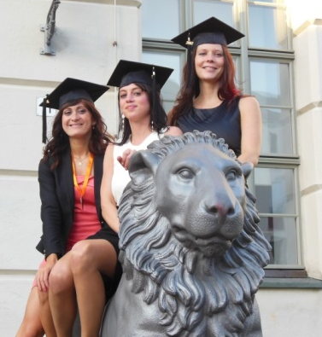
Teacher Training at MLU
About 750 students every year, who enrol in one of the following courses:
teaching degree in primary schools
teaching degree in secondary schools
teaching degree in high schools
teaching degree in special schools

Slide 6
Order of Study
Core Studies for teachers
(Educational Sciences, Key Skills,Teaching Practice Placements)
Teaching Subject 1
Scientific Discipline
+
Teaching Methodology
Teaching Subject 2
Scientific Discipline
+
Teaching Methodology
State Examination
Scientific Paper + Final Examinations

Slide 7
Example: teaching degree in high schools
Core Studies for teachers
60 ECTS
Teaching Subject 1
95 ECTS
Teaching Subject 2
90 ECTS
State Examination
25 ETCS

Slide 8
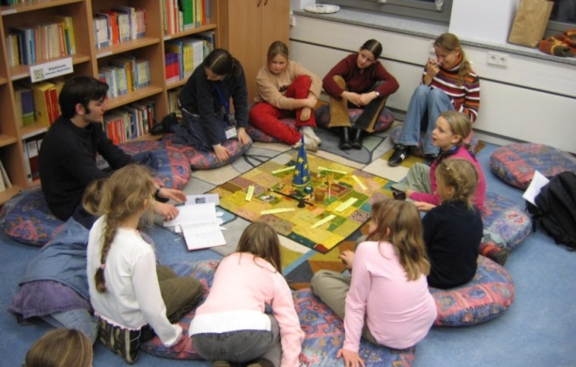
Field Experiences for Future Teachers
Orientational School Placement
(Orientierungspraktikum)
Non-School Pedagogical Placement
(Außerunterrichtliches Pädagogisches Praktikum)
Initial Teaching Experience
(Schulpraktische Übungen)
Teaching Practice Placement at School I
(Schulpraktikum I)
Teaching Practice Placement at School II
(Schulpraktikum II)

Slide 9
Contact
Martin-Luther-Universität Halle-Wittenberg
Zentrum für Lehrerbildung
Dachritzstraße 12
06108 Halle
Germany
http://www.zlb.uni-halle.de
zlb@uni-halle.de

Slide 10
Presantations in the follow rooms
202 - Susanne: "New approaches to teacher training: The programme ‘Qualitätsoffensive Lehrerbildung’"
207 - Peter: International Cooperations / Field experiences abroad
208 - Anne: Intercultural Communication skills for future teachers
213 - Katharina: Special projects to develope modern teaching skills
215 - Max/Marek: Inclusion and multiprofessional teams in education
- Alexander: Field experiences for future teachers

