Slide 1
Continuing professional development – what does it look like?
Melissa Parker

Slide 2
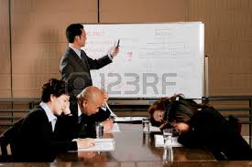
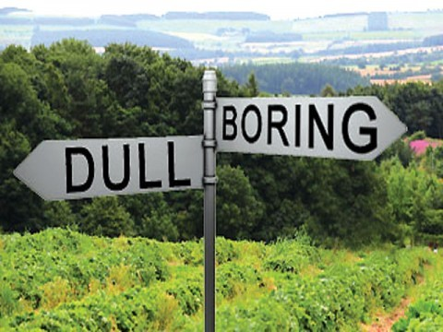
Think about this
Professional Development
Notes:
I know I am supposed to talk about communities of practice, but first we need to put these into perspective - what purposes do they serve and where do they fit into your life as a teacher. So I will start with a bit about PD or continuning education

Slide 3
CPD - What is it?
a variety of educational experiences related to an individual’s work
designed to improve practice and outcomes (Darling-Hammond & McLaughlin, 2011)
voluntary or mandatory
individual or collaborative
formal or informal

Slide 4
core features
“building the capacity of teachers to help students
learn” (Dipaola & Hoy, 2014; p. 101)
can be linked to:
teacher engagement
teaching practice, And
student learning

Slide 5
Core Feature 1: Based on Teachers’ Needs and Interests
Participant identified needs
Teachers’ active involvement in designing learning experiences
Focus on real work in schools
Acknowledgement of teachers’ prior knowledge and experience
Variety of formats
WHAT this looks like

Slide 6
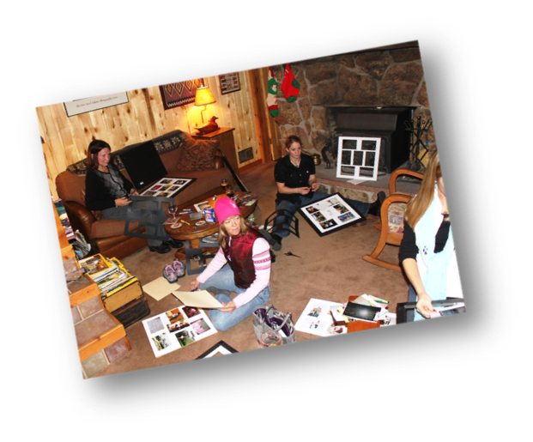
Core Feature 2: Acknowledges That Learning Is a Social Process
Builds strong relationships between teachers –
trust and ability to work together
Collaborative; sharing of knowledge
Informal settings away from school
Supportive environment that allows application of learning
Activity 1: What does this look like in your setting?

Slide 7
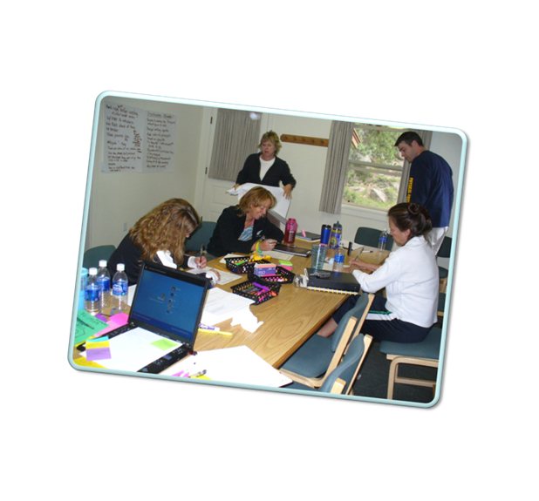
Core Feature 3: Includes Collaborative Opportunities Within Learning Communities of Educators
Extends beyond the school boundaries
Collaboratively generated knowledge
Camaraderie and respect; Trust
Safe, supportive and challenging environment
Common search for meaning in work lives
Activity 2: What does this look like in your setting?

Slide 8
Core Feature 4: Is Ongoing and Sustained
Ongoing and sustained over time
Interact on a regular basis
Critical dialogue with chances to practice change
Activity 3: What does this look like in your setting?

Slide 9
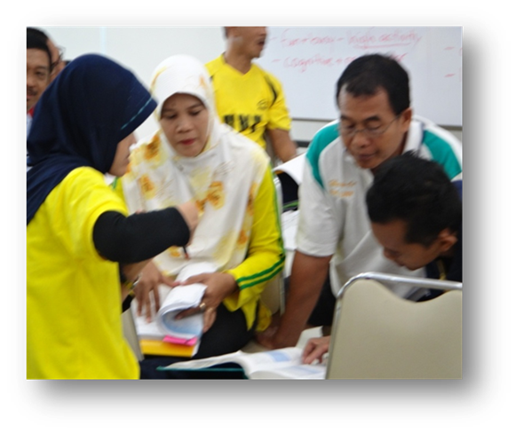
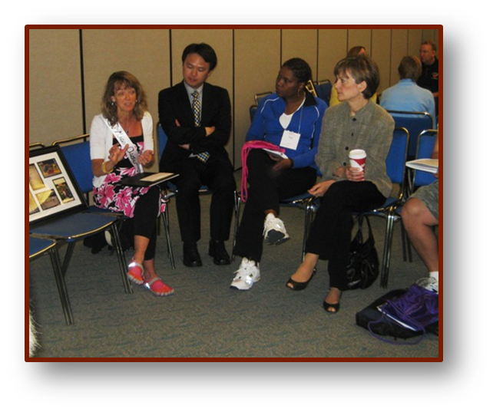
Core Feature 5: Treats Teachers as Active Learners
Hands-on activity that builds knowledge of academic content & how to teach in teachers’ context
Action research --- presentations --- giving and receiving feedback
Inquiry based
Activity 4: What
does this look like
in your setting?

Slide 10
Core Feature 6: Enhances Teachers’ Pedagogical Skills and Content Knowledge
Hone teaching skills; master content; evaluate performance and implement change
Concrete tasks of teaching; assessment; observation; and reflection
Content and pedagogy specific
Activity 6: What does this look like in your setting?

Slide 11
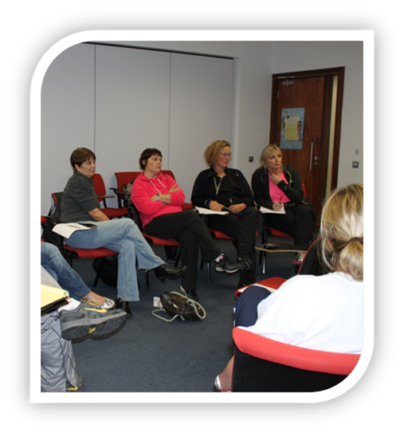
Core Feature 7: Is Facilitated With Care
Acknowledges how teachers’ construct new meaning based on prior knowledge
Recognises the influence of others in a non-judgemental environment
Guides rather than directs
Listens rather than tells
Gently push and pull
Activity 5: What does this look like in your
setting?

Slide 12
Core Feature 8: Focuses on Improving Learning Outcomes for Students
Related to student achievement
Discussions of goals; what is evidence of achieving those goals; and how evidence can be gathered is must become the starting point
Activity 7: What does this look like in your setting?

Slide 13
What does your final picture for CPD look like?

Slide 14
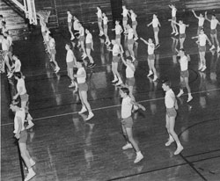
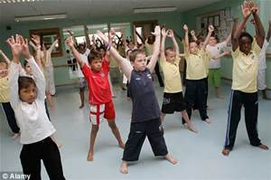
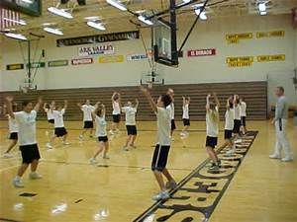
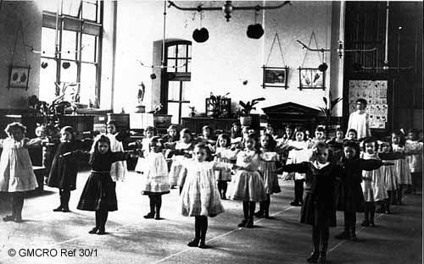
Notes:
If we conduct teacher education with 19th century practices then we will continue to have 19th century teaching going on in schools.
Would you go to a dentist who practiced? Why should education be any different or teacher education be any different?
After all you would not want to go to a dentist who was practicing using 1899 or 1931 practices. So why we would be want teachers who taught the same way as 50 years or were educated the same manner that their grandparents had been.
Is this what we want?

Slide 15
Overall
Start Small
Start Smart
Don’t Stop
Notes:
Attention needs to be paid to how the groups are designed and facilitated - they do not happen by chance.

Slide 16
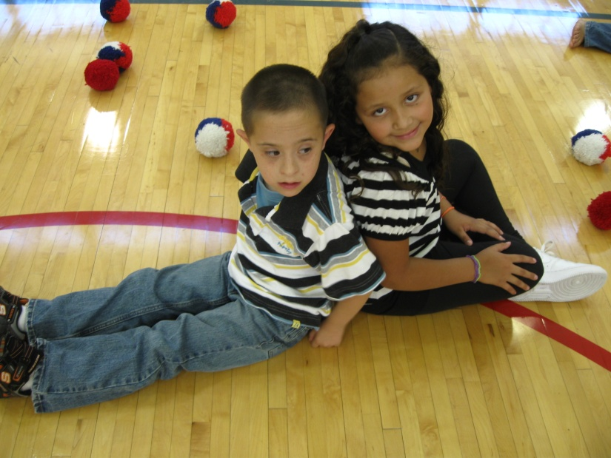
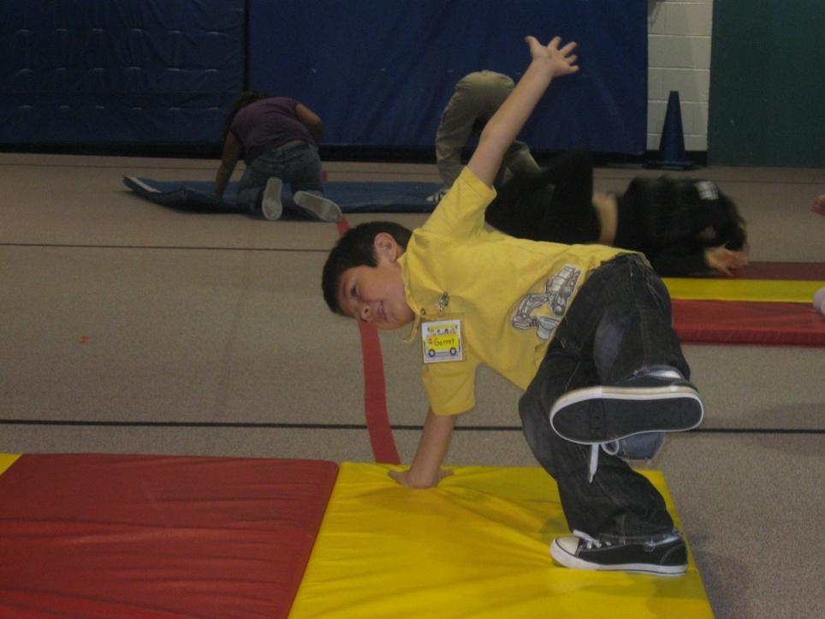
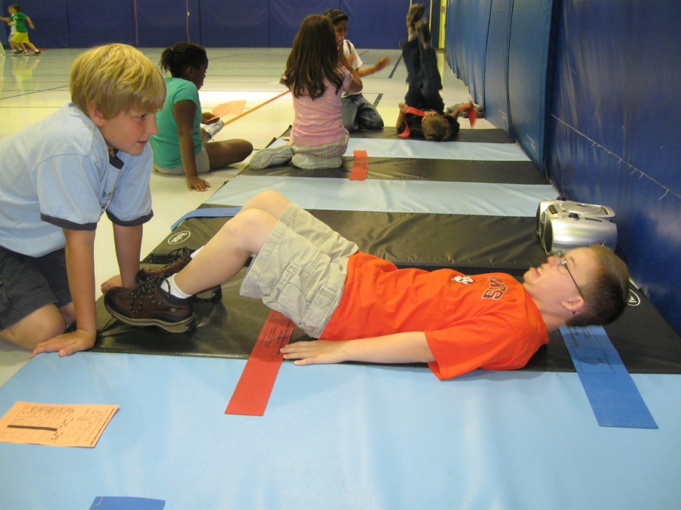
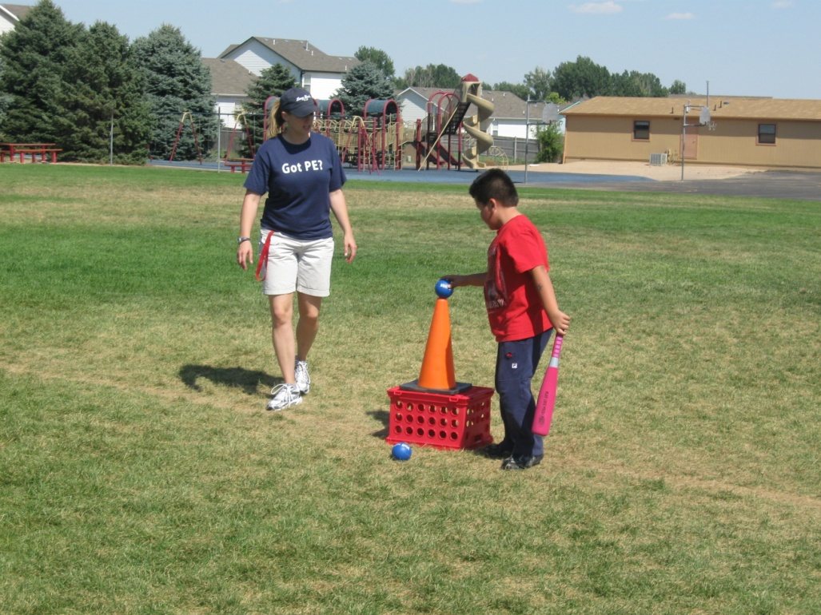
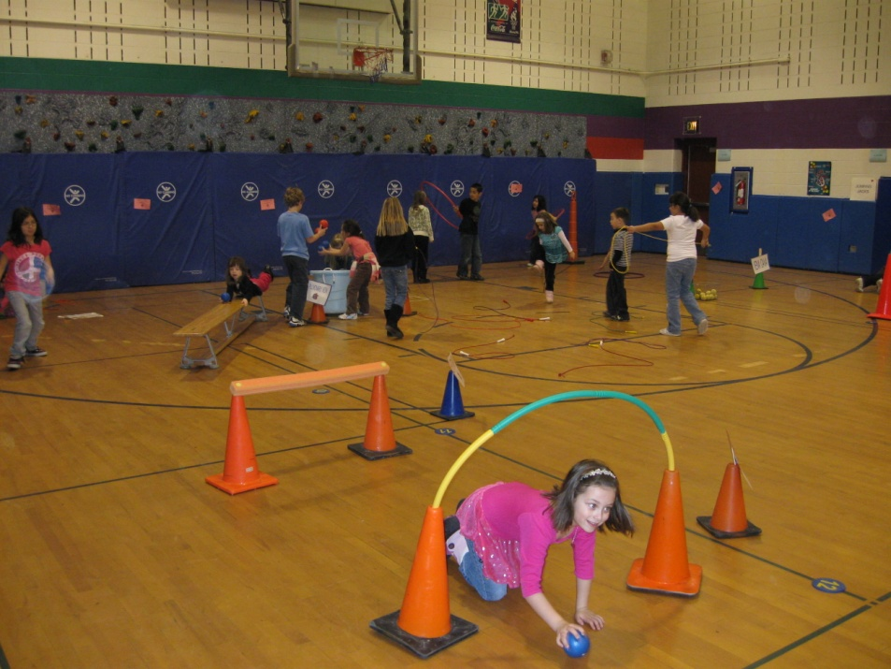
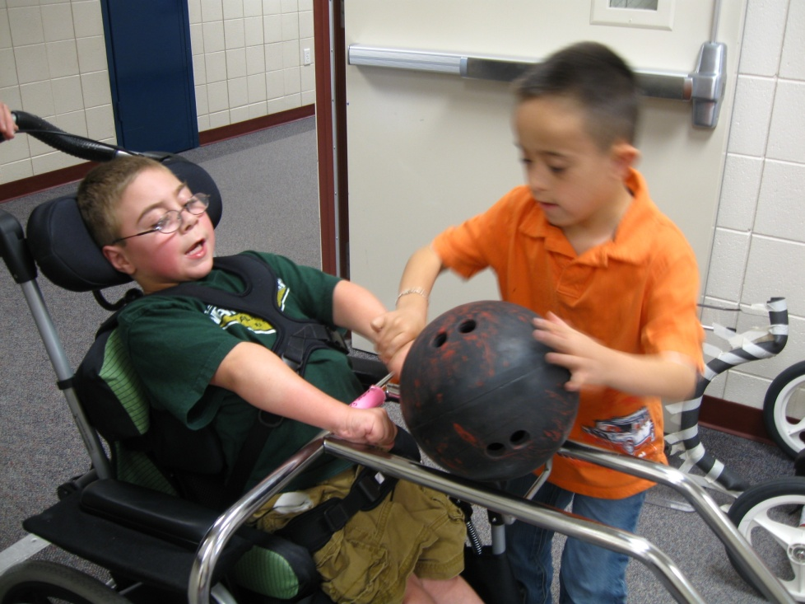
Notes:
After all it is about them

