Slide 1





The University of Limerick &
Our International Outlook
Dr Anca Minescu, Vice-Dean International, Faculty of Education and Health Sciences
Anca.Minescu@ul.ie

Slide 2


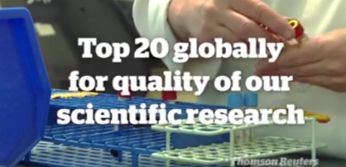


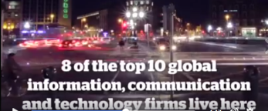
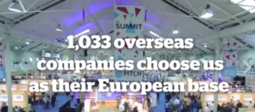

Notes:
2

Slide 3
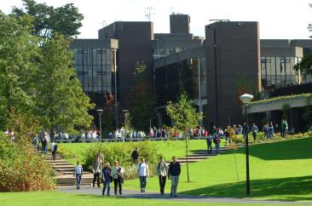
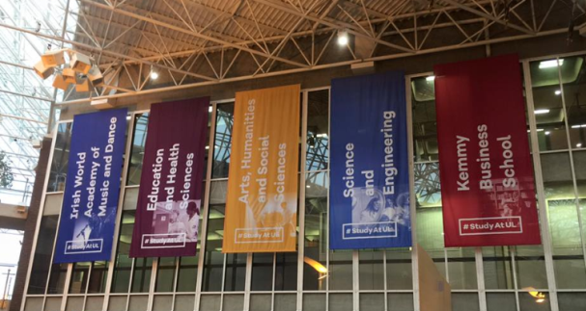
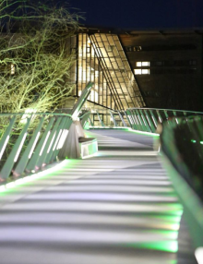
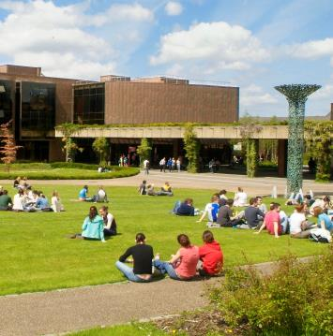

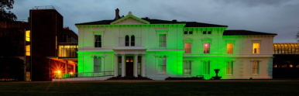

Slide 4
There are 4 faculties in UL
Faculty of Education and Health Sciences
Faculty of Arts, Humanities and Social Sciences;
Faculty of Science and Engineering
Kemmy Business School
University of Limerick:
Over 12,000 students, including more than 2,000 international students each year
UL offers more than 70 undergraduate programmes and 100 taught postgraduate programmes to Doctoral and Post-doctoral level.
A survey of Irish students voted UL Ireland’s most popular university with a satisfaction rating of 85% (2015)
http://www.ul.ie/about-ul

Slide 5
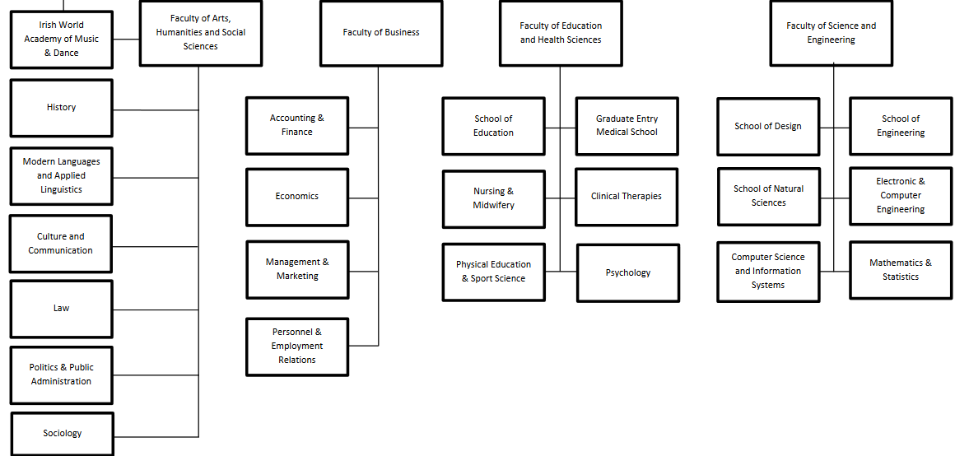
1. Faculty of Education and Health Sciences
2. Faculty of Science and Engineering

Slide 6
3. Faculty of Arts, Humanities and Social Sciences
4. Faculty of Business
KBS

Slide 7
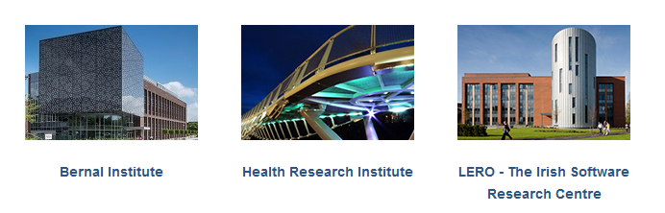
There are 3 Interdisciplinary
Research Institutes at UL
Reflecting strengths in the areas of Materials, Advanced Manufacturing, Software, Health, and Applied Mathematical Sciences.
http://www.ul.ie/research/content/institutes-centres

Slide 8
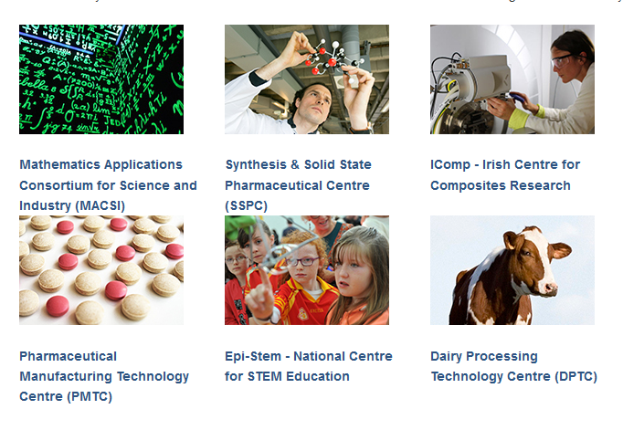
There are several research centres and units
National/international/interdisciplinary
http://www.ul.ie/research/content/institutes-centres

Slide 9
More on UL:
Research: http://www.ul.ie/research/
Technology Transfer: http://www.ul.ie/research/content/technology-transfer-office
NEXUS Innovation Centre: http://www.nexusinnovation.ie/about/
International Exchanges and Other Programs: http://www.ul.ie/international/

Slide 10

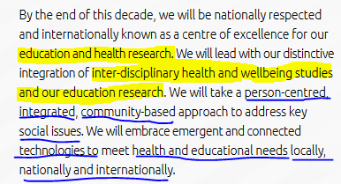

Faculty of Education and Health Sciences
4 Areas of Strength:
Social Inclusion
Optimising Health
Physical Activity and Human Performance
Professional Practice and Education
6 departments & schools

Slide 11
UL
COMMUNITY & PRACTICE impact
INDUSTRY partnerships
Specific Domain Collaboration
(STEM)
International University Partners
Specific Area Collaborations
(In and Outside Europe)
UL
Other Irish Universities
Irish University Association
European Higher Education Area
European Association for International Education
International Association of Universities
UL
LIMERICK CITY
ALUMNI
GLOBAL LIMERICK NETWORK
Be in the game, to play & change the game

Slide 12
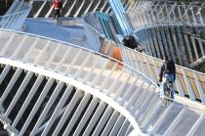
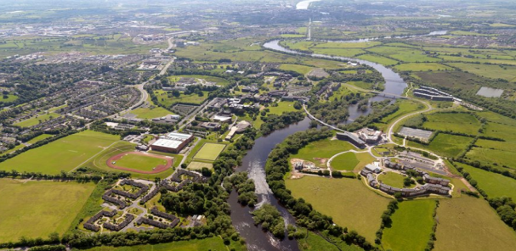
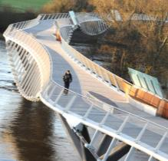
UL
COMMUNITY & PRACTICE impact
INDUSTRY partnerships
Specific Domain Collaboration
International University Partners
Specific Area Collaborations
UL
Other Irish Universities
Irish University Association
European Higher Education Area
European Association for International Education
International Association of Universities
UL
LIMERICK CITY
ALUMNI
GLOBAL LIMERICK NETWORK
Create flow… harness & channel information, collaboration, knowledge

Slide 13
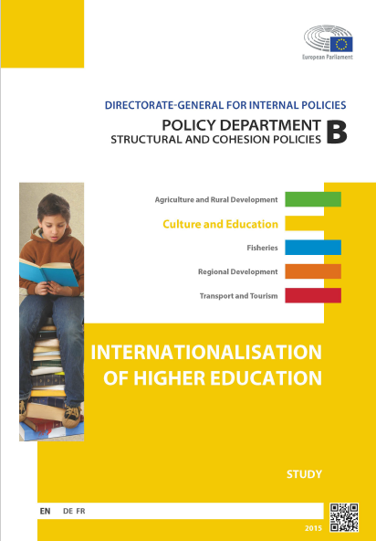
Future agenda for internationalisation
Areas of development (p.287)
1. Enhancing the quality and diversity in programmes involving the mobility of students and academic and administrative staff;
2. Increasing focus on the internationalisation of the curriculum and of related learning outcomes;
3. Gaining commitment on a global basis to equal and ethical higher education partnerships.
http://www.eaie.org/community/projects-advocacy/european-parliament-study.html

Slide 14



Thank you for your attention!
“Internationalisation is the intentional process of
integrating an international, intercultural or global dimension into the purpose, functions and delivery of post-secondary education,
in order to enhance the quality of education and research
for all students and staff,
and to make a meaningful contribution to society.”
(Knight, 2015)
http://www.eaie.org/community/projects-advocacy/european-parliament-study.html
Notes:
14

