Slide 1

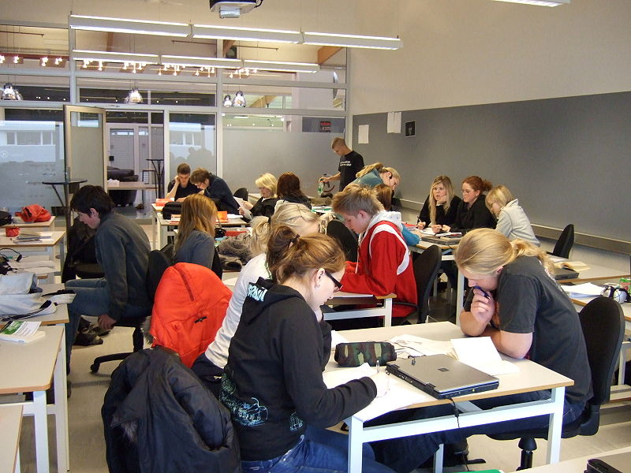
Lesson Study: towards a holistic approach for collaborative deep learning?
Lesson Study Research Group
School of Education

Slide 2
Some foundations for Lesson Study

Slide 3
Thinking about classrooms and learning
What do we tend to focus on when we observe a lesson?
How do we use the information we collect?
When we are observing a lesson, to what degree are we ‘seeing’ learning?
Nuthall (2007) characterises learning as occurring in layers that become
increasingly difficult to observe:
a visible layer which is that which is public and teacher-led;
(2) a semi-visible layer which is the student-led culture, relationships and interaction;
and
(3) an invisible layer which is that of the mental processes, such as prior learning and working memory that are central to individual sense making

Slide 4

Lesson Study Research Group
School of Education

Slide 5
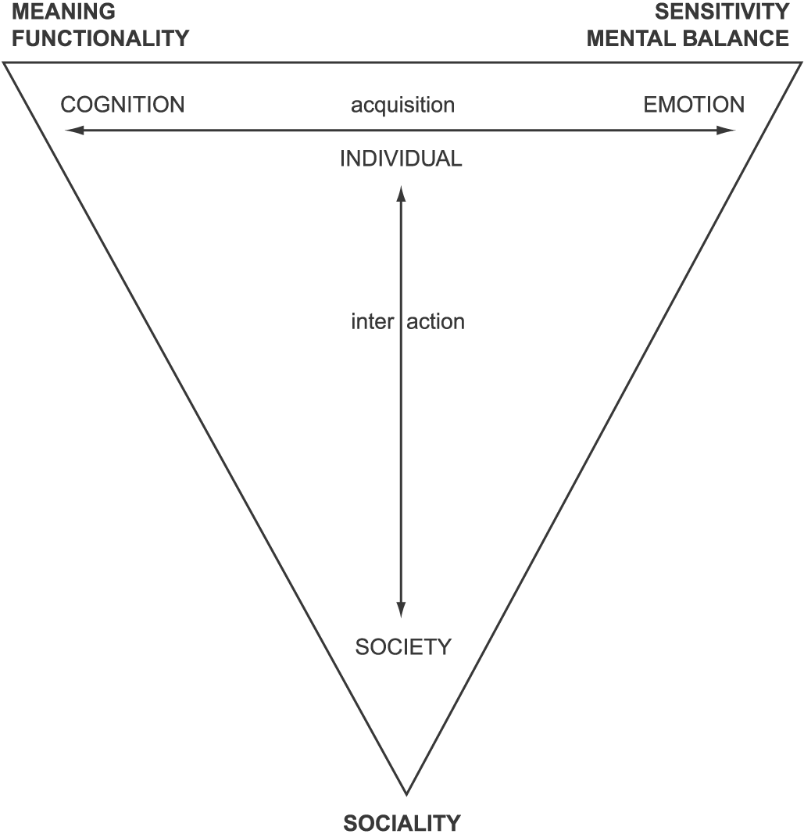
One possible view of learning - Using Knud Illeris
Lesson Study Research Group
School of Education
3 Dimensions of Learning

Slide 6
Introduction to Lesson Study

Slide 7
Background and context
Lesson Study Research Group
School of Education
Japanese Lesson Study (‘jugyou kenkyuu’ )
collaborative research-oriented learning activity (plan-teach-observe-evaluate)
deeper understanding of students’ learning leads to continuously refined pedagogy
contrast: top-down lesson dipping approaches to teacher development

Slide 8
Lesson study and teacher development
Lesson Study Research Group
School of Education
growing body of evidence
powerful dynamic approach to teacher education and professional learning (Fernandez, 2002; Lewis & Tsuchida, 1997; Puchner & Taylor, 2006; Lim, Lee, Saito & Haron, 2011)
use in England but limited research
‘reflexive, recursive and collaborative’ (Dudley, 2011)

Slide 9
Lesson Study Research Group
School of Education
Some core characteristics of Lesson Study
collaborative,
case-student specific,
classroom-based,
lesson specific,
qualitative,
Learning and pedagogy-focused.
FLEXIBLE - Variation in application might occur due to purposes and contexts

Slide 10
Lesson Study Research Group
School of Education
Introduction to Lesson Study
1. Teachers form LS groups to identify a specific challenge that students have with an aspect of learning
4. The group evaluates the lesson, focusing on evidence for student learning and engagement during each phase of the lesson.
2. Having agreed the focus, the LS group meet together and plan a 'research lesson' in detail, focusing on the intended learning of the students
3. The research lesson is taught by one of the group. The other members each observe the learning of 3 'case' pupils and note how they are engaging.
5. Evaluation of the research lesson leads to resolutions for future practice and to collaborative planning of another research lesson for teaching to the same or other group.

Slide 11
Reflecting on Learning
Can you identify a focus for learning that students tend to struggle with?
Now try to think about what it is that leads to their struggle?
How might you begin to build a learning opportunity to tackle this issue?

Slide 12
Lesson Study Research Group
School of Education
‘A true glimpse of what it means to learn from teaching’ (Sims and Walsh, 2009, 732)
Lesson Study allows teachers to see inside the pedagogical ‘Black Box’ of planning – teaching/learning – evaluation
A form of ‘team pedagogy’, working to develop conceptualisation of learning as a process
Difficult to gain explicit and consistent evidence of the processes involved. Much is ‘hidden’.

Slide 13
Lesson Study Research Group
School of Education
Making time-space for discussion about learning and teaching
It’s that feeling of ‘you’re not a student, you’re actually a member of the department ’. Your advice is as important as anyone else’s. I actually respect what you’ve got to say because you actually see things in observations that I don’t because I’m thinking of other things like OfSTED progress ……What it does is it allows me to use your eyes and your interviewing [of case students]. ……. I need to depend on you [observing]. (Geography Mentor)
What I enjoyed most was the meeting at the end, everyone gave ideas, …… it’s been like a team coaching exercise not only for the experienced teacher. It’s the same process as happened for me. …….it felt like we were all on the same level which was really quite nice and… enjoyable! (Geography trainee)
Reasserting a sense of professionalism and agency
I think somewhere along the line teachers lose confidence and young teachers are willing to make mistakes and learn from that. But somewhere along the line they [teachers] almost feel that there’s a right way to do this and a wrong way to this and I’ve got to be very careful to do it the right way….it’s breaking through that. (Geography mentor)

Slide 14
Lesson Study Research Group
School of Education
Making formative and positive use of observation – moving away from the Ofsted model
And I think as a department when we observe each other it’s observing what’s going on more with the activities in the class rather than the reaction of the pupils. And I think focussing on how pupils respond is…. Is better really, isn’t it? (ML mentor)
It’s just literally been a revelation for me. I’ve never really had the chance to sit with one of my groups that I teach and be able to get to know them in that way, because it’s a shame really that there’s not more room for it because I’ve learnt now that X ….has got quite a high sense of what’s fair and what’s not and that needs to be addressed…….. (Geography Mentor)
Affective impacts on teacher groups
And then we kind of put it all together and I think it kind of bonded us more as friends even, than just teachers. … I really liked it. (Viv)
Opening up the pedagogic black box

Slide 15
Augmenting Lesson Study and thinking about implications

Slide 16
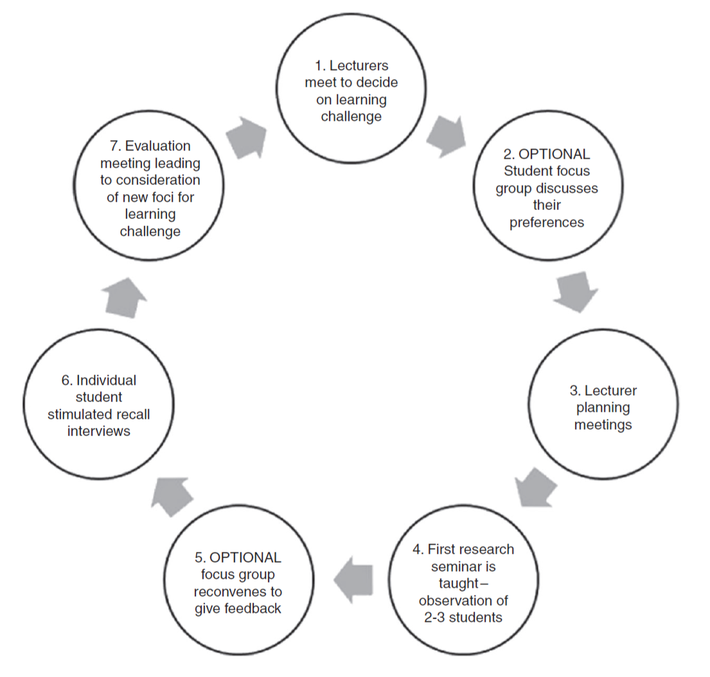
Participatory Lesson
Study Model

Slide 17
Lesson Study Research Group
School of Education
A Dialogic Approach to Teacher Development
The use of professional capital
Professional Capital = Human Capital + Social Capital + Decisional Capital
(Hargreaves and Fullan, 2012, 88)
HC – development of knowledge and skills in teaching
SC – interaction and social relationships – working in groups
DC – discretionary judgement (a major characteristic of professionals)
This requires space and time

Slide 18
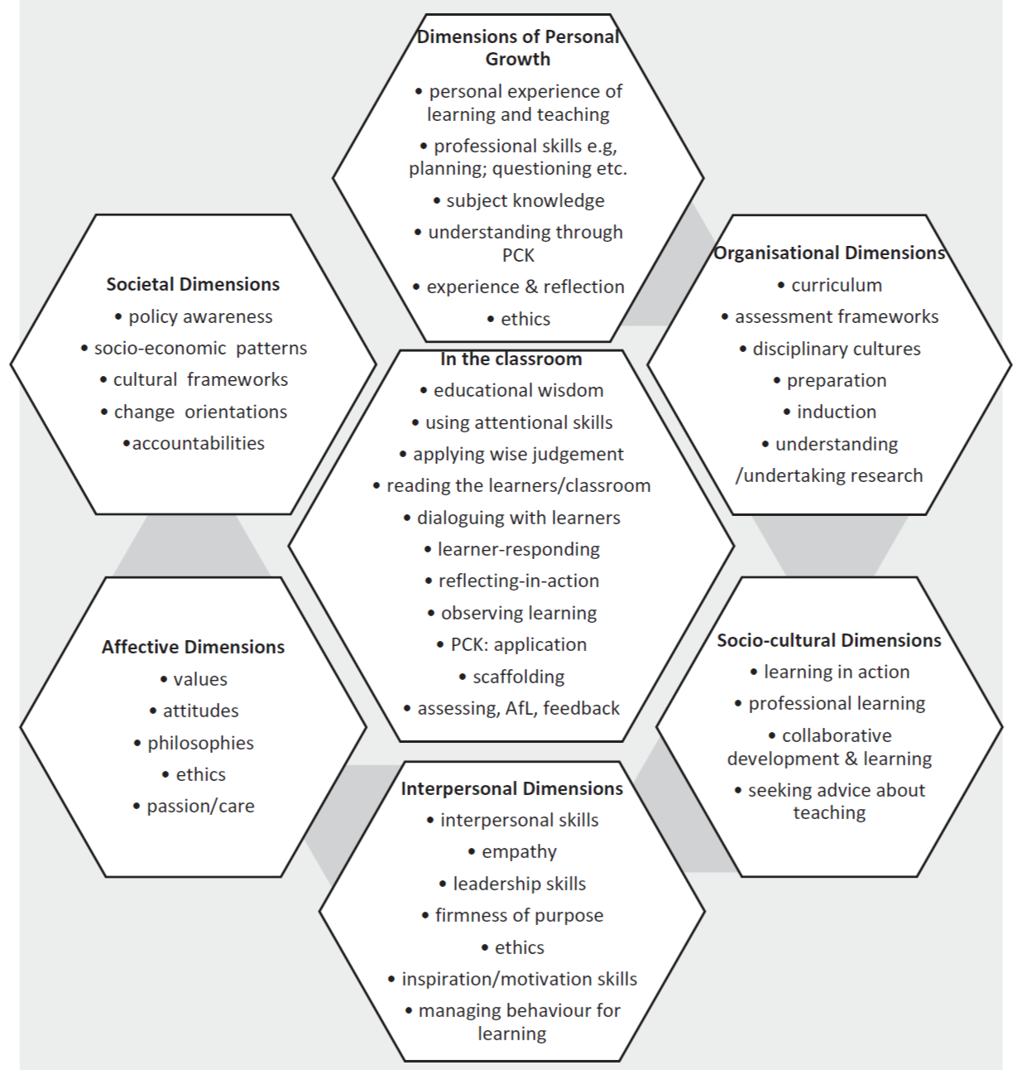
Pedagogic
Literacy

Slide 19
Lesson Study Research Group
School of Education
Three Challenges
how we characterise learning (and teacher learning) as a process
how we capture the process of learning through a suite of methods, including multi-media data
analysis of those data, informed by the perspectives of LS participants (teachers and their pupils).

