Slide 1

Creating Learning Communities through Active Blended Learning at the University of Northampton
Jo Palmer and David Cousens

Slide 2

What is Active Blended Learning (ABL)
Notes:
Why are we following ABL: Discuss the video and the report: Dynamic and engaging, ownership of pace and place,

Slide 3
Benefits of Active Blended Learning
it enables an effective community of inquiry to be established. (Garrison, 2004)improved completion rates, retention, student attitudes, satisfaction with the mode of instruction compared to traditional methods and versatility (Heterick and Twigg, 2003 cited by Garrison and Kanuka, 2004)
Blended Learning offers flexibility both as regards the pace and place of the learning (Vaughan 2007; Smyth et al., 2012)
autonomy in their learning thereby developing independence

Slide 4

What does this look like in practice?
Notes:
ABL allows the development of Learning Communities both face to face and online – How? Jo to explain by using a walk through of her NILE site.

Slide 5
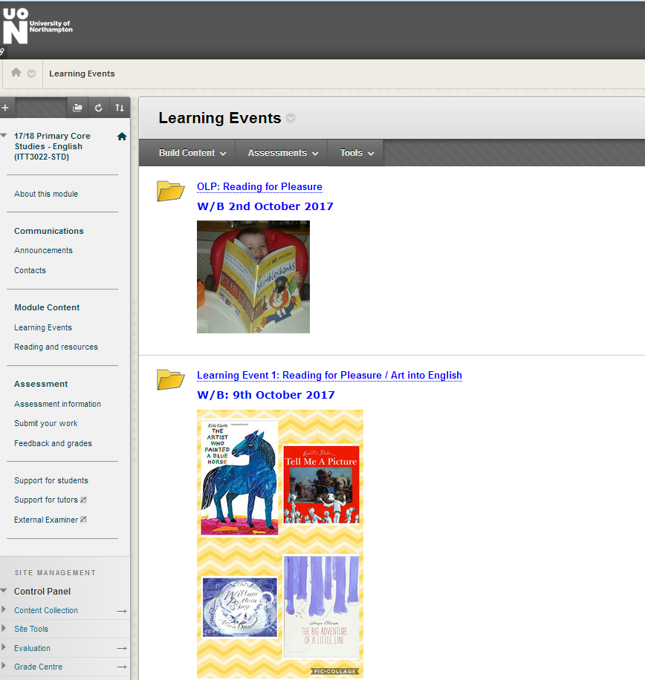
Notes:
What the OLP looks like on the Learning Events page.

Slide 6
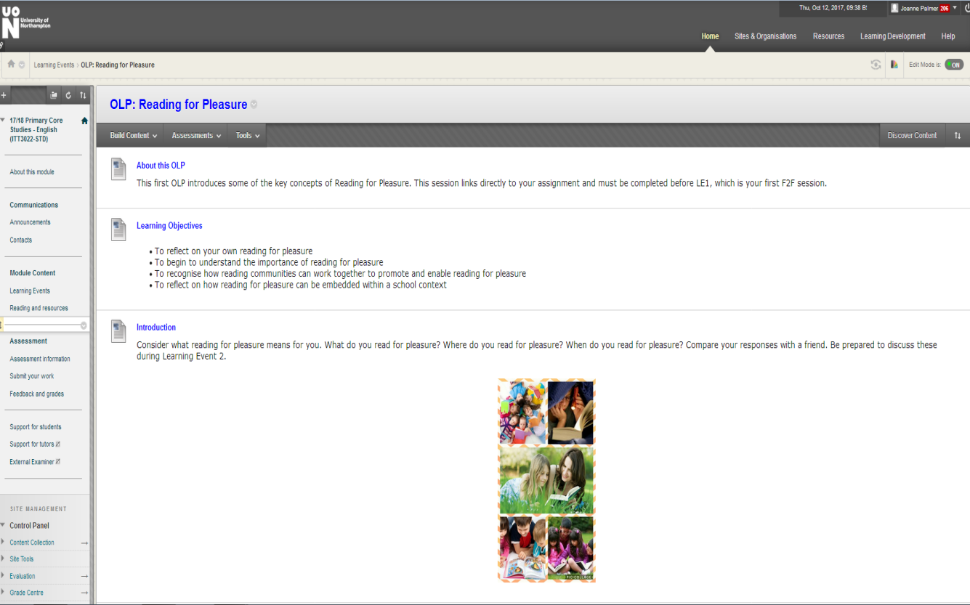
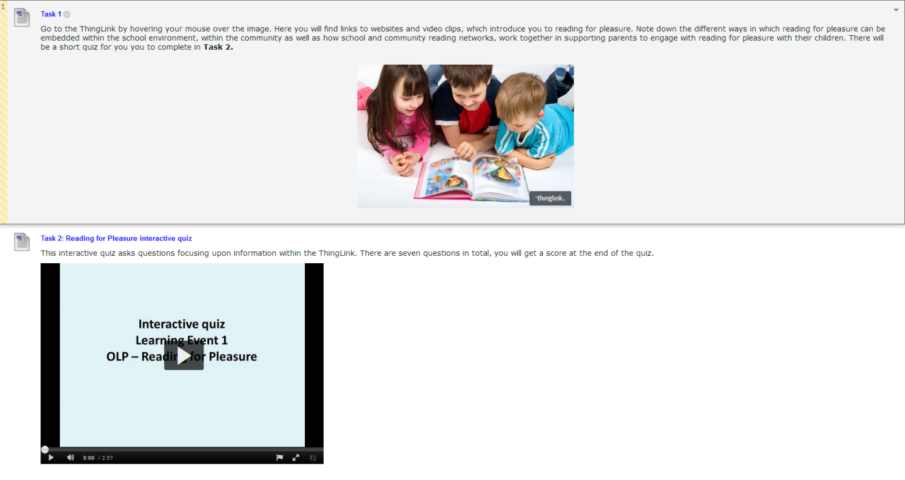
Notes:
How the OLP is organised within the folder.
-About this OLP
-Learning objectives
-Introduction
-Task 1 (Thinglink)
-Task 2 (Quiz – Kaltura)

Slide 7
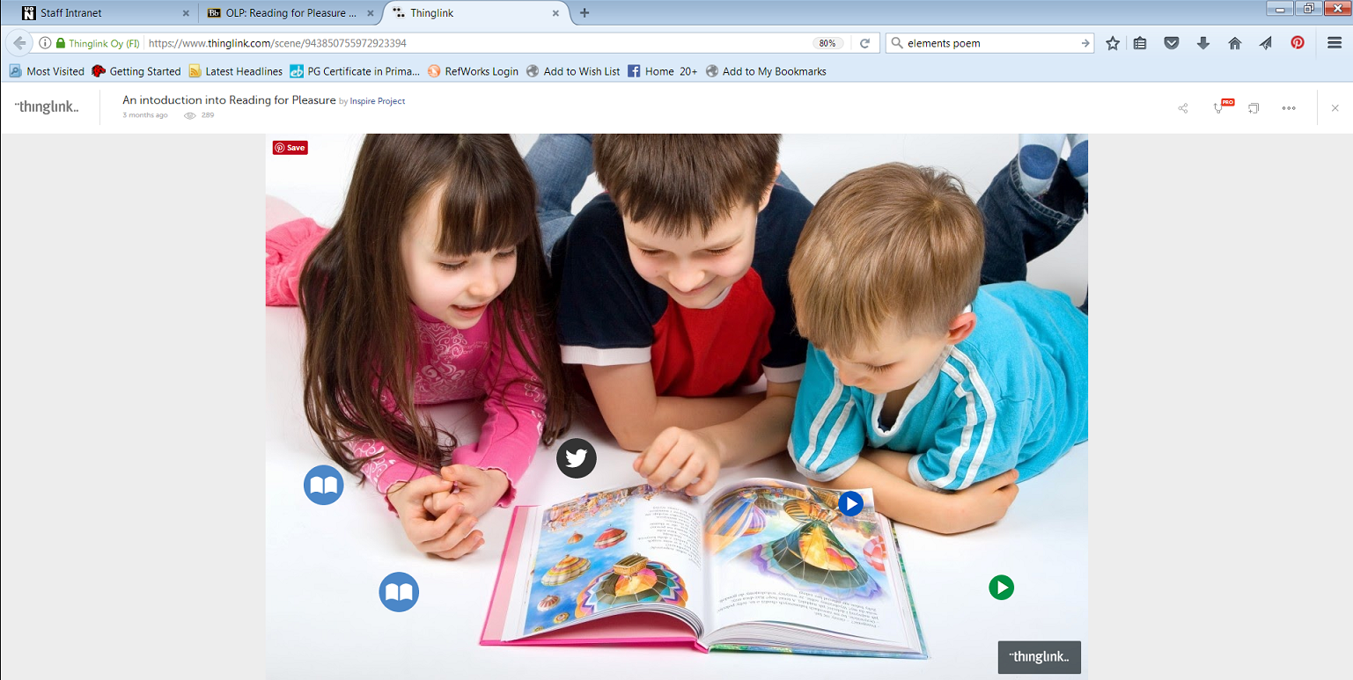
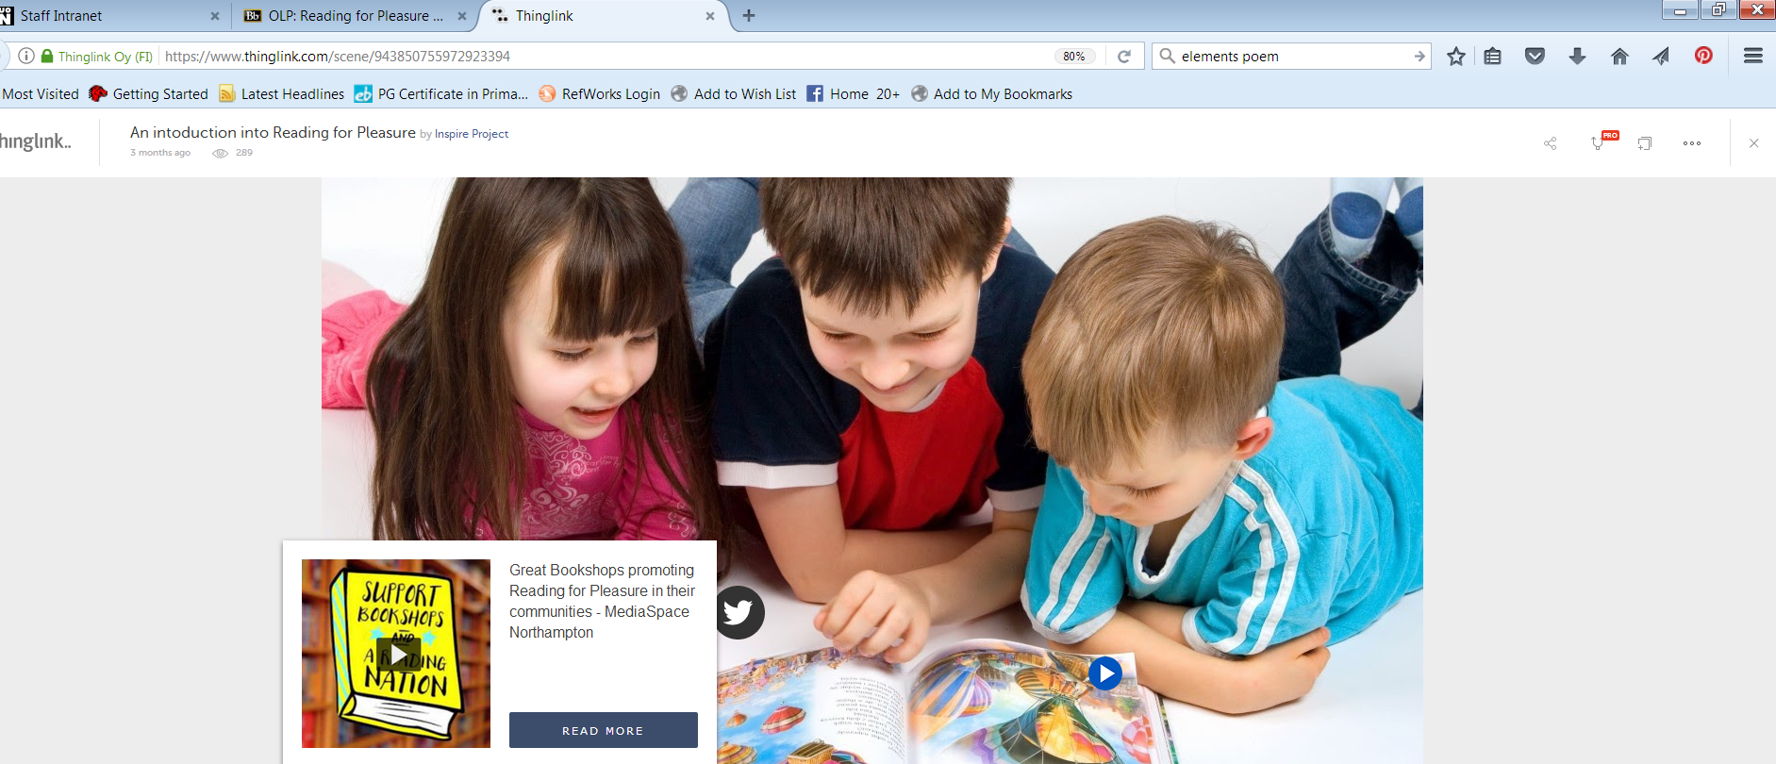
Notes:
Thinglink is a website which enables you to group information/videos/websites etc… Students interacted with this and were encouraged to make notes.

Slide 8
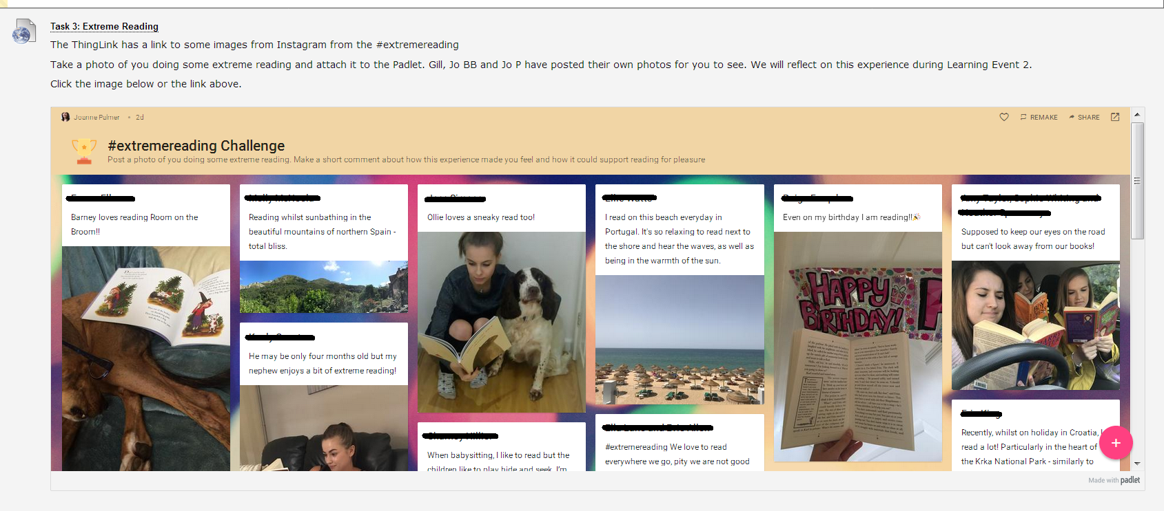
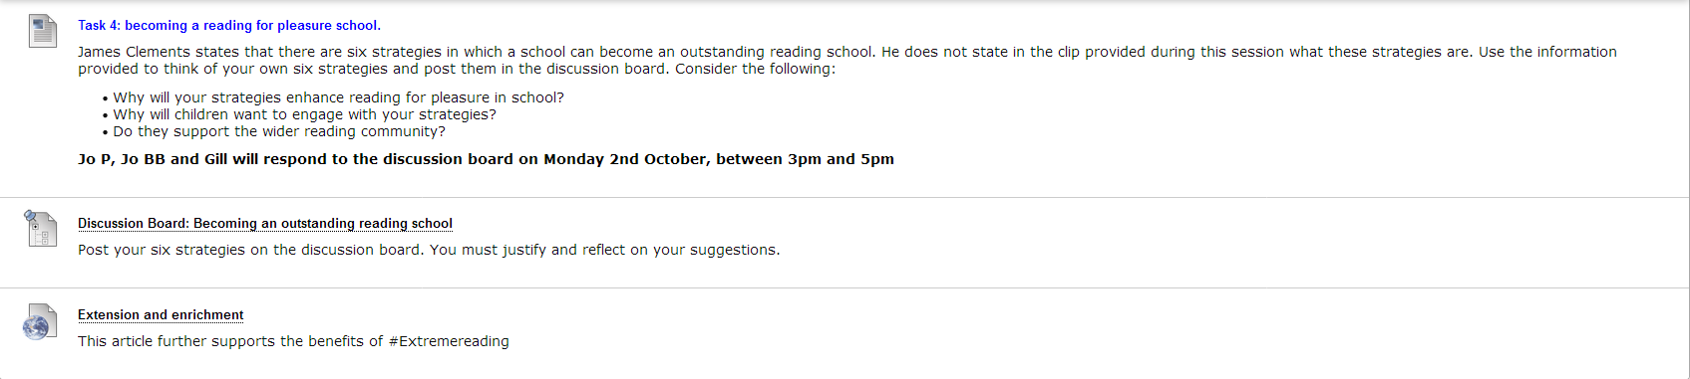
Notes:
-Task 3 (Padlet)
-Task 4 (Discussion board)
-Extension and enrichment (Linked to assignment)

Slide 9
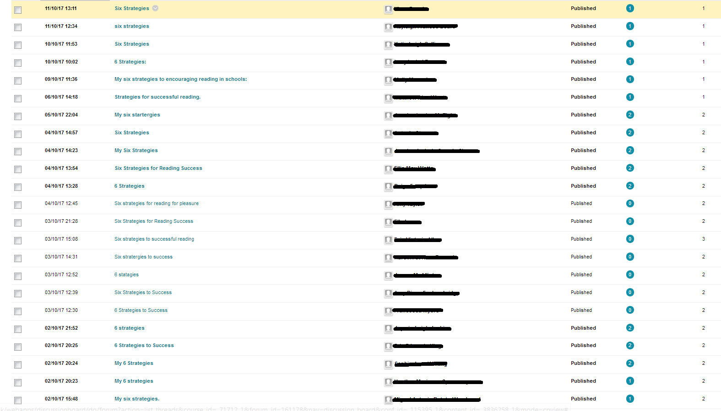
Notes:
A high number of students interacted with this.

Slide 10
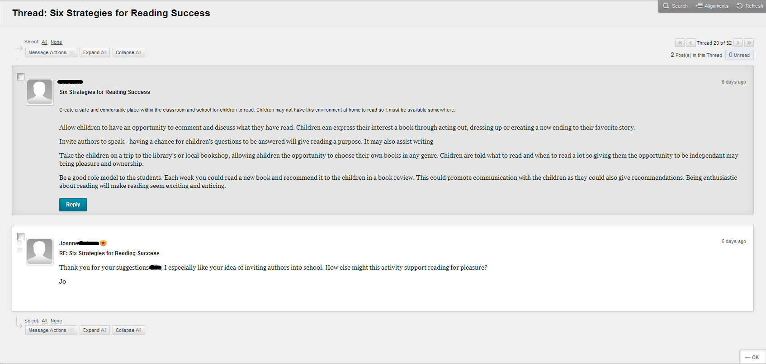
Notes:
Tutors interacted with the students at a given time, but have also gone back and responded to any late posts.

Slide 11
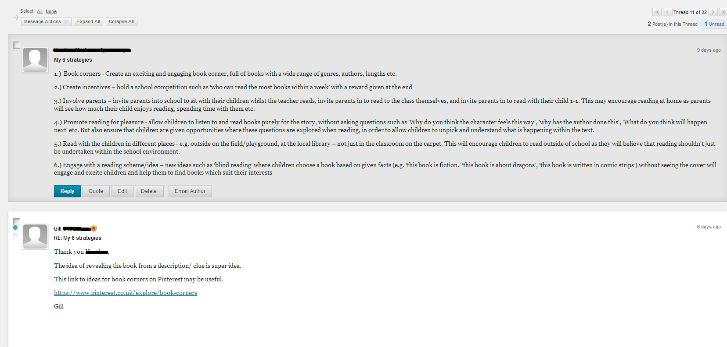
Notes:
Tutors have asked stated what responses they felt were well considered, asked questions to extend thinking and directed students to further sources.

Slide 12
Student responses to ABL
‘There is the Google + community, where you can share ideas with other people. I liked that because again you can see what everyone elses’ views are and what they are thinking of putting in their blog and it just helps each other really, it’s not, like competition, It is a lot of sharing. ‘
‘Quite a positive in terms of learning as going into teaching it is a social profession, it is all made by bouncing different ideas off each other and by being able to bounce different ideas and communicate effectively, it is a positive way to come to each of the sessions knowing that the actual taught sections, the ideas … all the ideas have been bounced about beforehand so that we all have a rough idea of what’s going to happen.’

Slide 13
Questions?
Contact details:
Jo Palmer; joanne.palmer@northampton.ac.uk
David Cousens: david.cousens@northampton.ac.uk

