Slide 1
Introduction to the University of Northampton
Dr Helen Scott
Dean of the Faculty of Education and Humanities

Slide 2
The University of Northampton: Key information
Gained Full University status in 2005
Four Faculties:
Business and Law, Health and Society, Arts, Science and Technology and Education & Humanities
Staff: approx. 2400 academic staff, 1000 professional services
Students: approx. 14000 (1500 international, 12500 UK/EU) Undergraduate, PGT and PhD
International Partnerships
Ambitious strategy (social impact (in the locality and internationally), research and graduate employability)
TEF (Teaching Excellence Framework) Gold
Move to new “Waterside” campus in September 2018

Slide 3
Strengths of UON
High levels of support for students
Volunteering and paid employment opportunities
Study abroad opportunities for all UG courses
Innovative Learning and Teaching (Active Blended Learning)
Focus on Graduate Employability and Work based/Placement Learning
Social Impact
Relationships with local employers
Growing international partnerships

Slide 4
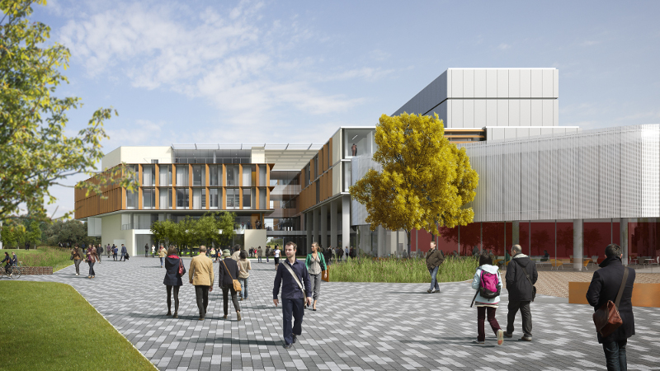
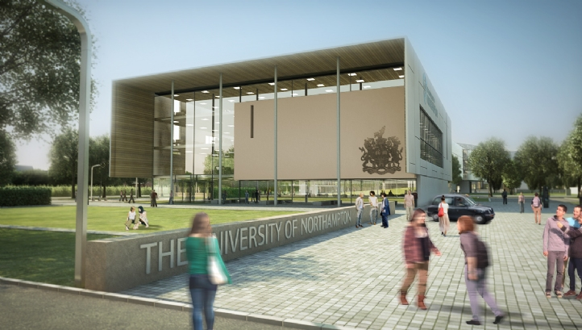
New Waterside Campus http://hellowaterside.northampton.ac.uk/

Slide 5
Faculty of Education and Humanities
8 Subject Areas:
Early Years
Education, Children and Young People
Educational Linguistics
English and Creative Writing
History
Initial Teacher Training
Special Educational Needs and Inclusion
Teacher Continuing Professional Development
Approximately 100 staff and 1600 students

Slide 6
Undergraduate Courses
Foundation Framework
Foundation Degrees: Early Years and Learning and Teaching
BA (Hons) Childhood and Youth
BA (Hons) Creative Writing
BA (Hons) Early Childhood Studies
BA (Hons) Education Studies
BA (Hons) English
BA (Hons) Learning and Teaching
BA (Hons) Primary Education (5-11)
BA (Hons) Special Educational Needs and Inclusion

Slide 7
Post Graduate Courses
PGCE Primary 3-7
PGCE Primary 5-11
PGCE English
PGCE Computing
GEB Early Years Teacher
MA SENI
MA Education (with pathways in English Language Teaching, Early Years, Mathematics, Leadership and Management)
MA Contemporary Literature
MA History

Slide 8
Research
Centre for Education Research
5 Professors, 3 Associate Professors
Research projects related to innovative pedagogies, SENI, nationally and internationally.

Slide 9
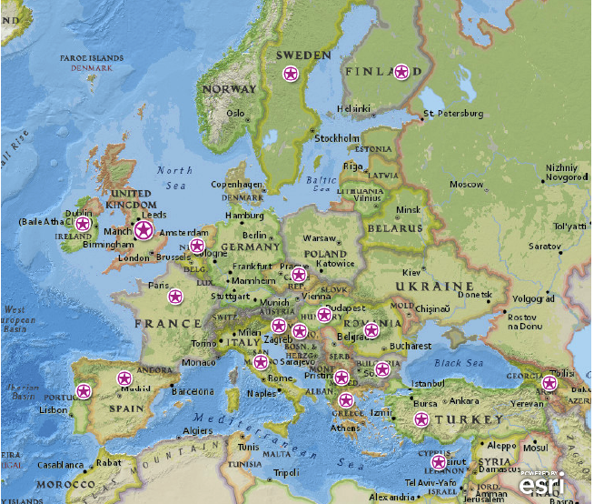
Research in Europe
E+ projects
Consultancy
Erasmus exchanges
MoUs
PhD research projects
Other research projects

Slide 10
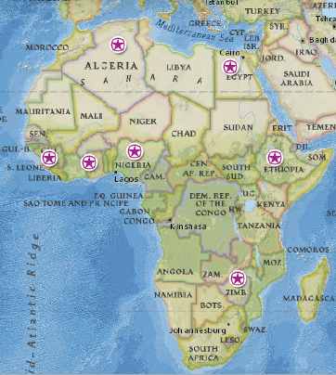
Research in Africa
PhD research projects
UNICEF funded research
Other funded research (e.g., Sierra Leone)

Slide 11
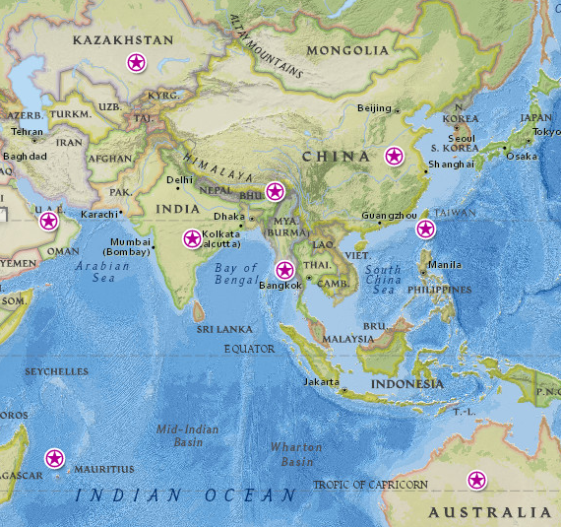
Research in Asia and Australia
Funded projects
PhD research projects
PG teaching
Centre for Inclusive Practice
Consultancy

Slide 12
The programme for the next 2 days…..
Contact details if needed:
Sue Robertson: 01604 892018 (sue.robertson@northampton.ac.uk)
Helen Scott: 07702442827 (helen.scott@northampton.ac.uk)
James Underwood: 07568 105168 (james.underwood@northampton.ac.uk)

