Slide 1



Education for Global Citizenship

Slide 2
Workshop Focus:
1- What is global citizenship?
2- Key elements for global citizenship.
3- Importance of teaching global citizenship.
4- What is Education for global citizenship (EGC)?
5- Aims and associated themes.
6- Classroom activities.

Slide 3
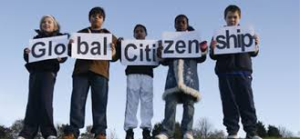
Activity (1)
In pairs, write down words and phrases that come to mind when you hear the word “Global Citizenship”

Slide 4
There are different interpretations of the notion of “global citizenship”. It is based on the universal values of human rights, democracy, non- discrimination and diversity. It is about civic actions that promote a better world and future.

Slide 5
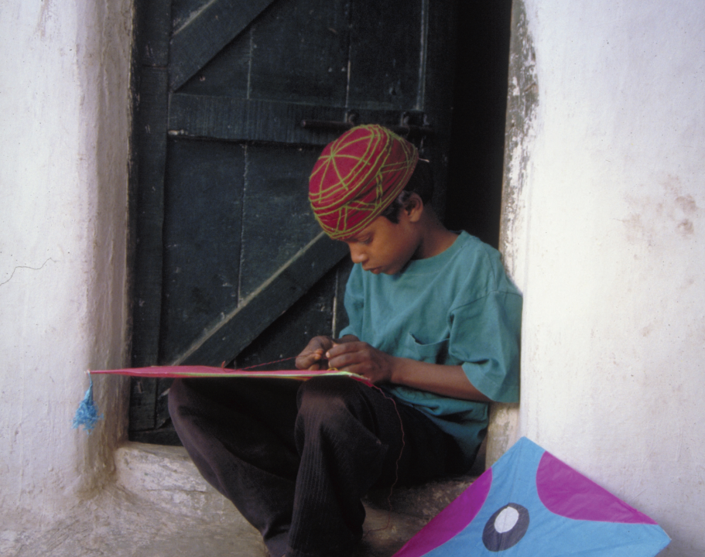
Activity (2) Look at this picture ; What can you deduce about this child?

Slide 6
Look at this picture again; focus on similarities rather than differences

Slide 7
SO, It is all about Similarities rather than differences

Slide 8
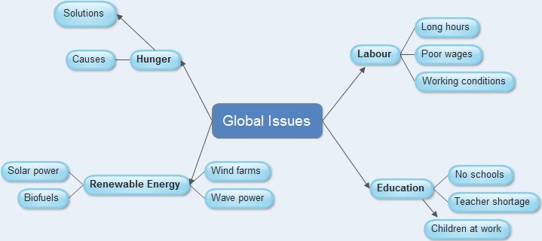

Slide 9
Activity (3)
In groups of 4, try to identify the main pillars for developing a
responsible Global citizenship.

Slide 10
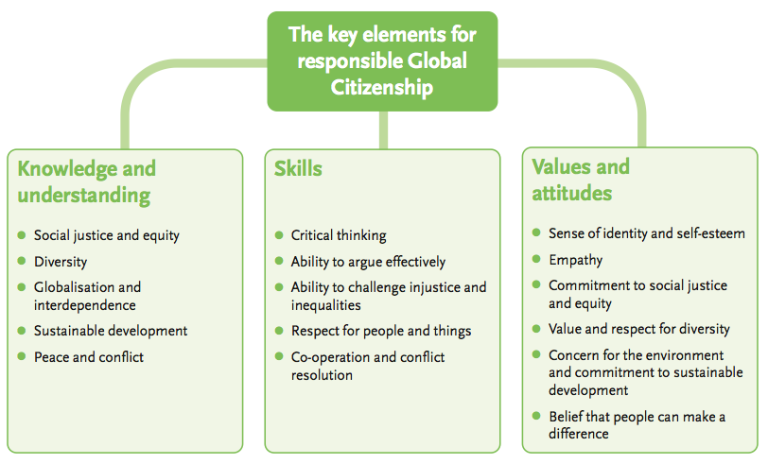

Slide 11

Now, why is important to teach global citizenship?

Slide 12
Therefore, Education for global citizenship involves………….

Slide 13
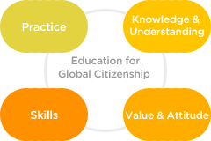

Slide 14

Education for global citizenship helps students learn about global issues like poverty, human rights , peace and cultural diversity, and therefore leading them to become mature global citizens.

Slide 15

Activity (4) In groups, discuss the following questions:
1- What does the Education for global citizenship (EGC )picture look like at your schools?
2- What is our role personally and professionally?

Slide 16
Global Citizenship Education
Aims
create a sense of belonging to the global community and common humanity
create respect for the universal values of human rights, democracy, non-discrimination and diversity.
empower learners to engage and assume active roles to shape a more peaceful, tolerant, inclusive world.
Associated themes
peace and human rights
intercultural understanding
citizenship education
respect for diversity and tolerance
inclusiveness

Slide 17
Template for classroom activites
Title
Time
Learning outcomes
Materials
Procedures

Slide 18
Example (1)
Title: Fair Treatment (suggested for all grades)
Time: 15- 20 min
Learning outcomes:
1- Appreciate fairness and justice values
2- Demonstrate just behaviors in various situations
3- Compare between just and unjust behaviors.
Materials: Sack of candy
Procedures: Bring a sack of candy containing 5 less than the total number of students in the class. Pass the sack around and tell everyone they can take one. When the students discover the unfair situation and that there is not enough candy for everyone, discuss the following questions:
1. How did those students that did not get the candy feel? How about those that did?
2. What would be the fair solution to the problem?
3. Can you think of another situation when people might feel left out or rejected?

Slide 19
Example (2)
Title : Hearing disabilities – communicating (9 th grade- English subject, unit 9 , lesson 4 “ The deaf school in Cairo”)
Time:15-20 min
Learning outcomes:
1- show empathy towards disabled people
2- Show respect to disabled people.
Materials: Sheet of sign language alphabet.

Slide 20
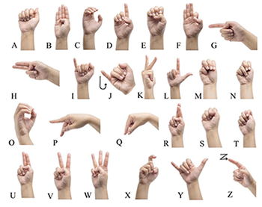
Sign Language Alphabet

Slide 21

A final word ……..

Slide 22


