Slide 1

MINTegration:
STEM activities for Refugee Kids
Martin Lindner, Jette Lippmann, Anna-Lena Korzeng,
Anita Schewnin, Stephanie Nentwig
Martin-Luther-University Halle / Germany

Slide 2
Overview
The situation in Germany
Our project: MINTegration
Evaluation with Concept Maps

Slide 3
1. The situation in Germany
Immigration of 800.000 refugees went to Germany in 2015
STEM Sector needs staff
Xenophobia in Germany

Slide 4
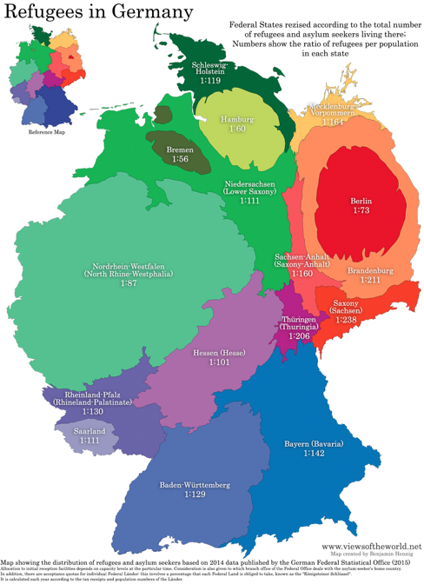
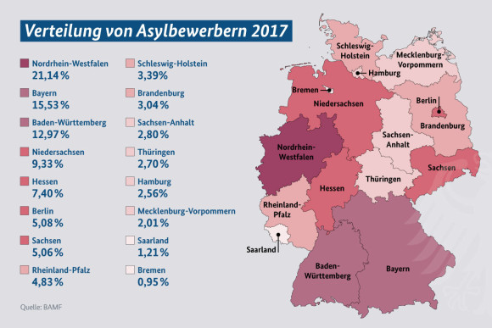
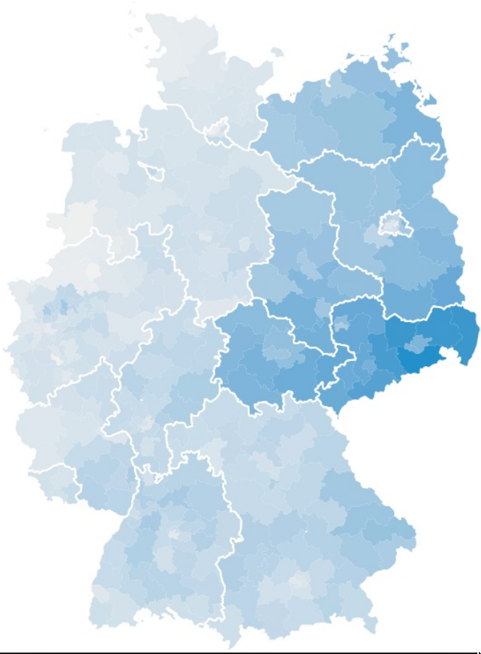
Election 2017: Xenophobic Pary AFD

Slide 5
2. Our project: MINTegration
Mobile Science Lab
Moving from school to school
One-week courses
Experimantal
Focus on human health
  Hygenic behavior
  Healthy nutrition
  Drug prevention
  Sexual education

Slide 6
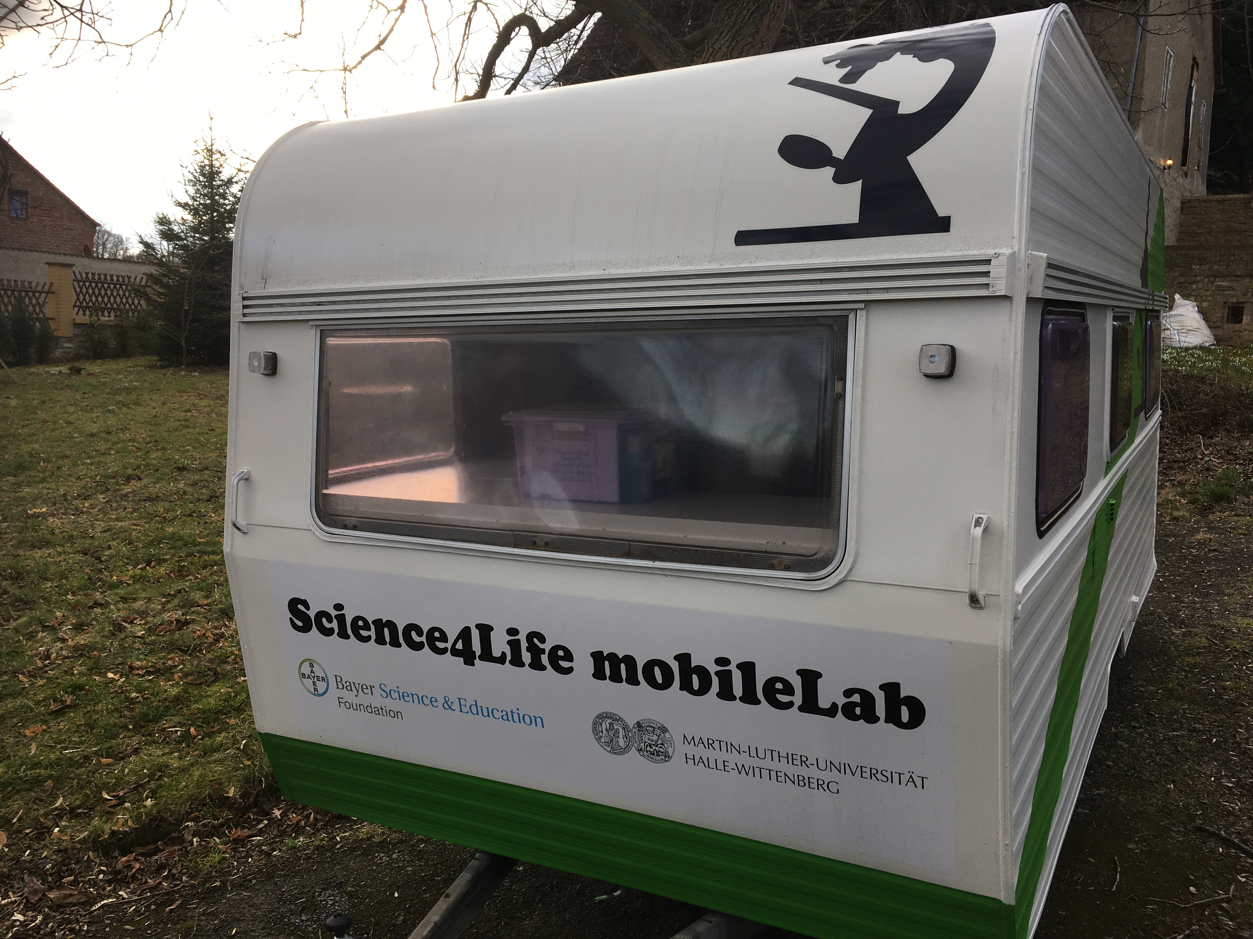
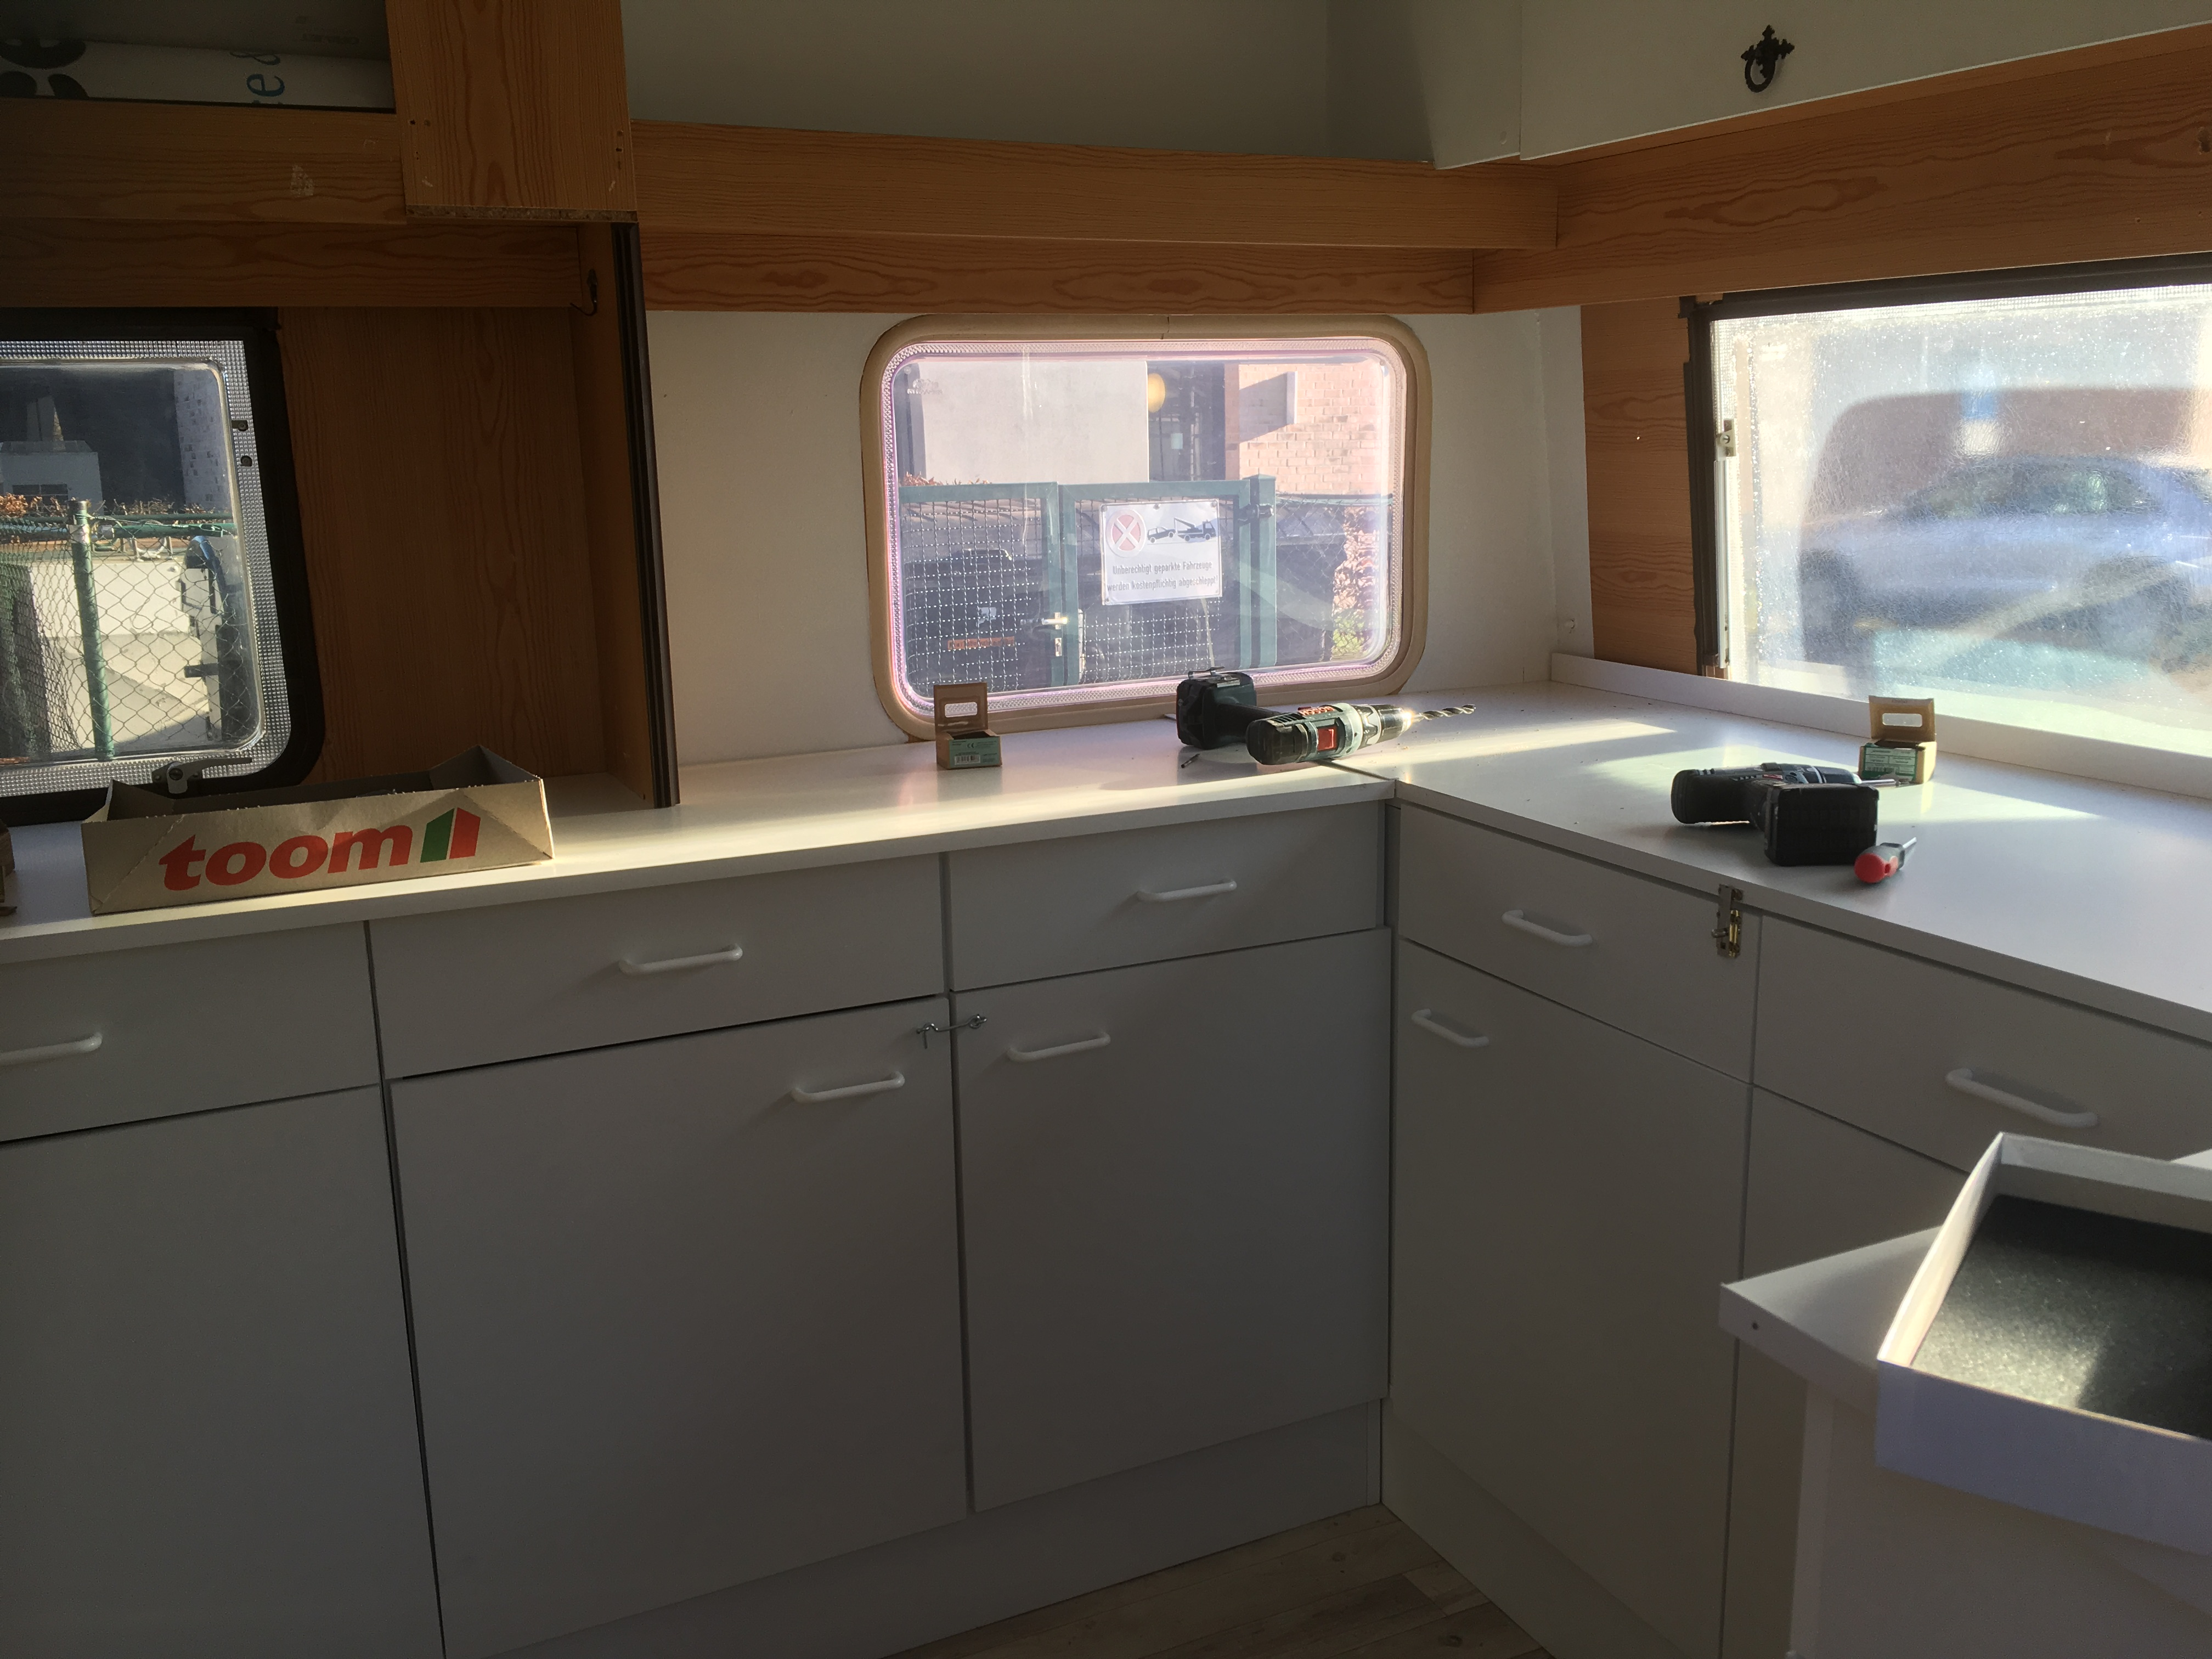
The Science Caravan

Slide 7
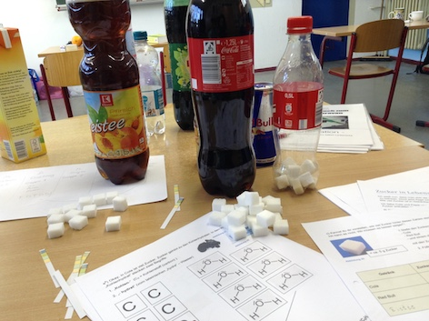
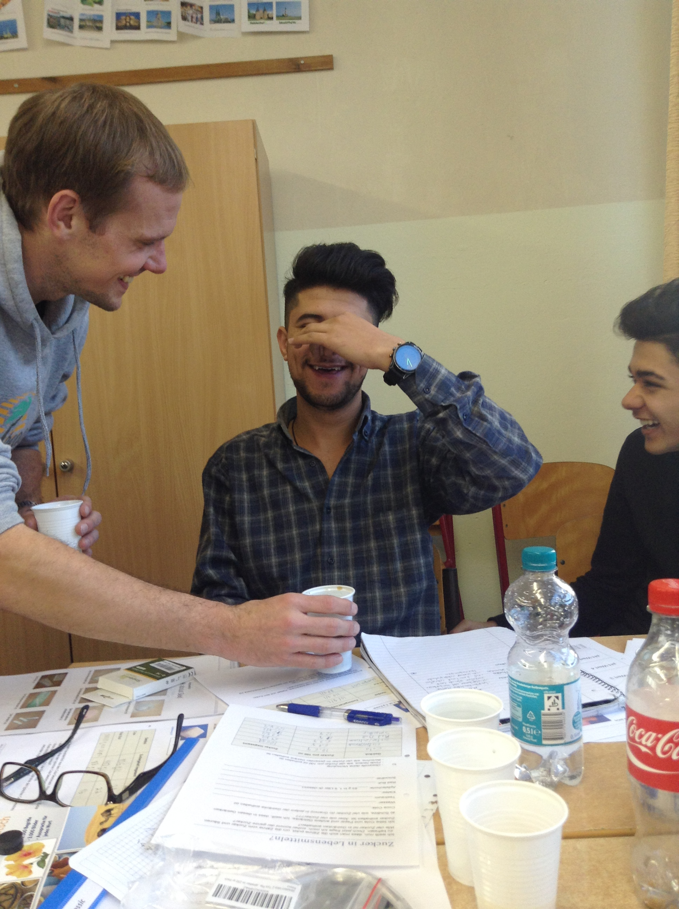
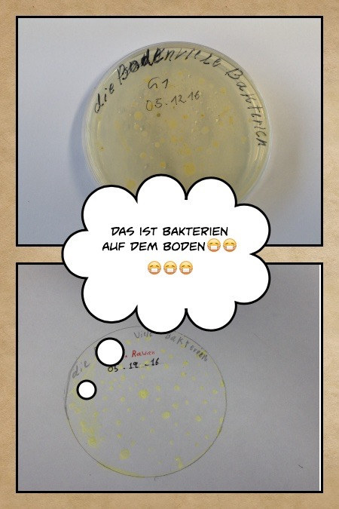
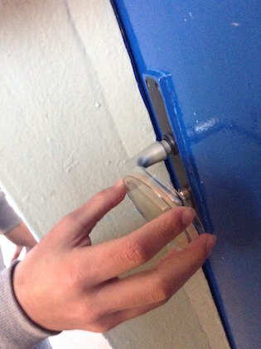
Examples of Expreriments

Slide 8
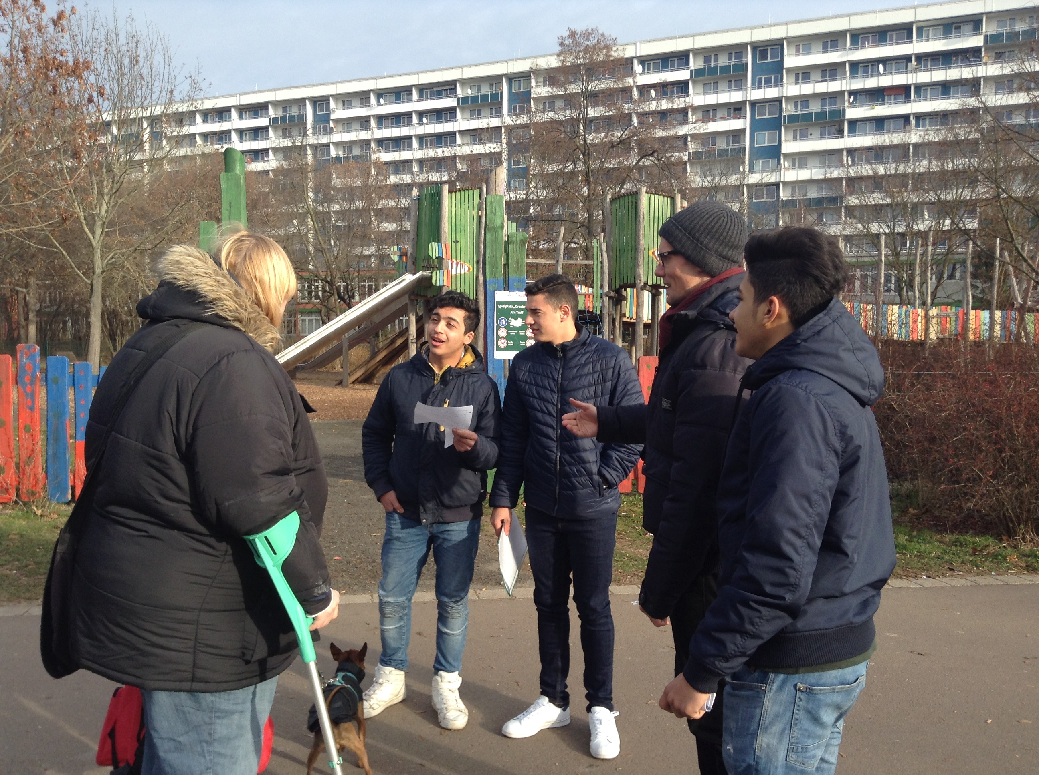
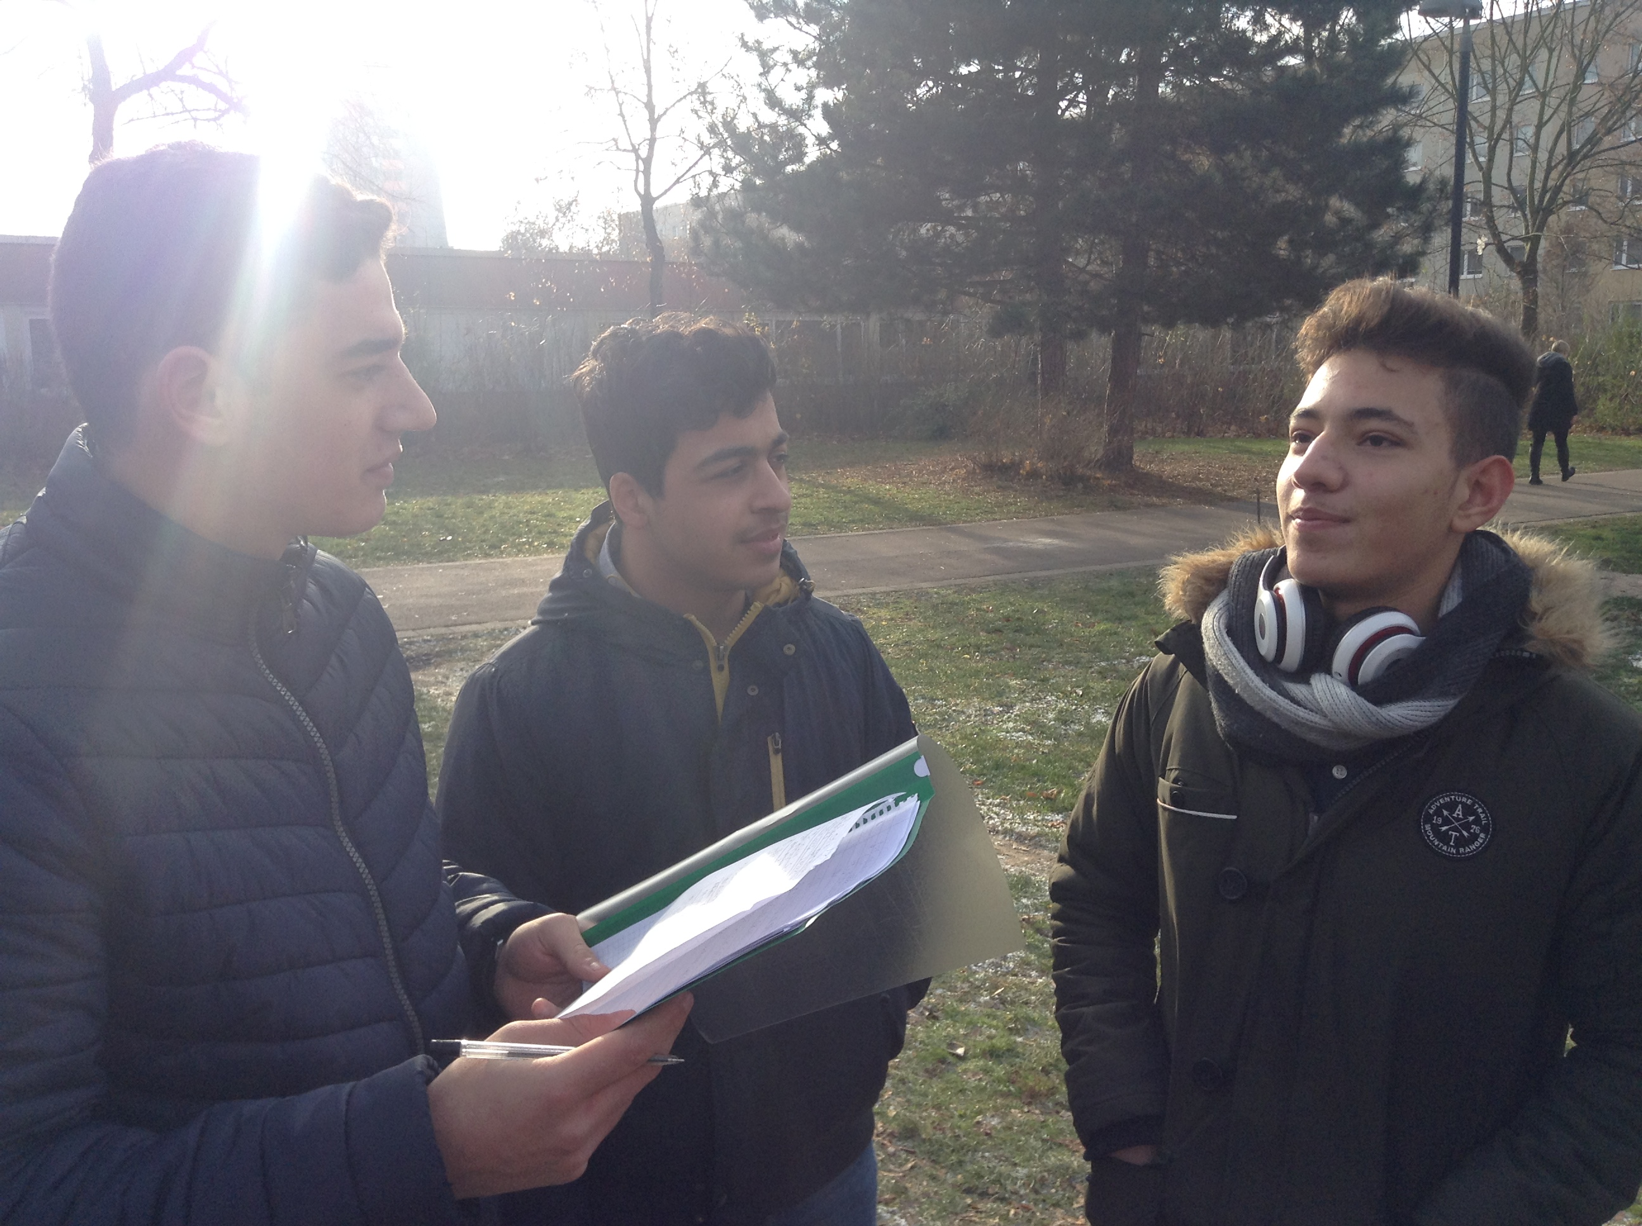
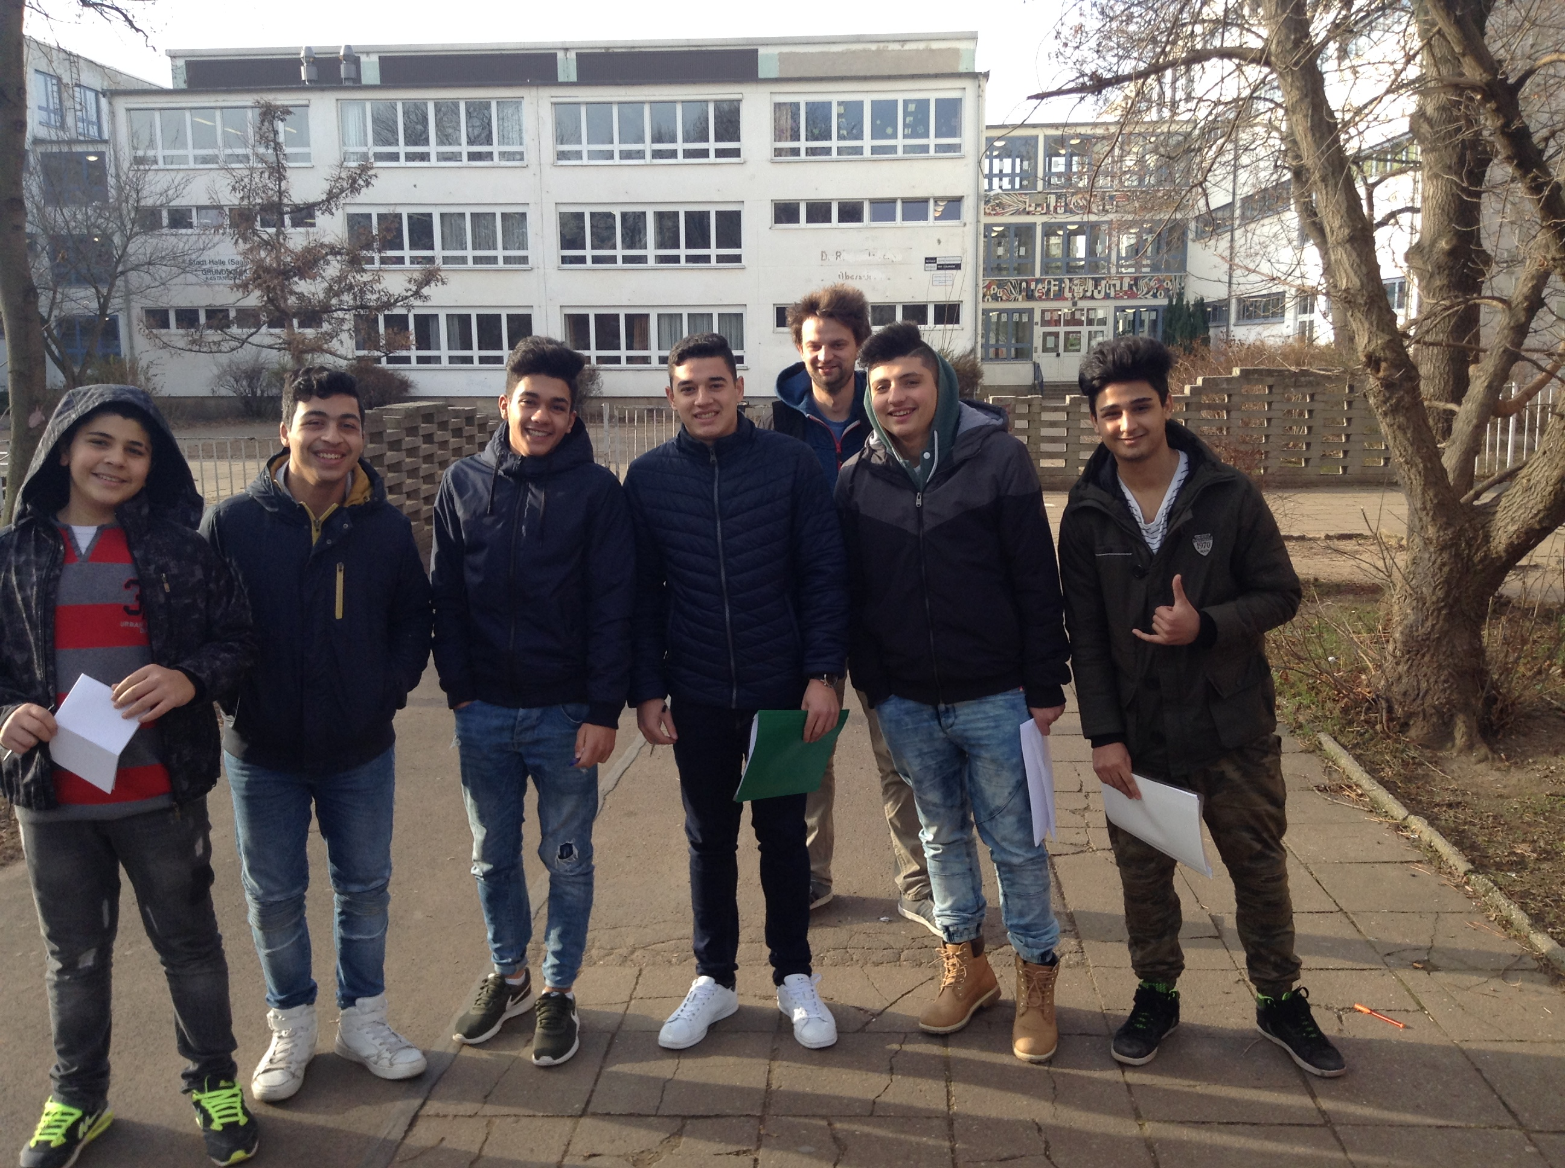
Refugee students created an interview about drug use and conducted it in the public

Slide 9
3. Evaluation of the project
Method: Concept Map
  Before starting the project (=pretest) and after two days (=posttest)
  Comparison of previous knowledge and the new learned concepts and their connection
  Problems
    Students didn‘t know the method „Concept Map“
    Limitation by language skills

Slide 10
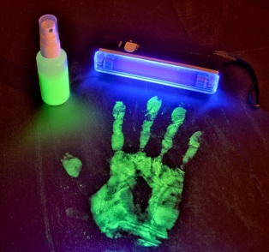
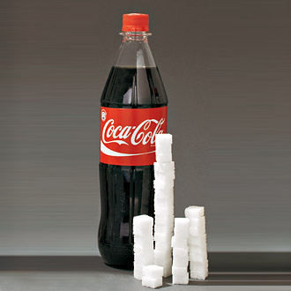
3. Evaluation of the project
evaluation of the increase in knowledge in two days
Day 1– bacteria are everywhere,
transmission path
DAY 2– sugar and acid in drinks,
nutrition

Slide 11
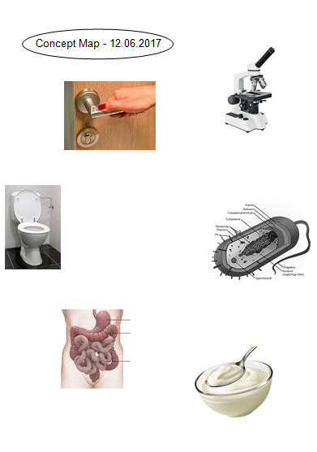
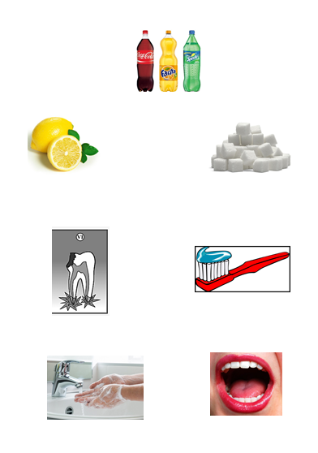
3. Evaluation of the project
Write the vocabulary in German and in your mother language under the pictures!
Draw arrows between the pictures which are connected!
Write explanations on the arrows!
For example:
microscope bacteria
makes them visible

Slide 12
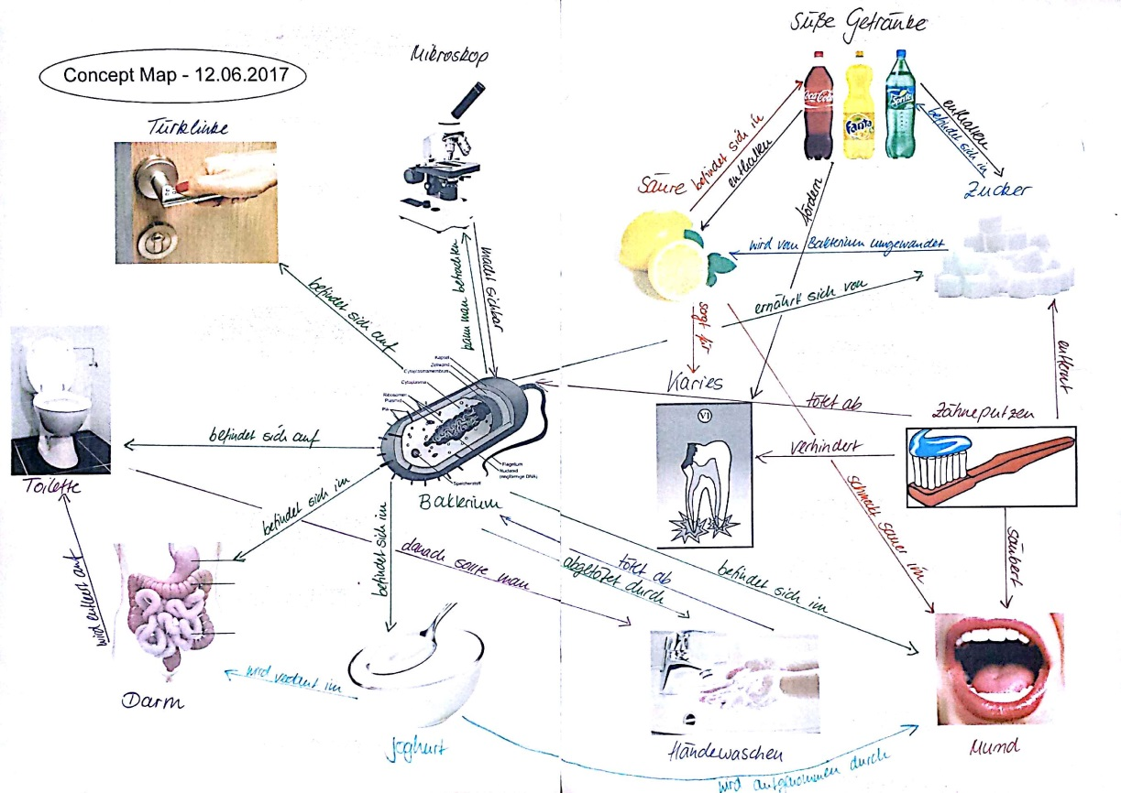
All possible connections

Slide 13
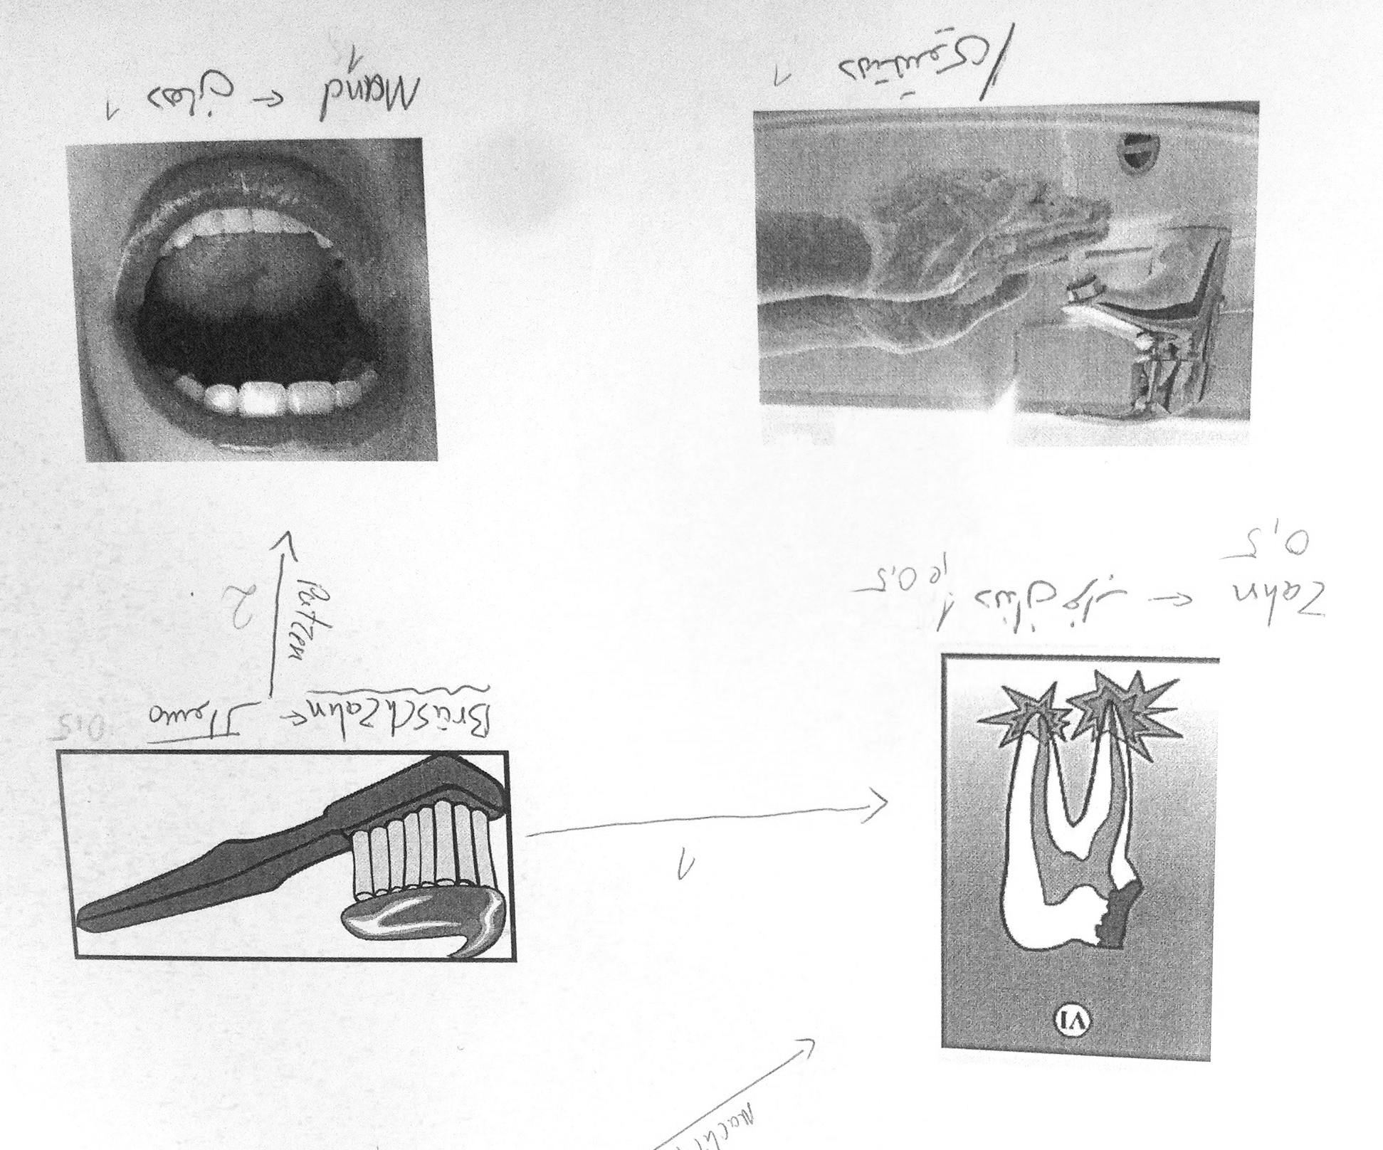
3. Evaluation of the project
We distributed points to compare the first with the second Concept Map
  1 point for the right vocable in German
  1 point for each arrow
  1 point for the comment on the arrow
  0,5 point for a word that was almost right, but spelled wrong

Slide 14
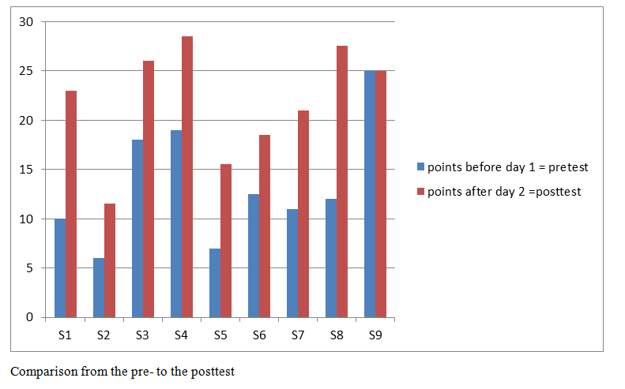
Results of pre- and post-Test

Slide 15
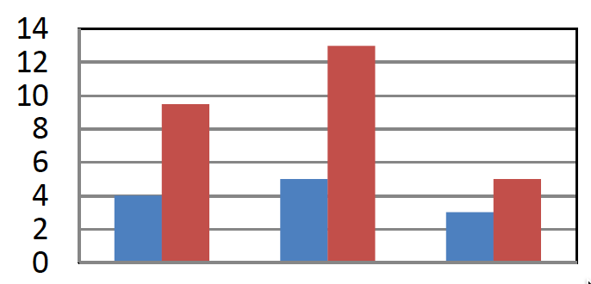
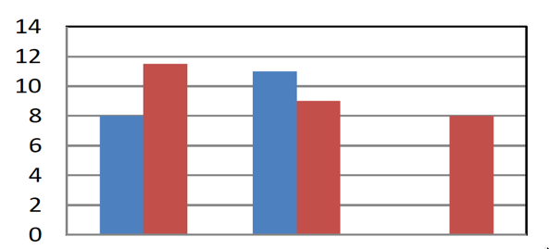
Results of individual students
pretest
posttest
Student 1
Student 2
German Arrows Comments
vocabularies
German Arrows Comments
vocabularies
Comparison (pre-post) of two students´ Concept Maps

Slide 16
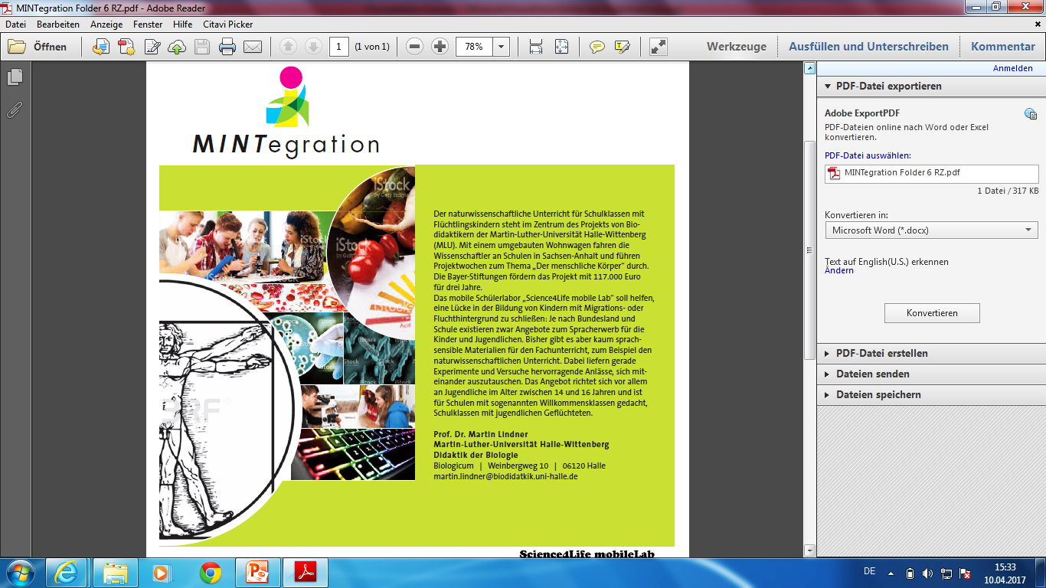
Results of the evaluation
Every student learned German vocabulary & connections
→ Although they were not allowed to take their folders home
All in all:
They practiced their German skills and improved it
They enjoyed the project week and learned content in STEM

