Slide 1
Overview local meeting ain shams team 5-6 july 2017

Slide 2
overview
Team Division.
Plan of developing materials, overview of the topics covered related to the material development activity
Reviewing the school profile assessment tool
presented by AUC

Slide 3
overview
Discussions for its modification
Conducting A Needs Assessment Tool - Working collaboratively & New Ideas for PD Schools.
Closure & Way Forward

Slide 4
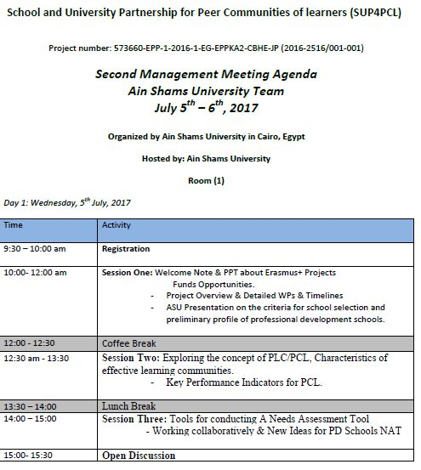
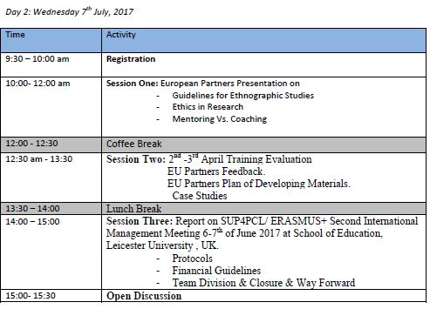

Slide 5
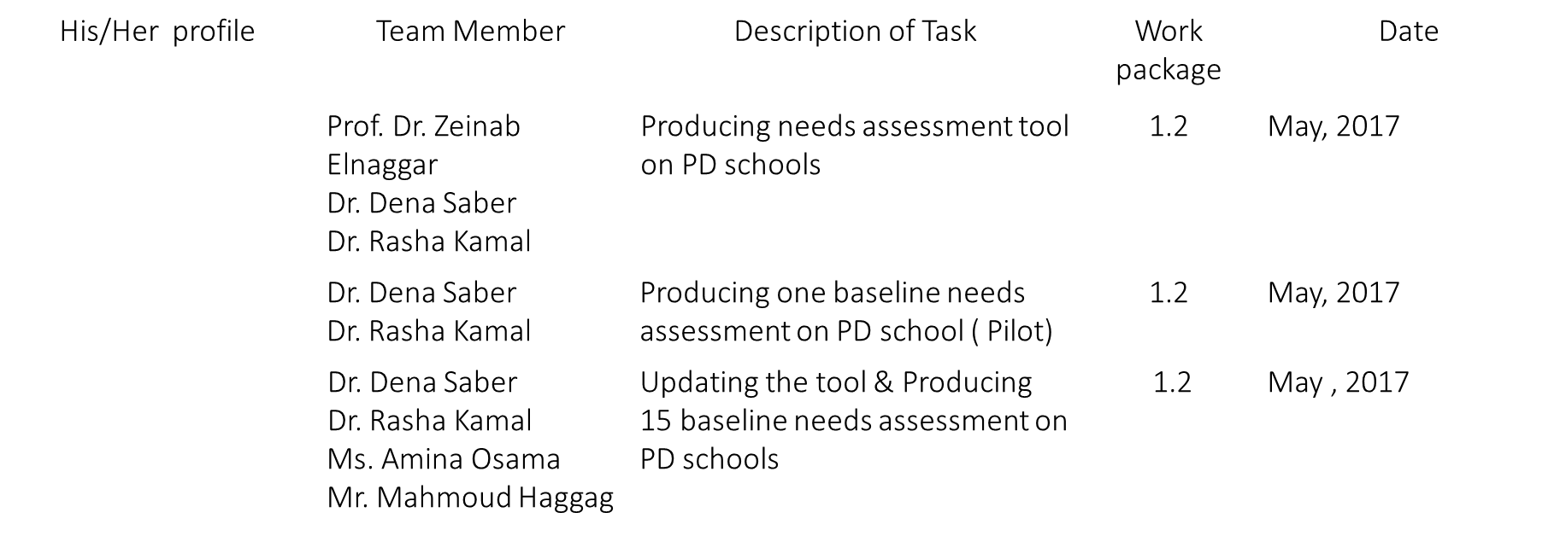
1- Team Division

Slide 6
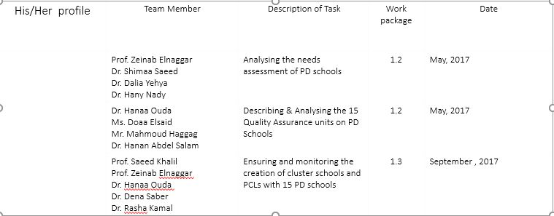
1- Team Division

Slide 7
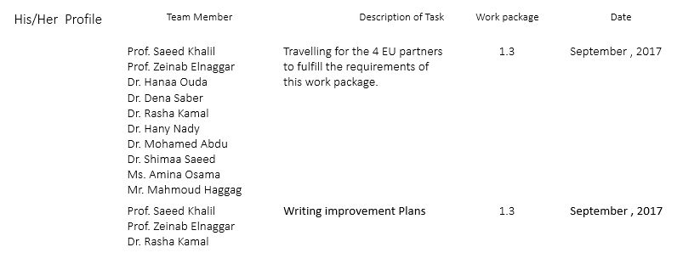
1- Team Division.

Slide 8
2- Plan of developing materials, overview of the topics covered related to the material development activity
The teams after divisions worked together to suggest the characteristics of the material which included STEM/STEAM , Active learning/ Blended learning/ Teacher as researcher/ Special needs/ Global Citizenship.
Each group had a presenter, introduced the content and characteristics of the material.

Slide 9
Examples on group work.
STEM/STEAM (characteristics) group:
Learner based (Innovative creativity approach)
Interactive technology approach
flexible adapted material.
Individual differences oriented.
Mixed and integrated teaching strategies.
Examples ( concepts based on STEM), applications.
Evaluation according to creativity levels.

Slide 10
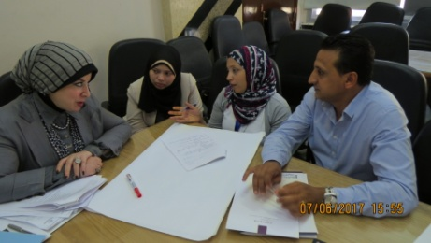
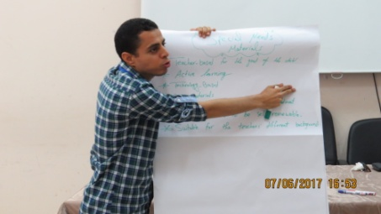
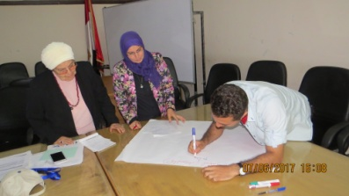

Slide 11
3- Reviewing the school profile assessment tool presented by AUC -Discussions for its modification-
The modifications included adding the following points:
School address.
• The number of disabled and special students must be known also the type of disability.

Slide 12
3- Reviewing the school profile assessment tool presented by AUC -Discussions for its modification-
The number of teachers who are garneted master or doctoral degree in education.
Are all the teachers graduated from education school.
• Is there a rewarding system.

Slide 13
• Are all technological tools needed for communication
available.
• The hierarchy of decision making in the school.
• Issues related to time of sessions inside the school.
• Issues related to the degree of job satisfaction of teacher.
• Relation between parents and teachers and school
management.

Slide 14
4- Conducting A Needs Assessment Tool - Working collaboratively & New Ideas for PD Schools
Also As a result of these discussions, a suggestion arouse for designing a new questionnaire which can be more specific

Slide 15

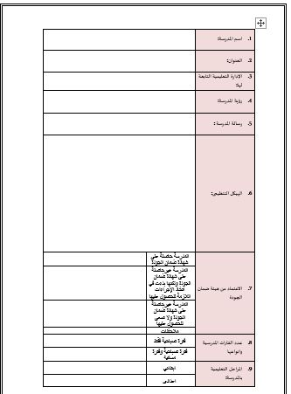

Slide 16

Discussions also pointed to check the researches which have been done in ARAS project as they were based on action research principals.

Slide 17

At this point we agreed to establish a bond between the researches held by ARAS and their schools to apply the NA.

Slide 18
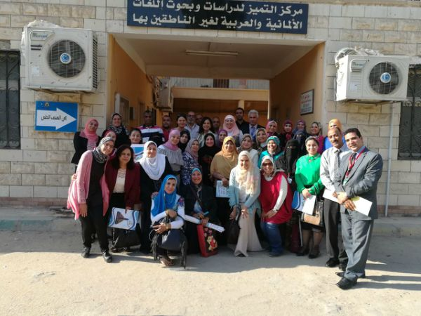
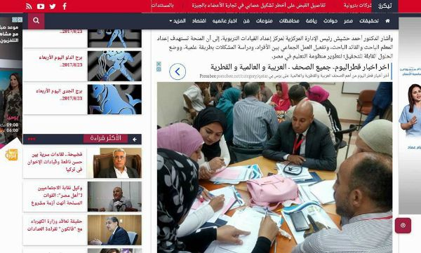

Slide 19
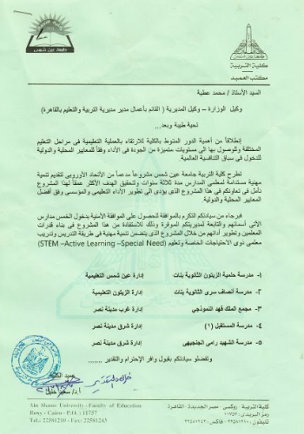


Slide 20
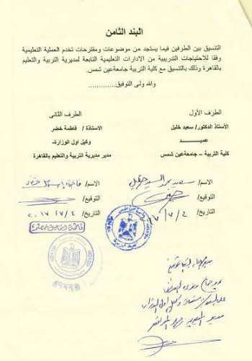
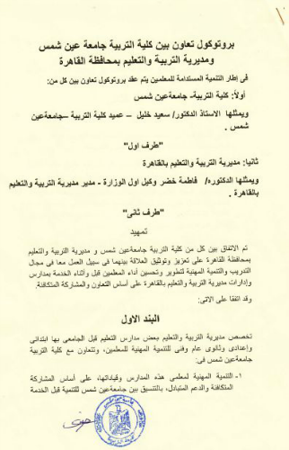
We started to coordinate with MoE in order to receive a feedback on our request to visit the first five schools and this was the replay for our request

Slide 21
What is next ?
Waiting to present the questionnaire to a group of expertise
waiting the approval of minister of education on the agreement ( protocol of cooperation between ANSU and MoE to start visiting the schools)

Slide 22
Travel arrangements

