Slide 1



Project Name:
School and University Partnership for Peer Communities of learners
(SUP4PCL)
Project Number:
573660-EPP-1-2016-1-EG-EPPKA2-CBHE-JP (2016-2516/001-001)
Fourth Local Management Meeting
Tuesday November 21st , 2017
The American University in Cairo (AUC), Egypt
This project has been funded with support from the European Commission. This publication [communication] reflects the views only of the author, and the Commission cannot be held responsible for any use which may be made of the information contained therein

Slide 2

This project has been funded with support from the European Commission. This publication [communication] reflects the views only of the author, and the Commission cannot be held responsible for any use which may be made of the information contained therein

Slide 3
Meeting in October 3rd ,this meeting was held to discuss travel arrangements and divide the teams and select leader for each school.
This project has been funded with support from the European Commission. This publication [communication] reflects the views only of the author, and the Commission cannot be held responsible for any use which may be made of the information contained therein

Slide 4
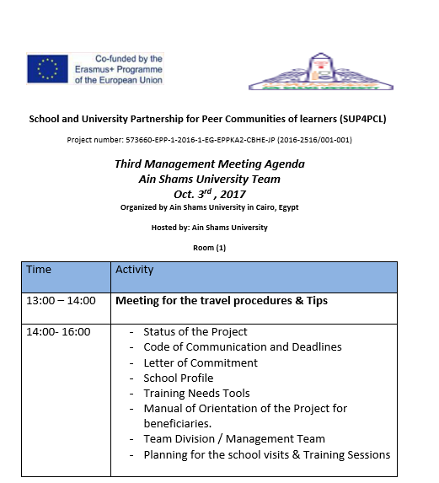
agenda
This project has been funded with support from the European Commission. This publication [communication] reflects the views only of the author, and the Commission cannot be held responsible for any use which may be made of the information contained therein

Slide 5
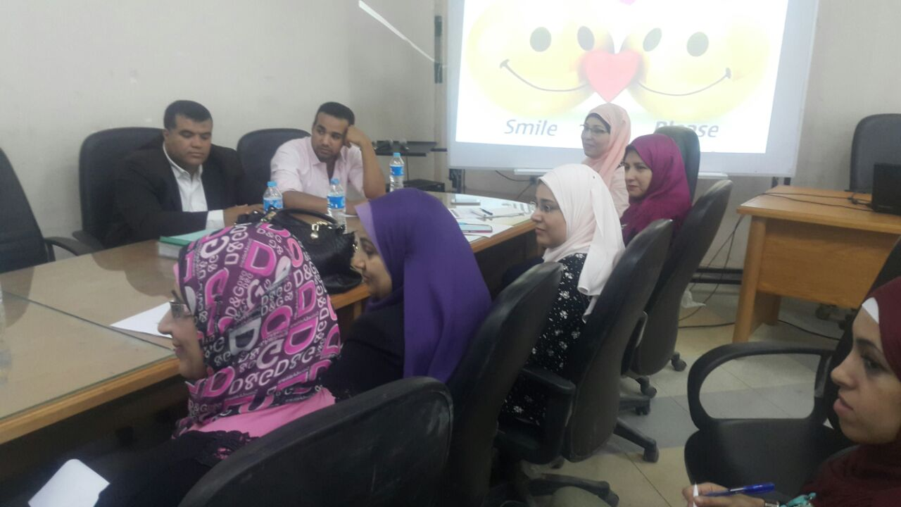
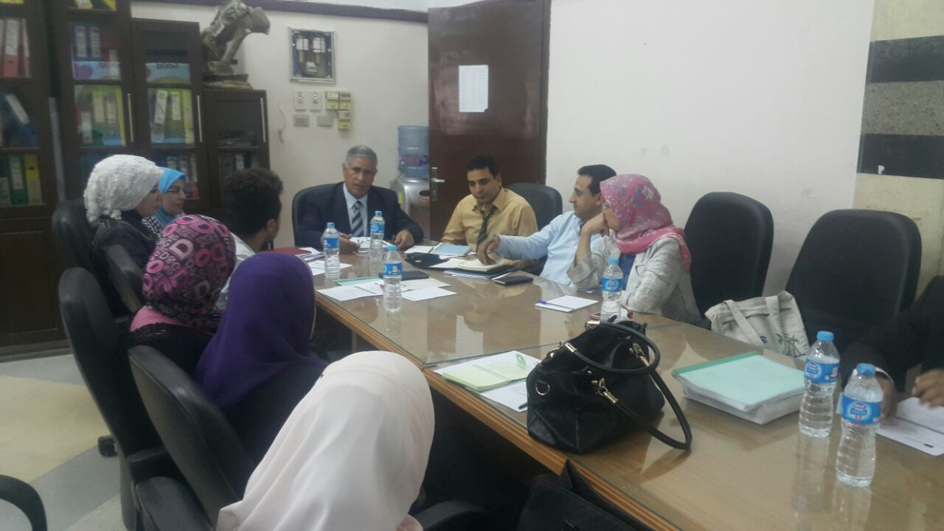
This project has been funded with support from the European Commission. This publication [communication] reflects the views only of the author, and the Commission cannot be held responsible for any use which may be made of the information contained therein

Slide 6
Main points of meeting
Discussions were held about the travel procedures and tips were given by dr. Zeinab and dr. Rasha for the group who will be travelling.
Planning for School Visits :
  Arranging ( event ) orientation day and ceremony in October 30th for launching of the project and inviting the participants and the principles of schools in the ministry of education.
  Arrange action research workshops for all project participants on October 31st and November 1st .
  Action research workshops will be planned and executed by dr. Dina Saber and Mr. Mahmoud Haggag.
This project has been funded with support from the European Commission. This publication [communication] reflects the views only of the author, and the Commission cannot be held responsible for any use which may be made of the information contained therein

Slide 7
Main points of meeting
school profile , training needs tool collected
Another tool were suggested to be designed which is for the School Leaders
Blog designed for the project for documentation and effective communication between the teams.
Team leaders selected, 5 leaders for the 5 participant schools.
team leaders are : Dr.Mohamed Abdo - Dr.Yasser - Dr.Dina - Dr.Hanan - Dr.Sally
Leader School
This project has been funded with support from the European Commission. This publication [communication] reflects the views only of the author, and the Commission cannot be held responsible for any use which may be made of the information contained therein

Slide 8

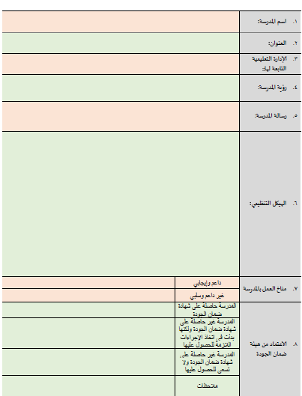
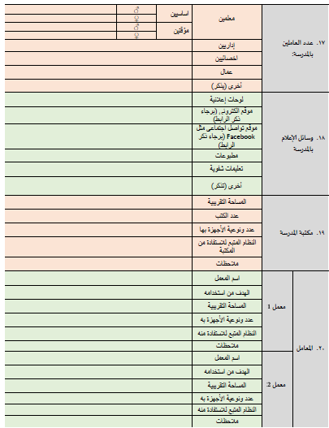
This project has been funded with support from the European Commission. This publication [communication] reflects the views only of the author, and the Commission cannot be held responsible for any use which may be made of the information contained therein

Slide 9

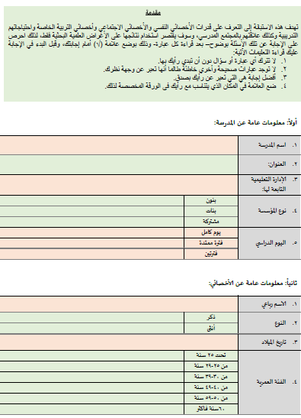
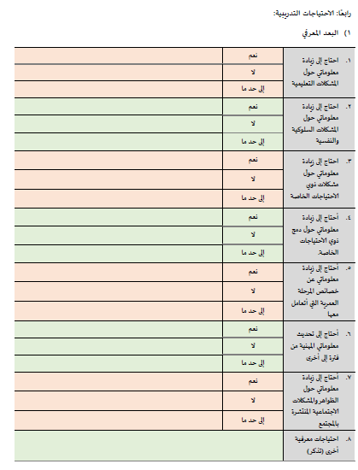
This project has been funded with support from the European Commission. This publication [communication] reflects the views only of the author, and the Commission cannot be held responsible for any use which may be made of the information contained therein

Slide 10

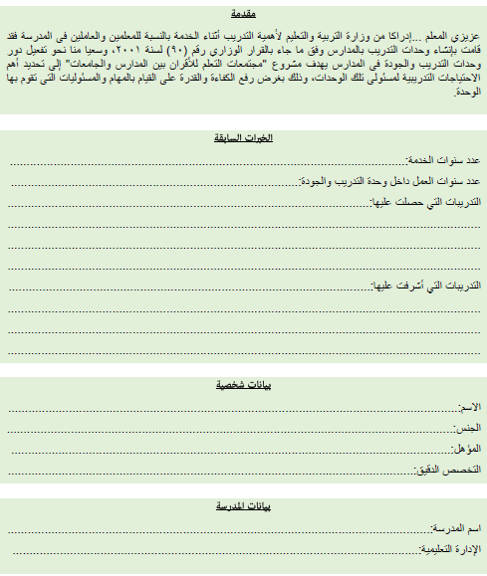
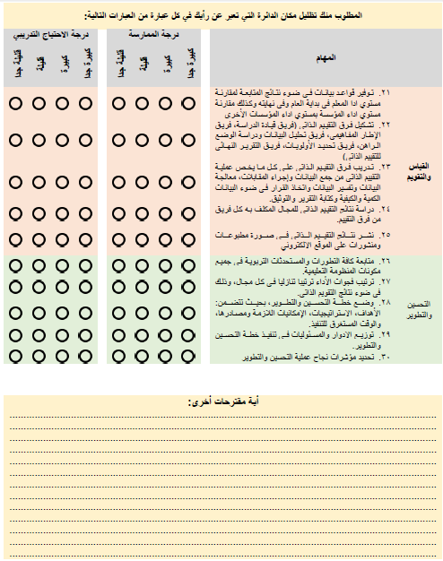
This project has been funded with support from the European Commission. This publication [communication] reflects the views only of the author, and the Commission cannot be held responsible for any use which may be made of the information contained therein

Slide 11

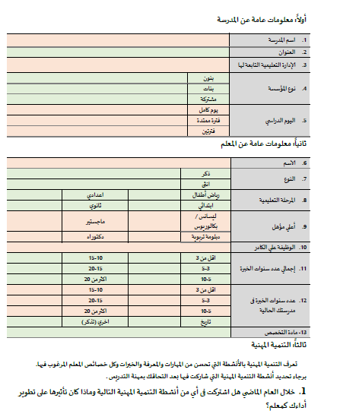
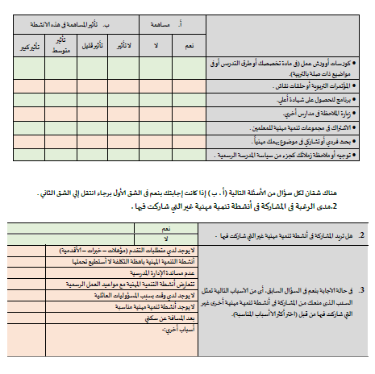
This project has been funded with support from the European Commission. This publication [communication] reflects the views only of the author, and the Commission cannot be held responsible for any use which may be made of the information contained therein

Slide 12
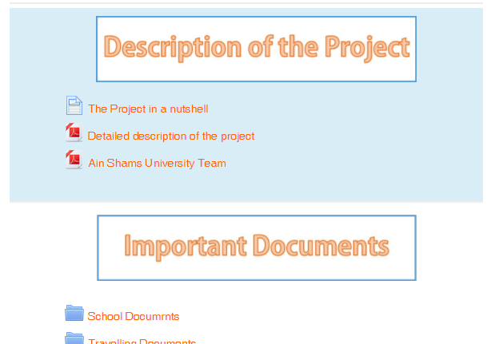
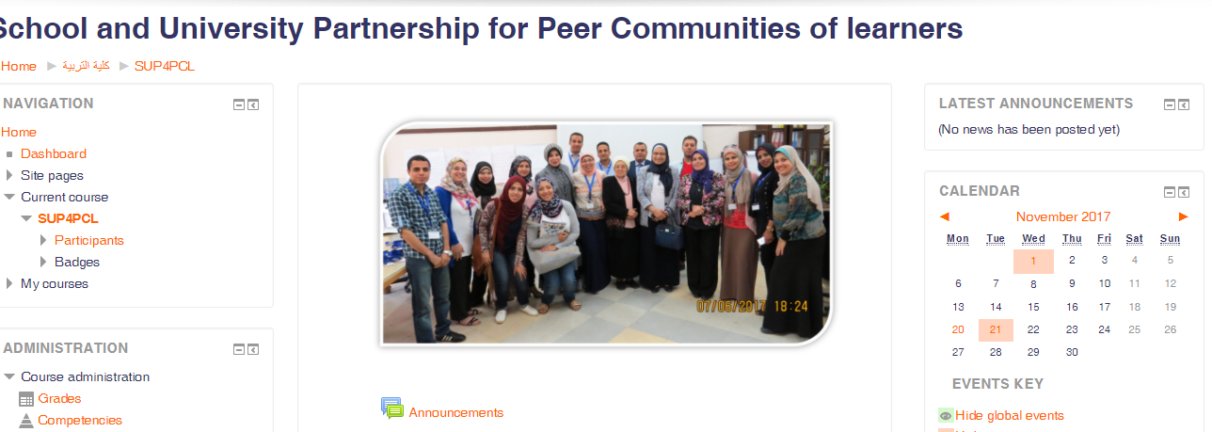
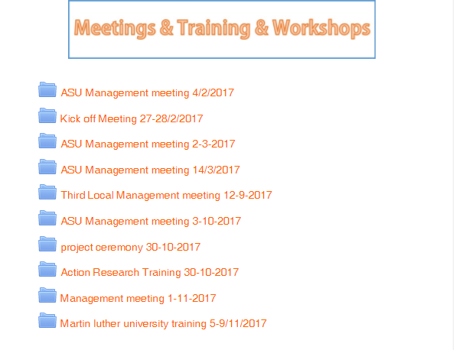
Blog:
This project has been funded with support from the European Commission. This publication [communication] reflects the views only of the author, and the Commission cannot be held responsible for any use which may be made of the information contained therein

Slide 13
Criteria for selecting school leaders
Highly committed
Well knowledge with ethnographic studies and documentation
Strong relation with school ( either by action research or practicum)
Personal communication
Team work skills
This project has been funded with support from the European Commission. This publication [communication] reflects the views only of the author, and the Commission cannot be held responsible for any use which may be made of the information contained therein

Slide 14
what have been done ?
Next
Manual introduced
Event was organized
Plans were put by the school leaders
Final step : Application of tools
This project has been funded with support from the European Commission. This publication [communication] reflects the views only of the author, and the Commission cannot be held responsible for any use which may be made of the information contained therein

Slide 15
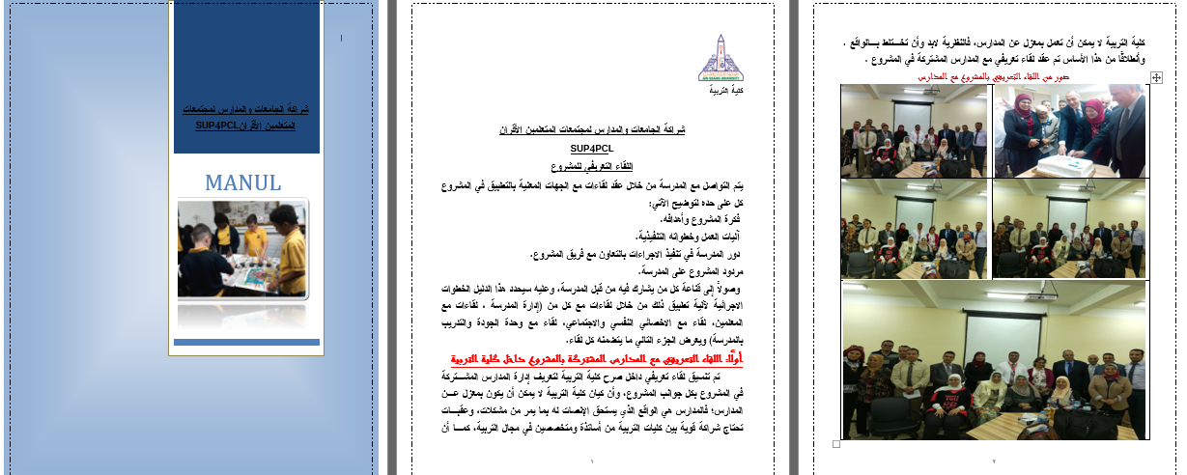
This project has been funded with support from the European Commission. This publication [communication] reflects the views only of the author, and the Commission cannot be held responsible for any use which may be made of the information contained therein

Slide 16

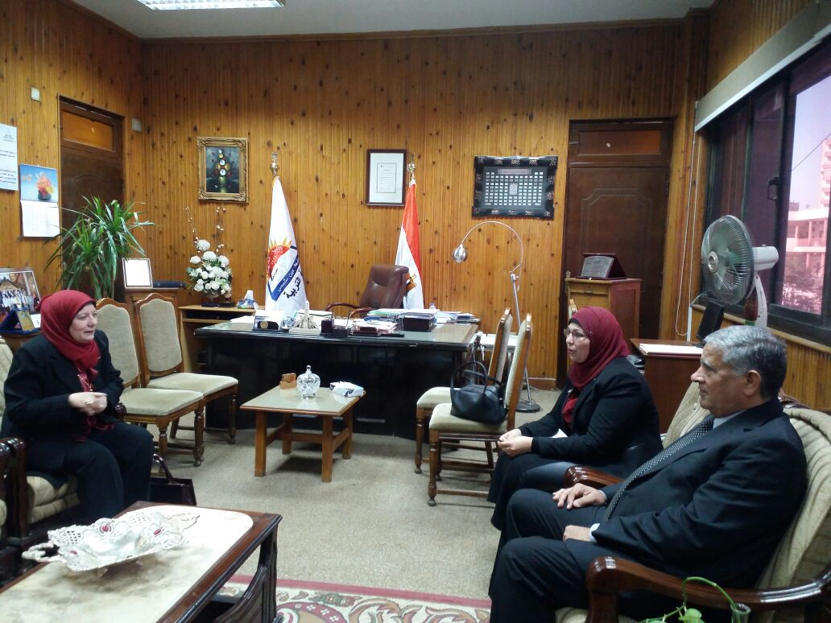
This project has been funded with support from the European Commission. This publication [communication] reflects the views only of the author, and the Commission cannot be held responsible for any use which may be made of the information contained therein

Slide 17

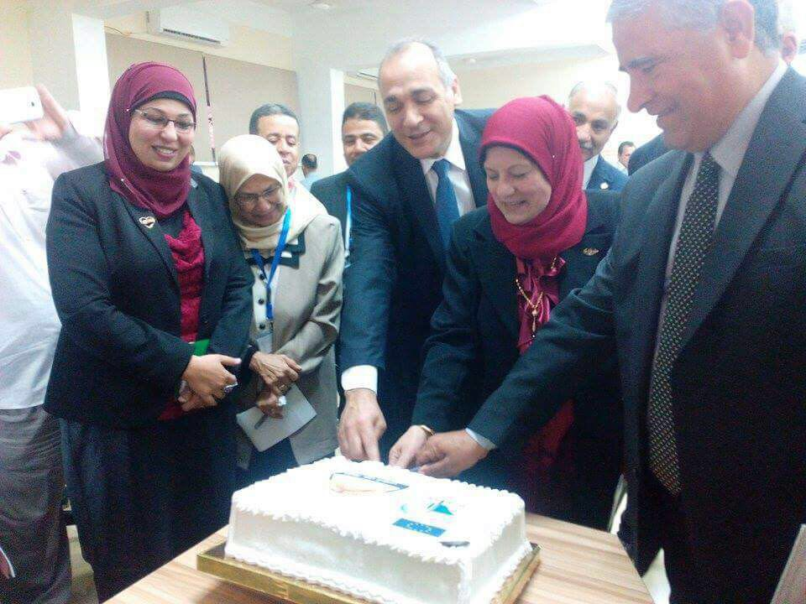
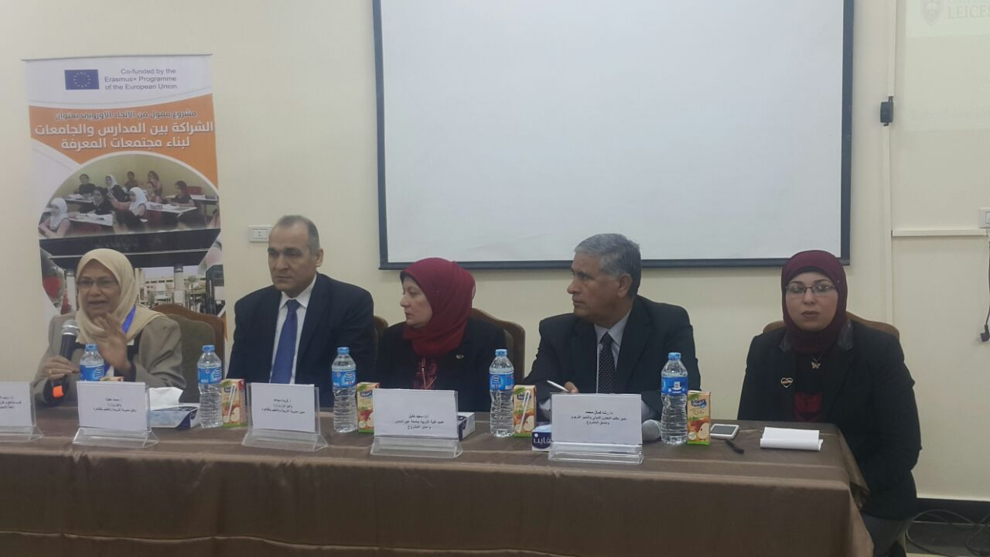
This project has been funded with support from the European Commission. This publication [communication] reflects the views only of the author, and the Commission cannot be held responsible for any use which may be made of the information contained therein

Slide 18
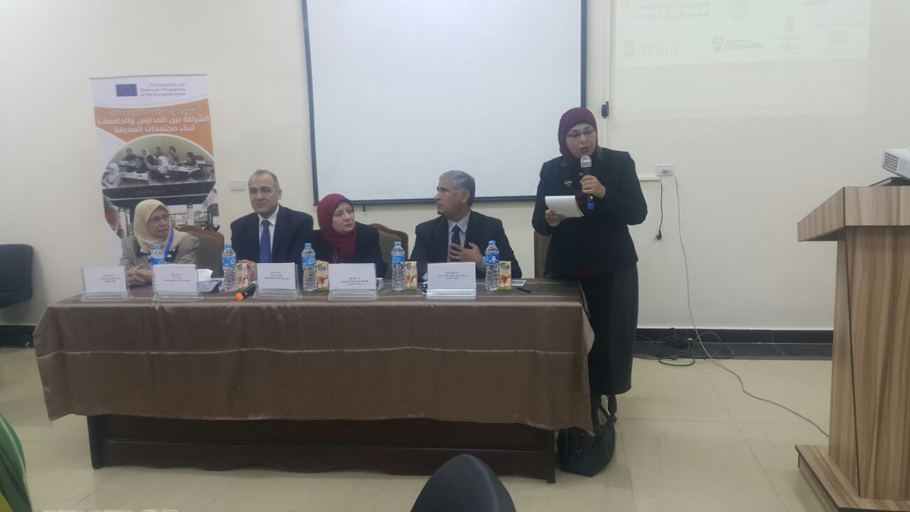
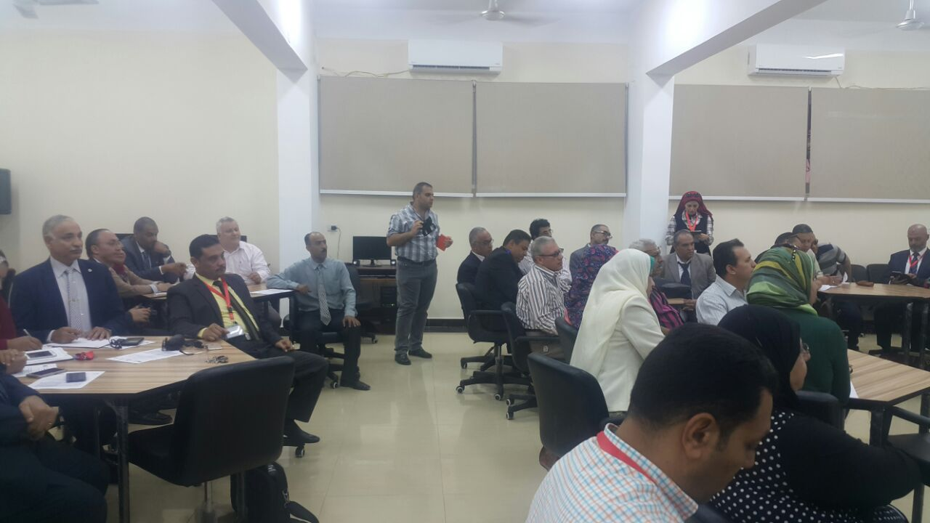
This project has been funded with support from the European Commission. This publication [communication] reflects the views only of the author, and the Commission cannot be held responsible for any use which may be made of the information contained therein

Slide 19
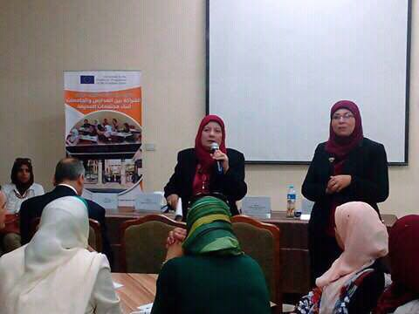
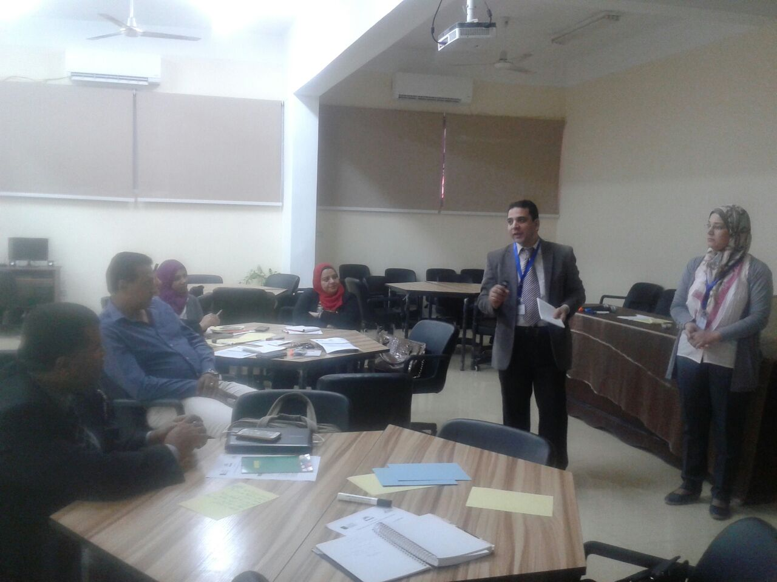
This project has been funded with support from the European Commission. This publication [communication] reflects the views only of the author, and the Commission cannot be held responsible for any use which may be made of the information contained therein

Slide 20
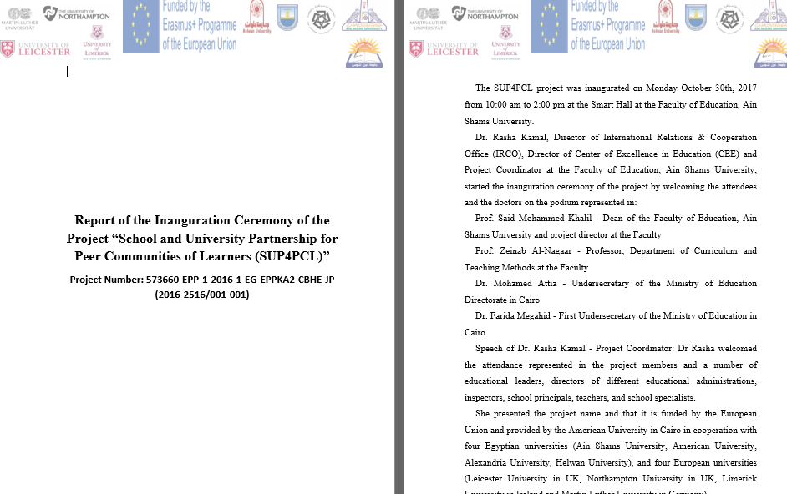
This project has been funded with support from the European Commission. This publication [communication] reflects the views only of the author, and the Commission cannot be held responsible for any use which may be made of the information contained therein

Slide 21
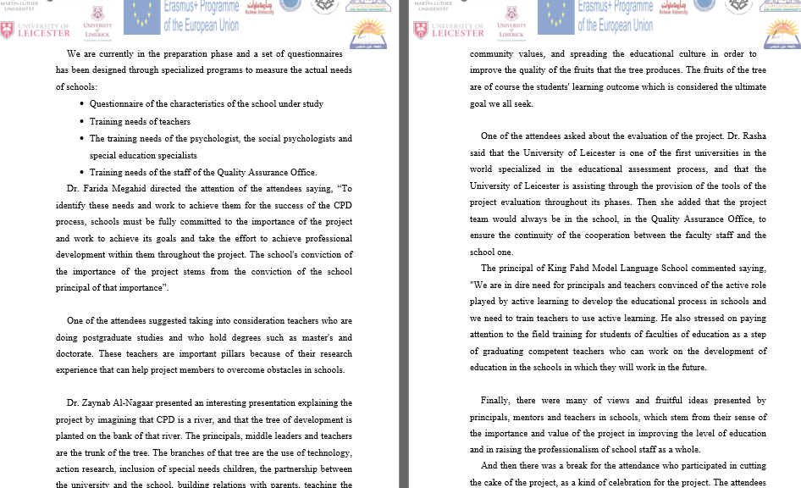
This project has been funded with support from the European Commission. This publication [communication] reflects the views only of the author, and the Commission cannot be held responsible for any use which may be made of the information contained therein

Slide 22

This project has been funded with support from the European Commission. This publication [communication] reflects the views only of the author, and the Commission cannot be held responsible for any use which may be made of the information contained therein

Slide 23
what have been done ?
Next
Manual introduced
Event was organized
Plans were put by the school leaders
Final step : Application of tools
This project has been funded with support from the European Commission. This publication [communication] reflects the views only of the author, and the Commission cannot be held responsible for any use which may be made of the information contained therein

Slide 24
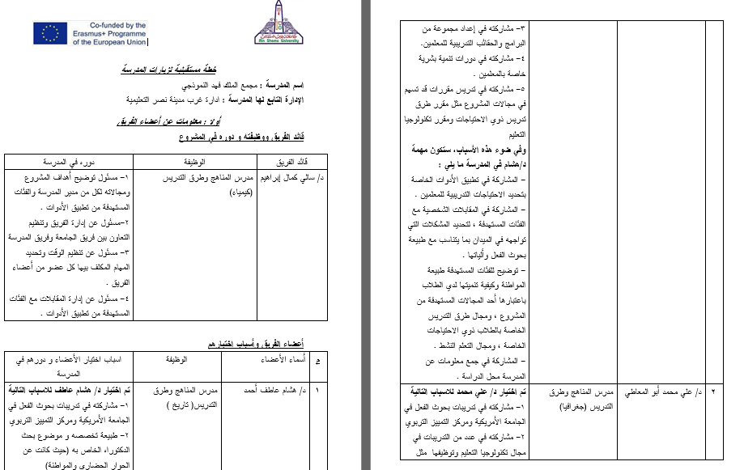
This project has been funded with support from the European Commission. This publication [communication] reflects the views only of the author, and the Commission cannot be held responsible for any use which may be made of the information contained therein

Slide 25
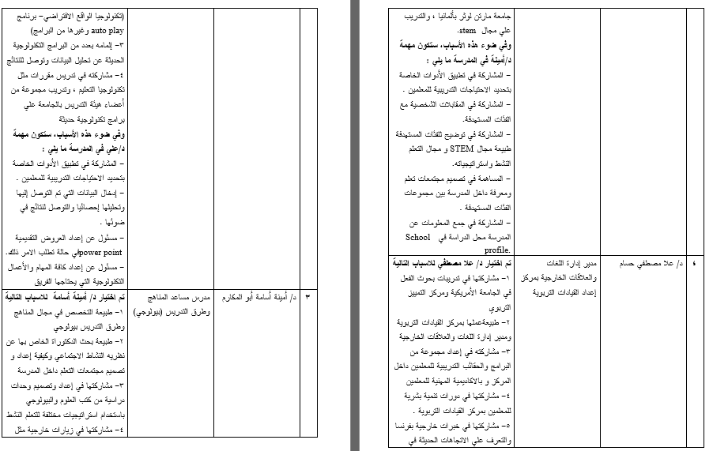
This project has been funded with support from the European Commission. This publication [communication] reflects the views only of the author, and the Commission cannot be held responsible for any use which may be made of the information contained therein

Slide 26
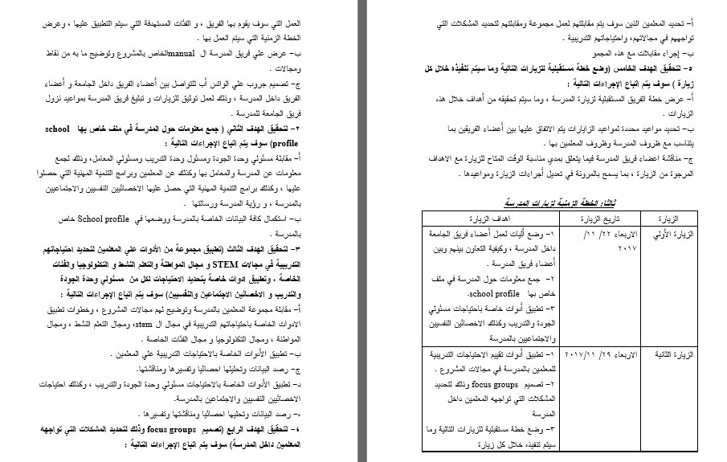
This project has been funded with support from the European Commission. This publication [communication] reflects the views only of the author, and the Commission cannot be held responsible for any use which may be made of the information contained therein

Slide 27




ASU Visit to the European Universities and Schools
This project has been funded with support from the European Commission. This publication [communication] reflects the views only of the author, and the Commission cannot be held responsible for any use which may be made of the information contained therein

Slide 28
Inclusion/special needs/ learning disabilities | School placement | Mentoring | STEM | PLC
Using technology in providing the educational services to the Special Needs One to one learning through communicative tools advanced with technology. |  | mentoring is a structured process for supporting professional learners through significant career transition. Concerning ITE, all trainee teachers have a mentor (classroom teacher) who is trained by university staff to be a mentor. The mentor gives advice and help for no voice and untrained teachers. The outcome of this process is to improve the students’ performance inside schools. |  | Learning communities through active blended Learning. What is active blended learning? Benefits of active blended learning What does learning communities through active blended leaning look like in practice? Student responses to the active blended learning. | University of Northampton
This project has been funded with support from the European Commission. This publication [communication] reflects the views only of the author, and the Commission cannot be held responsible for any use which may be made of the information contained therein

Slide 29
Inclusion/special needs/ learning disabilities | School placement | Mentoring | STEM | PLC
They have sections in school s for inclusion that contains a resource room for special educational needs and disability (SEND) students. This section helps Low achievers, students with ADHD, physically handicapped, dyslexics, and autism spectrum disorders. They have plans for those students and |  |  |  | Lesson Study which is a classroom-based, collaborative mode of professional learning. a lesson study cycle will involve small groups of teachers collaboratively planning a ‘research lesson’ which one teaches while other members of the team observe. In schools Schools collaborate together to help each other as a kind of forming PCL. Schools collaborate with universities as university staff in Leicester university helps them in PD for teachers and solving students’ problems. Teachers hold regular meetings (once a week) outside the school to develop their performance and solve their problems. | University of Leicester
This project has been funded with support from the European Commission. This publication [communication] reflects the views only of the author, and the Commission cannot be held responsible for any use which may be made of the information contained therein

Slide 30
Inclusion/special needs/ learning disabilities | School placement | Mentoring | STEM | PLC
 | It takes place : - 2nd year placement takes place in the Spring semester of Year 2 when student teachers participate in a School Placement of eight weeks. - 4th year placement takes place in the Autumn semester of Year 4 when student teachers participate in a School Placement of ten weeks. The school placement is organised by the School Placement Office. Undergraduate student teachers normally fill out school placement school option forms at least 6 months before school placements |  |  | Online courses Using technology in teacher education: employing student podcast to support the University of Limerick’s graduate attributes. It shed light on the definition of embedded podcasts and its benefits for university students. Then we had a training on a computer program classed “Corel Video studio x8”. | University of Limerick
This project has been funded with support from the European Commission. This publication [communication] reflects the views only of the author, and the Commission cannot be held responsible for any use which may be made of the information contained therein

Slide 31
Inclusion/special needs/ learning disabilities | School placement | Mentoring | STEM | PLC
 | 3 stages: The Orientation School Placement: This is done during the first semester for 2 weeks in which student teachers are placed in schools to observe teaching. When they come to the university they reflect on what they observed with their instructors. Teaching Practice Placements at School I: From the fourth semester and for four weeks pre-service teachers teach ten lessons and observe another 10 for each of the two specializations Teaching Practice Placements at School Ii : For 4 weeks during the fifth semester, student teachers observe 15 lessons and observe an equal number in each of the two specializations | Mentoring is indirect way through school placement process. | They don't name it STEM education but they practice its principals. They call it MINTegration (MINT stands for STEM in German). Since Germany hosts many refugees (800,000 in 2015), learning German is essential. This project is aMobile Science Lab that moves from school to school, offers one week courses and focuses on human health (Hygenic behavior, Healthy nutrition, Drug prevention and Sexual education).Students are evaluated and every student learned German vocabulary & connections. They practiced their German skills and improved it. They also enjoyed the project week and learned content in STEM. | Forming PLC in schools is officially decreed by the Ministry of Education | University of Martin Luther
This project has been funded with support from the European Commission. This publication [communication] reflects the views only of the author, and the Commission cannot be held responsible for any use which may be made of the information contained therein

Slide 32
Benefits of the visits
Projects : ( example)
Martin Luthur University
projects financed by the Higher Education Pact of the government to improve the education of teacher trainees from now till 2020.
These three projects are:
Project "Working against Doubts": This project deals with doubts or concerns that student teachers might have concerning their studies or while working as teachers.
This project has been funded with support from the European Commission. This publication [communication] reflects the views only of the author, and the Commission cannot be held responsible for any use which may be made of the information contained therein

Slide 33
Benefits of the visits
Projects : ( example)
Martin Luthur University
Project "Digitization of Teacher Training": The purpose of this project is two-fold: To develop courses for students and teachers at the university to enhance digital competence of current and future teachers and create awareness for students' ability to learn with the help of digital media
This project has been funded with support from the European Commission. This publication [communication] reflects the views only of the author, and the Commission cannot be held responsible for any use which may be made of the information contained therein

Slide 34
PLC
The MoE to adopt PLC's as a viable strategy for CPD in Egyptian schools. If there is support from decision makers, leaders and middle leaders for this strategy, it will be effective in improving teachers' performance and consequently student learning.
Using Pre-lesson planning and post-lesson evaluation meetings in Egyptian schools can provide discursive opportunities for detailed planning and in-depth reflection about the quality of teaching and learning. The collaboration in lesson study can help teachers to develop a sense of collective efficacy.
Case- based studies and reflections
This project has been funded with support from the European Commission. This publication [communication] reflects the views only of the author, and the Commission cannot be held responsible for any use which may be made of the information contained therein

Slide 35
Mentoring
Training cooperating teachers to mentor student teachers as well as other newly-qualified teachers in their schools.
Close cooperation between university and schools.
The role of mentorship and reflection in TPD.
This project has been funded with support from the European Commission. This publication [communication] reflects the views only of the author, and the Commission cannot be held responsible for any use which may be made of the information contained therein

Slide 36
FOE Context
Developing intercultural communication training courses.
Developing Lab Schools
Close cooperation between university and schools. Real COP
The role of mentorship and reflection in TPD.
Deep reflection through case studies
Developing Teacher Practicum
Project based learning approach in teaching

Slide 37
SUP4PCL Context
Developing PCL between Students and teachers (strategies).
Developing class management skills in TPD.
Creating learning culture at schools.
Developing PD for the school leaders, middle leaders and seniors.
Deep reflection through case studies at schools.
Developing online courses for SPNE
Project based learning approach in developing the TPD material.

Slide 38
Challenges we are facing
Time line must be changed or adjusted
Language barrier.
Exams at universities and schools.
The EU Visit objectives/real status
This project has been funded with support from the European Commission. This publication [communication] reflects the views only of the author, and the Commission cannot be held responsible for any use which may be made of the information contained therein

Slide 39

This project has been funded with support from the European Commission. This publication [communication] reflects the views only of the author, and the Commission cannot be held responsible for any use which may be made of the information contained therein

