Slide 1


Project Name:
School and University Partnership for Peer Communities of learners
(SUP4PCL)
Project Number:
573660-EPP-1-2016-1-EG-EPPKA2-CBHE-JP (2016-2516/001-001)
“Progress Reporting on case studies and school visits”
Fifth Local Management Meeting
Tuesday June 26th , 2018
Organized by The American University in Cairo (AUC), Egypt
Location: Tolip Hotel –Alexandria
This project has been funded with support from the European Commission. This publication [communication] reflects the views only of the author, and the Commission cannot be held responsible for any use which may be made of the information contained therein

Slide 2


Slide 3
Faculty of Education Case Study
Schools Case Studies
Ansaf Seri Secondary School for Girls
Al-Tabary preparatory School for Boys
Helmiet El-Zaiton Secondary for Girls
Saidia Preparatory School for Boys
Youssef El Sebai Language school

Slide 4

Faculty of Education

Slide 5
Case study outline
History & context (faculty profile)
PCLs (e.g. how many, etc…)
New teaching styles
New programs or courses
New policies
Engagement of students
Human relationships (Between faculty , and faculty with students)
Impact on faculties

Slide 6
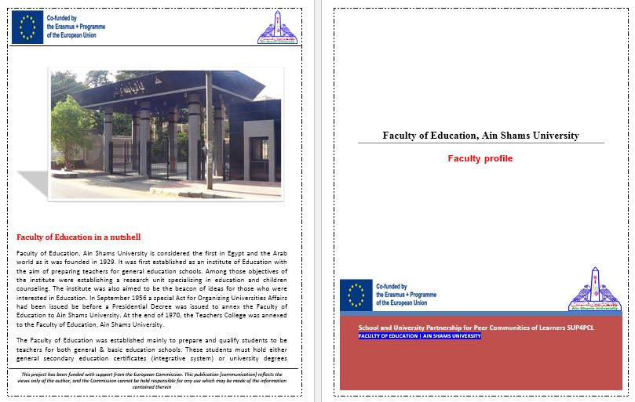
Faculty of Education profile

Slide 7
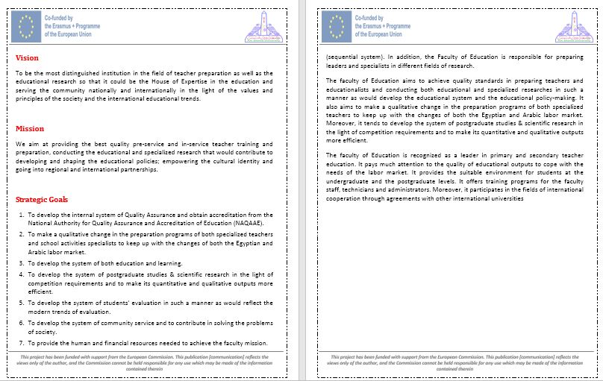

Slide 8
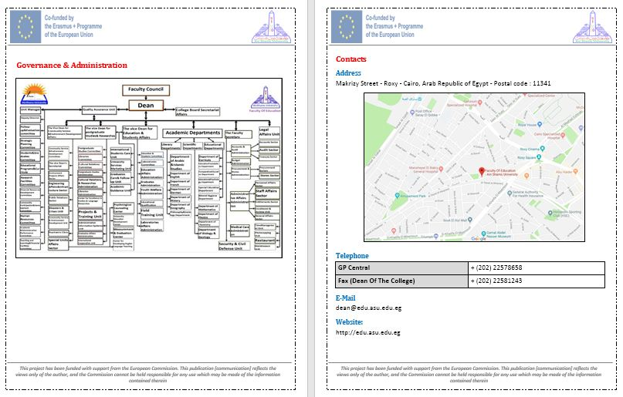

Slide 9
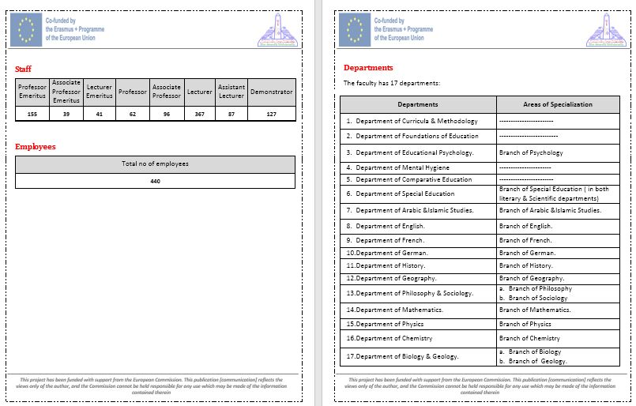

Slide 10
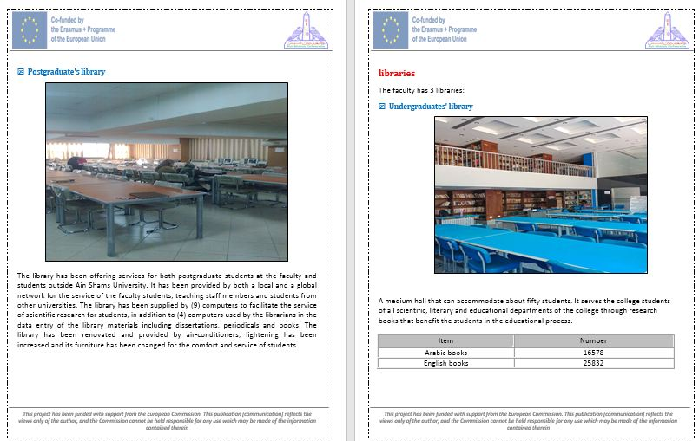

Slide 11
Evolution of PCLs
FOE Team Regular Meetings
ASU/UL skype Meetings
ASU/UL Face to face training

Slide 12
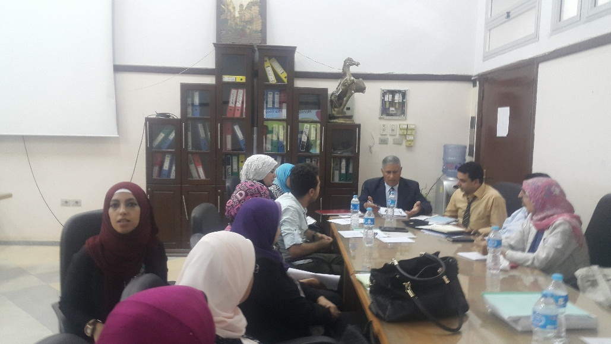
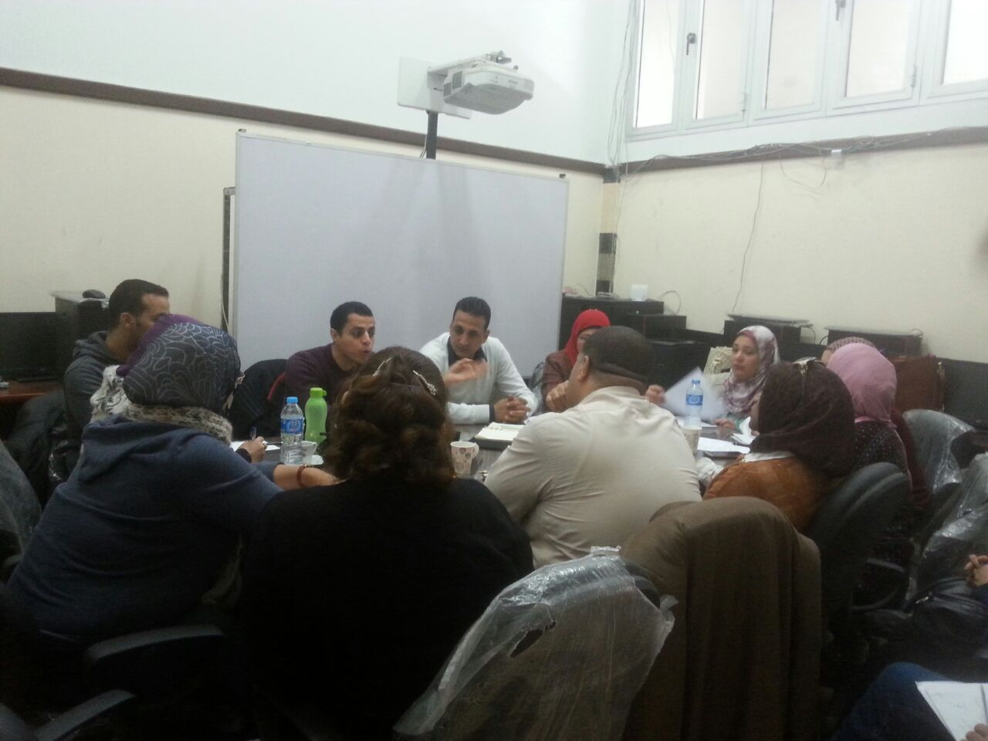
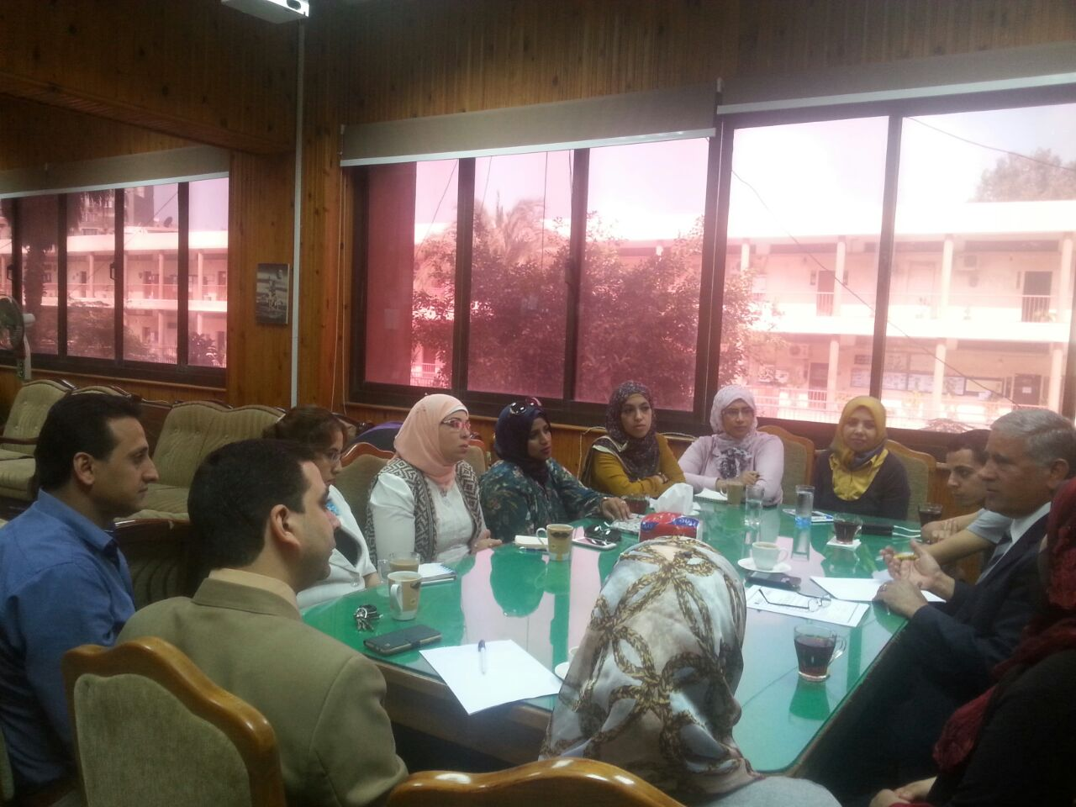
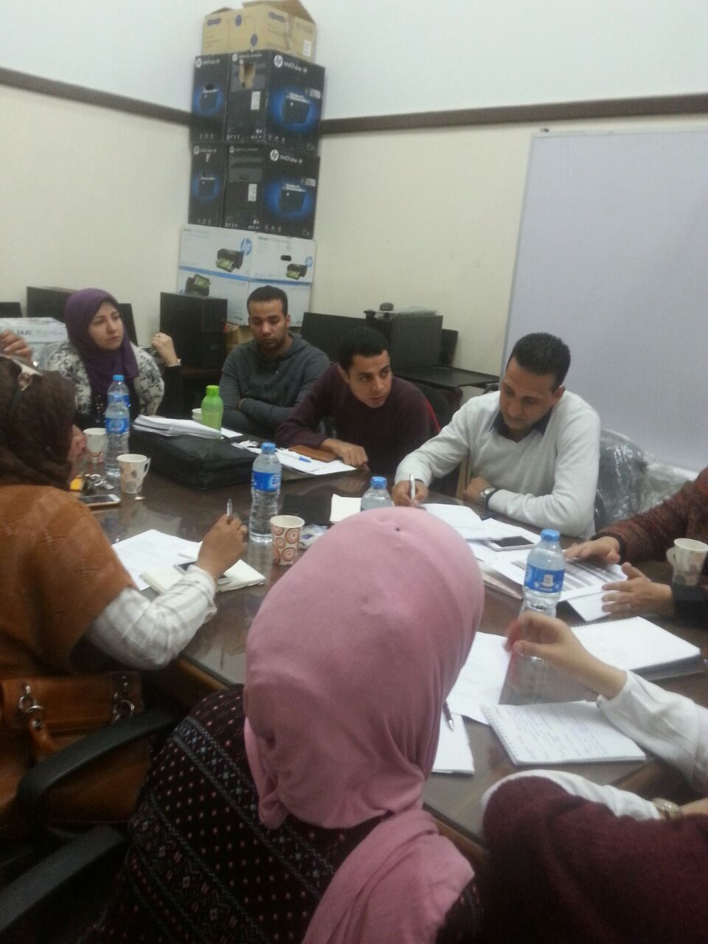
FOE Team Regular Meetings

Slide 13
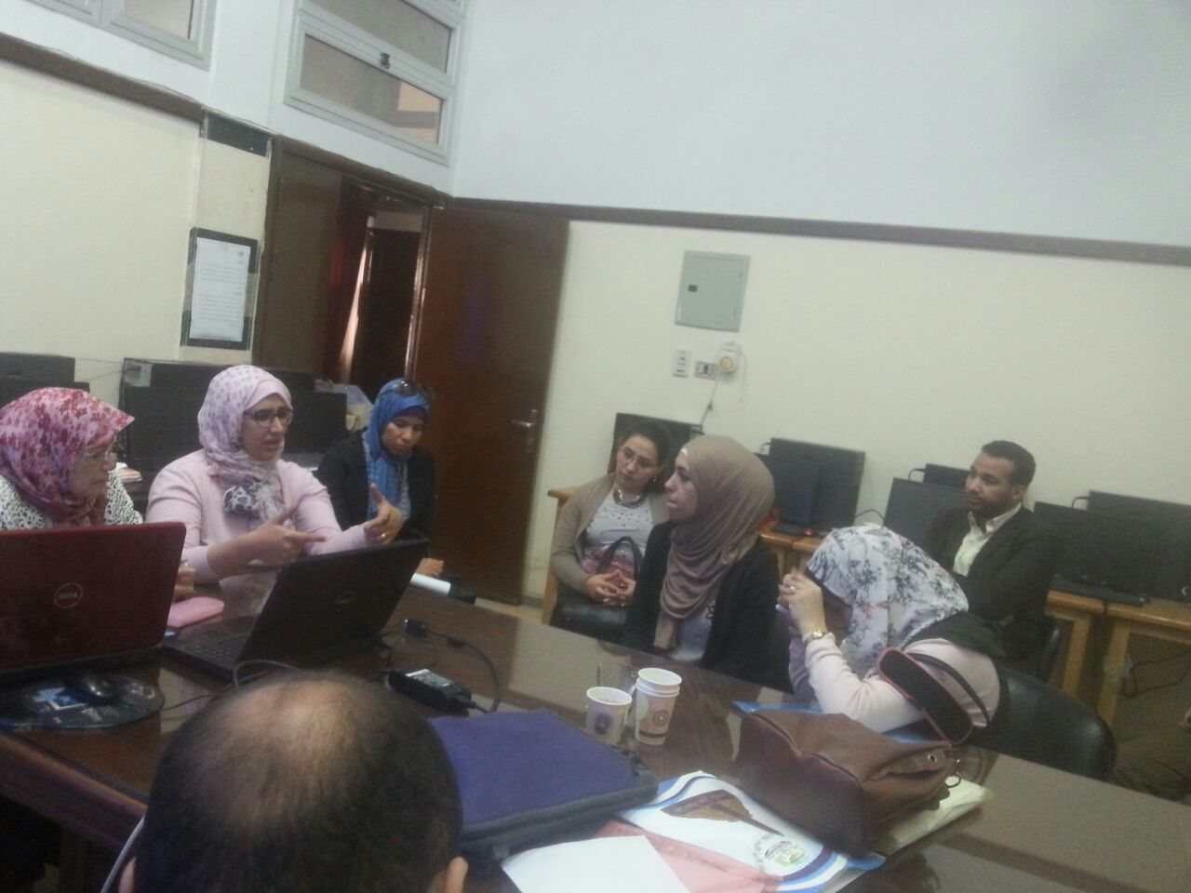
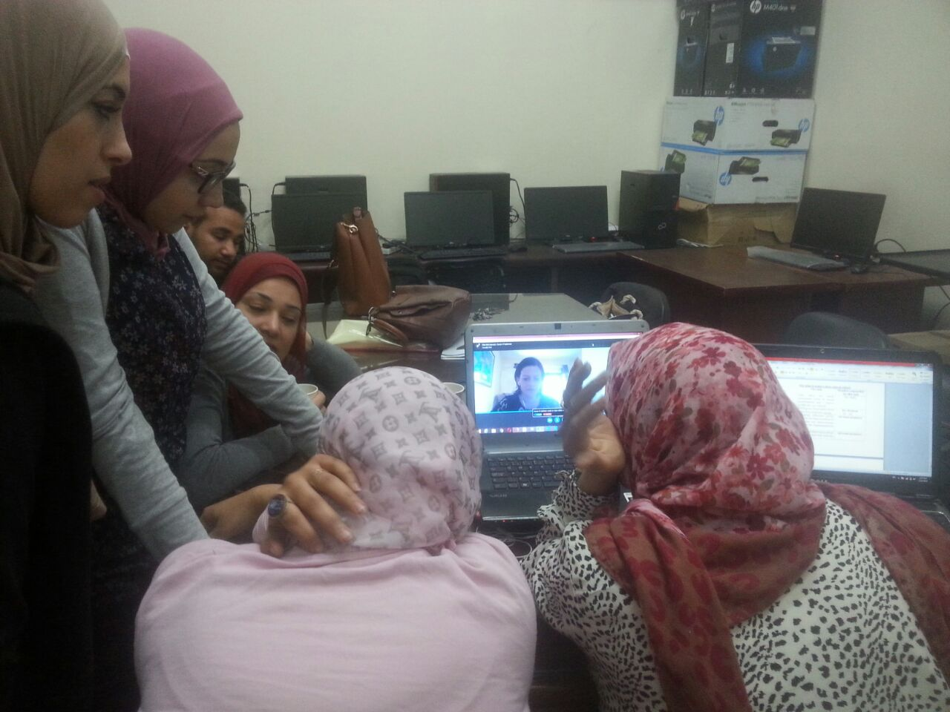
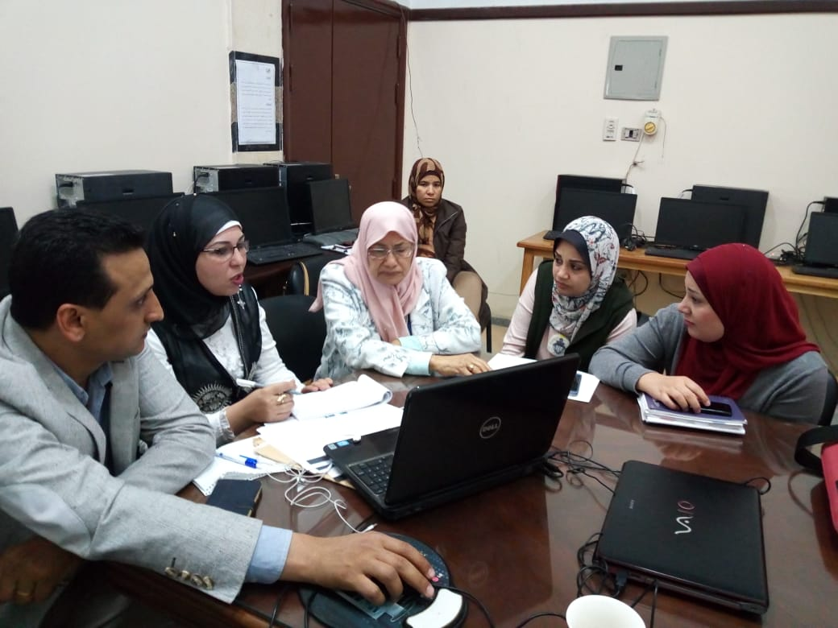
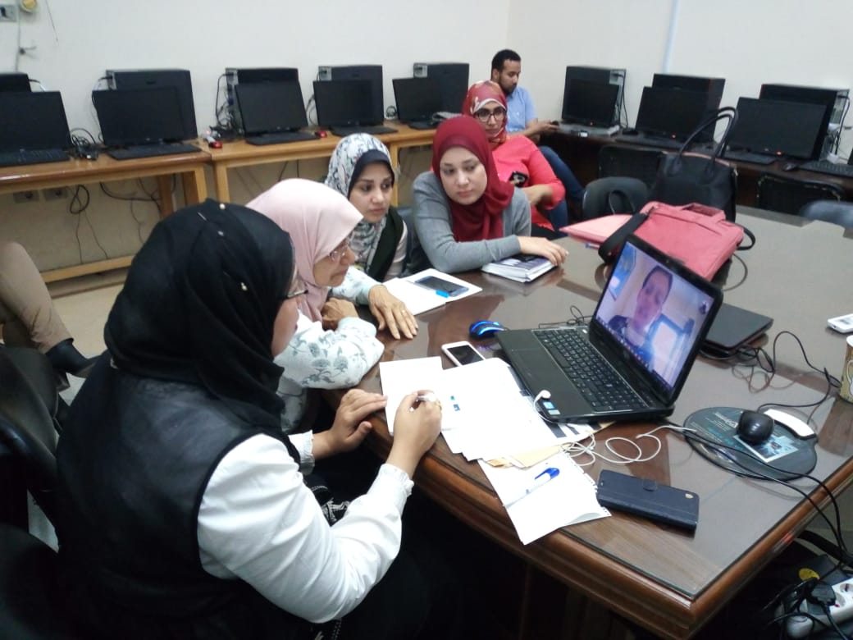
ASU/UL skype Meetings

Slide 14
ASU/UL Face to face training
Questionnaire of Mentors needs by UL
What strengths do you feel you currently bring to your role as mentor?
What mentoring qualities/skills do you feel you currently possess?
How might you further develop those mentoring strengths?
What assistance/support do you need in developing these skills?
How can we (UL) be most helpful to you during the upcoming visit?
How do you currently view your role as mentor (what do you think it involves)?
What issues/difficulties are you currently experiencing with your school?

Slide 15
Responses: Example-1
What strengths do you feel you currently bring to your role as mentor?
The strengths that I bring to my role as mentors are
how can I design integrated team work ?
how can I put a plan to this team TO achieve different objectives?
How can I know the abilities of each member in my team to give them a suitable task?
How can I solve any problem that may face me during my work?
How can I make good and respectful relationship between my team?
How can I use my verbal and non verbal communication skills to illustrate any idea to others
How can I facilitate any trouble that may face my team?
How can I play different roles beside as leader to achieve my plan?
How can I be more confident to take any decision in my team?
How can I make a motivated working environment to encourage my team?

Slide 16
What mentoring qualities/skills do you feel you currently possess?
Skill of decision making , skill of planning, skill of communication, Skill of problem solving , skill of building motivated environment , skill of building teams, skill of time management
How might you further develop those mentoring strengths?
By practising these skills in other life situations , by participating in different training about leadership and mentoring .
What assistance/support do you need in developing these skills?
I need more activities to improve these skills for me , I need more work shops about all leaders` skills, I need to see a real situations for good leaders.
How can we (UL) be most helpful to you during the upcoming visit?
By helping me how can I make a good PCL in my school, how can I write a case study during school visits , how can I make different pd activities to teachers to change their attitude, how can I deal with traditional and routine school principals?

Slide 17
What issues/difficulties are you currently experiencing with your school?
The difficulties that I am currently experiencing with my school are
Teachers` negative attitudes towards any professional development activities
Traditional and routine leadership
Misconception for my team about the meaning of PCL
Anxiety from sharing any activities , problems , and information between my PCL team

Slide 18
Responses: Example-2
What strengths do you feel you currently bring to your role as mentor?
Mutual trust between members of the school team and members of the Faculty of Education.
Counseling and constant advice
Establishing social relations
What mentoring qualities/skills do you feel you currently possess?
Establishing social relations
Good listening
Counselling
Social communication skills
How might you further develop those mentoring strengths?
homeliness
Continuity
Follow-up & establishing new social relations

Slide 19
What assistance/support do you need in developing these skills?
Further training and follow-up
Knowledge of strengths and weaknesses during the guidance process
How can we (UL) be most helpful to you during the upcoming visit?
Identify models of Coaching and Mentoring and the difference between them
How do you currently view your role as mentor (what do you think it involves)?
Enhance social relations between project members both inside and outside the school
Identify the strengths and weaknesses within the school
Exploiting the potential and human potential
Record all things Happened and document them
What issues/difficulties are you currently experiencing with your school?
The vision is unclear in the future
We need to develop a clear plan for their implementation

Slide 20
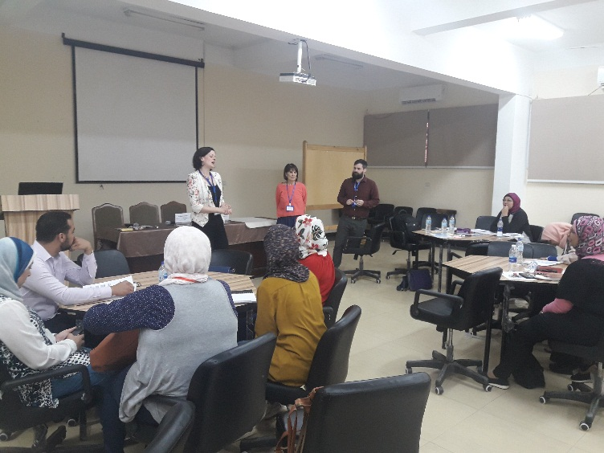
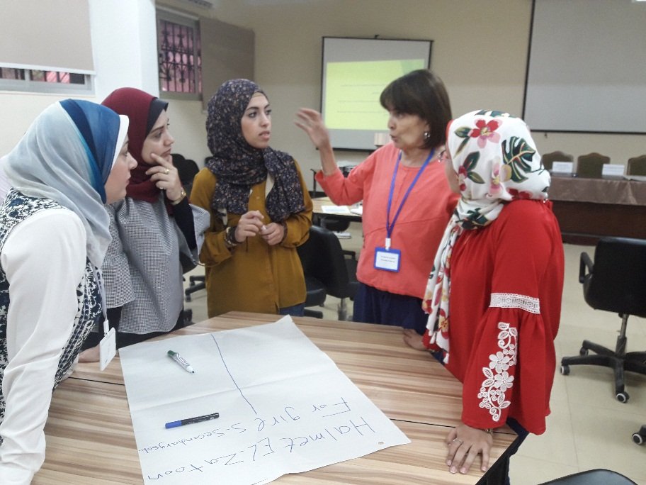

Slide 21
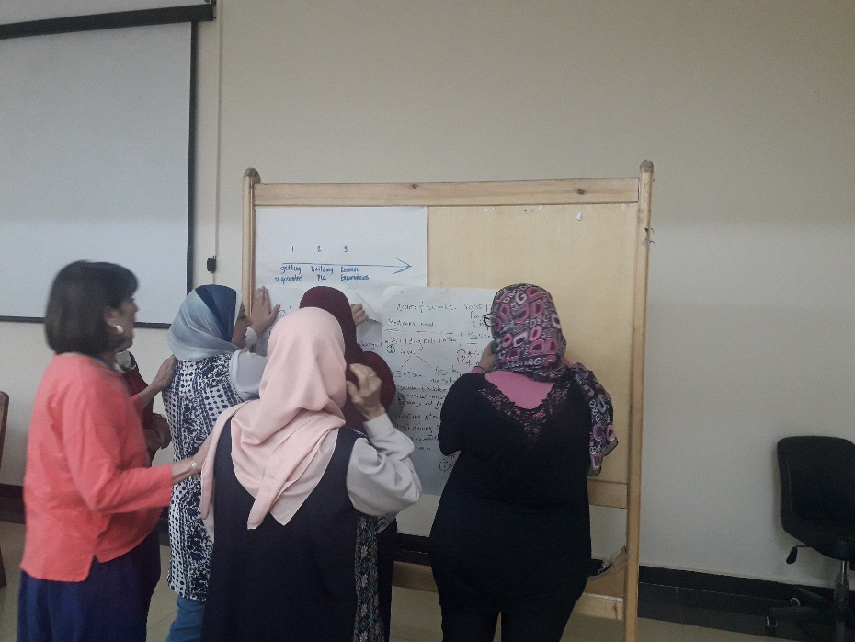
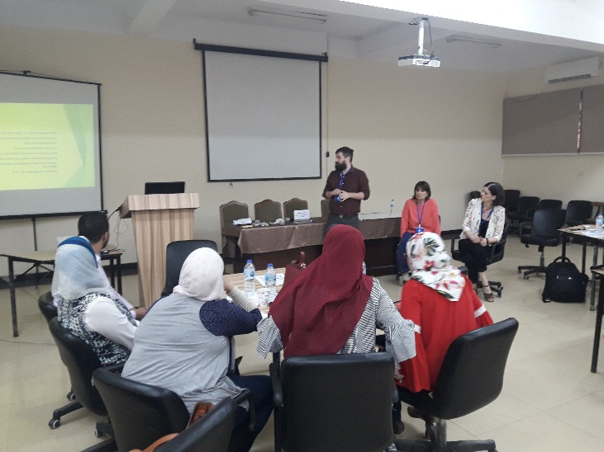
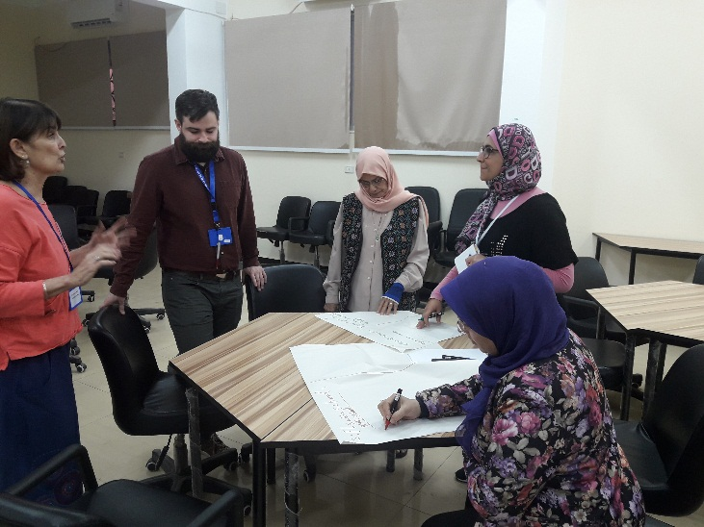

Slide 22
Hello ASU community
It has now been a week since our exciting two days with the entire ASU/UL team strengthening our relationships and moving toward a cooperative community. We so enjoyed our interactions with all of you and were impressed by your commitment to developing both our ASU/UL community and the communities in your assigned schools. Your willingness to explore and share your insights and understandings was exciting and was perhaps the most important reason we were able to make progress in coming together as a community.
As we discussed, we see three communities working together as part of our collaborative work.
The entire ASU/UL team working together to become a community focused on facilitating your needs in the ASU setting and with the schools in which you are striving to develop communities.
ASU mentor teams who are in fact a mini community; made up of the five mentors and their teams who working to develop school/ASU communities ASU mentors teams and school communities to empower teachers and improving the learning of pupils in schools.
ASU mentor teams and their assigned schools working to become a community to empower teachers and improve the learning of pupils in the schools.
ASU/UL community
ASU mentor /school communitiess
ASU mentor community

Slide 23
As requested by you and promised by us, we are pulling together the following:
Identifying a faculty member with expertise in special populations to design a webinar and question / answer session to assist you in your ASU coursework and links with the school communities
Selecting examples of case studies that might inform development of our own case studies
Selecting published articles to meet your identified needs for developing communities
Collecting PowerPoint presentations, handouts, and information collected during our recent visit
As soon as the Dropbox is set up we will place all documents there for you to access.
As a result of your request for ideas on how to move forward with your schools, you all brainstormed a number of terrific ideas on communicating with schools to let them know you were prepared, interested, and willing to move forward with your collective work. You also indicated it would be helpful to share your first steps with the entire ASU/UL community as a means of holding yourselves accountable. So, after a week, please post on What’sApp what your ASU mentor team has done to link with your schools. Hopefully, we will be added to the What’sApp group to read them this week.

Slide 24
Schools

Slide 25
Case study outline
School Context (baseline + profile+ needs assessment + ethnographic study + history of schools + demographics)
Evolution of Quality Assurance Unit
Evolution of PCL
Evolution of Mentorship
Evolution of school-based research for professional development

Slide 26
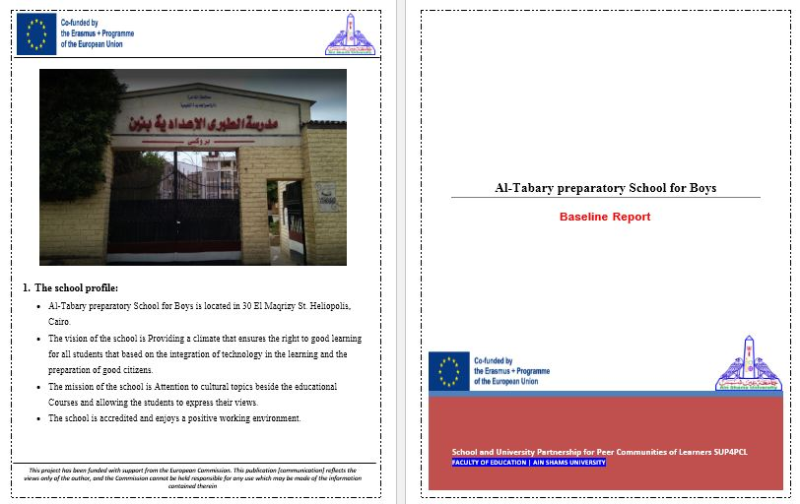
School Context
(baseline + profile+ needs assessment + ethnographic study + history of schools + demographics)

Slide 27
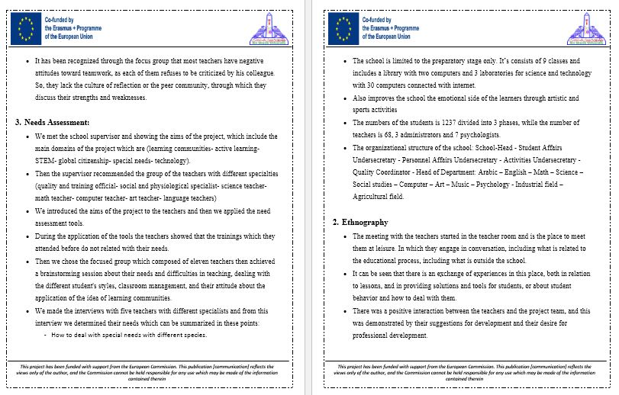

Slide 28
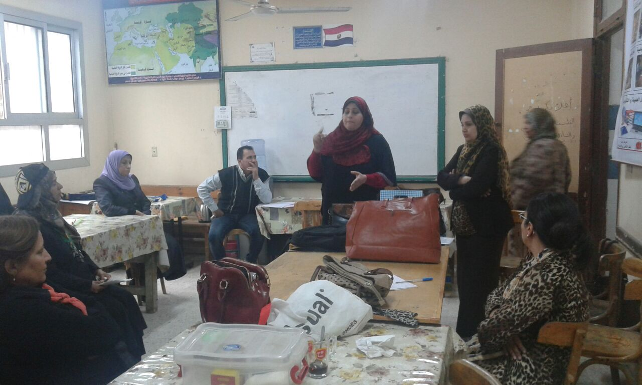
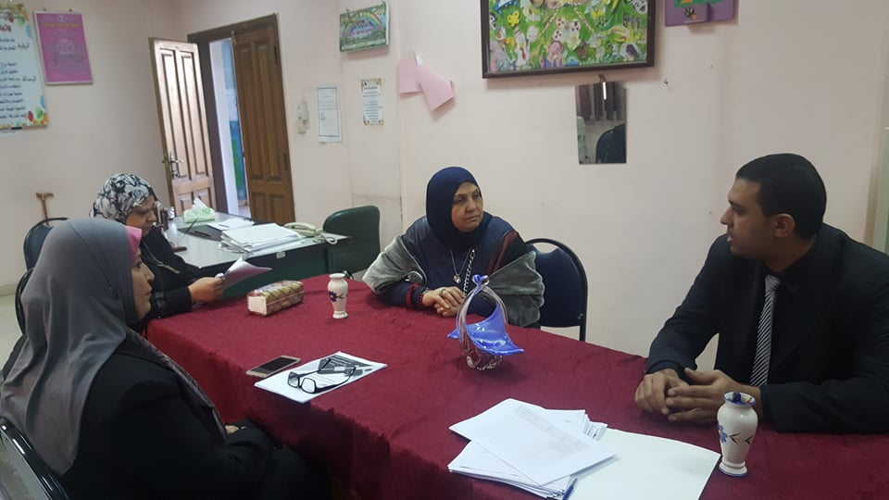
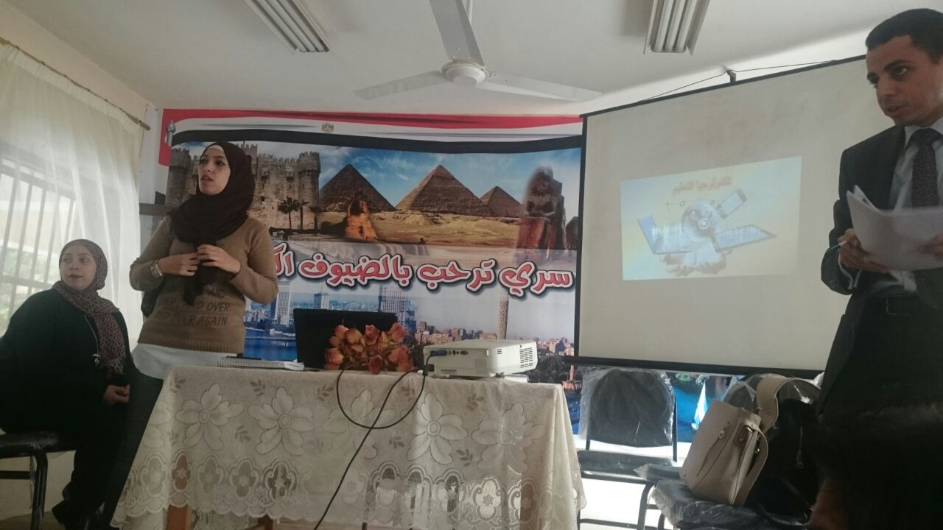
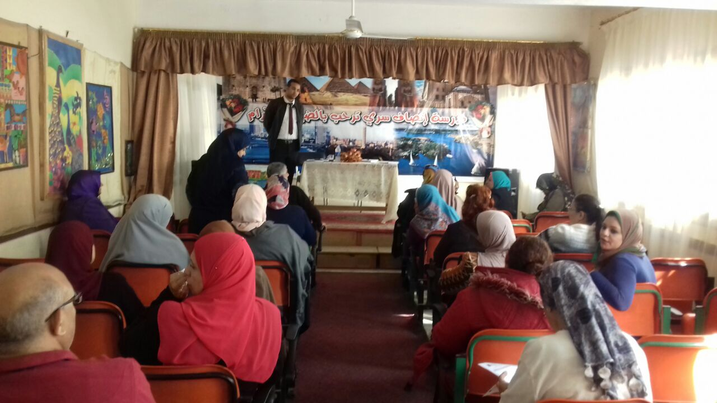
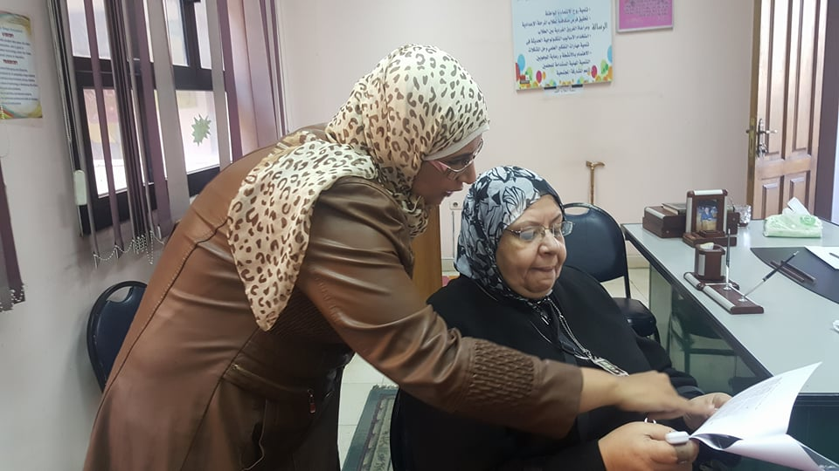
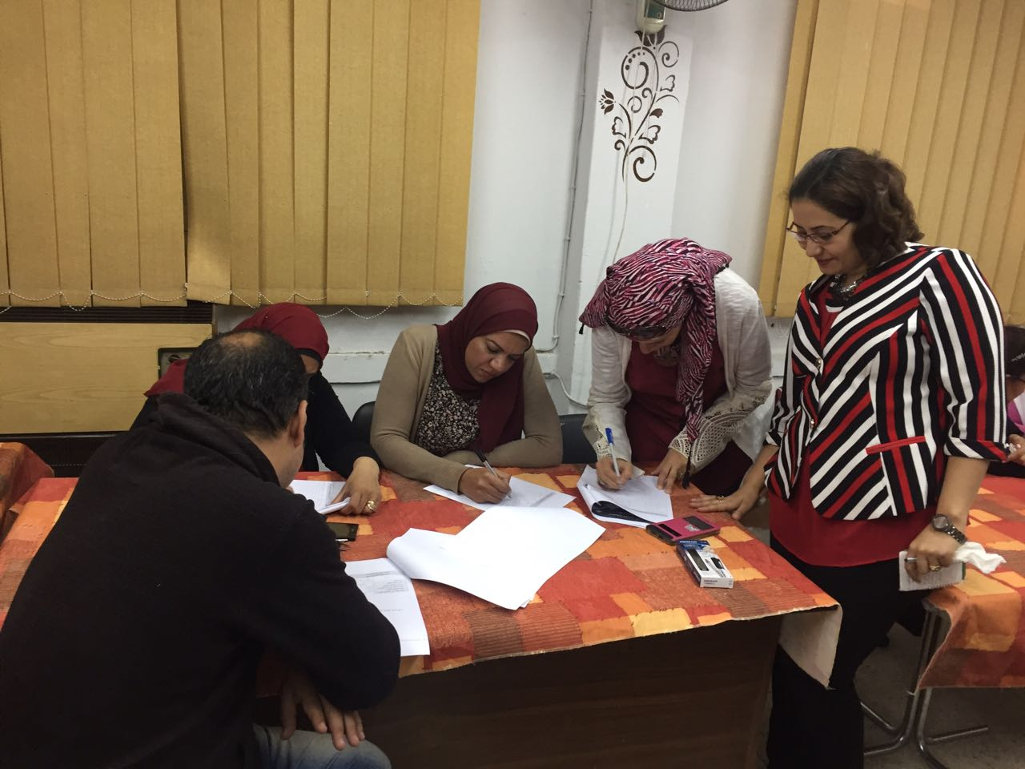
Evolution of PCL

Slide 29
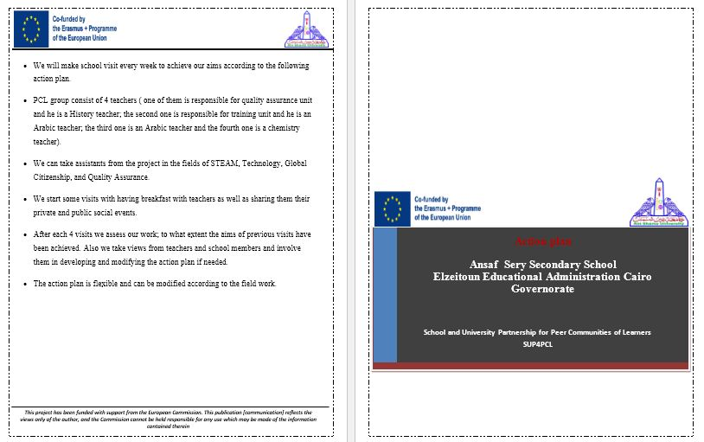
School Action Plan

Slide 30
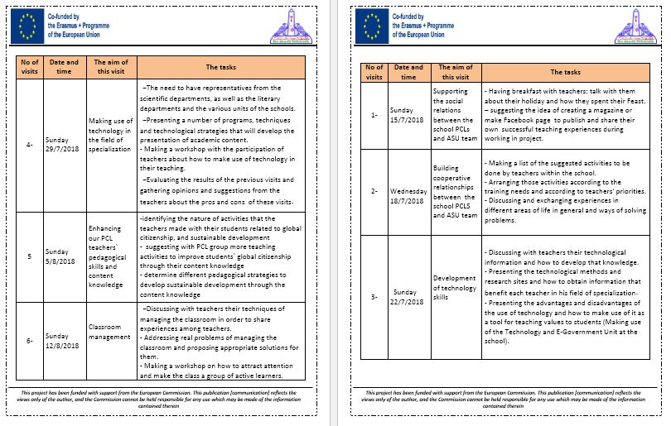

Slide 31
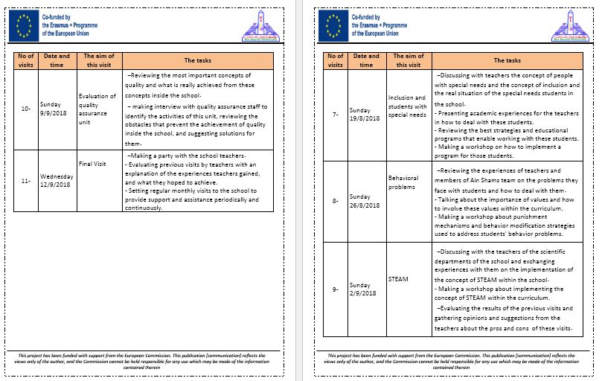

Slide 32

training package of technology

Slide 33
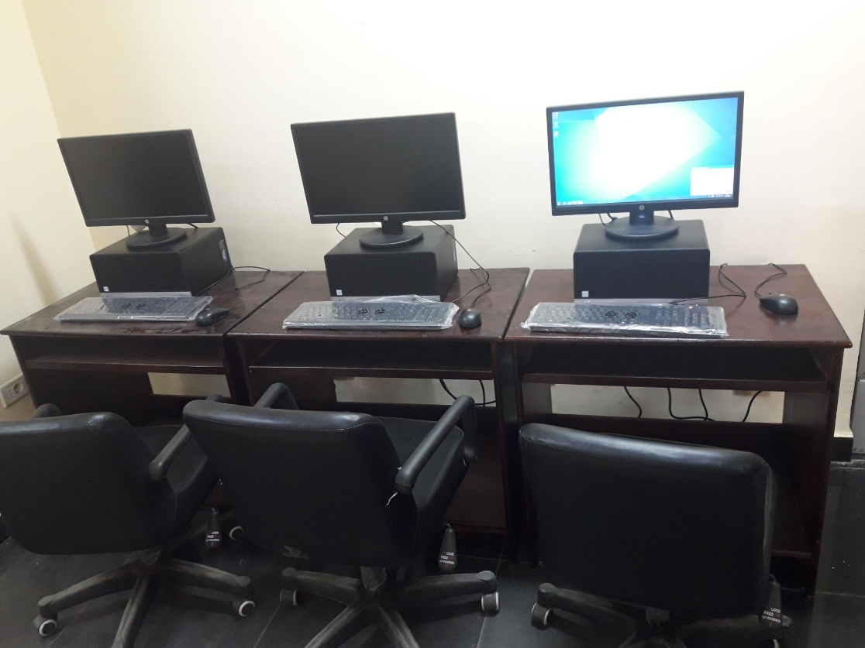
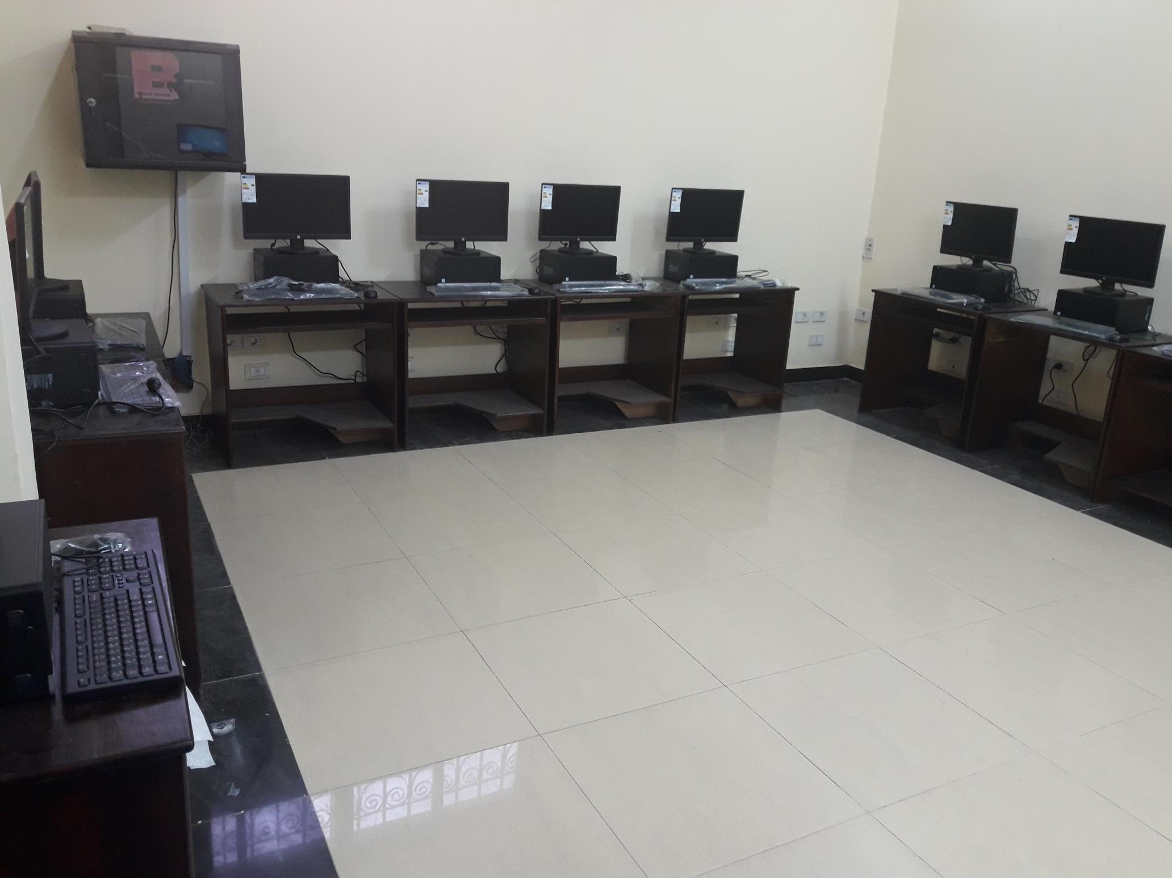
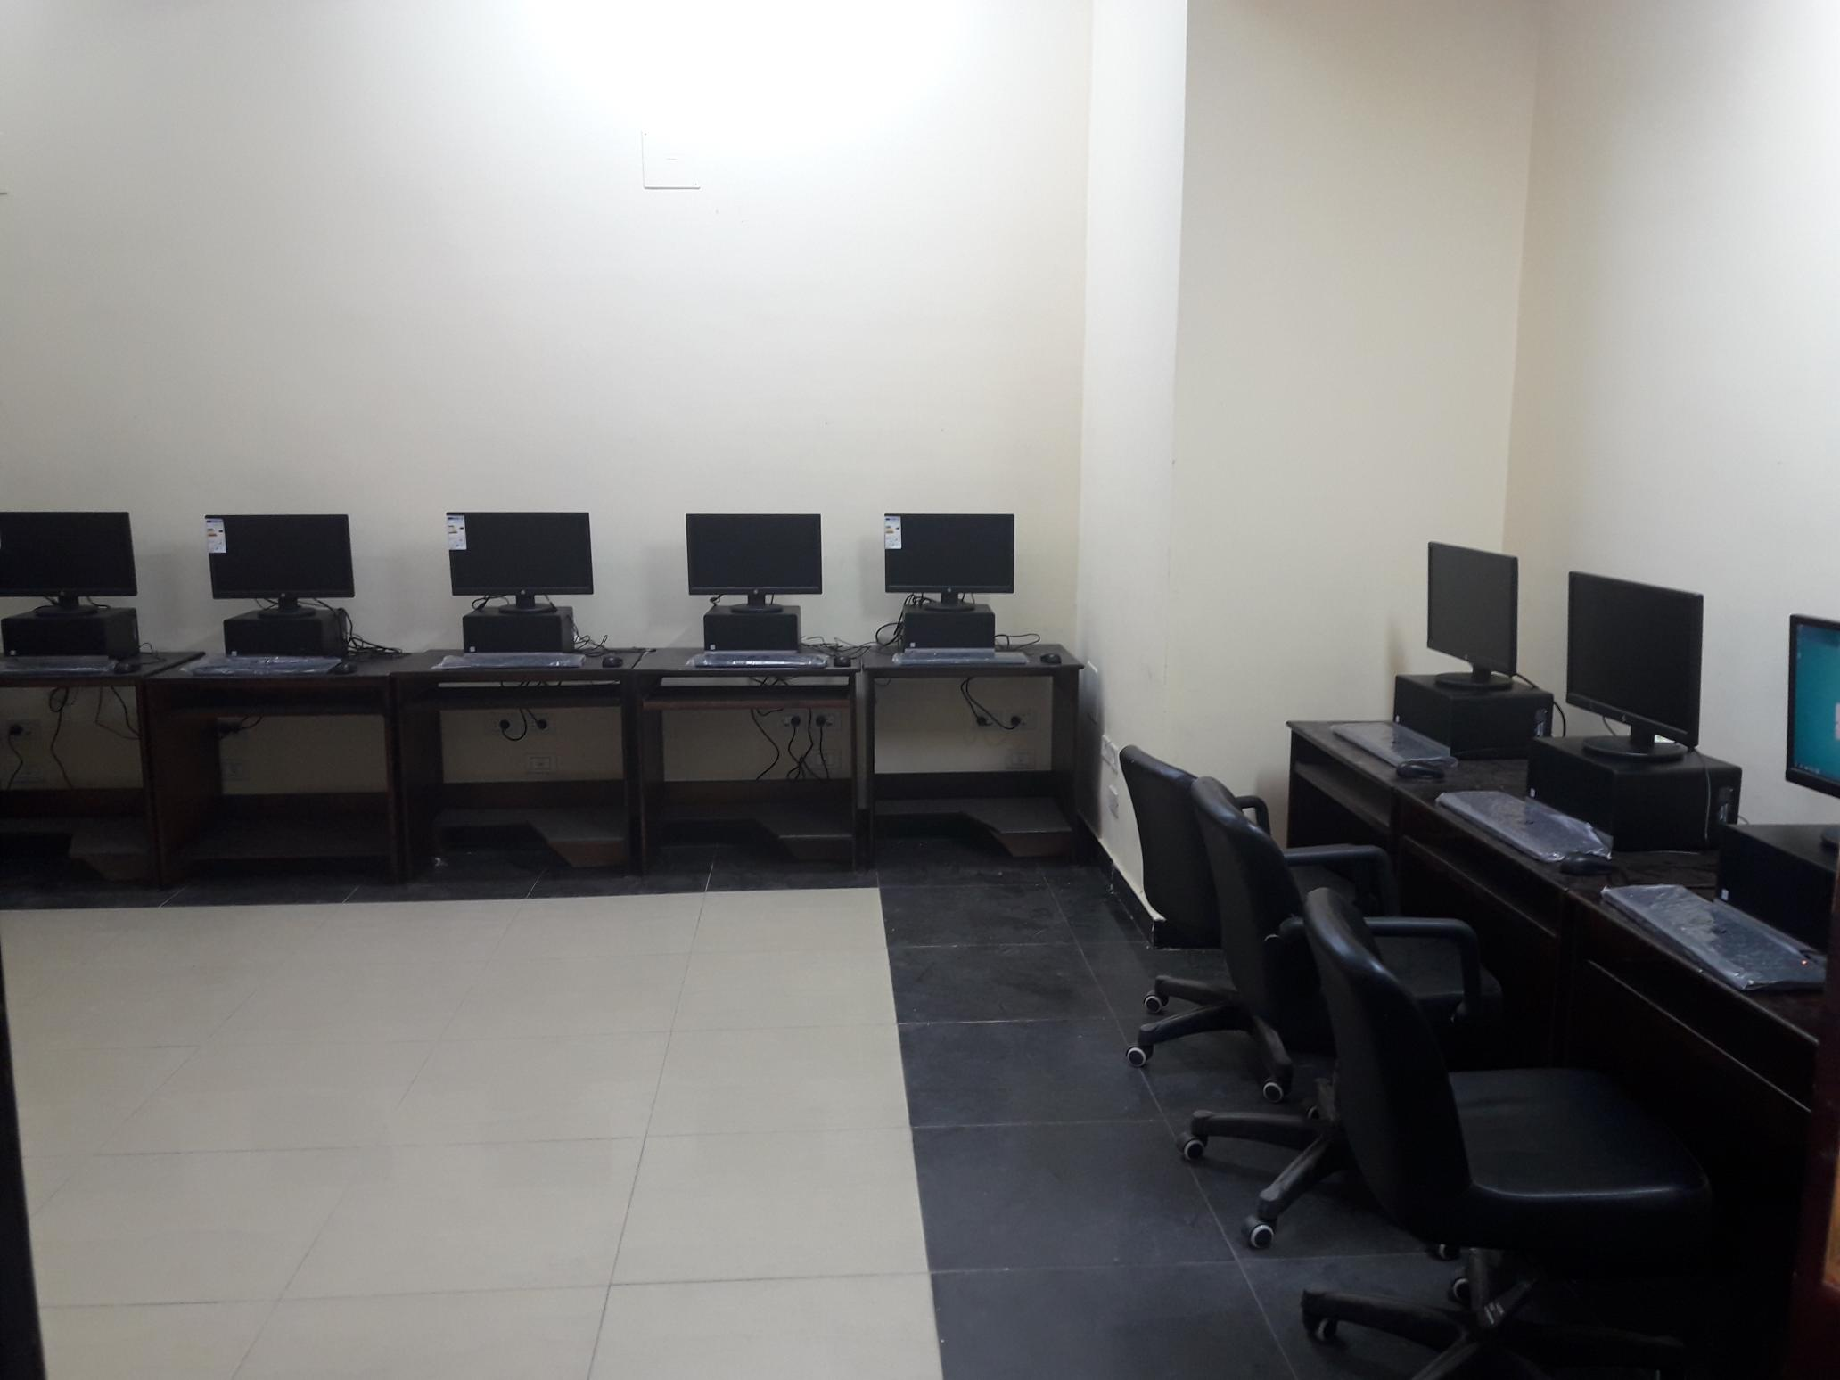

Slide 34
Google classroom (An electronic platform for communication, uploading the produced projects, forming the PCL) Crocodile (For building virtual labs in physics and chemistry) Flipbook maker (For producing E-books) Movie maker-6 (For producing educational movies) Some office 365 applications (Forms-One drive – advance power point 2016)

Slide 35


