Slide 1


Project Name:
School and University Partnership for Peer Communities of learners
(SUP4PCL)
Project Number:
573660-EPP-1-2016-1-EG-EPPKA2-CBHE-JP (2016-2516/001-001)
Kick off Meeting
February 27th –28th, 2017
The American University in Cairo (AUC), Egypt
This project has been funded with support from the European Commission. This publication [communication] reflects the views only of the author, and the Commission cannot be held responsible for any use which may be made of the information contained therein

Slide 2
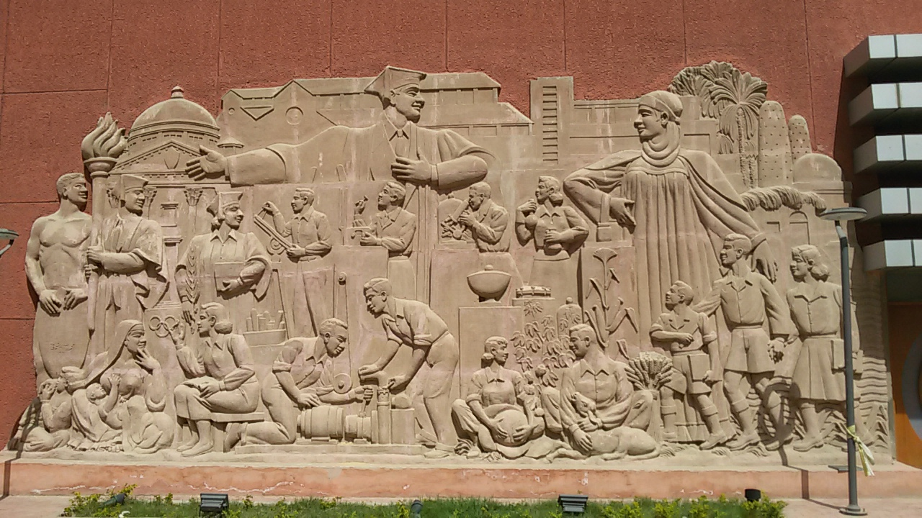

Ain Shams University, Faculty of Education in a Nutshell
This project has been funded with support from the European Commission. This publication [communication] reflects the views only of the author, and the Commission cannot be held responsible for any use which may be made of the information contained therein

Slide 3
In 1880, The Teacher' s School was established for the purpose of preparing school teachers to be qualified to teach different school subjects.
In 1929, the name of the school changed to " High Institute of Education" with a mission of providing the future teachers with qualifications required for university graduates.
In 1945, The School of Teachers was reestablished again for the purpose of preparing secondary school teachers.
In 1950, The High Institute of Education was annexed to Ibrahim Basha University ( Now, Ain Shams University).
In 1962, The High School of Teachers was changed to the Faculty of Teachers in Cairo.
In 1970, The Faculty of Teachers in Cairo was annexed to the High Institute of Education under the Title of " Faculty of Education, Ain Shams University“.
This project has been funded with support from the European Commission. This publication [communication] reflects the views only of the author, and the Commission cannot be held responsible for any use which may be made of the information contained therein

Slide 4
Departments
A-Educational Departments:
1- Foundations of Education Department
2- Comparative Education and Administration Department
3- Mental Health Department
4- Curricula and Methods of Teaching Department
5- Educational psychology Department
6- Special Education Department
This project has been funded with support from the European Commission. This publication [communication] reflects the views only of the author, and the Commission cannot be held responsible for any use which may be made of the information contained therein

Slide 5
B- Scientific Departments
1- Biological and Geological Sciences Department
2- Physics Department
3- Mathematics Department
4- Chemistry Department
This project has been funded with support from the European Commission. This publication [communication] reflects the views only of the author, and the Commission cannot be held responsible for any use which may be made of the information contained therein

Slide 6
C- Humanities Departments:
1- Arabic Language and Islamic Studies Department
2- Geography and Geographical information systems Department
3- English Language Department
4- French Language Department
5- German Language Department
6- Philosophy and sociology Department
7- History Department
This project has been funded with support from the European Commission. This publication [communication] reflects the views only of the author, and the Commission cannot be held responsible for any use which may be made of the information contained therein

Slide 7
Units, Offices and Centers:
D- Units:
1- Quality Assurance Unit
2- Standardization and Assessment unit
3- Scientific Publication Unit
4- Distance Education Unit
5- Long Life Learning Unit
6- Information Technology Unit
This project has been funded with support from the European Commission. This publication [communication] reflects the views only of the author, and the Commission cannot be held responsible for any use which may be made of the information contained therein

Slide 8
E- Offices:
1- International Relation and Cooperation Office
F- Centers:
1- Center for Psychological counselling
2- Center for Developing University Education
3- Center for Developing English Language Teaching
4- Center of Excellence for Studies and Researches in German and Arabic as foreign
languages
5- Center for Educational Excellence
6- Community Service Center
This project has been funded with support from the European Commission. This publication [communication] reflects the views only of the author, and the Commission cannot be held responsible for any use which may be made of the information contained therein

Slide 9
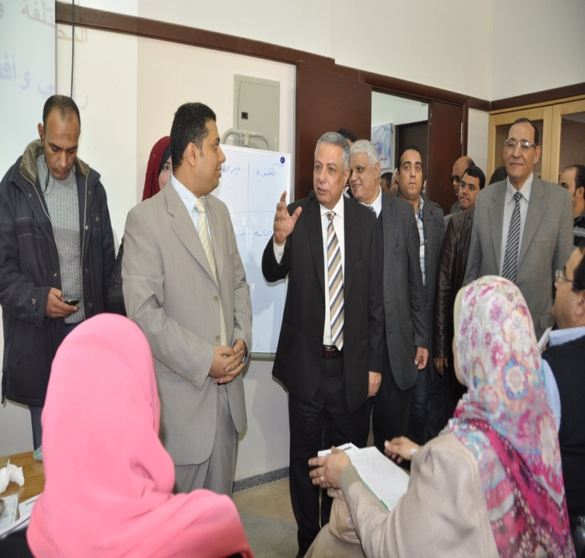
MOE & ASU Collaboration
Teacher Certification Program
for
(Non-Education Faculty Graduates)
by
Center for Educational Excellence
Faculty of Education, Ain Shams University
In Collaboration with Ministry of Education
PAT The Professional Academy for Teachers
This project has been funded with support from the European Commission. This publication [communication] reflects the views only of the author, and the Commission cannot be held responsible for any use which may be made of the information contained therein

Slide 10
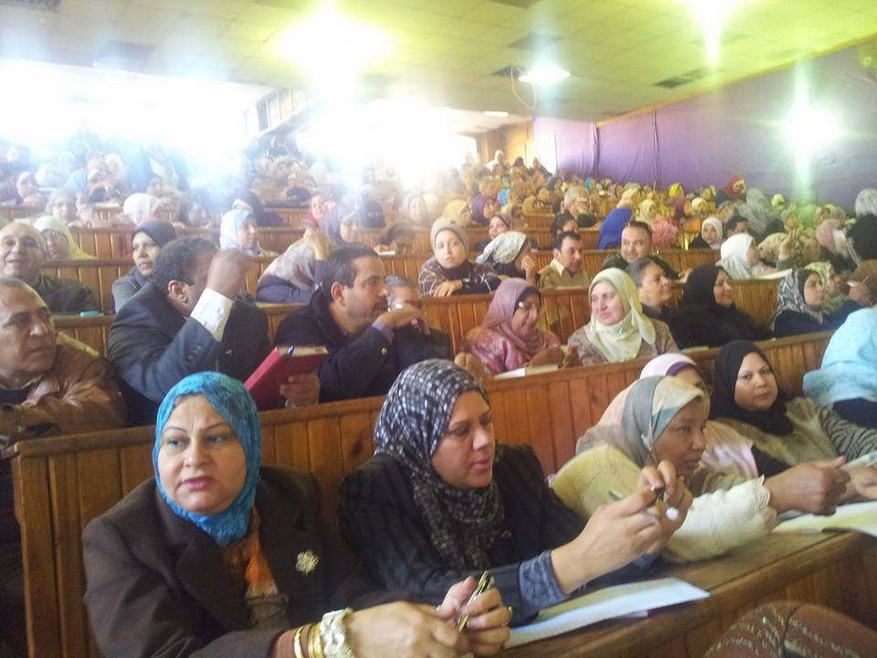
Project Plan
1- Start Date
August 2013
2-Target Group
Non- Education graduates serving in The Ministry of Education in the positions of ( first teacher, first teacher A, expert teacher and head of teachers)
The program was delivered in the 27 governorates of Egypt.
This project has been funded with support from the European Commission. This publication [communication] reflects the views only of the author, and the Commission cannot be held responsible for any use which may be made of the information contained therein

Slide 11
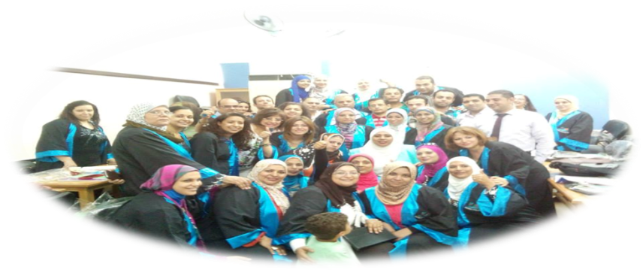
Program Objectives:
The program aims at providing the non-Education graduates who are working in The Ministry of Education with the education certification.
The Minor Objectives include:
Improving the competence of teachers working in The Ministry of Education in order for them to improve their teaching skills
Improving teacher- student interaction skills and teacher- school administration interaction.
This project has been funded with support from the European Commission. This publication [communication] reflects the views only of the author, and the Commission cannot be held responsible for any use which may be made of the information contained therein

Slide 12
Providing training for knowledge and application of strategic management in Education;
Making the trainees fully aware of the discipline of Methodology and Curriculum as well as integrating technology into the learning process;
Improving the strategy used to assess the students improvement and course content;
Integrating technology and local environment into the teaching process;
Illustrating the mission of the teacher as a main player in reforming the education process in Egypt
This project has been funded with support from the European Commission. This publication [communication] reflects the views only of the author, and the Commission cannot be held responsible for any use which may be made of the information contained therein

Slide 13
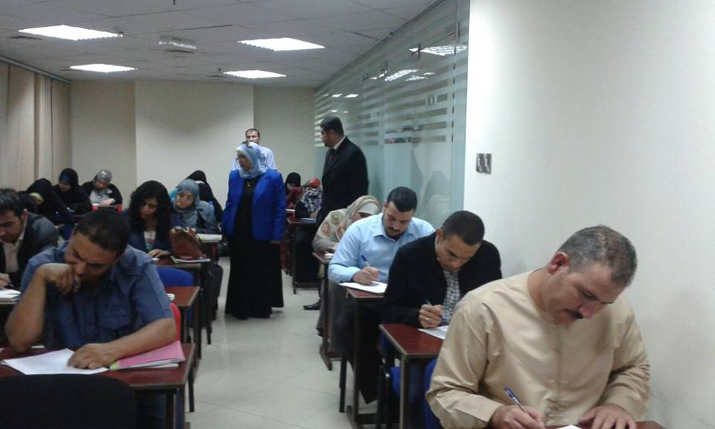
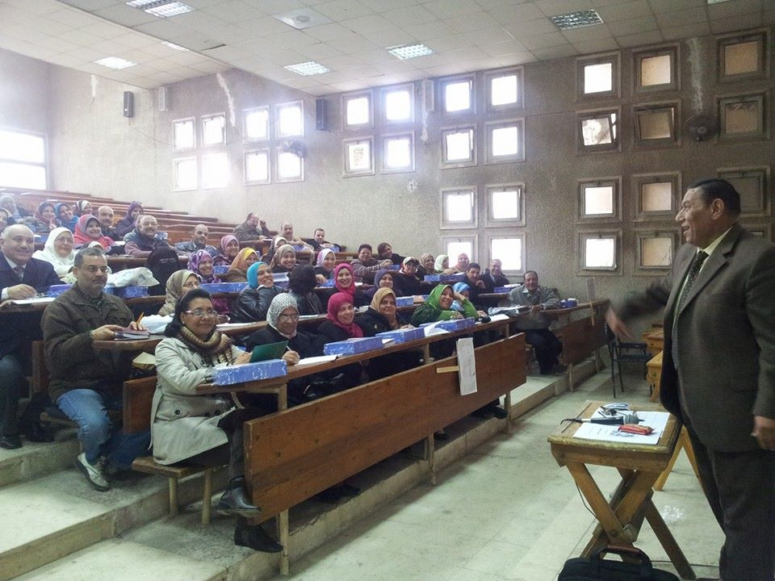
Study Plan
This program runs for three months (40 classroom hours. It can be delivered either in the classroom or online.)
This project has been funded with support from the European Commission. This publication [communication] reflects the views only of the author, and the Commission cannot be held responsible for any use which may be made of the information contained therein

Slide 14

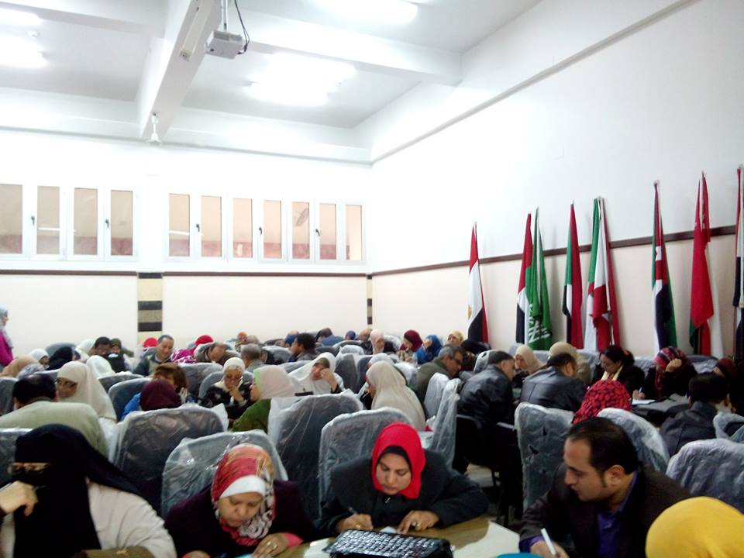
The Program covers 8 subjects
Methodology
Education Management and Leadership
Effective Learning Psychology
Strategic Planning
Multiple Intelligences
Education Technology
7. Learners Mental Hygiene
8. Caring with people with Special Needs
This project has been funded with support from the European Commission. This publication [communication] reflects the views only of the author, and the Commission cannot be held responsible for any use which may be made of the information contained therein

Slide 15
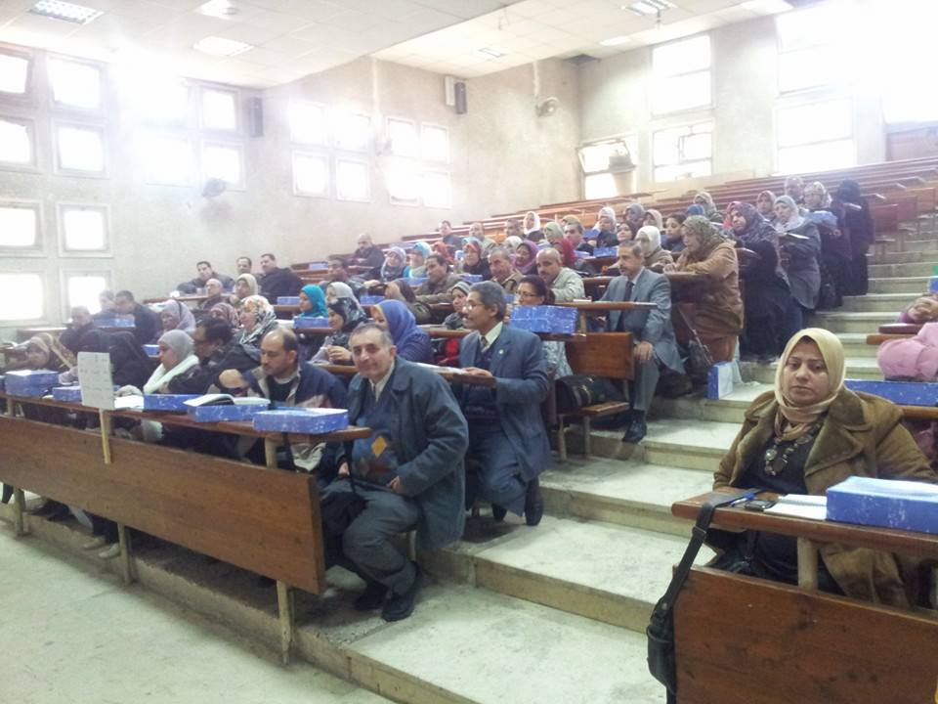
Supervising the Program:
The program coordinator and a committee of Professors from Faculty of Education, Ain Shams University supervise the program. A report was submitted to the program administration to identify points of weakness and strength.
The project succeeded to provide training for 175,000 in-service teachers in 27 Governorates.
This project has been funded with support from the European Commission. This publication [communication] reflects the views only of the author, and the Commission cannot be held responsible for any use which may be made of the information contained therein

Slide 16
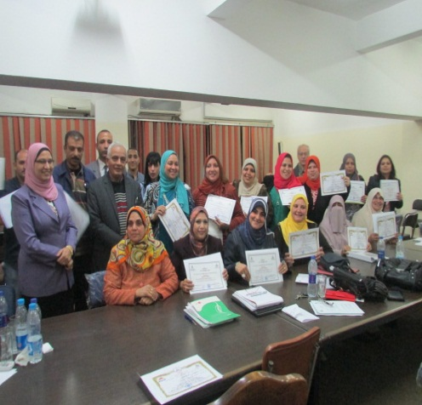
MOE & ASU Collaboration
Teacher Preparation Programs
for
(In-Service Teachers)
by
Center for Developing University Education C.D.U.E
Faculty of Education, Ain Shams University)
This project has been funded with support from the European Commission. This publication [communication] reflects the views only of the author, and the Commission cannot be held responsible for any use which may be made of the information contained therein

Slide 17
Place of Training | Number of Trainees
FOE | 30
Manaret ElMostakbl School | 120
ElFarouq School | 30
FOE | 40
FOE | 120
FOE | 30
Resala School | 51
FOE | 35
Notion International Schools | 30
FOE | 37
Madenty School | 111
Future School | 44
FOE | 72
This project has been funded with support from the European Commission. This publication [communication] reflects the views only of the author, and the Commission cannot be held responsible for any use which may be made of the information contained therein

Slide 18
Place of Training | Number of Trainees
FOE | 27
International Teacher Preparation Program
Place of Training | Number of Trainees
FOE | 12
TOT Program
Place of Training | Number of Trainers
FOE | 25
FOE | 24
FOE | 16
This project has been funded with support from the European Commission. This publication [communication] reflects the views only of the author, and the Commission cannot be held responsible for any use which may be made of the information contained therein

Slide 19

This project has been funded with support from the European Commission. This publication [communication] reflects the views only of the author, and the Commission cannot be held responsible for any use which may be made of the information contained therein

Slide 20
Using Modern Technology in Teaching
Place of Training | Number of Trainees
FOE | 16
‘ BEDAIA School’ | 25
FOE | 19
Training Diploma in Informatics
Place of Training
FOE
Capacity Building of the head of Administrations
Place of Training | Number of Trainees
FOE | 12
This project has been funded with support from the European Commission. This publication [communication] reflects the views only of the author, and the Commission cannot be held responsible for any use which may be made of the information contained therein

Slide 21
Ain Shams University will work with 15 PD Neighboring Schools with which there is a persistent cooperation through different training courses and Practicum. ASU has got approval from the following schools of different administrations in Cairo Governorate:
Administration | Name of School | Administration | Name of School
Elnozha | Yousef Elsebaeey | Elzeton | Elgeel Elgdeed
Elwayly | Elshaheed Tayar | Elzeton | Elglel
Elwayly | Elmostakbl | Elzeton | Senan Elhadetha
Elwayly | Elshaheed Ali Emad | Misr Elgdeda | Eltabry
Nasr City | Kolyet Elsalam | Misr Elgdeda | Elkwakeb
Elzetoun | Elazez Bellah | Misr Elgdeda | Elkholfaa Elrashedeen
Elnozha | Elgamaa Eleslamia for Girls | Elnozha | Elauroba
 |  | Elnozha | Salah Eldeen
This project has been funded with support from the European Commission. This publication [communication] reflects the views only of the author, and the Commission cannot be held responsible for any use which may be made of the information contained therein

Slide 22
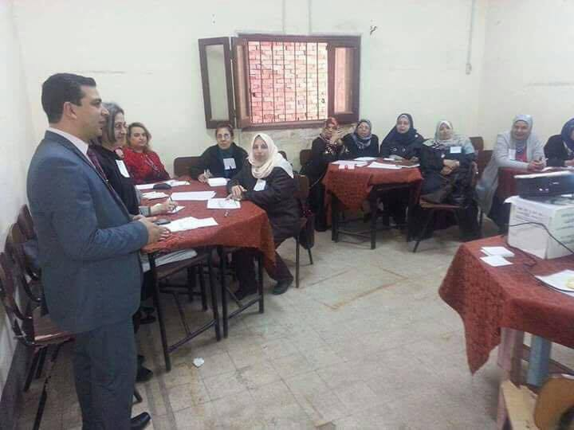
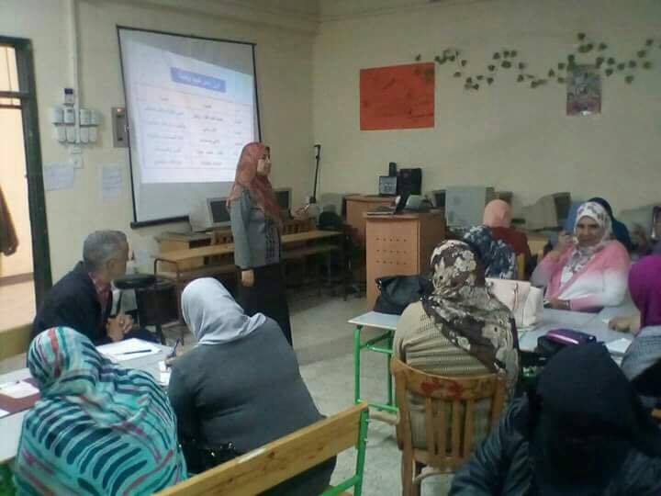
Criteria of Choosing these Schools:
1- Neighboring Schools
2- The supporting Administration
3- The Effective Community Participation
4- Good Infrastructure
5- FOE pre- service teachers training( Practicum)
6- Quality Assurance Unit
This project has been funded with support from the European Commission. This publication [communication] reflects the views only of the author, and the Commission cannot be held responsible for any use which may be made of the information contained therein

Slide 23

This project has been funded with support from the European Commission. This publication [communication] reflects the views only of the author, and the Commission cannot be held responsible for any use which may be made of the information contained therein

Slide 24
Thank You
ANSU Team
This project has been funded with support from the European Commission. This publication [communication] reflects the views only of the author, and the Commission cannot be held responsible for any use which may be made of the information contained therein

