Slide 1


School and University Partnership for Peer Communities of Learners )SUP4PCL(
Project Number : 573660-EPP-1-2016-1-EG-EPPKA2-CBHE-JP (2016-2516/001-001)
Second Local Meeting – AUC - 11 May 2017
AU Follow-up

Slide 2
If we keep our dreams in our head they can be forgotten.
If we write down our dreams they become tangible.
Once they are physical they have taken the first step in
becoming attainable.
Morris R.Gates

Slide 3
Content
Feedback for the April “Training of Potential Mentors”
Full Profile of AU team & Division of labor
Final list of schools
Plan for fulfilling academic integrity

Slide 4
Feedback for the April “Training of Potential Mentors”

Slide 5
Feedback for the Training in April
Goals
Developing knowledge, skills and attitudes towards mentoring as a key vehicle for PD
Familiarizing participants with their expected roles as mentors
Identifying possible routes for establishing partnership between schools and universities.
Identifying tools and procedures to assess schools’ needs

Slide 6
Feedback for the Training in April
Participants
EU: Chris Willkins (ULEIC), Helen Scott & James Underwood (UNH), Deborah Tannehill (UL)
AU: 16 participants – Staff from AU – Curricula & Instruction Dep English Dep & Foundation of Education Dep.

Slide 7
Feedback for the April “Training of Potential Mentors”
Day 1
key concepts (e.g. needs assessment, ethnographic research)
Procedures for assessing the needs of the PD schools
Research ethics
Small & whole group discussions & feedback

Slide 8
Feedback for the April “Training of Potential Mentors”
Day 2
Mentoring: key concepts, roles, mentoring & coaching, selecting mentors & training for mentors
Professional Learning Communities: construction, supporting & sustaining
Monitoring & evaluation of the impact of PLCs
Expected roles & tasks when in schools

Slide 9
Feedback for the April “Training of Potential Mentors”
Reflections
Participants were able to construct comprehensive understanding of the project’s goals & plan of work.
The training marked an important step in the cooperative relationship between AU & EU partners.

Slide 10
Feedback for the April “Training of Potential Mentors”
Next Steps
Meeting with AU team to set action plan
Communication with the MoE to plan for school visits
Preparing for ethnographic study tools
Initiating communication with UNH to prepare for the case study

Slide 11
Full Profile of AU team & Division of Labor

Slide 12
Full Profile of AU Team & Division of Labor
Communication & Logistics Management
Assistant Research Team
Lead Research Team
Technical Support Team

Slide 13
Full Profile of AU Team & Division of Labor
Technical Support: Facilitating Work packages implementation & Monitoring & Evaluation & Reporting
Dr. Salah Elkharashi
Dr. Medhat Ahmed ElNemr
Dr. Dalia Elhawary
Communication & Logistics Management
Dr. Maha Elkomy
Dr. Alsaeed Alshamy

Slide 14
Profile of AU Full Team & Division of Labor
Lead Research Team
Dr. Saher Maher
Dr. Nermeen El-Defrawi

Slide 15
Profile of AU Full Team & Division of Labor
Assistant Research Team
Dr. Neveen Helmy
Dr. Rania Adel
Dr. Heba saber
Dr. Dalia Hammoud
Dr. Elshaymaa Abdulgawad
Dr. Marwa Eladwee

Slide 16
Final List of Schools

Slide 17
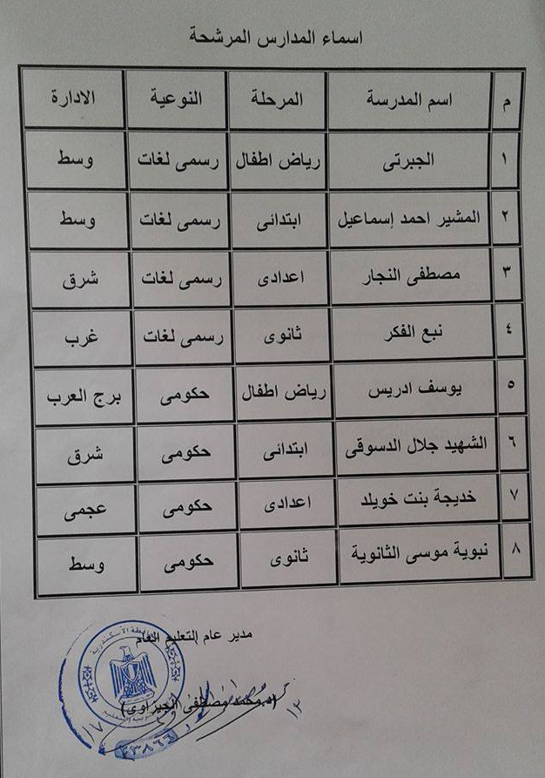
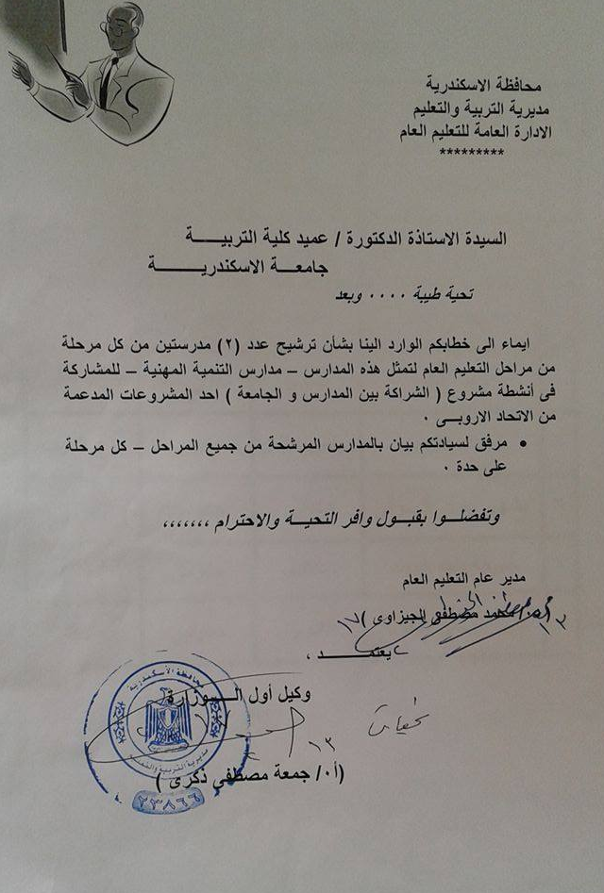

Slide 18
PDS Schools
ElJabarti (Kindergarten- Official Language School)
ElMosheer Ahmed Ismail (Primary- Official Language School )
ElShaheed Jalal Eldessouky (Primary School)
Mustafa ElNajjar (Preparatory- Official language School)
Nabaweya Mussa (Secondary School)
Other schools:
Yusuf Idris (kindergarten)
Khadija Bent Khuwaylid (Primary)
Nabaa Elfekr (Secondary- Formal)

Slide 19
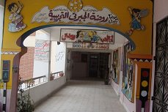
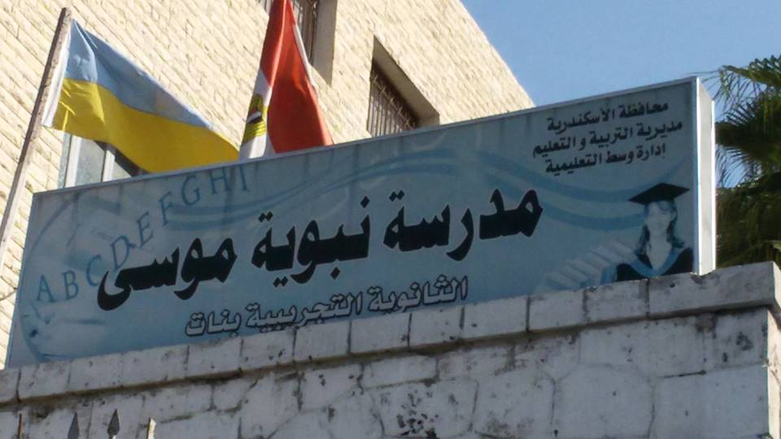



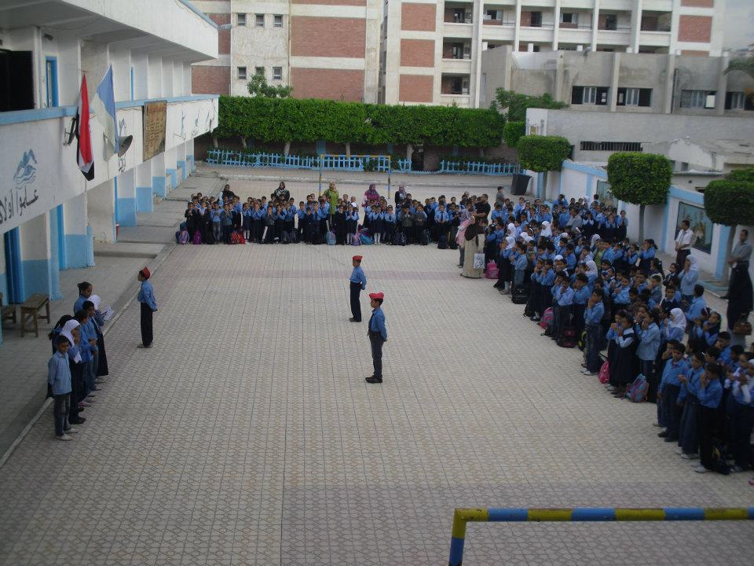

Slide 20
Plan for Fulfilling Academic Integrity

Slide 21
Plan for Fulfilling Academic Integrity
Conduct a workshop for AU team to plan for research academic integrity (e.g. EU research ethics guidelines, needed procedures, timelines).
Produce manual of guidelines to be used by research team during all stages of research work.
Produce Research Ethics Assessment tools
Produce research documents (e.g. schools informed consent)
Ongoing communication with EU partner for consultation on EU research ethics regulations

Slide 22
Examples of Ethical Issues identified by EU Guidelines
Data protection and privacy
Informed consent
Dual use
Research involving developing countries

Slide 23
Useful Resources
EUREC is a network that brings together already existing national Research Ethics Committees (RECs) associations, networks or comparable initiatives on the European level. It also offers free and open access to online training program on research ethics and regulation.
http://www.eurecnet.org/index.html
http://www.eurecnet.org/materials/index.html

Slide 24
Thank You
AU Team

