Slide 1


School and University Partnership for Peer Communities of Learners )SUP4PCL(
Project Number : 573660-EPP-1-2016-1-EG-EPPKA2-CBHE-JP (2016-2516/001-001)
Management Meeting – AUC – 21st November 2017
Alexandria University (AU)

Slide 2
Content
Gaining Access to Schools : Context and Challenges
Schools’ Visits: Progress
Expected Outputs before EU partners’ visit in December 2017
Next Steps
Challenges

Slide 3
Gaining Access to Schools: Context & Challenges
First round of correspondences between FOE & MOE Directorate: January- September 2017
Attempt failed to have a Protocol signed between AU & the MOE Directorate in Alexandria
Memorandum of understanding : MOHE & MOE & AUC Middle East Studies institute
New round of correspondences between FOE & MOE Directorate: September- October 2017

Slide 4
Gaining Access to Schools: Context & Challenges
Visit from AU team representatives to the MOE Directorate, Community Participation manager: Monday 2nd October, 2017
Gaining Verbal consent to access schools
AU team first INFORMAL Visits to schools: 23-26 October, 2017
More challenges (official documents in schools, more documents required by the MOE Directorate, processing official letters at the FOE, etc.)

Slide 5
Gaining Access to Schools: Context & Challenges
Using all possible formal & informal channels of communications with the MOE Directorate (formal letters, phone calls, WhatsApp)

Slide 6
Schools’ Visits: Progress
A comprehensive & shared plan for schools’ visits till the end of December 2017 (mid-term exams).
Plan outlines:
Aims & objectives of visits
Teams assigned to each school
Schedule for schools weekly visits
Tools used
Expected outcomes
Sharing outcomes & next steps

Slide 7
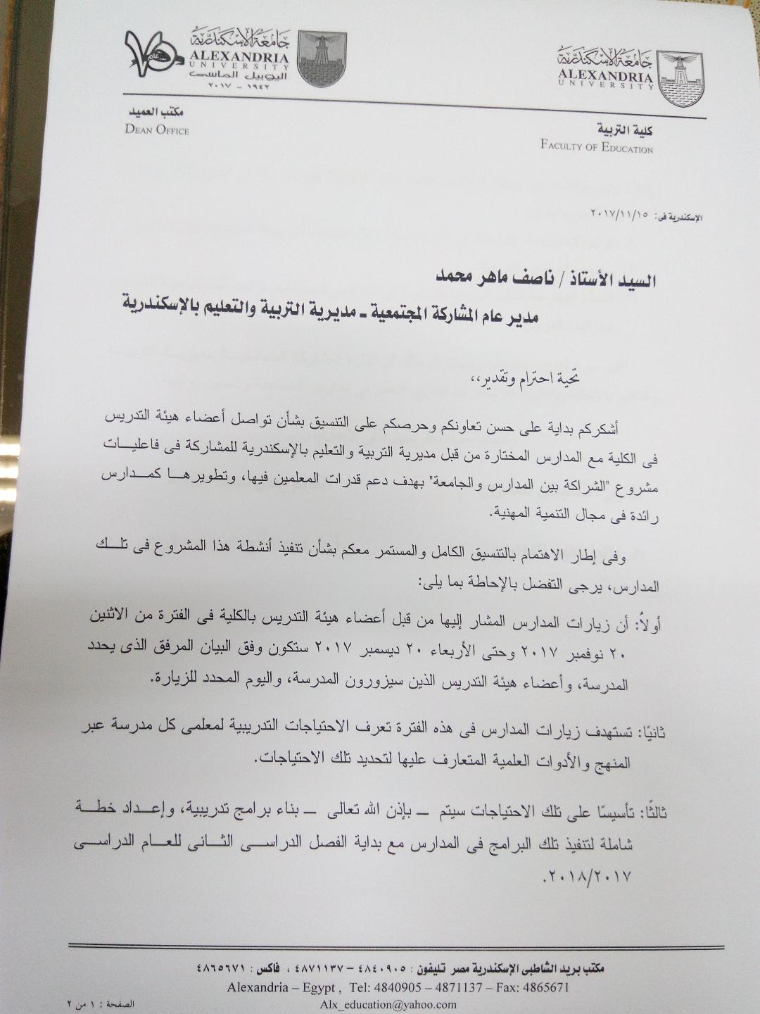
Schools’ Visits: Progress

Slide 8
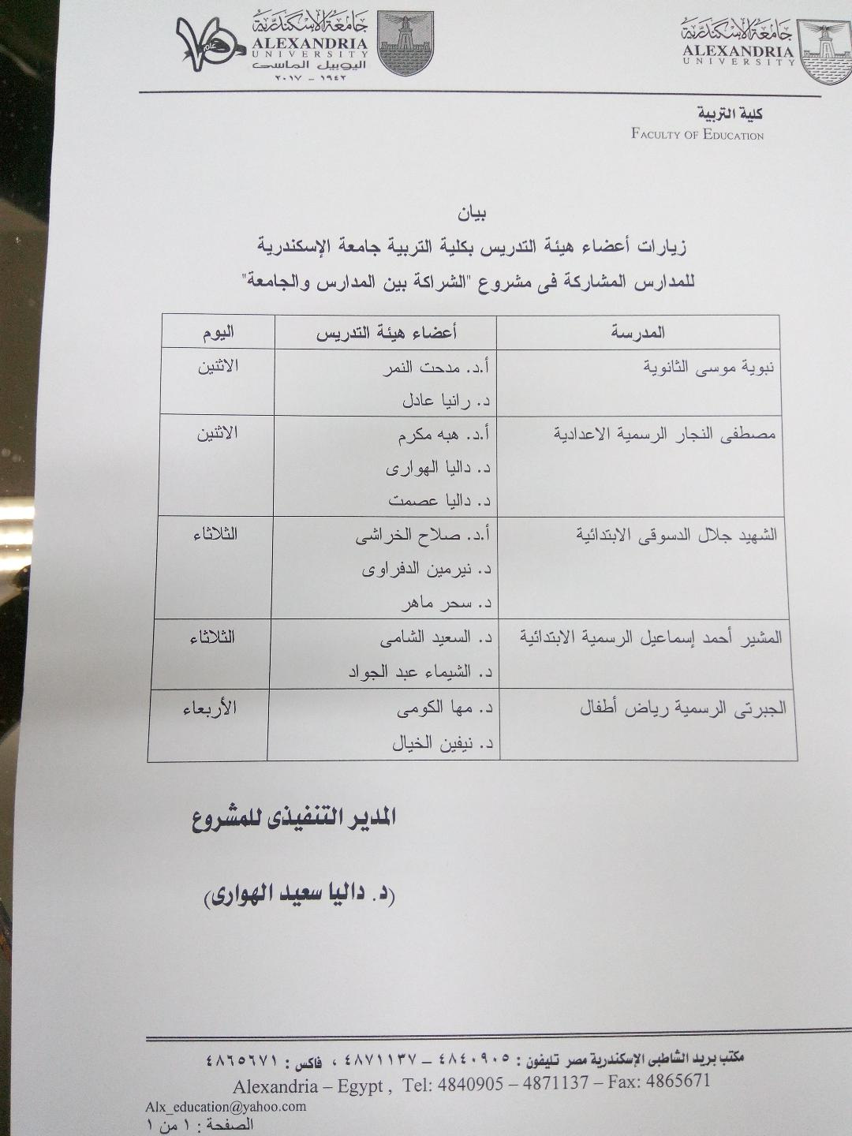
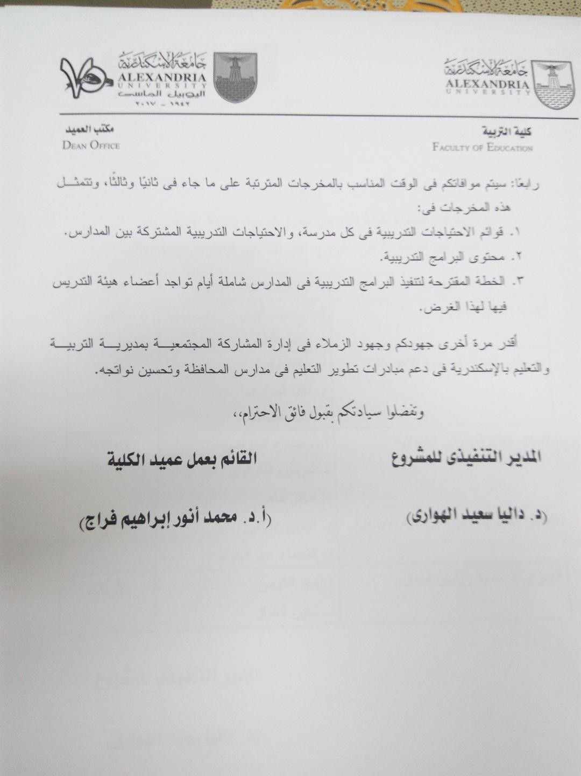
Schools’ Visits: Progress

Slide 9
Schools’ Visits: Progress
Schools have a comprehensive understanding of the project (meetings with school heads, Quality assurance teams & subject head teachers)
Building trust (formal & informal dialogue)
Planning meetings with different stakeholders (e.g. students & parents
Planning classroom observations

Slide 10
Schools’ Visits: Progress
Weekly individual school visit report
Schools’ profiles
Phase one of identifying schools needs (Open questions- development of questionnaire)
Identifying possible areas to be the focus for the ethnographic study

Slide 11
Schools’ Visits: Progress

Slide 12
Expected Outputs before EU partners’ visit in December 2017
Specific list of shared needs
Clear identification of needs in the project key areas; e.g.
Mentorship & coaching
PCL
STEM
Identification of target audience for different training programmes

Slide 13
Next Steps
Resolution of training-related key issues:
Time
Mode
Use of available resources (e.g. websites)
Etc.
Identifying mentors & mentees in each school
Developing mentorship plans in coordination with quality assurance teams in schools.

Slide 14
Next Steps
Producing five schools’ baseline studies
Identifying the focus & scope of schools’ ethnographic studies
Selecting AU mentors teams
Developing training materials

Slide 15
Challenges
Time
EU visit (time – clearances)
End-of-term exams (Schools & University)
Flow of information
Coordination with other universities
Building a strong & sustainable co-operative relationship with MOE

Slide 16
Thank You
AU Team

