Slide 1


School and University Partnership for Peer Communities of Learners )SUP4PCL(
الشراكة بين المدرسة والجامعة لبناء مجتمعات الأقران من المتعلمين
Project Number : 573660-EPP-1-2016-1-EG-EPPKA2-CBHE-JP (2016-2516/001-001)
Progress Reporting on AU Schools’ Visits
Alexandria
Local Fifth Management Meeting
26th June, 2018

Slide 2
AU Schools’ Visits during the Second Academic Term 2017-2018: Context
Focus at schools on follow-up work to the February 2018 workshop
Limited number of schools’ visits (average: 4 visits): Holidays – Elections - Preparation for end-of-year exams - Special cases
Schools unavailability during May & June due to end-of-year exams
Exam work at AU

Slide 3
Moving Towards Schools 'Ethnographies & in-depth Comprehensive Profiles (March-April 2018): Tools
Field Notes
AU team members’ individual & collective reflections

Slide 4
Moving Towards Schools 'Ethnographies & in-depth Comprehensive Profiles: Outcomes
Emerging different profiles for each school, for example:
Marashal Ahmed Ismail School:
Leadership styles
Initial SWOT analysis
Mostafa Elnagar School:
Leadership styles
PLCs
Mentorship

Slide 5
Management and leadership style:
Mainly authoritarian in Al-gabarty & Al-mushir
Levels of leadership:
Teachers follow the principal because
1. they have to (position) and
2. the services that are being done to improve the school (production: results)

Slide 6
Power Relationships: who are the decision makers?
Principals and administrators are the main figures who make decisions.

Slide 7
Evolution of Quality Assurance Unit - Algabarty school
- Staffing: Two teachers are responsible for the Quality Assurance Unit - How active are they? Very active
- What impact do they have? They are responsible for the yearly plan of the trainings offered to teachers. - What activities do they do? They coordinate and organize these trainings together with the MOE. They also plan the curriculum that will be taught. They monitor teachers’ performance on regular basis. - Frequency of activities
These activities are ongoing

Slide 8
Moving Towards Schools 'Ethnographies & in-depth Comprehensive Profiles: Plan (May- September 2018)
AU planned visits’ schedule in coordination with schools that spans over 9 weeks (July- September 2018).
AU has developed a training plan addressing both project’s themes & schools’ specific needs.
AU has developed draft tools for the data collection of the ethnographic studies.

Slide 9
Schools Ethnographic Studies: Tools
Interview Protocols
Field Notes
Photos
Templates

Slide 10
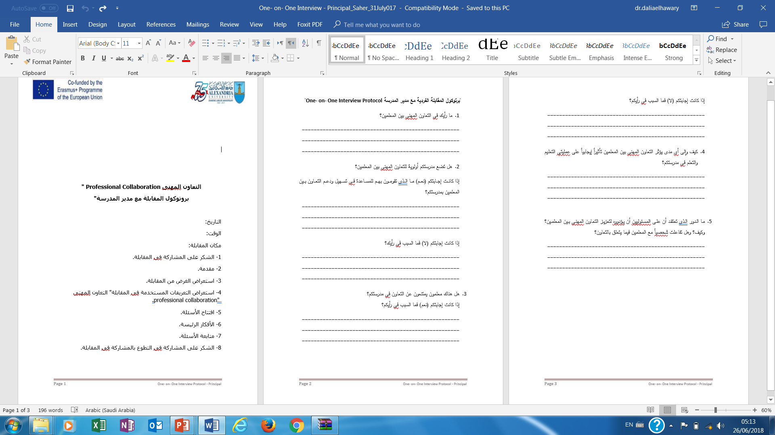
Interview Protocols

Slide 11
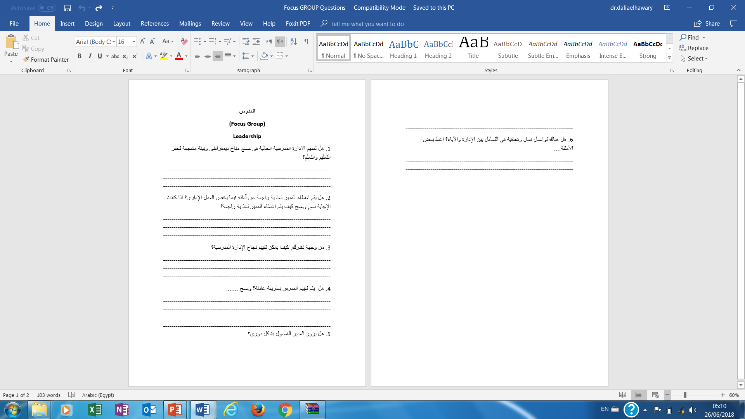
Interview Protocols

Slide 12
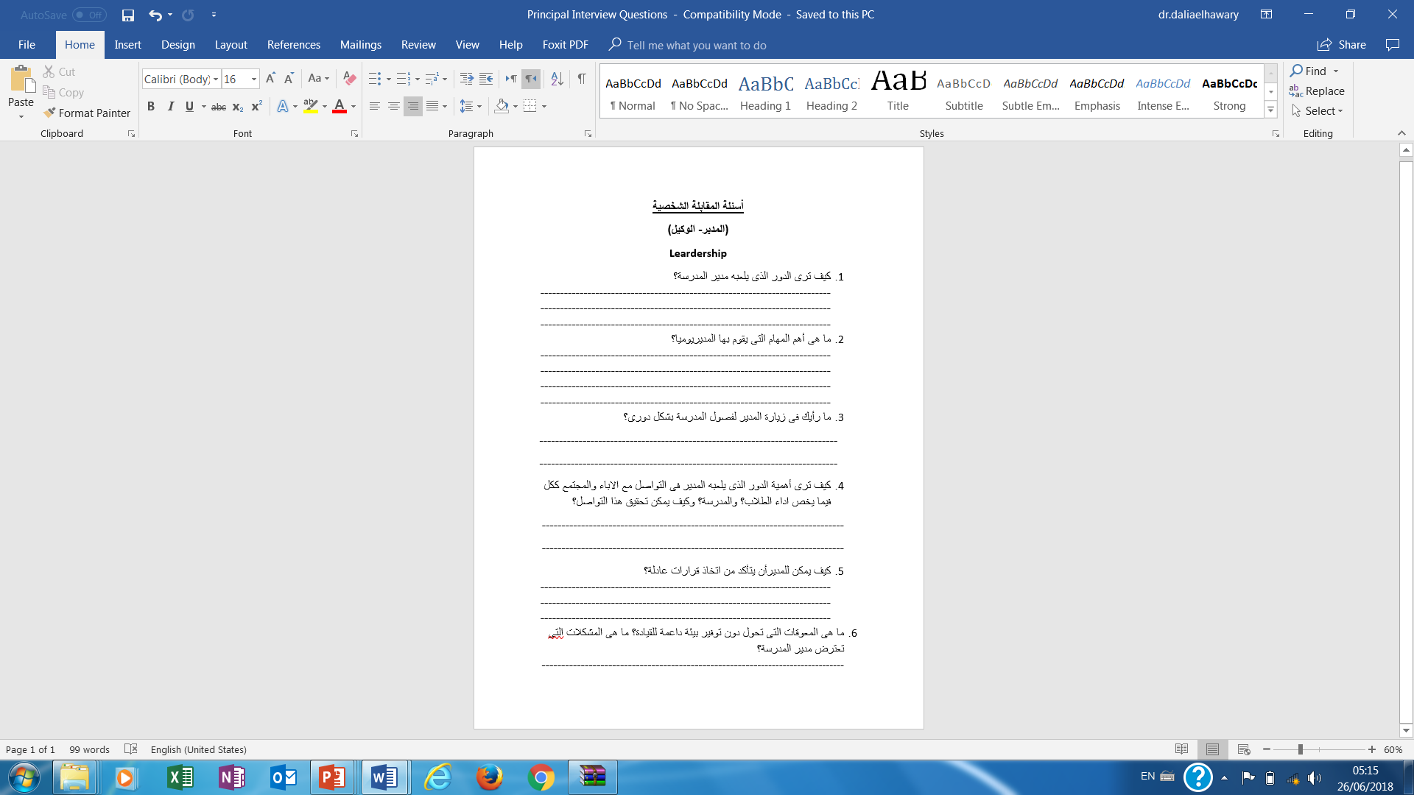
Interview Protocols

Slide 13
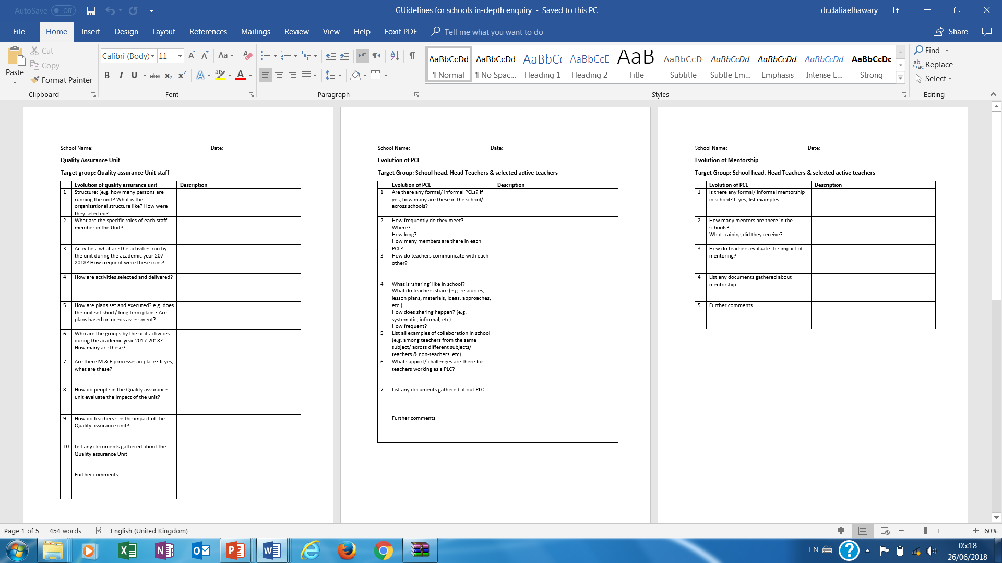
Templates

Slide 14
Thank You

