Slide 1


School and University Partnership for Peer Communities of Learners )SUP4PCL(
الشراكة بين المدرسة والجامعة لبناء مجتمعات الأقران من المتعلمين
Project Number : 573660-EPP-1-2016-1-EG-EPPKA2-CBHE-JP (2016-2516/001-001)
Progress Reporting on AU Case Study
Alexandria
Local Fifth Management Meeting
26th June,2018

Slide 2
Framework of Case study: Setting the Boundaries
18th & 19th February, 2018
The school University Partnership (AUC)
Schools (FOE)
FOE (AU & UNH)

Slide 3
Starting Points
History & context of AU
AU team as an emerging PLC
What’s different?
Practices, relationships, teaching, courses, etc.
Human relationships
Impact on AU FOE
Impact on Students

Slide 4
Stage 1 Initial questions
How are AU team members becoming more conscious about how they communicate with each other?
How are they mentoring each other?
What are group dynamics like?
What is “listening’’ & “dialogue” like?
What is collaboration and mentoring like?
What is awareness of the process like?

Slide 5
Stage 1 Possible Layers
How does AU case study relate to Schools’ case studies?
What helps change?
What hinders change?
Does this have to do with culture or leadership?
How can we have sustainable change?
What has to change at AU & at schools?
How can AU team help schools/ teachers see that doing things differently is beneficial?
How to embed the change and make it sustainable?

Slide 6
Stage 1 Needed Actions
Define the roles and responsibilities of each twin partner
Decide on the main focus area / layer
How do we collaborate?
How much focus and depth should we aim at?

Slide 7
Stage 1 Suggestions
Exploring the change in the use/ perceptions about research methodology
Exploring the change in the use of research ethics
Exploring change at UON
The possibility of Extending the research team & drawing on MA students

Slide 8
Stage 1 Conclusions
Forming small AU research team to lead on the work of the case study
Identifying research team members’ roles & responsibilities
Dialogue with the extended AU team to share & agree on themes for the study and ensure whole team participation
Deciding on Research Methodology: qualitative research approach

Slide 9
Stage 1 Conclusions
Setting timeline
Planning monthly meetings with UON via Skype
Sharing resources with UON via Dropbox

Slide 10
Stage 2 Meetings
Online Meetings with UON
Thursday 5th April 2018 – Skype meeting
Wednesday 2nd May 2018 – Skype banned inn Egypt- Moving to Messenger & texting
Thursday 7th June
AU extended team meetings
Wednesday 9th May 2018
Saturday 26th May 2018
Tuesday 12th June 2018

Slide 11
Stage 2 Outcomes
AU team agreed on exploring “How AU team is developing as PLC at national and international level”
Ten members of the AU team gave their consent to be the “participants” for the study + two members from the UON team
Research team developed an initial draft of a data collection tool ‘’Reflective journal entry’’ that was revised and further developed by the whole team

Slide 12
Stage 2 Outcomes
The entry is made available in Arabic & English
The ‘’Reflective journal entry’’ was shared with UON team
We agreed on using a coding system to ensure privacy when filling in the journal entries
A team member is responsible for the collection and archiving of entries

Slide 13
Stage 2 Outcomes
We agreed on a working title for the study: ‘AU’s PCL: Mechanism, Development and Effectiveness’
We have started first round of data analysis
We are using a conceptual framework developed by the UON for the first round of data analysis

Slide 14
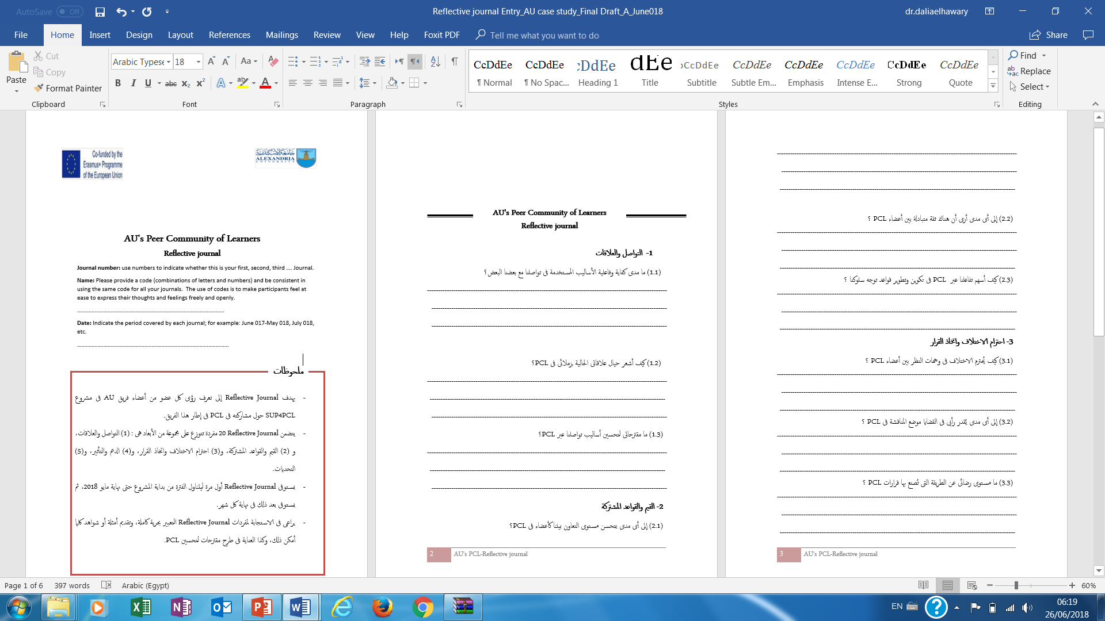
Journal entry

Slide 15
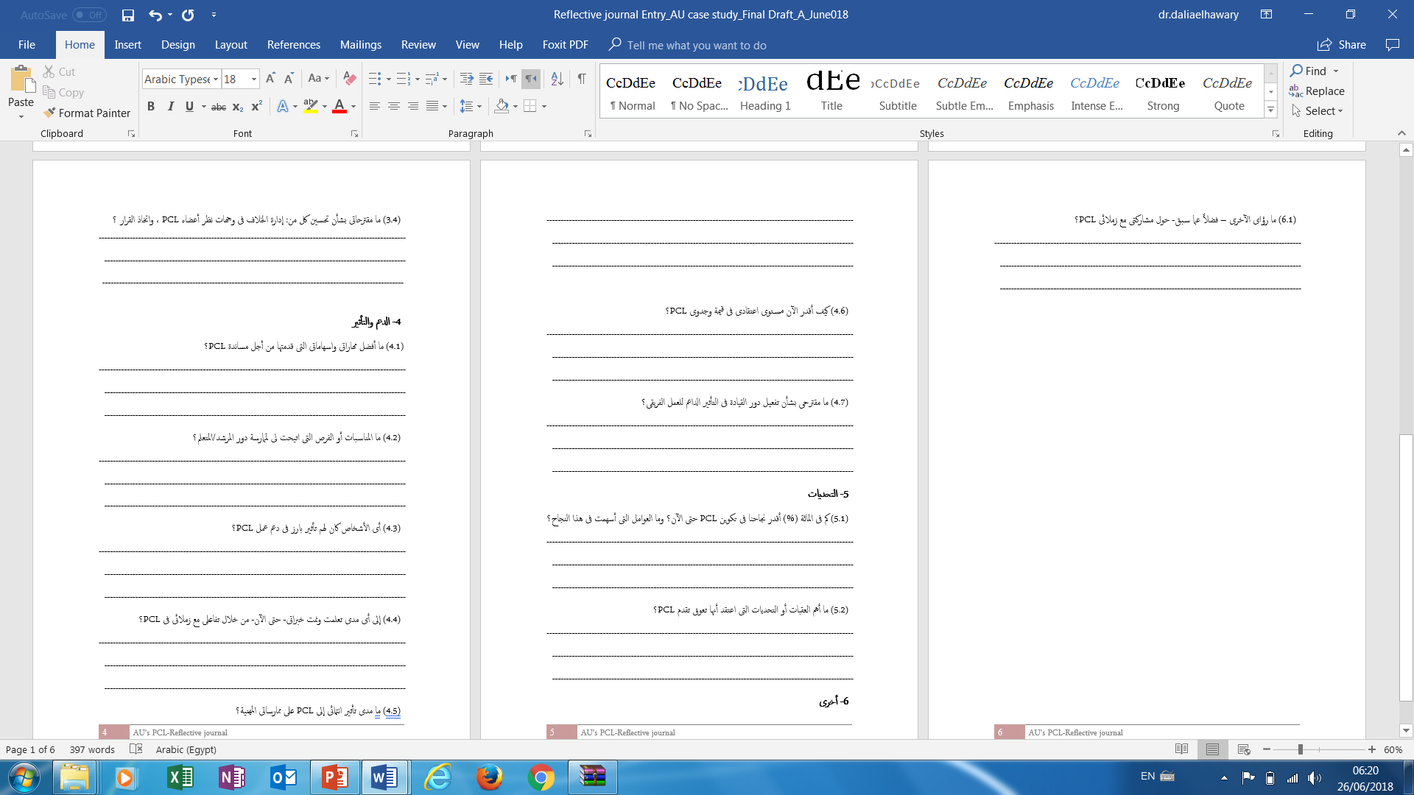
Journal entry

Slide 16
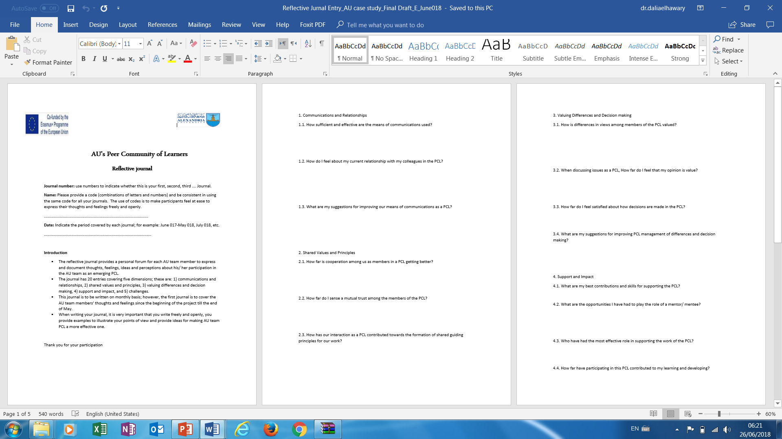
Journal entry

Slide 17
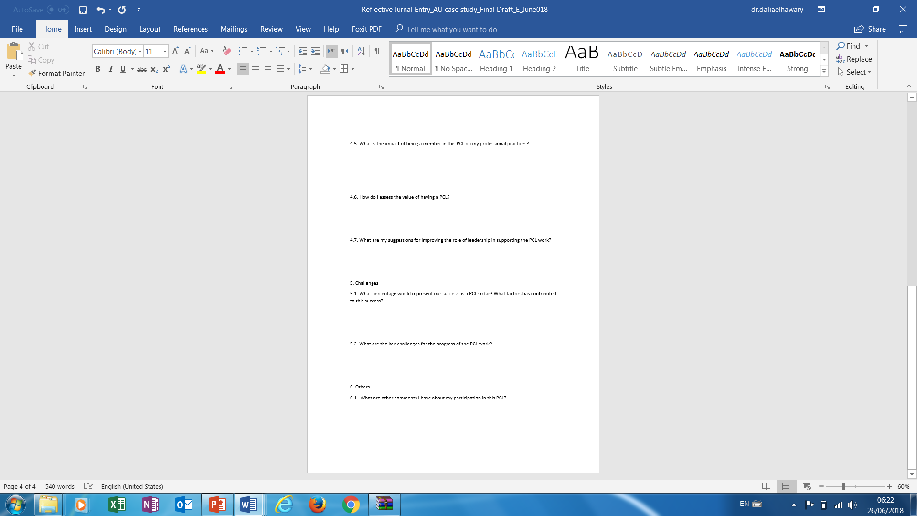
Journal entry

Slide 18
Next Steps
Revise the conceptual framework in light of initial data analysis
Use initial findings to guide AU team work as a PLC
Decide on other data collection tools / resources (e.g. interview protocol, document analysis, discourse analysis, etc.)
Write up first draft of the study.

Slide 19
Thank You

