Slide 1
Project number:
573660-EPP-1-2016-1-EG-EPPKA2-CBHE-JP (2016-2516/001-001)
School and University Partnership for Peer Communities of Learners
(SUP4PCL)
Overview
Kick off meeting 27th -28th Feb, 2017
The American University in Cairo
"This project has been funded with support from the European Commission. This presentation reflects the views only of the author, and the Commission cannot be held responsible for any use which may be made of the information contained therein

Slide 2
Content
The partnership- foundational principles
Project Overview:
Rationale and Philosophy
Objectives
Impact and Sustainability
Partners
Summary of Work packages
WP5: Management
- Management Style and communication method
- Conflict committee
- Consultations
- Reporting and accountabilities
- Management Meetings timeline
- Website

Slide 3
The Partnership Foundational Principles
The Partnership is about Change and Transformation
  “Never doubt that a thoughtful group of citizens can change the world. Indeed, it is the only thing that ever has.”
  Margaret Mead
The Partnership is a Collaborative and Collegial one
  “Alone we can do so little; together we can do so much.”
  Helen Keller

Slide 4
The Partnership constitutes a Community of Learners
  “What we have to learn to do we learn by doing.”
  Aristotle
The Partnership respects Diversity, Multiculturalism and Internationalization
    “If we cannot end now our differences, at least we can help make the world safe for diversity.”
    J.F. Kennedy

Slide 5
The Rationale and Philosophy
The journey towards School University partnership is not an entirely new one
Some of us already began the journey.
Through the evaluation of the previous TEMPUS partnership, it became clear that a more in-depth phase was needed.

Slide 6
The TEMPUS project entitled Capacity Development for Faculties of Education CDFE focused on three strategic entry points to reform:
Action Research
Practicum
Continuous Professional Development CPD
The area needing greater in depth work was CPD to ensure the most critical component of school university partnership, was well established following best practices

Slide 7
The recognition of the importance of Continuing Professional Development CPD that is school based underlines this consortium’s conviction that teacher learning and performance lie at the heart of societal transformation and reform.
Innovative approaches to Professional Development for educators are complex and multifaceted. They require deep transformations in professional understandings, reflections, practices and behaviors

Slide 8
The current consortium has come together because of a strong belief that creating an Egyptian-European Peer Community of Learners is the best method of supporting change and of experiencing together the amount of detail and planning such a transformation will entail.
Through exposure, dialogue, praxis, mentorship, coaching, and reflection, new professional habits are expected to emerge at the faculty and school levels.

Slide 9
Peer communities of learners will be the main conduit through which transformation will occur not only between partner countries, but also between university and school and within each of the participating institutions.
The work of this consortium touches on many of the much required facets of the transformation.

Slide 10
Cultural and relational facets such as peer learning, coaching and mentorship support moving away from traditional hierarchies.
Technical facets such as promoting STEM, Inclusive and special education encourage and embrace multi-disciplinary and integrated approaches.

Slide 11
Objectives
Wider Objective:
Build the capacity of FOEs to enhance and modernize CPD in the Egyptian context.

Slide 12
Specific Objectives
Develop Professional Development schools.
Produce baseline needs assessment of PD schools
Develop pedagogical leaders and mentors in the PD schools
Develop new habits of mind such as reflection and journaling.
Develop Peer Communities of Learners at school and university levels

Slide 13
Develop materials for school based learning
Develop systems of assessment and quality assurance
Develop systems of recognition and incentives

Slide 14
Impact and sustainability
The work of the consortium aims at creating sustainable impact by:
Institutionalizing the SUP, PCL and school based quality assurance units.
Designing technology enhanced materials
Widening the network of beneficiaries such as PAT.
Creating policy frameworks for the school university partnerships at highest levels
Catalyzing and linking to existing national efforts for the FOE reform

Slide 15
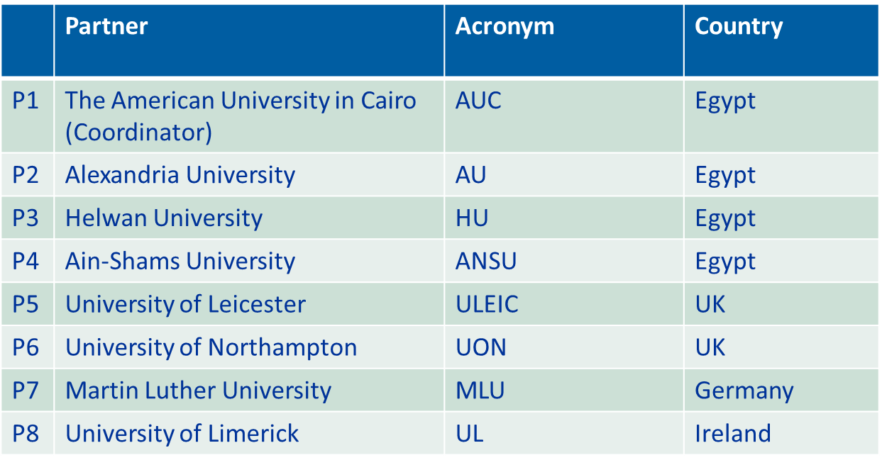
Partners

Slide 16
Summary of Work Packages
WP No. | WP Title | Lead
WP 1 | Preparation | AUC
WP 2 | Development | UON
WP 3 | Quality Plan | ULEIC
WP 4 | Dissemination and Exploitation of Results | HU and AUC
WP 5 | Management | AUC

Slide 17
Roles and responsibilities
Please refer to the documents in your file which outline preliminary roles for each partner. The roles are also reflected in the annexes of your partnership agreements. You will note that all the various activities and roles are based on very tight and intertwined partnerships.

Slide 18
WP 5 :Management
WP 5.1 : Meetings
WP 5.2: Create Website
WP 5.3: Adjust Work Plan
WP 5.4: Creation of Internal organization
WP 5.5 : Technical reporting and documents review
WP 5.6: Financial Reporting and documents review.

Slide 19
Management Style and Communication Method
The management style will be :
Consultative
Participatory
Empowering all partners to voice their opinions and ideas
Respectful of cultural diversity.
Collegial to ensure team spirit and collective ownership of the process and outcomes of the work.

Slide 20
The lead coordinating institution will be responsible for overall quality control of the work packages and activities therein, for example Visit programs are to be reviewed by AUC
Communication will be effectuated both virtually and face to face.
Regular circulars and emails will be sent on almost bimonthly bases and as needed.
Management meetings will take place both on local and Global levels every four months.

Slide 21
Preferred mode of communication is e-mail
Always copy the coordinating institution with a clear subject title to the e-mail. Please indicate level of urgency, importance or FYI
Please always cc. the whole AUC Team or other teams as needed
Please address specific queries on logistics, travel, finance or contractual issues to the relevant focal person
Focal persons for financial transactions and reporting must be in direct communication constantly to ensure all accompanying documents are collected in a timely manner.

Slide 22
Conflict committee
In cases of conflict (ex. due to poor communication, or inactive partners or late submissions, or other reasons),a tripartite committee for conflict resolution, which is comprised of: Prof. Ahmed Heggi from Helwan University, Prof. Hilary Burgess from University of Leicester and Dr. Medhat El- Nemr from Alexandria University will be established. This is in the case of minor conflicts. However, if the case escalates to litigation proper between the partners, the Belgian Law will apply, but if a conflict arises between AUC and EACEA, EU law applies.

Slide 23
Consultations
Other modes of consultation as Skype, video conferencing, telephone will all require minutes

Slide 24
International Management meetings
 | Date | Location
Kick off Meeting | 27-28 Feb, 2017 | AUC
2nd Management Meeting | 6-7 June, 2017 | ULEIC or MLU
3rd Management Meeting and Midterm Review | Feb- March, 2018 | AU
4th Management Meeting | Oct, 2018 | UL

Slide 25
Local Management meetings
 | Date | Location
1st Local Management Meeting | 21 Feb 2017 | AUC
2nd Local Management Meeting | 9-10 Oct, 2017 | ANSU
3rd Local Management Meeting | June, 2018 | AU
4th Local Management Meeting | February, 2019 | HU

Slide 26
Internal Organization
All additional resolutions and decisions reached during the course of the project implementation and/or during management meetings will be shared with EACEA and will constitute the management manual of the project.

Slide 27
Website
A website for the project is currently being created as a link to the current Graduate School of Education/ MEIHE Website and will be entitled ERASMUS+SUP4PCL.

Slide 28
Thank You

