Slide 1


School and University Partnership for Peer Communities of Learners )SUP4PCL(
الشراكة بين المدرسة والجامعة لبناء مجتمعات الأقران من المتعلمين
Project Number : 573660-EPP-1-2016-1-EG-EPPKA2-CBHE-JP (2016-2516/001-001)
Progress Reporting on AU Schools’ Clustering
Alexandria
Local Fifth Management Meeting
26th June, 2018

Slide 2
AU Schools’ Clustering
Requirements
Intensive work with schools to:
Equip mentors with the knowledge, skills & attitudes needed
Support mentors inside their schools
Train teachers & empower schools to become leading PD schools
Support the schools quality assurance units

Slide 3
AU Actions
Preparing a training programme based on project’s themes and overarching aims & schools’ specific needs
Assigning roles and responsibilities to team members for material development
Initiating communications with schools to agree on a work plan during July- September 2018
Initiating communication with the Directorate in Alexandria to get clearances

Slide 4
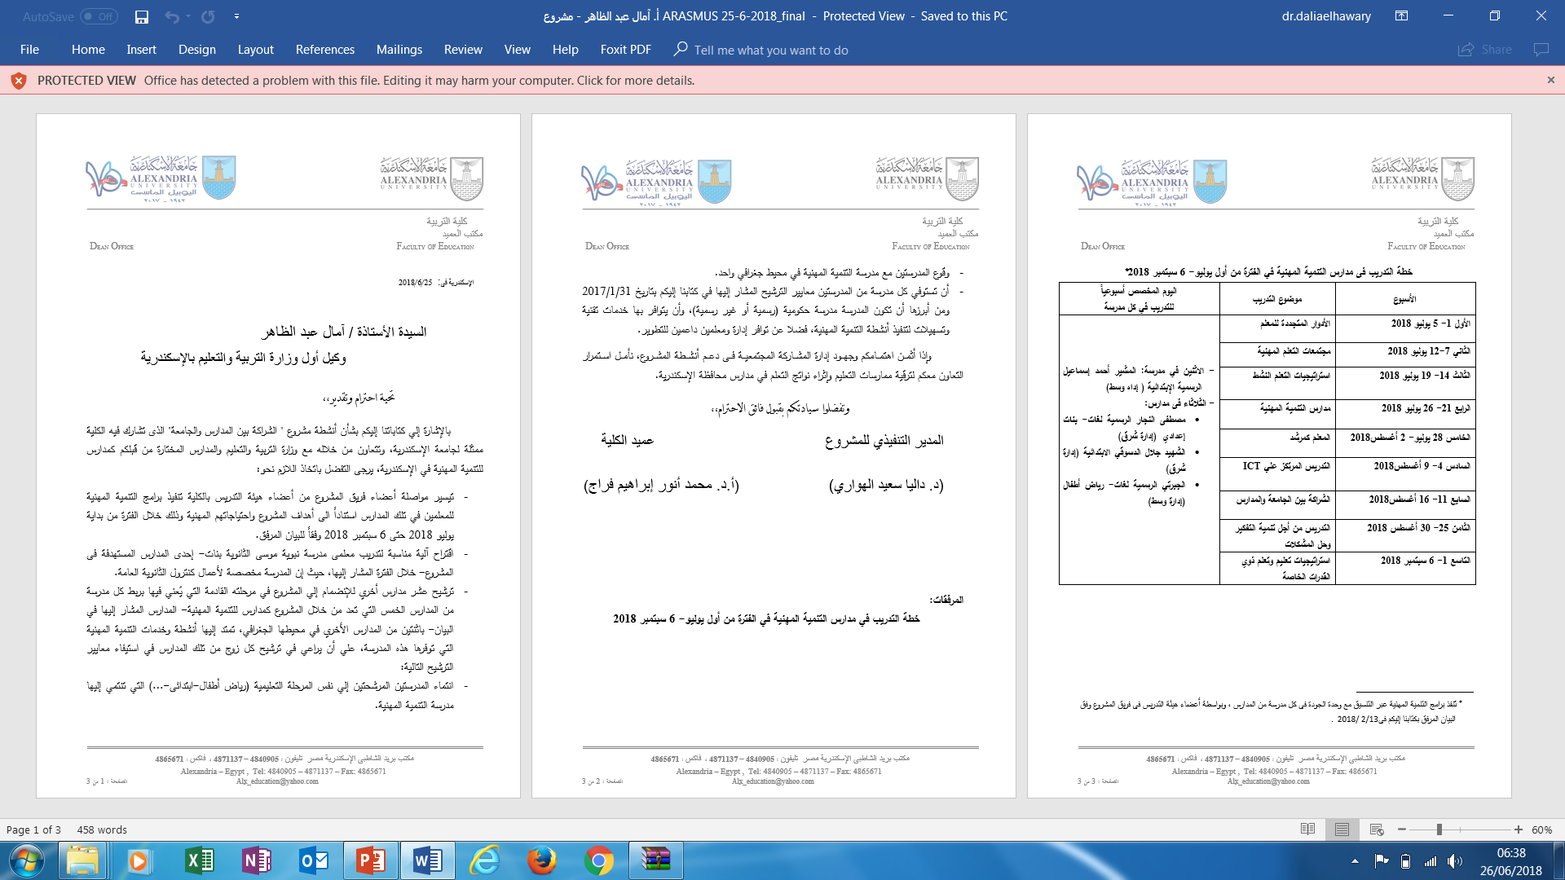

Slide 5
Next Steps
Setting plans for involving supervisors
Using incentives for teachers and schools
Brainstorming ideas for effective clustering techniques / models
Handling challenges (e.g. Nabawya Moussa school)

Slide 6
Thank You

