Slide 1


School and University Partnership for Peer Communities of learners
Project number:
573660-EPP-1-2016-1-EG-EPPKA2-CBHE-JP (2016-2516/001-001)

Slide 2
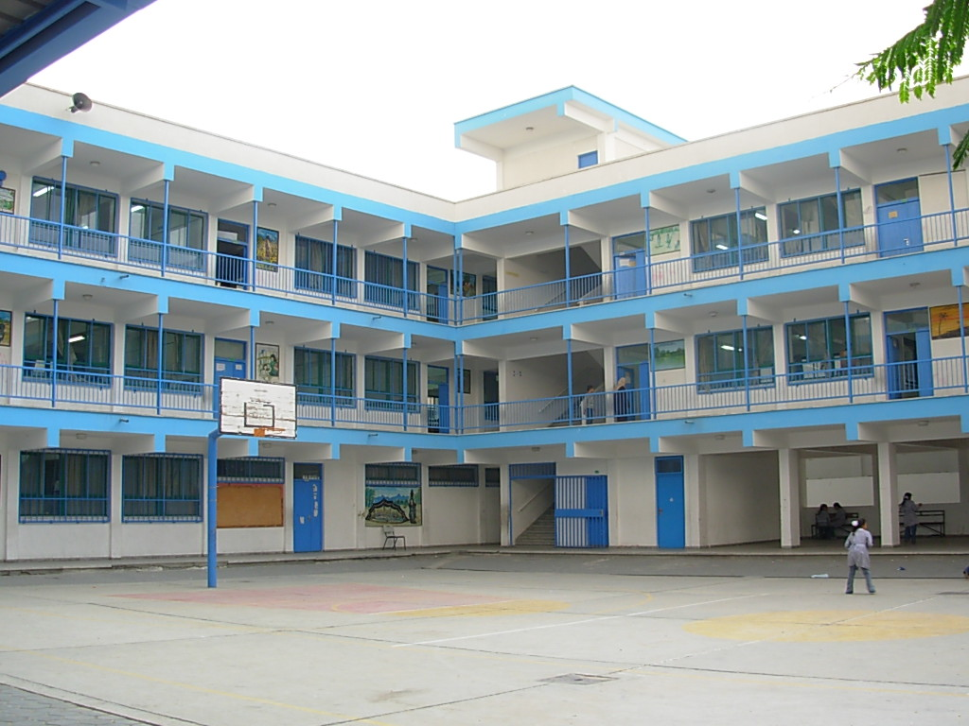
PD Schools

Slide 3
Professional Development Schools
Helwan Educational Administration
El- Sadat Preparatory School
Om El- abtal Preparatory School
Helwan Elkadeema Primary School.
Hoda Shaarawy state school ( Primary- Preparatory- Secondary

Slide 4
15th of May Educational Administration
5- Zaid Ibn Elharesa Secondary School.
EL Tebbin Educational Administration
6- Khaled Ibn Alwaleed Primary School
Maadi Educational Administration
7- El Maadi School Secondary
Al Masarah Educational Administration
8- Abobaker Elsedeek Primary School

Slide 5

Project Team

Slide 6
Needs assessment
Mentoring
Research Ethics
Ethnography Study
Quality Assurance

Slide 7
Needs Assessment Team:
Dr. Hassan Makhlouf:
Assistant professor of Educational psychology.
Director deputy of Assessment Unit in FOE.
Has experience in data analysis and statistics.
Participant of Tempus project.
Trainer in evaluation and assessment areas.

Slide 8
Mohamed Adel:
Assistant lecturer of Comparative education and educational administration.
Mentor of student teacher.
Participated in applying action research during practicum to solve school problems and traditional strategies of teaching.

Slide 9
Dr. Shaza Emam:
Lecturer of Curricula and teaching methods.
Supervisor of student teachers in schools.
Has experiences in active learning strategies

Slide 10
Ahmed Yasser:
Demonstrator in Math discipline
Has training experiences in International school.
His research area in STEM schools.
Enas Fathi
Demonstrator in Comparative Education and Educational Administration.

Slide 11
Research Ethics Team:
Prof. Magda Mostafa:
Professor of Curricula and Teaching Methods.
Ex- dean of FOE.
Participated in different projects.
Has TOT certificate.

Slide 12
Prof. Mohamed Ghonem:
Professor of Educational Psychology
Participant in Tempus project.
Ex-dean of FOE.
Vice dean of Students Affairs.

Slide 13
Prof. Nahla Hassan:
Professor of Comparative Education and Educational Administration.
Trainer in Faculty& Leadership development Center/ Helwan University in different areas as research skills, scientific research management and strategic planning.

Slide 14
Mentoring Team
Dr. Lamia Kamel:
Lecturer of Curricula and Teaching methods.
Coordinator of training committee in FOE.
Has experiences in training student teachers, Faculty staff, administrators.

Slide 15
Dr. Dina Maher Assem:
Lecturer of Comparative Education and Educational Administration.
Participated as trainer in Tempus project in different areas as quality assurance, strategic planning and school administration.
Internal auditor in QAU.
Trainer at PAT.

Slide 16
Dr. Ahmed Laithy:
Lecturer of Mental Hygene.
Trainer of faculty staff, administrators, and school teachers.
Dr. Hany Fouad:
Lecturer of Educational Psychology
TOT Certificate.

Slide 17
Dr. Ahmed Youssef:
Lecturer of Educational Technology
TOT certificate.
Trainer at CDC( Career Development Center)

Slide 18
Ethnography Study Team:
Dr. Khaled Malek
Assistant Professor of Educational Technology
Post Doctoral research in U.S.A
TOT Certificate.
Dr. Eman Raoof.
Dr. Aliaa Fekry.
Mahmoud Hassan.

Slide 19
Quality Assurance Team:
Maha Abu Hatab:
Assistant professor of Kindergarten Education
Director of Quality Assurance Unit.
Professional trainer in different areas.
Participant in Tempus project in capacity building of school teachers and principals.

Slide 20
Doaa Abdel Karim
Associate Professor of Curricula and Instruction
A certified trainer of the Professional Academy of Teachers.
Holding training sessions of the European Framework Program , and the German Vocabulary Program 2012/2013.
Supervisor of the Practical Training.

Slide 21
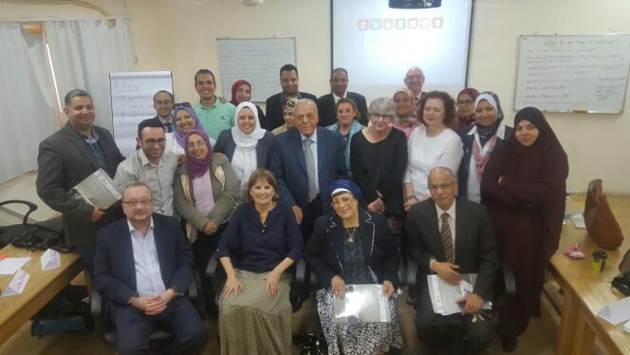
Feedback of Needs Assessment Workshop

Slide 22
The Workshop was fruitful in the following areas:
Characteristics of effective communities of learning.
Data collection methods of needs assessment.
Needs assessment tools.
Exploration of different definitions: learning communities, mentoring, coaching, professional development……etc.
The difference between mentoring and coaching.

Slide 23
Skills of mentors and coaches.
Principles of educational research.
Research ethics.

Slide 24
Workshop was interactive:
Though some of Egyptian team members are not professional in English language, but they were interactive within their team and managed to develop improvement plans for the project.

Slide 25
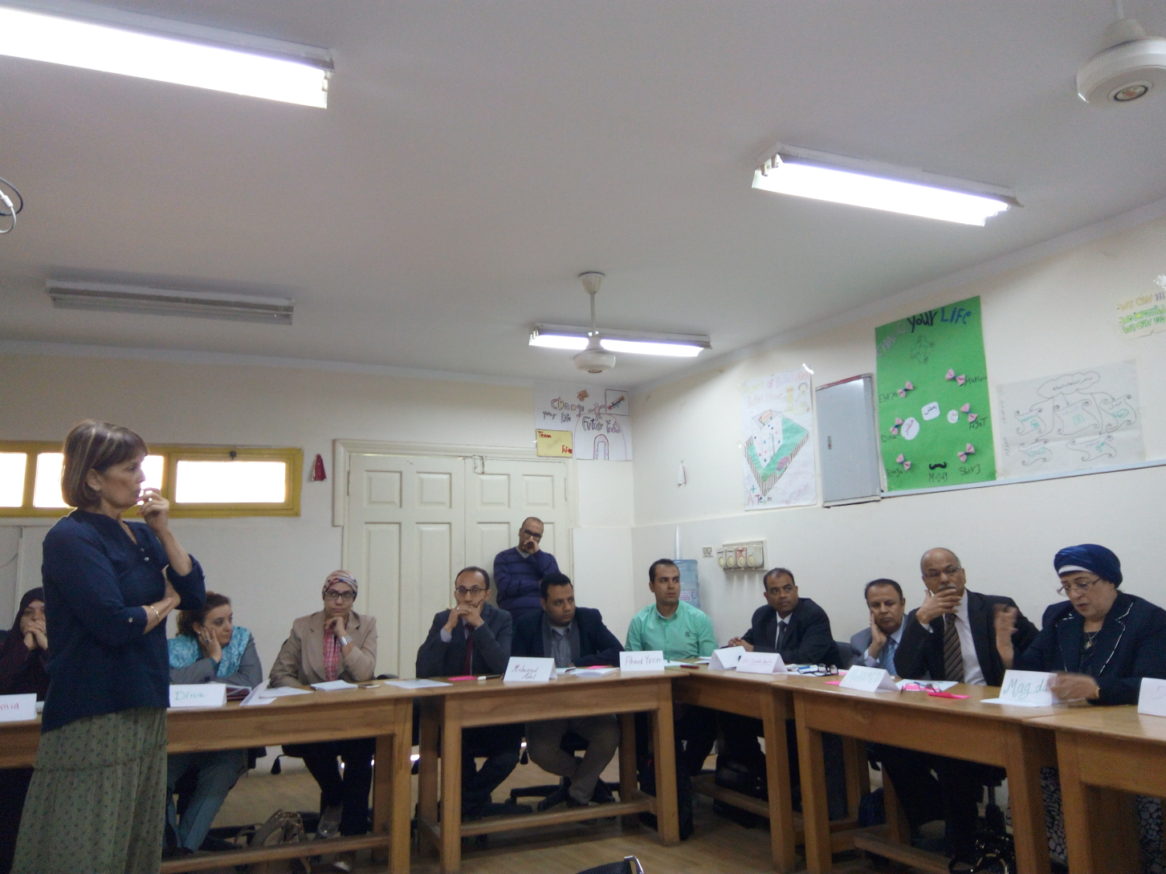

Slide 26
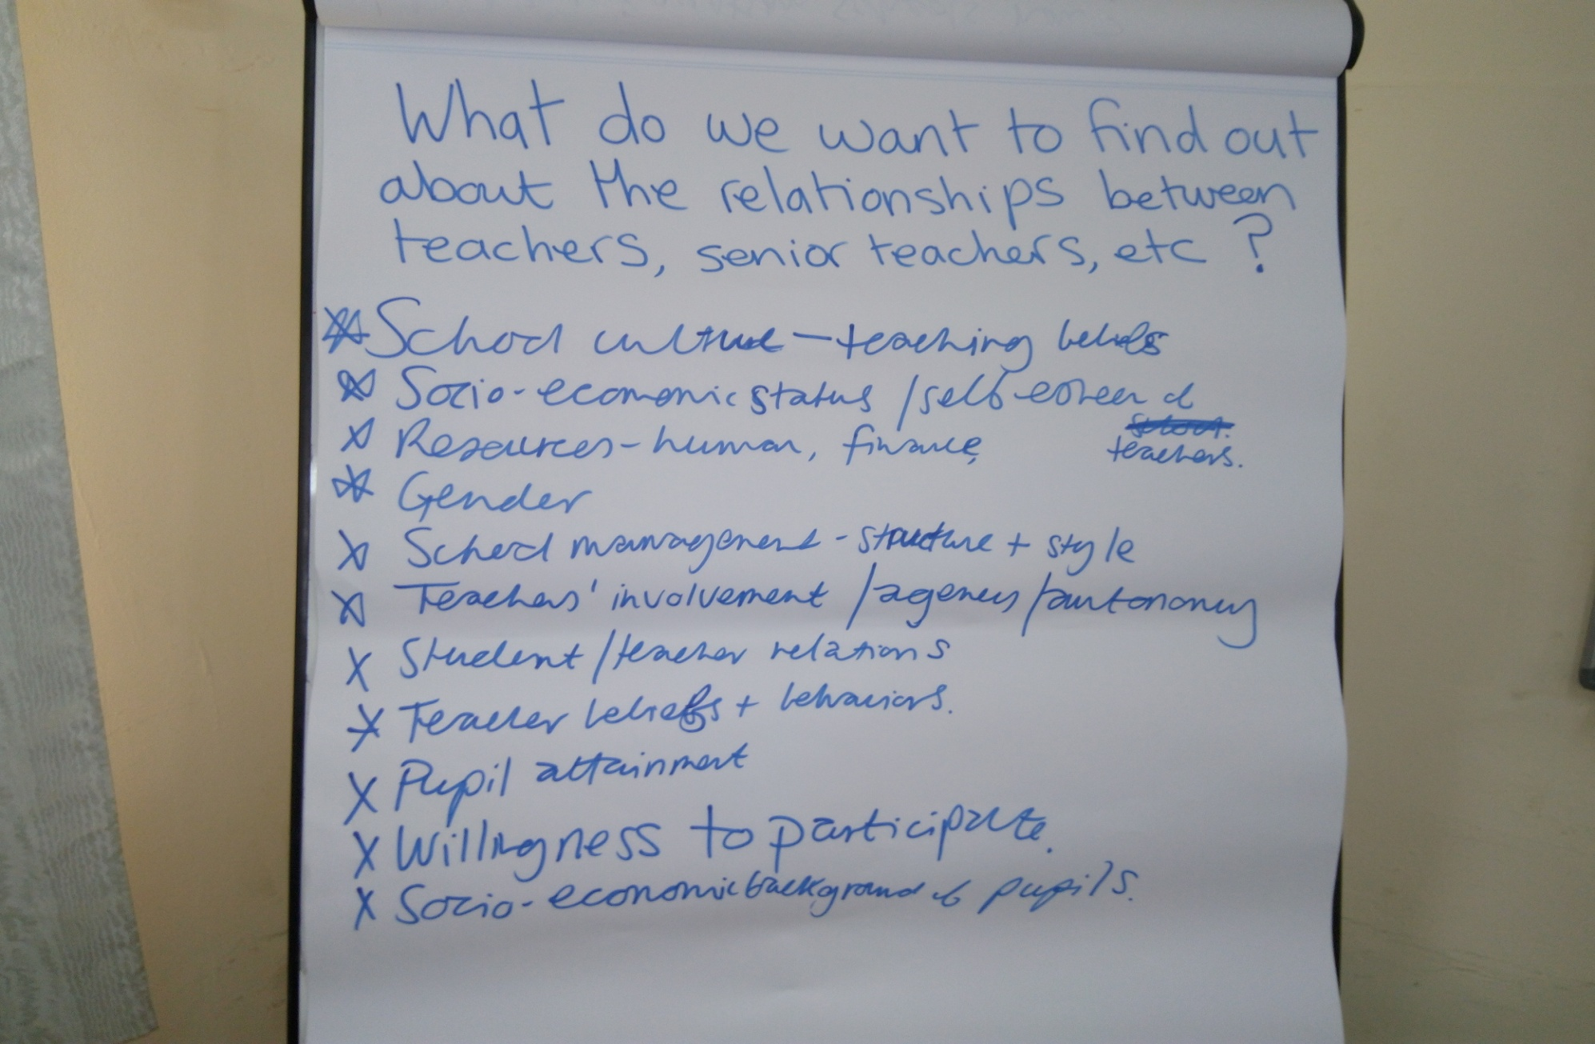

Slide 27
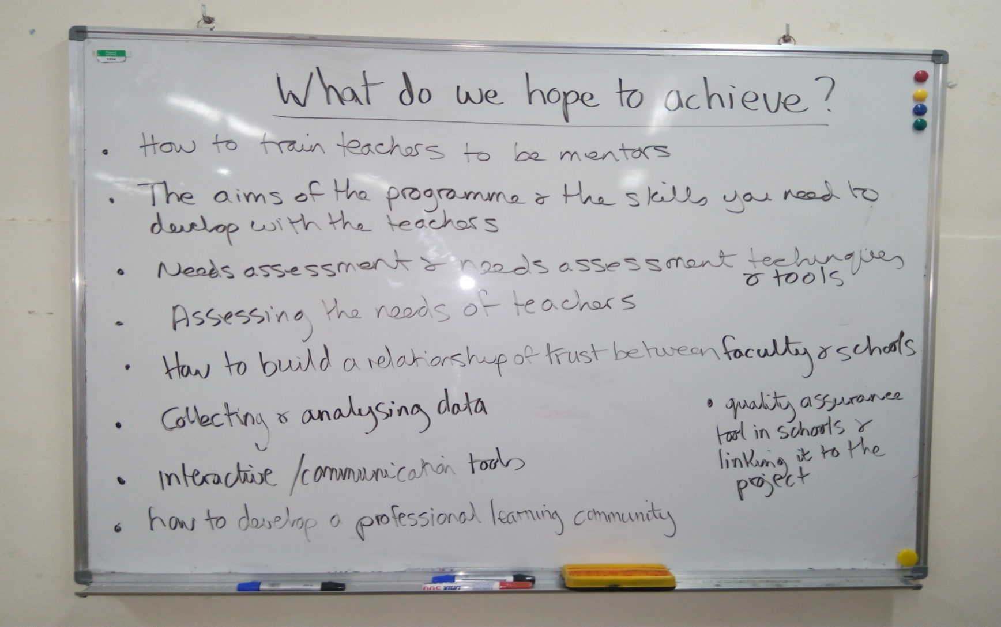
Participants were committed and engaged:

Slide 28
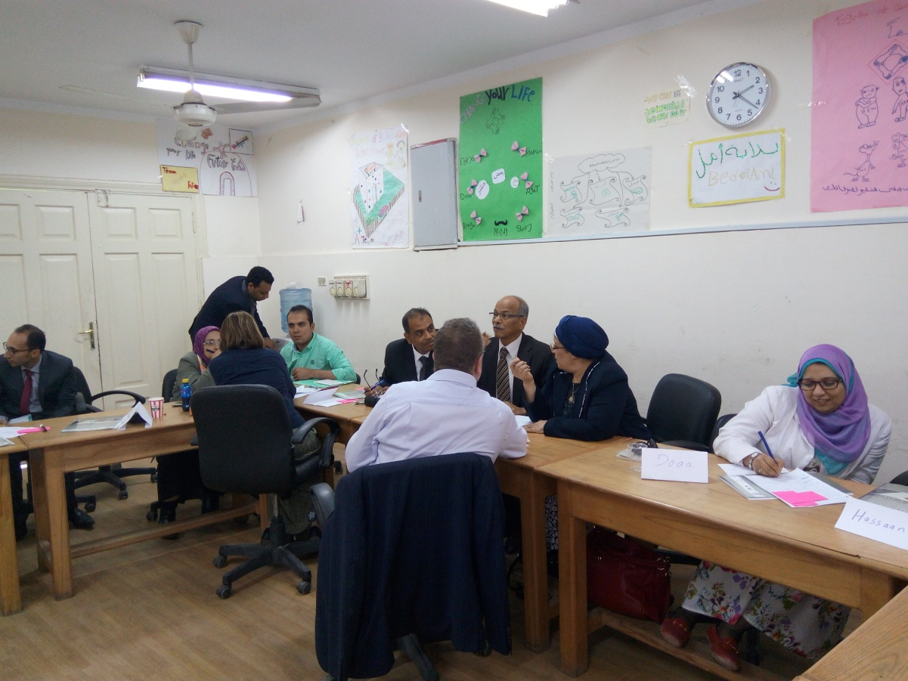
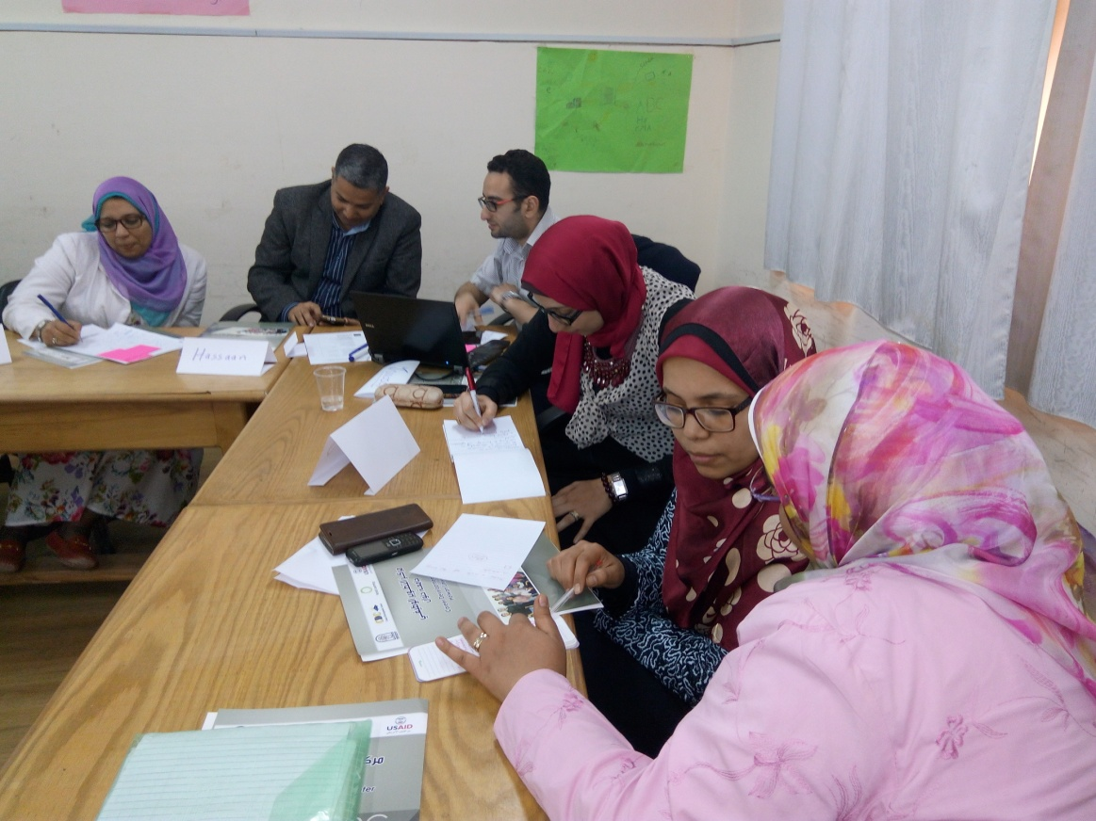

Slide 29
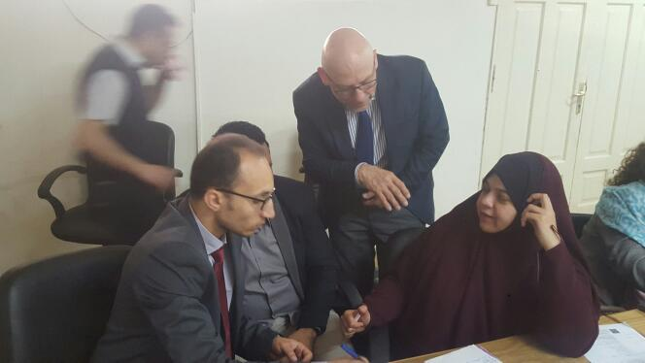
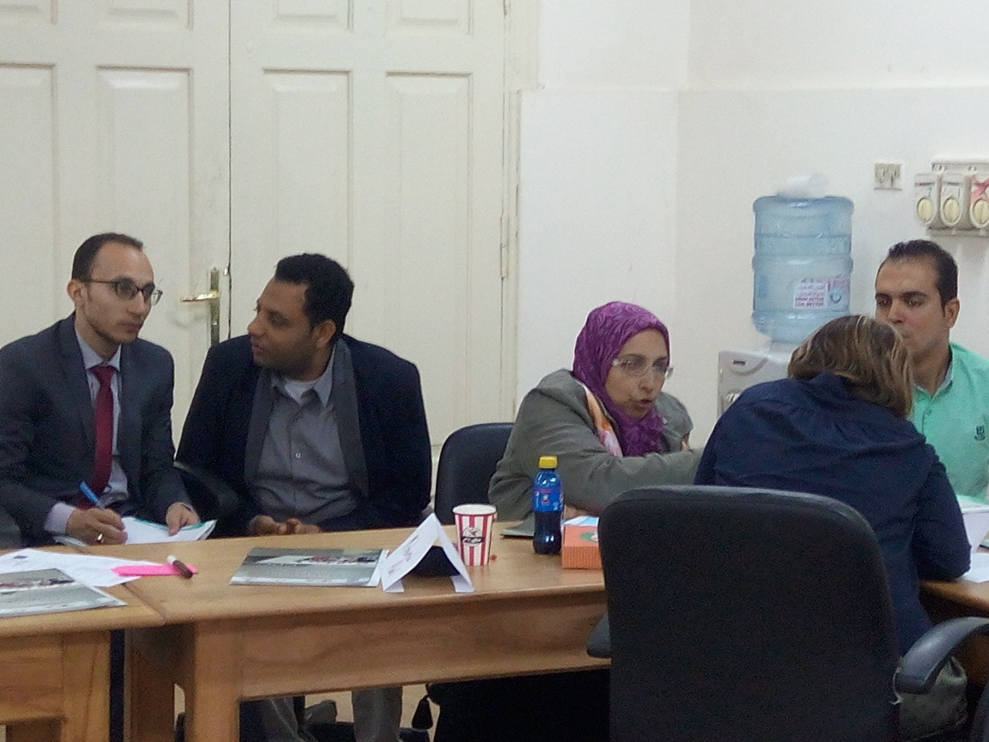

Slide 30
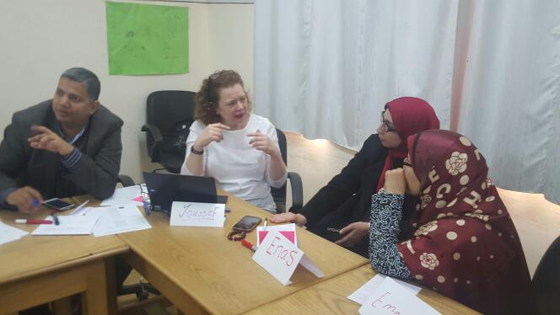
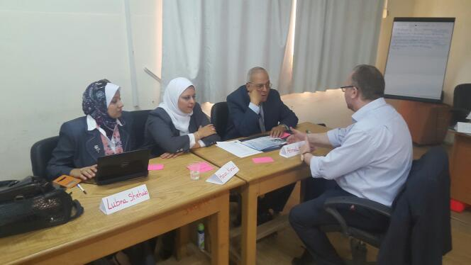

Slide 31
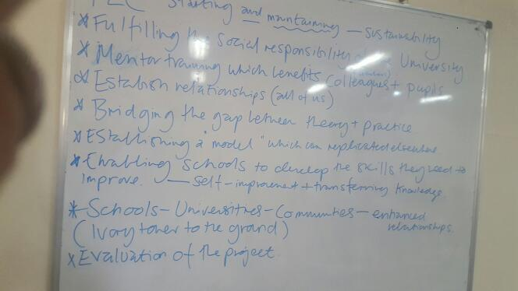
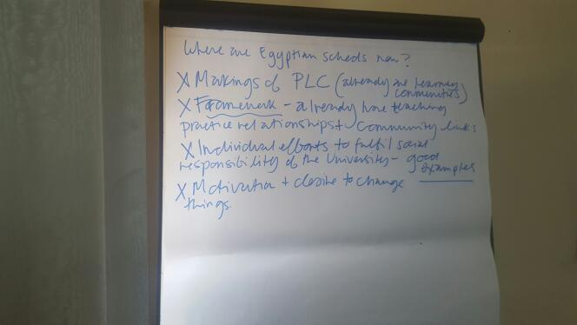
Common understanding amongst EU and EG partners was reached

Slide 32
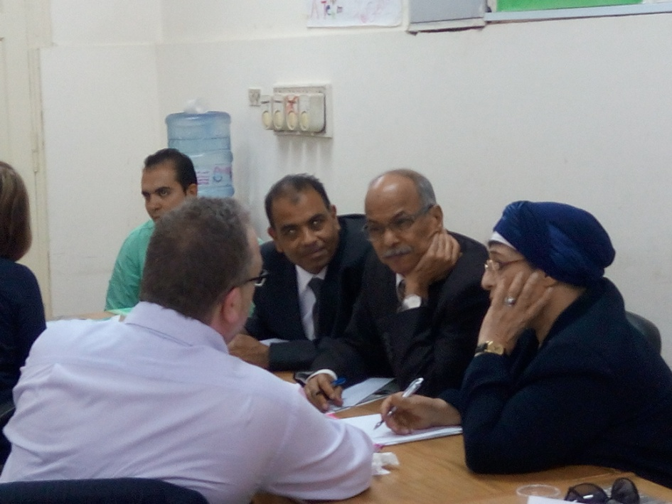
Language & Culture
Nobody felt that the language was a barrier
No cultural sensitivity
Evidences:
Collaborative group works
Interactive focus groups

Slide 33
Organization
All Facilities were available:
PCs and wifi connection.
Laptops.
Data show.
Printer.
photocopy machines.
white boards….etc.

Slide 34
Other points we would like to give feedback on:
The workshop based on literature rather than best practices in UK and Germany.
Not all the Egyptians expectations were fulfilled, the EU strategy depended on stimulating HU to take decision concerning the future plan rather than providing us with tools, documents, videos, or distinguished experience in their country.

Slide 35
Next steps from HU team point of view:
Training teachers to be mentors.
Determine needs assessment tools.
Conduct needs assessment.
Collect and analyze data.
Develop professional learning communities.
Social Responsibility of the university towards schools.

Slide 36
Areas that need more concentration
Ethnography Research.
Quality Assurance in schools.

Slide 37
Ideas for the visits that will take place in EU.
Best practices in schools.
School visits.
Quality assurance system of PLCs.
Meetings with mentors, members of PLCs.
Documentation of PLCs activities.
Sharing videos and interactive materials instead of theoretical presentation.

Slide 38
Future Plan
Communicate with the schools teams to clarify the goals of needs assessment:
Assessment of
Students needs
School needs
Teachers needs
training needs

Slide 39
Determine the target group in schools, classification of the groups.
Assign a needs assessment committee.
Schedule of reporting.
Prepare data collection templates.
Conduct needs assessment.
Organize the training needs in priorities.
Data analysis.
Determine the gap between the current status and the desired.
Organizing focus group with the school team to decide the best delivery system of training.
Prepare a report.

Slide 40
Challenges
Timeline of needs assessment is critical.
Validity and honesty of responses.

Slide 41


