Slide 1

L
E
I
C
E
T
E
L
I
E
M
PLU
A
I
N
A
N
R
H
T
H
A
P
T
O
N
L
W
A
N
I
C
K
L
E
X
A
N
D
R
I
A
H
A
M
S
A
RT
A
I
N
L
U
T
H
E
R
C

Slide 2


School and University Partnership for Peer Communities of learners (SUP4PCL) Project number: 573660-EPP-1-2016-1-EG-EPPKA2-CBHE-JP (2016-2516/001-001) Fifth Local Management Meeting Tuesday June26th, 2018

Slide 3
Progress of Case Studies
HU management team developed a framework for the FOE case study in collaboration with MLU.
Each school team developed work plan for developing the PCLs and managing the case studies.

Slide 4
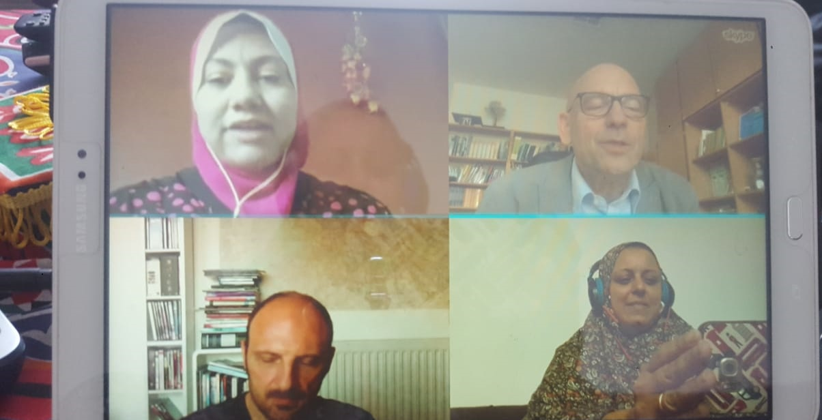
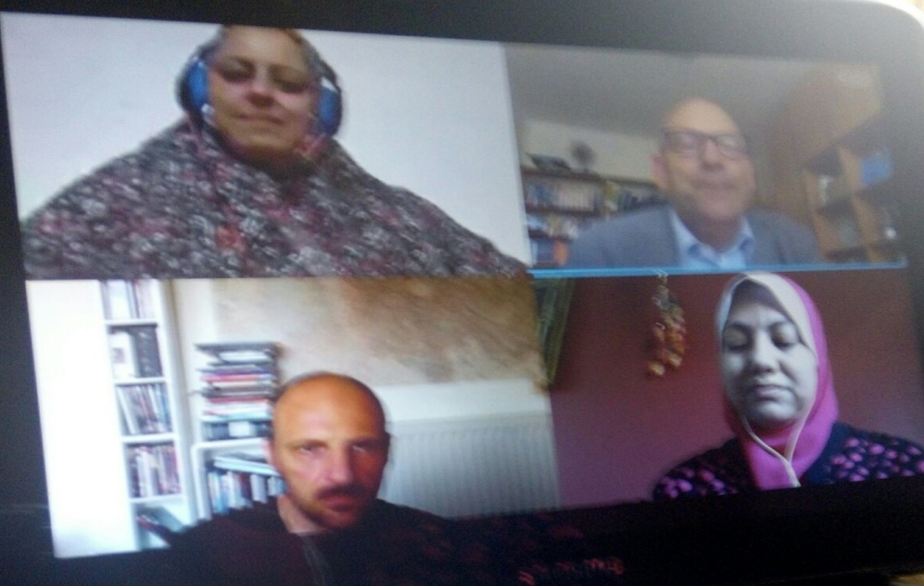
FOE case study in collaboration with MLU

Slide 5
Case study framework
 | HU | Method | MLU | Method
History etc. | Management team | Data collection as a word-file, numbers
New teaching styles | Faculty staff | Report and answering the questionnaire | Develop a questionnaire Deadline 1st August. | Online
New programs / practices Edmodo Exchange experiences | Management team | Descriptive study Plan from each team in July, action plan Templates of reports Oct. Not before two months | Francesco | Comment
New policies FOE reform | Prof. Hegi | Interview by Martin sep | Develop of an interview | Interview and description
Engagement of students | 1 MA student and maybe more teachers to research on the topic Ain shams MA researchers Visit MLU Informal supervision online on skype meeting | Research papers, and also MA thesis | Invitation to MLU for research, paricipatory supervision | Agreements and protocols (MOUs) Mutual supervision for MA and PHD
Human relationship | Project team, coordinators of schools | Interviews between faculty staff and teachers/ principals | MLU team Translators for arabic Dates: sep 4- 13 Meet with faculty staff and prof Heggi( | Interview between faculty staff members

Slide 6
HU and MLU teams discussed the progress of case study through Skype meeting that included the following outcomes:
HU began data collection of HU history, HU profile in numbers, Institutional Strategic Priorities 2015-20, Key International Partnerships.

Slide 7
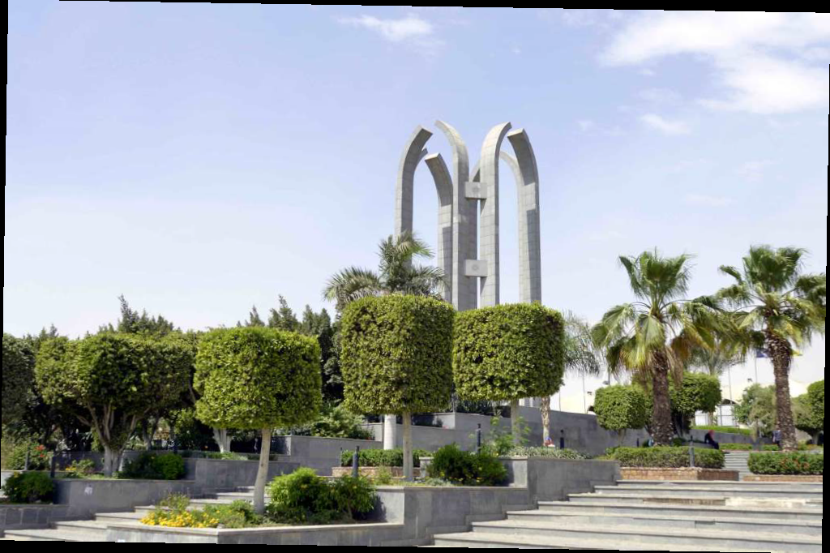
We planned to have two files:
HU profile
FOE profile.

Slide 8
Setting timeline and dates for certain tasks:
1 August for designing questionnaire by MLU to be applied at the beginning of the academic year. Sep. 2018
July- Oct. HU will prepare descriptive study of New programs / practices as Edmodo and methods of exchanging experiences

Slide 9
Sep. 2018: MLU will arrange an interview with Prof. Heggi about the new policies and FOE reform.
Sep. 4- 13: MLU team will arrange different meetings with faculty staff and management team.

Slide 10
Each school team developed work plan for developing the PCLs and managing the case studies.

Slide 11
Om El- Abtal Summer Work Plan
The PLC started with 4 members of the Faculty of Education, Helwan University, and became 10 members (4 from the Helwan University team and 6 from the school teachers and administrators.

Slide 12
Action Plan
school visits by HU team twice a month.
Organize meetings with school team to make sure that they use the template of lesson preparation in the right way.
Follow-up of peer- learning Community among school teachers.
Follow- up the collaboration between teachers from different subjects to work together using STEM approach.
Organize meeting with those responsible for quality assurance to make sure that the PCLs activities help in their standards.

Slide 13
Training school teachers on the following : effective presentation , communication skills )
Follow their use of Edmodo in uploading their work .

Slide 14
Zamalek Girls School Action Plan
Timeline | Mechanisms | Team | Activity | The main objective
2018- 2019 | Collect data and apply a questionnaire to school teachers | HU team in collaboration with the school and management team | - Identify the team of teachers for training / trainers - Build on the previous quality activities - Regular assessment of training needs - Provide some training | Development of quality units (there is no quality unit in the school and in this case can be replaced by training unit

Slide 15
 | data collection Edmodo program and electronic communication sites meetings at the school or the Faculty of Education in Helwan | - HU team in collaboration with the school team | Regular meetings - A doption of model of learning communities (training workshop) - Create a team of learning communities - Using the ICT to develop learning communities | Developing learning communities

Slide 16
 | Interviews With teachers and the principal | HU team and school management team | Its activities will be included with training | Leadership style and management support

Slide 17
 | Cooperation through meetings and the specific website | the faculty team and the school team | -Formation of a team from the school - Publish the template on the website | Monitoring of the work of the panel
 | data collection - Edmodo program and electronic communication sites |  | Dissemination of the culture of scientific research among teachers - Follow-up and guidance of teachers - Prepare a report on research and activities | Developing school-based research

Slide 18
Meetings and Workshops at HU
HU team organized three meetings and training workshops for school PCLs :
The outcomes of those meetings and workshops will help in development of:

Slide 19
Leadership Style
Mentorship
Organizational Culture
Developing PCLs
Quality Assurance Culture

Slide 20
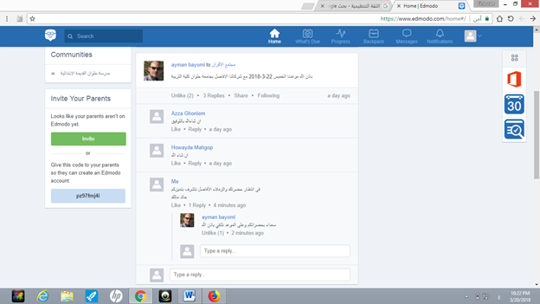
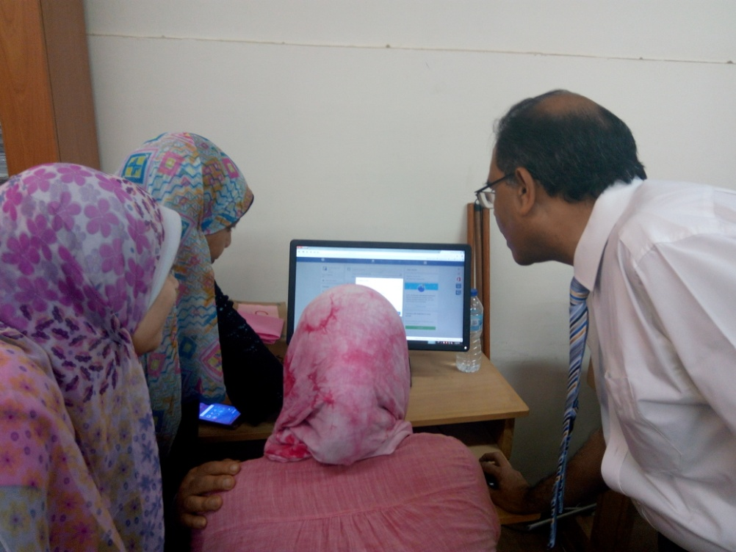
First: The Use of ICT in enhancing PCLs

Slide 21
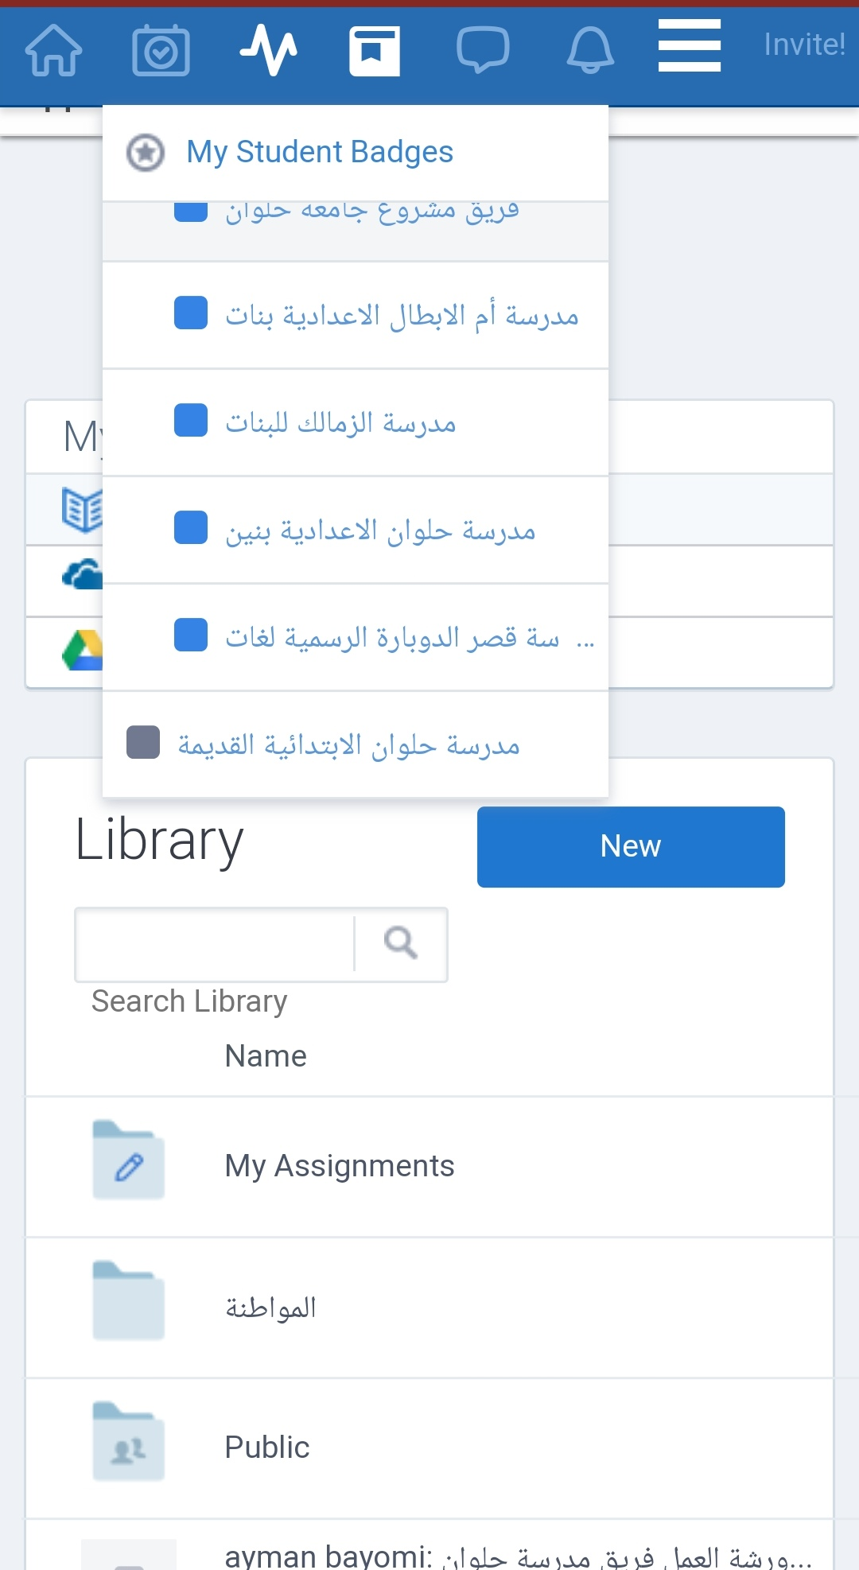
Outcomes

Slide 22
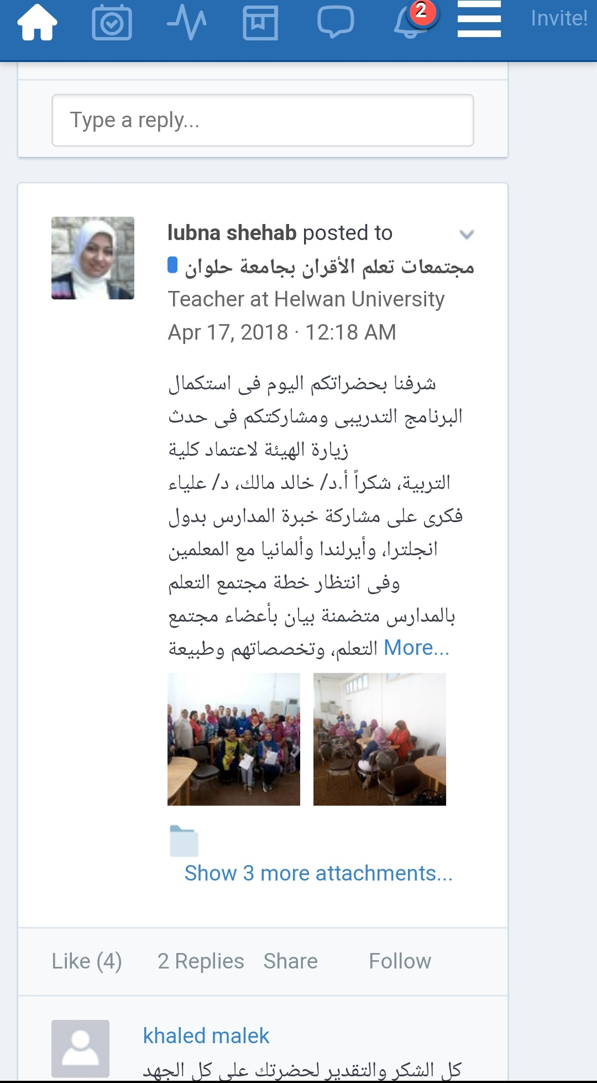

Slide 23
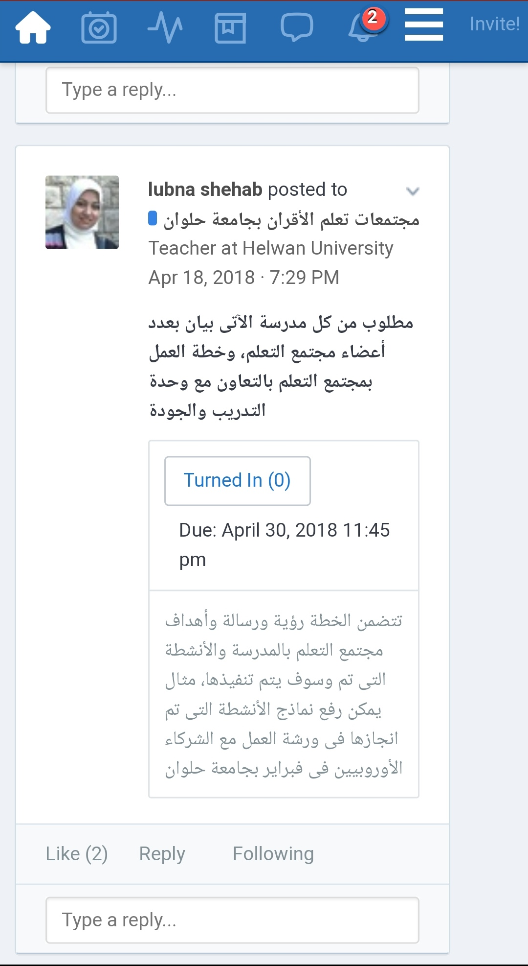

Slide 24
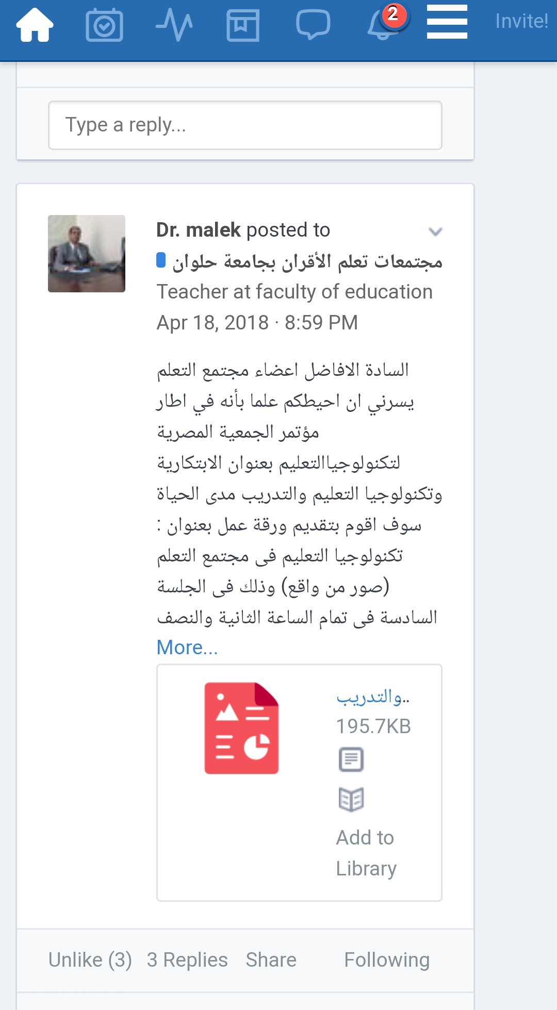

Slide 25
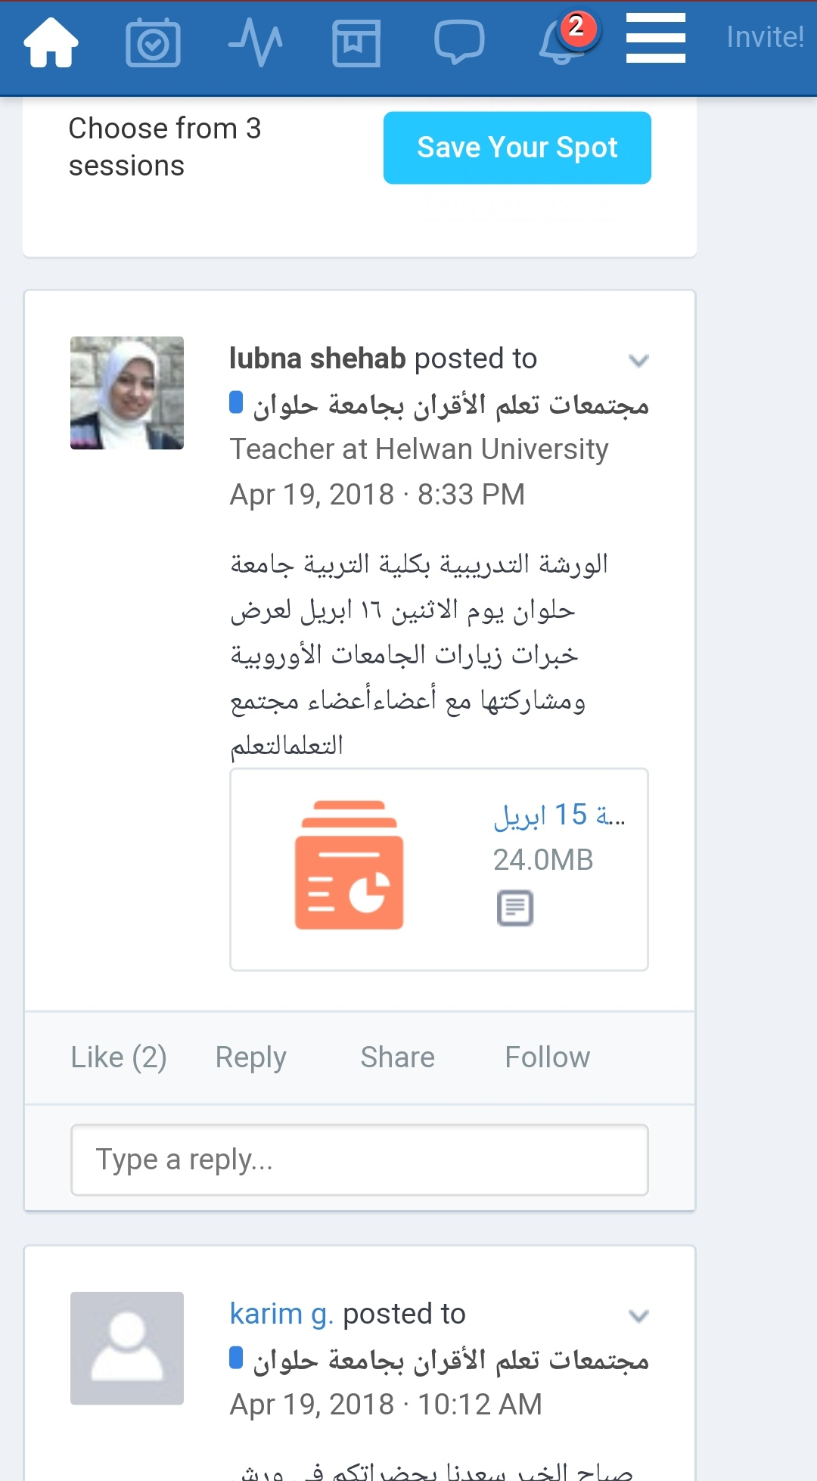

Slide 26
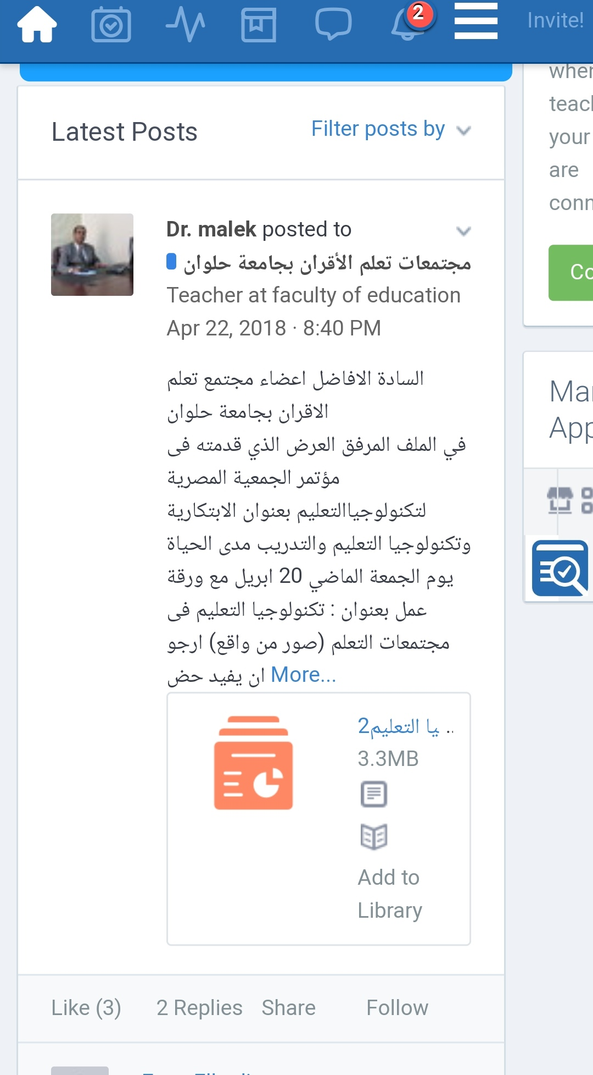

Slide 27
Second: Dissemination of Quality Assurance and Accreditation Culture
HU invited the school teachers and those responsible for quality assurance and training units to participate in NAQAEE accreditation visit in HU.
Also, HU team will help the schools to support quality activities.

Slide 28
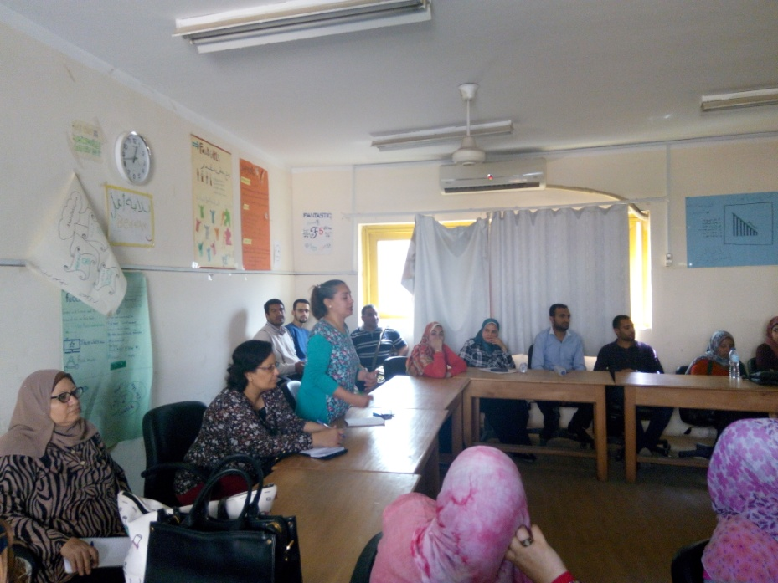
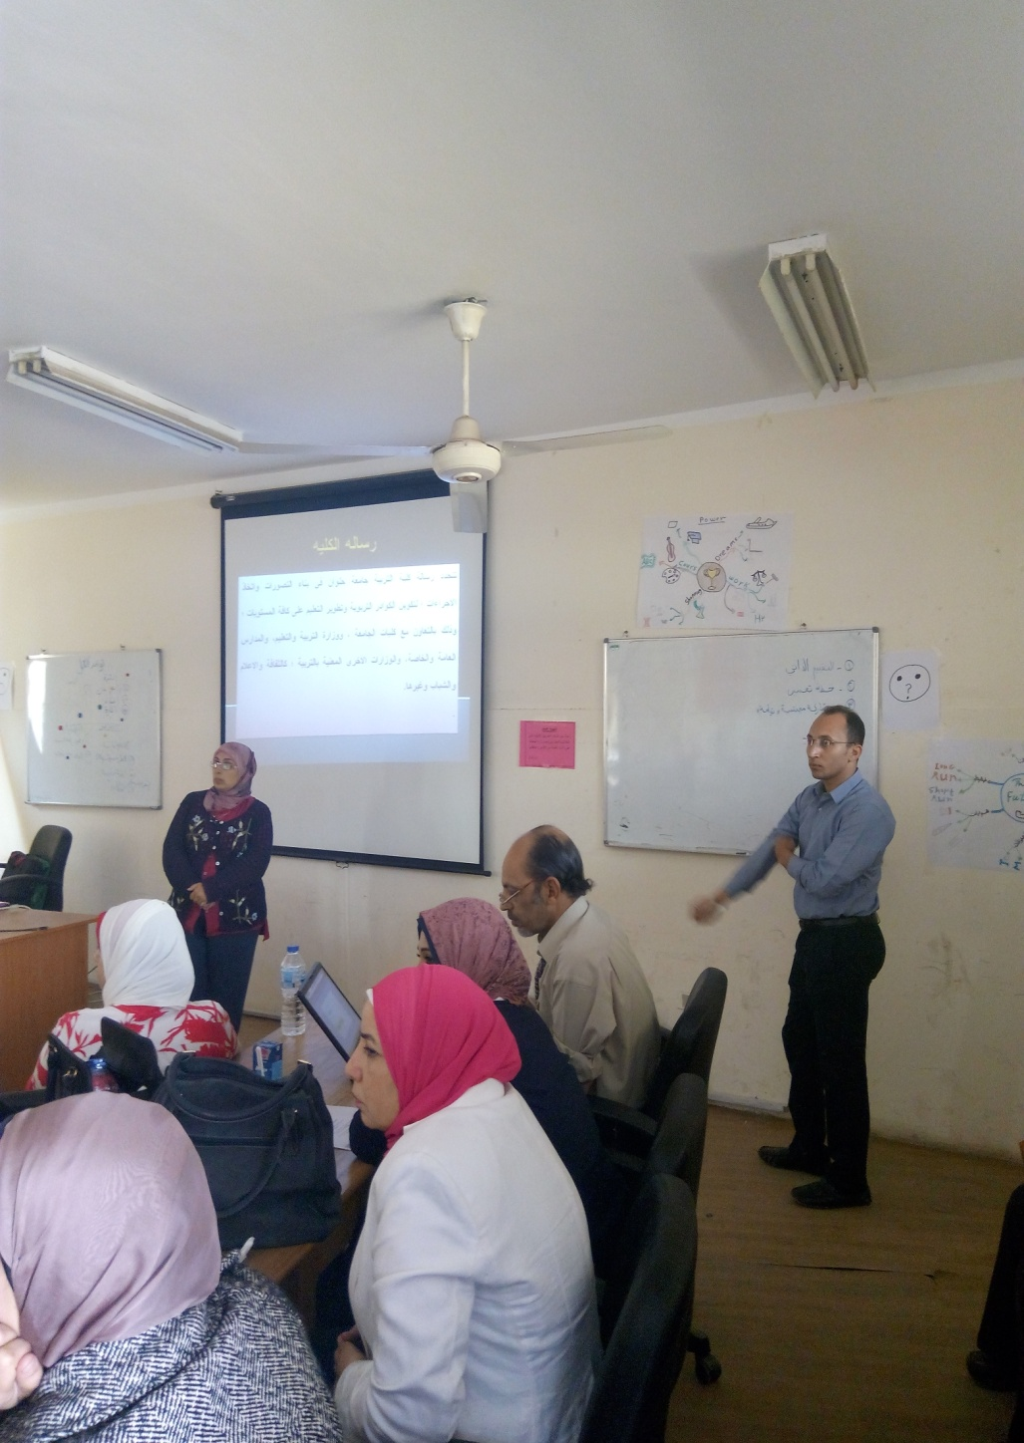
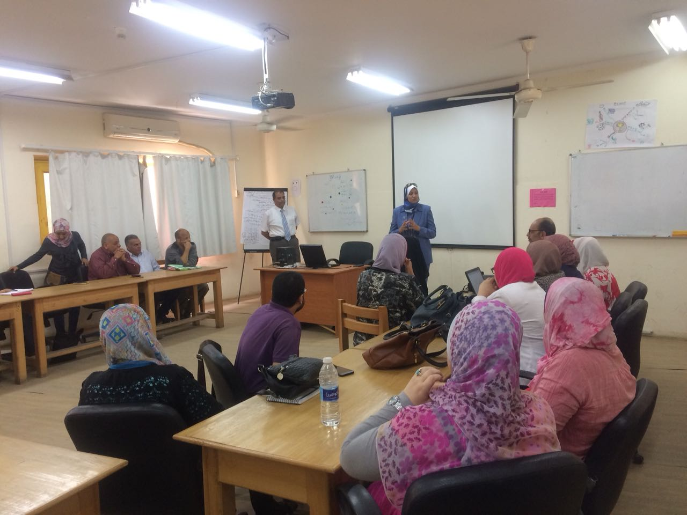

Slide 29
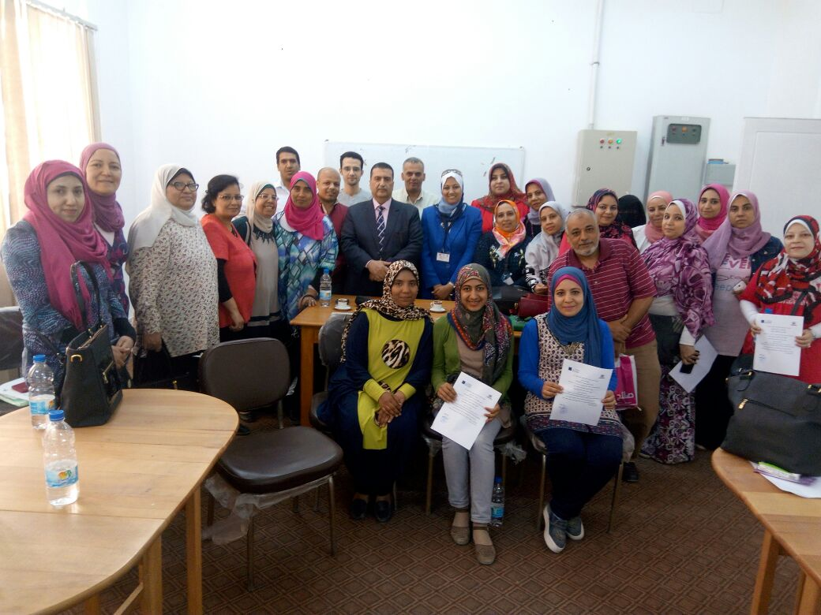

Slide 30
Third: Foreign Experiences in Developing PCLs
EU visits experiences.
Selection of the most suitable experiences that suit the Egyptian context.
Teachers were attracted to the experiences that help in solving school problems( action research).

Slide 31

Skype Meeting with Teachers
MLU invited school teachers to join their discussions on skype meetings to exchange experiences of PCLs.

Slide 32
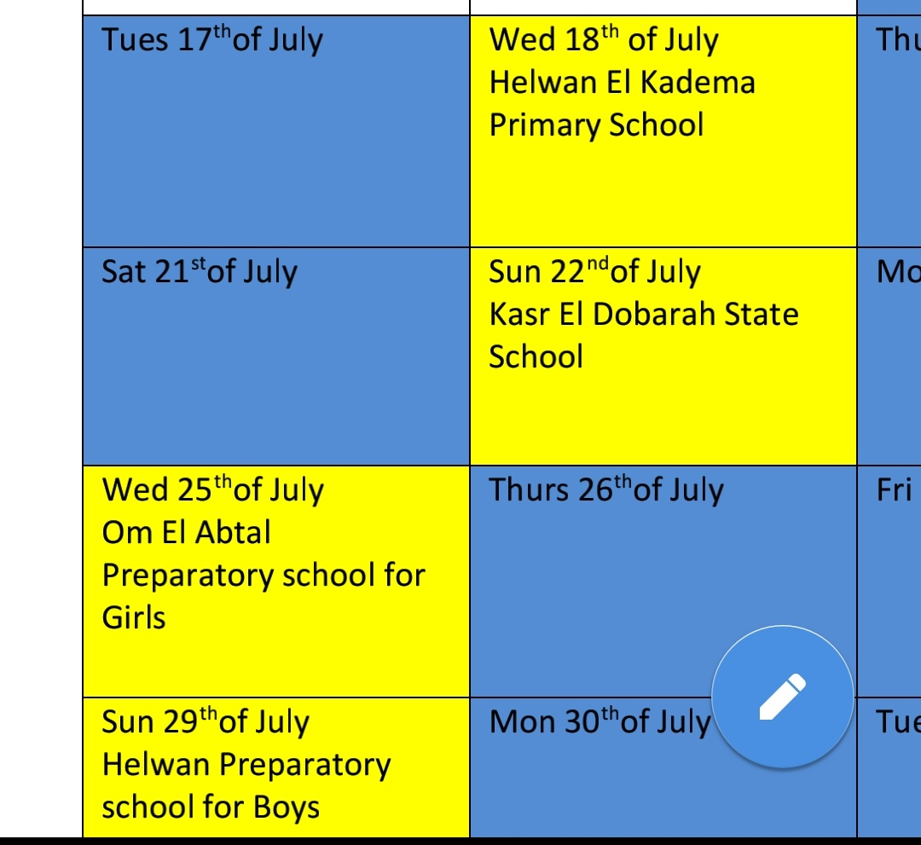
Schedule of AUC visit

Slide 33

School Clustering

Slide 34
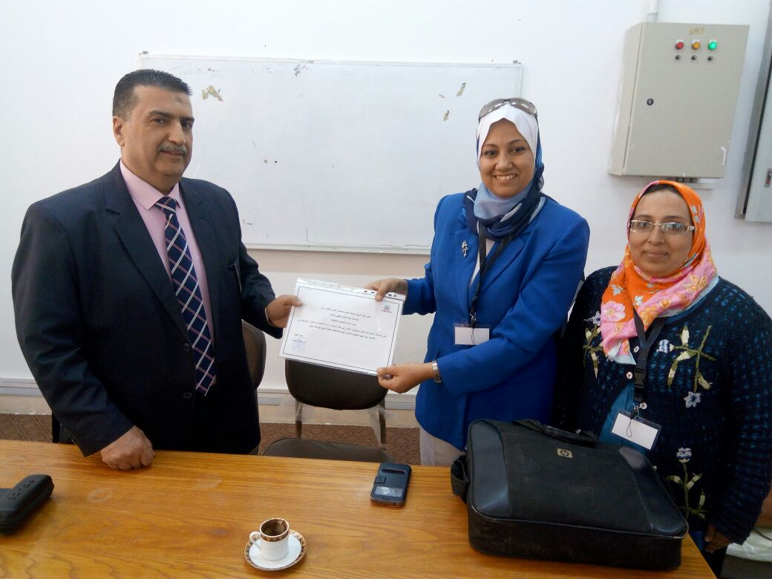
Communication with Cairo Educational Directorate
The five schools will support 10 schools.
Organize meetings with heads of educational administrations:
( Helwan- El Maasara- El Maadi- West Cairo)

Slide 35
School support
Info sessions about the project and its goals.
Interviews and assessment of the five schools performance to assess their readiness to support other schools( quality of their performance).

Slide 36

Classification of schools

Slide 37
Criteria of Classification
Educational Administration
Location.
Educational stage.
HU team( STEM school).
The school performance in EU workshops.
The School recommendation.

Slide 38
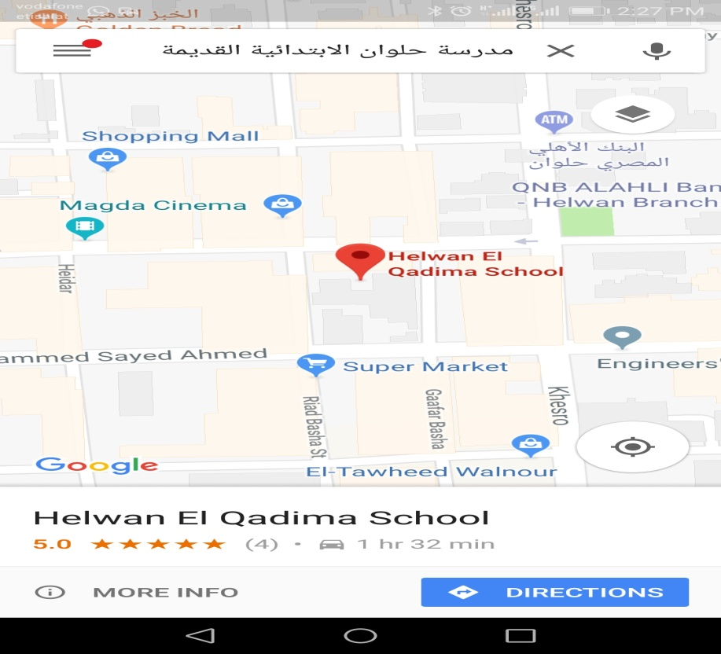
Helwan El Kadima Primary School
Omar Ebn El Khatab Primary School
Mohamed Farid Sarhan
Om El Momneen Primary

Slide 39
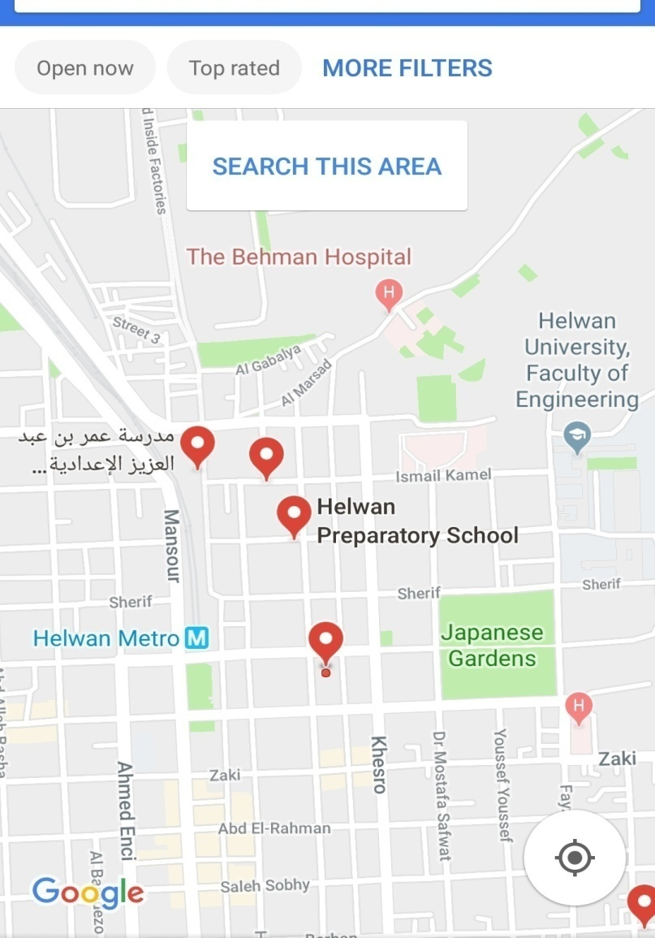
Helwan Preparatory School for Boys
Ahmed Marzouk Preparatory
School for Girls.
Omar Ebn Abd El Aziz
for Boys.
Salah Salem Secondary
for Boys

Slide 40
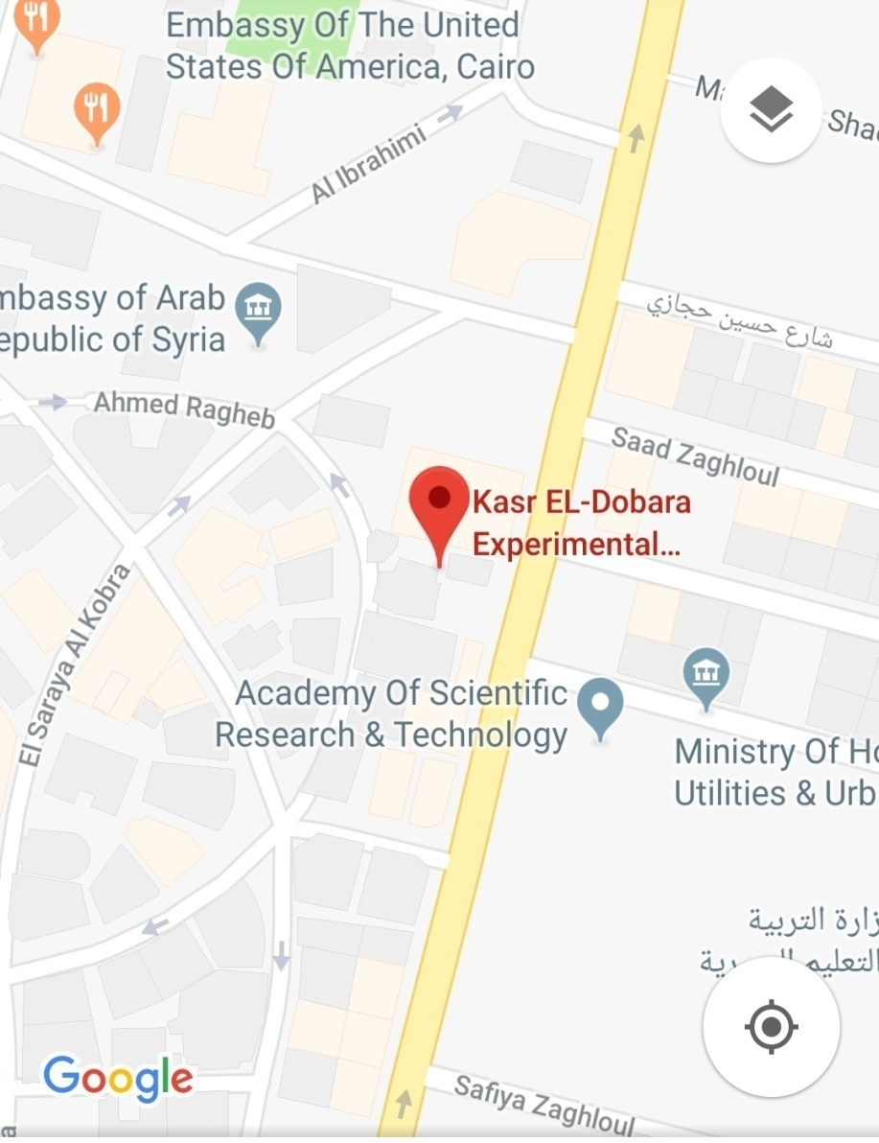
Kasr El Dobarah State School
?????

Slide 41
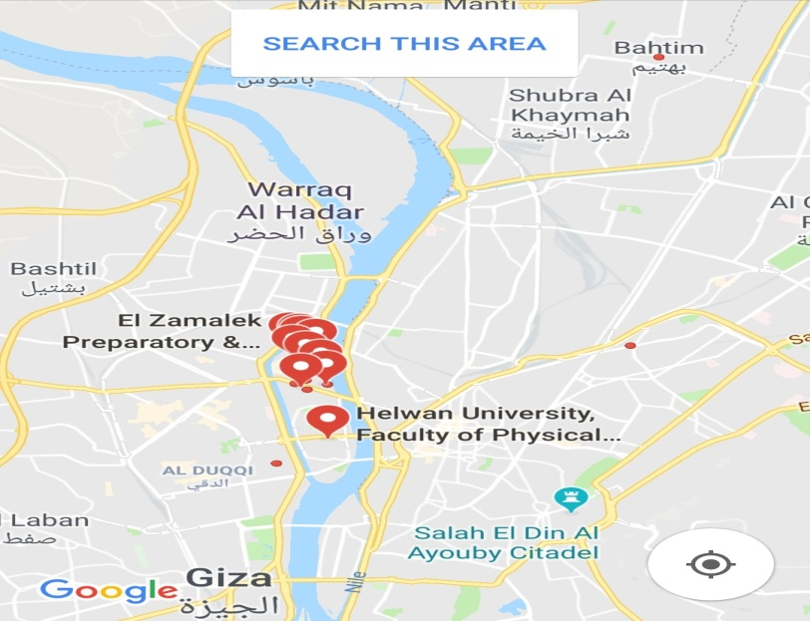
Zamalek School for Girls
El Gezera State Language School.
El Zamalek primary school.

Slide 42
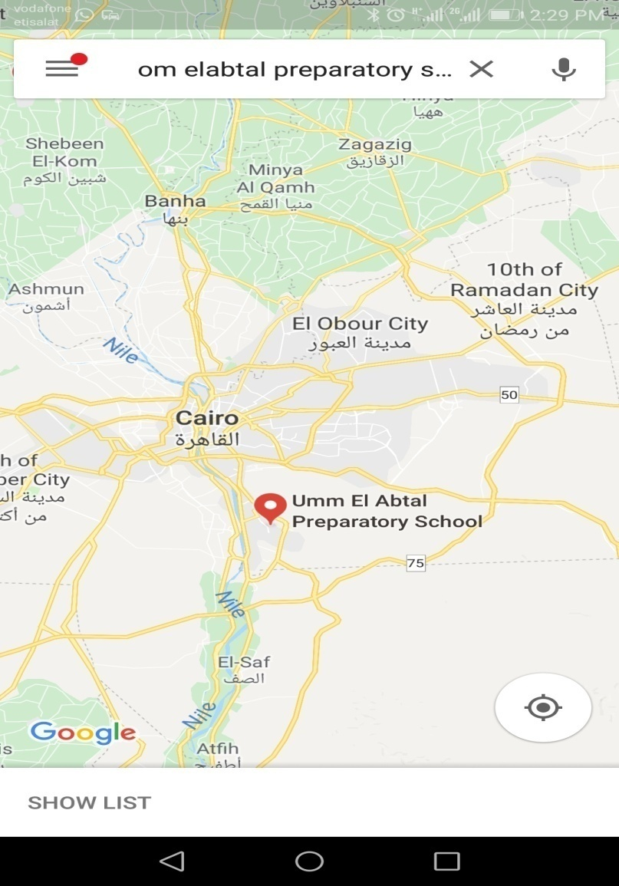
Om El Abtal Preparatory School for Girls
Zahraa Helwan Secondary
School.
Helwan Secondary School
for Girls.
El Maadi Talented school for
Science and Technology.

Slide 43

Together Towards:

