Slide 1


School and University Partnership for Peer Communities of learners
Project number:
573660-EPP-1-2016-1-EG-EPPKA2-CBHE-JP (2016-2516/001-001)

Slide 2
Workshop in HU
The development of PLCs between HU team, EU partners and school community enriched through the successful workshop in December.

Slide 3
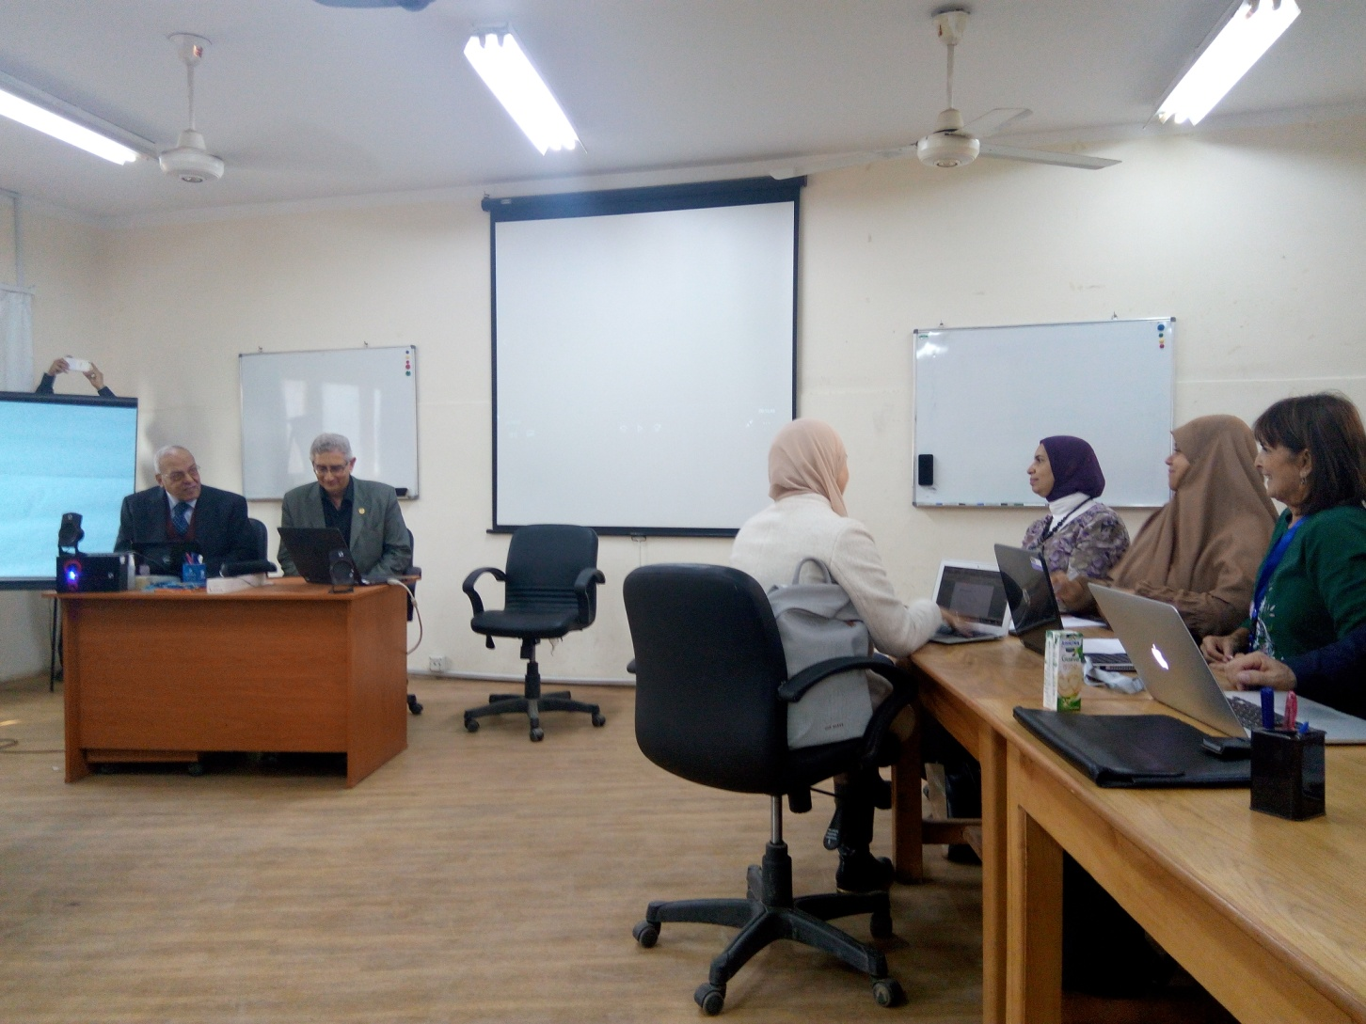
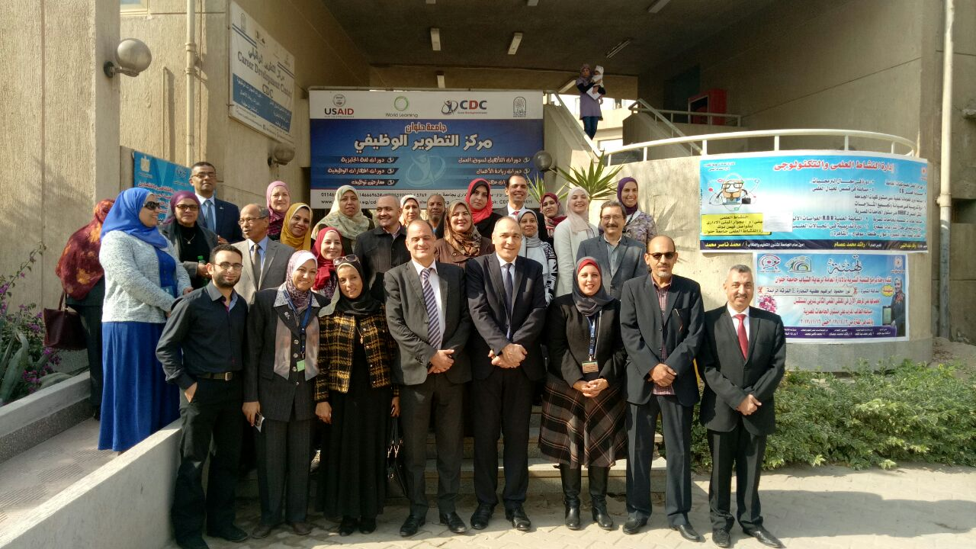

Slide 4
Development of PLCs in HU
The project team developed PLC through monthly regular meetings to discuss different issues:
- Exchange experiences of the EU trips.
- Feedback of the different school visits.
- Organization for the EU workshop.
- Feedback of management meetings` recommendations.
- Monitoring and Evaluation

Slide 5
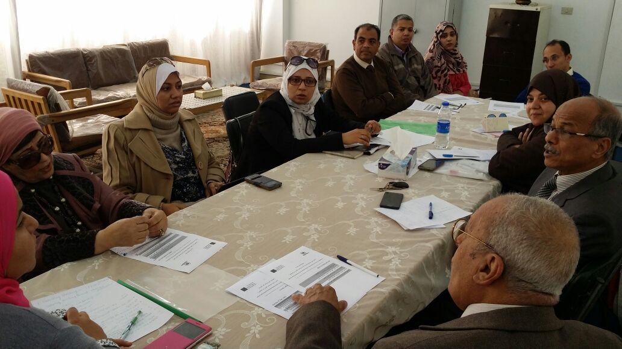
Progress in FOE
Development of PLCs between the project team:
Decision of monthly meeting to exchange academic experiences.

Slide 6
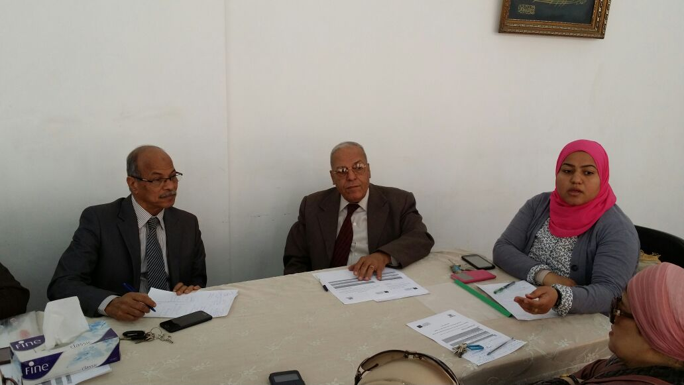
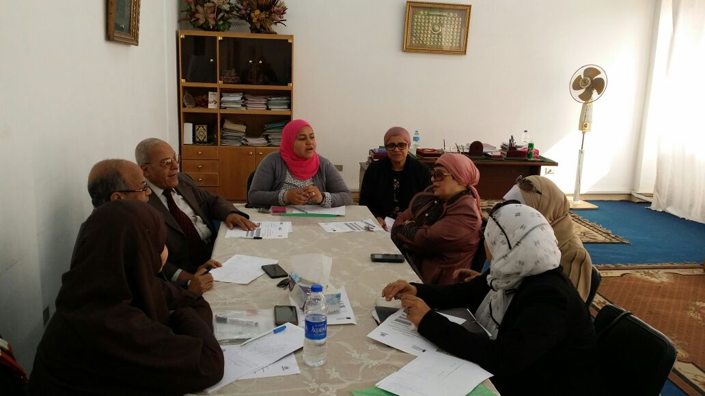

Slide 7
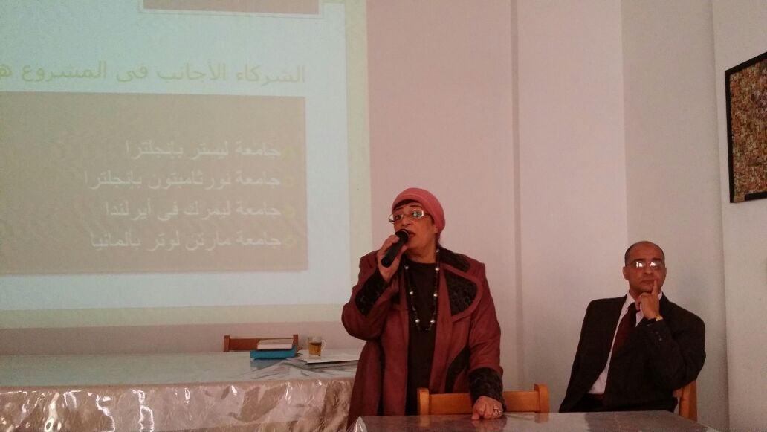
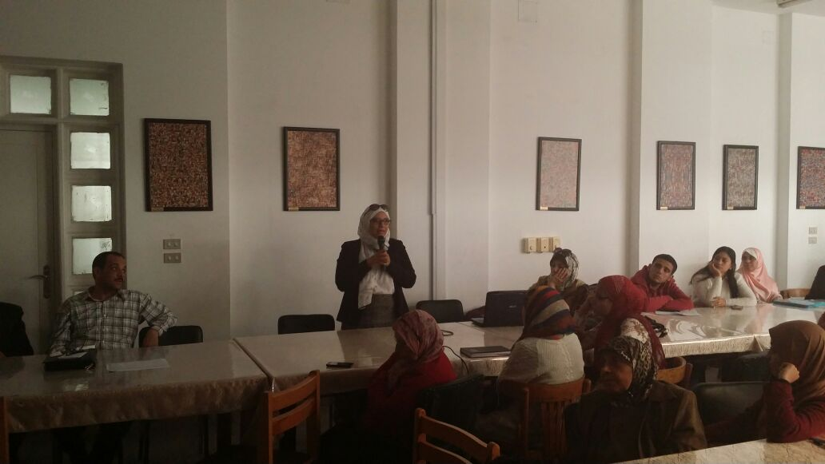
Development of PLC in departments

Slide 8
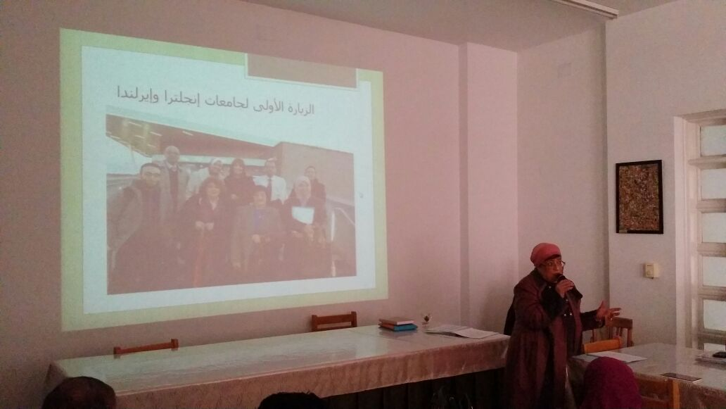
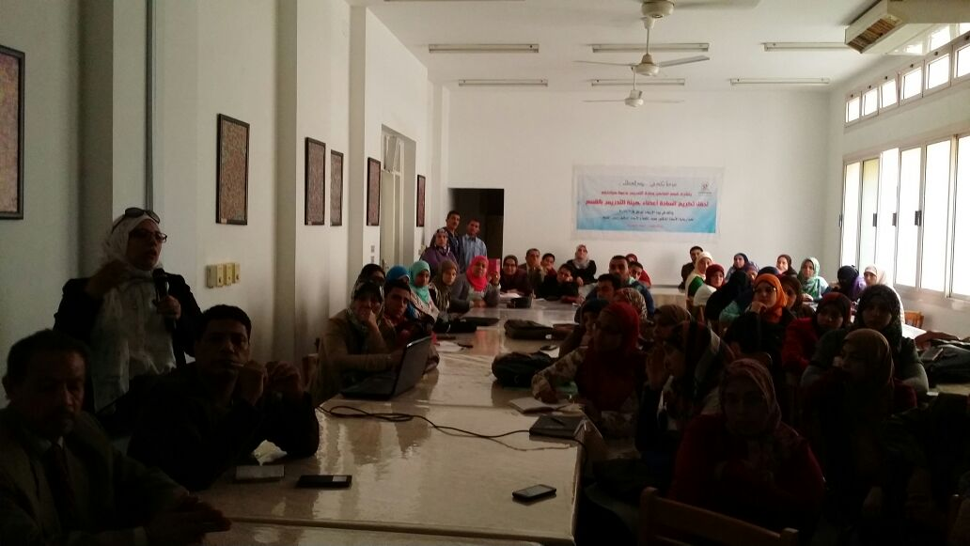

Slide 9
PLC between EGY and EU partners
HU team began to develop PLC through exchanging of materials on dropbox in the areas of Global Citizenship, STEAM and Sustainable Development.

Slide 10

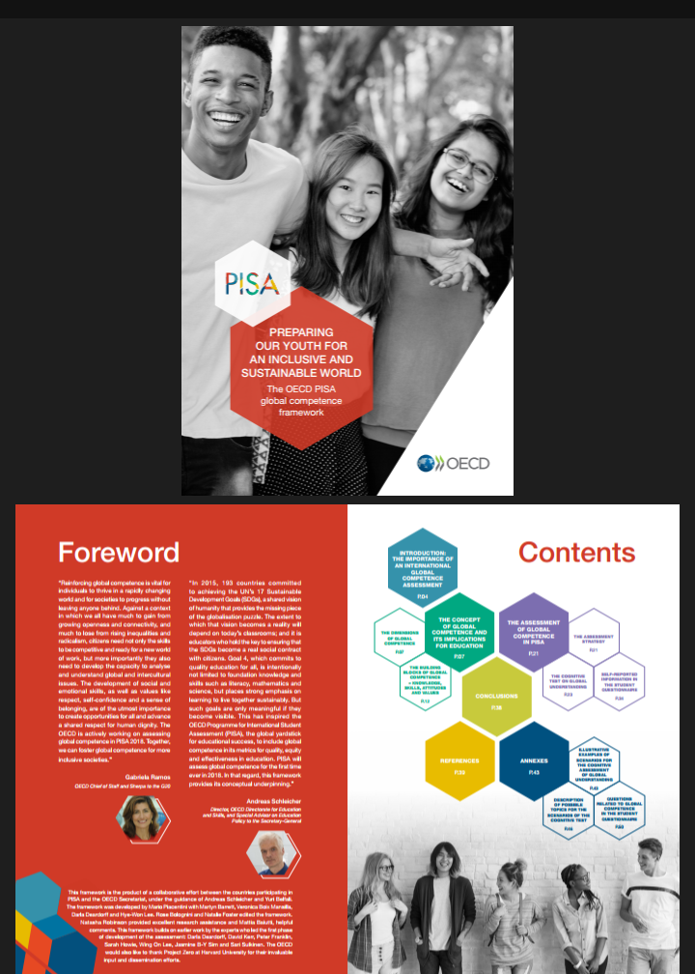

Slide 11



Slide 12
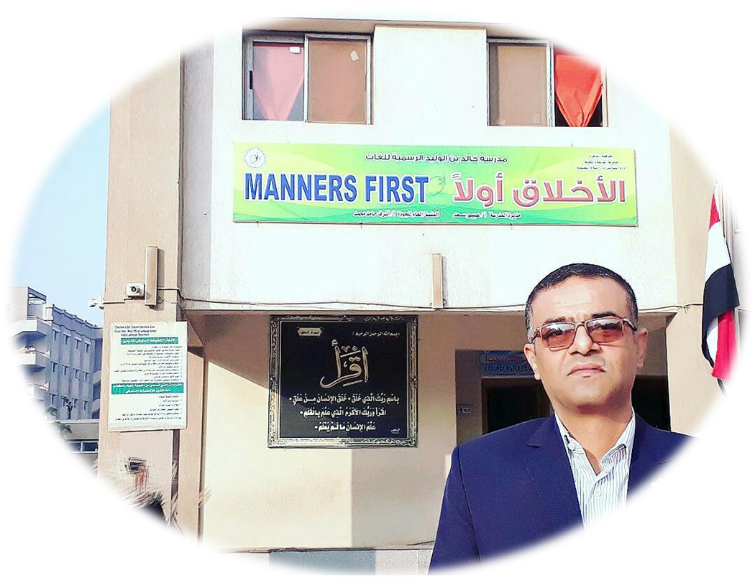
Dissemination of PLCs culture among Post Graduate Researchers

Slide 13
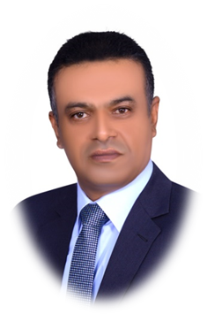
CV
* Name: Ashraf Hamed Mohammed Ali
* Age: 51 (And I am still learning.)
* Qualifications:
Bachelor of Education, Faculty of Education, English Department, Helwan University, 1989.
Curriculum and Education Programs Diploma - English Language department - 2012 - Helwan University.
Curriculum and Methods of Teaching English Language Diploma - 2013 - Helwan University.
Master Degree in Education (Curricula &Teaching Methods of English) - 2016 - Helwan University.
* Experience:
I have been working as a teacher of English for 26 years now.

Slide 14

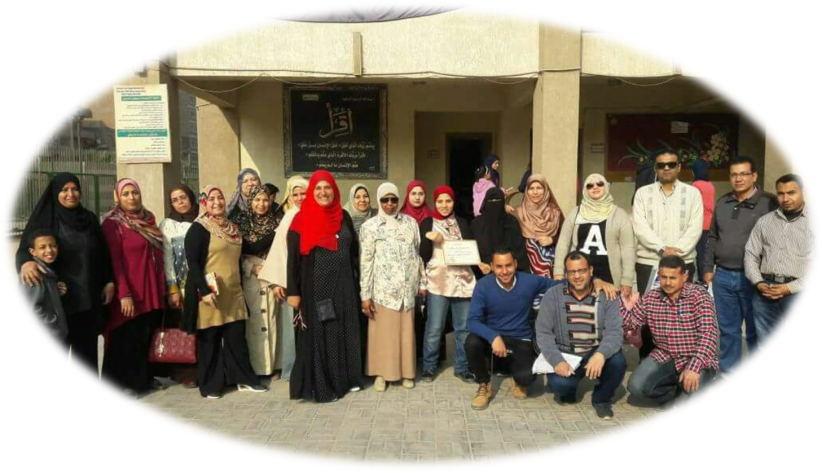

Slide 15

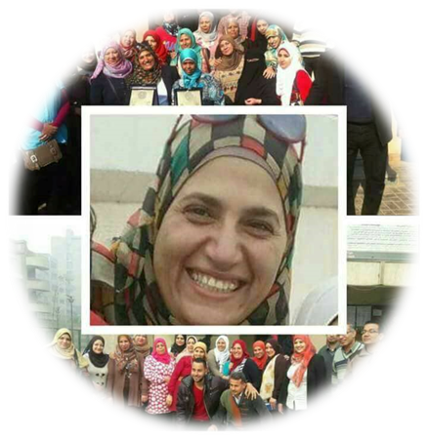
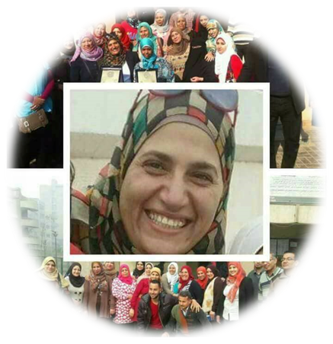
This was my start points
Manners
Teamwork

Slide 16
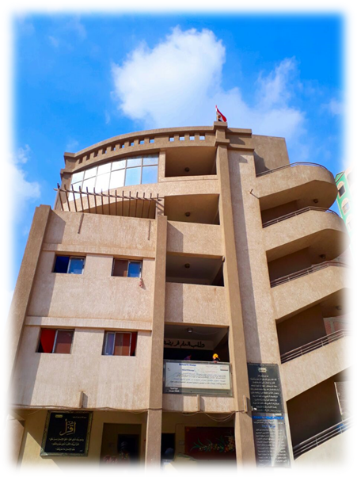
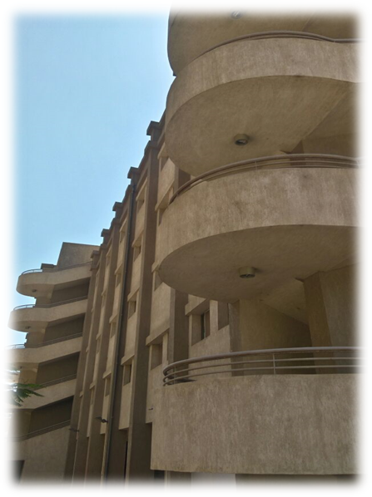
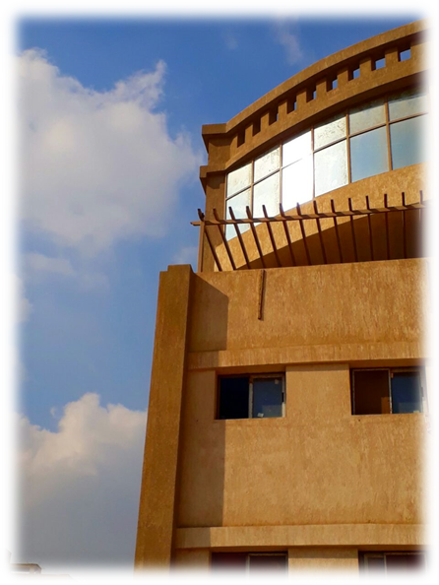
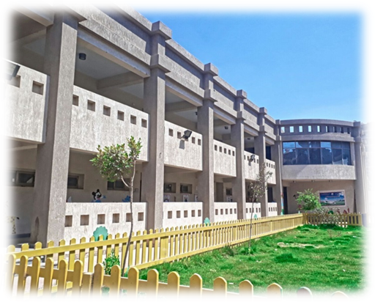
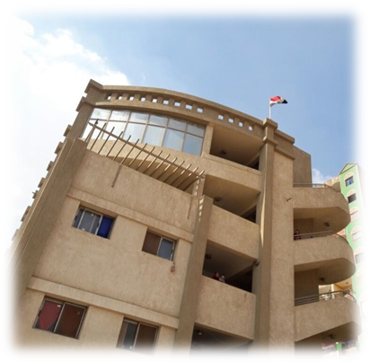
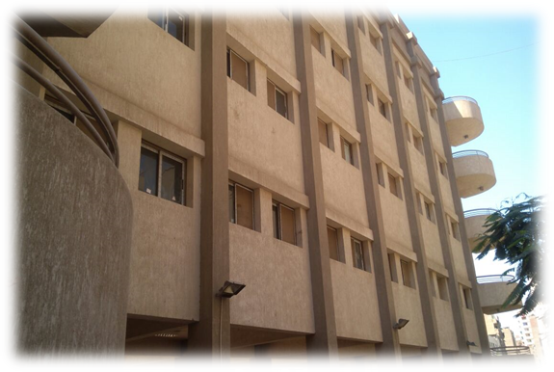
This is the school

Slide 17
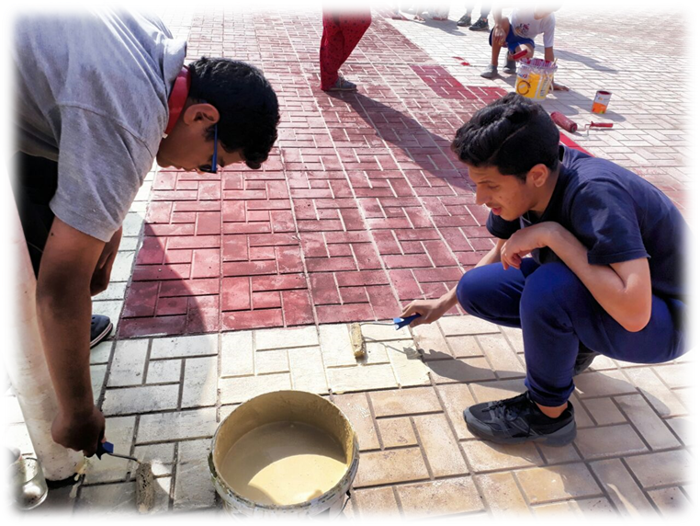
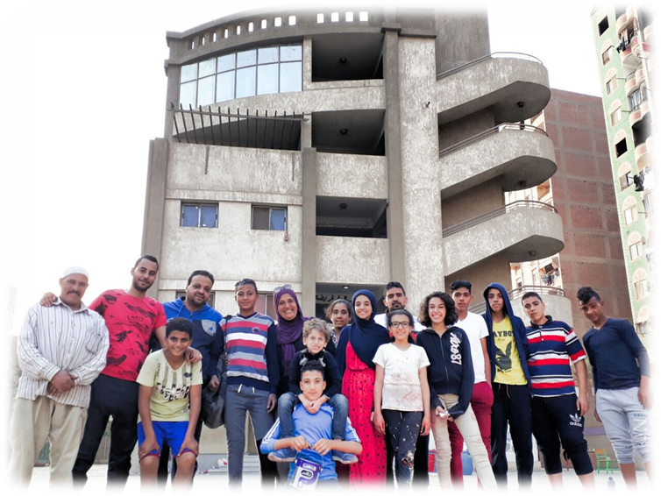
School Community
Our community includes
(teachers - workers - students - students’ parents)

Slide 18
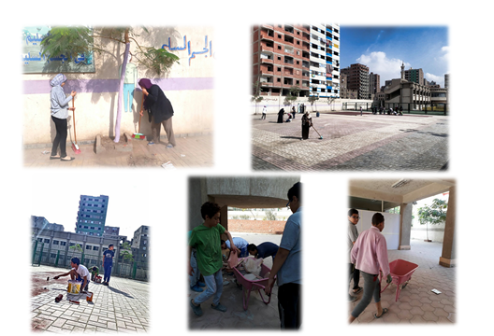

Slide 19
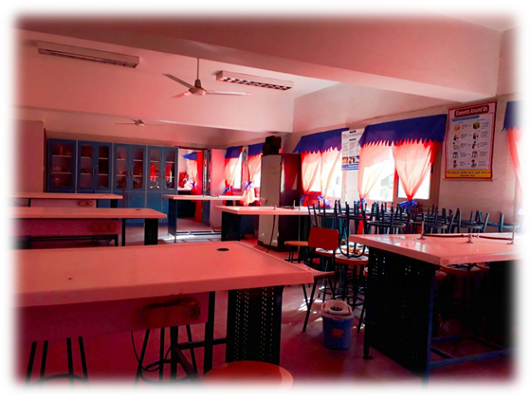
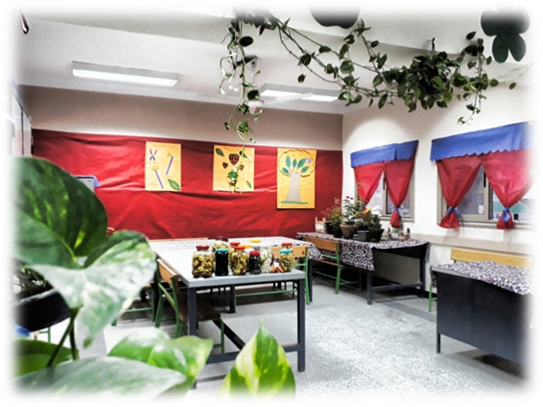
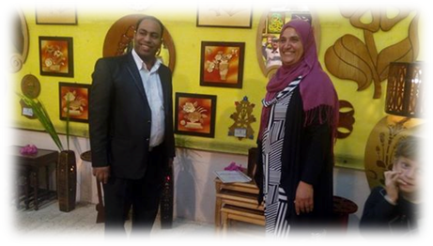
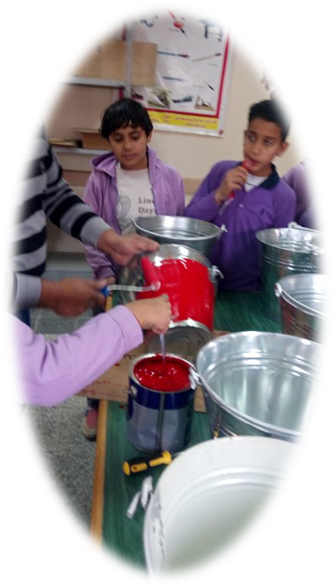
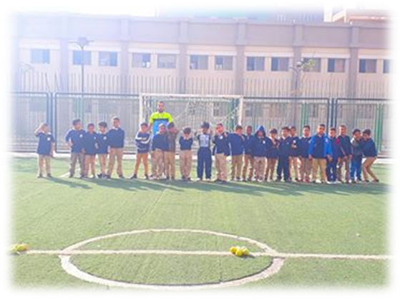
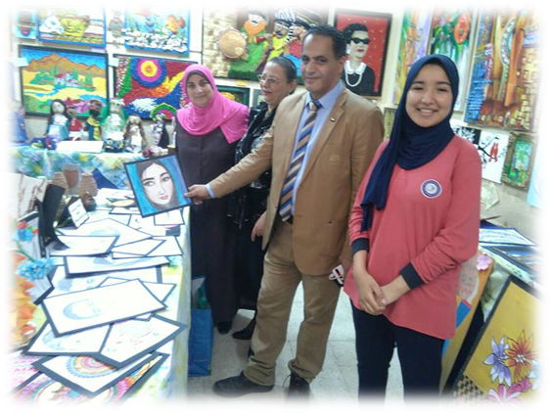
Labs & activities

Slide 20
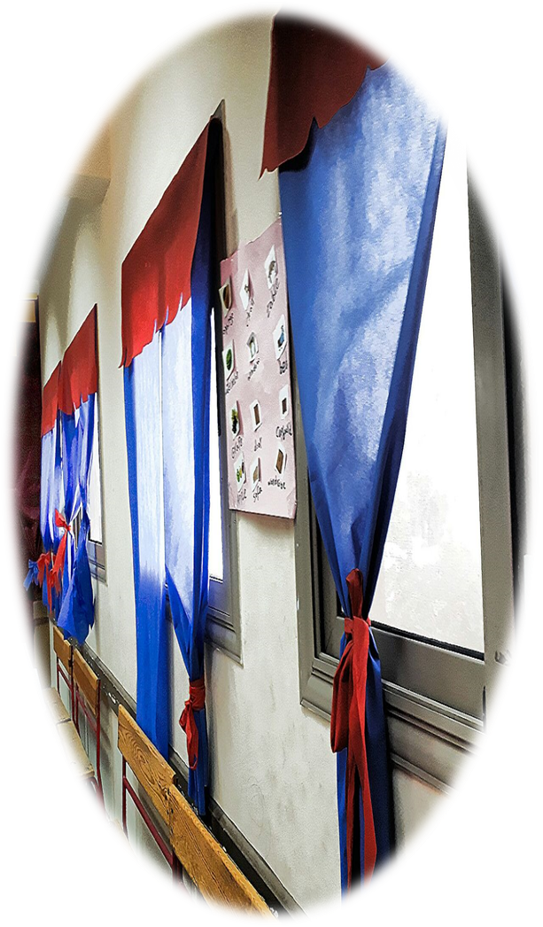
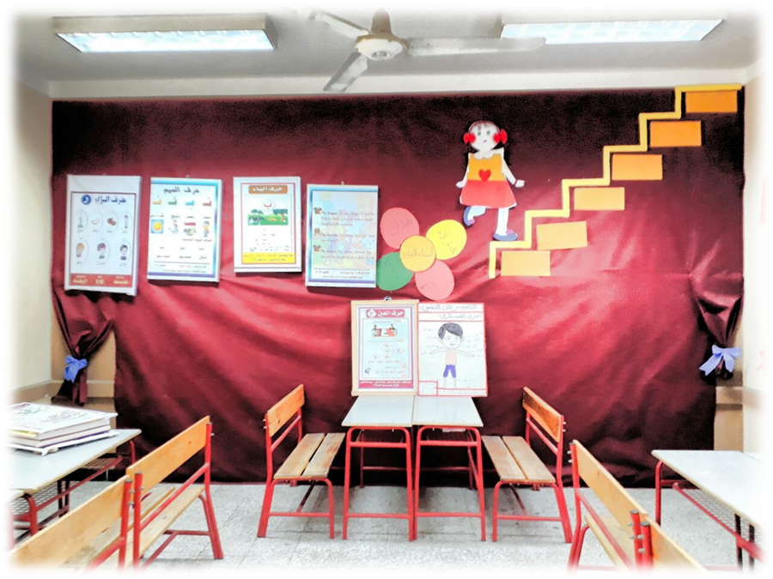
Classes

Slide 21
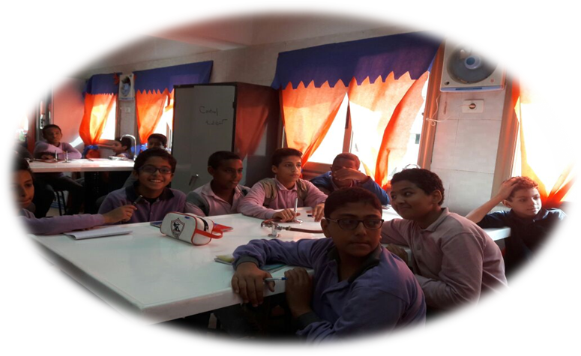
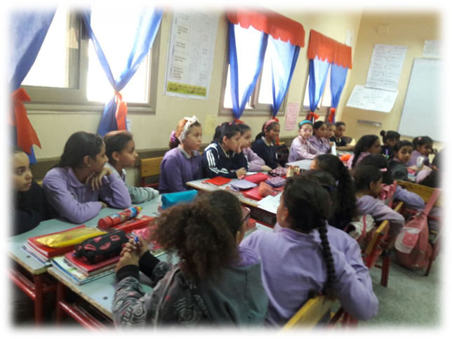
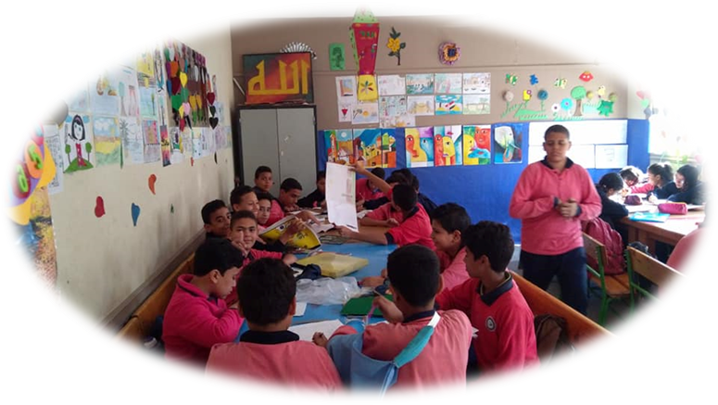
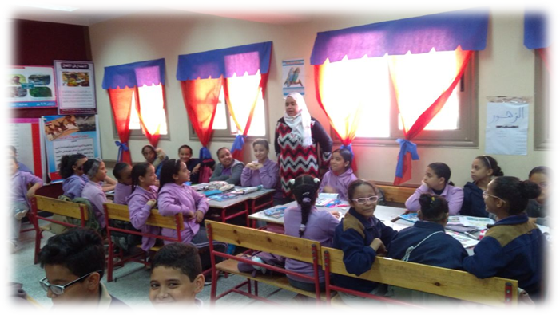
Active learning

Slide 22

Progress on Schools Base line Reports

Slide 23
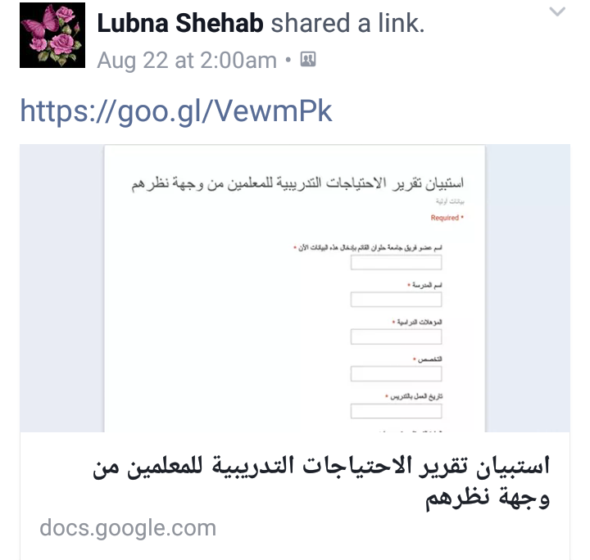
The Process of Data Entry

Slide 24
HU team had different meetings with the teachers and principals in schools to get more involved in the school community.
The different meetings and school visits help in the development of the ethnographic study during the interaction between FOE staff and the school community to develop materials to deepen the culture of global citizenship, sustainable development and STEM between teachers and students through the textbooks

Slide 25
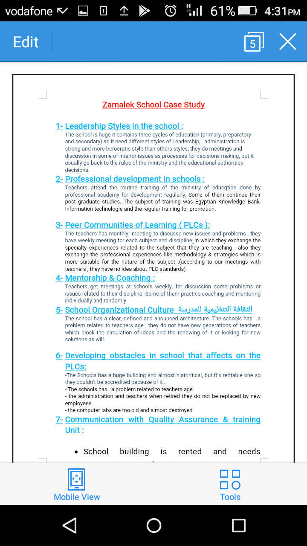

Slide 26
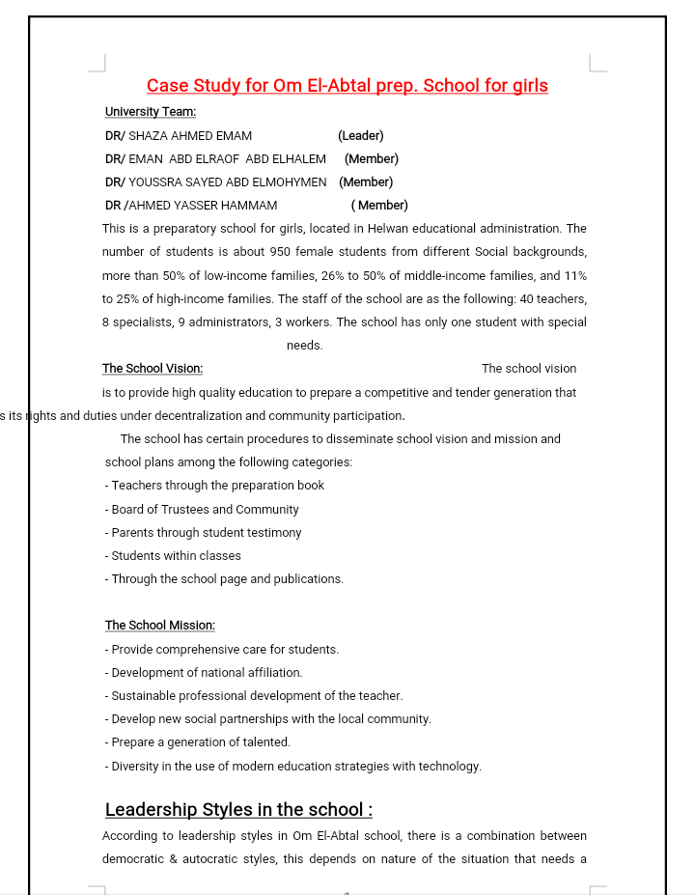
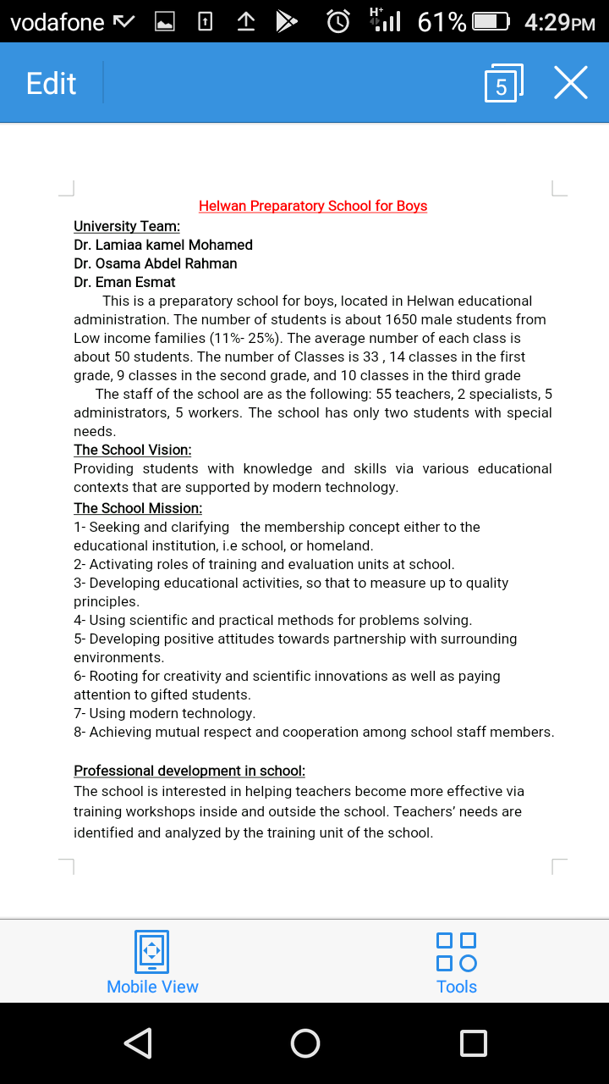

Slide 27
Progress in Mentorship
HU team began the mentoring of teachers during the school visits to disseminate the project future steps and to mentor them during the planning of teaching activities.

Slide 28
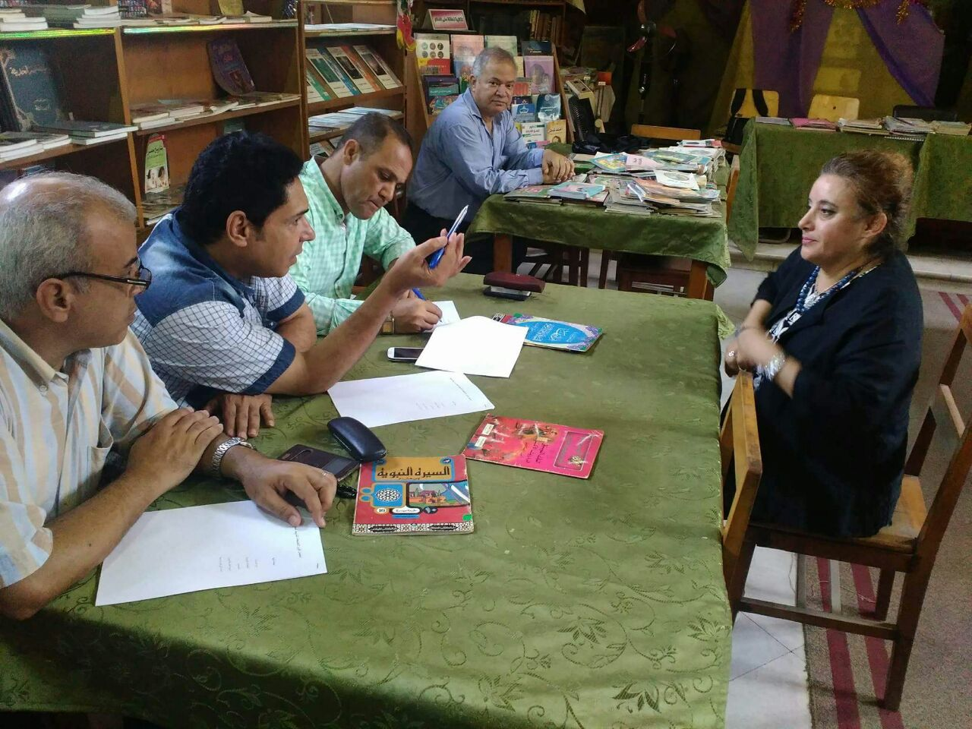
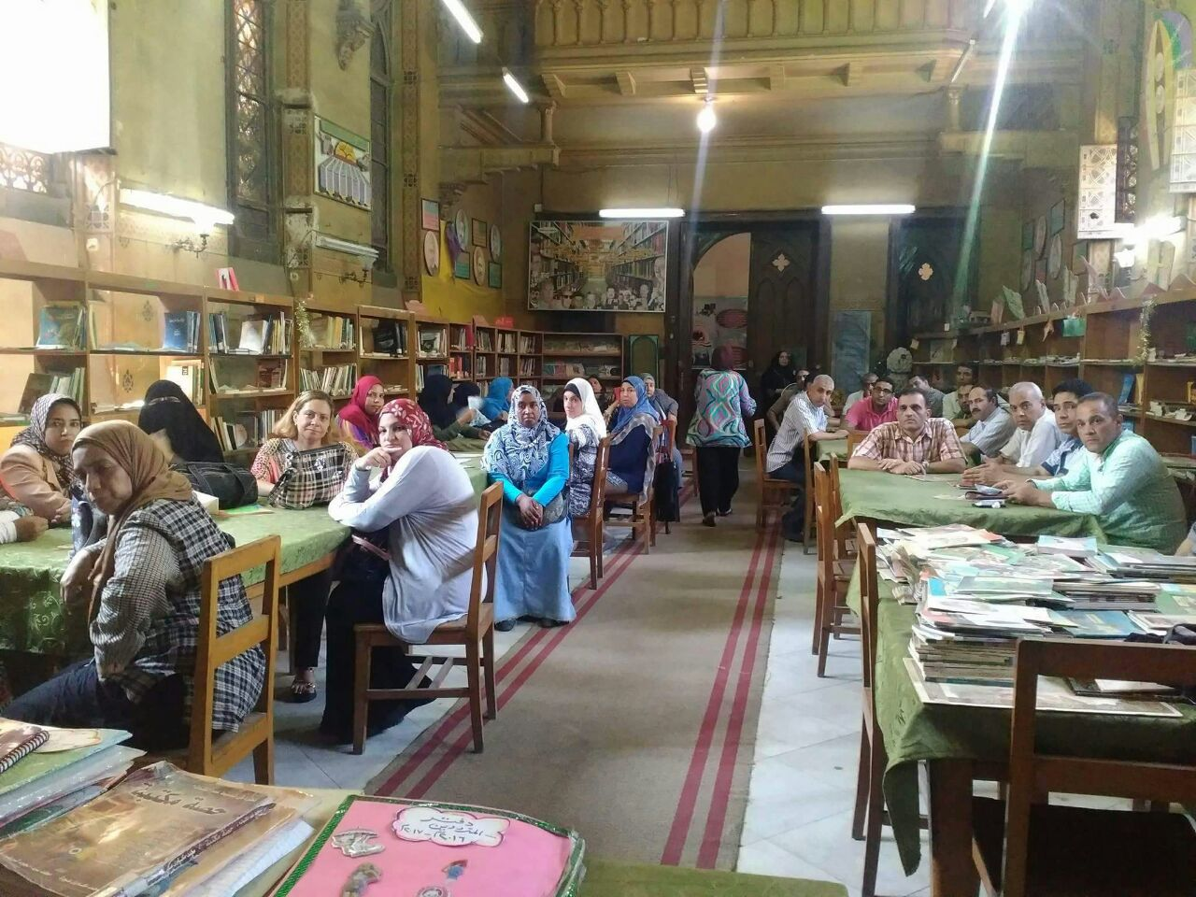

Slide 29
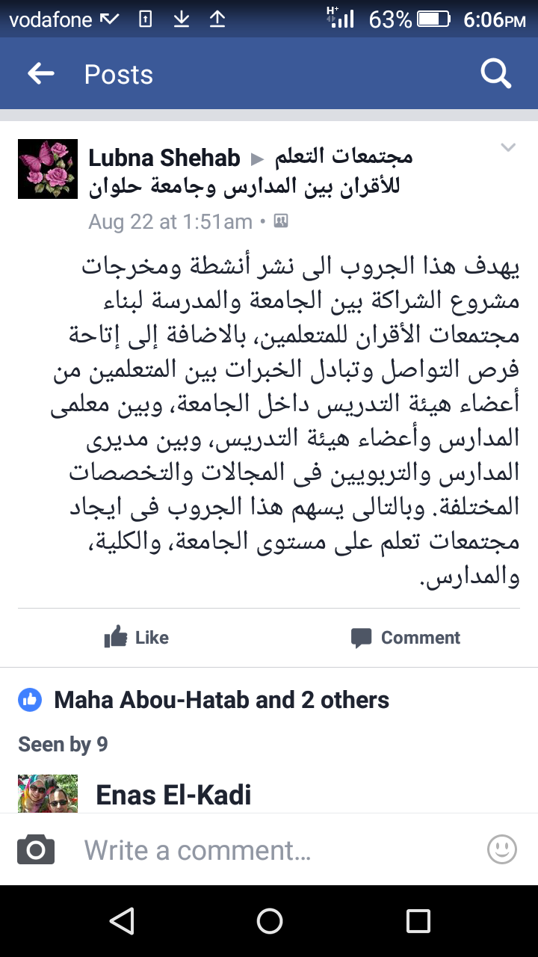

Slide 30
26- 27 Feb workshop
Division of roles and responsibilities.
Preparation of theoretical presentation of the three areas.
Designing of sample activities for teachers.
Setting the logistics of the workshop.
Communication with Educational Directorate.

Slide 31
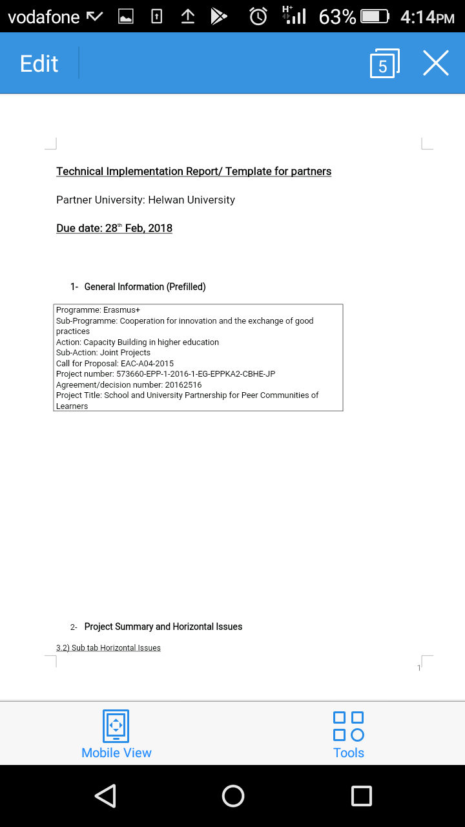
Submission of Intermediate Report

