Slide 1

L
E
I
C
E
T
E
L
I
E
M
PLU
A
I
N
A
N
R
H
T
H
A
P
T
O
N
L
W
A
N
I
C
K
L
E
X
A
N
D
R
I
A
H
A
M
S
A
RT
A
I
N
L
U
T
H
E
R
C

Slide 2


School and University Partnership for Peer Communities of learners
Project number:
573660-EPP-1-2016-1-EG-EPPKA2-CBHE-JP (2016-2516/001-001)

Slide 3
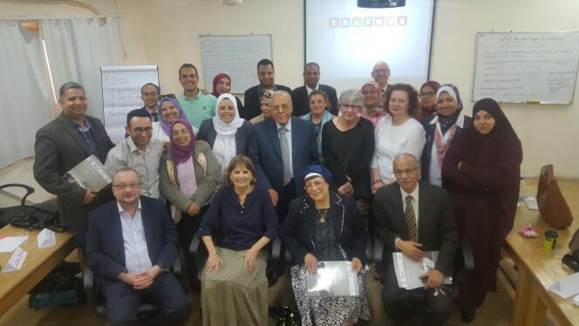

Slide 4

Progress on Needs Assessment

Slide 5
Meetings with HU Team
HU team has different meetings to develop - baseline reports on 5 schools that include:
First: School Profile
Second: Needs Assessment.
Third: Ethnography Study.

Slide 6
Procedures for developing school baseline reports
1- School Visits:
Introduction of the project through an info session between HU team and the school principal.
Application of needs assessment tools( questionnaire, interviews, focus groups)
Completion of School Profile.

Slide 7
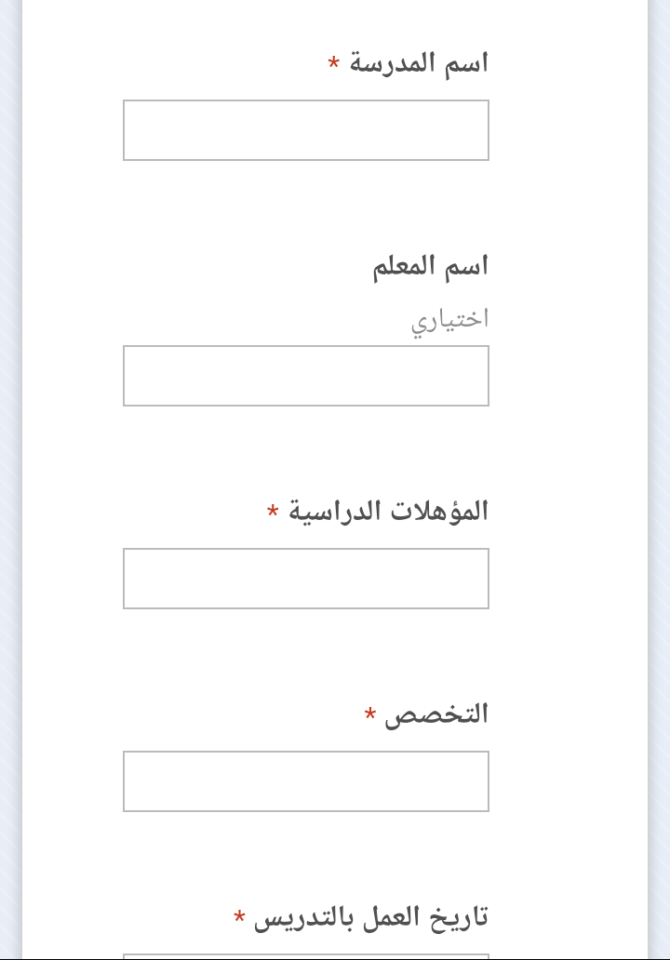

2- Design Electronic Tool for Data Entry

Slide 8
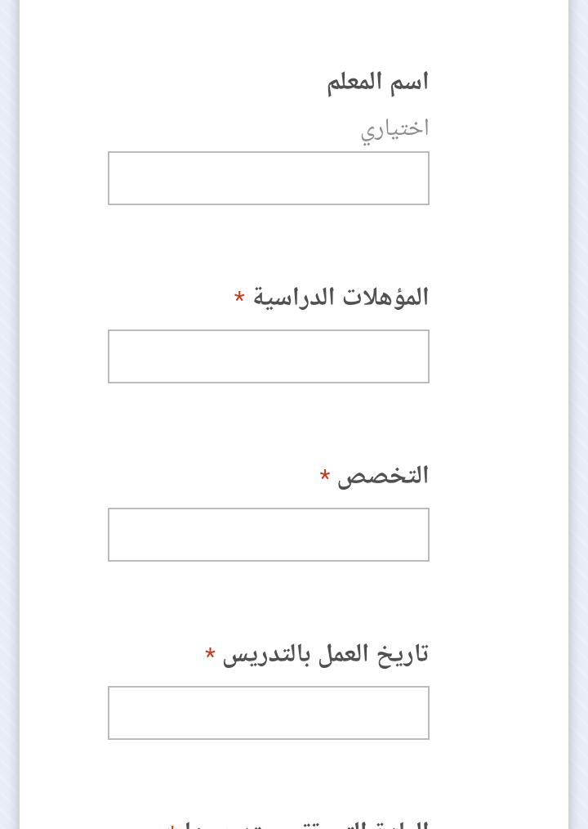
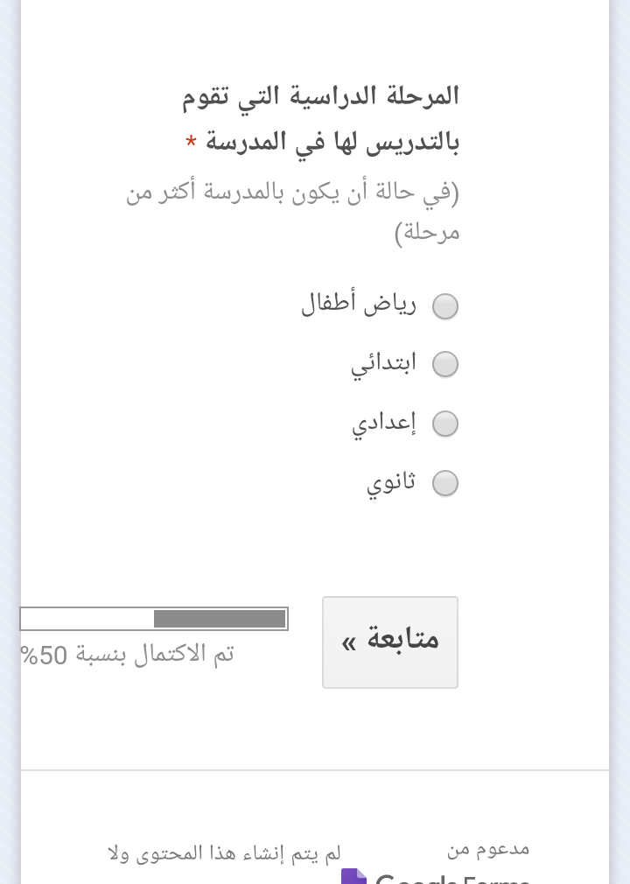

Slide 9

3- Statistical Analysis Committee
Team Selection:
Prof. Mohamed Abdel Salam
Dr. Hassan Makhlouf

Slide 10
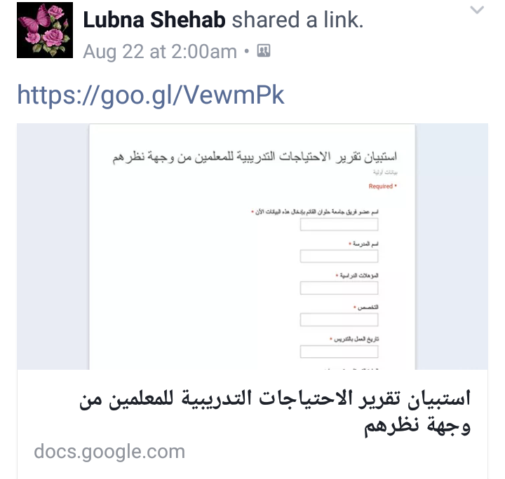
4- The Process of Data Entry for 125 questionnaire.

Slide 11
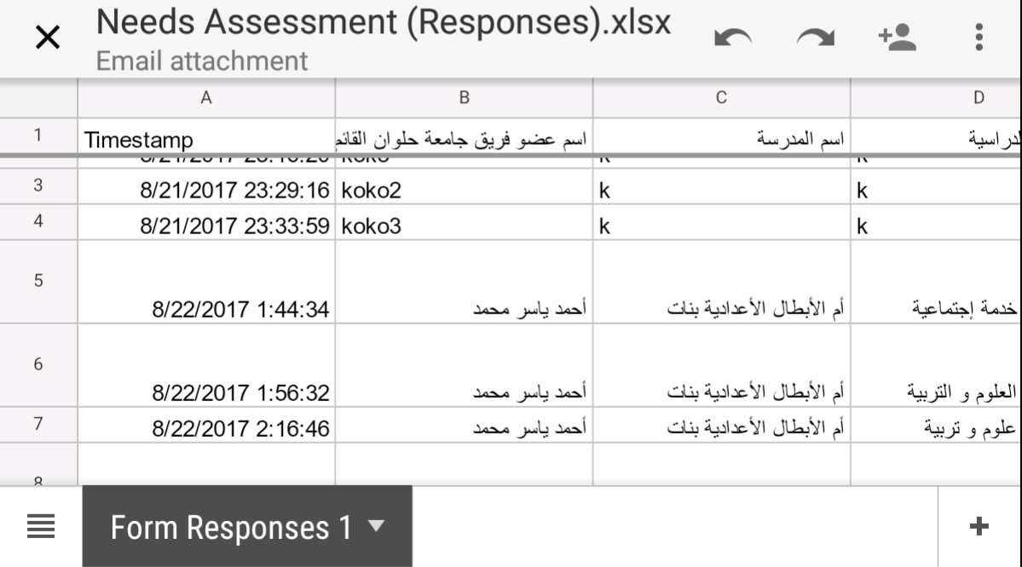

Slide 12
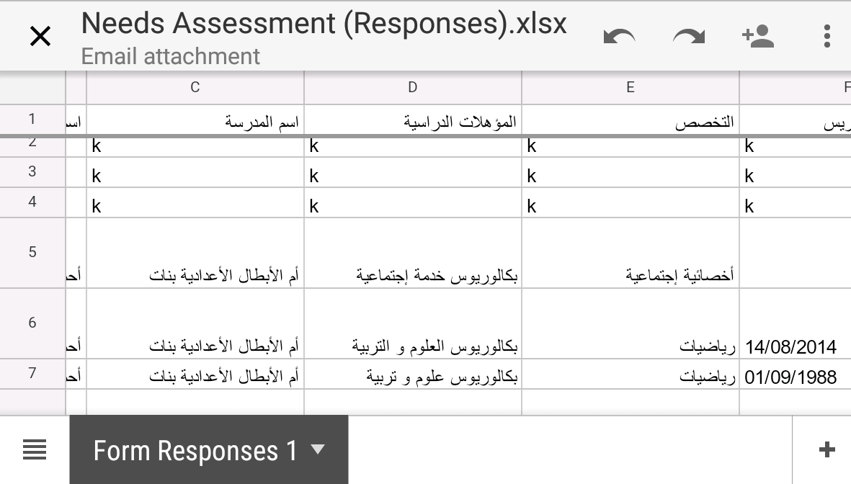

Slide 13
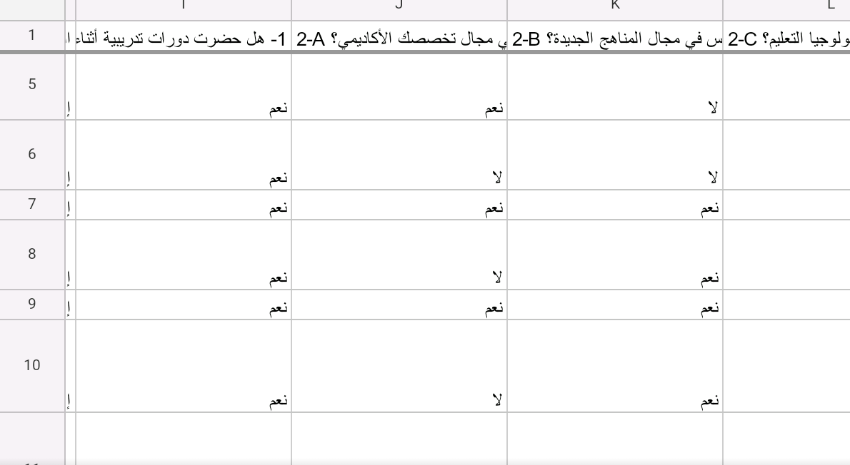

Slide 14
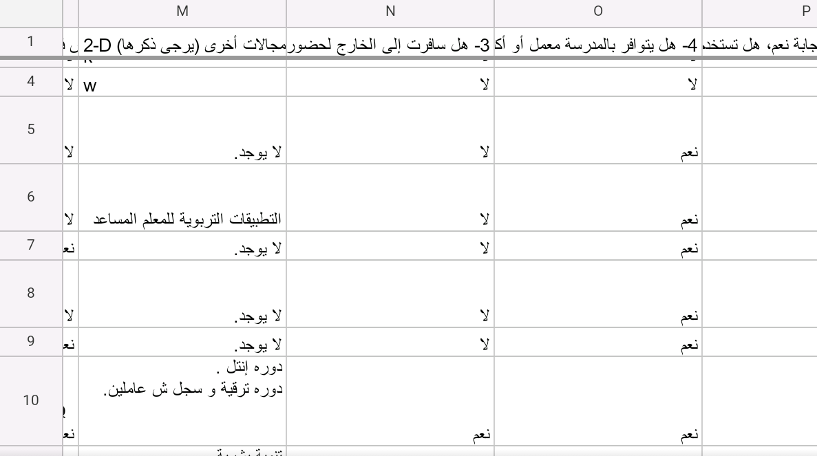

Slide 15
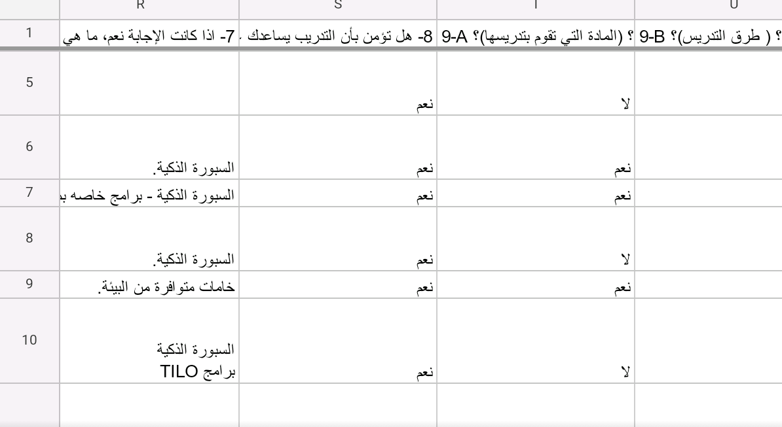

Slide 16
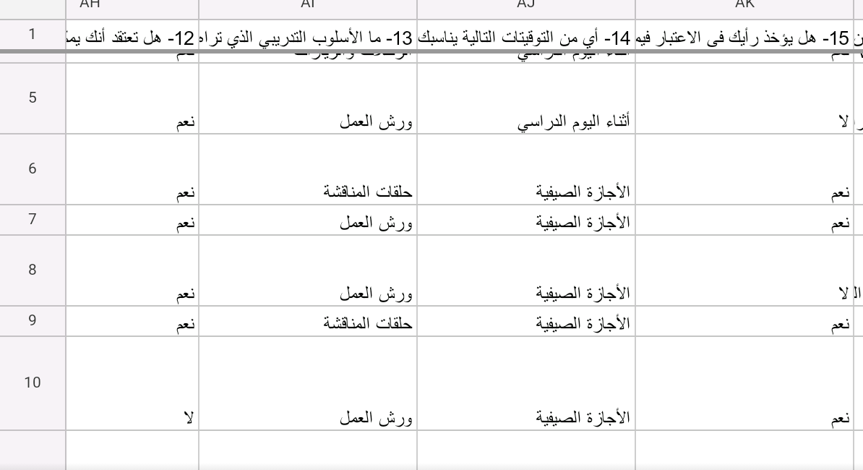

Slide 17
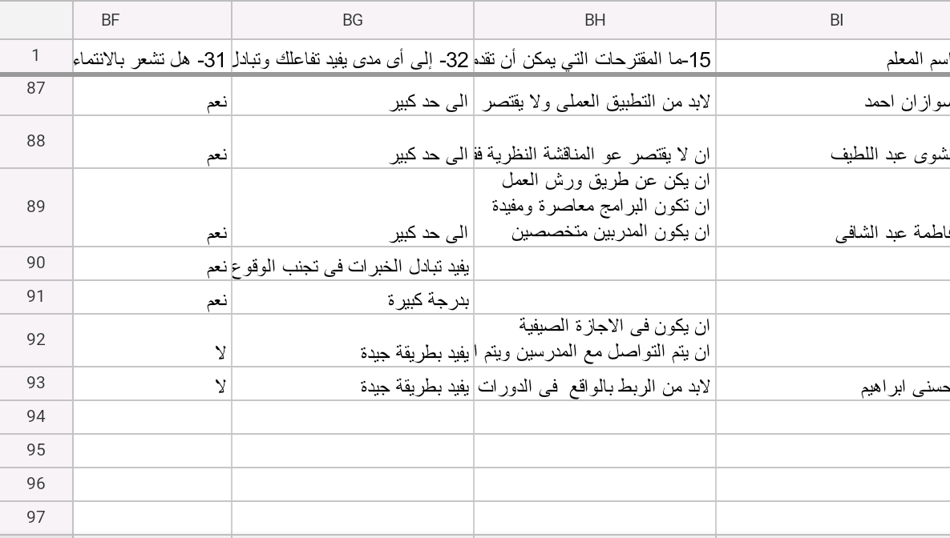

Slide 18
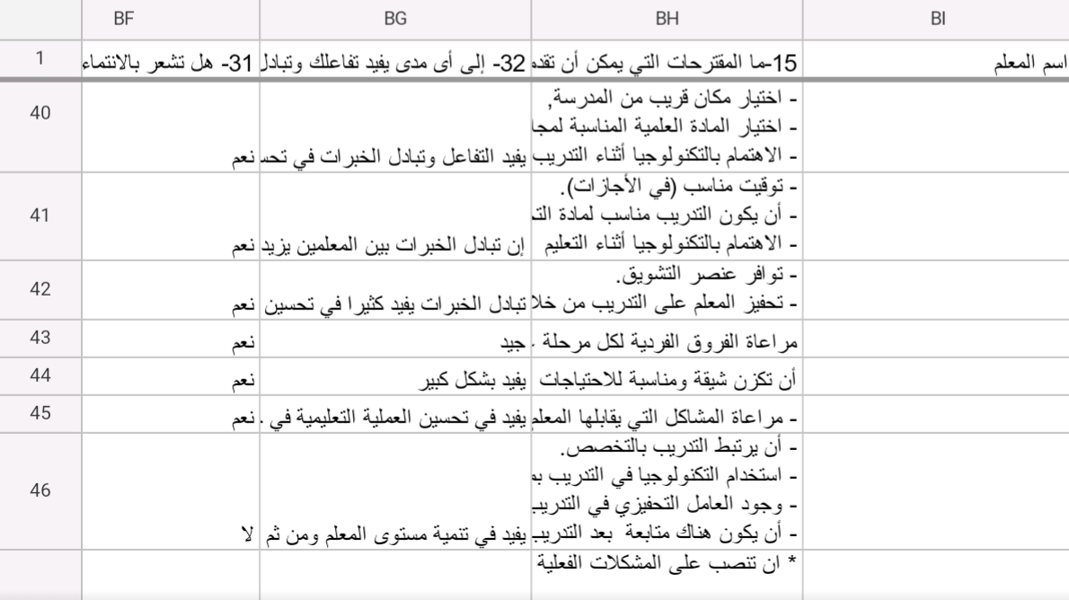

Slide 19
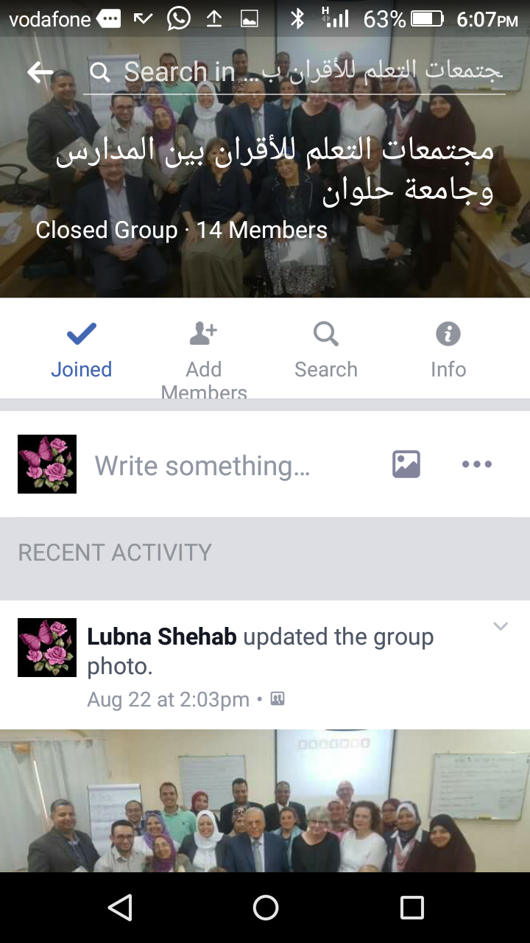

Slide 20
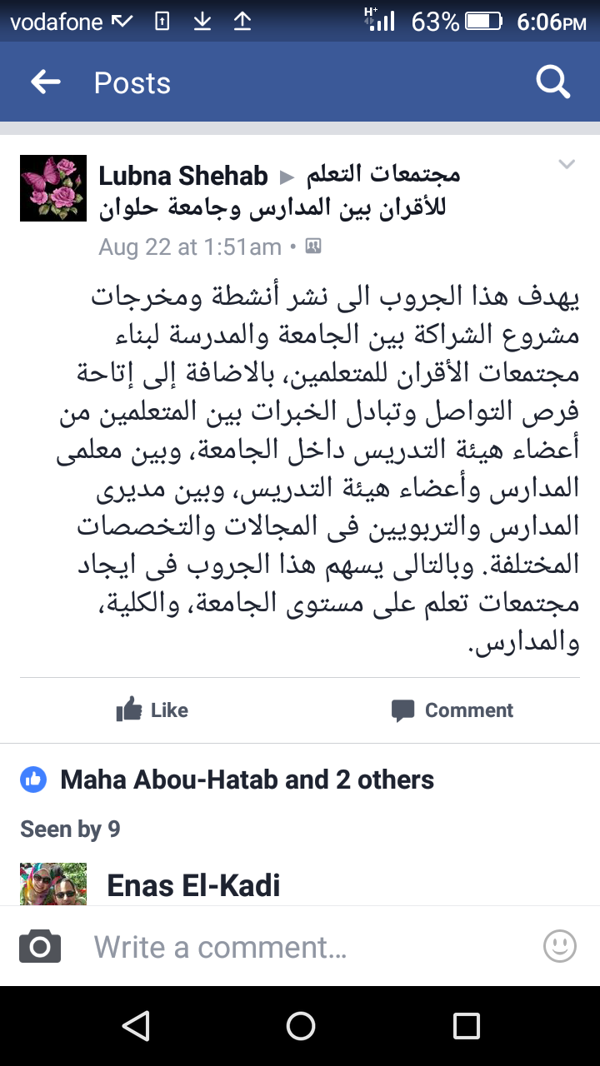

Slide 21
The main topics of the Report:
- Training needs.
- Training Methods.
- Peer communities management.
- Resources and equipments.
- Professional activities& students learning.

Slide 22
Final Report
1- Training Experience:
96% of teachers participated in training courses.
Academic specialization.
ICDL
Educational Technology.
Curricula& Teaching methods.

Slide 23
2- Equipments:
54% of teachers expressed the need for facilities and equipments for developing PLCs.
3- Teachers Needs:
- Educational Technologies.
- Modern Learning Theories.
- How to deal with student behaviors.
- Class Management.
- Strategic Planning.

Slide 24
Quality Assurance.
Assessment and Evaluation.
Mentorship.
4- 53% of teachers prefer peer learning, workshops, school visits.
5- 86% of teachers believe in the need of developing PLCs.
6- 47% of teachers are not satisfied with the school management

Slide 25
7- 16% only of teachers participate in decision making.
8- 51% of teachers are not satisfied with the process of decision making in schools.
9- 36% of teachers have no individualized activities.
10- The need of social justice, especially in reinforcement and accountability system.

Slide 26
4- Professional activities& students learning:
53% of teachers expressed that the school cares about their professional development through training, workshops, academic guidance, psychological support and recognition.
61% of teachers participate in supporting their colleagues through professional activities, developing printed materials, competitions and forums.

Slide 27
- 54% of teachers confirmed that exchange experiences through peer learning had a great positive influence on student learning.
So, The main need is Developing
PLCs in Schools

Slide 28
First School Zamalek Girls’ School (primary, preparatory and secondary levels) West Cairo E.A.
School Profile
Educational administration: west cairo
Number of Classes: 61
primary grade: 31 classes
preparatory grade: 15 classes
Secondary grade: 15 classes
Total Number of students: 2687 students
(Primary students: 1560, Preparatory: 687, and secondary :420)
Average number of each class: 50 students at primary, 45 preparatory, 28 secondary.
Economic& Social background status of students: Low income families (11%- 25%)

Slide 29
First School Zamalek Girls’ School (primary, preparatory and secondary levels)
School Staff Members:
Teachers: 208
Social workers: 6
Administrative staff: 6
Workers: 10
Others: none
Number of students with SEN (Special Educational Needs): none
School Canteen
Computers : 30 for each grade (in a really bad shape)

Slide 30
First School Zamalek Girls’ School (primary, preparatory and secondary levels)
Resources
Educational materials ( textbooks, … etc)
A library
Theatre
Audio educational aids.
Laboratory equipments
Teachers staff rooms
School Canteen
Computers : 30 for each grade (in a really bad shape)

Slide 31
Needs Assessment
Training needs.
- 1-Curricula
2-Learning and Teaching skills
3- Using modern educational technology
4- Self- improvement
5- Class Management
6- Quality Assurance.
7- Strategic Planning.

Slide 32
Other needs according to the qualitative analysis:
Training Methods.
- Most teachers prefer training inside schools and not more
than 3 days.
- visits/ workshops.
Assessment of the impact of the training sessions.
Optional training not obligatory.
Peer communities management.
Teachers believe in the importance of peer learning.
Teachers were not satisfied with the leadership due to different reasons as the lack of human resources management skills.
They need social justice in professional decision making.

Slide 33
Professional activities& students learning:
The need of regular meetings between teachers to exchange experiences, the teachers confirmed the great influence of regular and institutional meetings on students learning.

Slide 34
Ethnography Study
Professional Development
The school is interested in helping teachers become more effective via training workshops inside and outside the school. Teachers’ needs are identified and analyzed by the training unit of the school.
Peer Learning Communities:
Teachers exchange the experiences of their teaching through exchanging the materials, building trust and respect.
The burdens of work and school schedule affect their readiness to exchange experiences.

Slide 35
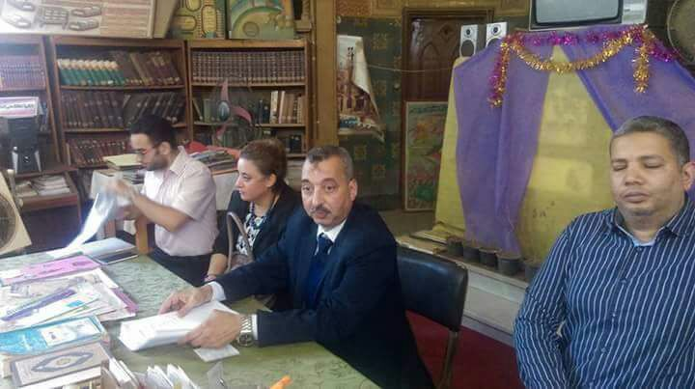
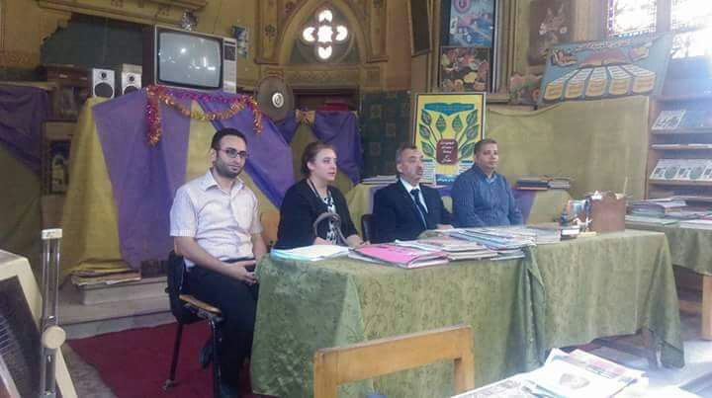

Slide 36
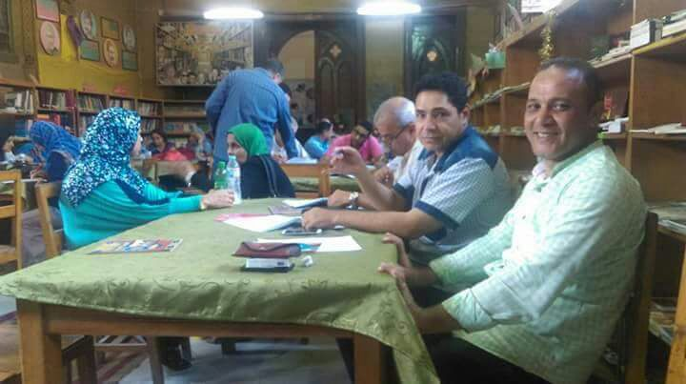
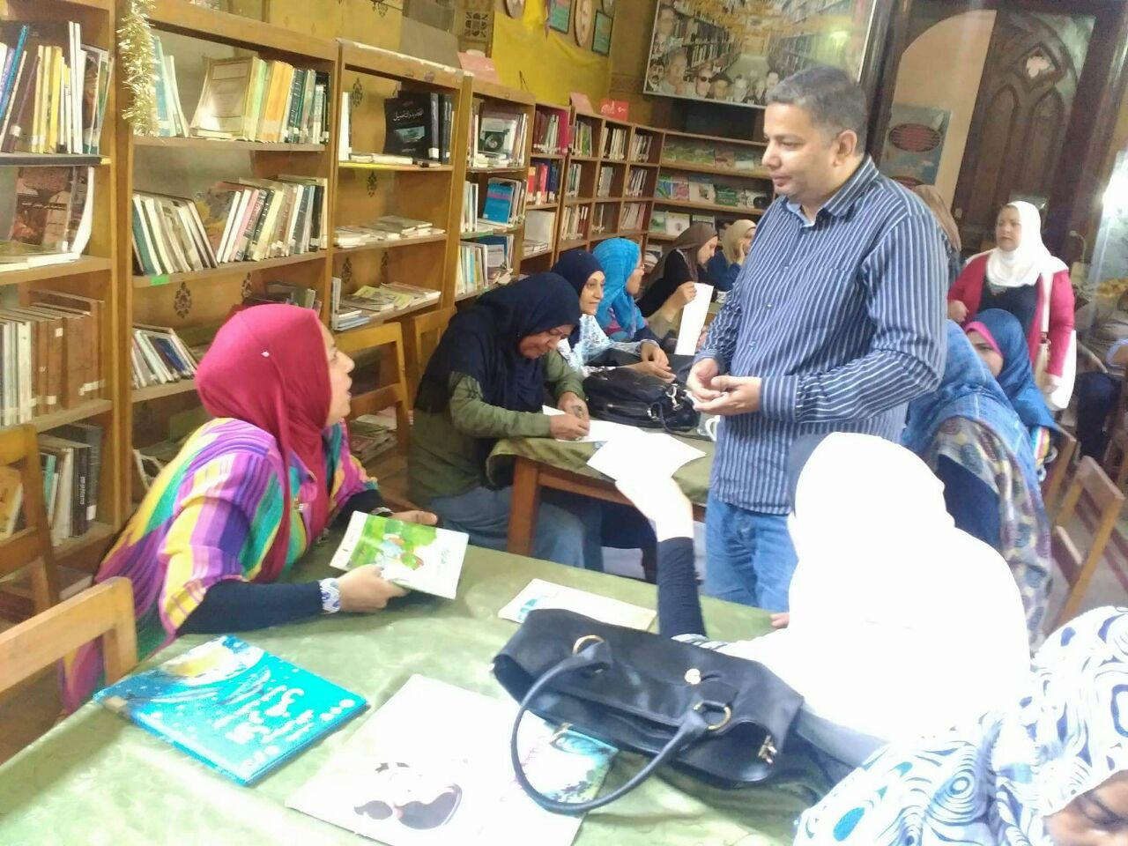

Slide 37
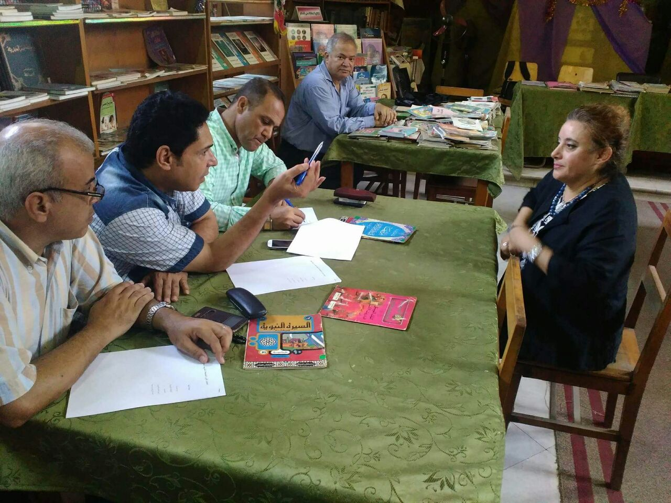
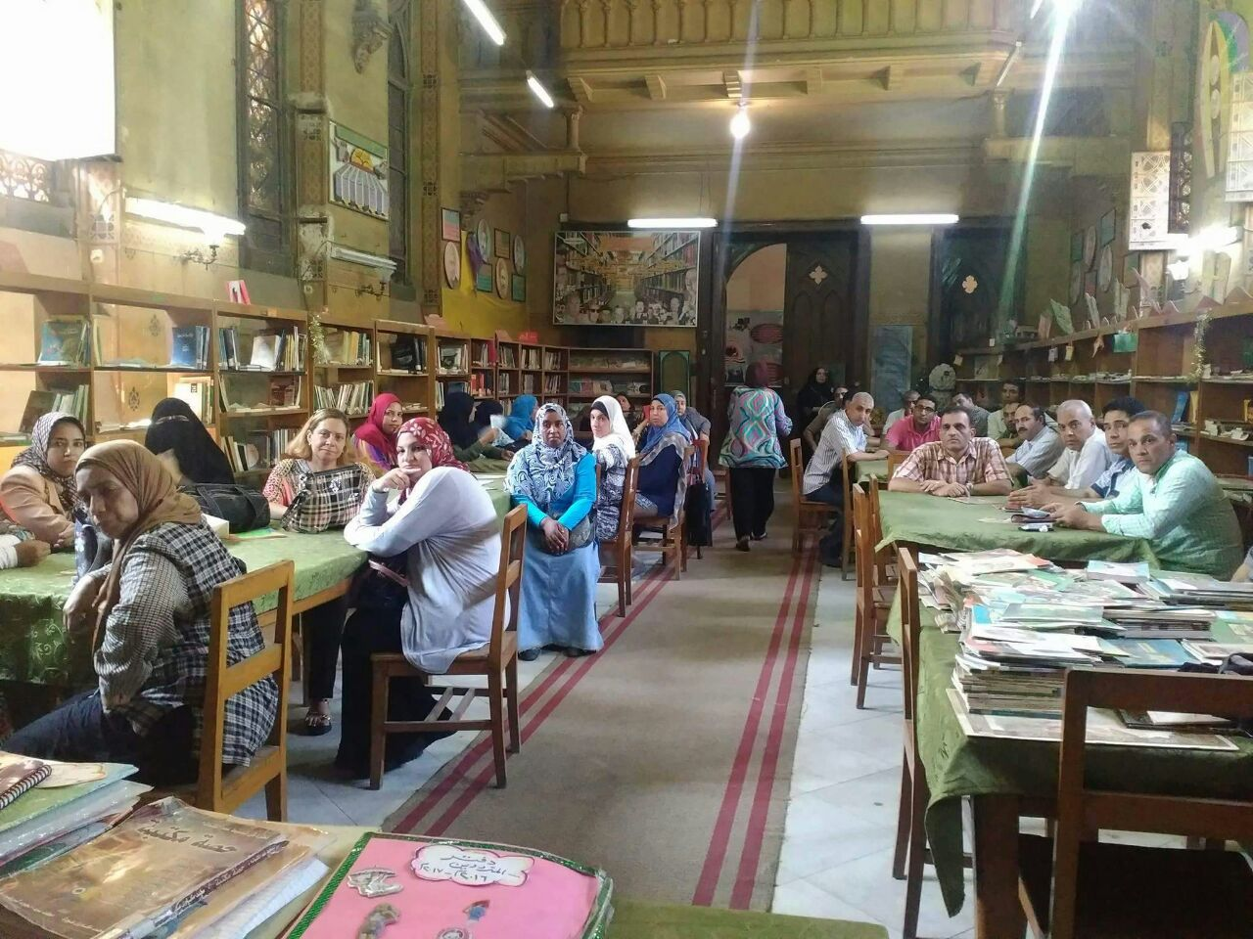

Slide 38
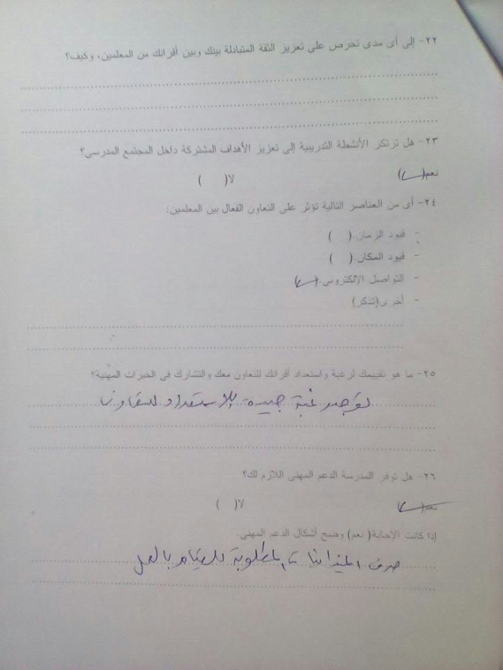
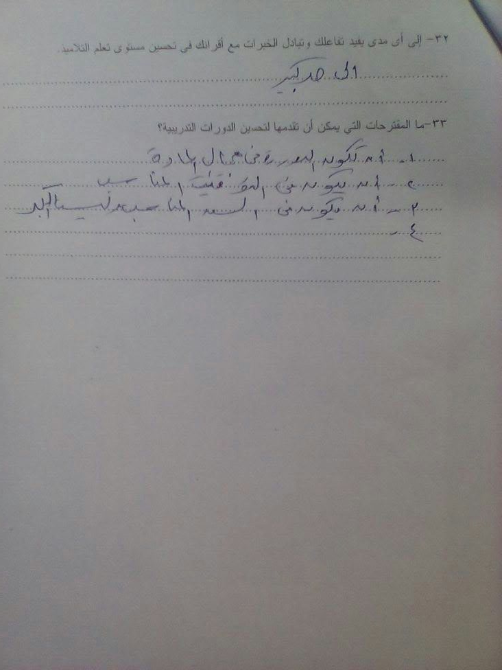
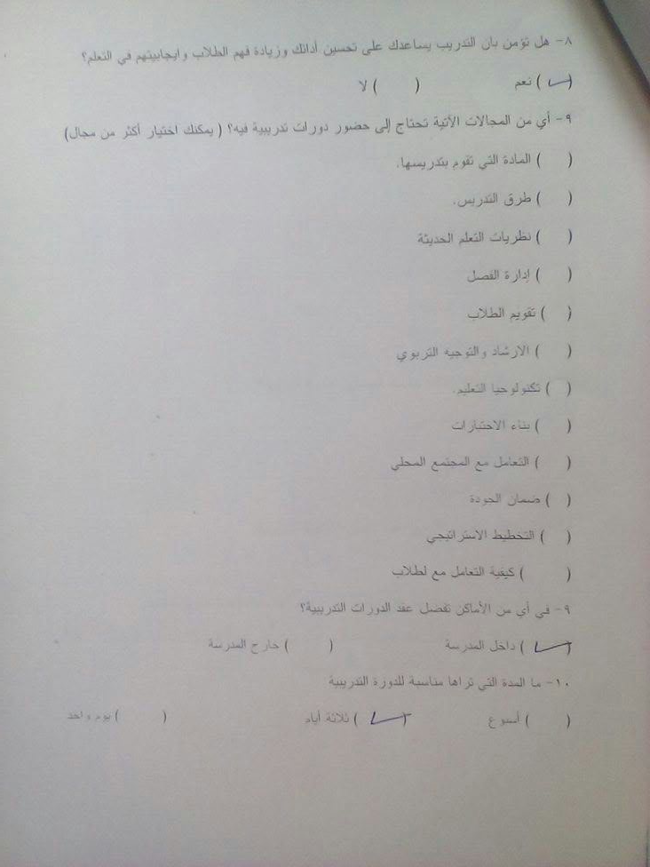
Second School Om Elabtal Girls’ preparatory School Helwan E.A.

Slide 39
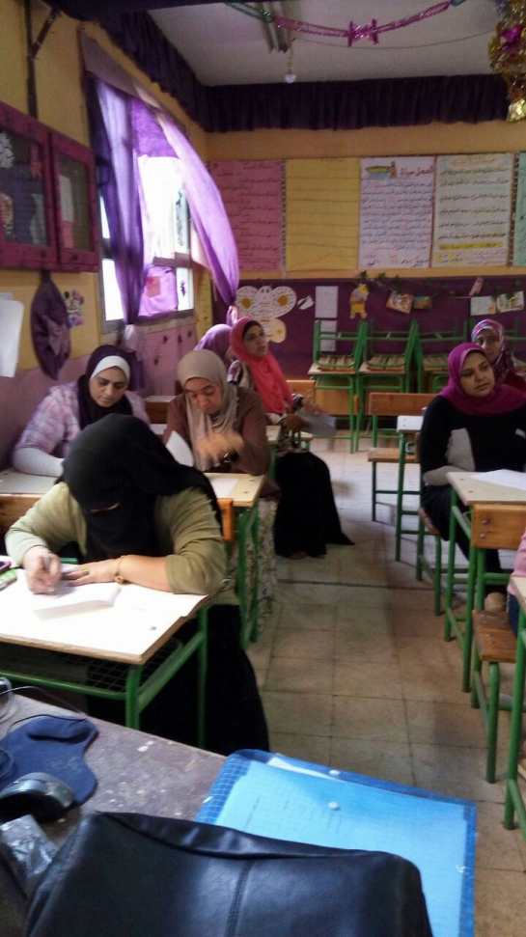
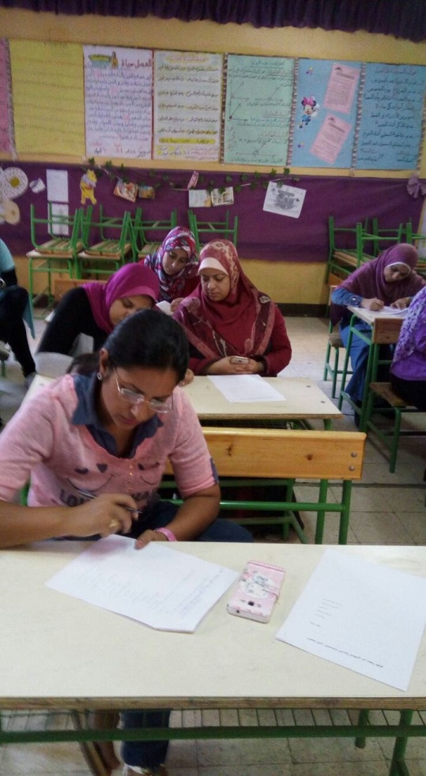
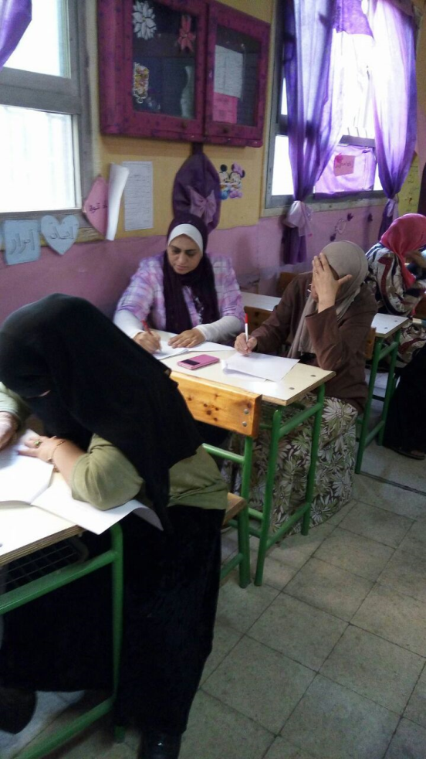
Second School Om Elabtal Girls’ preparatory School Helwan E.A.

Slide 40
School Profile
Educational Stages:Preparatory Stage Students
Number of students: ( Male/ Female):950 student - female
Number of teachers: ( Male/ Female):40 teacher
Social background of students:More than 50% of low-income families / From 26% to 50% of middle-income families / From 11% to 25% of high-income families
Number of employees:
Teachers: 40
Specialists: 8
Administrators: 9
Workers: 3

Slide 41
Needs Assessment
Training needs.
Students` behavior management.
- Training Methods.
They need applicable training material not only theoretical.
- Peer communities management.
They need to be involved in decision making.
- Resources and equipments.
They prefer E- communication and online meetings between teachers.
- Professional activities& students learning.
Teachers prefer joint training between different schools to exchange experiences.

Slide 42
Ethnography Study
The teachers are ready to develop PLCs that they share the teaching materials
The school provide teachers with all facilities to develop their performance.
Teachers used to exchange the teaching materials which helped in developing their teaching methods.

Slide 43
Quality Assurance Unit
The quality assurance unit is not activated
According to discussions with those responsible for QAU, HU Suggested collaborating with QA team to introduce some sessions for teachers to help them to improve their knowledge, skills and attitudes and how to implement that in teaching.
CPD can be held weekly or monthly , one meeting with the teachers.
The focus of the meetings should aim at increasing their background about the Quality and how to reflect that in the Classroom.

Slide 44

School Profile
Average number of each class: 50 students
Economic& Social background status of students: Low income families (11%- 25%)
School Staff Members:
Teachers: 55
Social workers: 2
Administrative staff: 5
Workers: 5
Others: 3
Number of students with SEN (Special Educational Needs): 2

Slide 45
Resources
1-Educational materials ( textbooks, … etc)
2-A library
3- Audio/ Visual educational aids.
4- Laboratory equipments
5- Teachers staff rooms

Slide 46
Needs Assessment
Training needs.
- 1-Conflict Management
2-Learning and Teaching skills
3- Using modern educational technology
4- Modern Learning Theories
5- Self- improvement

Slide 47
Training Methods
Visits/ trips/ workshops.
- Peer communities management.
Teachers need to have free time during the schedule for weekly meetings.
- Resources and equipments.
Teachers need technological facilities to exchange experiences, materials….etc.
- Professional activities& students learning. Main training themes should be:
More related to the classroom activities.
Applicable within large classes.

Slide 48
Ethnography Study
Resources and equipments.
It was noticeable that there is not active involvement of parents in whatsoever activities related to the school community, for example special occasions: musical concerts, exhibits or sports competitions.
The school is opened to the idea of inclusive education. In fact SEN students are welcomed in the school. The school is also providing care and attention to those who are gifted via academic competitions.

Slide 49
School Services &Resources
The school is opened to the idea of inclusive education. In fact SEN students are welcomed in the school. The school is also providing care and attention to those who are gifted via academic competitions.

Slide 50
Professional Development
The school is interested in helping teachers become more effective via training workshops inside and outside the school. Teachers’ needs are identified and analyzed by the training unit of the school.
It was also evident that the school does not know anything about the peer communities of learners . But , the teachers displayed a positive attitude towards the idea

Slide 51
Quality Assurance Unit
Agenda of implementation:
Dissemination of QA culture in the school
Setting QA framework
Assigning roles and responsibilities
Time Measures
Monitoring& Supervision

Slide 52

Most Importantly

Slide 53
Posing the following questions
 |  | What are we going to do next?
 | How do we know?
How good is our school? | Through self-evaluation, a school is asking questions of itself which probe thoroughly all aspects of quality.

Slide 54
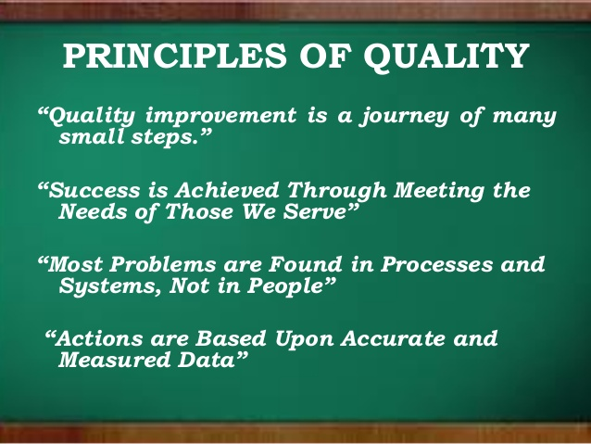
Principles of quality

Slide 55


Slide 56
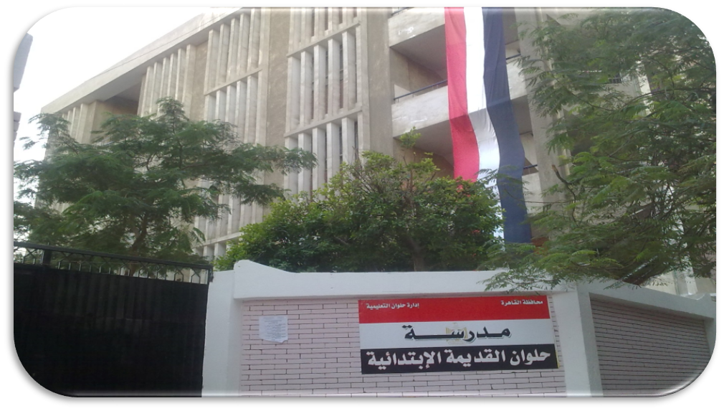
Fourth School Helwan Primary School Helwan E.A.

Slide 57
Fourth School Helwan primary School for Boys Helwan E.A.
School Profile
Social background of students: More than 50% of middle social level
Number of employees:
Teachers : (32)
Specialists : (32)
Administrators: (3)
Workers: (3)
Others: none
Number of Students with special needs: none

Slide 58
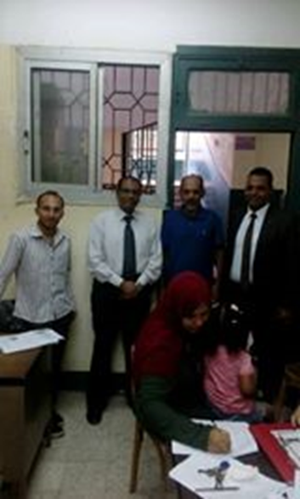
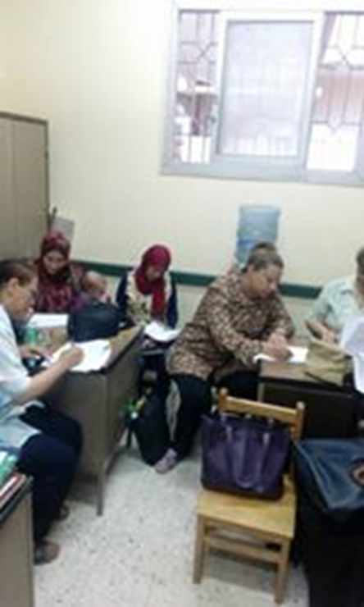
Fourth School Helwan primary School for Boys Helwan E.A.

Slide 59
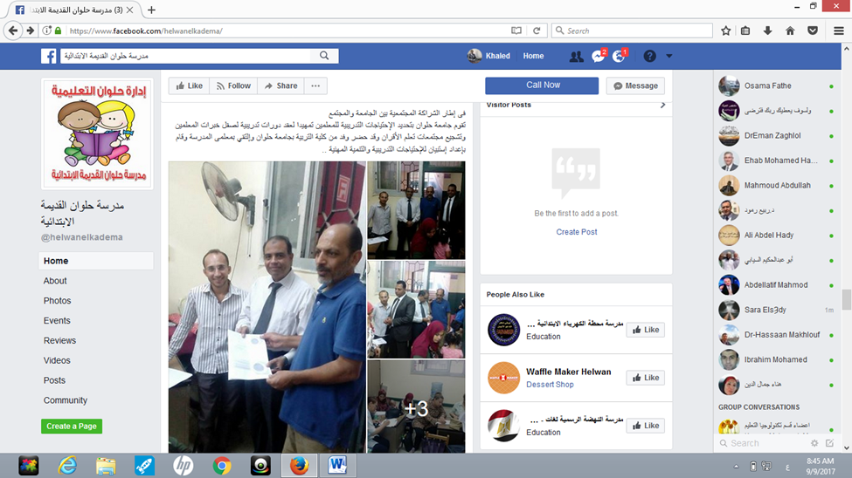
Fourth School Helwan primary School for Boys Helwan E.A.

Slide 60
Needs Assessment
Training needs.
1- Curricula
2- Using Technology in Teaching.
3- Quality Assurance

Slide 61
Training Methods
Workshops/ interactive training/school visits.
- Peer communities management.
Teachers need more time and space.
- Resources and equipments.
Teachers need handouts/ training material/ incentives for sharing experiences and attending training.
- Professional activities& students learning.
They need assessment and monitoring of the impact of training inside classrooms/ themes need to be more related to everyday students` problems.

Slide 62
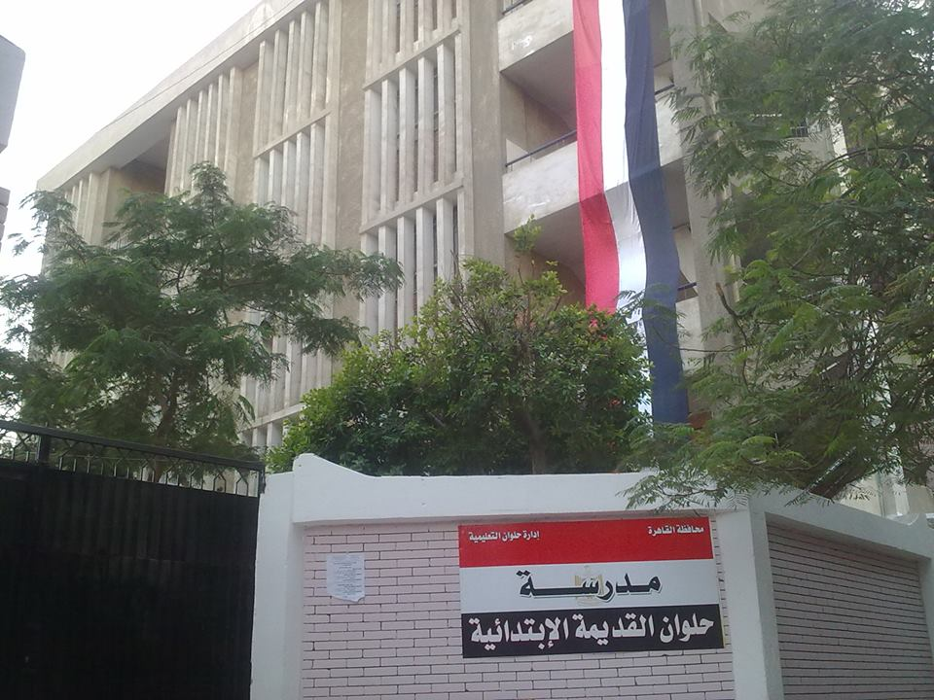
proposed plan for Helwan old primary school

Slide 63
Our proposed plan for Helwan old primary school
Towards the formation of a professional learning community within Helwan Elementary School
Disseminating culture of peer learning among teachers
preparing a Guide to Implement lesson study strategy
Enabling teachers to apply the lesson study strategy
preparing coaches and mentors

Slide 64
Fifth School Kaser Eldobara Formal School (Kindergarten, primary, preparatory levels) West Cairo E.A.
School Profile:
Number of classes:
Kindergarten (2)
Primary (6)
Preparatory (3)
Number of students in each class : 50
Number of students with SEN (Special Educational Needs):

Slide 65
Needs Assessment
Training needs.
1-Class Management
2-Educational Mentorship.
3- Quality Assurance

Slide 66
Training Methods
workshops.
- Peer communities management.
Teachers need to have opportunities of participation in decision making, also enough time to share experiences.
- Resources and equipments.
Teachers need technological infrastructure to facilitate the exchange of information, concept maps, journals….etc.
- Professional activities& students learning. Main training themes should be:
They seek decentralization in professional activities.

Slide 67
Ethnography Study
Important remarks by the school staff:
Training is better to be conducted during vacations l (better Midyear vacation).
The school team was very cooperative and has a positive attitude towards training and its impact on teaching.
Activating roles of training and evaluation units at school.

Slide 68
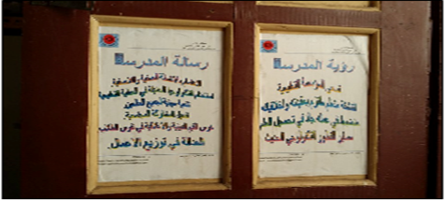
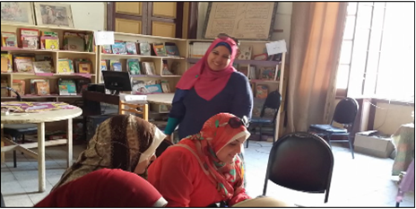
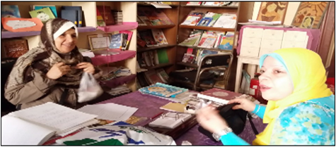
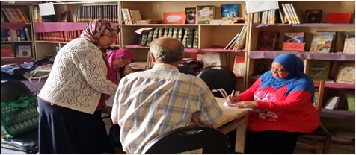

Slide 69
progress on the selection of mentors
Criteria for selection:
1- TOT
2- Experience in mentoring.
3- Good relations with schools.
4- Leadership skills.
5- Experience in adult learning.
6- Communication skills.
7- Enthusiasm to change.

Slide 70
Dr. Khaled Malek.
Dr. Doaa Abdel Karim
Dr. Dina Maher.
Dr. Ahmed Youssef.
Dr. Lamiaa Kamel
Mohamed Adel
Ahmed Yasser

Slide 71


