Slide 1

L
E
I
C
E
T
E
L
I
E
M
PLU
A
I
N
A
N
R
H
T
H
A
P
T
O
N
L
W
A
N
I
C
K
L
E
X
A
N
D
R
I
A
H
A
M
S
A
RT
A
I
N
L
U
T
H
E
R
C

Slide 2


School and University Partnership for Peer Communities of learners
Project number:
573660-EPP-1-2016-1-EG-EPPKA2-CBHE-JP (2016-2516/001-001)

Slide 3
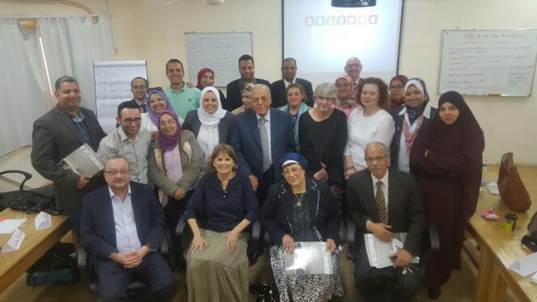

Slide 4
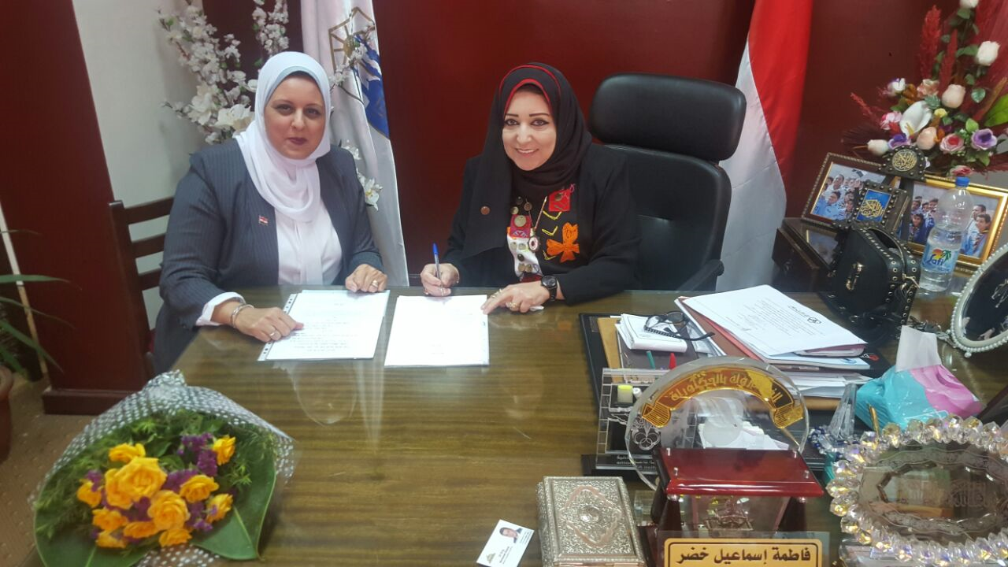
Signing A Protocol
23rd May 2017

Slide 5
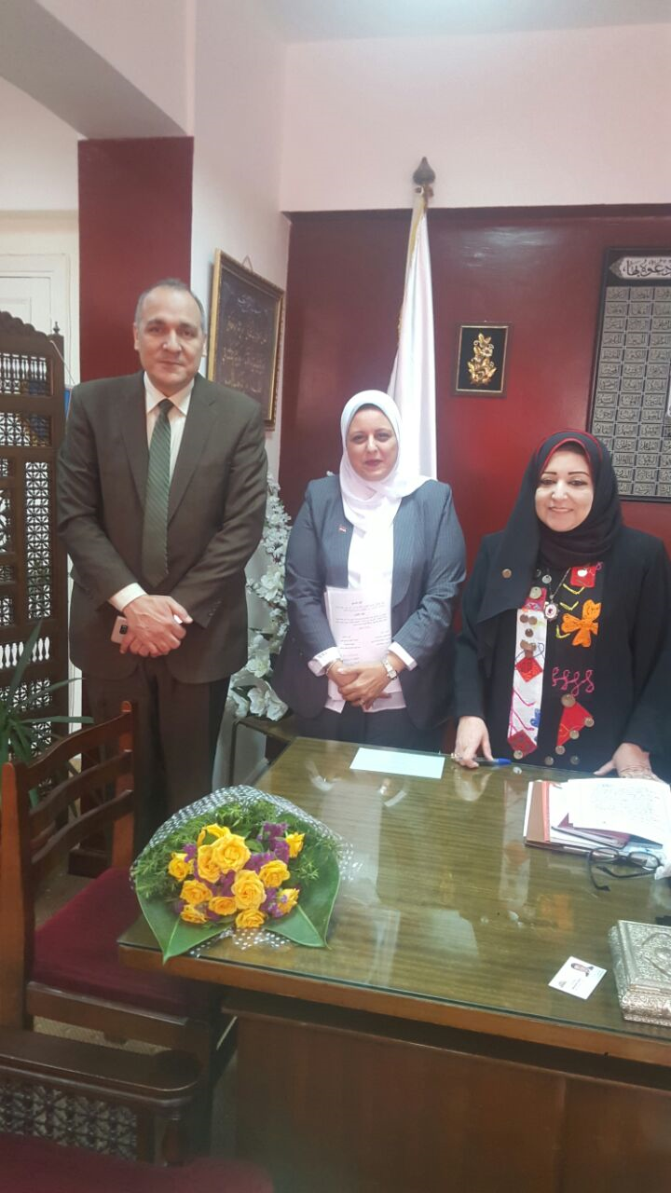
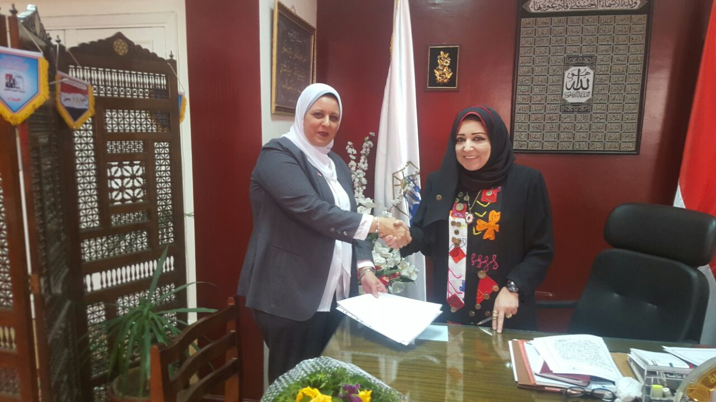
Signing A Protocol

Slide 6
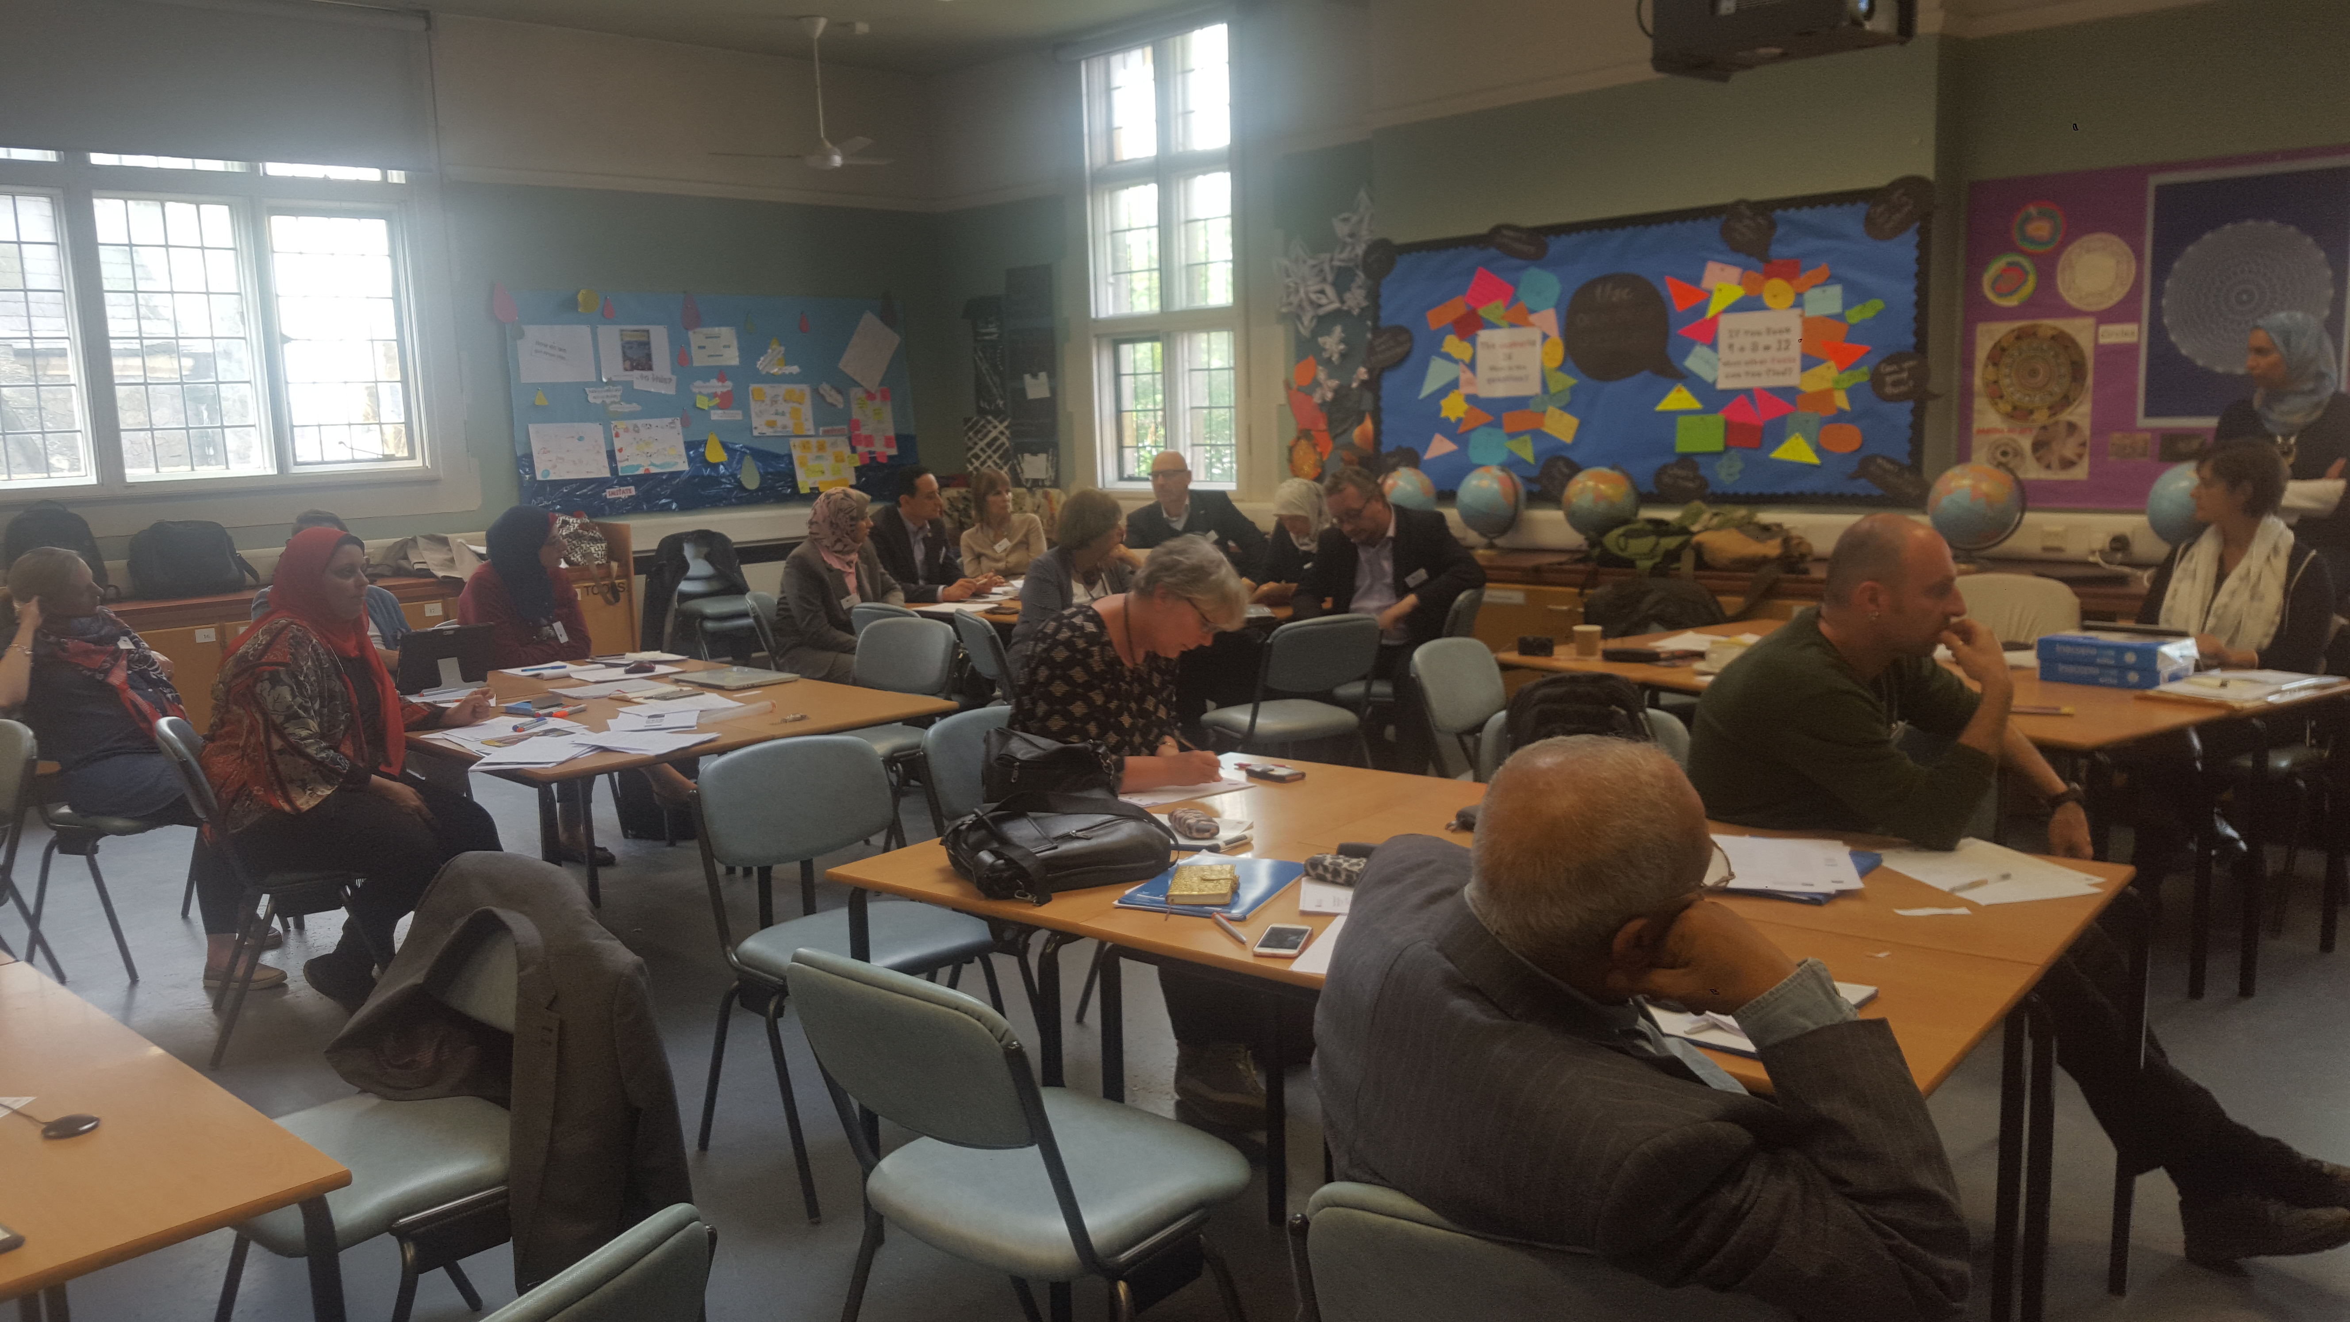
Leicester Management meeting
7th June 2017

Slide 7
Meetings with HU Team
HU team has different meetings to achieve the following goals:
- To get feedback concerning the selection of the team and division of responsibilities.
- Preparation and designing of needs assessment tools.
- Reviewing the tools and getting feedback.
- Communicating with schools to apply needs assessment.
- To provide the whole team with more details concerning the main goal of the project through comprehensive presentation and to divide the tasks for the needs assessment stage.

Slide 8
Outcomes
Designing of tools necessary for the needs assessment.
Setting a committee responsible for statistical analysis of results.
Developing the draft of the tools to be tested by experts.
Reviewing the needs assessment tools and providing feedback.
Update the protocol between HU and Cairo educational directorate
Beginning the procedures of communicating with Cairo educational directorate to take the security approval for applying research tools

Slide 9

Progress on Needs Assessment

Slide 10
Needs Assessment Stags:
- The selection of the team responsible for needs assessment stage in schools.
- Setting criteria for the selection of the needs assessment team:
1- Desire to develop and build relationships between FOE and schools.
2- Enthusiasm for change.
3- Young researchers and lecturers.
4- Has good relations with teachers in schools.
5- Live within the geographical area of the school to be able to monitor the needs assessment process.

Slide 11

Statistical Analysis
Team Selection:
Prof. Mohamed Abdel Salam
Dr. Hassan Makhlouf

Slide 12
The main topics of the tools:
- Training needs.
- Training Methods.
- Peer communities management.
- Resources and equipments.
- Professional activities& students learning.

Slide 13
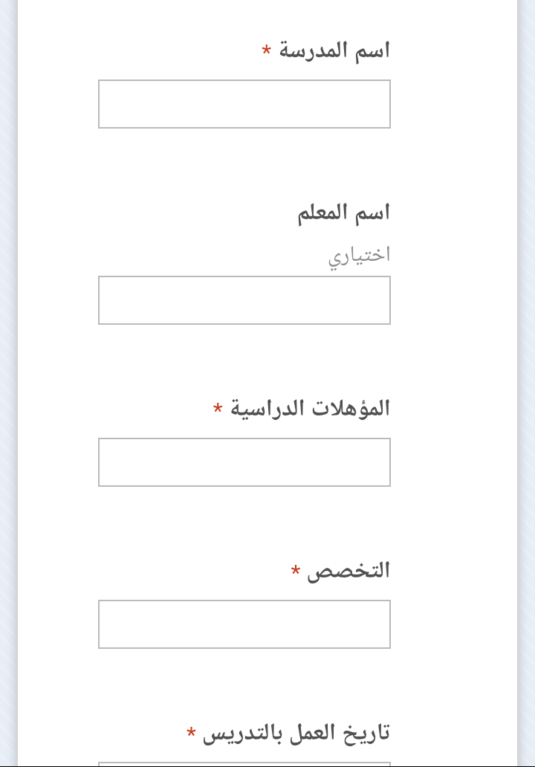

Design Electronic Tool for Data Entry

Slide 14
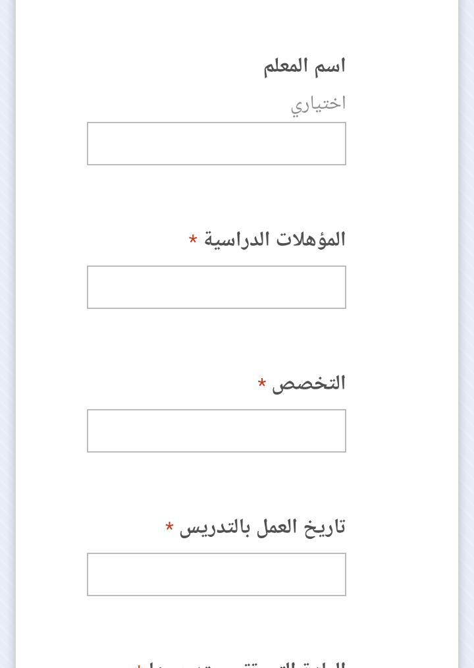
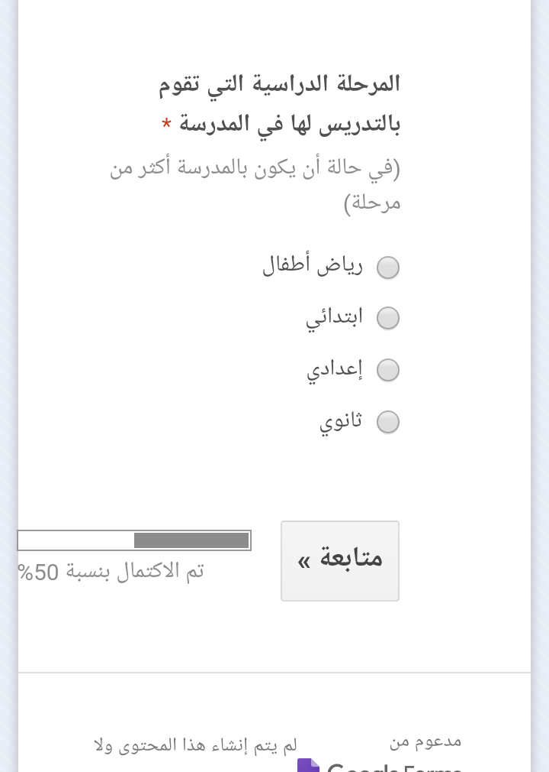

Slide 15
First School
Zamalek Girls’ School
(primary, preparatory and secondary levels)
West Cairo E.A.
School Profile
Educational administration: west cairo
Number of Classes: 61
primary grade: 31 classes
preparatory grade: 15 classes
Secondary grade: 15 classes
Total Number of students: 2687 students
(Primary students: 1560, Preparatory: 687, and secondary :420)
Average number of each class: 50 students at primary, 45 preparatory, 28 secondary.
Economic& Social background status of students: Low income families (11%- 25%)

Slide 16
First School
Zamalek Girls’ School
(primary, preparatory and secondary levels)
School Staff Members:
Teachers: 208
Social workers: 6
Administrative staff: 6
Workers: 10
Others: none
Number of students with SEN (Special Educational Needs): none
School Services &Resources
The school is opened to the idea of inclusive education. In fact SEN students are welcomed in the school. The school is also providing care and attention to those who are gifted via academic competitions.
School Canteen
Computers : 30 for each grade (in a really bad shape)

Slide 17
First School
Zamalek Girls’ School
(primary, preparatory and secondary levels)
Resources
Educational materials ( textbooks, … etc)
A library
Theatre
Audio educational aids.
Laboratory equipments
Teachers staff rooms
School Canteen
Computers : 30 for each grade (in a really bad shape)

Slide 18
First School
Zamalek Girls’ School
(primary, preparatory and secondary levels)
School local community
It was noticeable that there is not active involvement of parents in whatsoever activities related to the school community, for example special occasions: musical concerts, exhibits or sports competitions.
Level of Education of students’ parents: over 20% are uneducated, 30% with a middle education (schools), 30% with vocational technical backgrounds, and 15% with college degree.

Slide 19
First School
Zamalek Girls’ School
(primary, preparatory and secondary levels)
Professional Development
The school is interested in helping teachers become more effective via training workshops inside and outside the school. Teachers’ needs are identified and analyzed by the training unit of the school.
Main training themes would be:
1-Curricula
2-Learning and Teaching skills
3- Using modern educational technology
4- knowledge explosion and education
5- Self- improvement

Slide 20
First School
Zamalek Girls’ School
(primary, preparatory and secondary levels)
Professional Development
The team went on walk on the hall school, visiting the hall building, the art room the library, the theatre, after meeting the school administration and teachers.
It was also evident that the school does not know anything about the peer communities of learners nor have quality assurance unit, because of the building of school property problem.
But, the teachers displayed a positive attitude towards the idea and were enthusiastic about the training that they are going to get. Generally speaking, it was a successful visit to the school ,as the teachers were active during discussions and honest about what they liked and did not like about the school .

Slide 21
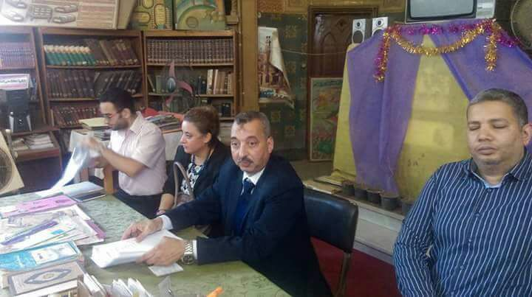
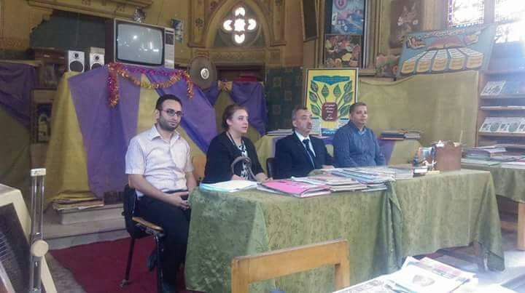

Slide 22
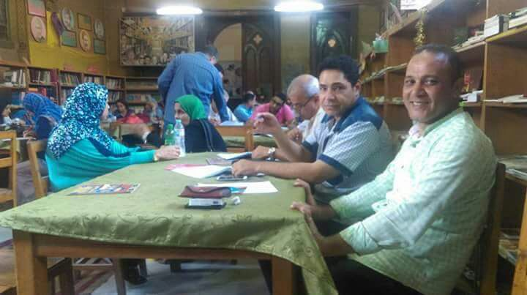
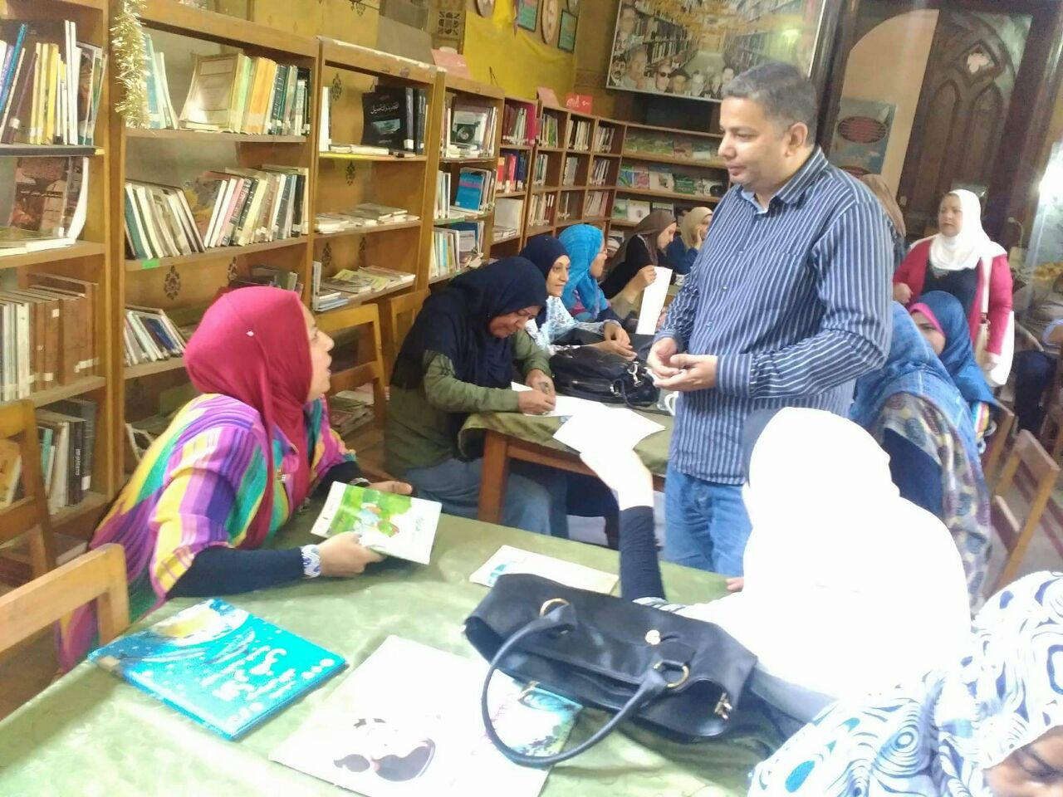

Slide 23
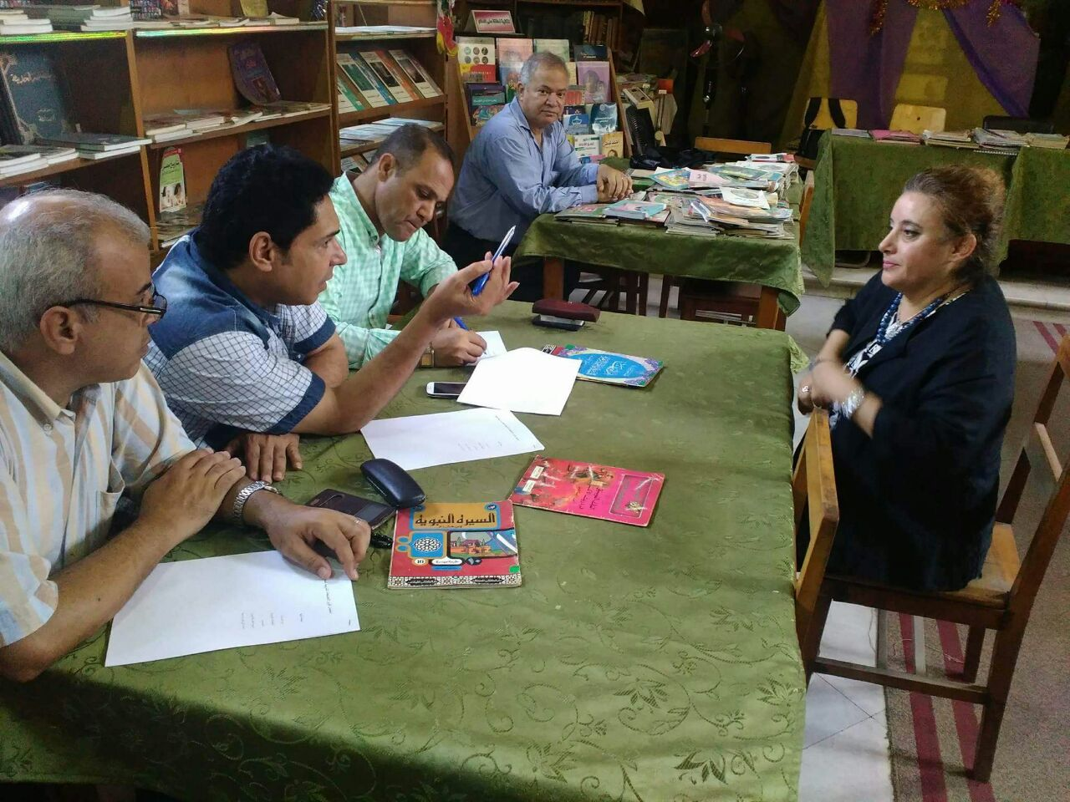
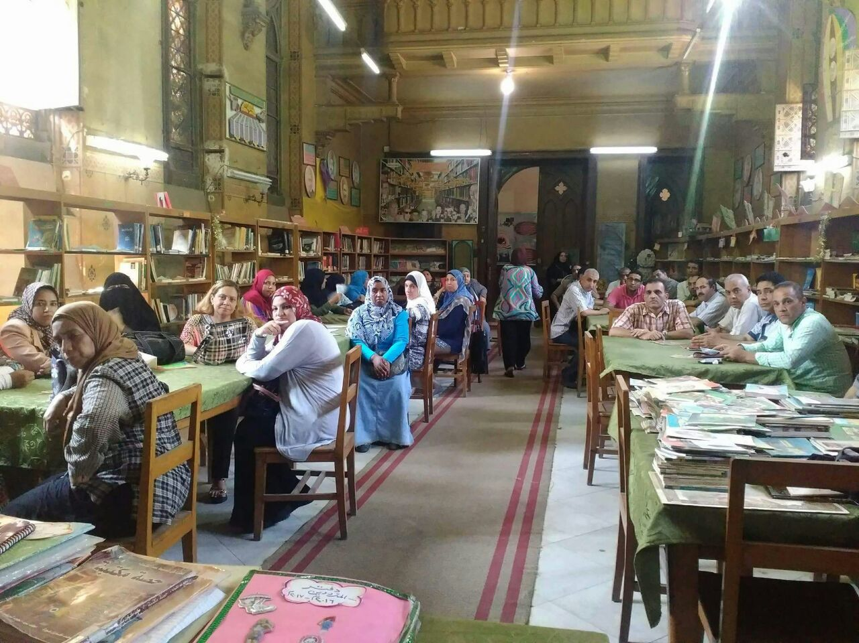

Slide 24
Second School
Om Elabtal Girls’ preparatory School
Helwan E.A.
23 questionnaires have been applied.
- The school has a page on Facebook is ( Om El Abtal prep. School) , All activities happens in school shown on this page daily.

Slide 25
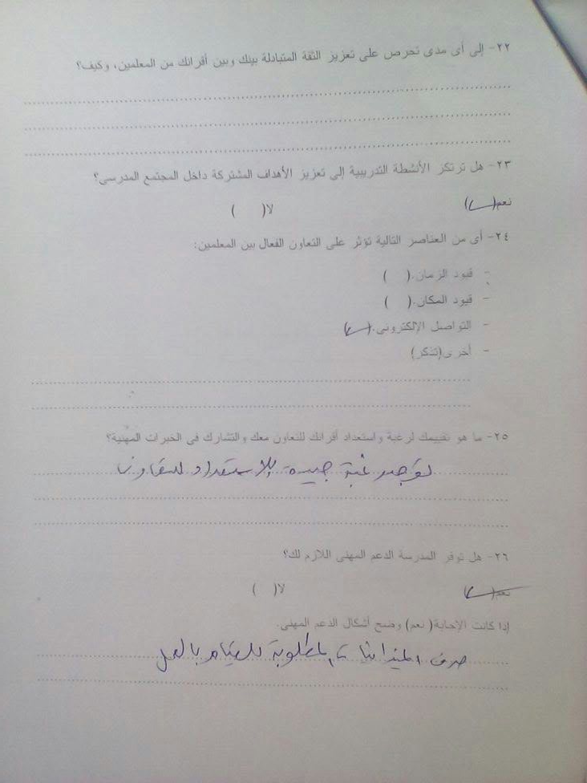
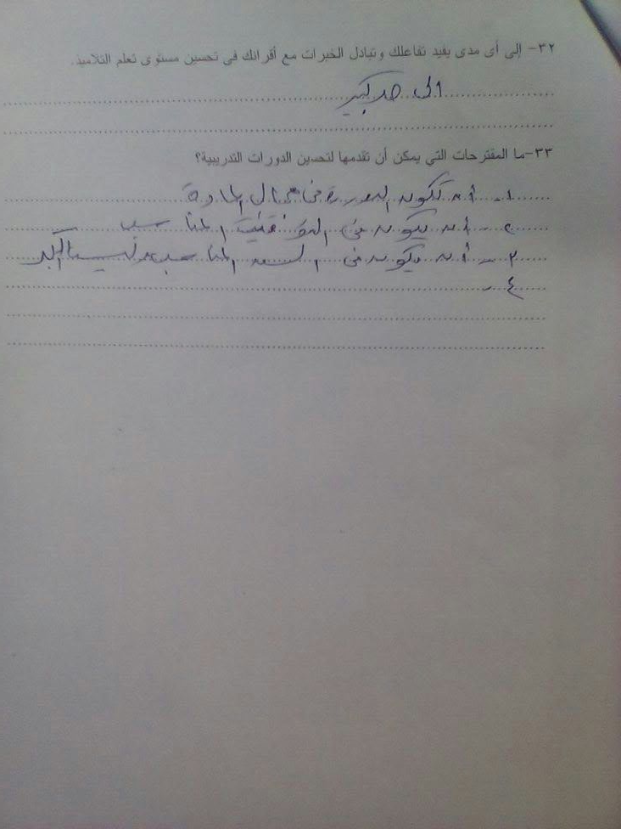
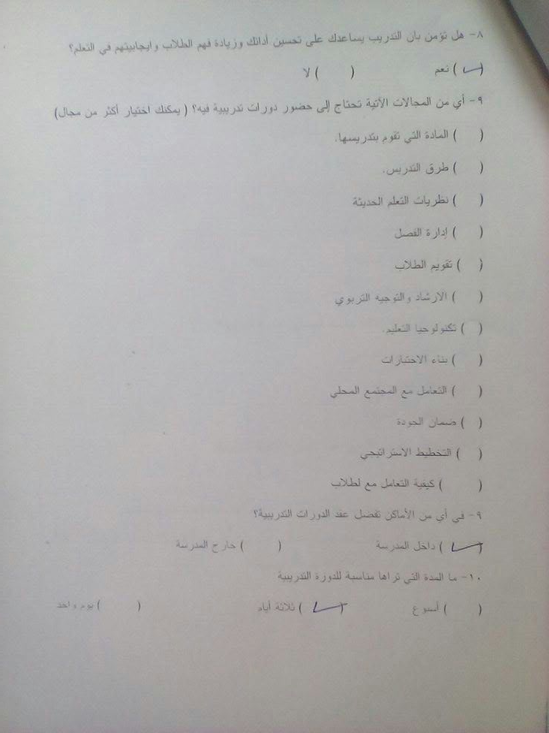
Second School
Om Elabtal Girls’ preparatory School
Helwan E.A.

Slide 26
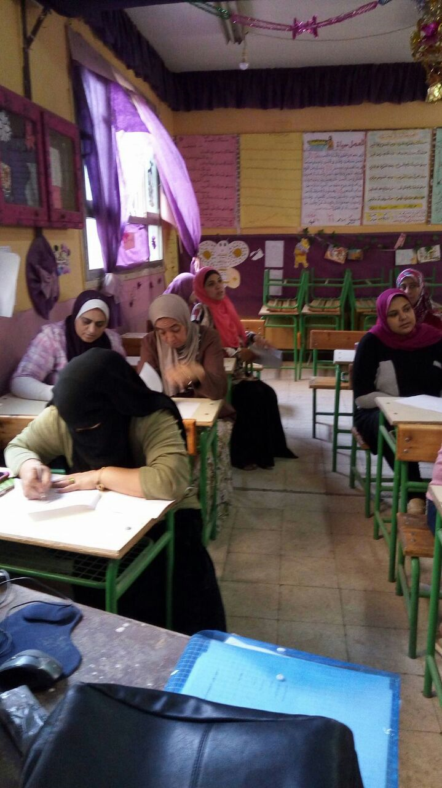
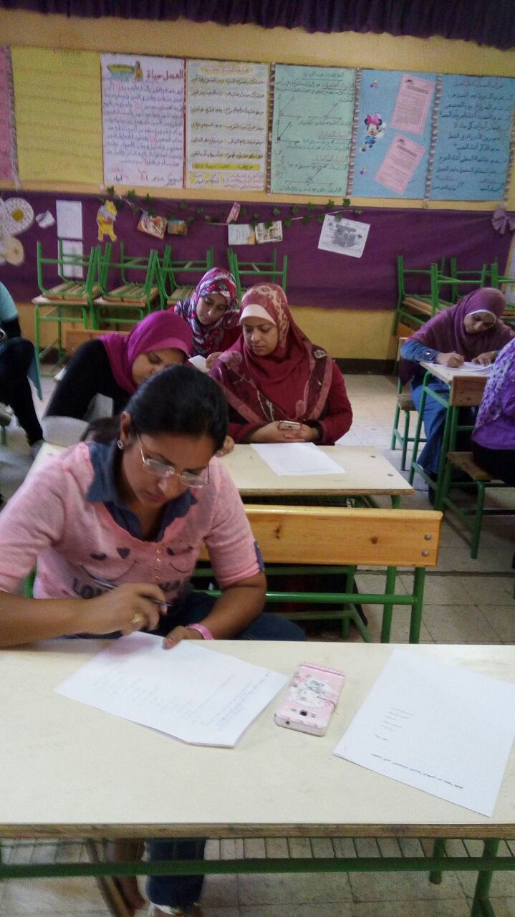
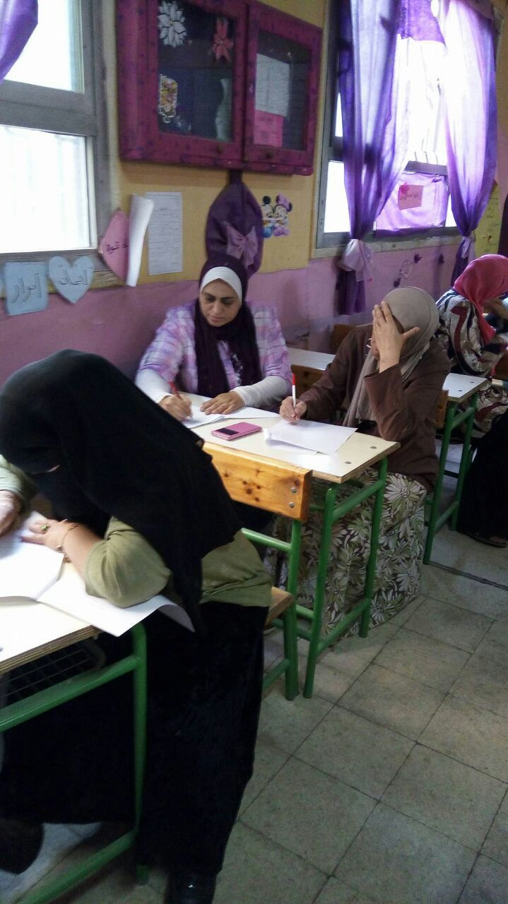
Second School
Om Elabtal Girls’ preparatory School
Helwan E.A.

Slide 27
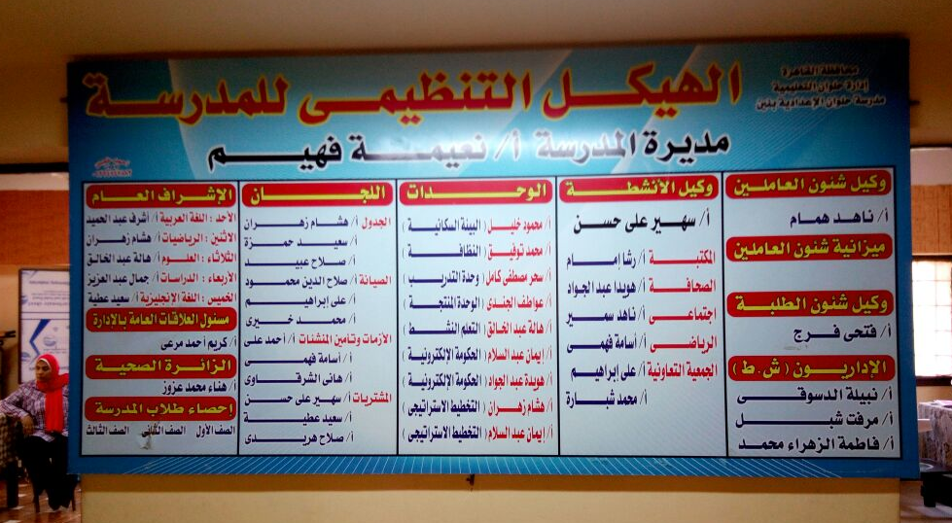
Third School
Helwan Preparatory School for Boys
Helwan E.A.

Slide 28
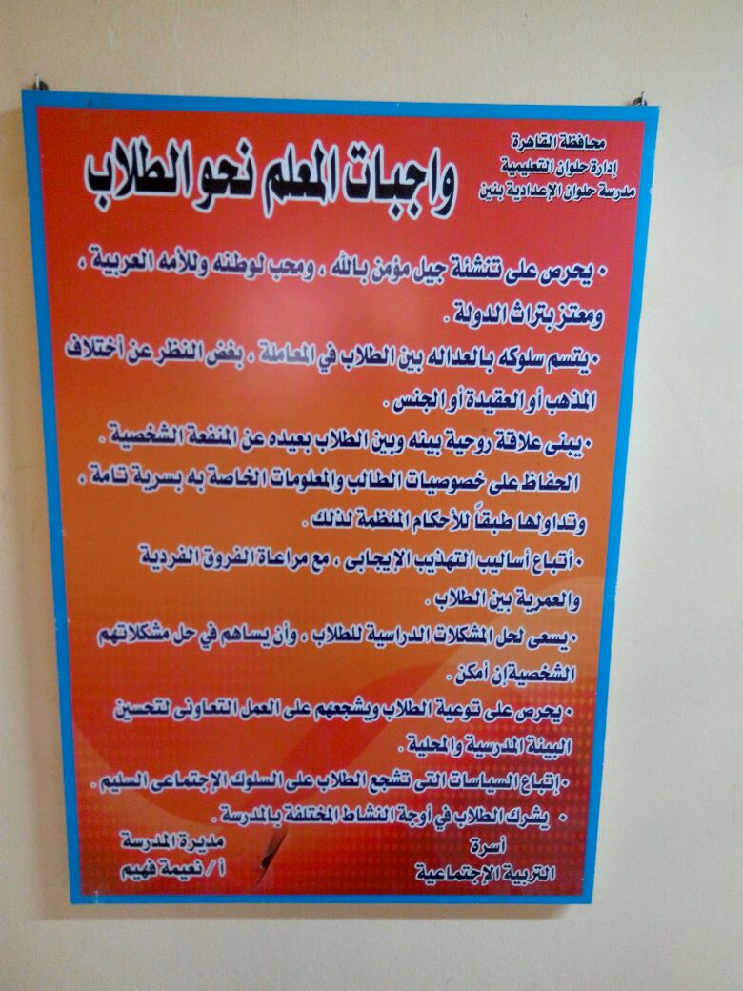
Third School
Helwan Preparatory School for Boys
Helwan E.A.

Slide 29

School Profile
School: Helwan Preparatory School for Boys
Educational administration: Helwan
Educational stage: Preparatory
Number of Classes: 33
i-First grade: 14 classes
ii-Second grade: 9 classes
iii- Third grade: 10 classes
Total Number of students: 1650

Slide 30
School Profile
Average number of each class: 50 students
Economic& Social background status of students: Low income families (11%- 25%)
School Staff Members:
Teachers: 55
Social workers: 2
Administrative staff: 5
Workers: 5
Others: 3
Number of students with SEN (Special Educational Needs): 2

Slide 31
School Services &Resources
The school is opened to the idea of inclusive education. In fact SEN students are welcomed in the school. The school is also providing care and attention to those who are gifted via academic competitions.
Resources
1-Educational materials ( textbooks, … etc)
2-A library
3- Audio/ Visual educational aids.
4- Laboratory equipments
5- Teachers staff rooms

Slide 32
School Services &Resources
6- School Canteen
7- Computers : 32 (in a really bad shape)
8- Internet access: USB
School local community
It was noticeable that there is not active involvement of parents in whatsoever activities related to the school community, for example special occasions: musical concerts, exhibits or sports competitions.
Level of Education of students’ parents: over 55% are uneducated, 43% with vocational technical backgrounds, and 2% with college degree.

Slide 33
Professional Development
The school is interested in helping teachers become more effective via training workshops inside and outside the school. Teachers’ needs are identified and analyzed by the training unit of the school.
Main training themes would be:
1-Curricula
2-Learning and Teaching skills
3- Using modern educational technology
4- knowledge explosion and education
5- Self- improvement

Slide 34
Professional Development
It was also evident that the school does not know anything about the peer
communities of learners nor have quality assurance unit . But , the teachers
displayed a positive attitude towards the idea and were enthusiastic about the
training that they are going to get. Generally speaking, it was a successful visit to
the school ,as the teachers were active during discussions and honest about what
they liked and did not like about the school .

Slide 35
Fourth School
Kaser Eldobara Formal School
(Kindergarten, primary, preparatory levels)
West Cairo E.A.
Number of classes:
Kindergarten (2)
Primary (6)
Preparatory (3)
Number of students in each class : 50
Number of students with SEN (Special Educational Needs):

Slide 36
Fourth School
Kaser Eldobara Formal School
(Kindergarten, primary, preparatory levels)
West Cairo E.A.
Important remarks by the school staff:
Importance of the presence of a brochure of the project including projective objectives and the overall outcomes of it directed to both teachers, school director and the whole school.
Importance of early notifications and collaboration with school director and teachers while arranging training agenda.
Training is better to be conducted during vacations l (better Midyear vacation).
The school team was very cooperative and has a positive attitude towards training and its impact on teaching.

Slide 37
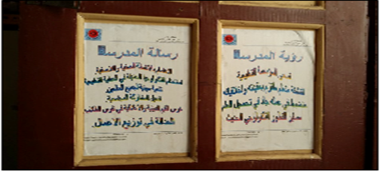
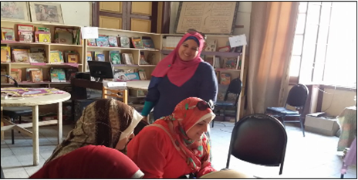
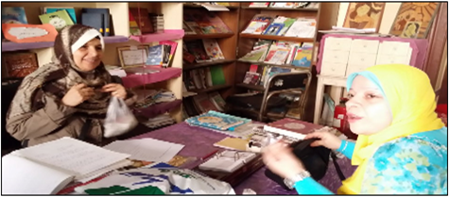
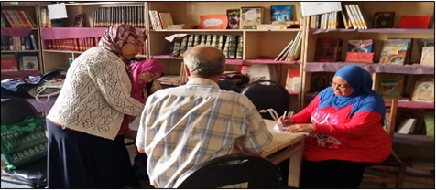
Fourth School
Kaser Eldobara Formal School

Slide 38
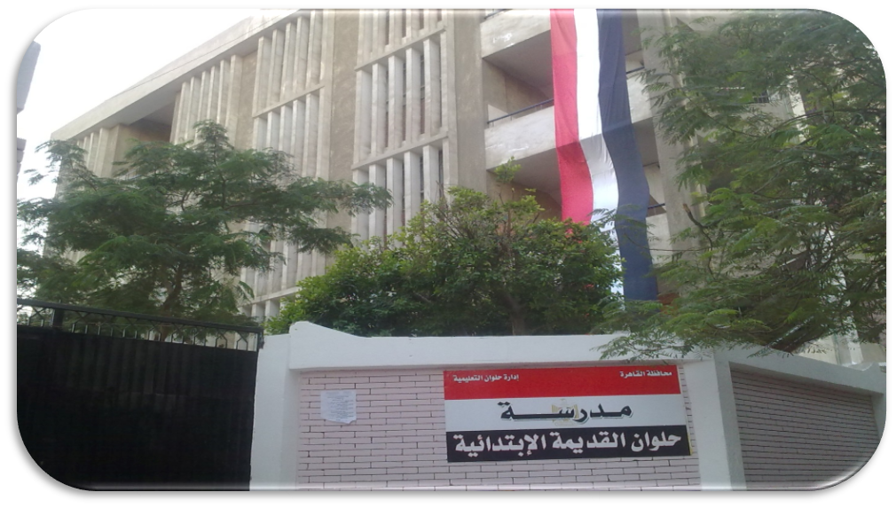
Fifth School
Helwan Primary School
Helwan E.A.

Slide 39
Fifth School
Helwan primary School for Boys
Helwan E.A.
School Profile
30 tteachers only
11 done and the team will resume.

Slide 40
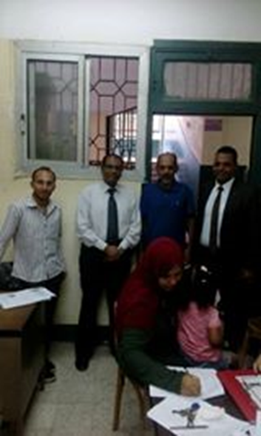
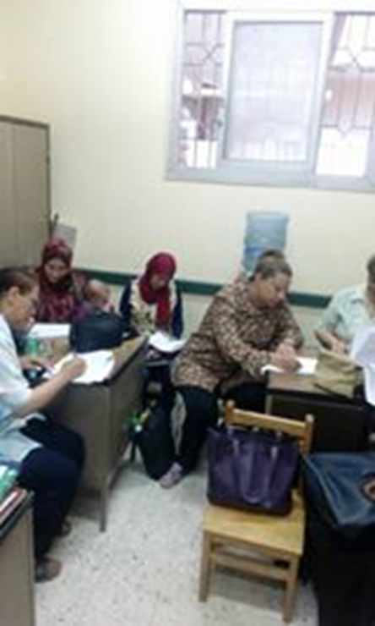
Fifth School
Helwan primary School for Boys
Helwan E.A.

Slide 41
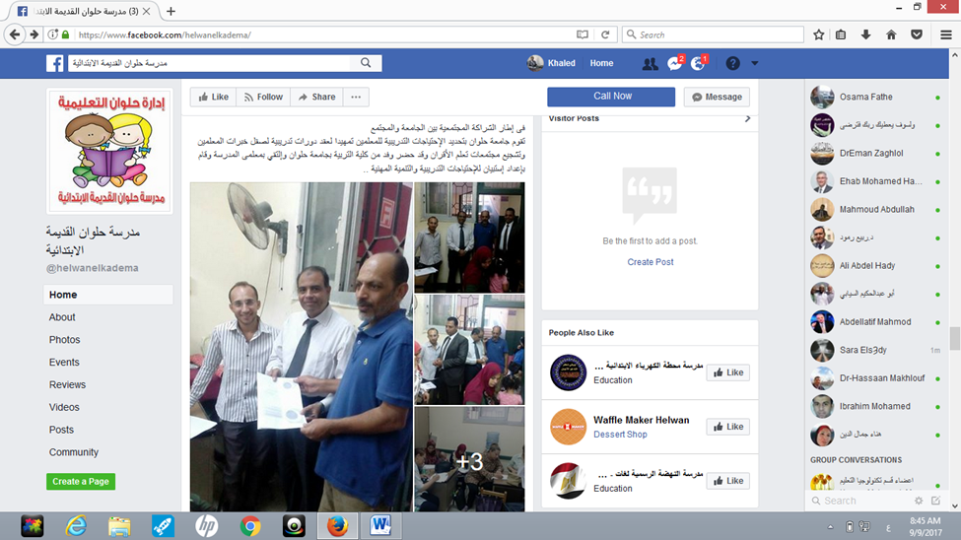
Fifth School
Helwan primary School for Boys
Helwan E.A.

Slide 42
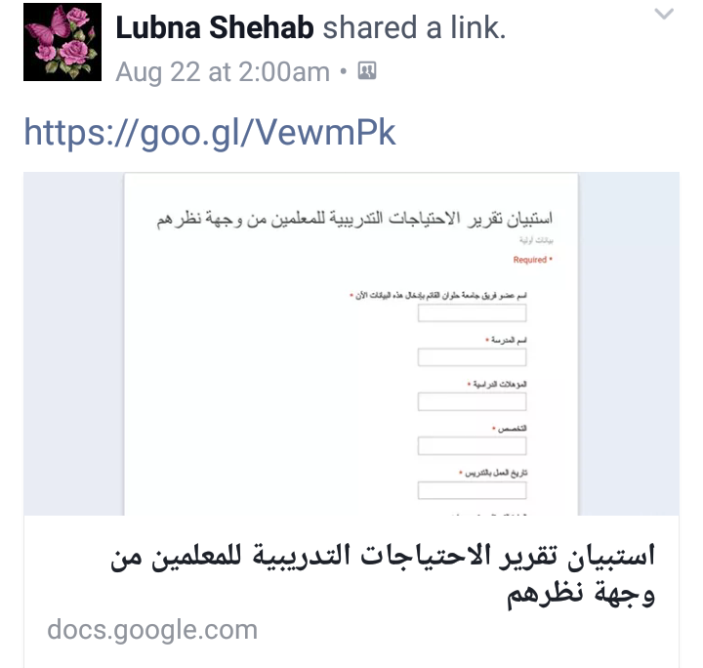
The Process of Data Entry

Slide 43
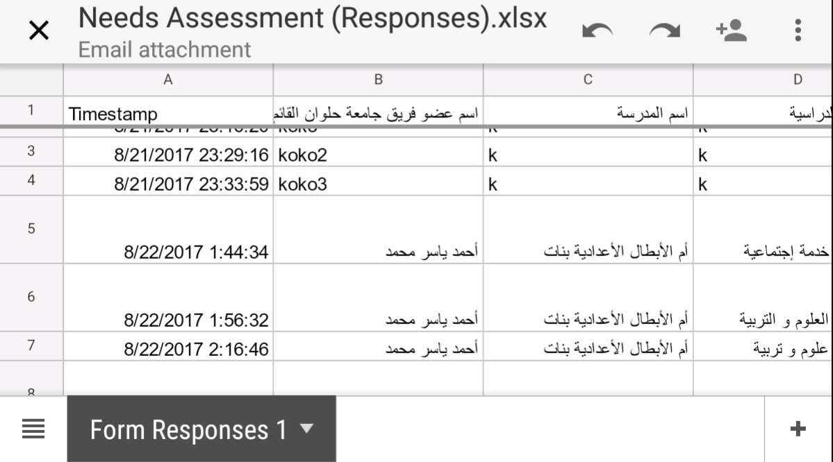

Slide 44
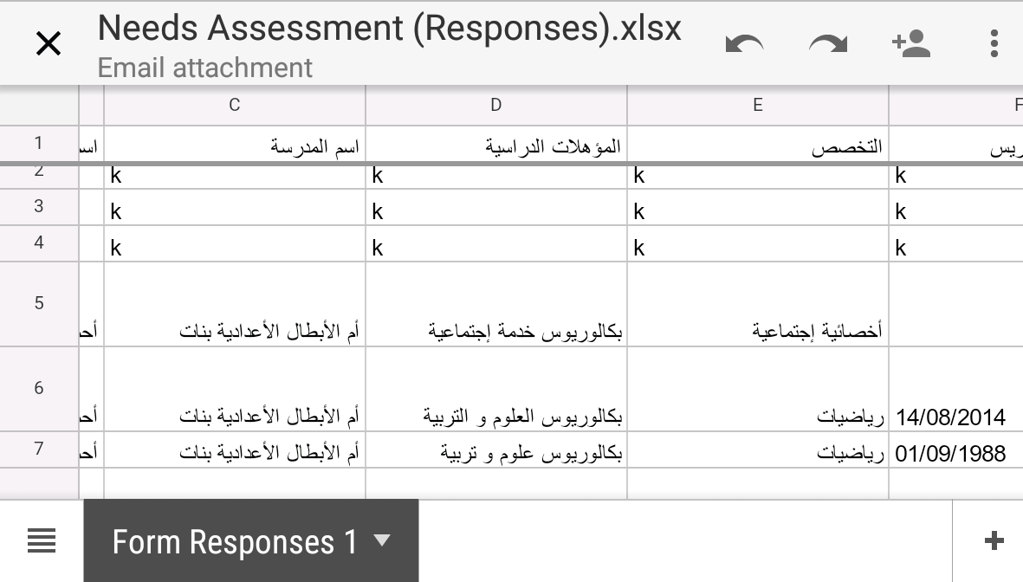

Slide 45
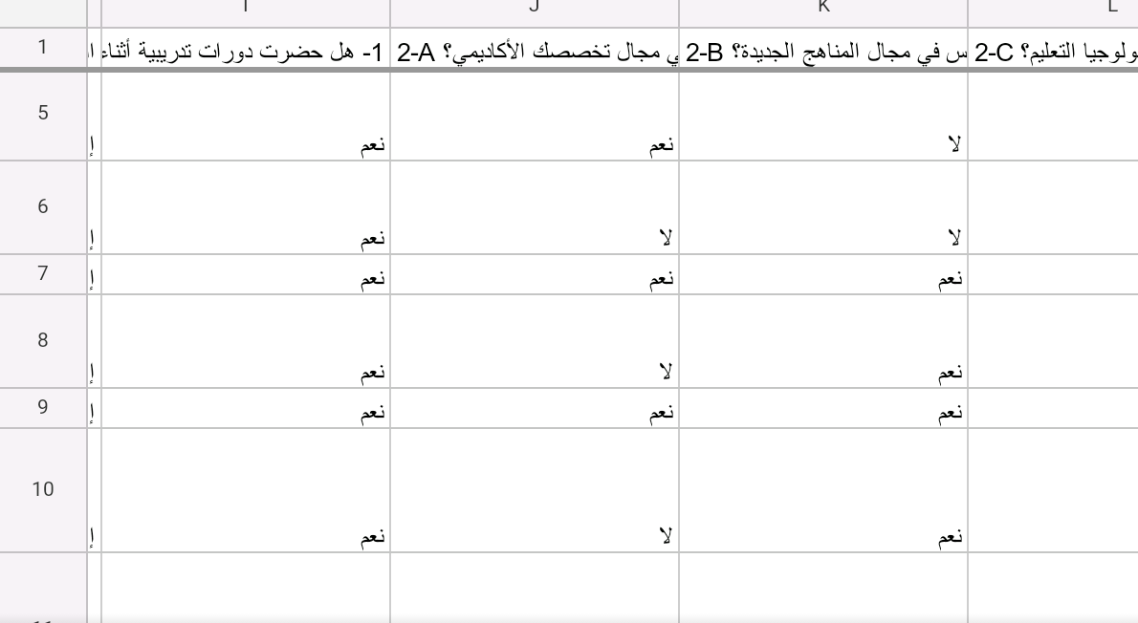

Slide 46
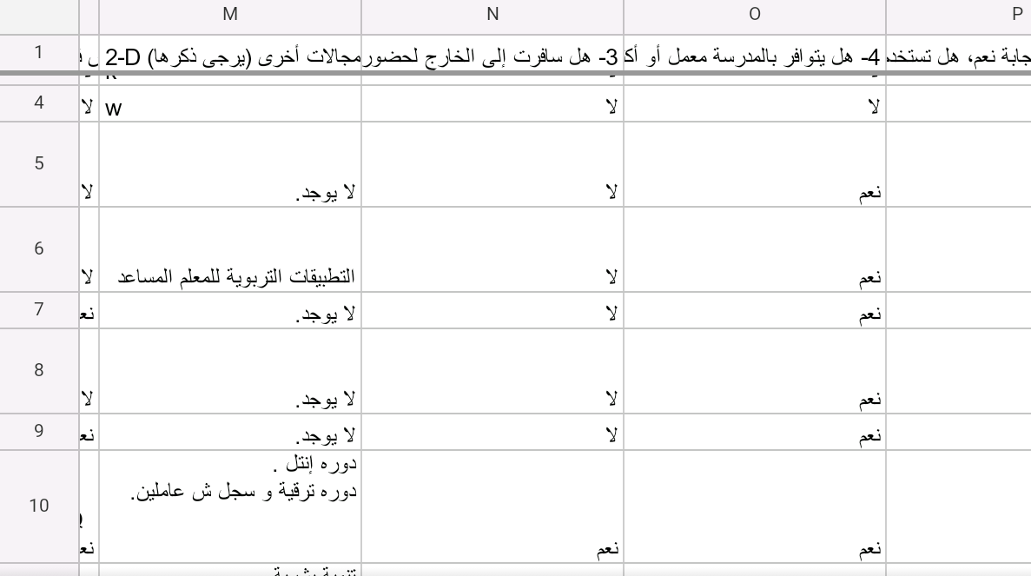

Slide 47
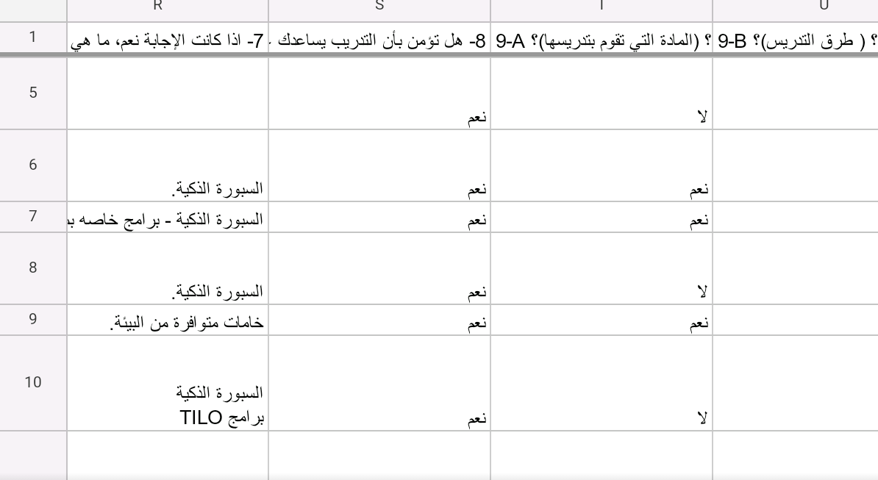

Slide 48
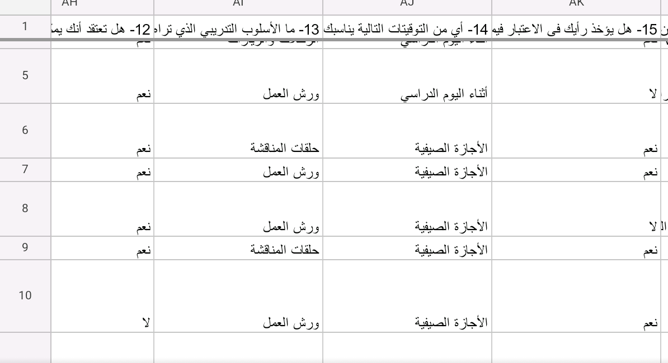

Slide 49
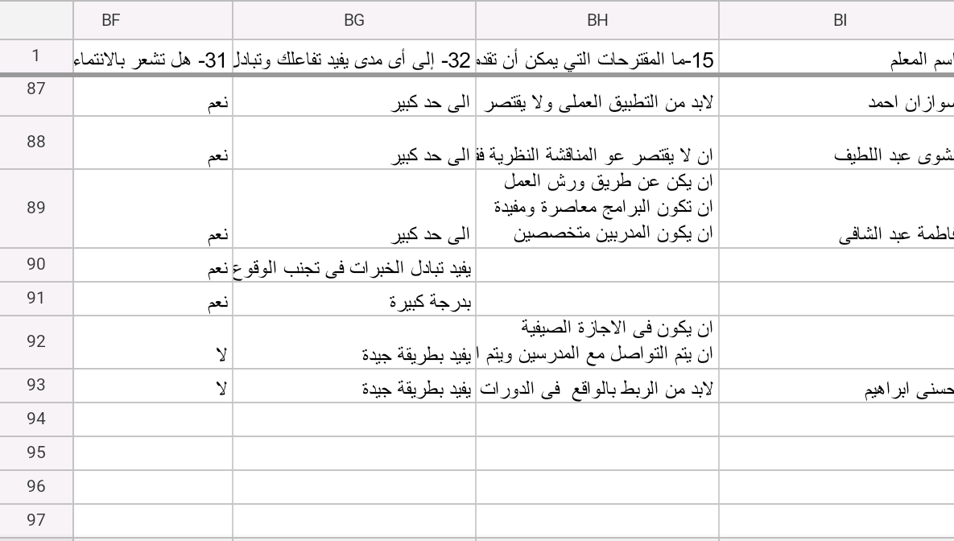

Slide 50
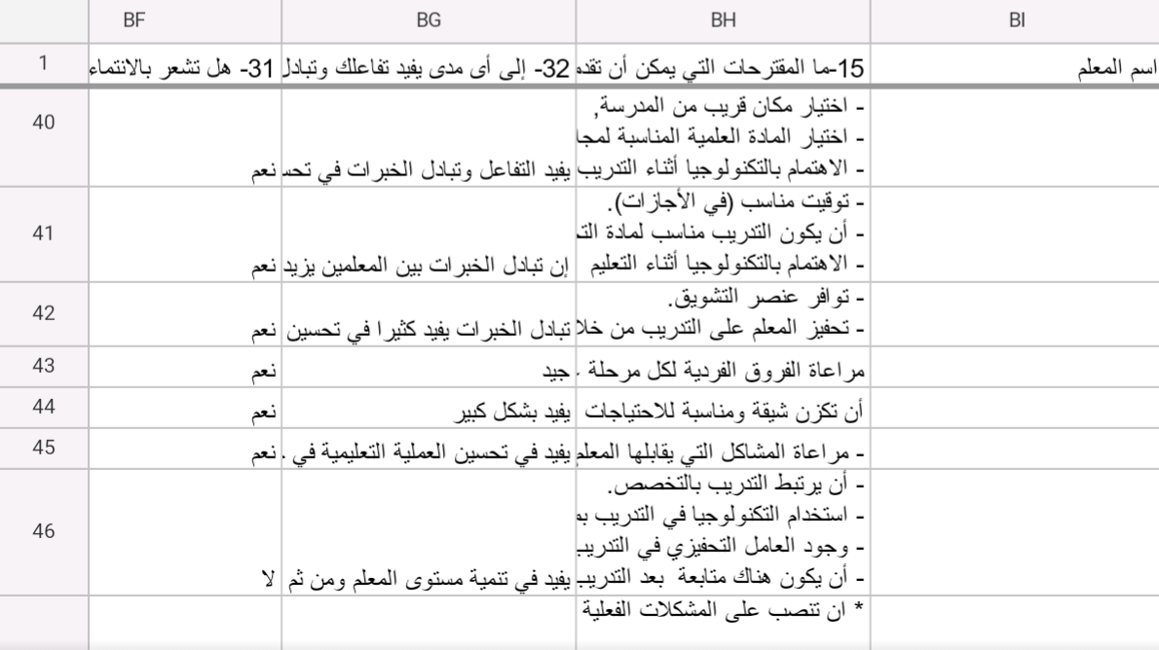

Slide 51
Outcomes of the needs assessment stage:
The collaboration between HU teams resulted in the beginning of developing learning communities during the application of the needs assessment tools.
- The management team assign coordinator for each school and each coordinator selected his team.-

Slide 52
Outcomes of the needs assessment stage:
- - HU communicated with Cairo educational directorate to assign coordinator between the university and the schools to facilitate the project activities.
- HU set system of monitoring and documentation of all activities done inside schools through asking needs assessment teams to prepare reports about each day, taking photos and joining Facebook page to disseminate the schools activities.

Slide 53
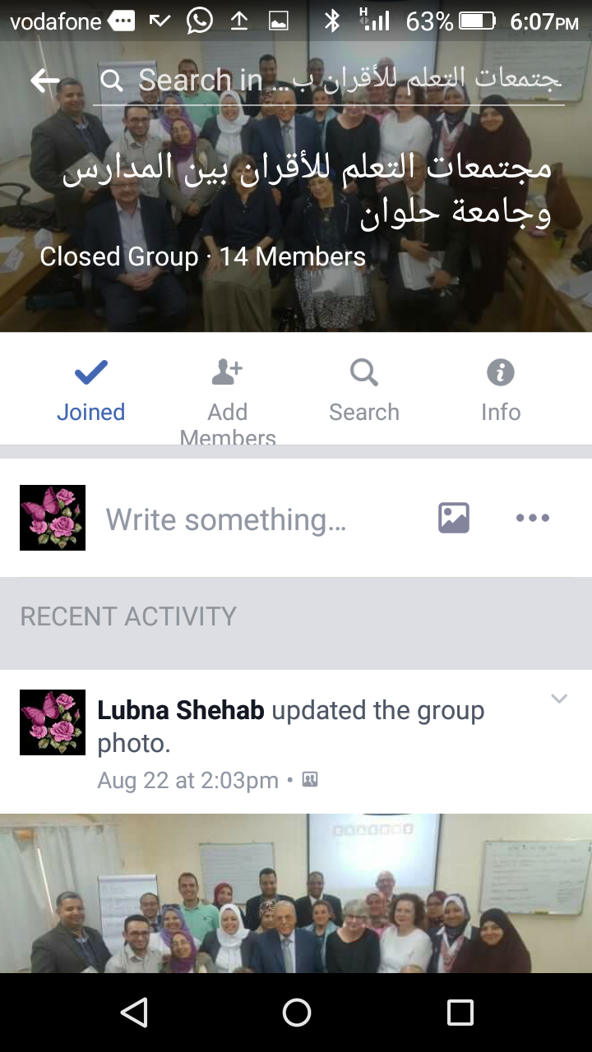

Slide 54
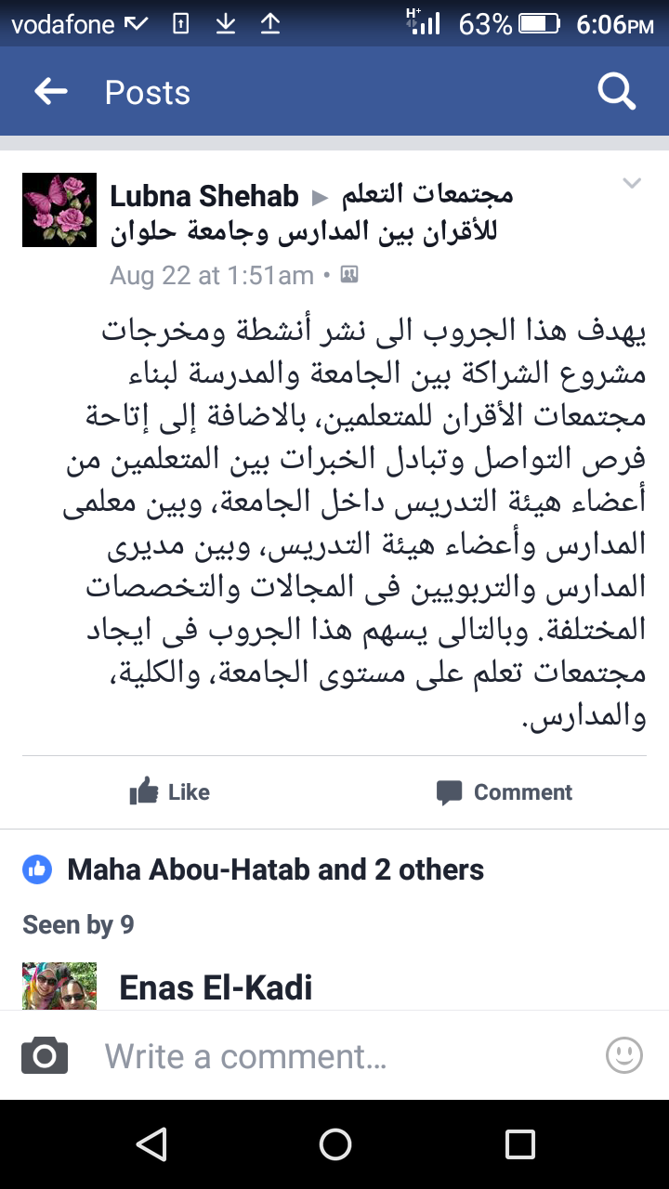

Slide 55
93 questionnaire.
Organizing open interviews with those responsible for the quality assurance unit in the school
some teachers showed interests in their answers & explains their need to put an effective framework for their needs , on the other hand, others thought that training is not important, especially about their relations with their colleagues
- Most of training activities done in the multimedia lab.

Slide 56
Most teachers in schools were very happy and enthusiastic to collaborate with HU.
The teachers showed interests in exchanging their experiences with their colleagues and university staff in HU.
- Most schools announced HU school visits on their website and facebook pages.

Slide 57
- Teachers’ needs are identified and analyzed by the training unit of the school.
- Main training themes are:
1-Curricula
2-Learning and Teaching skills
3- Using modern educational technology
4- Self- improvement.
6- smart board
7- leadership skills.

Slide 58
Training is better to be conducted during vacations l (better Midyear vacation).
The school team was very cooperative and has a positive attitude towards training and its impact on teaching.
- Activating roles of training and evaluation units at school.

Slide 59
progress on the selection of ten team members who will be travelling:
Now, HU has a new learning community (27 members of 30 +) for sharing the experiences and procedures to be able to complete the visa procedures, we have groups on email, whats app, in addition to different meetings to provide them with the needed information and answer their queries.

Slide 60


Update of Visa Procedures
6 out of 8 participants have the UK visa.
1 participant has not been given.

Slide 61

Update of Visa Procedures
4 of 9 participants have the Schengen visa.

Slide 62

Update of Visa Procedures
1 of 10 participants have the Ireland visa.

Slide 63
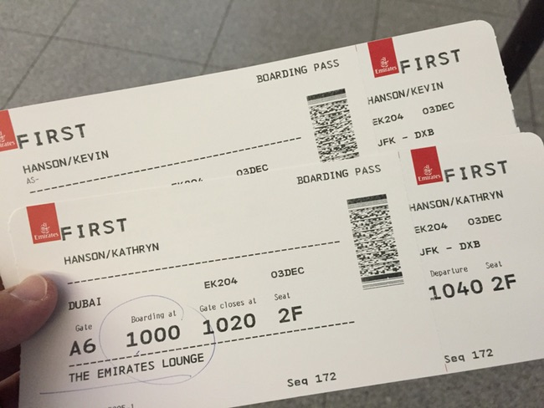
All tickets have been booked

Slide 64


