Slide 1
Teacher Professional Development and Communities of Practice. Findings from eight case studies
2017.04.24 - NARST Conference Francesco Cuomo

Slide 2




Teacher Professional Development and Communities of Practice. Findings from eight case studies
Francesco Cuomo
Università degli Studi di Napoli Federico II
Martin-Luther-Universität Halle-Wittenberg
E. Balzano, C. Minichini, M. Serpico
Research partly funded by EC under the 7th Framework Programme
2017.04.24 - NARST Conference Francesco Cuomo

Slide 3
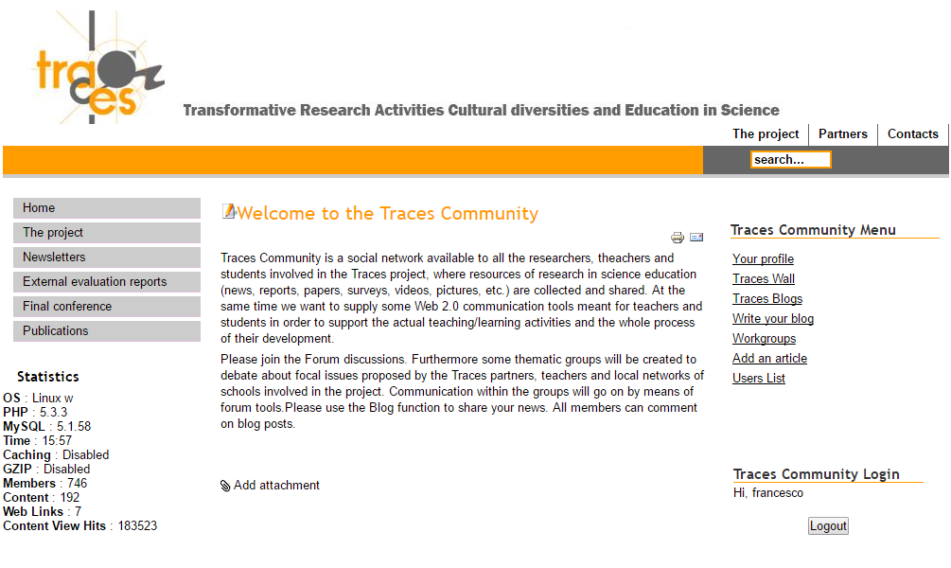

Slide 4
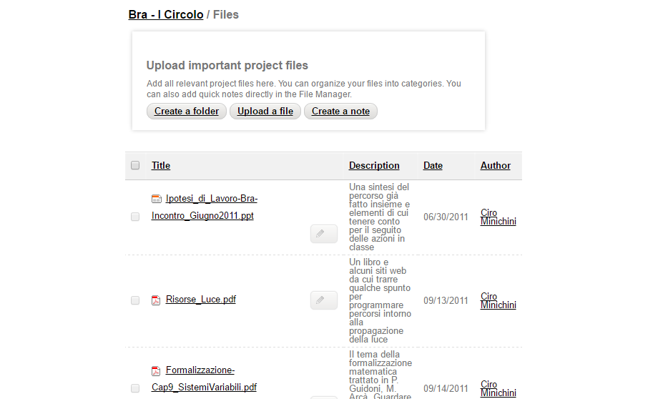

Slide 5
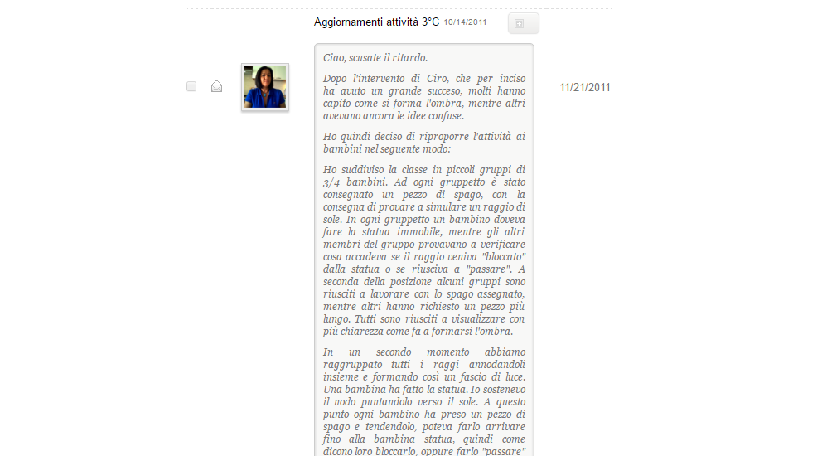

Slide 6
UNIFYING CONCEPTS
SYSTEMS, ORDER & ORGANIZATION
EVOLUTION AND
EQUILIBRIUM
CHANGE, CONSTANCY
AND MEASUREMENT
EVIDENCE, MODELS
AND ORGANIZZATION
FORM AND FUNCTION

Slide 7
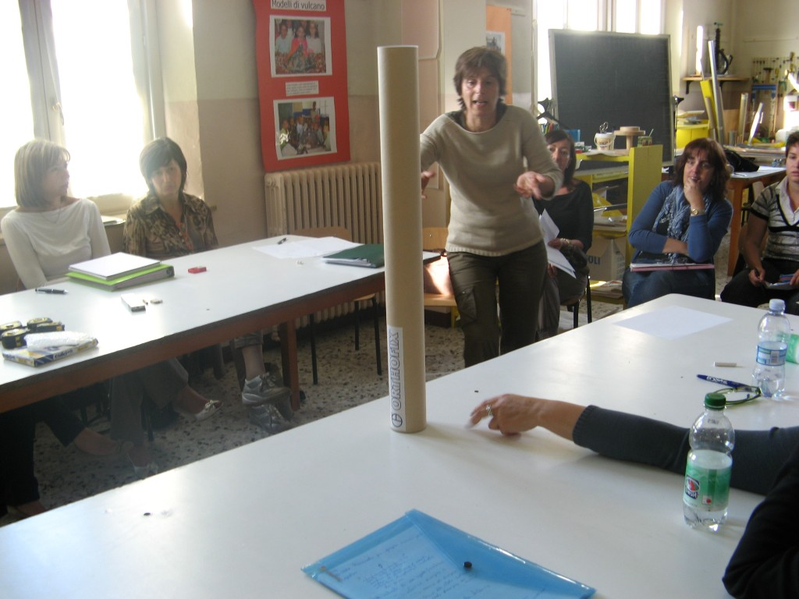

Slide 8
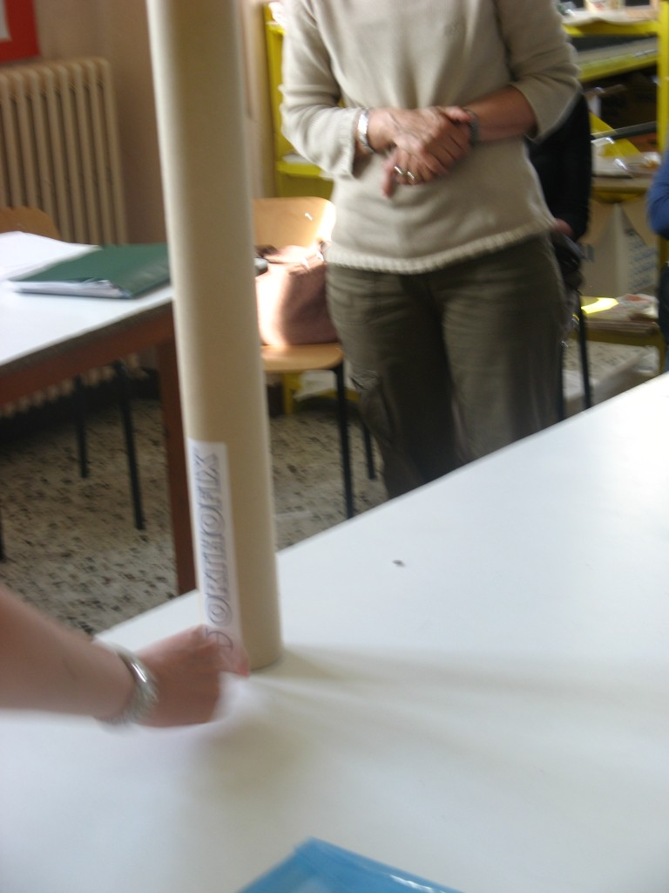

Slide 9
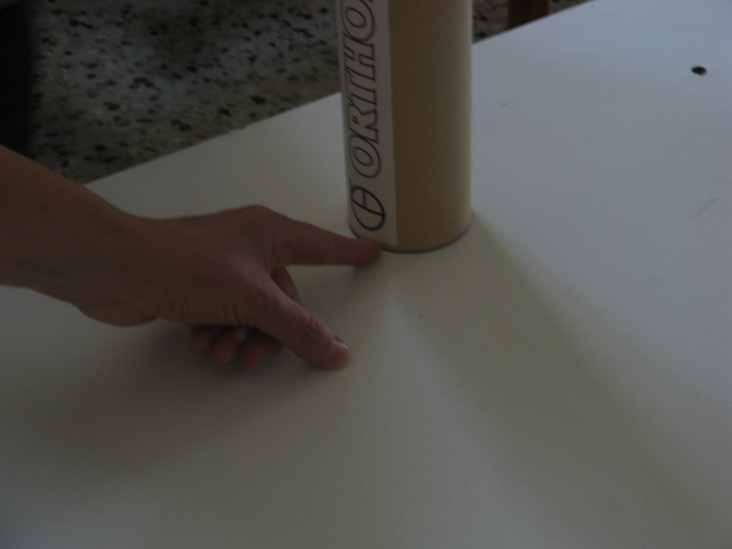

Slide 10
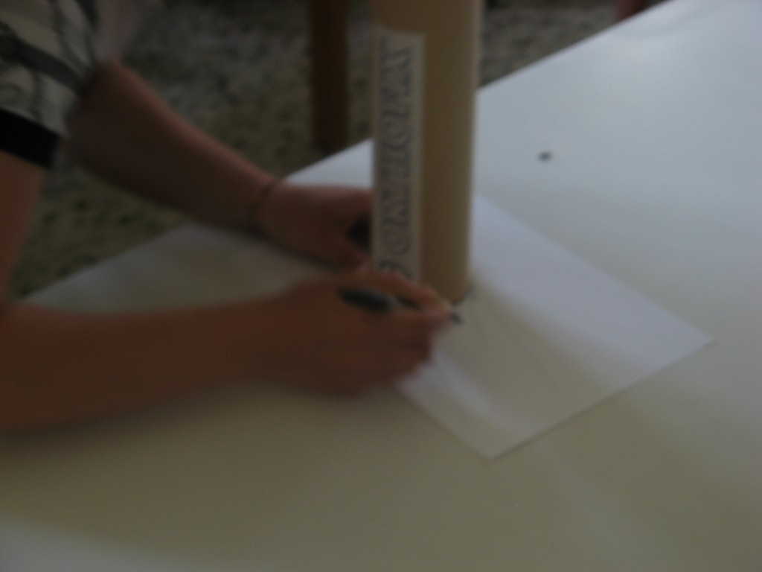

Slide 11
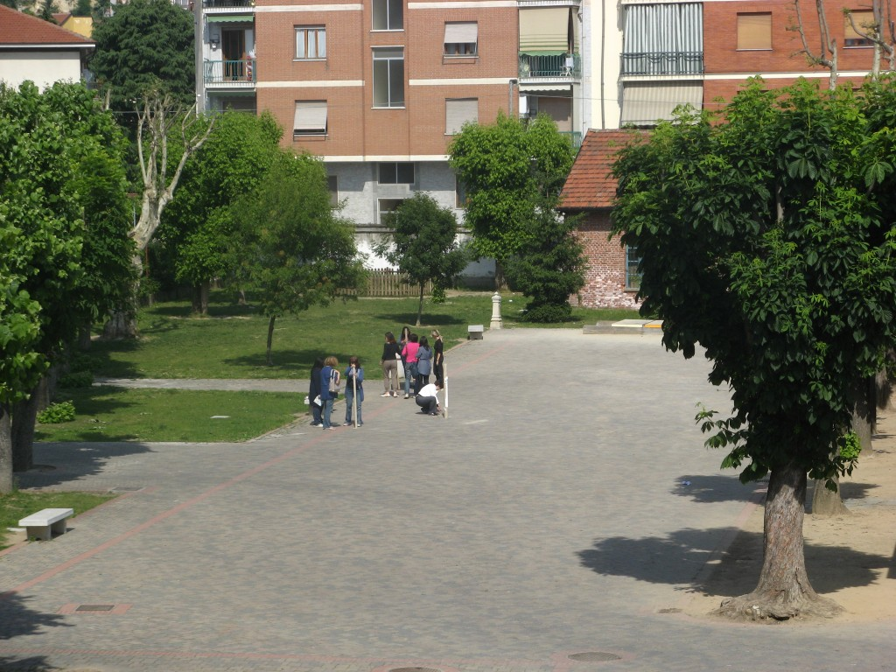

Slide 12
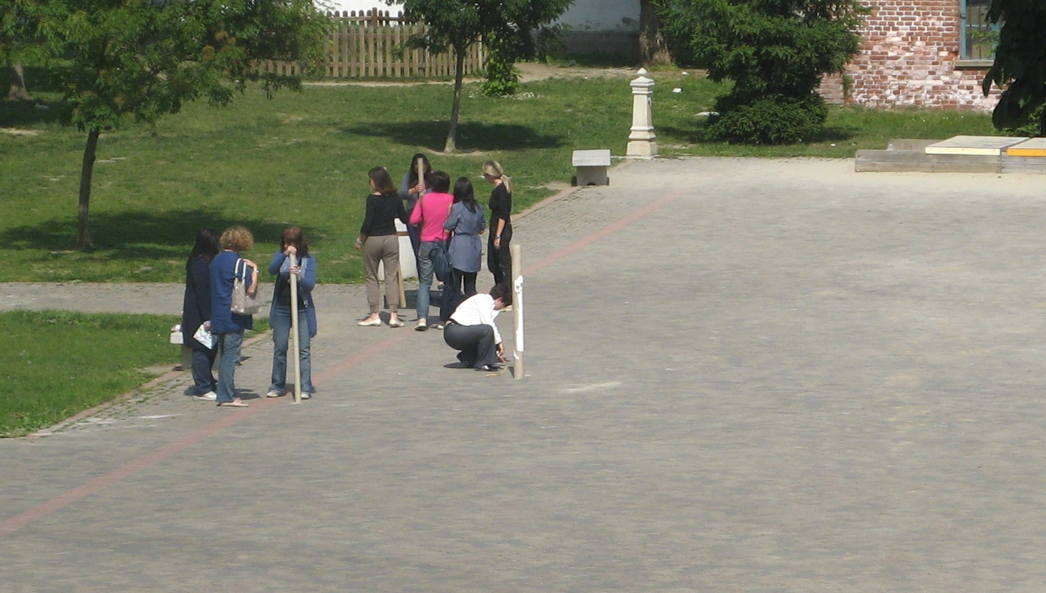

Slide 13
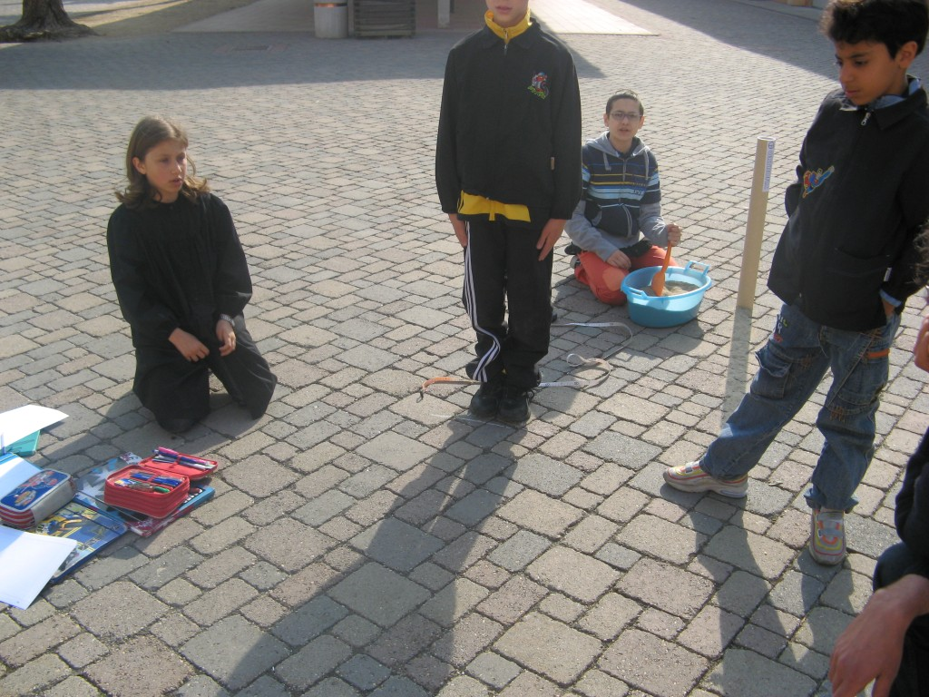

Slide 14
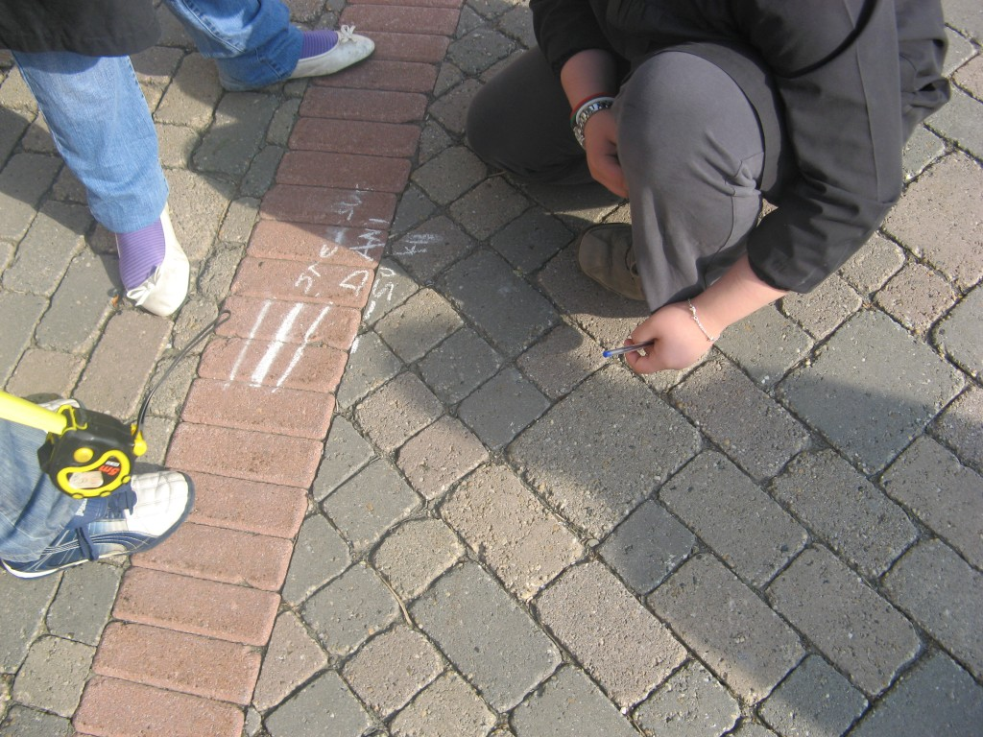

Slide 15
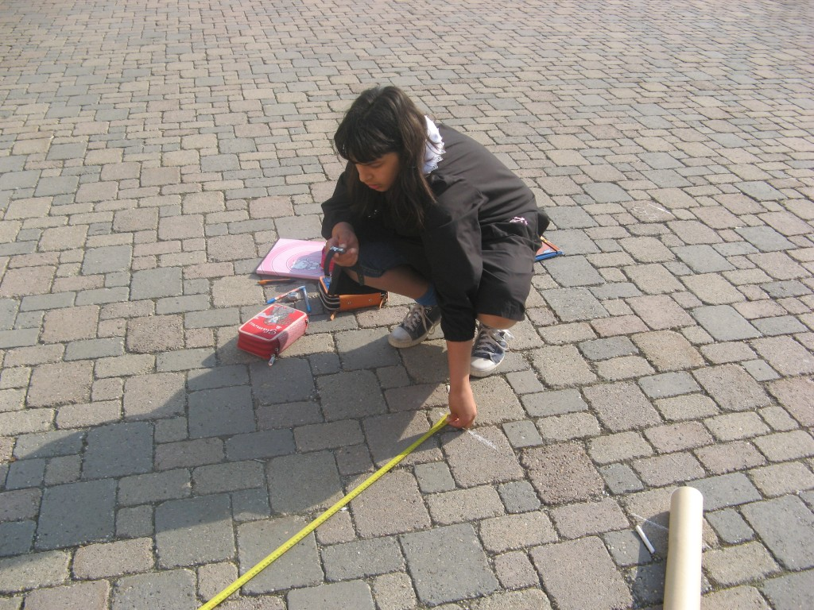

Slide 16
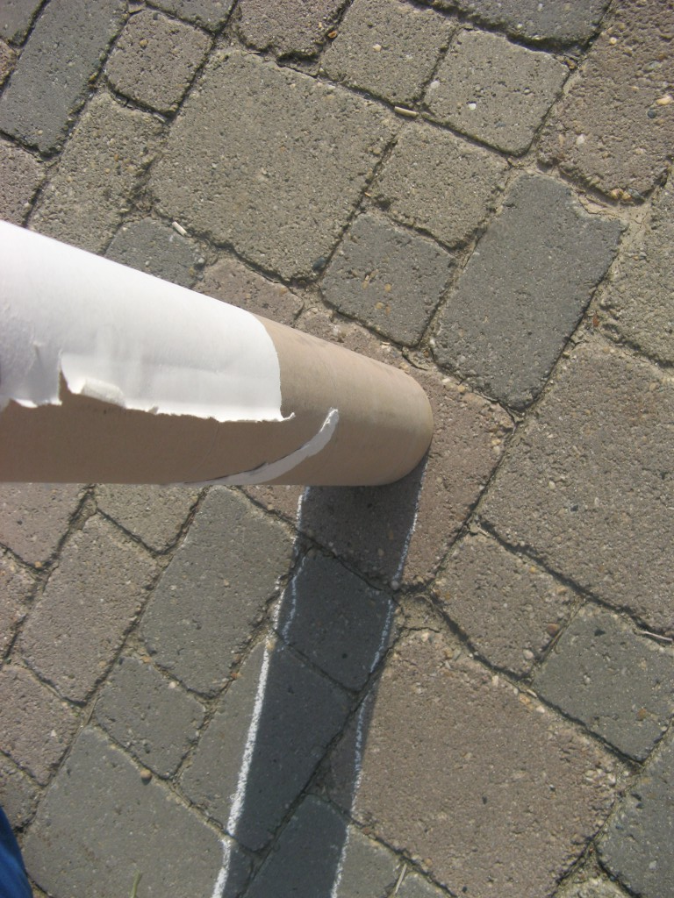

Slide 17
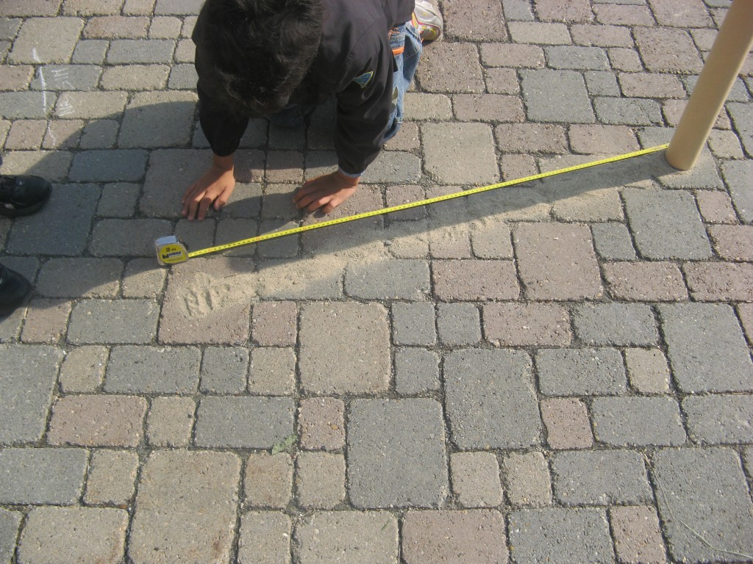

Slide 18
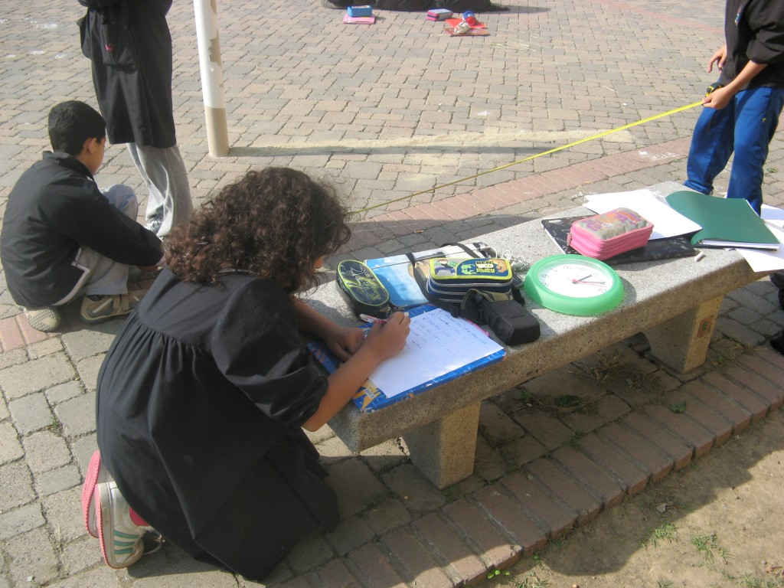

Slide 19
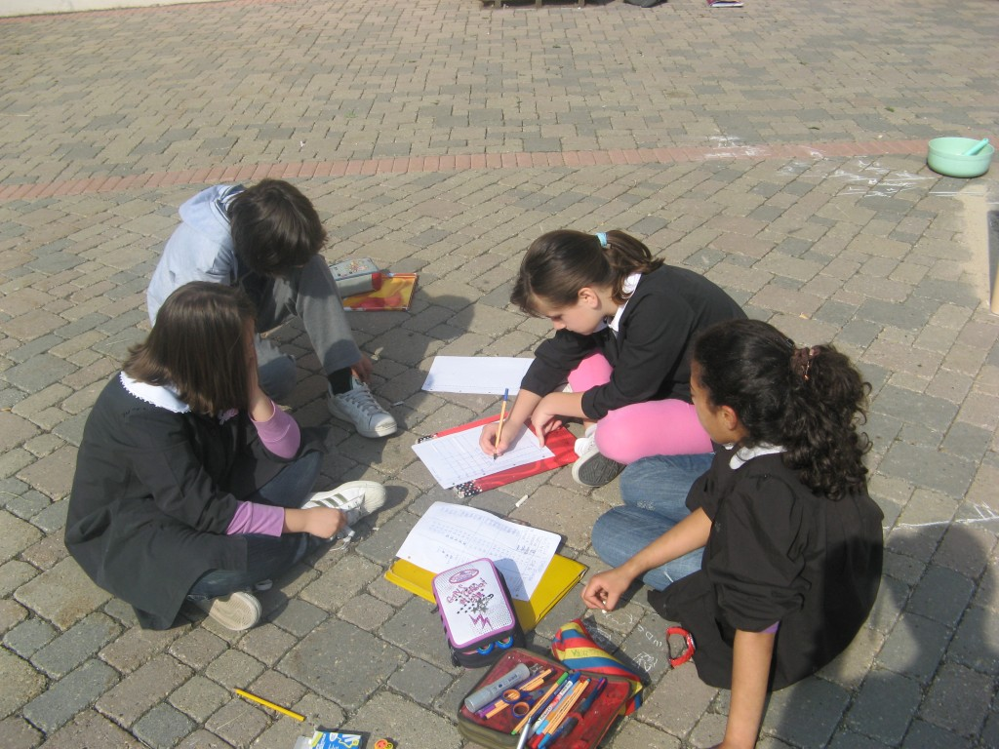

Slide 20
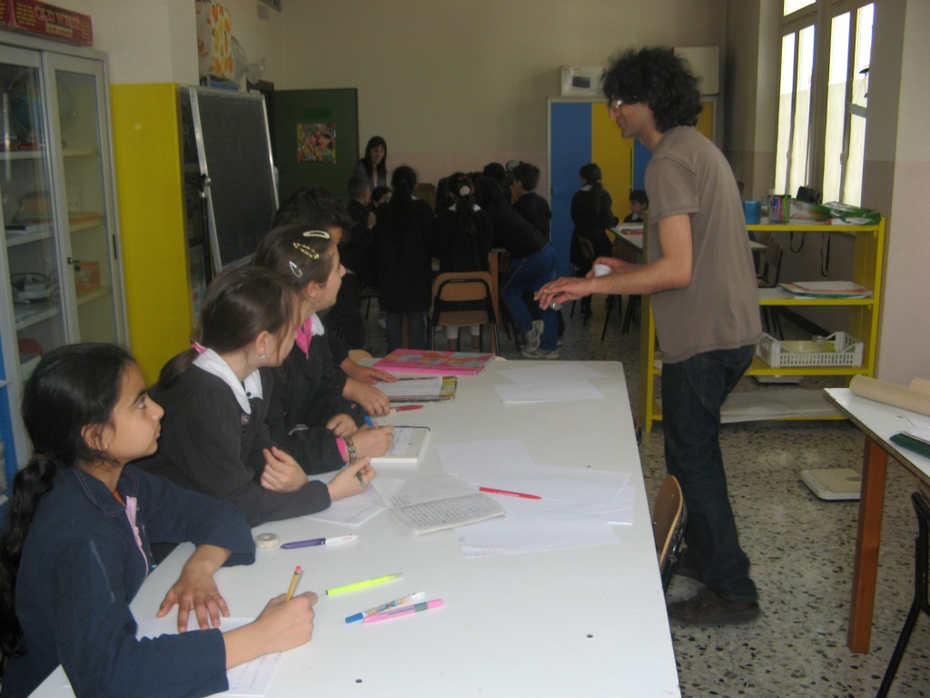

Slide 21
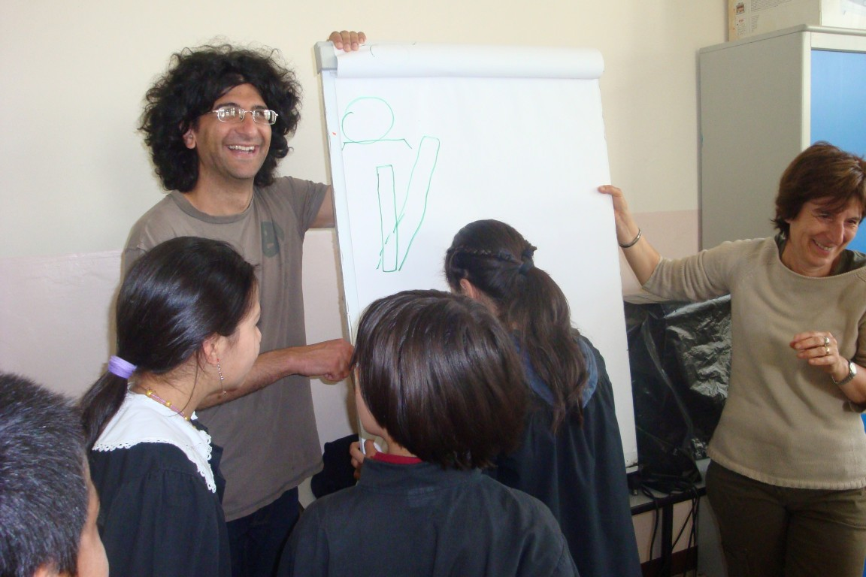

Slide 22
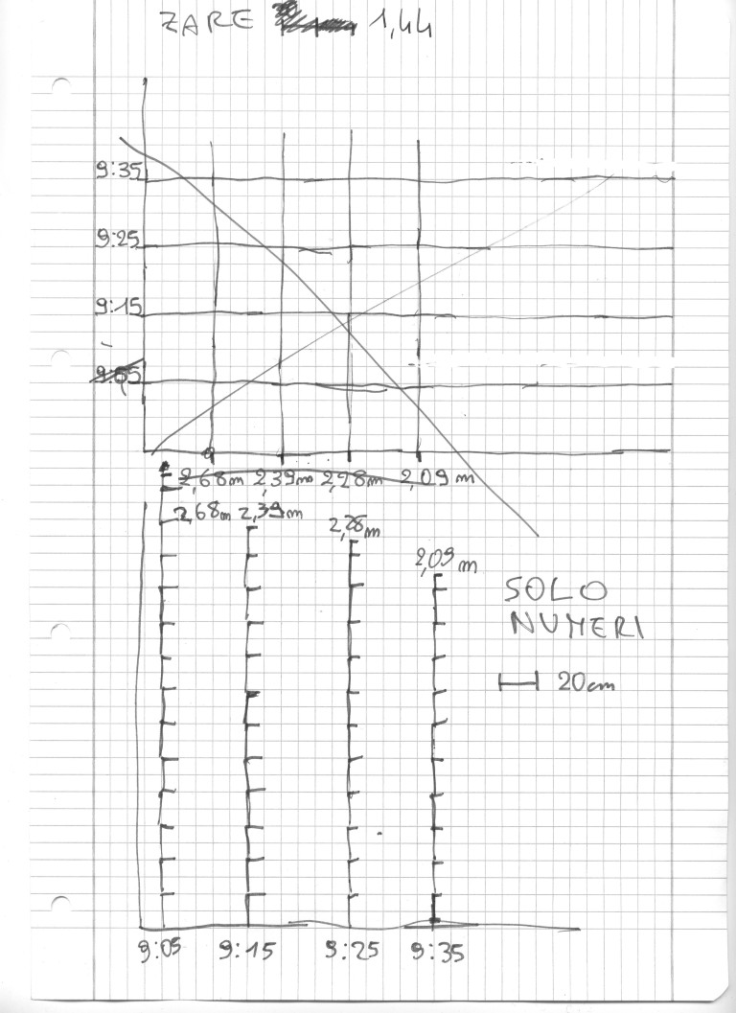

Slide 23
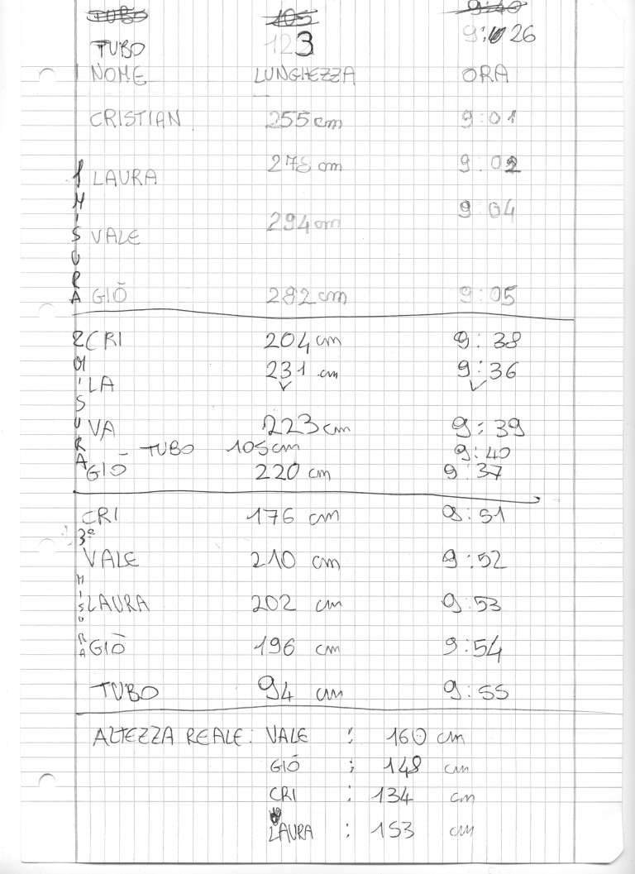

Slide 24
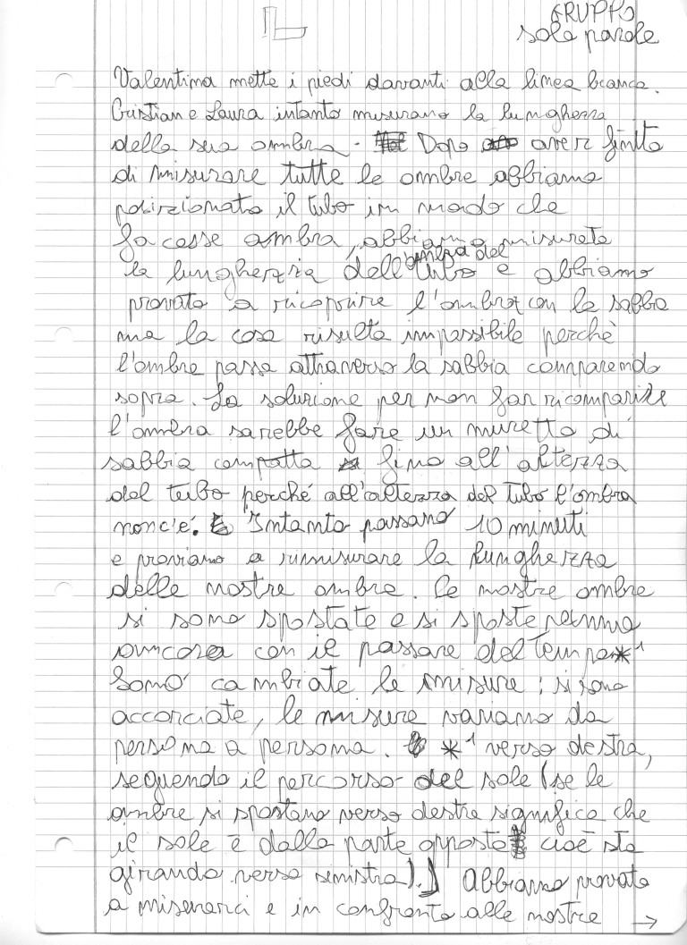

Slide 25
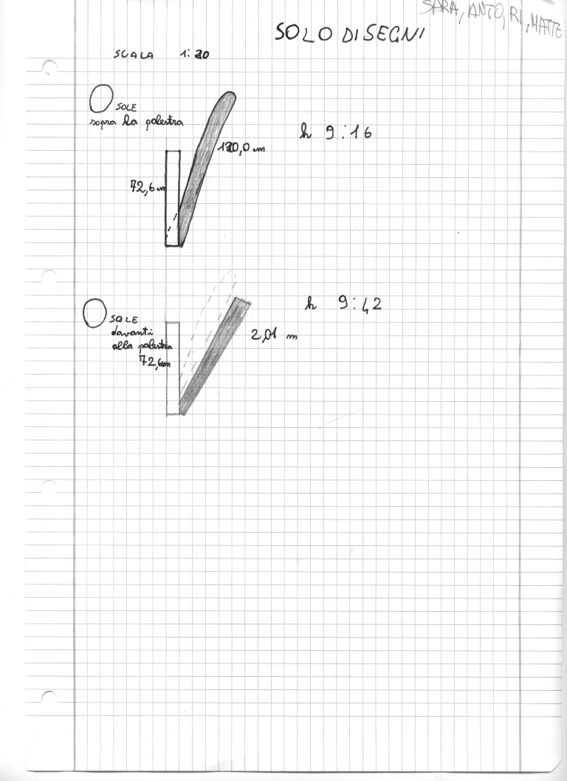

Slide 26
Germs of Cop
“T-s: You teach in primary school, so your attention is focussed on your pupils’ ability to reason more than it is focussed on their actual ability to compute correctly.
T-p: I think that you’ll reap what we’ve sown by focussing on reasoning about the way one uses some tools and contents (for example understanding that one needs to do a division in order to know a price). You will recognize all this work as a strength when they will be at secondary school.
T-s: But there’s something that doesn’t work. If a pupil arrives in secondary school and he is not fully capable of doing addictions, subtractions, multiplications and divisions, I think that the pupil will be left alone with those difficulties. And this is not because the teachers are lacking the will to solve the problem, but because we don’t have the tools to do better. We should discuss and reach an agreement about this issue.”

Slide 27
PD as CoP catalyst
“I once asked Ciro [TRACES researcher] to help me and he told me to look at the materials exchanged with you [another teacher in the workgroup] because it was the same issue you had, so he told me to look at your work and his interventions in your class. Many of the things [I found] resonated with my issues, so this is useful. One needs to get used to it.”
“I need your help in designing the activities, in integrating your hints and correcting my mistakes. I want to question my practice sharing with the workgroup the things I do with my class. I want to develop my teaching practice, especially for what concerns mathematics and science because I am lacking a specific training. I think, as a teacher, it is a duty to develop my teaching practice.”

Slide 28
Willingness to question practice
“The pupils find it hard to stay focused on several things at the same time. It’s not easy to control several variables. I was used to suggest the ‘correct’ answer at some point in the discussions in order to save time, but it’s interesting to make questions and let them the necessary time and freedom to discuss. It seems to me that their answers are not evolving that much from one activity to the other. This suggests me that I have to try an activity again and again.”

Slide 29
Research-based impact on practice in presence of CoP
“The good thing is that the academy is coming to us. University research usually remains inside the academy. The research work that is at the basis of the activities you proposed is usually inaccessible to schools. Research literature is usually too abstract and complex. The fact that you are entering the classrooms completely changes the perspective of the interaction.”

Slide 30
Value of cooperation
“That year it was interesting, because we were forced to reason a lot together. I remember what happened when in that experimentation we worked with that colleague (…) Since then, I have changed my way of teaching science. It has changed completely. For example, I was strongly dependent on the textbook and organized my teaching following the sequence of topics as it was presented in there. With her, we worked on the ideas that the human is a machine, where matter and energy come in, they are transformed and go out. Since then, I can no longer follow the textbook because the ideas I start from, are ‘What comes in a human body? What goes out? How do we transform it?’ So one begins to understand the function of organs and the systems work in terms of the logic of all these transformations, and this makes it interesting.”

