Slide 2



School and University Partnership for Peer Communities of learners (SUP4PLC)
Proj. n.: 573660-EPP-1-2016-1-EG-EPPKA2-CBHE-JP (2016-2516/001-001)
Kick-off Meeting
Cairo 2017.02.27-28
Towards a monitoring instrument for PLC
Francesco Cuomo, Anne-Kathrin Lindau, Tom Renner

Slide 3
Key literature
Lave, J., & Wenger, E. (1991). Situated Learning: Legitimate Peripheral Participation. Cambridge: Cambridge University Press.
Brown, J. S., & Duguid, P. (1991). Organizational learning and communities-of-practice: Toward a unified view of working, learning, and innovation. Organization Science, 2 (1), 40–57.
Wenger, E. (1998). Communities of practice: learning, meaning, and identity. Cambridge University Press.
Wenger, E., McDermott, R., & Snyder, W. (2002). Cultivating communities of practice: a guide to managing knowledge. Harvard Business School Press.

Slide 4
Definitions
“Communities of practice are groups of people who share a concern, a set of problems, or a passion about a topic, and who deepen their knowledge and expertise in this area by interacting on an ongoing basis”
(Wenger et al, 2002, p. 4)
“Communities of practice are formed by people who engage in a process of collective learning in a shared domain of human endeavor.”
(Wenger, 2006, p. 1)
“An effective professional learning community has the capacity to promote and sustain the learning of all professionals in the school community with the collective purpose of enhancing pupil learning.
(Bolam et al, 2005, p. iii)

Slide 5
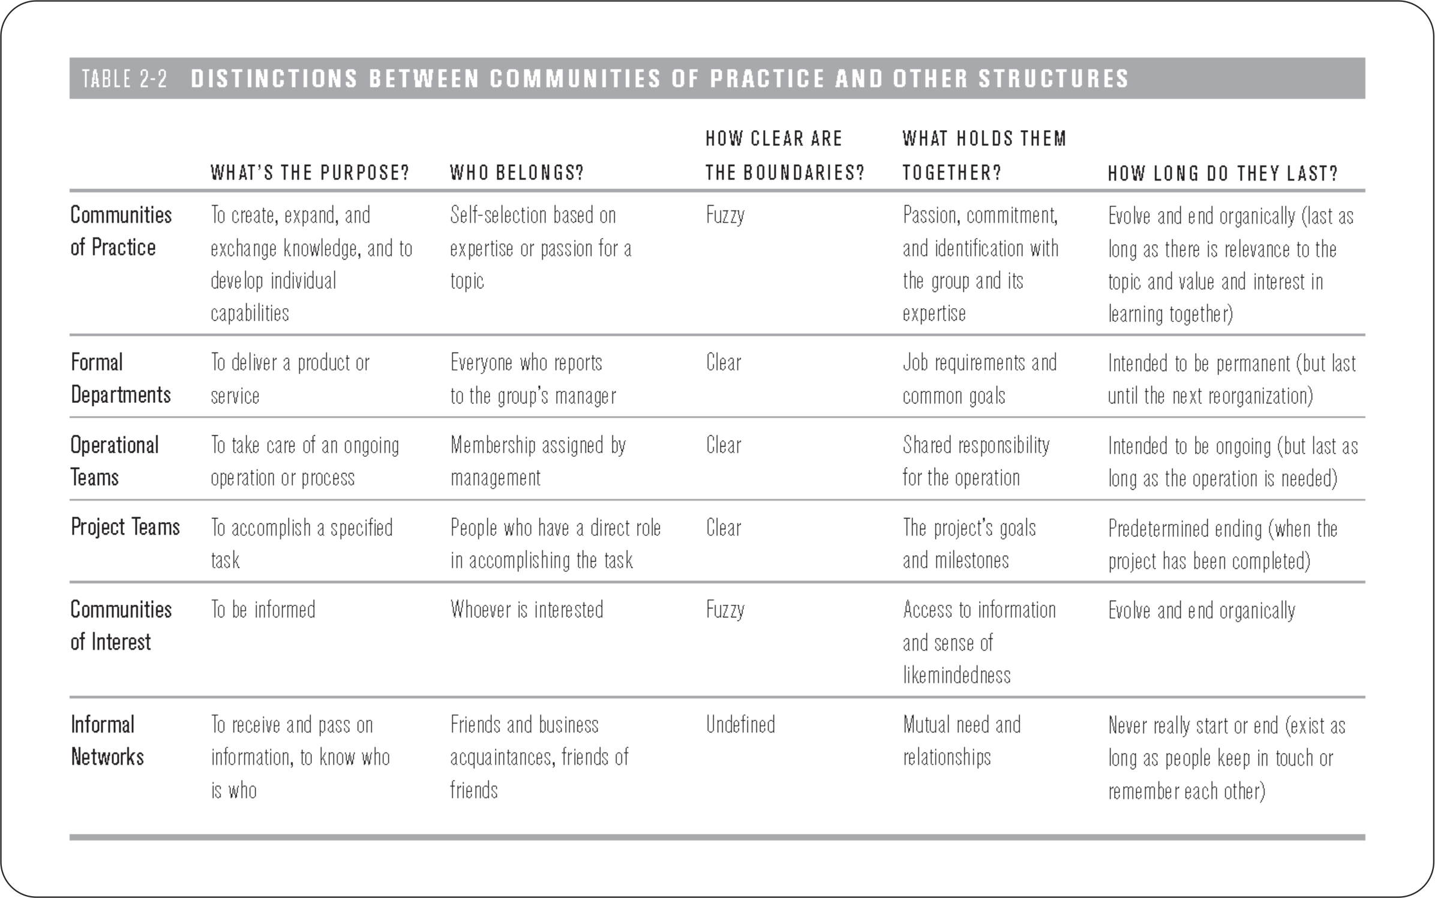
(Wenger et al, 2002)

Slide 6
Three key characteristics
DOMAIN
“A community of practice is not merely a club of friends
or a network of connections between people. It has an identity defined by a shared domain of interest. Membership therefore implies a commitment to the domain, and therefore a shared competence that distinguishes members from other people.”
(Wenger, 2012)

Slide 7
Three key characteristics
DOMAIN
“A community of practice is not merely a club of friends
or a network of connections between people. It has an identity defined by a shared domain of interest. Membership therefore implies a commitment to the domain, and therefore a shared competence that distinguishes members from other people.”
(Wenger, 2012)

Slide 8
Three key characteristics
COMMUNITY
“In pursuing their interest in their domain, members
engage in joint activities and discussions, help each other, and share information. They build relationships that enable them to learn from each other.”
(Wenger, 2012)

Slide 9
Three key characteristics
COMMUNITY
“In pursuing their interest in their domain, members
engage in joint activities and discussions, help each other, and share information. They build relationships that enable them to learn from each other.”
(Wenger, 2012)

Slide 10
Three key characteristics
PRACTICE
“Members of a community of practice are practitioners. They develop a shared repertoire of resources: experiences, stories, tools, ways of addressing recurring problems—in short a shared practice. This takes time and sustained interaction.”
(Wenger, 2012)

Slide 11
Three key characteristics
PRACTICE
“Members of a community of practice are practitioners. They develop a shared repertoire of resources: experiences, stories, tools, ways of addressing recurring problems—in short a shared practice. This takes time and sustained interaction.”
(Wenger, 2012)

Slide 12
“A community of practice can be viewed as a social learning system. Arising out of learning, it exhibits many characteristics of systems more generally:
emergent structure
complex relationships
self-organization
dynamic boundaries
ongoing negotiation of identity and cultural meaning.”
(Wenger, 2010, p. 179-80)

Slide 13
“Engagement in social contexts involves a dual process of meaning making.
On the one hand, we engage directly in activities, conversations, reflections, and other forms of personal participation in social life.
On the other hand, we produce physical and conceptual artifacts — words, tools, concepts, methods, stories, documents, links to resources, and other forms of reification—that reflect our shared experience and around which we organize our participation.
Meaningful learning in social contexts requires both participation and reification to be in interplay. Artifacts without participation do not carry their own meaning; and participation without artifacts is fleeting, unanchored, and uncoordinated.”
(Wenger, 2010, p. 180)

Slide 14
“Engagement in social contexts involves a dual process of meaning making.
On the one hand, we engage directly in activities, conversations, reflections, and other forms of personal participation in social life.
On the other hand, we produce physical and conceptual artifacts — words, tools, concepts, methods, stories, documents, links to resources, and other forms of reification — that reflect our shared experience and around which we organize our participation.
Meaningful learning in social contexts requires both participation and reification to be in interplay. Artifacts without participation do not carry their own meaning; and participation without artifacts is fleeting, unanchored, and uncoordinated.”
(Wenger, 2010, p. 180)

Slide 15
Communities develop their practice through a variety of activities. Typical examples:
Problem solving
Can we work on this design and brainstorm some ideas? I’m stuck.
Requests for information
Where can I find the code to connect to the server?
Seeking experience
Has anyone dealt with a customer in this situation?
Reusing assets
I have a proposal for a local area network I wrote for a client last year. I can send it to you and you can easily tweak it for this new client.
Coordination and synergy
Can we combine our purchases of solvent to achieve bulk discounts?
(Wenger, 2012, p. 2-3)

Slide 16
Communities develop their practice through a variety of activities. Typical examples:
Discussing developments
What do you think of the new CAD system? Does it really help?
Documentation projects
We have faced this problem five times now. Let us write it down once and for all.
Visits
Can we come and see your after-school program? We need to establish one in our city.
Mapping knowledge and identifying gaps
Who knows what, and what are we missing? What other groups should we connect with?
(Wenger, 2012, p. 2-3)

Slide 17
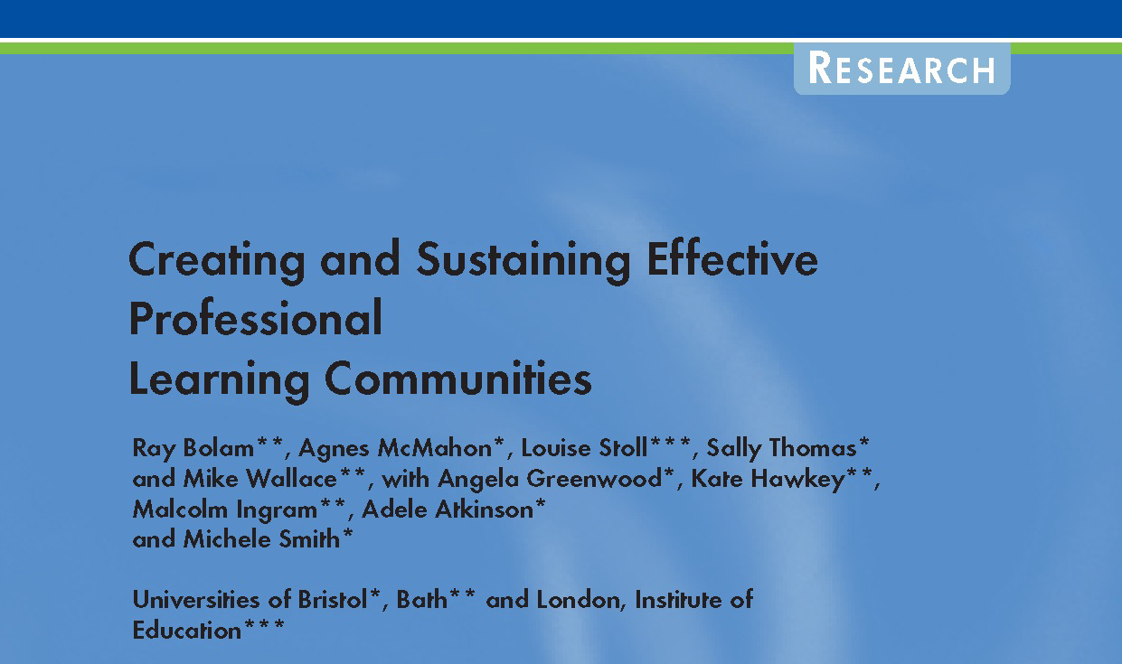
Questionnaire survey: 393 schools
Jan 2002 – Oct 2004
Case studies: 16 schools

Slide 18
A working definition?
“The project’s working definition offers a practical basis for staff in schools wishing to promote an effective PLC. In so doing, they should take account of the issues associated with the components of that definition (…) in particular, relate the definition to their own context.”
(Bolam et al, 2005, p. i)
Bolan et al. (2005) suggest that it is very necessary “to make explicit use of the idea of a PLC, and the terminology, and to seek a shared understanding of it in order to promote and sustain a PLC.” (p. vii)
And that “each school staff will probably need to formulate its own working definition of a PLC.” (Ib.)
(Situated character of professional learning)
(Bolam et al, 2005)

Slide 19
PLC development profile
12 dimensions
1. Shared values and vision
2. Collective responsibility for pupils’ learning
3. Collaboration focused on learning
4. Professional learning: individual and collective
5. Reflective professional enquiry
6. Openness, networks and partnerships
7. Inclusive membership
8. Mutual trust, respect and support
9. Optimising resources and structures to promote the PLC
10. Promoting professional learning: individual and collective
11. Evaluating and sustaining the PLC
12. Leading and managing the PLC
(Bolam et al, 2005)

Slide 20
Collective responsibility
“Professional community is connected to collective responsibility in the way teachers’ joint efforts develop a shared understanding for and commitment to improving practice in order to benefit all students. The formation of strong professional community occurs where teachers work together to deprivatise classroom practice in order to gain greater consistency in the quality of their teaching (Grossman et al, 2000). Teacher collaboration can lead to sharing expertise and a shared understanding of what matters for the goals of teaching (Lavie, 2006; Louis et al, 1996). These core practices are described as culminating “in a collective sense of responsibility for school operations and improvement” (Bryk et al, 1999, p.755).”
(Whalan, 2012, p. 11)

Slide 21
Collective responsibility
“Professional community is connected to collective responsibility in the way teachers’ joint efforts develop a shared understanding for and commitment to improving practice in order to benefit all students. The formation of strong professional community occurs where teachers work together to deprivatise classroom practice in order to gain greater consistency in the quality of their teaching (Grossman et al, 2000). Teacher collaboration can lead to sharing expertise and a shared understanding of what matters for the goals of teaching (Lavie, 2006; Louis et al, 1996). These core practices are described as culminating “in a collective sense of responsibility for school operations and improvement” (Bryk et al, 1999, p.755).”
(Whalan, 2012, p. 11)

Slide 22
Grossman, Wineburg and Woolworth’s (2001) model for the formation of teacher professional community has four dimensions
formation of group identity and norms of interaction
understanding difference/navigating fault lines;
negotiating tension
taking communal responsibility for individuals’ growth.
These four dimensions point to a necessity for teachers to find a common language with which to create a collective vision for their work.

Slide 23
INDICATORS
• Taking needs into account
• Taking opinions into account
• Managing conflict
• Valuing difference
• Availability of tools for effective collaboration
- online platform for sharing digital media
- physical repository for documents, literature and teaching materials
- online communication tools (email, forum, chat, blog)
• Availability of space and time resources
• Respondent’s disposition to collaborate w colleagues
• Colleagues disposition to collaborate
• ...

Slide 24
INDICATORS
Intrinsic Motivation Inventory (Deci & Ryan) (adapted from)
• To what extent do you enjoy taking part in the PLC?
• How interesting is it for you to participate in the PLC?
• To what extent does participation in the PLC hold your attention?
• How much effort do you feel you are putting into the PLC?
• How important is it for you to do well in the PLC?
• To what extent do you feel nervous in participating in the PLC?
• To what extent do you feel under pressure in participating in the PLC?
• To what extent do you participate in the PLC because you wanted to?
• To what extent do you participate in the PLC because you had to?

Slide 25
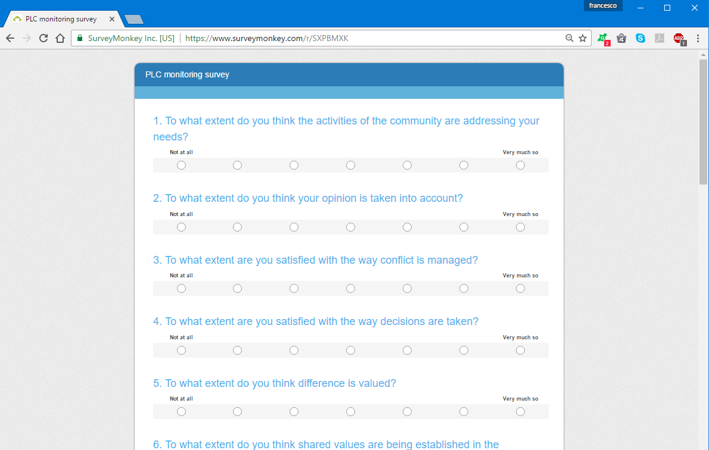
https://www.surveymonkey.com/r/SXPBMXK

Slide 26
Process-oriented evaluation
Outcome-oriented evaluation?
(Competences)
Indicators for Mentors and Pedagogical Leaders

Slide 27
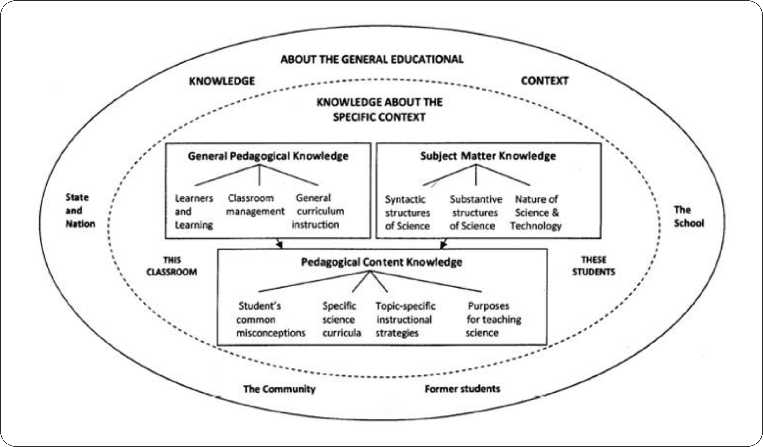
Domains of teacher knowledge (Carlsen, 1999)

Slide 28
Teachers‘ professional knowledge base categories
(Adapted from Shulman, 1987, p. 8)

Slide 29
 | CATEGORY | DEFINITION
General dimensions of teacher knowledge | Knowledge of educational ends | A comprehension of the purposes and values of education as well as their philosophical and historical grounds.
 | Knowledge of educational contexts | An understanding of the sociocultural and institutional dynamics of schools, communities and cultures.
 | General pedagogical knowledge | Command over the main principles, methods and strategies needed for effective teaching and learning.
 | Knowledge of learners | An understanding of learners' cognitive, psychological and affective characteristics, behaviors, interests and developmental stages.
Content-specific dimensions of teacher knowledge | Curriculum knowledge | A comprehension of the syllabus, topics, and isntructional materials designed for and expected in the teaching of a particular subject.
 | Content knowledge | Academic comprehension of both the content and the structure of a subject.
 | Pedagogical content knowledge | A combination of content and pedagogy that helps teachers make a subject comprehensible to others.
Teachers‘ professional knowledge base categories
(Adapted from Shulman, 1987, p. 8)

Slide 30
REFERENCES
Bolam, R., McMahon, A., Stoll, L., Thomas, S., & Wallace, M. (2005). Creating and sustaining effective professional learning communities. Research Report: RR637 May. Department for Education and Skills, United Kingdom. [accessed: 13 February 2012] http://dera.ioe.ac.uk/5622/1/RR637.pdf.
Brown, J. S., & Duguid, P. (1991). Organizational learning and communities-of-practice: Toward a unified view of working, learning, and innovation. Organization Science, 2 (1), 40–57.
Bryk, A. S., Camburn, E., & Louis, K. S. (1999). Professional community in Chicago elementary schools: Facilitating factors and organizational consequences. Educational Administration Quarterly, 35, 751–781.
Carlsen, W. S. (1999). Domains of Teacher Knowledge. In J. Gess-Newsome & N. G. Lederman (Eds.), Examining Pedagogical Content Knowledge (pp. 133 – 144). Netherlands: Kluwer Academic Publishers.
Grossman, P., Wineburg, S., & Woolworth, S. (2001). Toward a Theory of Teacher Community. The Teachers College Record, 103, 942-1012.
Lave, J., & Wenger, E. (1991). Situated Learning: Legitimate Peripheral Participation. Cambridge: Cambridge University Press.

Slide 31
REFERENCES
Shulman, L. (1987). Knowledge and teaching: Foundations of the new reform. Harvard Educational Review, 57 (1), 1-22.
Wenger, E. (1998). Communities of practice: learning, meaning, and identity. Cambridge University Press.
Wenger, E. (2006). Communities of practice: A brief introduction. http://wenger-trayner.com/wp-content/uploads/2012/01/06-Brief-introduction-to-communities-of-practice.pdf. Retrieved February 15, 2017.
Wenger, E. (2010). Communities of Practice and Social Learning Systems: the Career of a Concept. In C. Blackmore (Ed.), Social Learning Systems and Communities of Practice (p. 179-198). London: Springer.
Wenger, E., McDermott, R., & Snyder, W. M. (2002). Cultivating communities of practice (1st ed.). Watertown, MA: Harvard Business School Press.
Whalan, F. (2012). Collective responsibility. Redefining what falls between the cracks of school reform. Rotterdam, Boston, Taipei: Sense.

Slide 32

DISCLAIMER
This project has been funded with support from the European Commission. This publication [communication] reflects the views only of the author, and the Commission cannot be held responsible for any use which may be made of the information contained therein.

