Slide 1

University of Limerick: Global Citizenship and the Ubuntu Network
573660-EPP-1-2016-1-EG-EPPKA2-CBHE-JP (2016-2516/001-001)
School and University Partnership for Peer Communities of Learners
Disclaimer:
"This project has been funded with support from the European Commission. This publication [communication] reflects the views only of the author, and the Commission cannot be held responsible for any use which may be made of the information contained therein

Slide 3
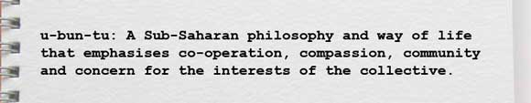

Slide 4
Poverty, debt, aid, migration, climate change, human rights, environmental preservation, the Sustainable Development Goals...all raise issues and questions about development that we need to consider in order to be responsible global citizens.
Education is a powerful force for change, enabling us to critically reflect on the way things are, to identify social injustices and unsustainable practices and to act for a better world. This is what Development Education (DE) is about.

Slide 5
The Ubuntu Network http://www.ubuntu.ie/about.html
The Ubuntu Network actively promotes that Development Education be embedded into post-primary Initial Teacher Education (ITE) in Ireland
The goal is to support teacher educators and student teachers to engage with local and global development issues, to see how they are relevant to their subject areas and disciplines, and to understand the value that such perspectives bring to teaching.

Slide 6
The Ubuntu Network
The Ubuntu Network was established in 2006 to support the integration of Development Education (DE) into post primary Initial Teacher Education (ITE) in Ireland.
It is made up of teacher educators from Higher Education Institutions, national government organisation representatives, and partner organisations with a commitment to education for social justice, equality and sustainability.
Notes:
http://www.ubuntu.ie/about.html

Slide 8
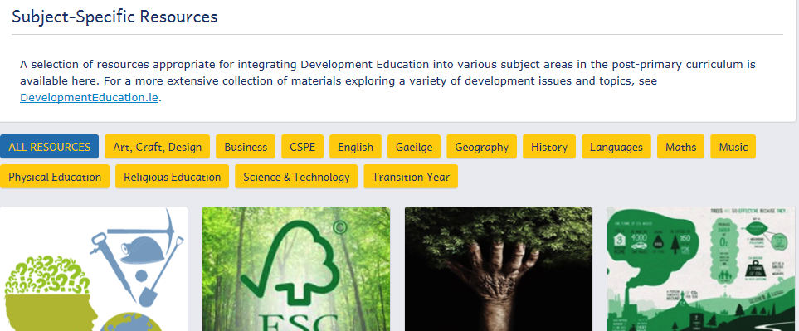

Slide 9
http://epistem.ie/our-people/faculty-staff/
Notes:
http://epistem.ie/our-people/faculty-staff/

Slide 10
STEM EDUCATION
STEM is a curriculum based on the idea of educating students in four specific disciplines — science, technology, engineering and mathematics — in an interdisciplinary and applied approach.
Rather than teach the four disciplines as separate and discrete subjects, STEM integrates them into a cohesive learning paradigm based on real-world applications.

Slide 11
EPI-STEM
The work of the centre is project-led within the following themes in STEM content:
Fourth and Third levels, Second level, Primary Education, STEM literacy.
Projects address important issues such as adapting good practices in STEM teaching and learning for use in Ireland by research interventions in schools and other institutes and piloting such practices.
These are then disseminated through CPD events organised by the Centre and all materials are made available on the Epi-Stem website.

Slide 12
Guiding Principles
The Centre is committed to and guided by an approach that:
attributes particular value to the development of strong subject-matter knowledge as a basis for strong pedagogical knowledge and practice in the STEM,
attaches importance to promoting practice that is informed by research,
seeks to maximise contribution through collaborations and networks.

Slide 13
The Mission of the National Centre is to:
Conduct best practice, evidenmce based research into teaching and learning in STEM.
Translate existing research into effective best practice in in STEM teaching and learning.
Design, inform, advise and deliver nationally recognised evidence based CPD programmes.
Collaborate and shares information with all universities/institutions to formulate strategies that enhance in STEM teaching and learning from primary school, through secondary school to third level and fourth level.
Promote scholarship in STEM h teaching and learning.

Slide 14
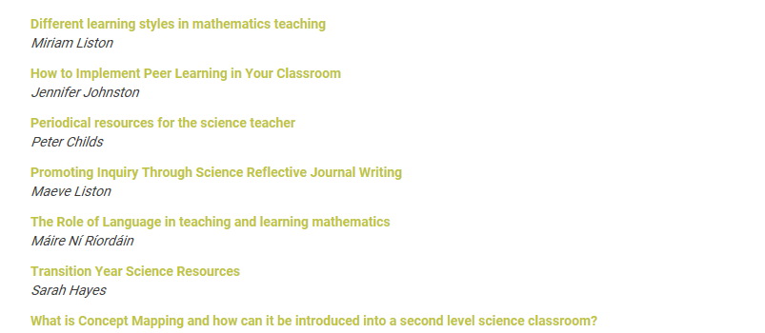
Sample resources

Slide 16
The Ubuntu Network
Vision:
Through Development Education, the Ubuntu Network contributes to building a world based on respect for human dignity and rights and is informed by values of justice, equality, inclusion, sustainability and social responsibility.
Mission:
The Ubuntu Network will support teacher educators to embed into their work a living understanding of and commitment to education for global citizenship, sustainable development and social justice, so that student-teachers at post-primary level can integrate into their teaching, and into the schools where they work, perspectives that encourage active engagement to build a more just world.

