Slide 1



LeadingLearning4All

Slide 2

Theory to practice
“… Taking the vision beyond the rhetoric”
Leading Learning 4 All is a web-based resource designed to support the learning of all students specifically those with disability and additional learning needs in Australian schools

Slide 3
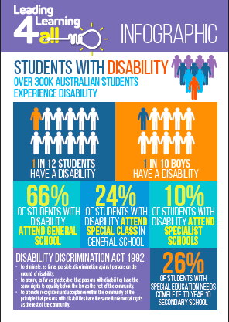
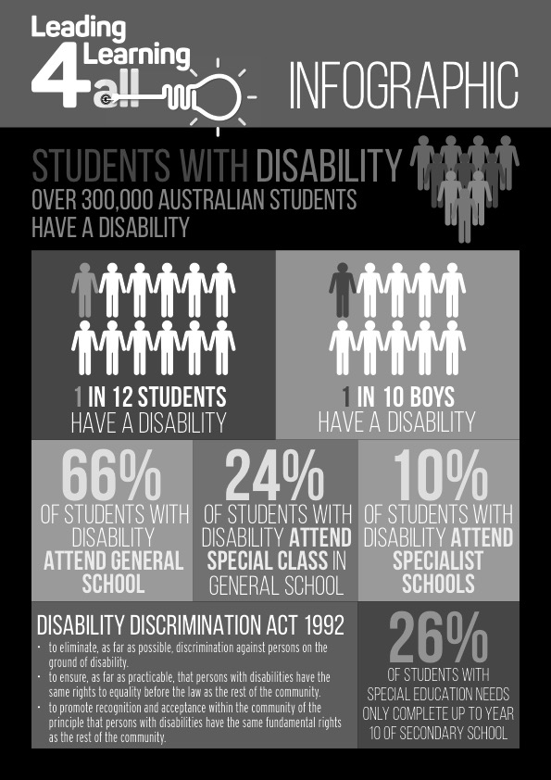
Rationale
10% of the world’s population live with a disability
Over 300,000 Australian students have a disability
66% of students with disability attend general school

Slide 4
National/International Policy Context
Disability Discrimination Act 1992
Disability Standards in Education 2005
Melbourne Declaration 2008
Australian Principal Standard 2017
Australian Standards for Teachers 2017
UN Convention on the Rights of the Child
UN Convention on the Rights of Persons with Disabilities

Slide 5
Based on three standards
Teachers
Standards
Principals
Standard
Disability
Standards

Slide 6
What does the website contain?
Reflection exercises for principals and their staff
Developmental process for building a professional learning community
Support materials and useful links
‘In Action’

Slide 7
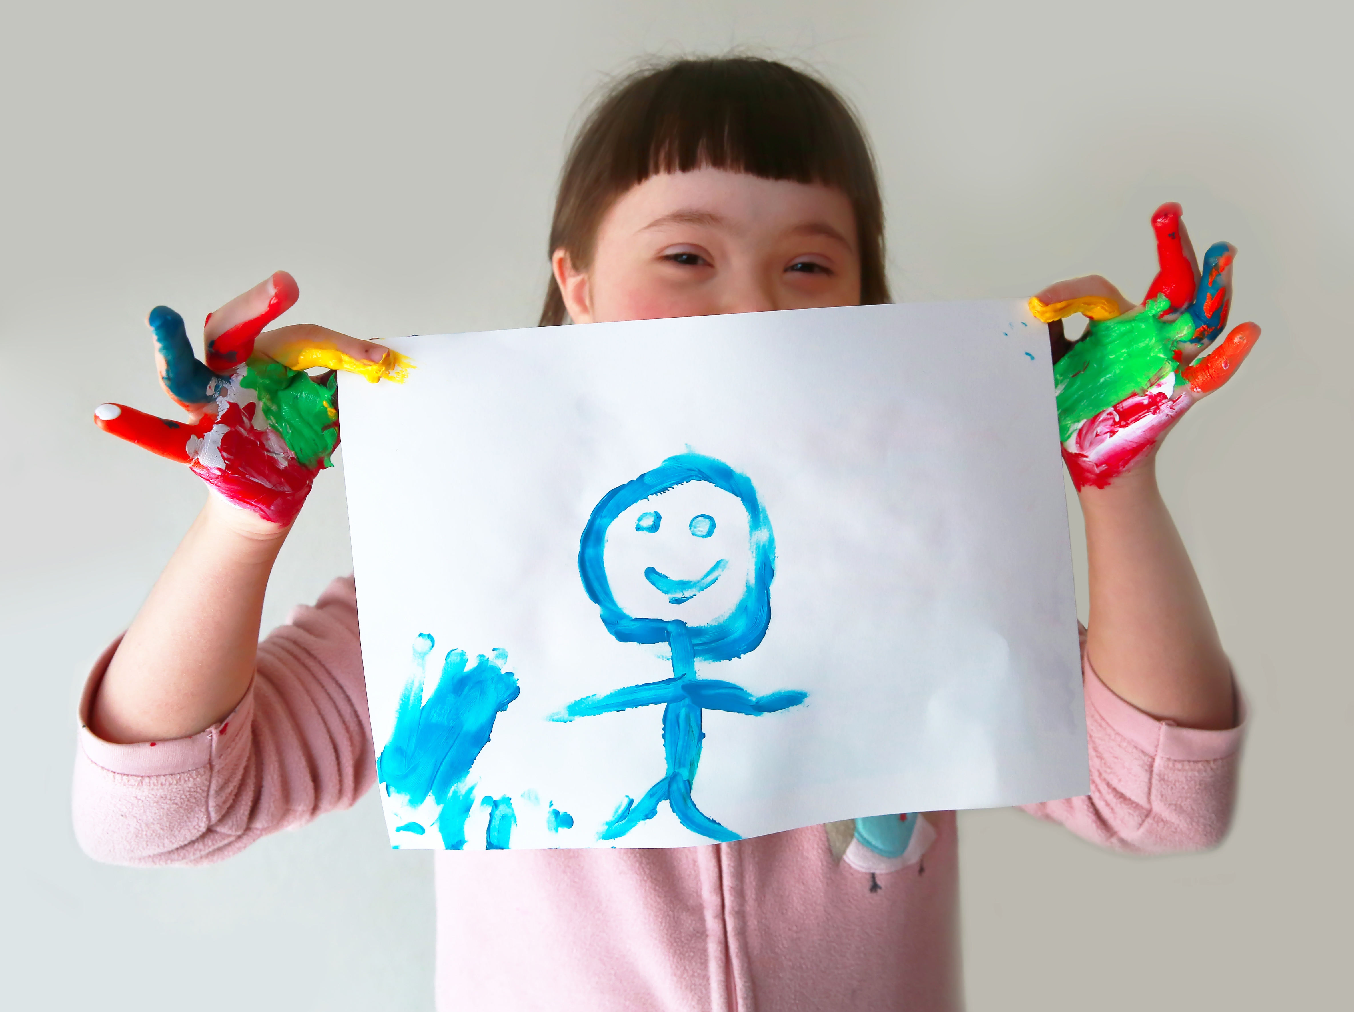
Let’s look at the
website

Slide 8


