Slide 1


Welcome to impact
By Paul Bramble
Third International Management Meeting
February 19th – 20th, 2018
School and University Partnership for Peer Communities of learners (SUP4PCL)
Project number: 573660-EPP-1-2016-1-EG-EPPKA2-CBHE-JP (2016-2516/001-001)

Slide 2
Thinking Erasmus+
Dissemination
Exploitation
Impact
Sustainability
What
Why
How
When
Where
Whom
Notes:
Dis and Expl should cover why, what, how, when, to whom and where disseminating results will take place, both during and after the funding period.
Exploitation is (a) a planned process of transferring the successful results of the programmes and initiatives to appropriate
decision-makers in regulated local, regional, national or European systems, on the one hand, and (b) a planned process of
convincing individual end-users to adopt and/or apply the results of programmes and initiatives, on the other hand.

Slide 3

What
Why
How
When
Where
Whom

Slide 4
WHAT DOES IMPACT MEAN?
“Impact is the effect that the activity carried out and its results have on people, practices, organisations and systems. Dissemination and exploitation of results plans can help to maximize the effect of the activities being developed so that they will impact on the immediate participants and partners for years to come. Benefits to other stakeholders should also be considered in order to make a bigger difference and get the most from the project.”
(Erasmus Programme Guide, 2018, p.308)

Slide 5
Key Action 3: Support for policy reform Social inclusion through education, training and youth - EACEA/07/2017
In line with the objective of Erasmus+ Key Action 3 to support policy reform, projects should demonstrate the capacity to generate impact not only at the level of the different partner organisations, but also at the systemic level (e.g. generating multiplier effects at territorial or sector-specific level, attracting or involving major players or networks – including from the private sector, obtaining support from public authorities, enhancing awareness and visibility of activities or outputs).
Projects focussing on dissemination/upscaling should primarily build on actions for which solid proof of their effectiveness can be provided and which show potential for being disseminated and/or scaled up.
Projects focussing on innovative practices should demonstrate their relevance, prospective actions and potential impact by building on previous analysis and evaluation work.
Learning communities established under this call should provide a platform for collecting and sharing expertise, disseminating and scaling up good practices as well as developing innovative approaches. Project activities should go beyond exchanging good practices and include concrete activities implemented at local level, preferably for disadvantaged groups.
Training institutions and learning providers involved in the project should demonstrate their commitment to promote inclusion and fundamental values also beyond the lifecycle of the project, for instance through relevant strategic plans.
The commitment of the school leadership and/or responsible authorities is particularly important and should be clearly demonstrated in the application.
Projects cutting across sectors and involving non-formal learning are encouraged with a view to creating synergies between education, training, youth, culture and sport.
https://www.up2europe.eu/calls/key-action-3-support-for-policy-reform-social-inclusion-through-education-training-and-youth-eacea-07-2017_1757.html
https://www.up2europe.eu/calls/key-action-3-support-for-policy-reform-social-inclusion-through-education-training-and-youth-eacea-07-2017_1757.html

Slide 6

So impact is
Quantifiable
Measurable
Sustainable
Real
Relevant
Evidence-based

Slide 7
Impact+ Exercise
Led by the United Kingdom Erasmus+ National Agency and CMEPIUS the Slovenian Erasmus+ Education and Training National Agency
Notes:
Please explain who will use these project outputs / products / results and how the consortium will reach them. Describe how the target groups (including participating institutions, stakeholders) will be reached and involved during the life of the project and how the project will benefit the target group at local, regional, national and or European level. Please structure your description according to the different levels of impact and stakeholders (limit 3000 characters).

Slide 8
Impact+ Exercise
The aim is to get you thinking about impact. Focus on getting your ideas down on paper first – you can review and revise them later.

Slide 9
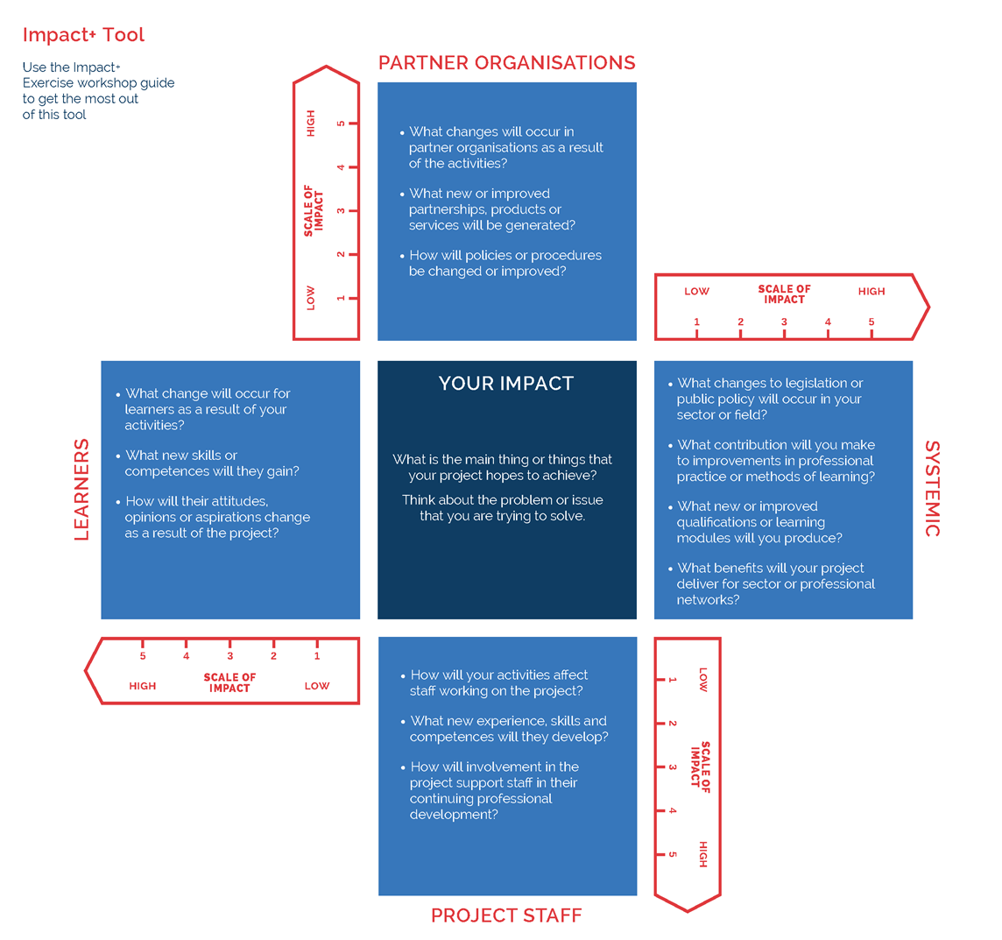

Slide 10
IMPACT+ EXERCISE SUMMARY TABLE
AREA OF IMPACT | IMPACTS / OUTCOMES | INDICATORS | DATA SOURCES | TIMESCALE
 |  |  |  | SHORT TERM | MEDIUM TERM | LONG TERM
SYSTEMIC
ORGANISATIONS
LEARNERS
STAFF

Slide 11
OUTPUTS
Outputs are the direct products of your activities. Counting them helps quantify your outcomes and impact.
Examples include the running of events or the number of people undertaking a training course.
Notes:
Output: a tangible product which is produced by a given project and which may be quantified; outputs can be accessible products like curricula, studies, reports, materials, events, or websites;

Slide 12
OUTCOMES
Outcomes are the changes, benefits, ,learning or other effects that occur as a result of your activities and outputs. Short-term outcomes should occur within 1-3 years and longer-term outcomes in 4-6 years.
Examples include people improving their communication skills or organisations improving their training provision.
Notes:
Outcome: an intangible added value achieved through the achievement of the project objectives and targets. Ordinarily, such added value defies quantification, whether it covers concrete events and actions such as training, training platforms, content or methodology, or more abstract consequences such as increased awareness, increased skills or improved abilities. knowledge and experience gained by participants, partners or other stakeholders involved in the project.

Slide 13
IMPACT
Impact is the fundamental change that happens as a result of an activity. It will generally occur in the long term, often after the activity has finished.

Slide 14
INDICATORS
Indicators are measures that allow progress towards a goal to be tracked.
For example, a project seeking to improve the quality of their training may measure student satisfaction or student employment as potential indicators.

Slide 15
DATA SOURCES
Data sources and data collection will feed from the indicator(s).
Data sources / collection methods can be relevant to more than one indicator.
Data can be qualitative or quantitative – both are valuable.

Slide 16
Expected impact of the project
What are they?
Notes:
Please explain who will use these project outputs / products / results and how the consortium will reach them. Describe how the target groups (including participating institutions, stakeholders) will be reached and involved during the life of the project and how the project will benefit the target group at local, regional, national and or European level. Please structure your description according to the different levels of impact and stakeholders (limit 3000 characters).

Slide 17
SUP4PCL Impact
On the national level one of the major targeted impacts of this project is to render faculties of education FOEs relevant to the long desired school based reform strategy that the Government of Egypt has for many years longed for as exemplified by all its major formal documents.
Major impact is for Egyptian Faculties of Education (FOEs) to enact and put in action school based CPD.
A complementary outcome the project will have an impact on the efficiency of the school-based quality assurance units which will be accredited by the Professional Academy of Teachers (PAT).

Slide 18
SUP4PCL Impact
A significant cultural impact will ensue namely the spreading of mentorship and coaching as a practice with clear results on the ground of well trained mentors.
Major impact is for Egyptian Faculties of Education (FOEs) to enact and put in action school based CPD. The adoption of the culture of assessment in all its forms including peer and self-assessment.
Contribute to the development of professional teachers countrywide drawing on all the globally acknowledged characteristics such as self-efficacy, empowerment and autonomy as well as the capacity to generate knowledge relevant to their own practices.

Slide 19
SUP4PCL Impact
A most significant impact will be fostering school university partnerships and supporting the school-based reform movement through the creation of PD schools
Impact on the capacity of universities and schools to engage in broader networks through school clustering and the formation of Peer Communities of Learners both within and across schools. Still at the national level it is expected that the resulting on the ground models will be incorporated in national policies.

Slide 20
SUP4PCL Impact
The Middle East Institute for Higher Education (MEIHE), representing the American University in Cairo (AUC), in spreading the model is to use its existing partnerships with the League of Arab States and its UN and other networks in the region to disseminate and reinforce the model.
European partners will gain a great deal of knowledge and insight about the region and will also be enabled to reflect on their own practices as a result of their exposure to different contexts.

Slide 21
Overview of indicators
Short and Long Term
Short term impact | Target groups/potential beneficiaries | Quantitative indicators | Qualitative indicators
Quality assurance units functioning and accredited | QA Units | Number of 45 units | Accreditation
Mentors and coaches trained | Pedagogical leaders, teachers, and faculty | 75 mentors school mentors | Assessed
PD schools established | Faculties and schools | 15 PD schools | Agreements and assessed
School clusters established | FOEs and schools | 18 clusters | Agreements and assessed
PCLs established | FOEs and Schools | 75 PCLs | Assessed
Long term impact | Target groups/potential beneficiaries | Quantitative indicators | Qualitative indicators
School based reform established | Whole school | Number of schools practicing | Existence of CPD, improvement planning, action research accreditation
Culture of mentorship spread | Faculty and school | NA | Case study of each institution produced
Culture of assessment spread | Faculty and School | NA | Case study of each institution produced
Notes:
P44

Slide 22
Examples of evidence and indicators of impact

Slide 23
Examples
Number of participants at training or events
    Information about the number and profile of people engaged and types of audience
Incorporation in training or CPD material
Documented evidence of influence on guidelines, legislation, regulation, policy or standards
Satisfaction measures
Incorporation in training or CPD material
Documented change to professional standards or behaviour
Panel criteria and working methods – the final guidance document to REF 2014

Slide 24
Examples
Critical external reviews of the engagement activity
Traceable reference to inclusion of research in national or international standards or guidance
Evaluation data
User feedback or testimony
Evidence of sustainability, through, for example, a sustained or ongoing engagement with a group, a significant increase in participation in events or programmes, downloads, or use of resources
Panel criteria and working methods – the final guidance document to REF 2014

Slide 25
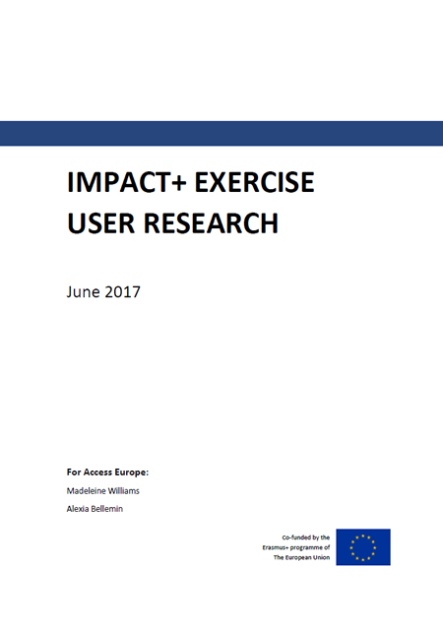
USER RESEARCH
ESIPP.eu
University of Northampton
Its been a really useful tool to enable us to get people to see that impact happens in a number of ways, and that impact, sustainability, dissemination is all intrinsically linked to each other and if nobody knows you’re doing something you’re not going to be having a lot of impact
Notes:
This report sets out the findings of research into the use of the Impact+ Exercise in helping individuals and their organisations understand how to assess the impact of their Erasmus+ projects.

