Slide 1


School and University Partnership for Peer Communities of Learners
(SUP4PCL)
Project number:
573660-EPP-1-2016-1-EG-EPPKA2-CBHE-JP (2016-2516/001-001)
Introduction to SUP4PCL Website
Extraordinary Management Meeting August 27th, 2018
The American University in Cairo
"This project has been funded with support from the European Commission. This presentation reflects the views only of the author, and the Commission cannot be held responsible for any use which may be made of the information contained therein

Slide 2

SUP4PCL Website

Slide 3
Structure of the Website
Home Page
About Us
Partners
Work Packages
Library
Contact
Internal Postal for SUP4PCL Members

Slide 4
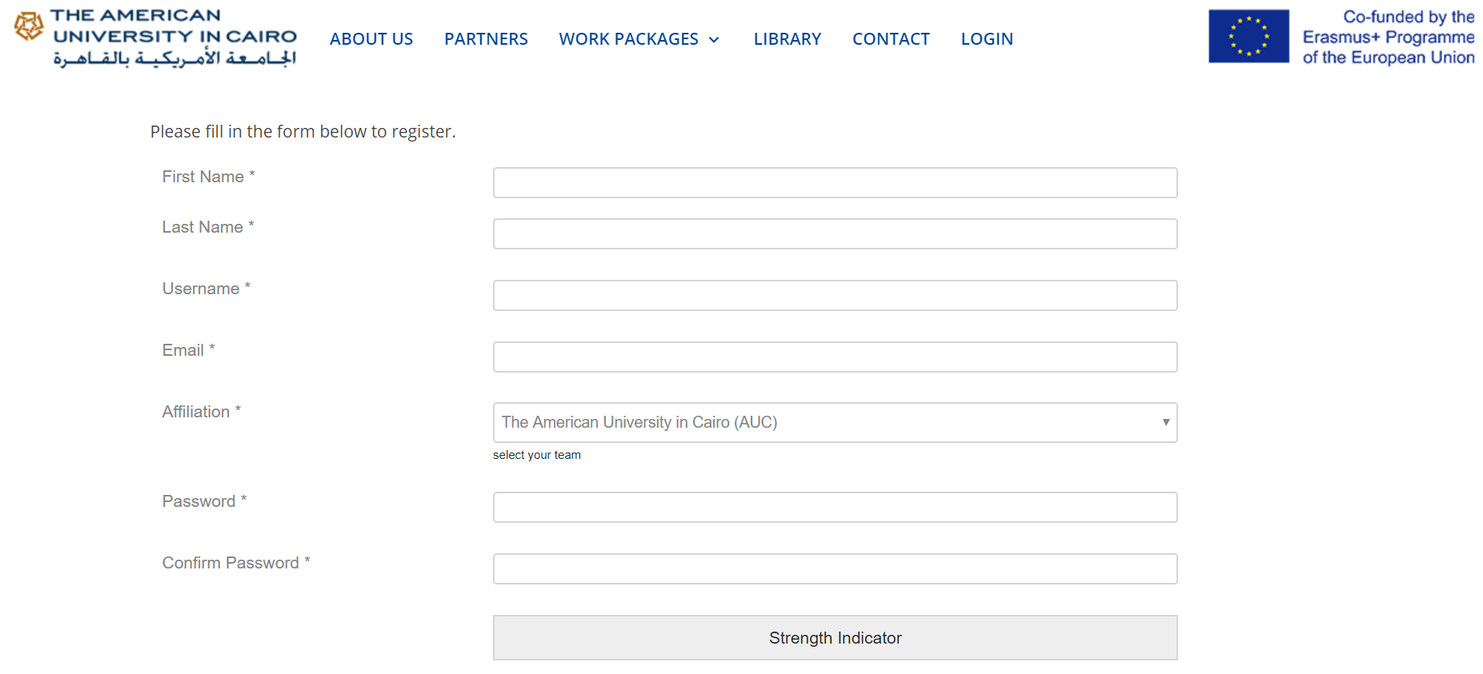
https://erasmus-test.insideout.io/registration/
https://erasmus-test.insideout.io/registration/
Registration
Registration in Testing Phase link:
https://erasmus-test.insideout.io/registration-2/

Slide 5
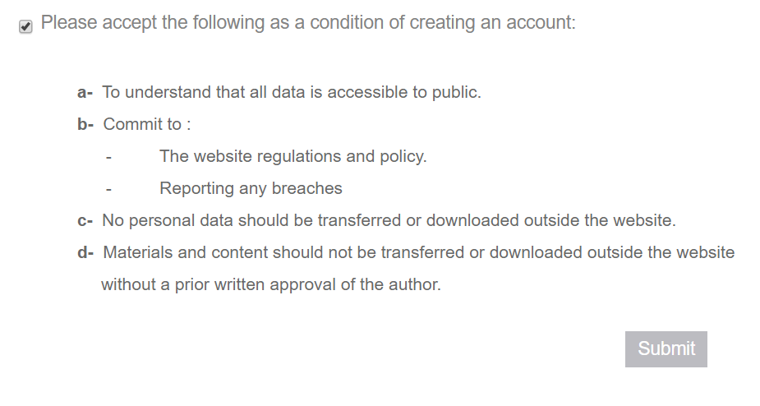
Registration
Privacy Policy:

Slide 6
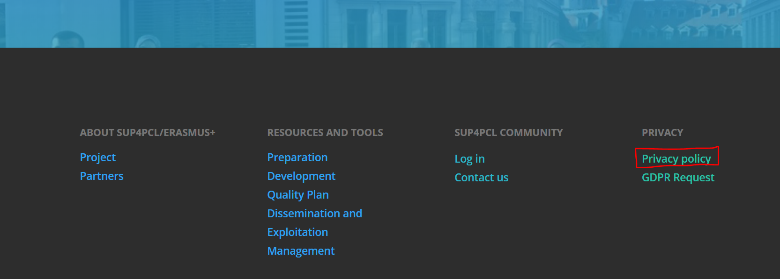
Registration
Privacy Policy:
Consent forms in regards to usage of pictures and videos

Slide 7
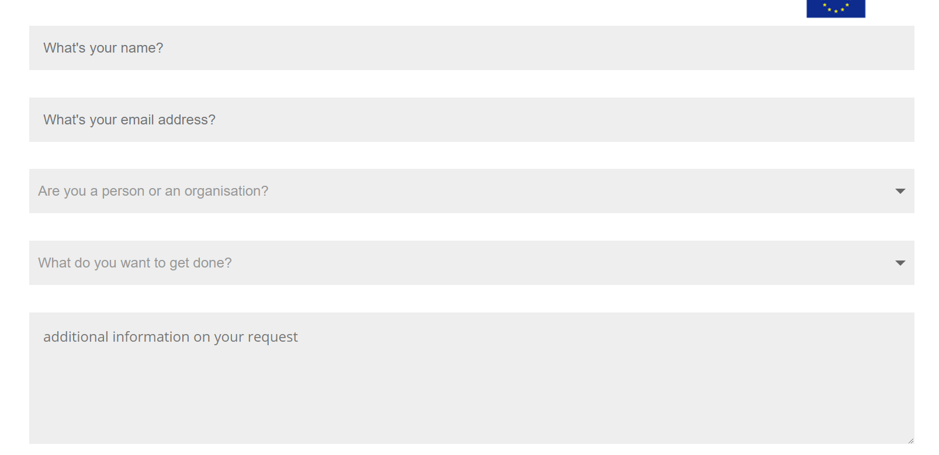
Registration
GDPR Request to report any breaches or preferences:

Slide 8
Registration
Edit Profile
Change Affiliation
Change Password
Change Email

Slide 9
Group Discussions
Join Group with relevant affiliation
Group activities are posting, attaching material, commenting, and liking posts

Slide 10
Roles on the website
Subscribers: They can access the frontend only, they can see private sections of the website, own a personal profile on the portal, can see and post on groups, can send requests to join groups and read articles.
Contributors: They can write, edit, and delete their own unpublished posts, but their content must be reviewed and published by an Admin or Editor. If they want to use specific images, videos, or audio files in the Media Library, they have to ask for assistance.

Slide 11
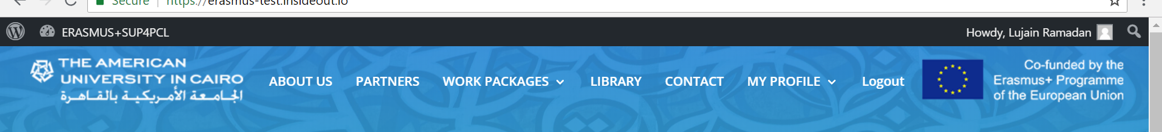
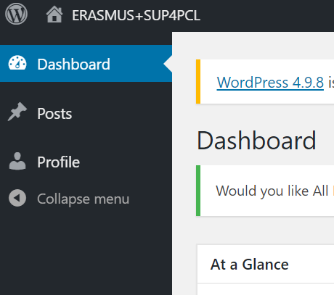
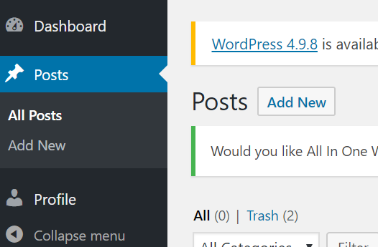
Roles on the website
Dashboard:
New post:

Slide 12
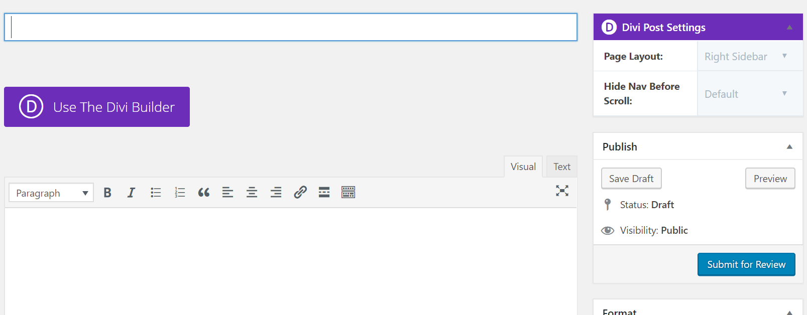
Roles on the website
New Post:

Slide 13
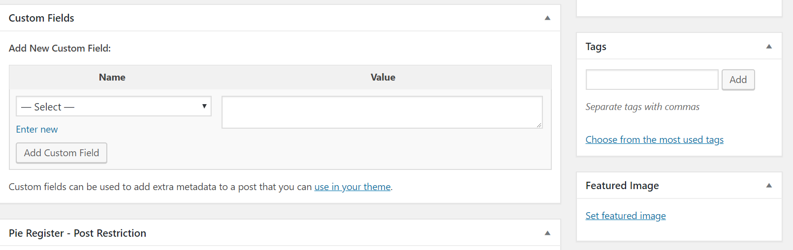
Roles on the website
Add tag to post:

Slide 14
Thank You

