Slide 1


Project Name:
School and University Partnership for Peer Communities of Learners
(SUP4PCL)
Fourth International Management Meeting
Wednesday 10th until Friday 12th of October, 2018
Organized by The American University in Cairo (AUC)
University of Limerick, Ireland
This project has been funded with support from the European Commission. This publication [communication] reflects the views only of the author, and the Commission cannot be held responsible for any use which may be made of the information contained therein

Slide 2

Progress Reporting on School Clustering

Slide 3
Criteria of clustering
Each school selected the satellite schools depending on the following criteria (bottom-up)
Reasonably closer to the core school
Eager to exchange ideas with the core school
Eager to improve the quality of its teaching and learning
Having enthusiastic leadership

Slide 4
Schools of clustering
In Cooperation with the Training Unit in the Cairo Governorate Educational Administration
Elshaheed Mohamed Ghoniem School | Ensaf Sery School
Elshaheed Sherif School
Yehia Elrefayi School | Yousef Elsebaay School
Abdel Aziz AAL Sauad School
Elkamal School | Eltabry School
Elnamozageya School
Elmostkabl School | Helmayet Elthanwya School
Elmotfoqueen School
Not Approved Yet | Elsaydya School

Slide 5
Designing a Tool of evaluating the Quality Assurance and Training Unit at each School
Clustering each PD schools with 2 schools according to the criteria created by ASU/ School teams
Forming teams at the clustering schools as a network for implementation of PLC
These teams consist of members of QA Units at the clustering Schools and the General Supervisors of the Cairo Governorate Administration.
Meetings with the Clustering Schools to introduce the concepts of the project.
The PLC Team of these schools started to present their academic needs highlighting the learning difficulties in some subjects.
The PLCs started to discuss the possibility of implementing the project themes to help teachers to tackle these learning difficulties.

Slide 6

Progress Reporting on Mentorship

Slide 7
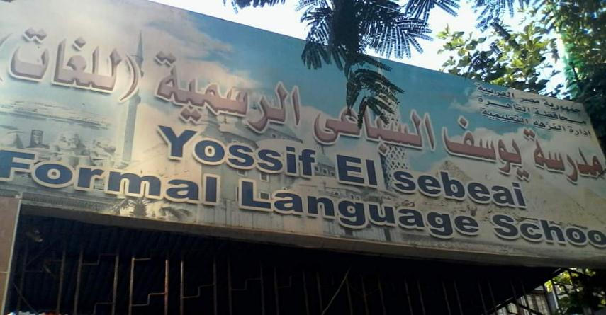
Example-1: Youssif El Sebeai Language school

Slide 8
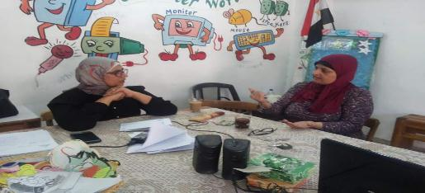
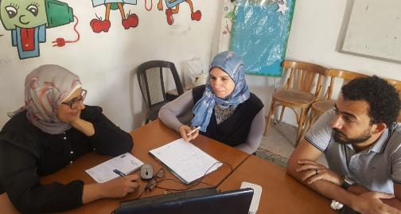
Mentorship helped the PCL of this school in the following:
Using different teaching strategies and methods such as:
- KWL
- Brain storming
- Miming
- Role play
- Human web
- The rocket
- Open discussion
- Problem solving
- Hot chair
- Small student teacher
- Cooperative learning
- Peer to peer learning
- Knowledge tree
- Ambassadors method
- Thinking wall
- Scaffolding

Slide 9
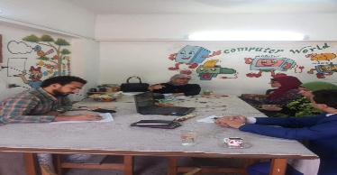
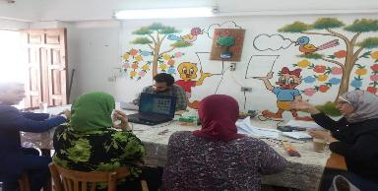
Mentorship helped the PCL of this school in the following:
Improvement of their performance
Their attitude towards share their experiences and activities began to change
They have a desire for change and develop their performance
They tried to search and think about the solutions for their problems

Slide 10
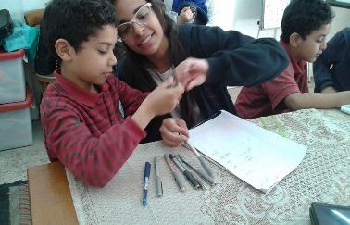
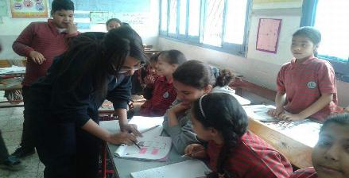
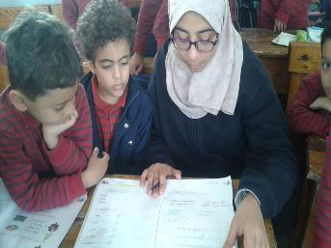
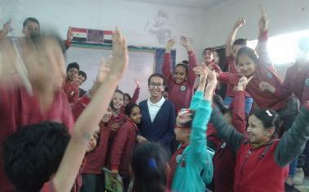
Ex1: learning primary one students the reading and writing Arabic through students in secondary stage from their school (sustainable development)

Slide 11
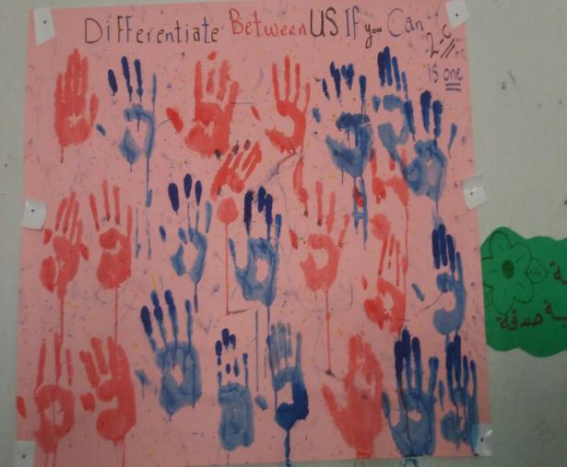
Ex2: Designing this painting with students to illustrate that they are a citizen in class , they are equal , and they have the rights and duties in their class.

Slide 12
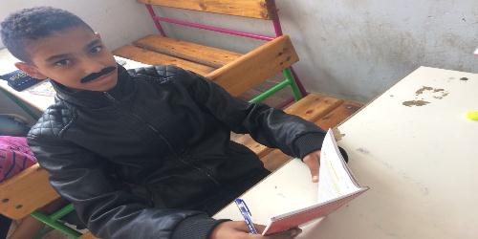
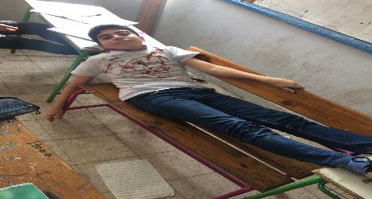
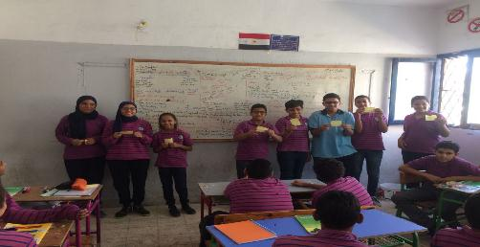
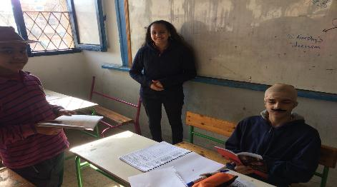
Ex3: Role play about the role of police

Slide 13
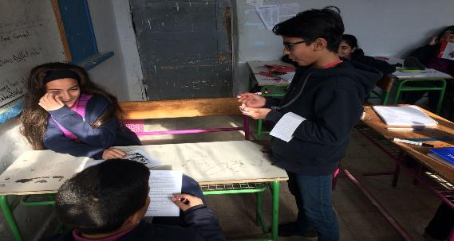
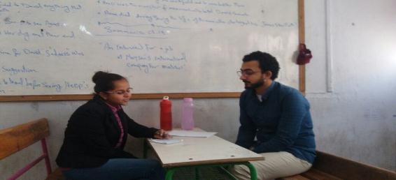
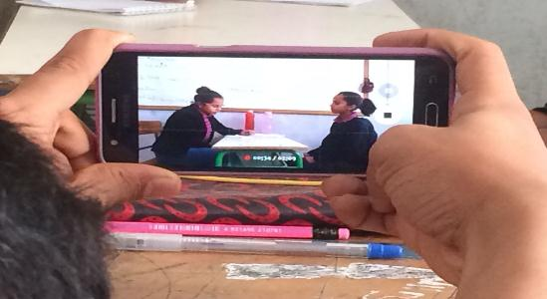
Ex4: English club

Slide 14
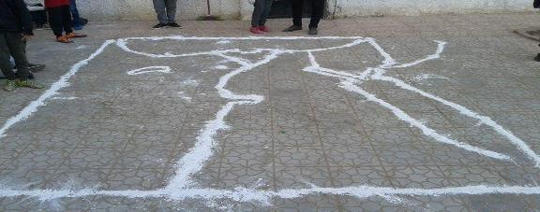
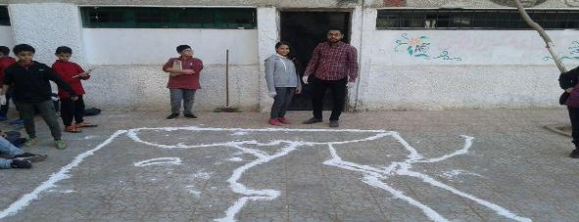
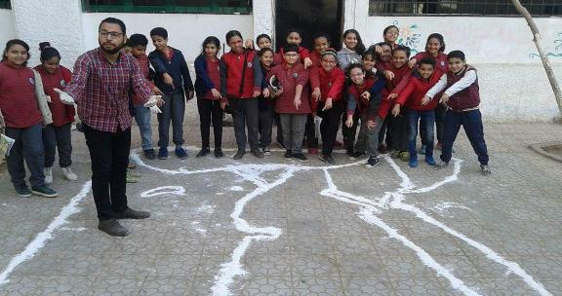
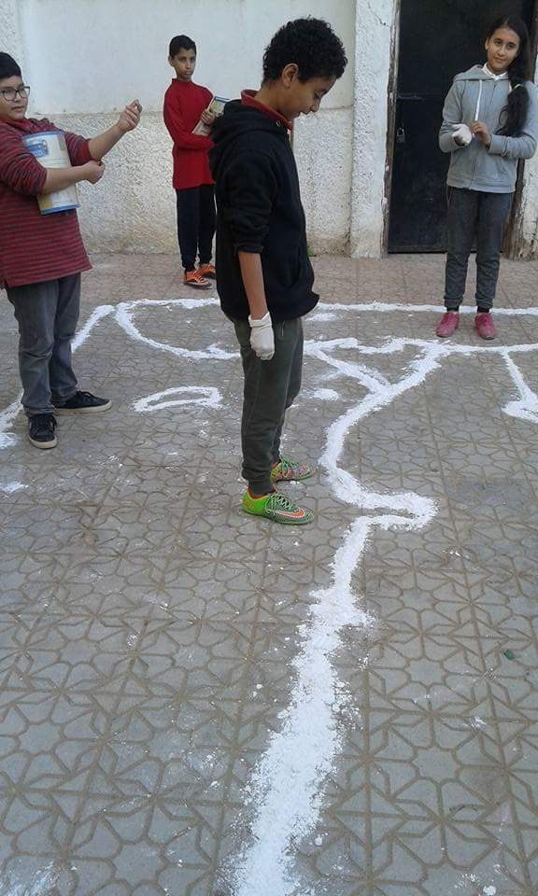
Ex5: Activities through teaching social studies

Slide 15
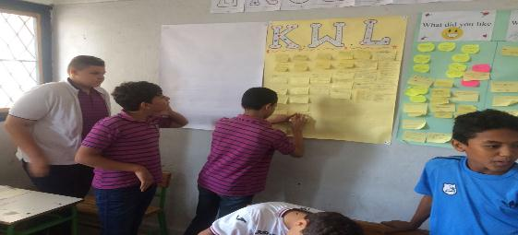
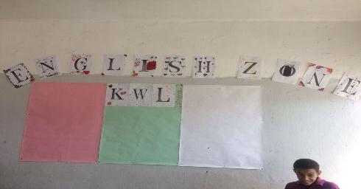
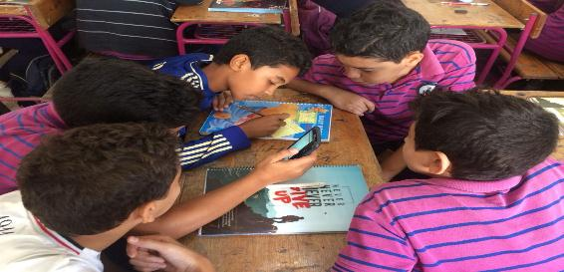
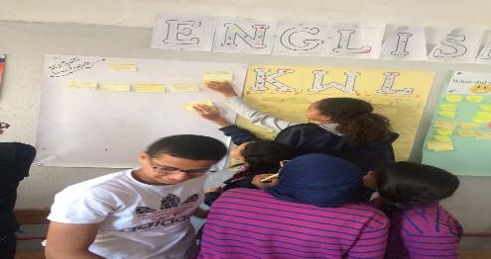
Ex6: KWL activity

Slide 16
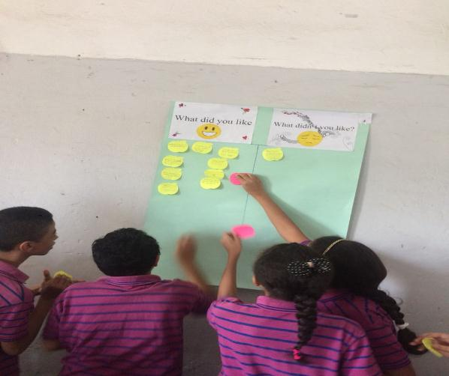
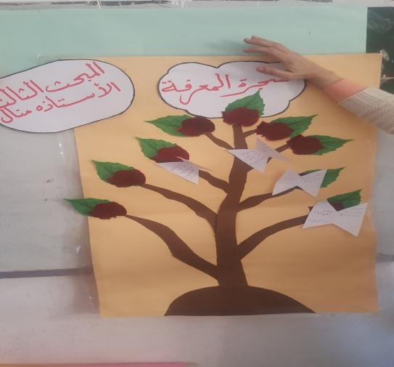
Ex7: Knowledge tree and thinking wall

Slide 17

Example-2: Helmyet El Zaytoun secondary school for girls

Slide 18
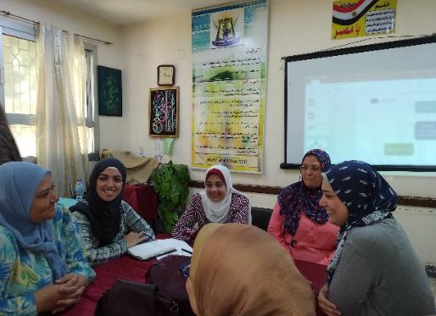
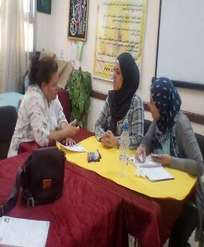
Mentorship helped the PCL of this school in the following:
Building communities of learning with their colleagues within the school.
Sharing ideas and exchanging experiences.
Implementing a Scientific magazine for the school.

Slide 19
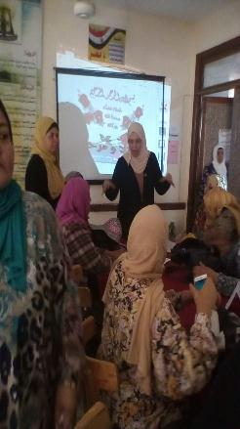
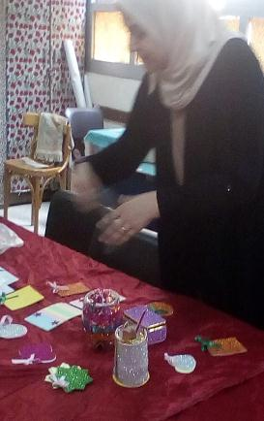
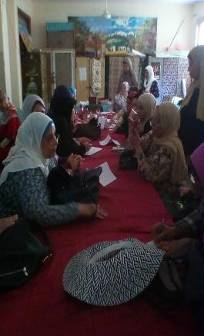
Ex1: a workshop held by teachers for other teachers about sustainable development

Slide 20
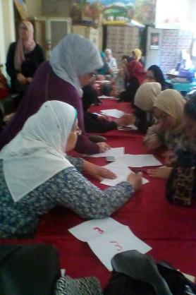
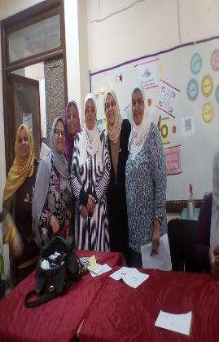
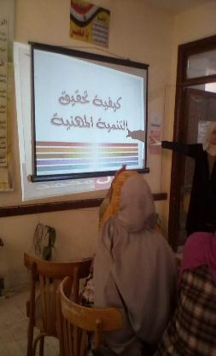
Ex1: a workshop held by teachers for other teachers about sustainable development

Slide 21
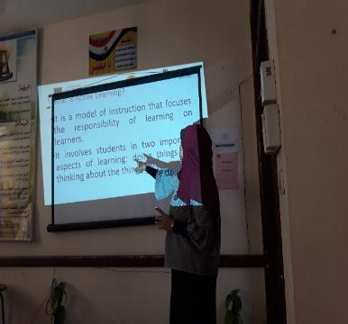
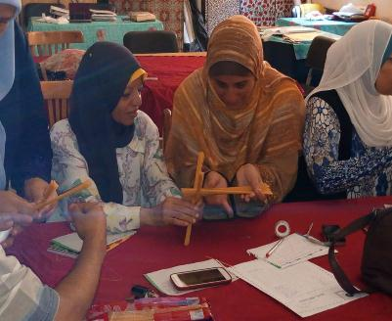
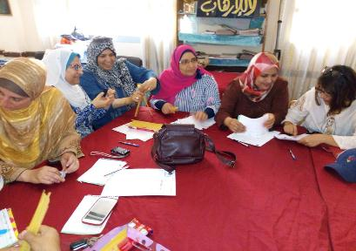
Ex2: a workshop on active learning by Faculty of Education team.

Slide 22
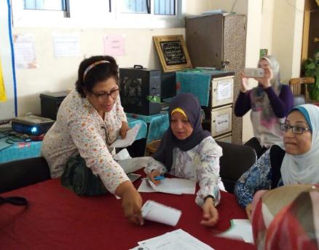
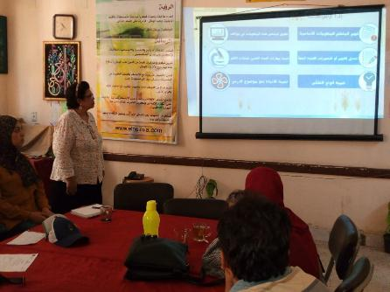
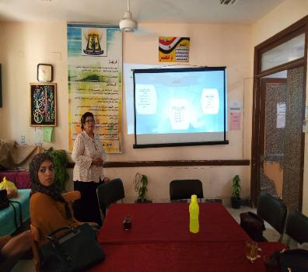
Ex3: a workshop on learning styles, and differentiated teaching by TEACHERS

Slide 23
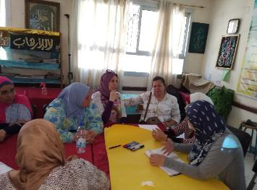
Ex4:
Implementing a Scientific magazine for the school.
Agreement on the journal cover
Dividing the journal parts into (psycho-social, educational and scientific).
Assigning fixed parts of the journal.
One of them will be titled Helmyet El Zaytoun mail, this part will discuss problems related to teachers and students and how they have been solved.
Another part will be titled I am distinguished in, this part will introduce anyone who has done a remarkable job or provided service to the community or the school. This part is Encouraging and motivating for anyone who has done something distinct.

Slide 24
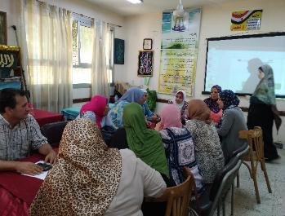
Ex4: a workshop for Implementing a Scientific magazine for the school.
A number of topics were proposed for the first issue:
Questions about the implementation of the tablet system in the new secondary school system.
Chemical industries
How to study languages
A meeting with the top secondary school students
Field trips

Slide 25

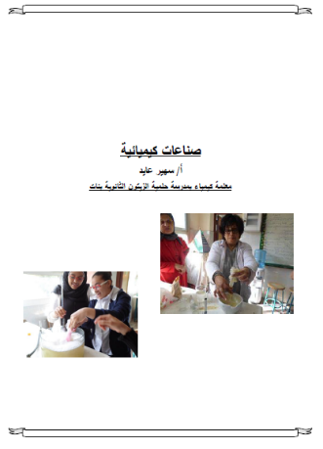

Ex4: a workshop for Implementing a Scientific magazine for the school.
Article-1
Article-2

Slide 26
Challenges and Difficulties
ISSUES
Commitment to/engagement with the project:
  Attendance at meetings
  Visits to schools
  Extrinsic motivation only
  Committed mentors becoming demotivated as a result
  Responses
  Focus on team building
  Process of mediation regarding uncommitted mentors resulting in 2 mentors being replaced
  More positive attitude and atmosphere within the group

Slide 27

Progress Reporting on Material Development

Slide 28

EX: Developing material for STEAM Training

Slide 29
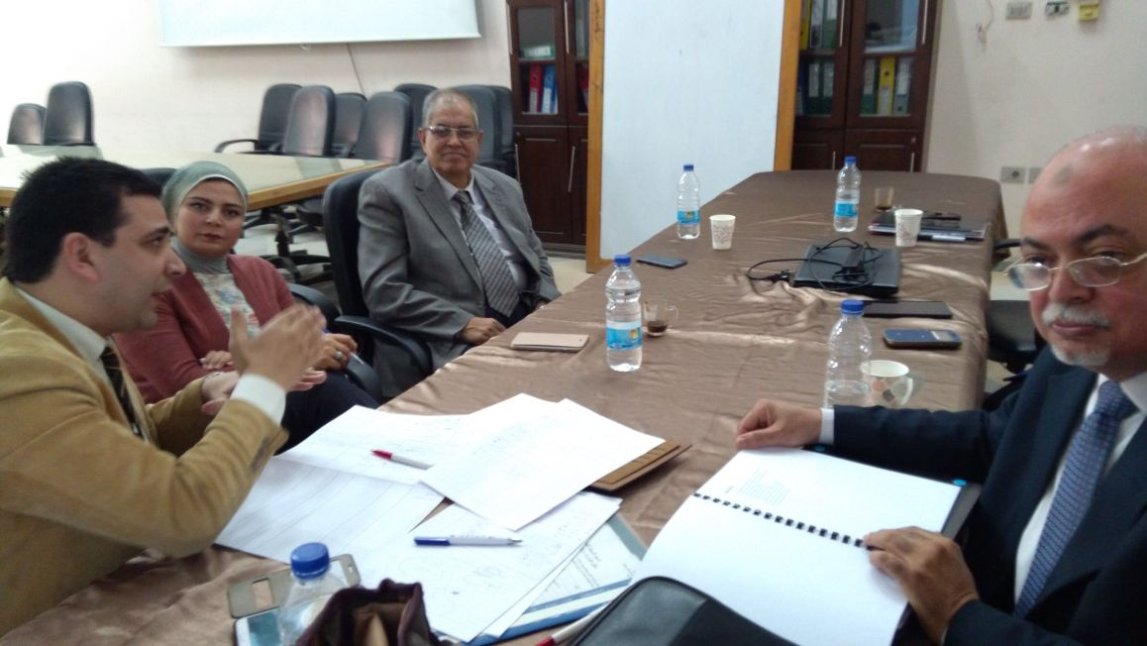
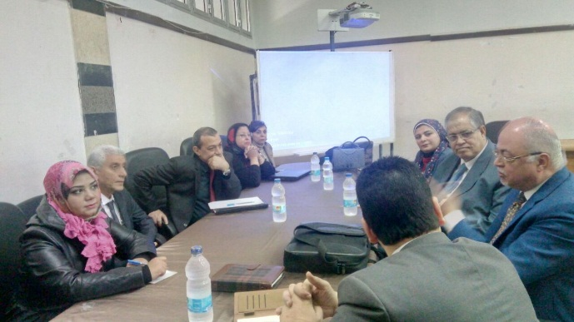
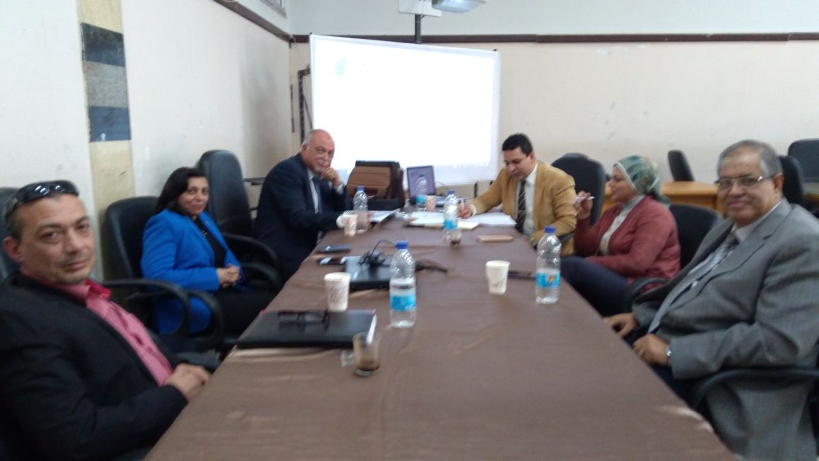
Phase 1:
Developing the material

Slide 30
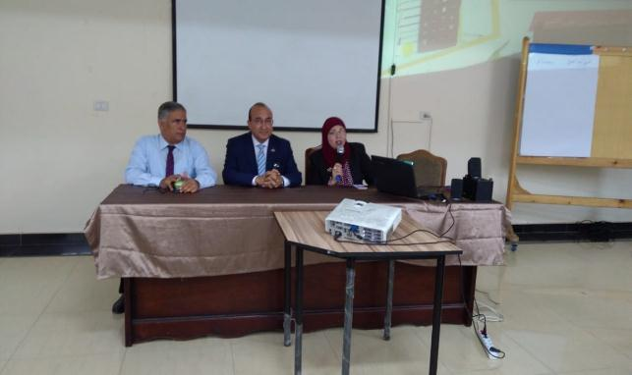
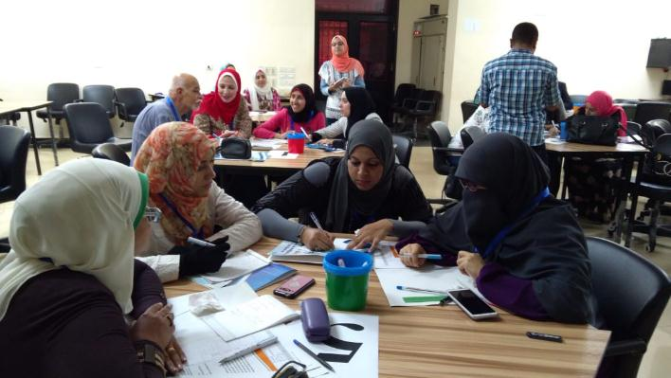
Phase 2:
Induction a training to apply the developed material

Slide 31
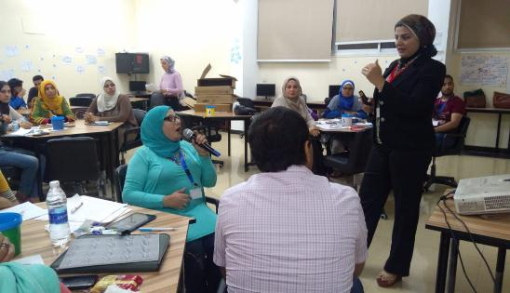



Phase 2:
Induction a training to apply the developed material

Slide 32




Phase 2:
Induction a training to apply the developed material

Slide 33



Phase 3:
Evaluation of the developed material

Slide 34

Progress Reporting on Research & Inquiry

Slide 35




Needs assessment tools
School profile
Psychologist
Teacher training
Training unit
Teacher-PD

Slide 36


Ethics documentation
Participant Consent Form and Information sheet for questionnaire/focus group

Slide 37


PCL development tools (PRINTED VERSION)
PCL Monitoring Survey
Reflective Journal Entry

Slide 38


PCL development tools (electronic version)
PCL Monitoring Survey
Reflective Journal Entry

Slide 39






PCL development tool responses

Slide 40

Evolution of Quality Assurance Unit

Slide 41

Survey for evaluating the quality assurance units in schools

Slide 42


A Case Study
On
The Development of PLC on the University Level
By a member of FOE Team
  Students centred learning
  Research based learning
  Implementation of STEM for developing PLC among students’ teachers
  Intrinsic and extrinsic motivation

Slide 43


A Case Study
On
The Development of PLC on the University Level
By a member of FOE Team
  Sustainable Professional Development (Senior & first years Students Teachers)
  Sharing experiences with practitioners of STEM Schools
  Implementation of Sustainable Development for developing PLC

Slide 44


ANSU & Limerick U Case study

Slide 45



Regular and skype meetings

Slide 46


Regular and skype meetings

Slide 47

Two day training workshop with mentors/case study, April 2018
Exploring our understanding of PCL
Collating our current understanding of our case study schools, identifying information we are missing
Identifying how to progress with our case study schools: next steps?
Identifying how to progress with ANSU/UL PCL: next steps?
Developing our own relationships

Slide 48

Google drive for FOE case study
A google drive was created for sharing the documents related to FOE case study between our team and the team of University of Limerick

Slide 49

Collected data about FOE for case study

Slide 50


Slide 51


Slide 52


Slide 53


Slide 54
Semi-structured interviews questions for round 1 of interviews
(additional questions may be asked depending on responses)
What is your own background/areas of experience (teaching/research)/ previous experience of PCL
How did you get involved in the project?
What is your role in the project? Has this role changed? If so, how?
What do you think the purpose of the project is?
What does PCL mean to you? How has your understanding of this changed since beginning the project?
What supports are present for the project? Impact of these

Slide 55
Semi-structured interviews questions for round 1 of interviews
(additional questions may be asked depending on responses)
What is working well within the group/project? Why are these working well? Evidence of this?
What could be improved? How could these be improved?
How open are people in the FoE to the project/concept of PCL? Why is this the case?
What changes have occurred to your practice/beliefs since starting the project? Why do you think these have changed? What changes do you think has happened to your colleagues?
New Question: What motivates people within the group do you think? How is this evident? What differences exist in relation to how people are motivated? What impact does this have on the project?
Anything else that you wished I asked you that I haven’t or that you want to say?

Slide 56
Some tentative potential areas to explore
Motivation: intrinsic versus extrinsic motivation; how this impacts on peoples engagement in the project
Impact of geographical distance on developing a PCL: does proximity matter?

Slide 57

MA Student
Alaa is graduated from faculty of education "English department" at Ain shams University. Her general estimate is very good with honor, May 2015. She is working now as a demonstrator at EFL curriculum and instructions department (faculty of Education –Ain shams University).she also worked as an English instructor at Future University in Egypt (FUE), an English instructor at CEDLT at faculty of education, Ain shams University and an English teacher at St. Fatima Language School in Cairo. She is very interested in Conducting her research about PLC as a new culture of work to improve the communication skills of the English Teachers. This MA will be co supervised between a professor at the EFL Curriculum and Instructions Department ASU and a professor at University of Limerick.
Suggested Title of the Research:
" The Effectiveness of PLC Approach to improve Communication Skills of English Teachers"

Slide 58
ASU & UL Potential Partnership
  We are on the same page
  The twining universities have the same strategic plan of internationalisation
  We agree on a sustainable collaboration not merely signing an MOU
  Key Action One ( Mobility of students and staff)
  Dual / Joint Degree in Leadership Graduate Program
  UL will Offer Scholarships for ASU Students for studying in this program
  Three parties MOU between UL, ASU and Ministry of Education for developing the Educational Leadership style at schools

Slide 59


