Slide 1


School and University Partnership for Peer Communities of Learners )SUP4PCL(
الشراكة بين المدرسة والجامعة لبناء مجتمعات الأقران من المتعلمين
Project Number : 573660-EPP-1-2016-1-EG-EPPKA2-CBHE-JP (2016-2516/001-001)
Progress Reporting
AU
Limerick
Fourth International Management Meeting
10-12 October, 2018

Slide 2
Outline
Schools & AU Partnership
Schools Clustering
Mentorship
Material Development
Research & Inquiry

Slide 3
1. Schools & AU Partnership
“From Building to Establishing”

Slide 4
Activities: April- September 2018
Developing tailored training programmes for the schools (project themes & goals + schools’ needs)
Developing guidelines & unified templates for conducting “in-depth” inquiry in schools and writing the updated schools’ reports.
Developing a working plan for building capacity of schools (training & quality assurance units- mentors- PCLs)
Planning regular weekly visits to schools
Communication & logistics with Directorate in Alexandria

Slide 5
Outcomes
Training programmes delivered in all schools
Training programmes integrated in the schools’ training plan for this academic year: 2018/ 2019
Building capacity of schools’ training and quality assurance units
Building capacity of schools’ mentors (selection- de-selection & re-selection)
Supporting emerging PCLs in schools
Raising awareness of a different culture for PD
Collecting data for schools’ reports

Slide 6
Challenges
Communication with the Directorate in Alexandria
Unavailability of some schools
Concurrent Intensive trainings by the MOE (teachers’ workload- motivation)
Losing some previously selected mentors
The unavailability of teachers/ schools on agreed visits days

Slide 7
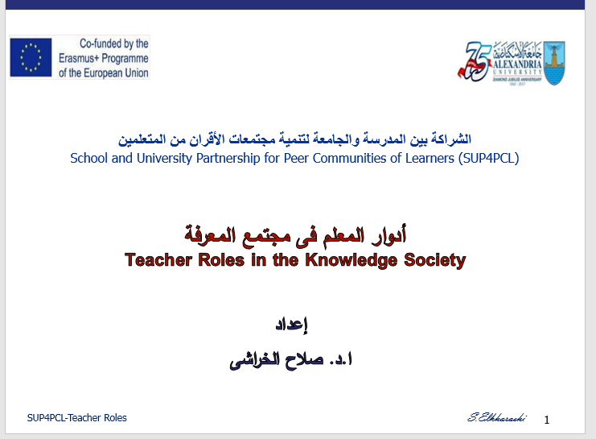

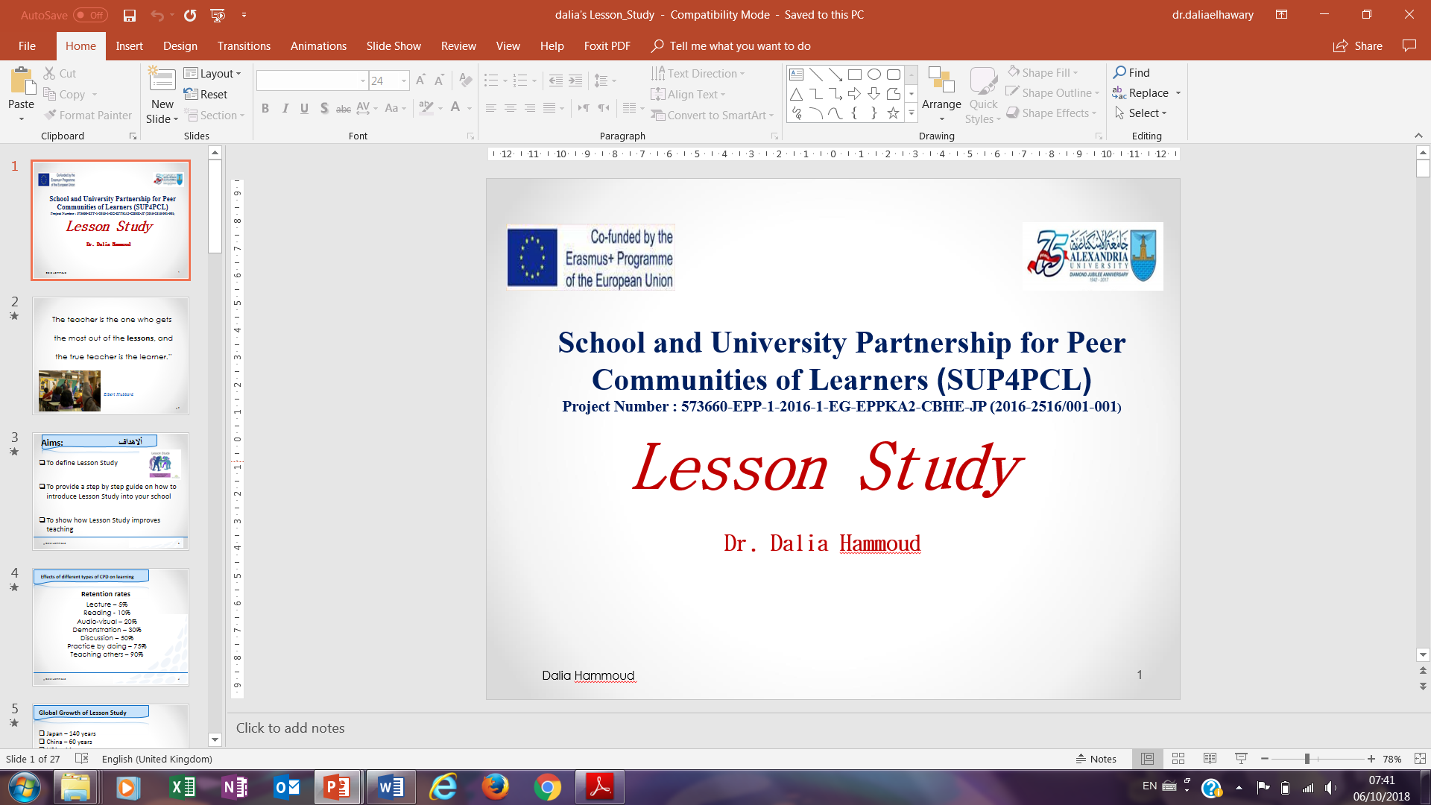

Slide 8
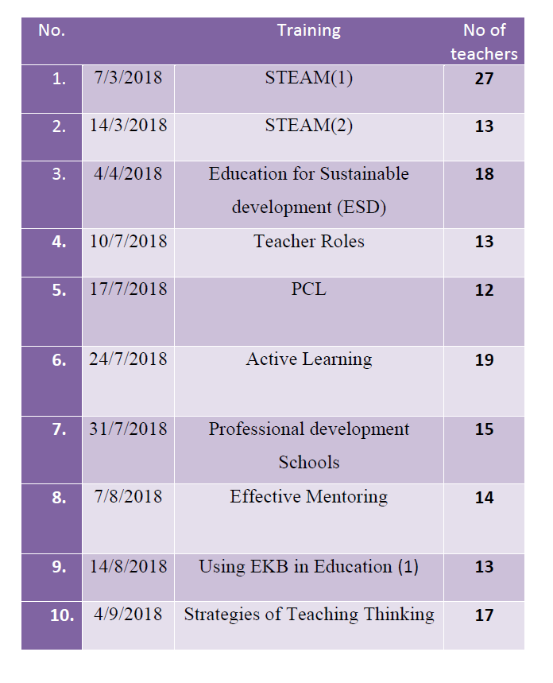
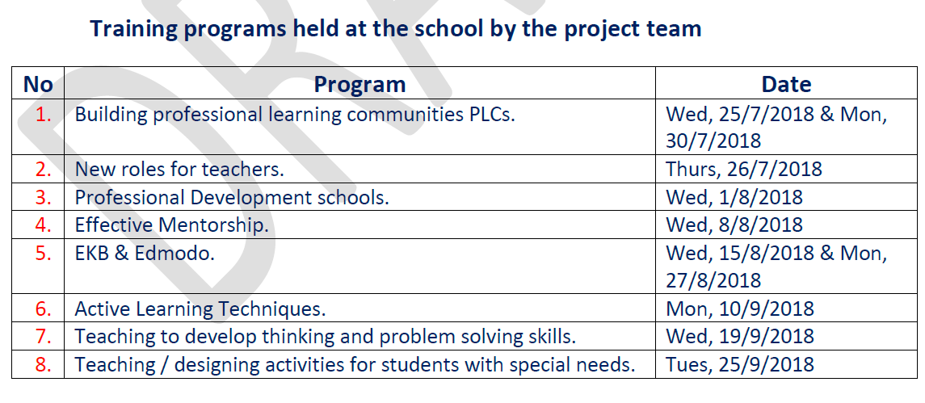
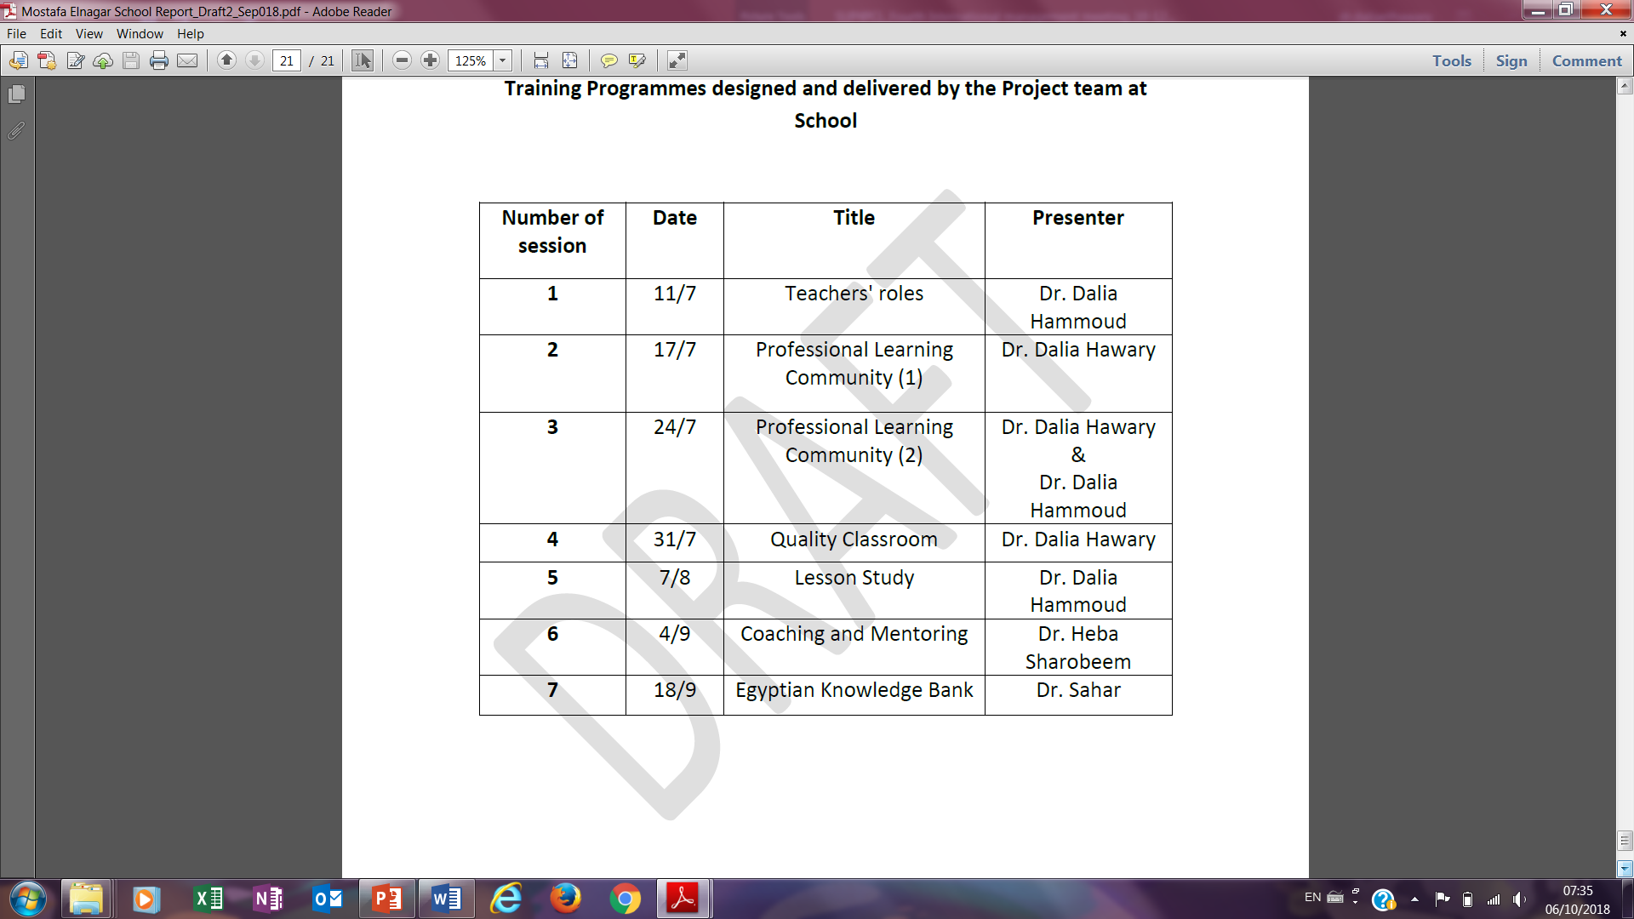


Slide 11
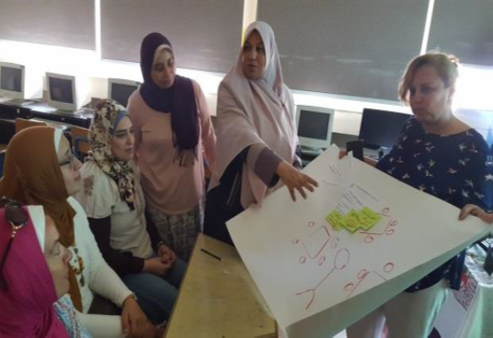

Slide 12
2. Schools Clustering

Slide 13
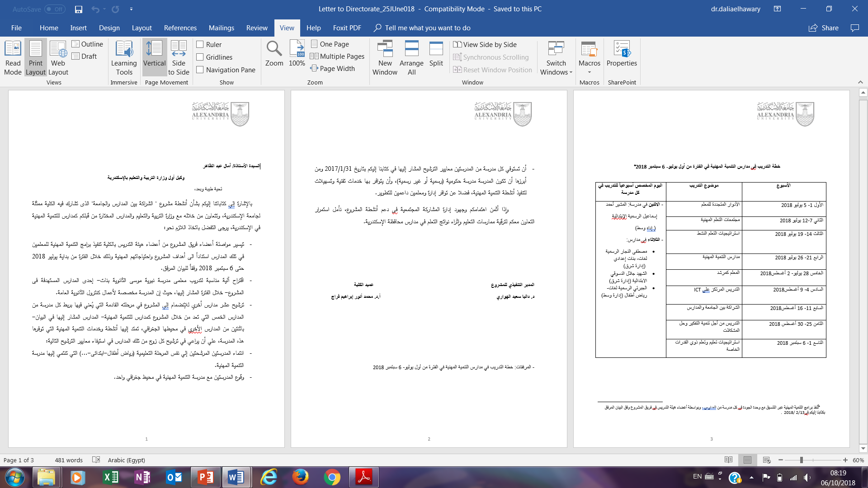

Slide 14
Actions
Identifying criteria for selecting schools
Official communication with the head of the Directorate in Alexandria to nominate schools
Informal and formal follow- up
Schools provided suggestions for clustering/ partner schools
Preparing mentors for the clustering stage
Arranging for a F2F meeting with the head of the Directorate via the dean’s office

Slide 15
Challenges
Communication with the Directorate in Alexandria
Level of Response
Coordination among schools and directorate
Mentors’ work loads

Slide 16
3. Mentorship

Slide 17
Mentorship at AU
Five established mentors
lead school work
provide guidance for AU team members
Mentorship among team members across different project tasks
Mentorship beyond project tasks
Junior staff
Learning from each other

Slide 18
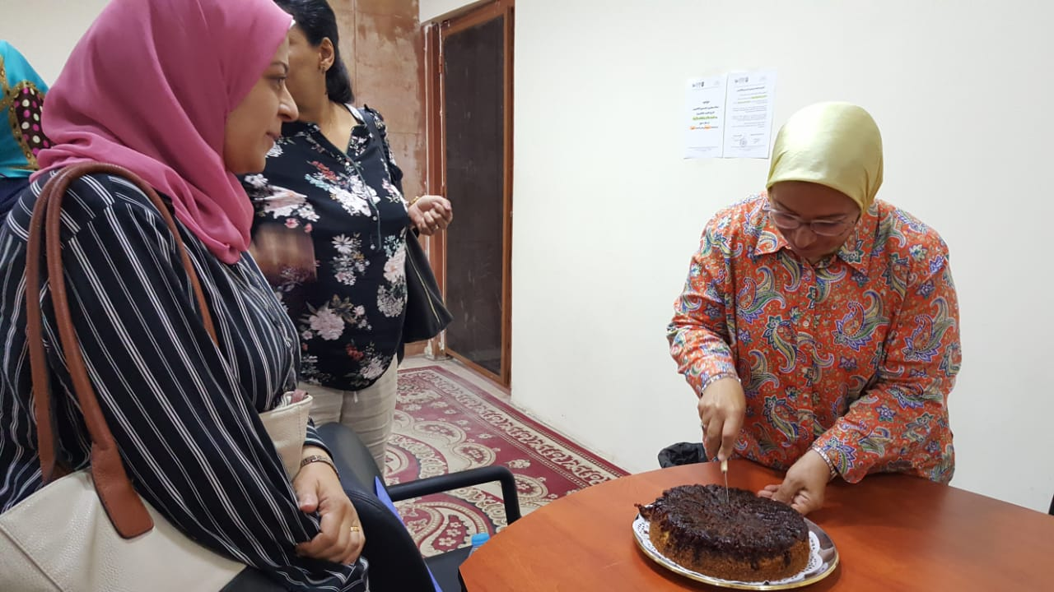
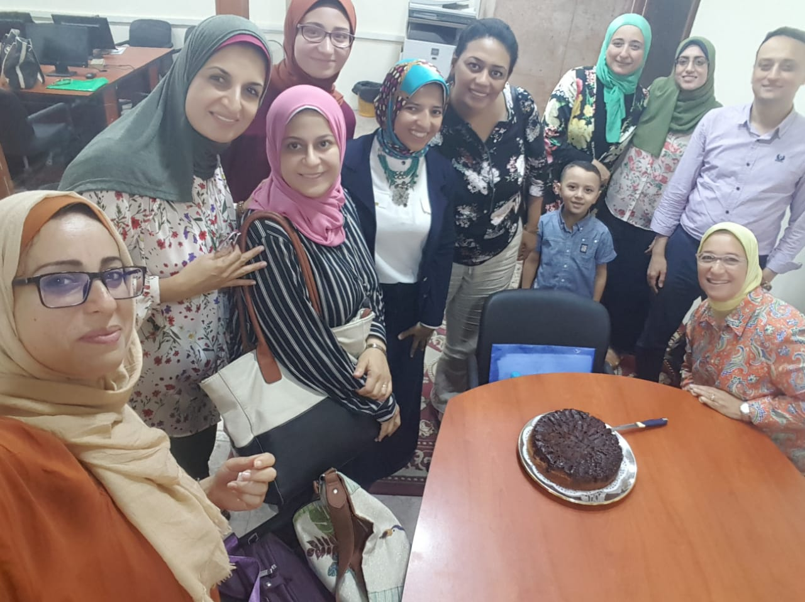
AU Team Meetings

Slide 19
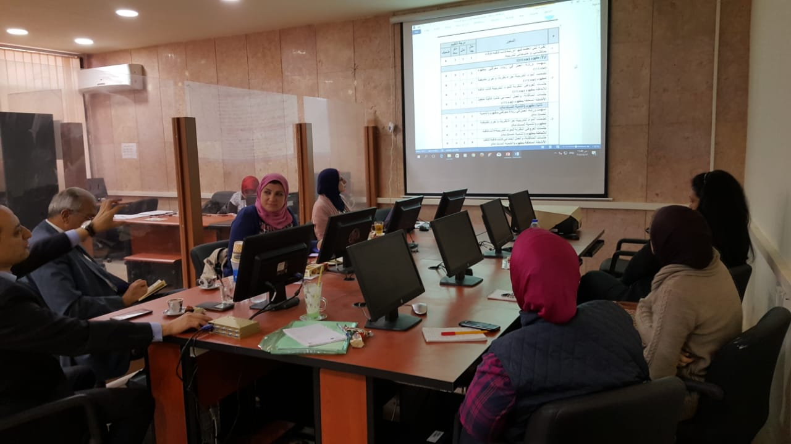
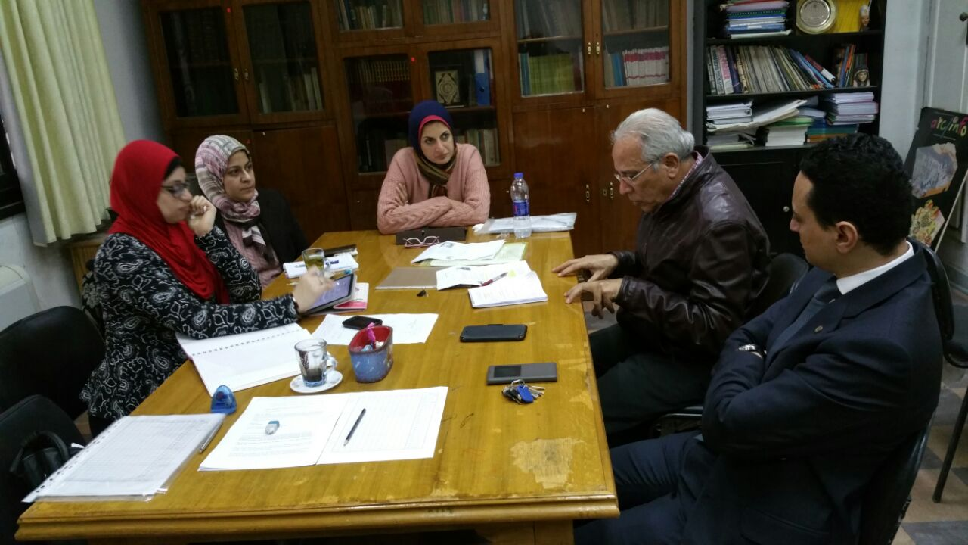
AU Team Meetings

Slide 20
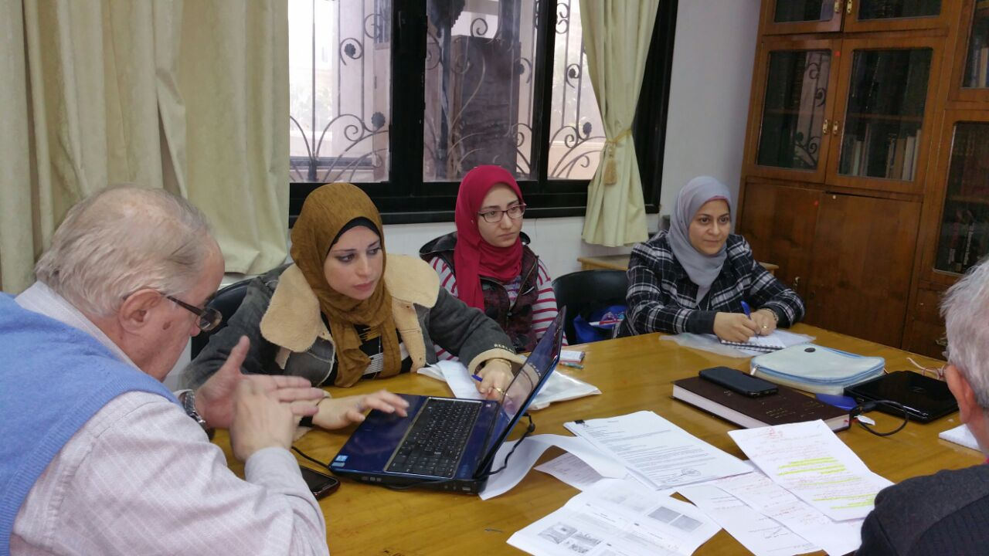
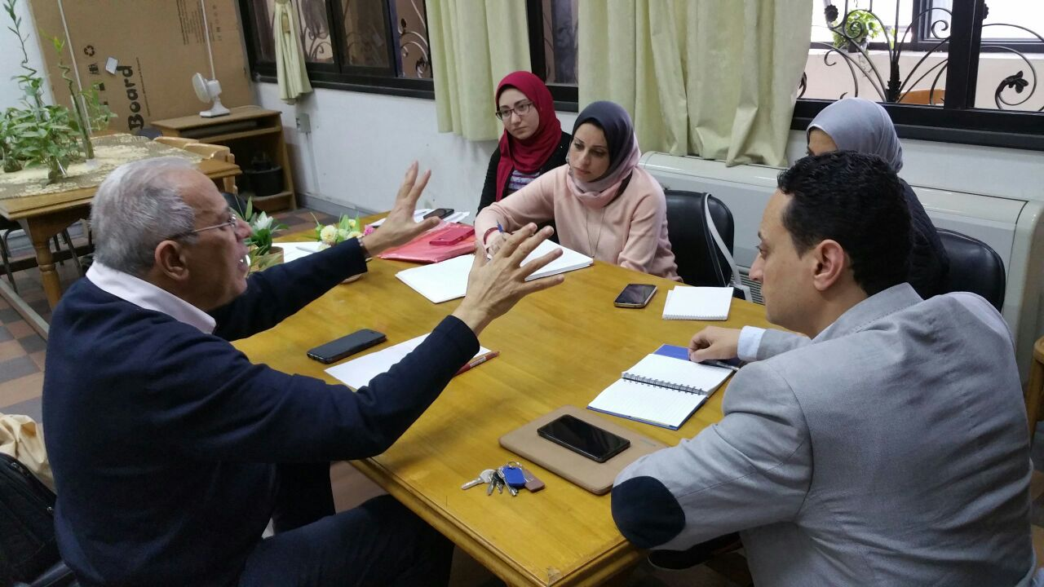
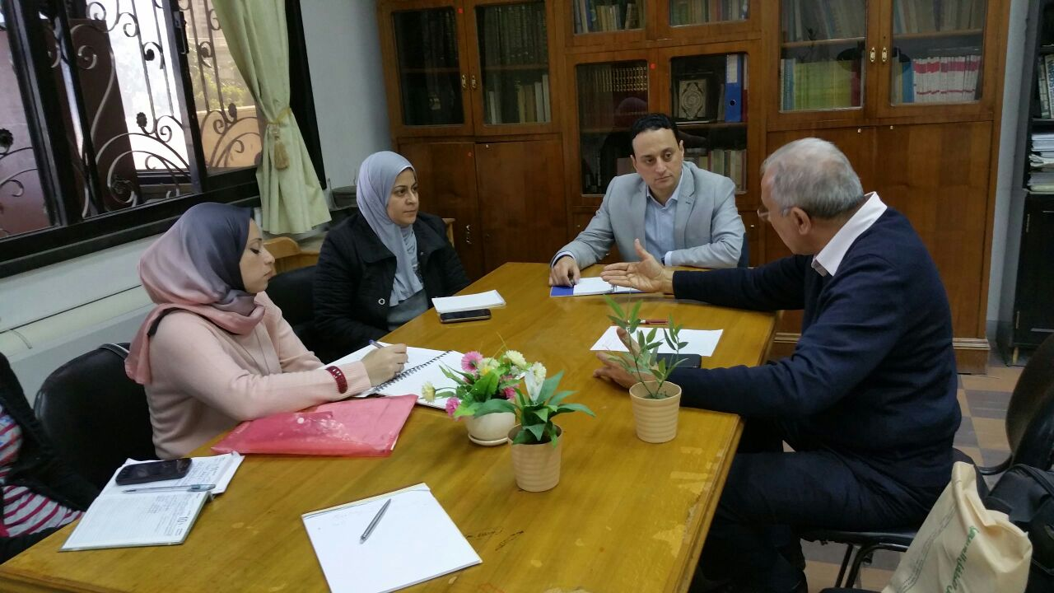
AU Team Meetings

Slide 21
Mentorship at Schools
Mentors selected, de-selected & re-selected
Developing materials on “Mentorship”
Training mentors at schools
Training and quality assurance unit role in mentorship
Raising awareness about “mentorship” among schools’ community

Slide 22
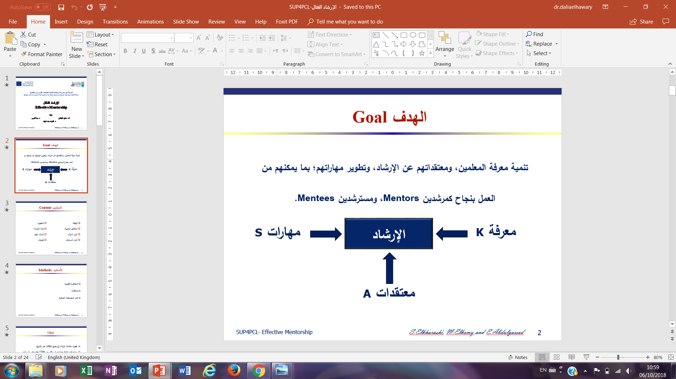
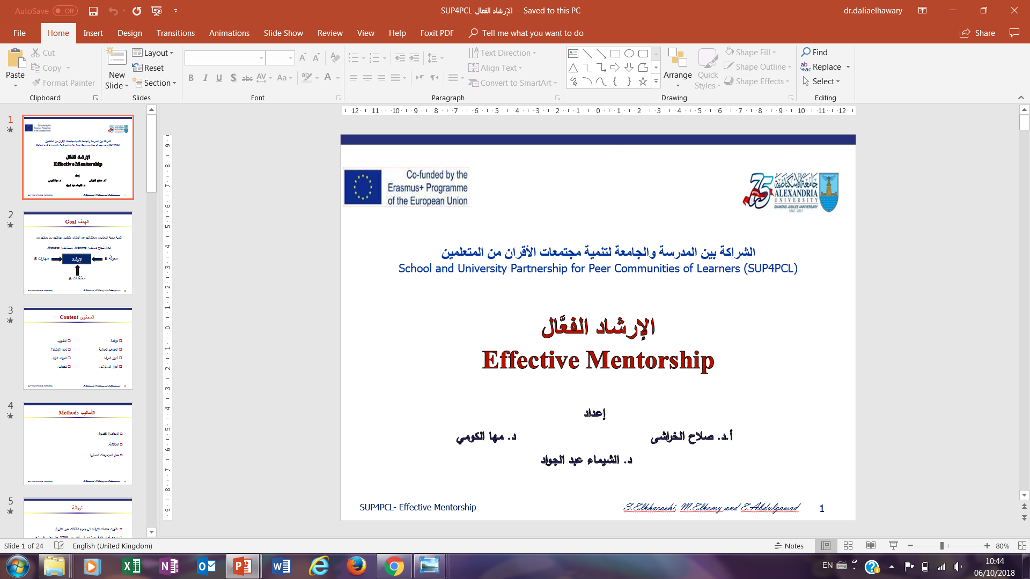

Slide 23
Challenges
Losing some active mentors (e.g. travel reasons)
Communication & awareness issues about the project at the Directorate level
Mentors’ working load
Resistance to change

Slide 24
4. Material Development

Slide 25
Developing Materials
Materials developed in GC, ESD & STEAM/ STEM
Collecting activities used by schools in these three areas (on- going)
Uploading all materials & resources to AU Google Drive
Drawing on AU experiences from STEM & Education for Sustainable Development projects
Developing materials for schools’ summer training programme

Slide 26
Developing Materials
1. STEAM, ESD, GC
2. Teachers’ Roles
3. PCLs
4. Active Learning
5. PD Schools
6. Effective Mentoring
7. Using EKB in Education
8. Strategies for Teaching Thinking Skills
9. SEN
10. Quality Classrooms
11. Lesson Study

Slide 27
5. Research & Inquiry

Slide 28
AU Case Study
Regular online meetings with UoN & follow up meetings with core team & AU larger team
Developing case study framework
Developing tools for qualitative data collection (e.g. Reflective journal- interview protocols)
Validating tools by twining partner
Identifying research participants

Slide 29
AU Case Study
Collecting data
Analysis of data
Overarching research questions, framework and data collection tools
Timelines
Plans for UoN visit

Slide 30
AU Case Study
Area | Highlights | Next Steps
History & Context of AU | Within institution mission, vision & strategic goals, team / group work is a must | Done
PCLs | Existence: Interviews across 14 departments Does it exist? How do people come together? What are the domains of interest for existing PCLs? What is the effect on individuals , departments & faculty? What are the challenges? | Done

Slide 31
AU Case Study
Area | Highlights | Next Steps
PCLs | PCL Monitoring Survey To be used by AU & UoN | Ongoing (AU & UoN)
 | PCL Indicators Categories Grounded in literature | Ongoing (UoN)
 | Agenda All AU PCLs meetings documented All AU / UoN meetings documented Use of template Analysis of meetings | Analysis of meetings & reflections Ongoing (AU & UoN)

Slide 32
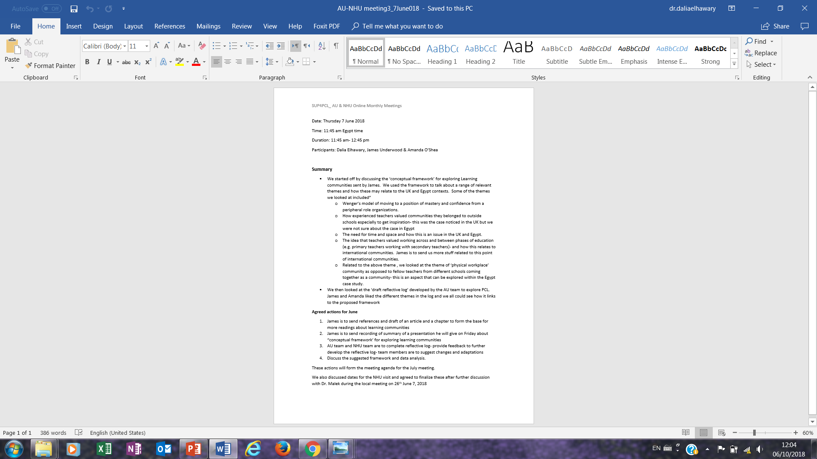
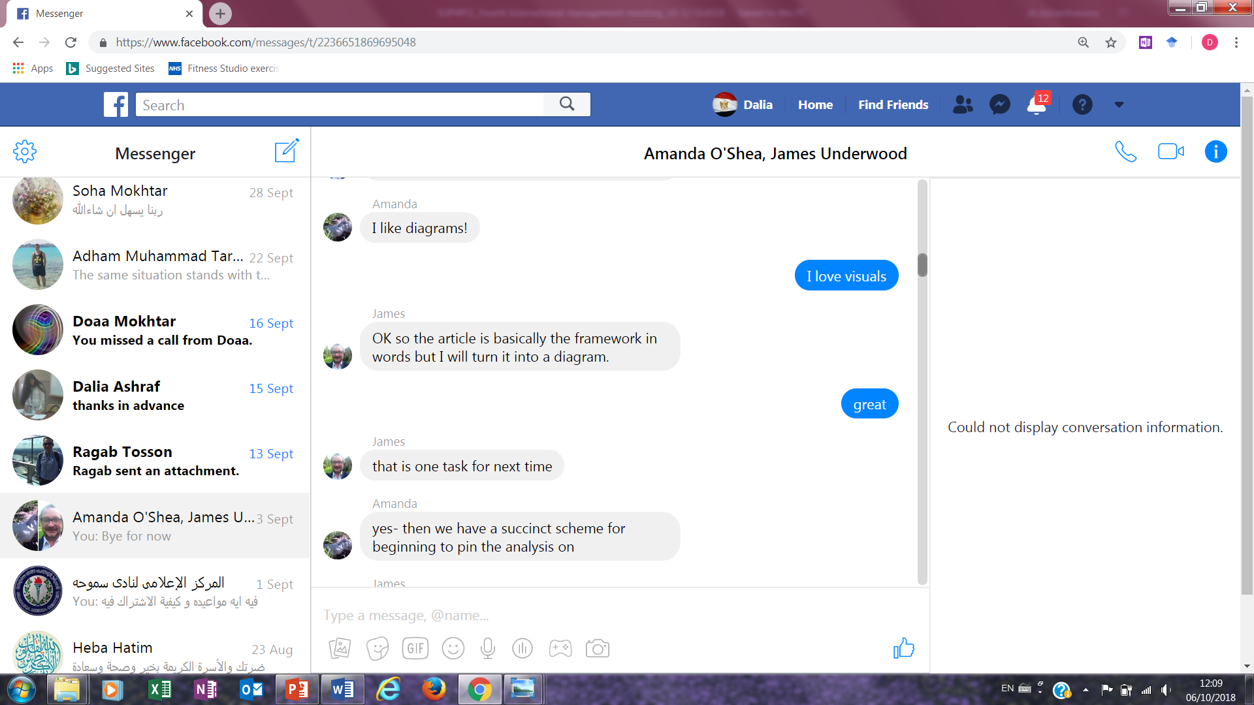

Slide 33
AU Case Study
Area | Highlights | Next Steps
PCLs | Reflective Journals Used by AU & UoN One – two rounds Conceptual framework for analysis | Two rounds Ongoing inductive & deductive analysis
New Teaching Styles | Learning (awareness, knowledge, practices) Reflective journals | Ongoing Focus group interviews UoN visit in December
New programmes/ courses / policies | MOU Innovations in existing courses Interviews with key stakeholders | Ongoing

Slide 34
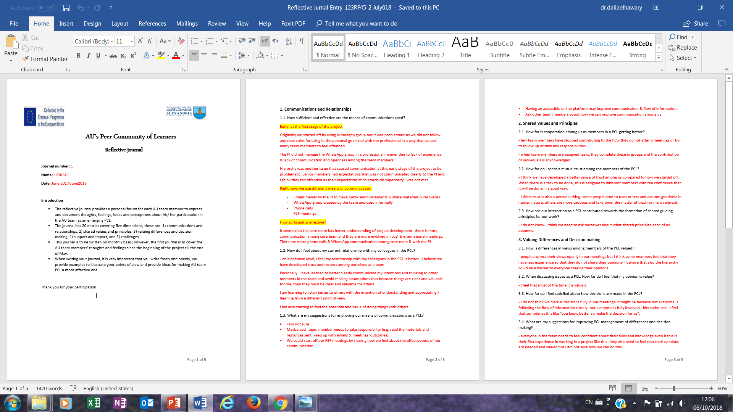

Slide 35
AU Case Study
Area | Highlights | Next Steps
Engagement of students | MA student on board Inviting junior staff to attend selected events Taught courses | Focus group interviews (UoN visit in December)
Human relationships | Reflective journals | Focus group interviews (UoN visit in December)

Slide 36
Schools Case Studies
Area | Highlights | Next Steps
Context | Drafts 1 & 2 of schools’ reports | Done
PCLs | Interviews AU team observations Existence Forms Impact on individuals/ institutions challenges | Ongoing Interviews Observations (November)

Slide 37
Schools Case Studies
Area | Highlights | Next Steps
Material Development | Collected & compiled | Ongoing What evidence & analysis are needed to investigate change/ impact? AU & UoN
Reflective Practices | PCLs meetings agenda introduced Reflective practices introduced | Ongoing Support in schools Analysis of documents
Mentorship | Awareness raising Training | Observations of PCLs meetings Focus group interview (UoN in December)

Slide 38
Emerging Research & Inquiry
AU Team members working together to:
Explore innovative practices
investigate the use of PCL as a learning strategy across different disciplines
Some schools exploring the use of:
lesson study as a tool for PD
classroom observation as a means for improving teaching and learning

Slide 39


