Slide 1


Slide 2



Helwan University Team Progress

Slide 3
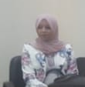
New Member
Radwa

Slide 4
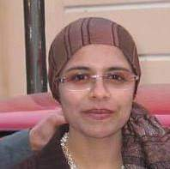
Prof.
Maha

Slide 5
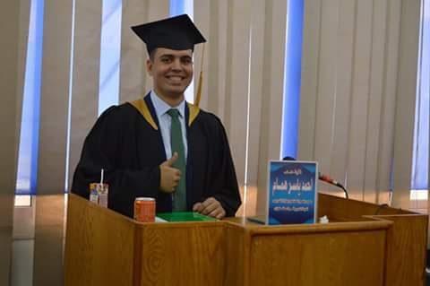
Master
Ahmed

Slide 6
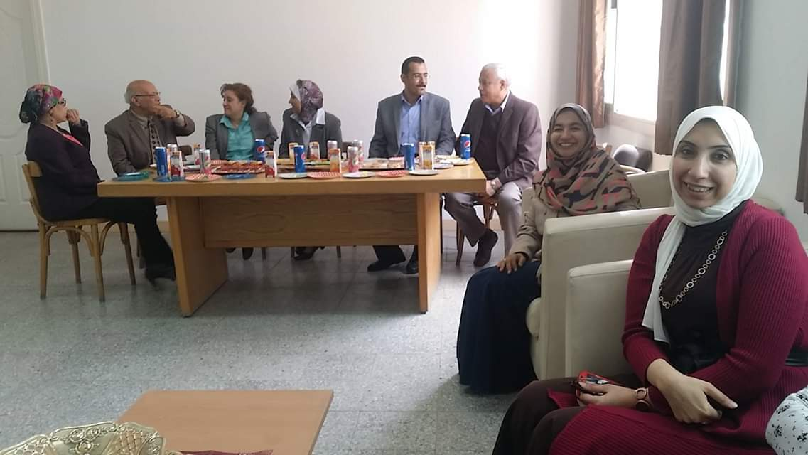
PHD
Enas

Slide 7
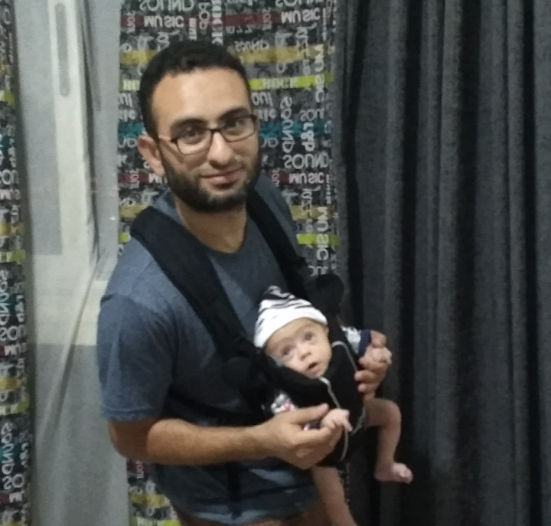
Ahmed
Baby

Slide 8
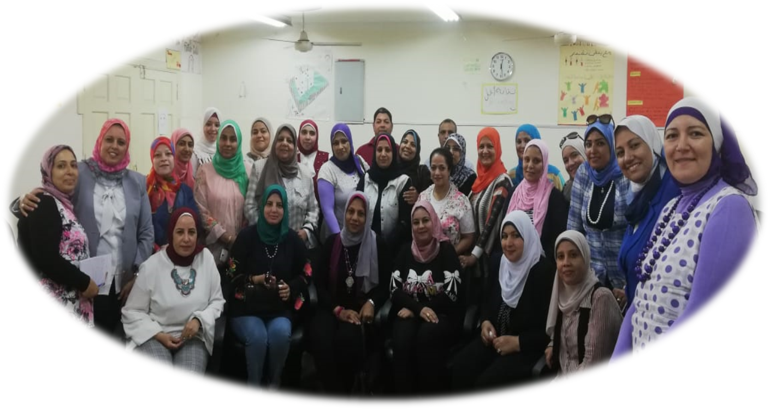
Helwan University
School Clustering
10th – 12th October
HU Progress

Slide 9
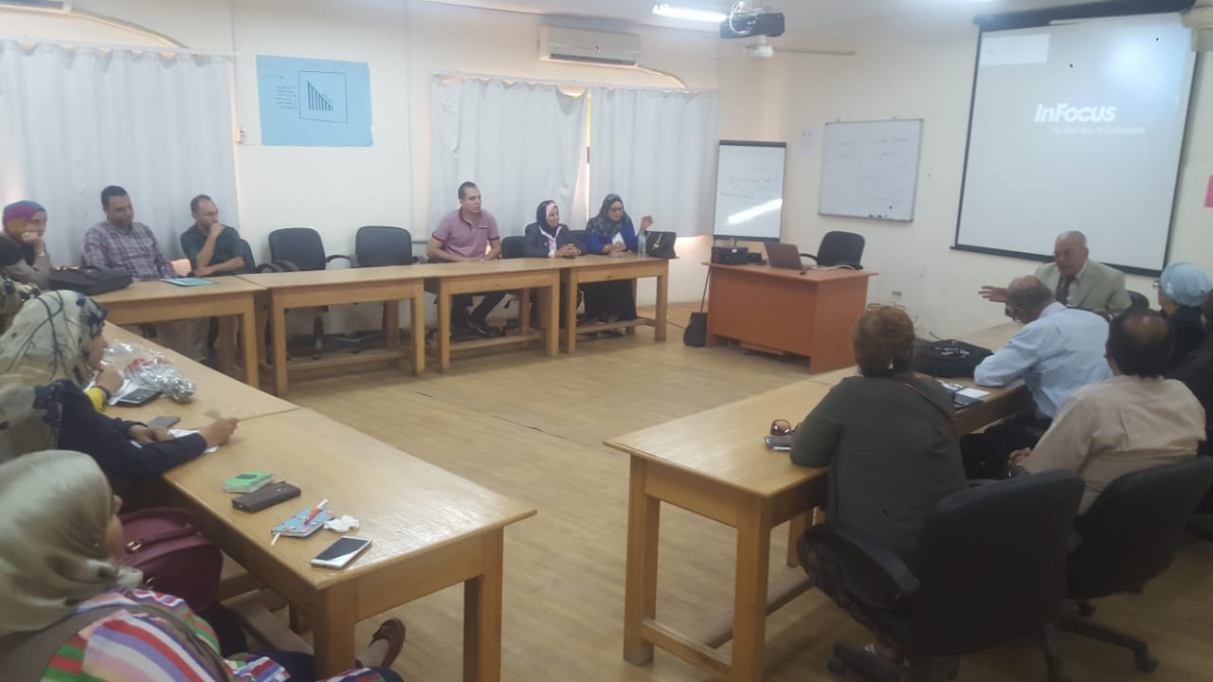
HU Team Sept. Meeting

Slide 10
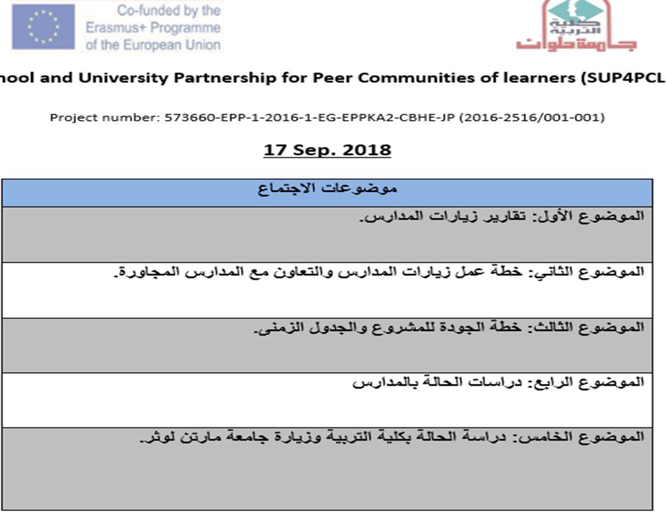

Slide 11
November | October | September | School
First Week: Thursday 1/11/2018 Third week: Thursday 22/11/2018 | First Week: Thursday 4/10/2018 Third week: Thursday 18/10/2018 | First Week: Thursday 6/9/2018 Third week: Thursday 20/9/2018 | Kasr El. Dobarah State School
Second week: Monday 12/11/2018 Fourth week: Sunday 25/11/2018 | Second week: Monday 8/10/2018 Fourth week: Sunday 21/10/2018 | Second week: Monday 10/9/2018 Fourth week: Sunday 23/9/2018 | Helwan Preparatory School for Boys
Second week: Wednesday 14/11/2018 Fourth week: Wednesday 28/9/2018 | Second week: Wednesday 10/10/2018 Fourth week: Wednesday 24/9/2018 | Second week: Wednesday 12/9/2018 Fourth week: Wednesday 26/9/2018 | Helwan El Kadima Primary School
Second week: Sunday 11/11/2018 Fourth week: Tuesday 27/11/2018 | Second week: Sunday 14/10/2018 Fourth week: Tuesday 30/10/2018 | Second week: Sunday 9/9/2018 Fourth week: Tuesday 25/9/2018 | Zamalek School for Girls
Second week: Tuesday 13/11/2018 Fourth week: Wednesday 28/11/2018 | Second week: Tuesday 9/10/2018 Fourth week: Wednesday 24/10/2018 | Second week: Tuesday 11/9/2018 Fourth week: Wednesday 26/9/2018 | Om El Abtal Preparatory School for Girls

Slide 12
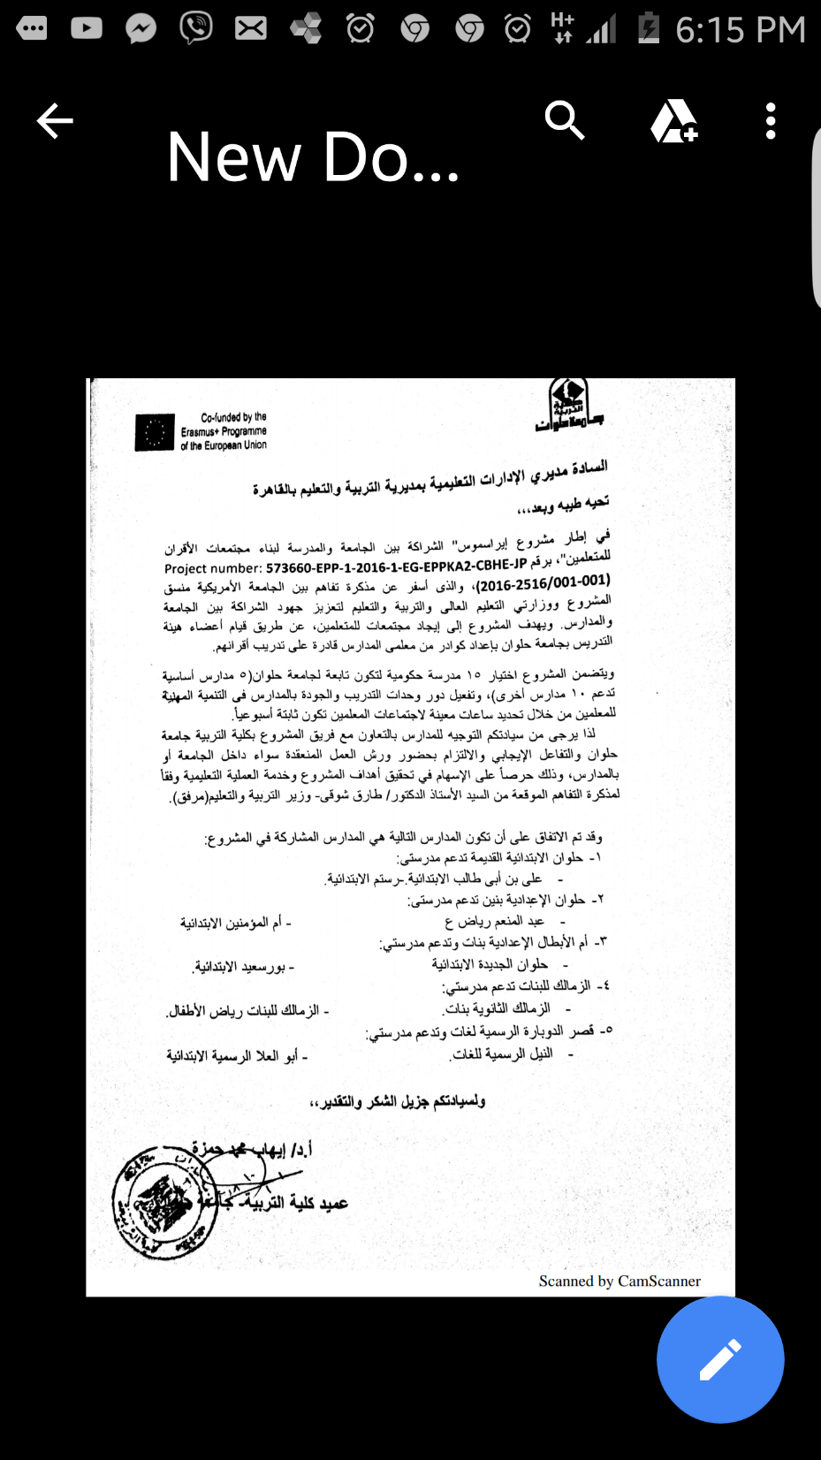

Slide 13
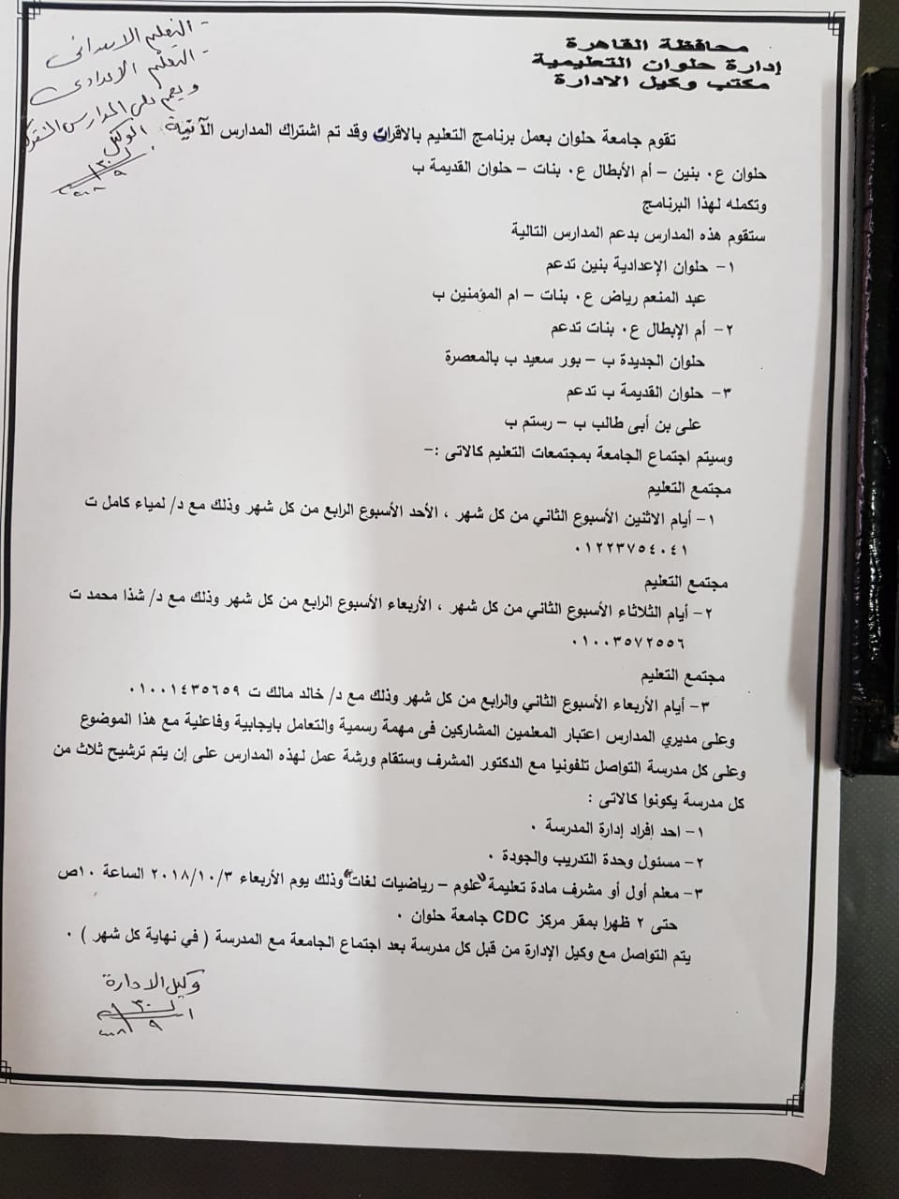

Slide 14
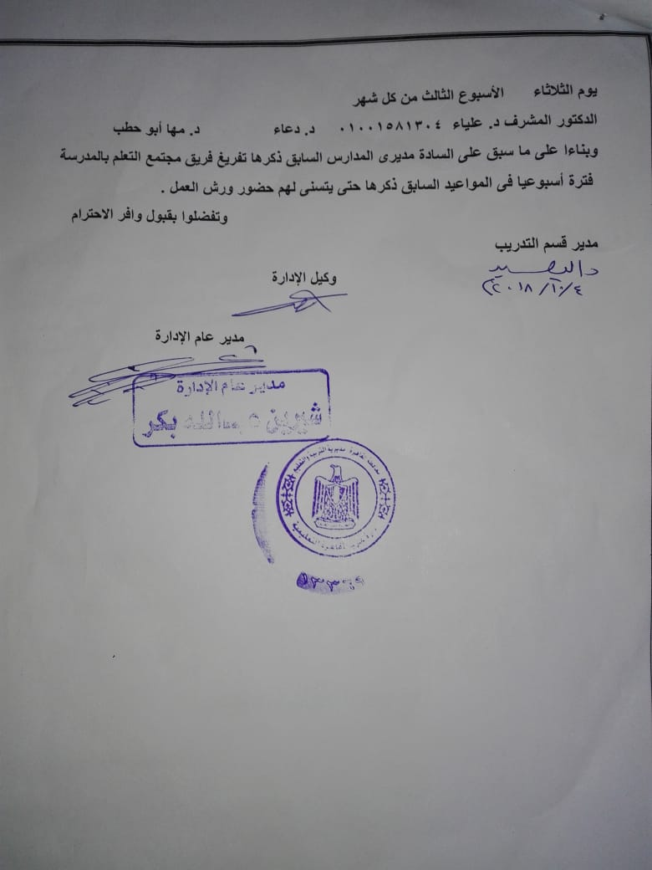
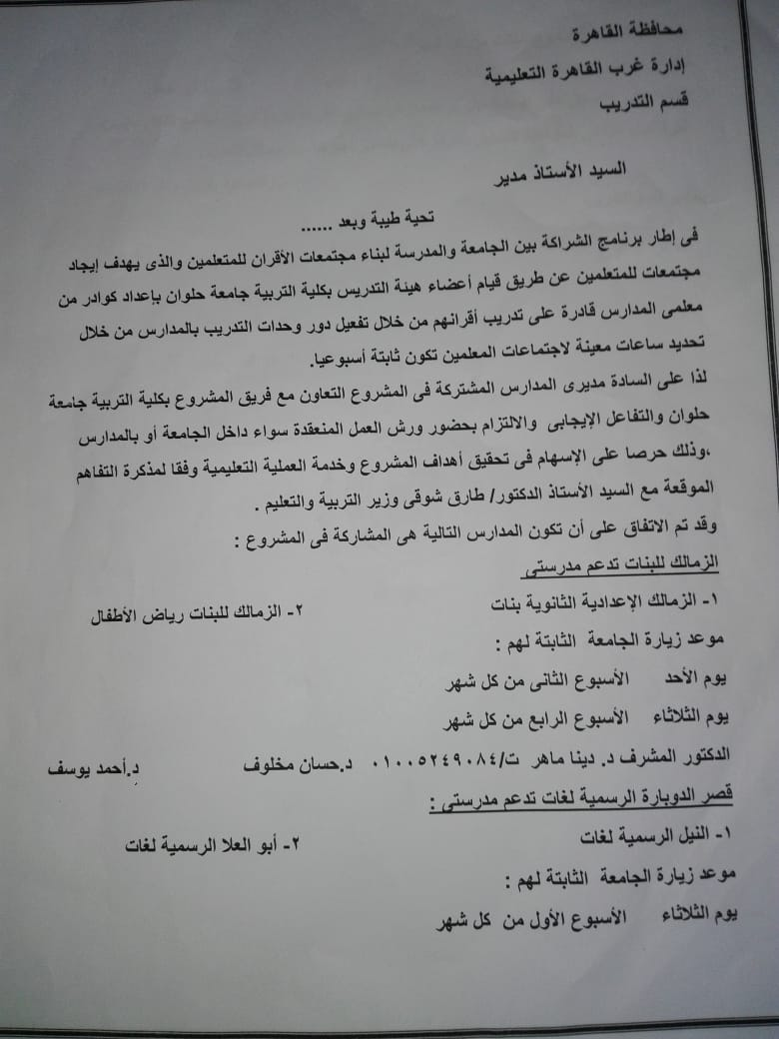

Slide 15
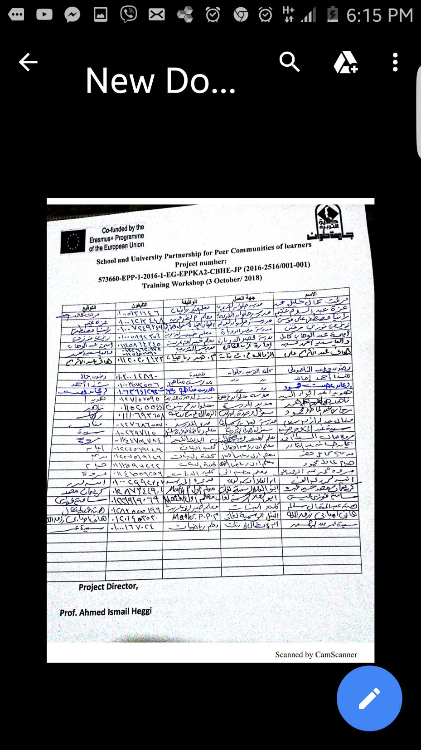

Slide 16
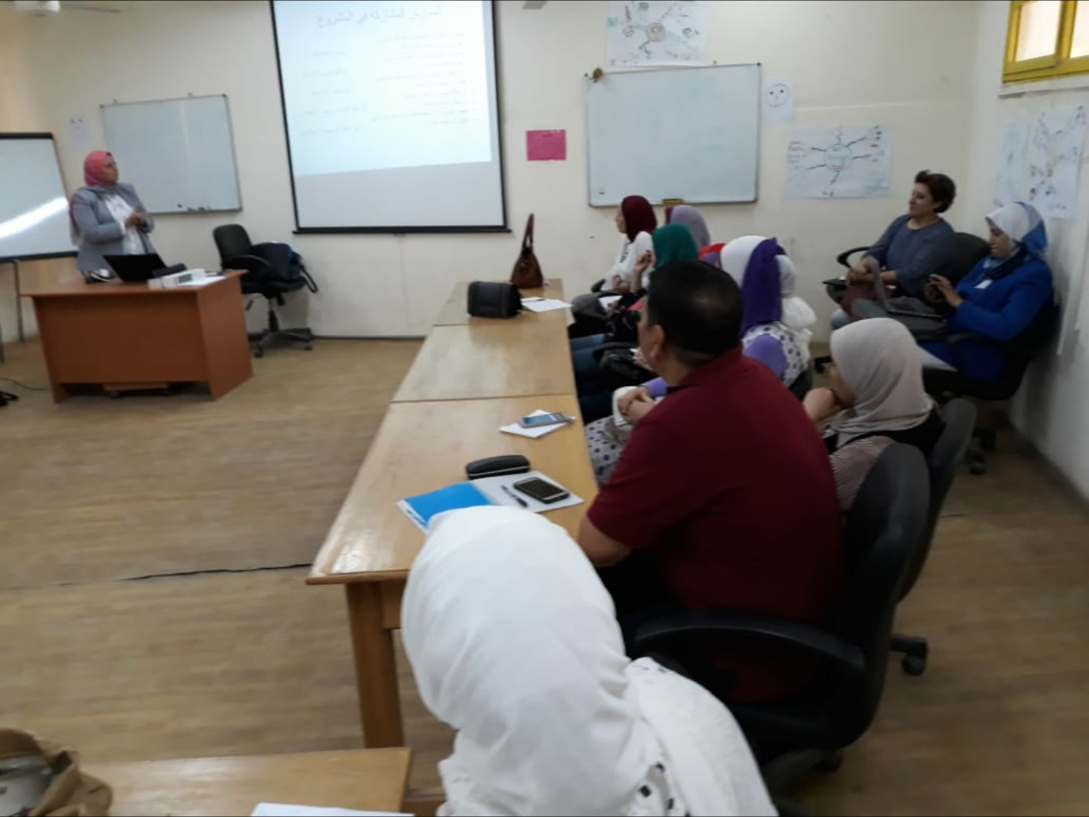
School Clustering work shop

Slide 17
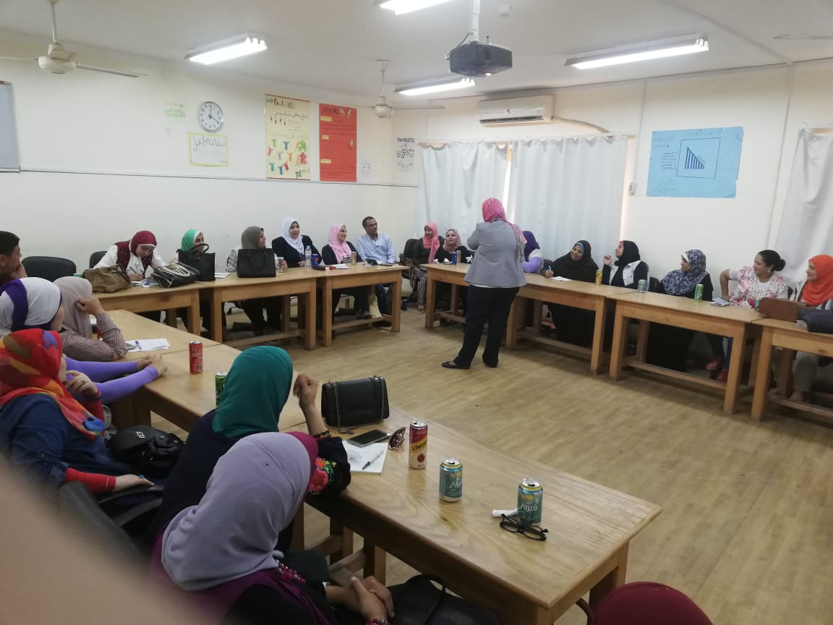

Slide 18
Participants
Clustering Schools
Management
Expert Teaches
Mentors
Q & T Manager

Slide 19
364

Slide 20
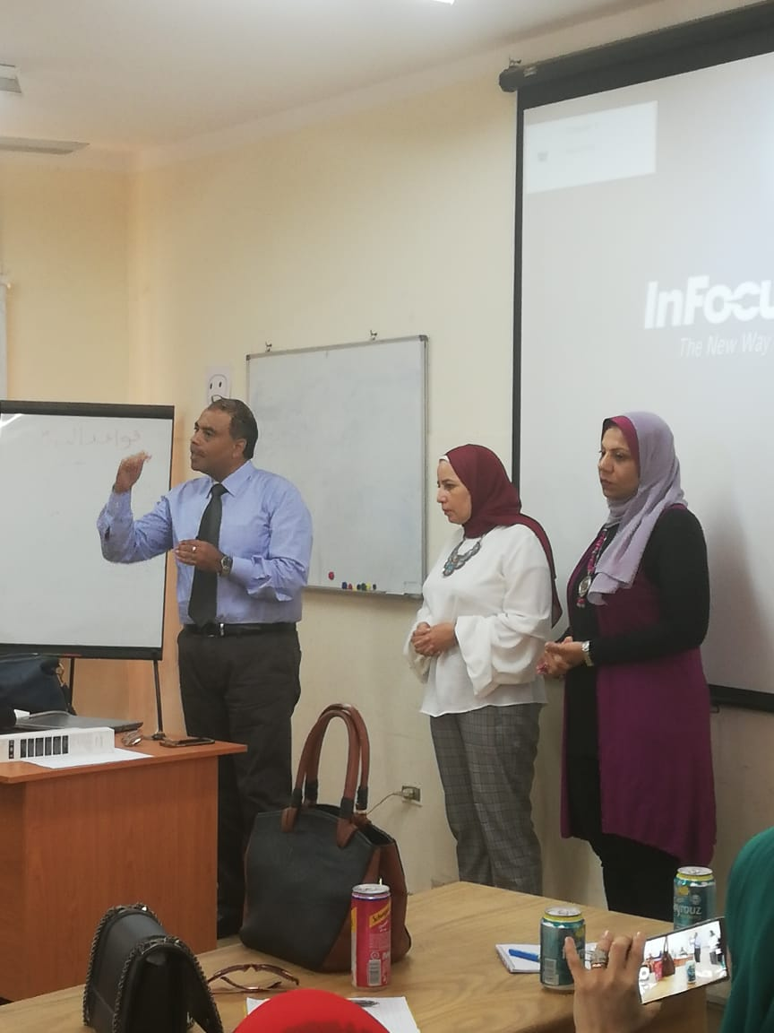
1

Slide 21
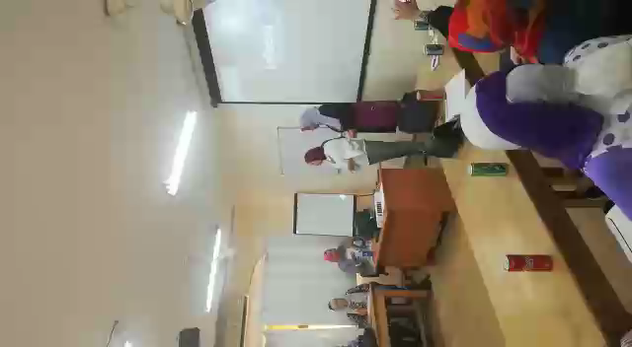

Slide 22
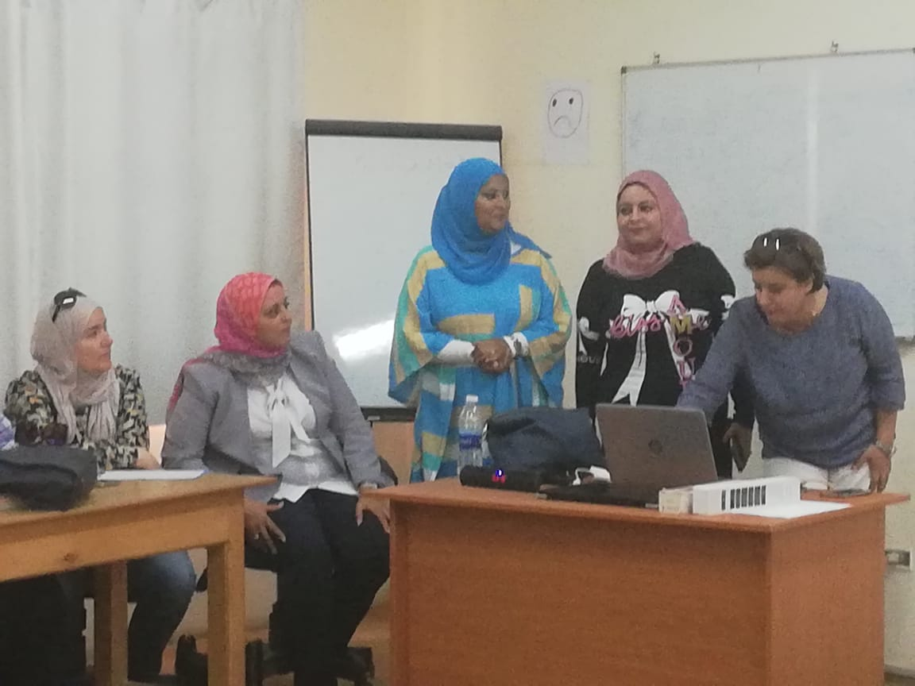
2

Slide 23
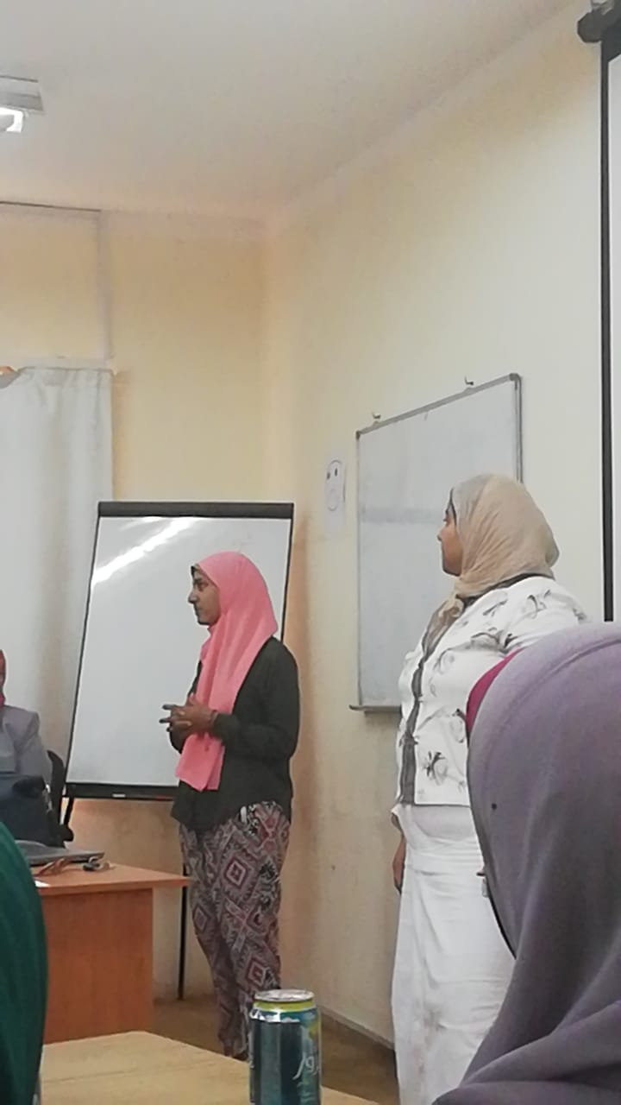
3

Slide 24
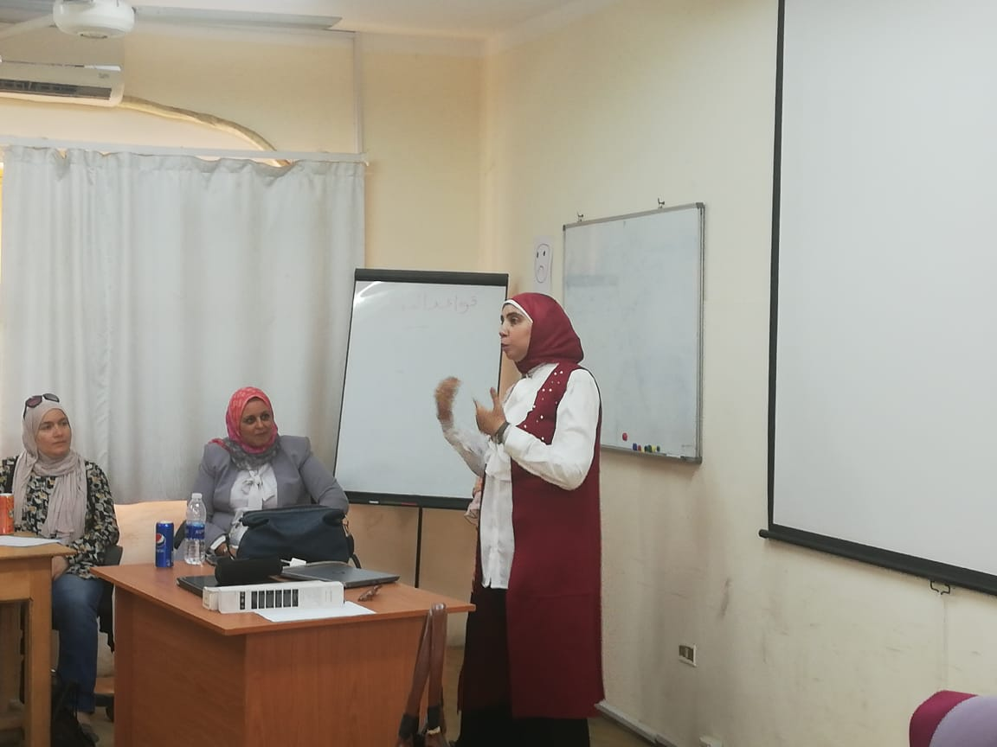
4

Slide 25
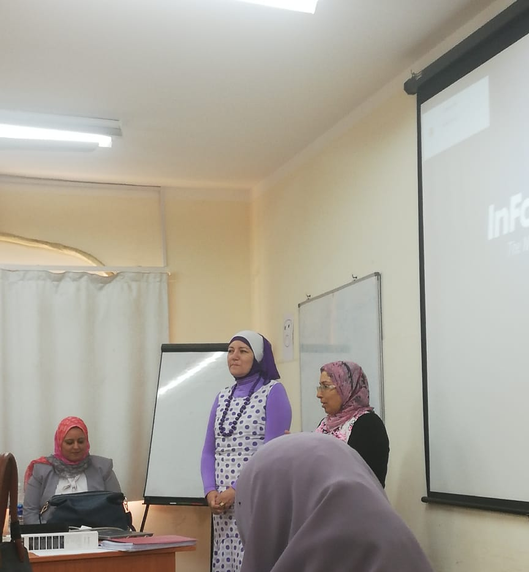
5

Slide 26
Incentives
HU Team
Working hours
TOT International Certificates
School Team
Certificates
Training of Teacher I C
Management Consultancy

Slide 27
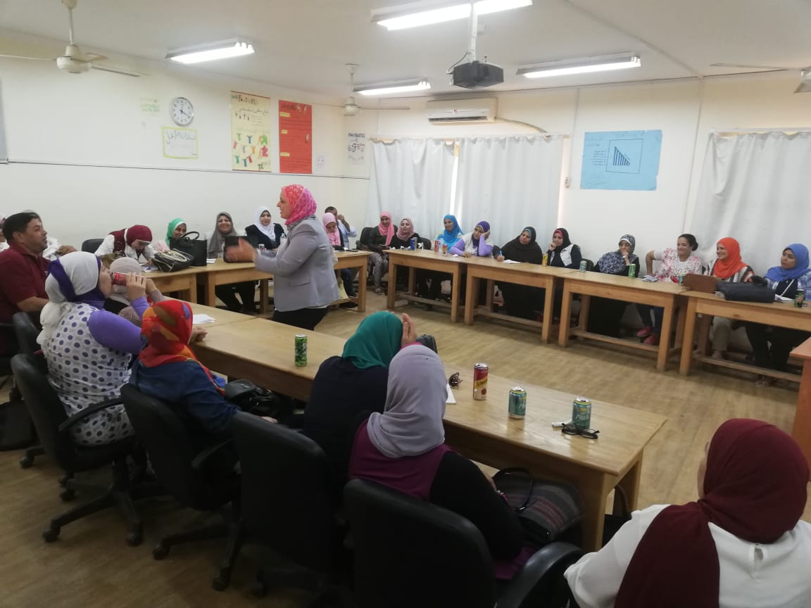
Learning Moment

Slide 28
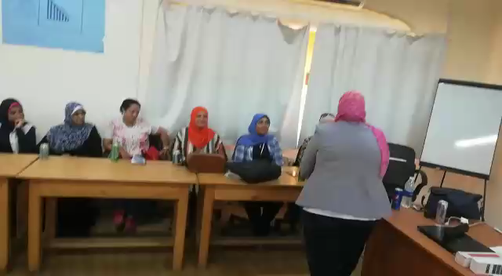

Slide 29
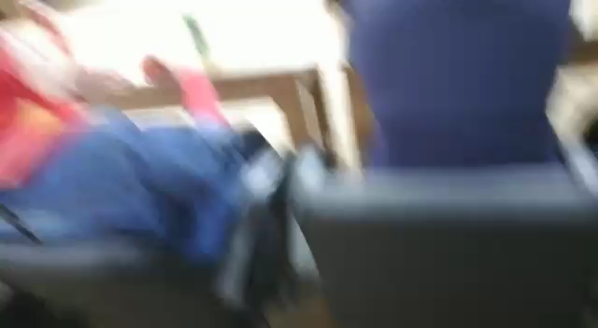

Slide 30
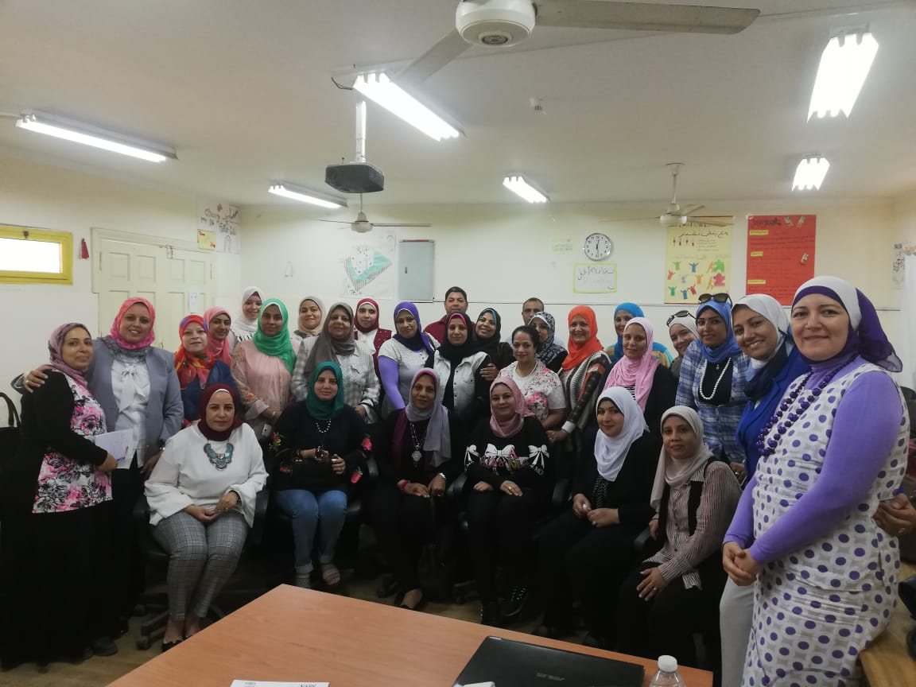

Slide 31
Mentorship
HU has three levels of Mentorship:
1- FOE & Teachers in schools
2- Teachers & Teachers
3- Project management team & FOE staff.

Slide 32


Slide 33


Slide 34

1- FOE & Teachers in schools
Workshops inside & outside schools.
Meetings inside & outside schools.
Reporting & reflections( HU templates)

Slide 35
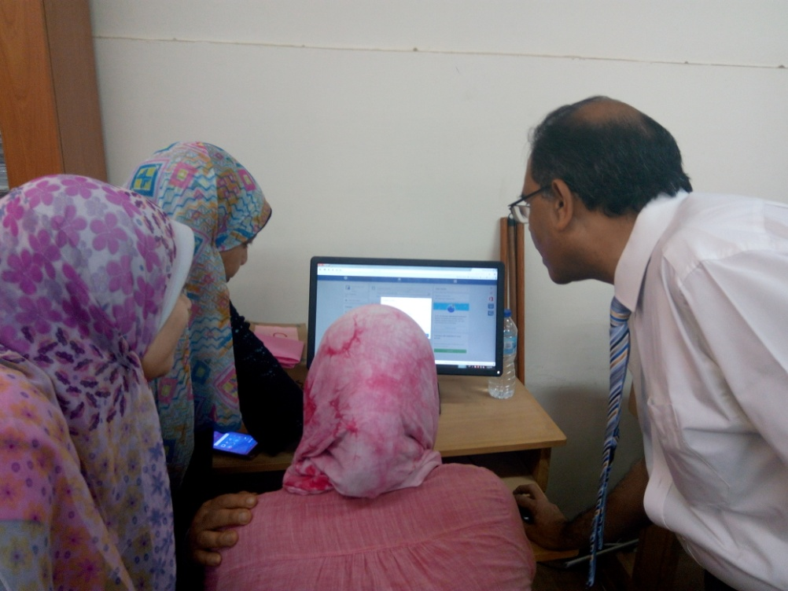
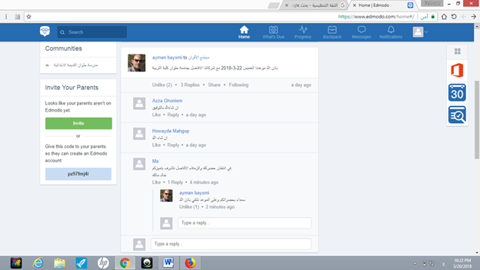
At HU campus
First: The Use of ICT in enhancing PCLs

Slide 36
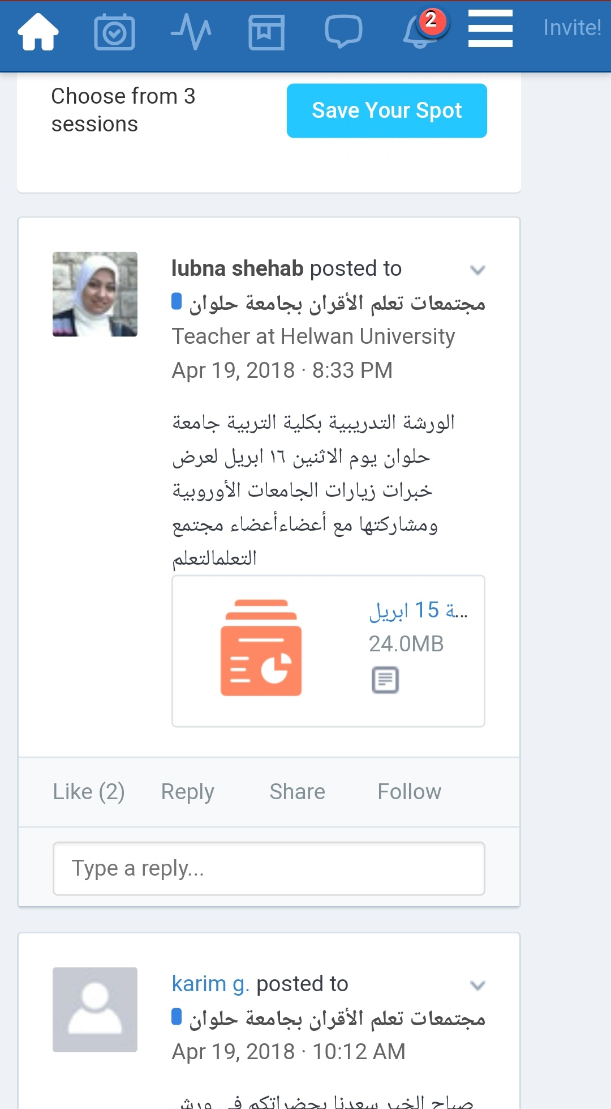
Foreign Experiences in Developing PCLs

Slide 37
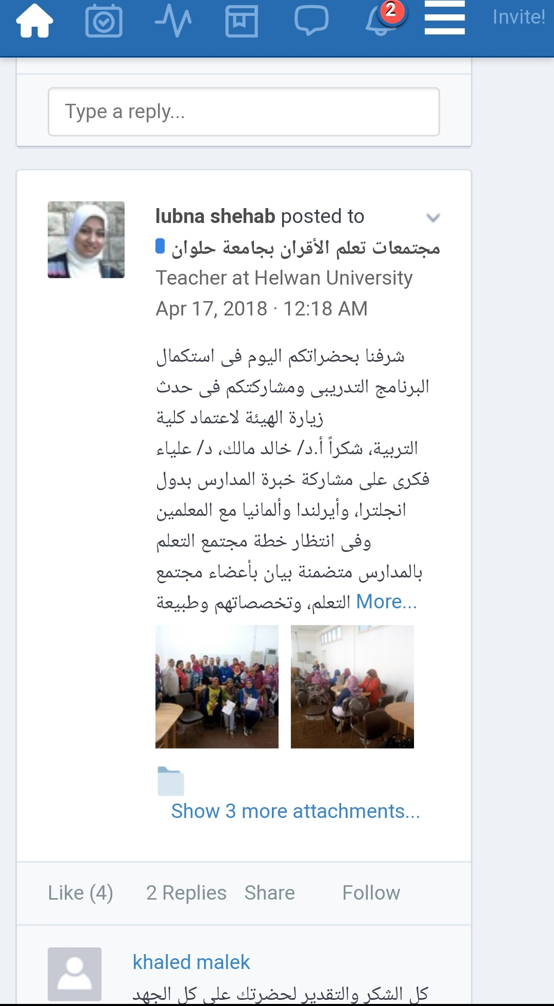
Dissemination of Quality Assurance and Accreditation Culture

Slide 38
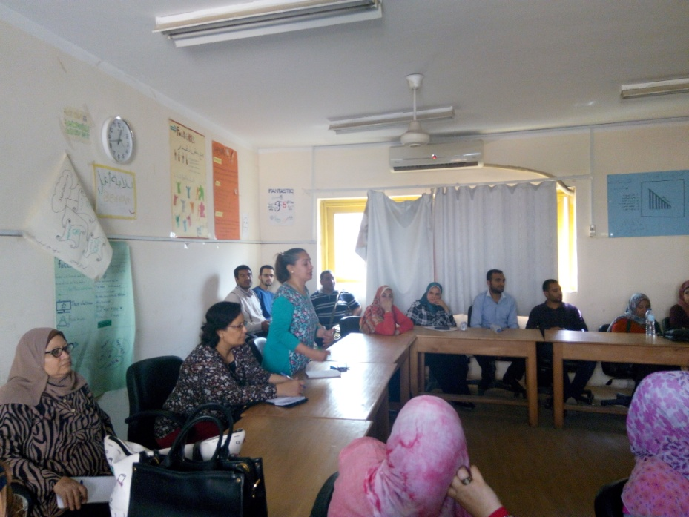
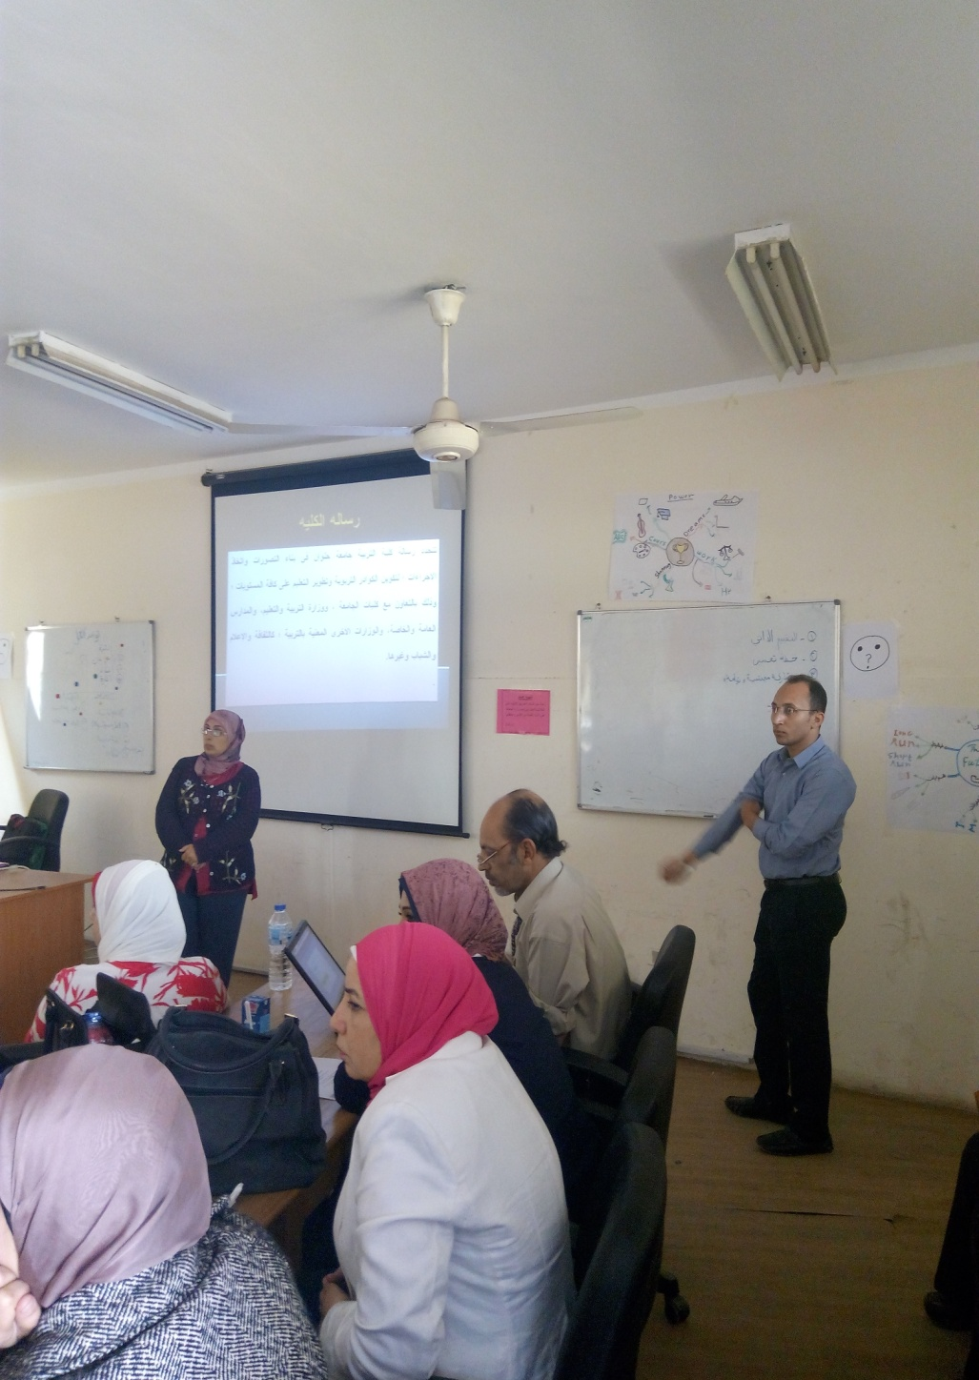
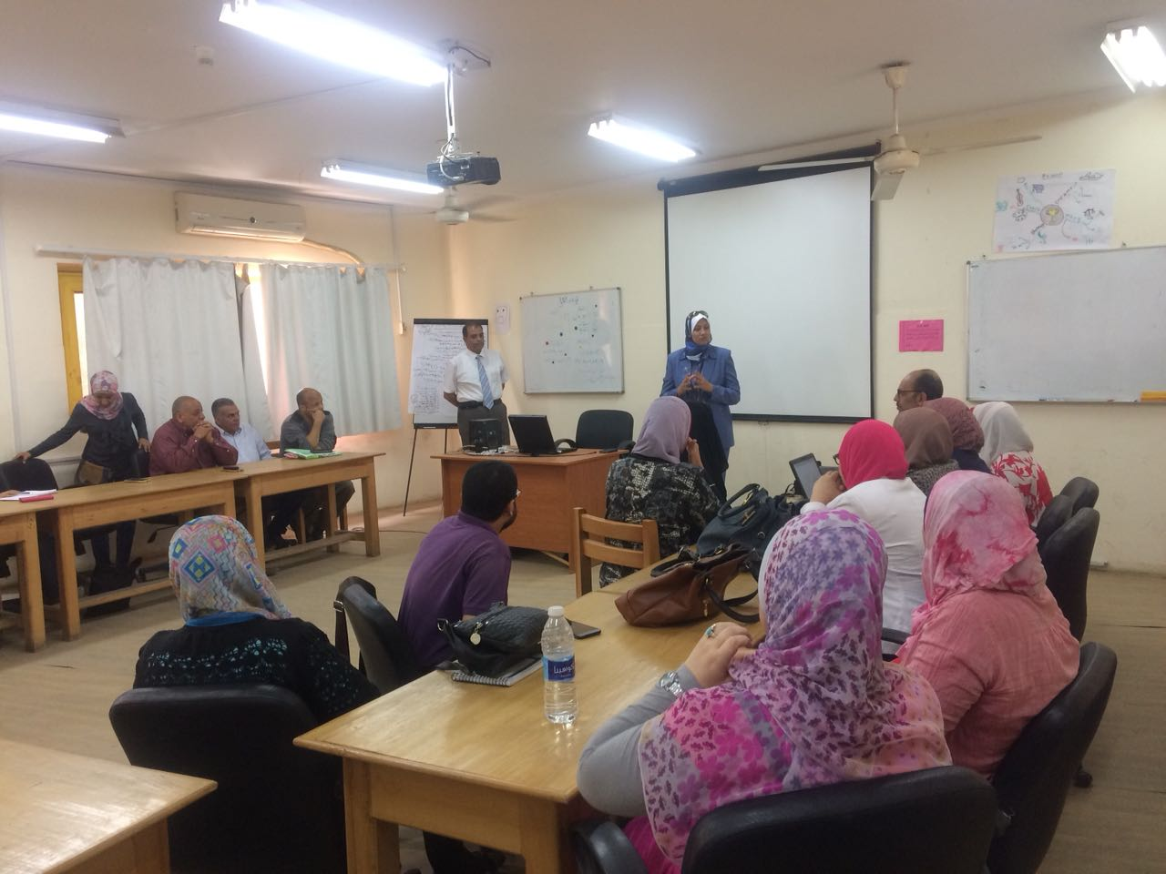

Slide 39
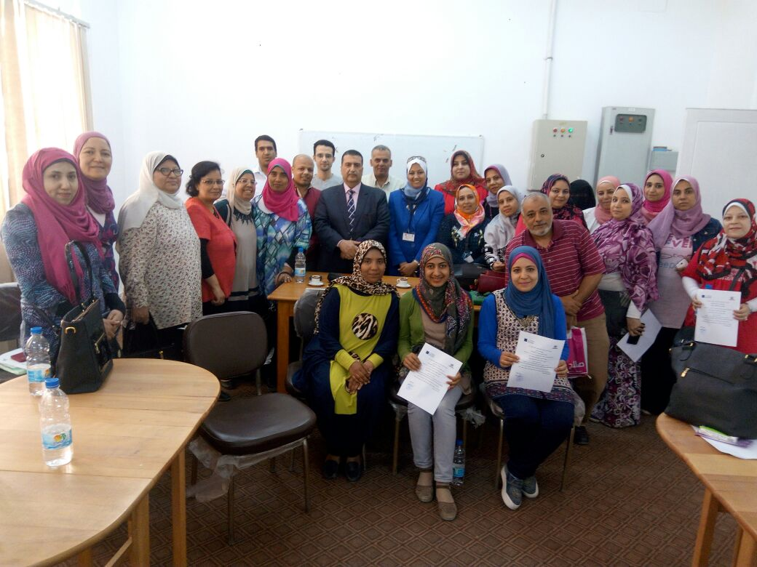

Slide 40
Inside Schools
Zamalek School for Girls | Om El Abtal Preparatory school | Helwan El Kadima primary School` | Helwan preparatory school for boys | Kasr El Doparah State School
1- Integration of citizenship in school subjects 2- Integration of STEM in school subjects. 3- Strategic planning. | 1-bLearning styles. 2- Using STEM approach to design activities to develop sustainable development. 3- Design a unit based on STEM to develop citizenship. | 1- Developing Learning communities. 2- The use of Technology in Education | 1- Peer learning communities. 2- Introduction of the three concepts: citizenship, STEM, SUD. | 1- Peer teaching learning strategy. 2- Quality system development in schools. 3- Quality assurance culture 4- Counselling and consultation. PLC.

Slide 41
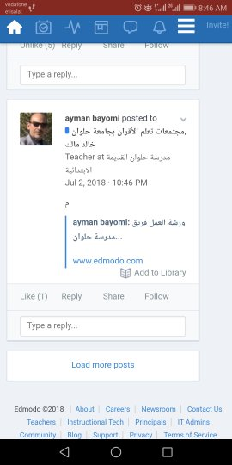

Slide 42
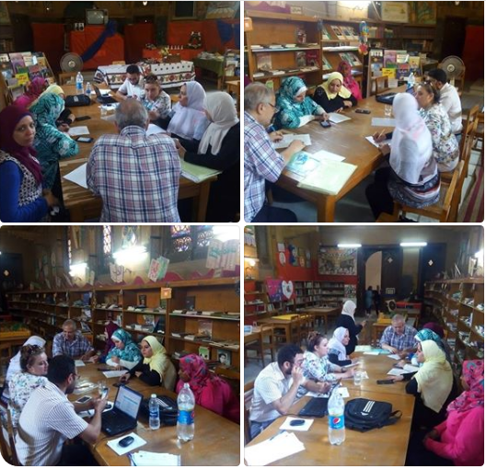

Slide 43
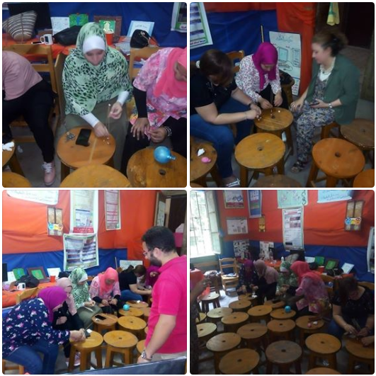

Slide 44
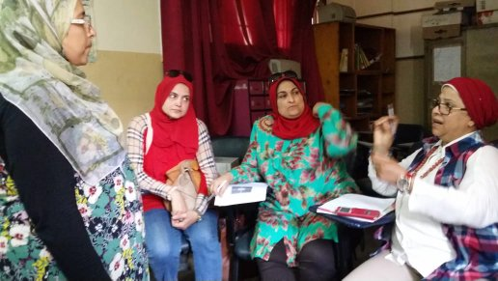
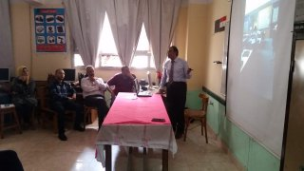
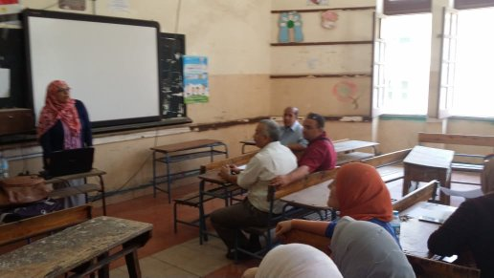
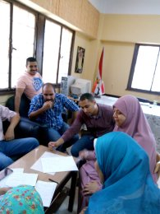

Slide 45
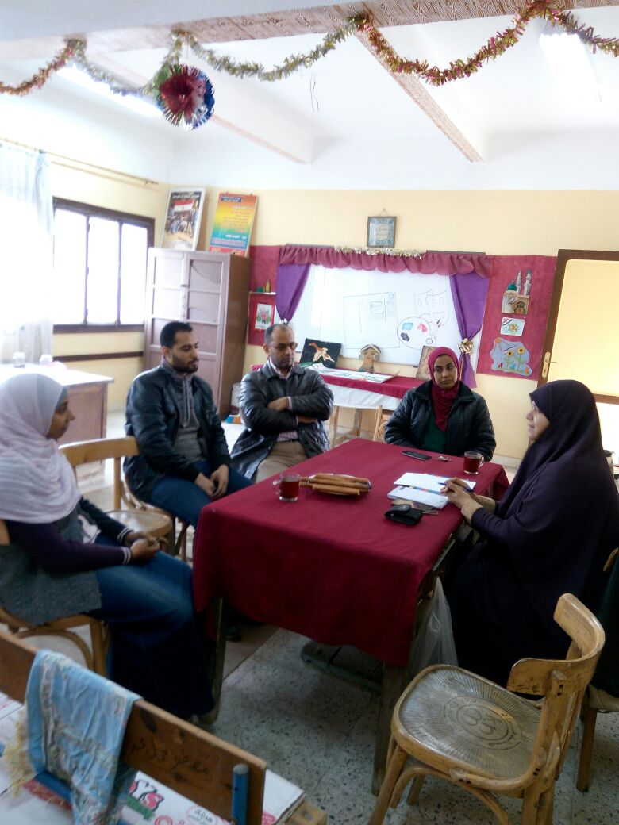

Slide 46
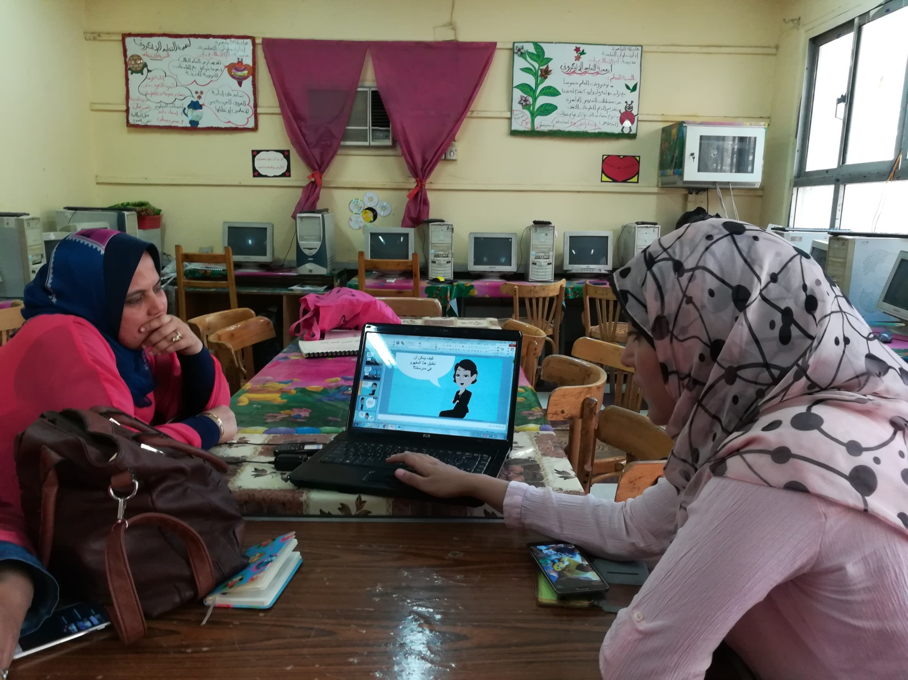
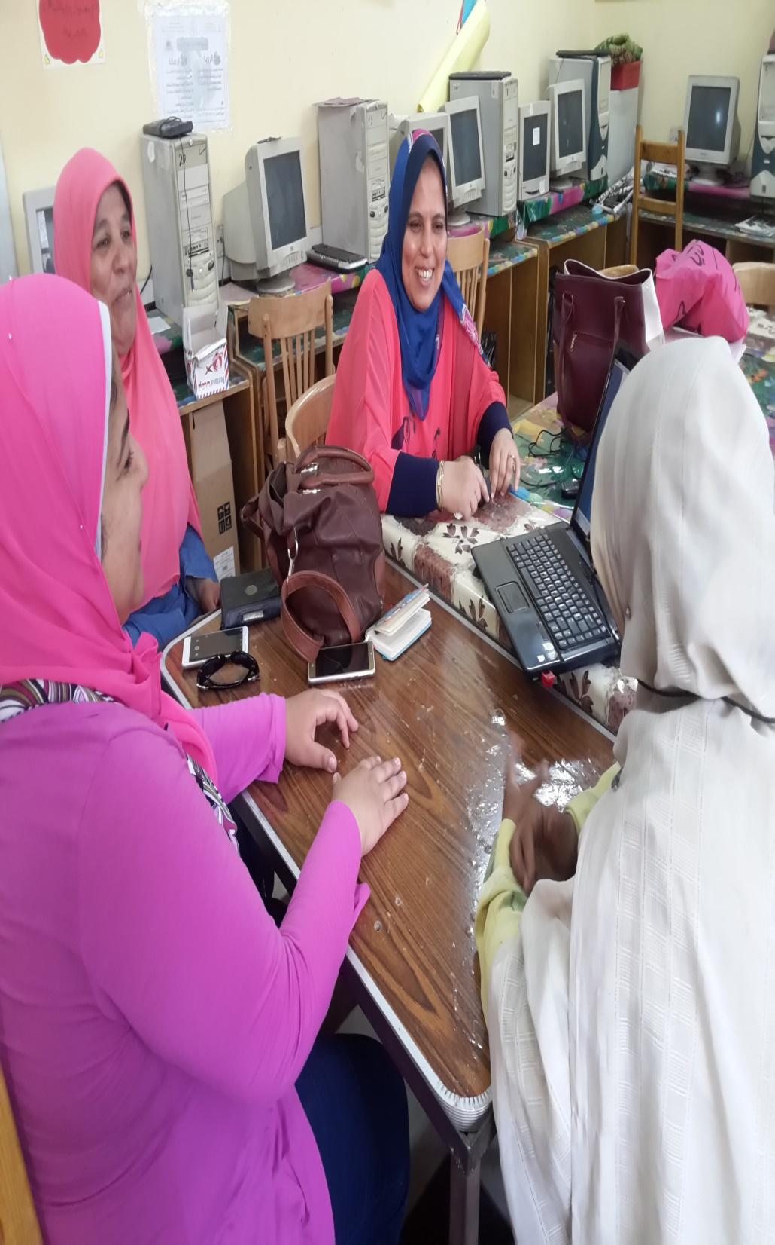

Slide 47
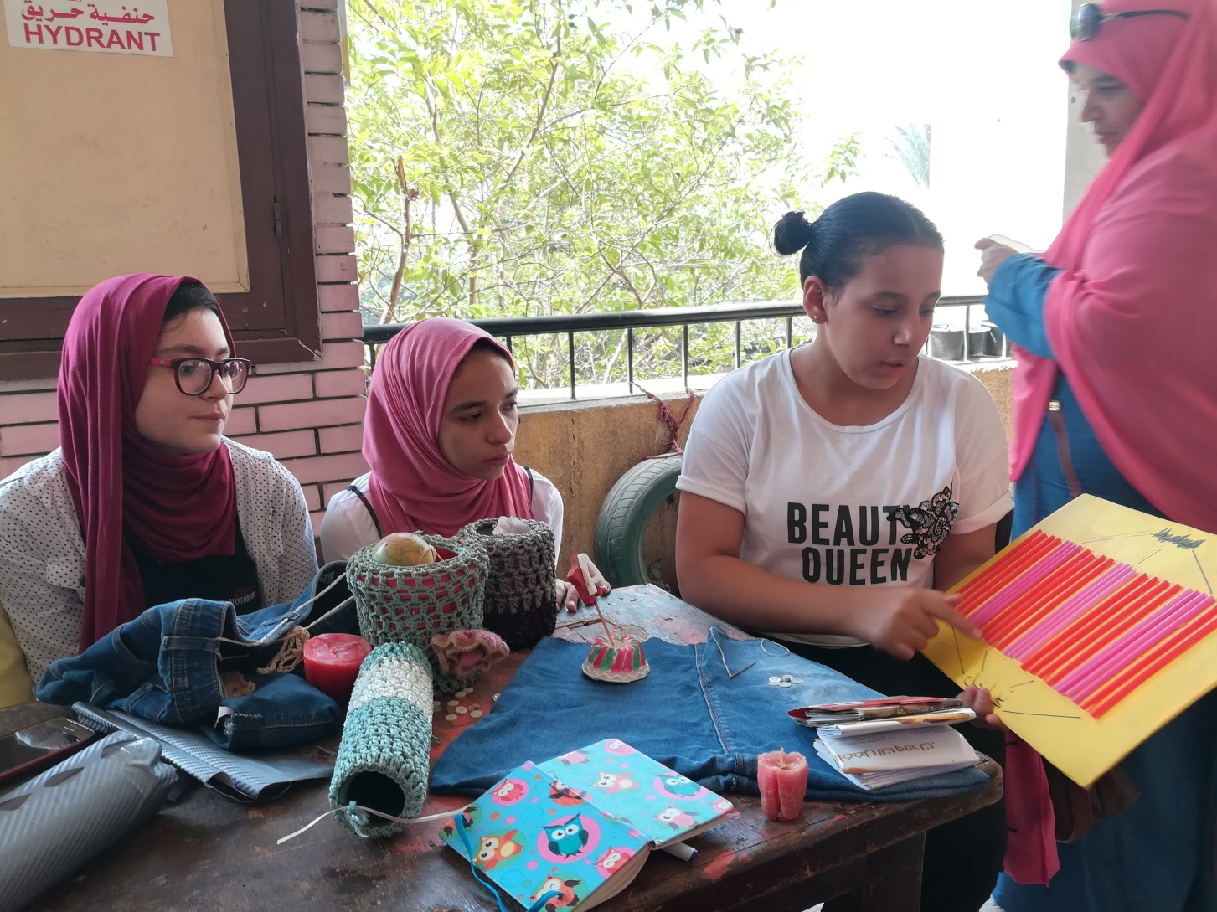

Slide 48
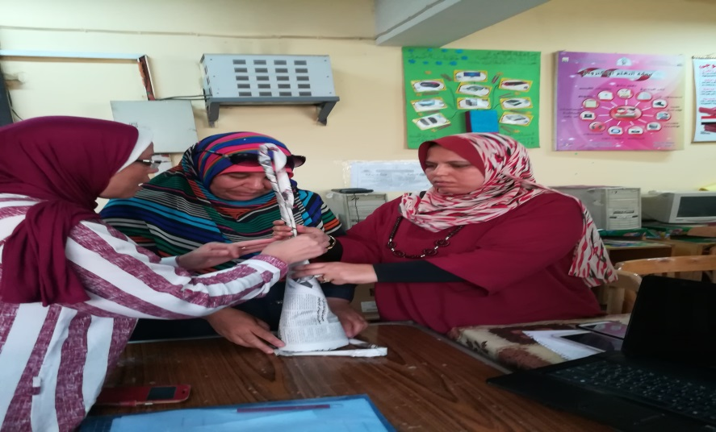
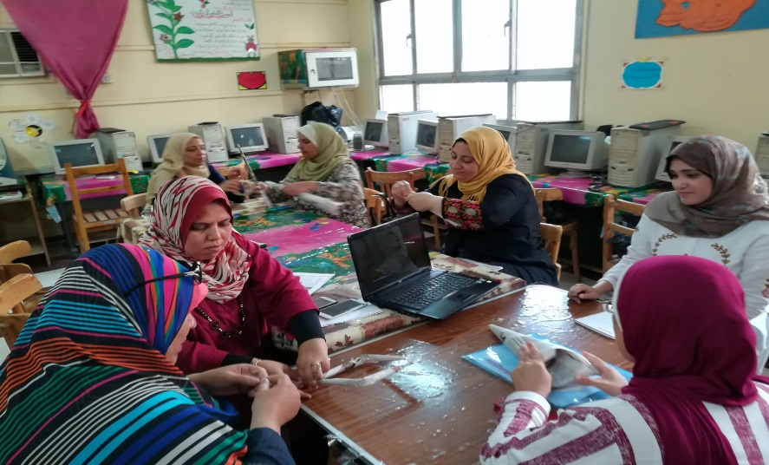

Slide 49
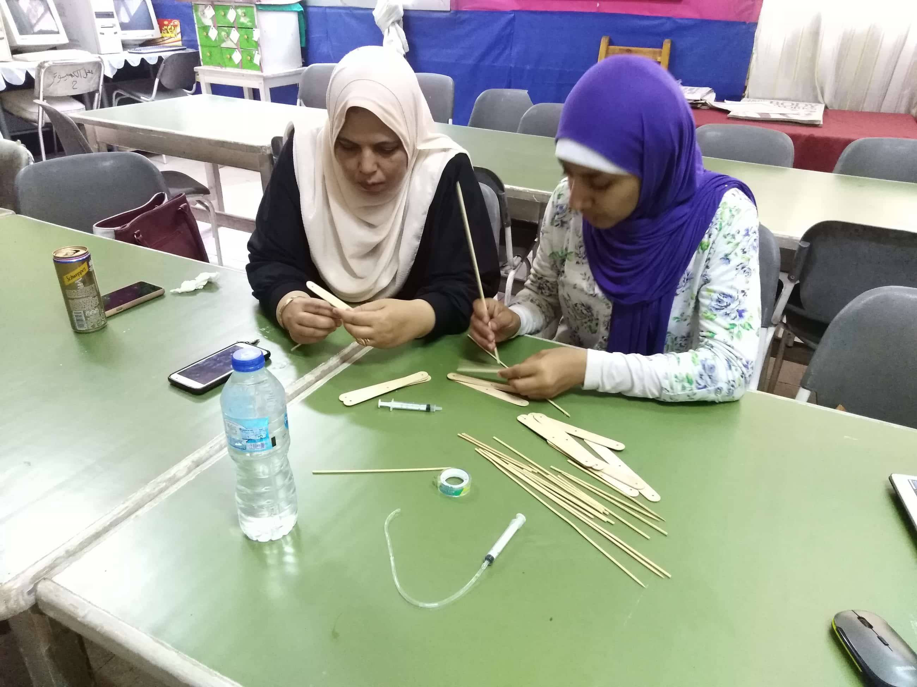
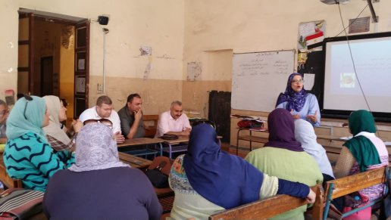

Slide 50
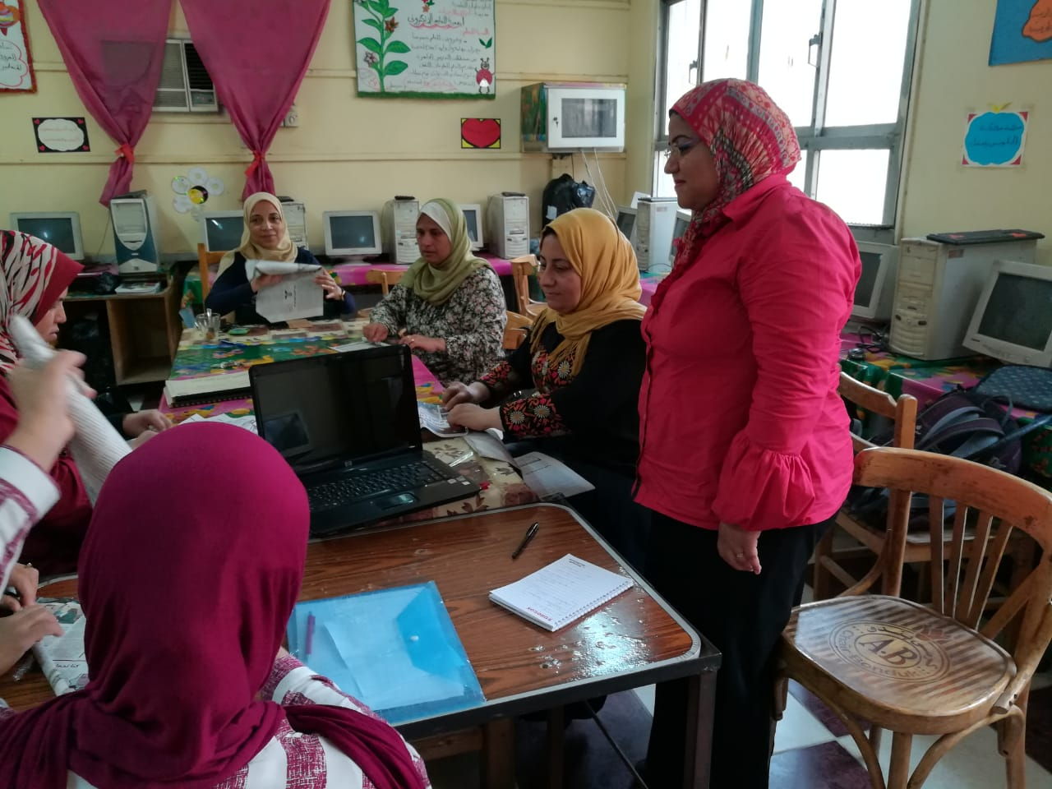

Slide 51
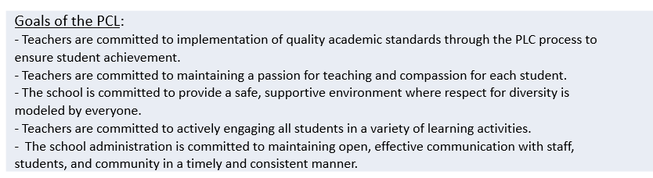

Meetings inside & outside schools.
Main pillars of meetings inside schools:
1- Plan for the school PCL( slogan, vision, mission, values & goals)

Slide 52

Together Every one Achieve More " TEAM"

Slide 53

2- Reporting

Slide 54

Impact assessment:

Slide 55


Slide 56

Activation of the quality and training unit:
Training annual plan 2018/2019

Slide 57


Slide 58
Examples of training programs received during the academic year 2017-2018: Preparing the school schedule electronically. Class management and modern teaching methods. Training on how to sign up to the Egyptian Knowledge Bank.

Slide 59


2- Teachers & Teachers
Training workshops between teachers
Formal meetings supported by HU
Arabic Language PCL

Slide 60


Math PCL

Slide 61



Slide 62


3- Project management team & FOE staff.
Monitoring visits
Follow up the impact of our PCL on students during their summer activities in school

Slide 63



Slide 64



Slide 65

FOE PCL Meetings
Fourth week of each month
Monday

Slide 66

Material Development
Templates

Slide 67

PCL Agenda

Slide 68
PCL Session Assessment

Slide 69

Activity Design

Slide 70

Mentors Observation sheet

Slide 71


Slide 72


Workshops PPT.

Slide 73



Slide 74
Research & Enquiry
Post graduate studies( PHD) 2 students.
School level( the student researcher):
through their participation to solve the school and community problems.
The students of preparatory stage developed research proposal with the help of HU and school mentors.

Slide 75



Slide 76



Slide 77


Science for Fun

Slide 78


Slide 79



Slide 80



Slide 81

MoU Between HU& MLU
In progress

Slide 82



Mobility exchange for PHD researcher in collaboration with MLU

Slide 83


