Slide 1
Project Name:
School and University Partnership for Peer Communities of Learners
(SUP4PCL)
Six^{th} Local Management Meeting
Monday February 4th, 2019
Organized by: The American University in Cairo (AUC), Egypt
Location: Alexandria
This project has been funded with support from the European Commission. This publication [communication] reflects the views only of the author, and the Commission cannot be held responsible for any use which may be made of the information contained therein

Slide 2
Material Development

Slide 3
STEAM
Global Citizenship
Sustainable development
Special needs

Slide 4

Workshop:
Training Package Development
28th November, 2018

Slide 5
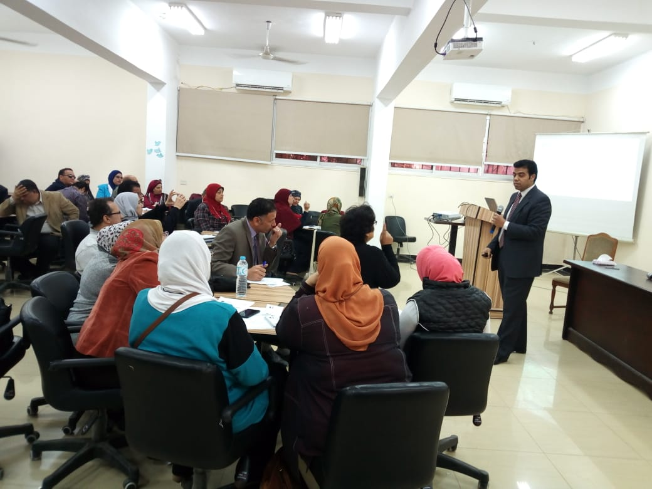
The target groups for this workshop were In-service Teachers participated in SUP4PCL Project and their mentors from FOE.
The trainees were divided into 5 groups according to the themes of the SUP4PCL Project which are: Global Citizenship, STEAM, Sustainable Development, Educational Technology and Special needs.
The methodology of the work during the workshop was as follow: the moderator raised some issues related to the training package development to be discussed among the trainees, then he kept trying to direct them to participate in the discussion in order to share their ideas and experiences relevant to those issues, and then he asked each group to apply what they concluded through the discussion.
The methodology helped the trainees to be more participated in all discussion held on one side, and enabled them to share their experiences and apply all what they learnt in their group cooperatively through their specialization.
Time | Activity
09:00 – 09:15 am | Welcome
09:15-10:15 am | Concept of Training Program Training Program Design.
10:15-12:00 am | Training Package: Concept, Tools and Procedures. Training Package Components
12:00-12:30 pm | Break
12:30-01:30 pm | The process of Training Package Design PAT Criteria for Designing the Training Package.
01:30-02:15 pm | Working Groups
02:15-02:45 pm | Groups Presentations & Discussions
02:45-03:00 pm | Closing & Conclusion

Slide 6
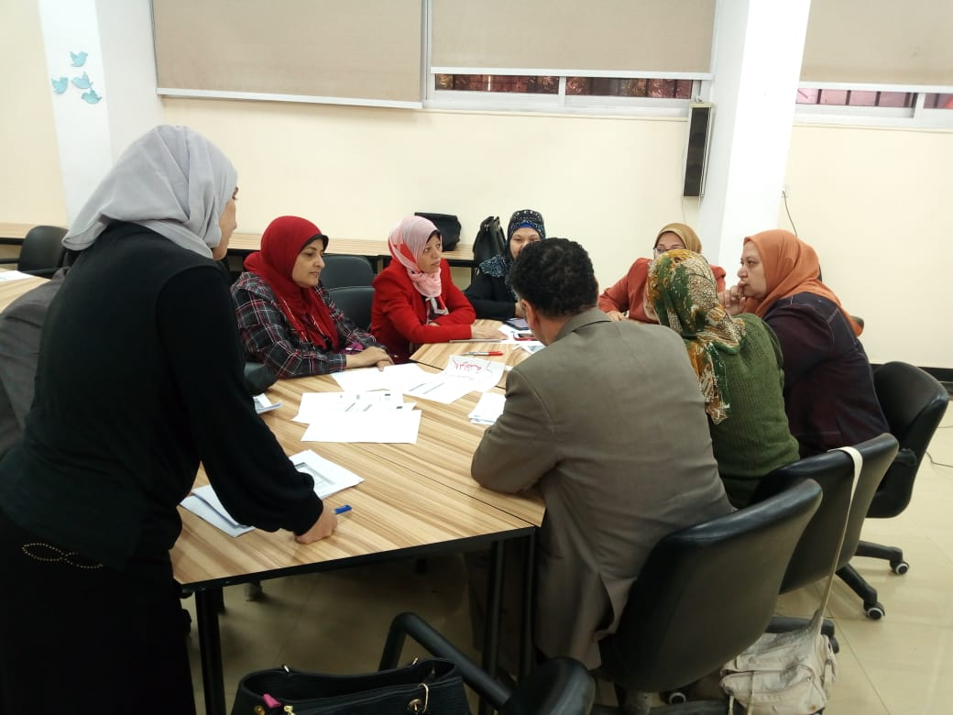
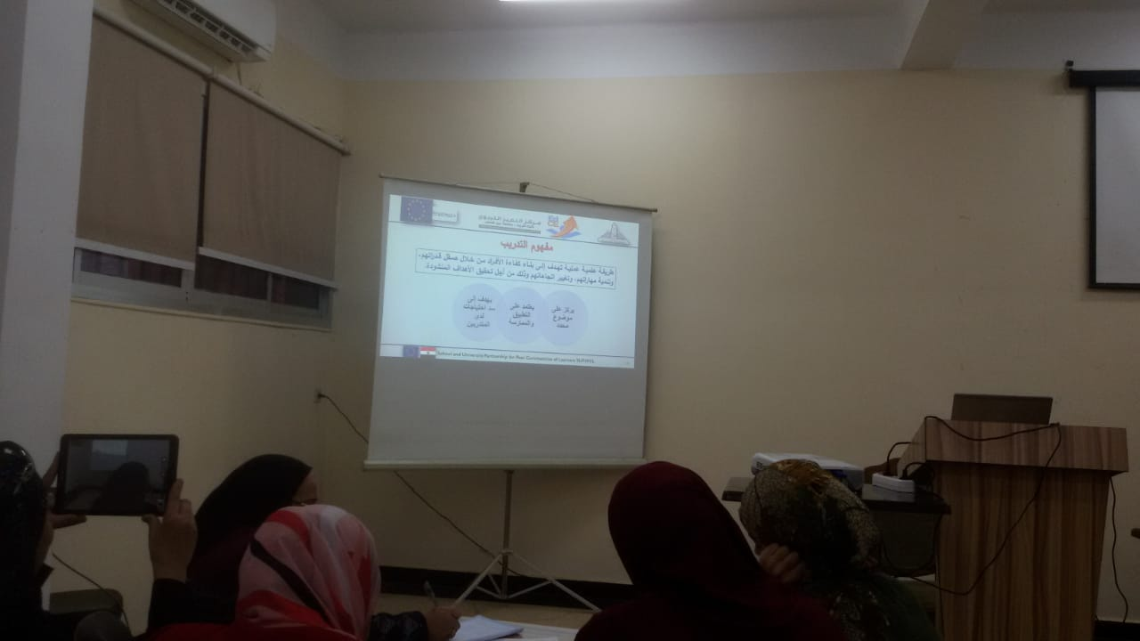
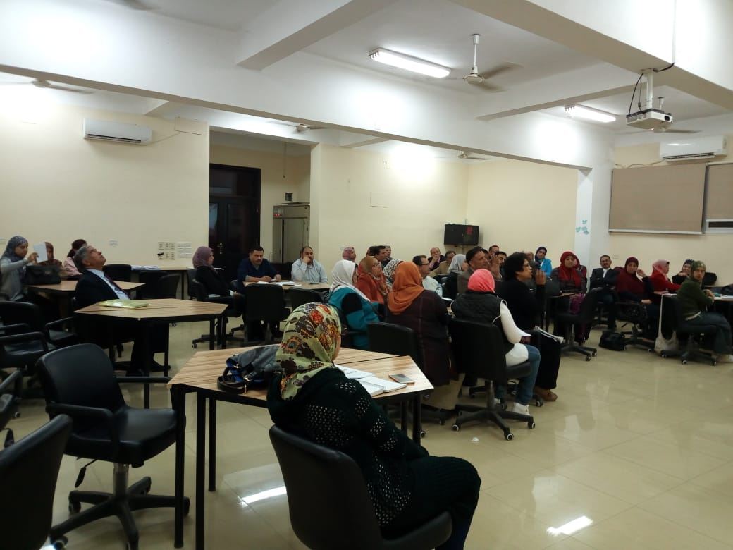
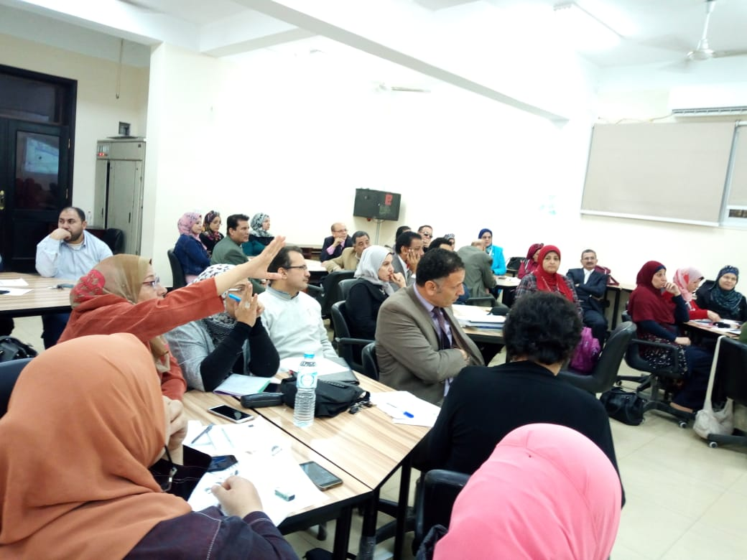

Slide 7
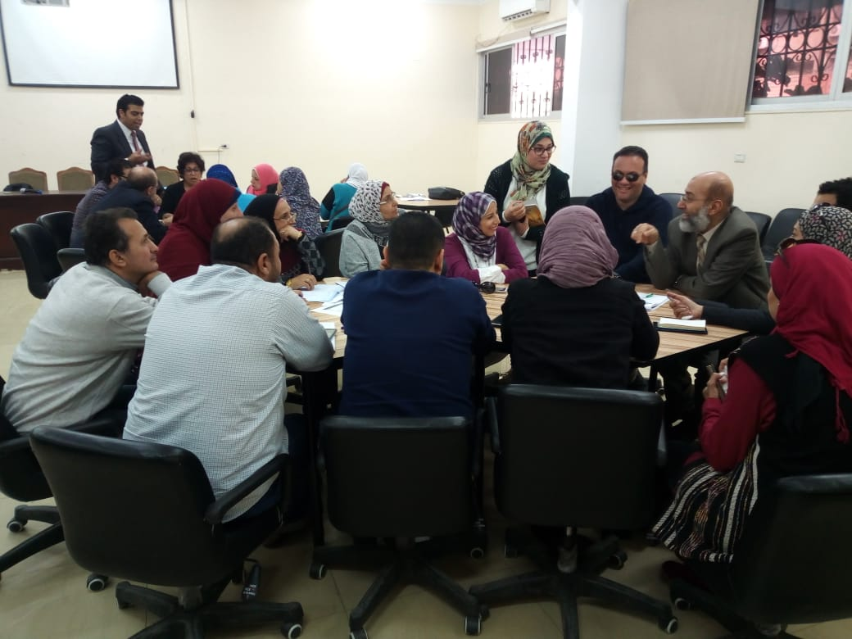
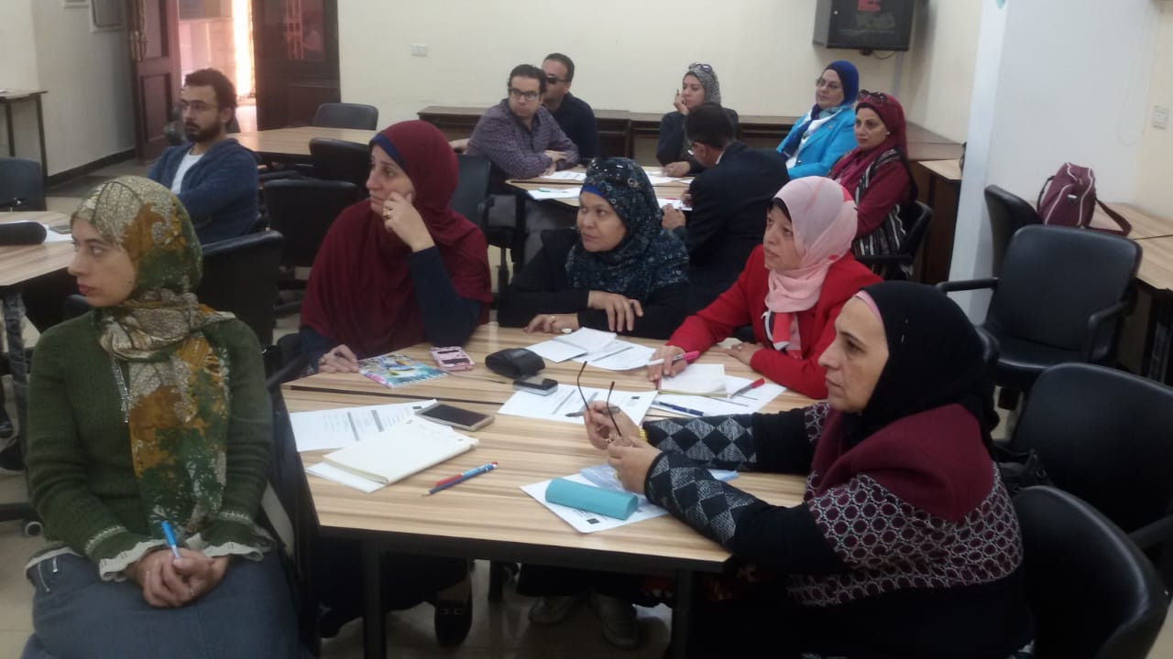
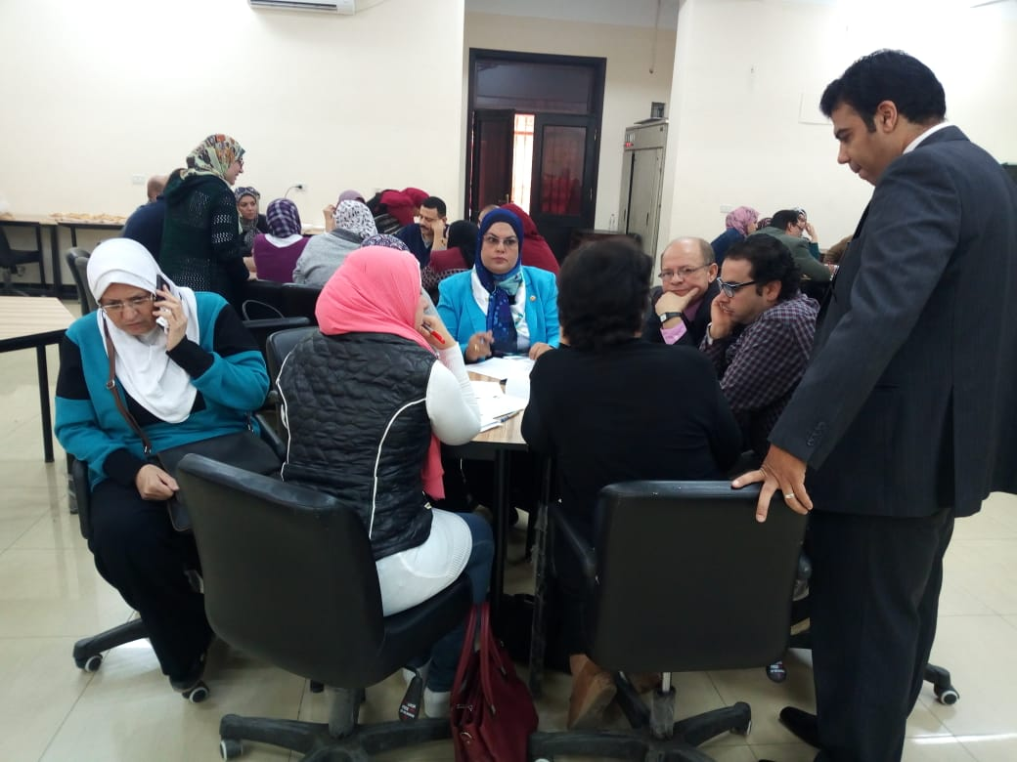
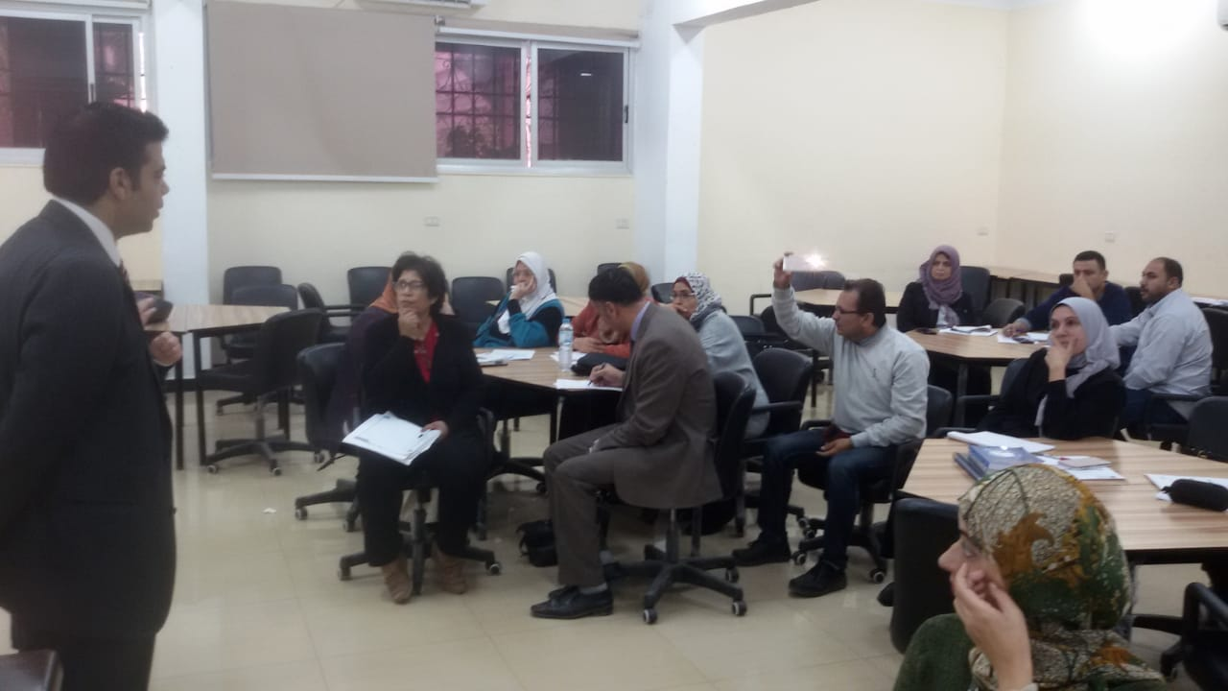

Slide 8
Framework of the training package
Outline
Trainer guide
Trainee guide
Enriching readings
Presentations
Pre and post tests of the whole package
Pre and post tests of each topic
Introduction
Vision & Mission
Philosophy
Components
Main and specific goals
Topics
Target group
Training methods
Duration
Resources and tools
Training Room specifications
Assessment methods
Agenda
Concepts / Terminology

Slide 9



Slide 10

Training package-1:
STEAM

Slide 11

A training entitled: “ Preparation of STEAM teacher and the 21st century skills" for 5 days (30 hours) was held by participation of the training unit in Cairo directorate and 5 Teachers from each core school and their mentors from FOE
This training was sponsored by the center of excellence in education, Ain Shams University.
Through this training the trainees worked together step by step to produce a training package of STEAM.

Slide 12
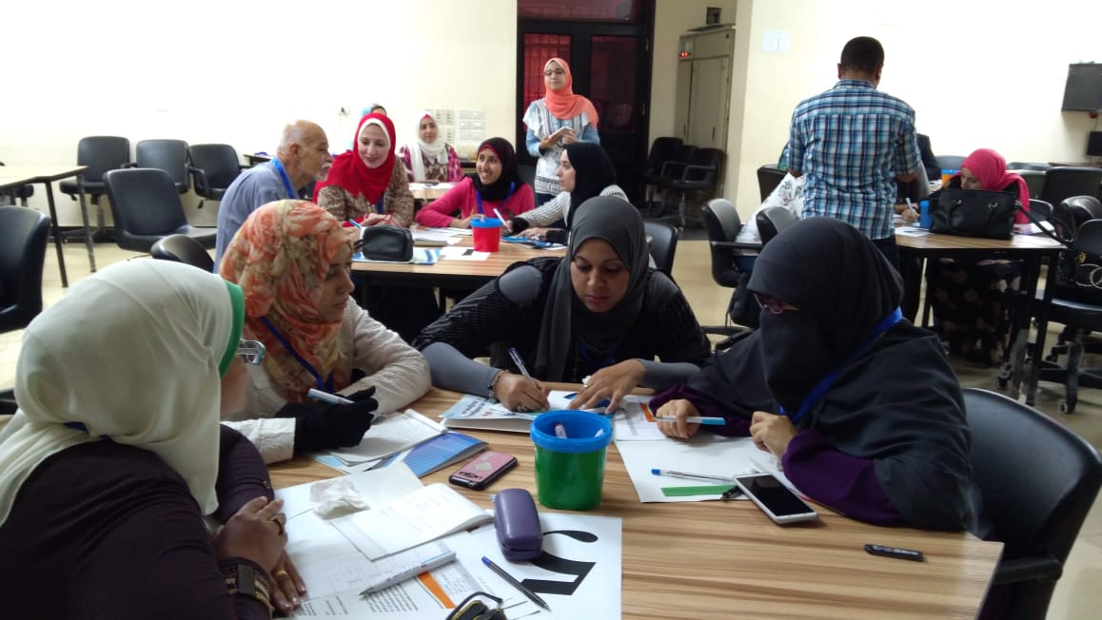
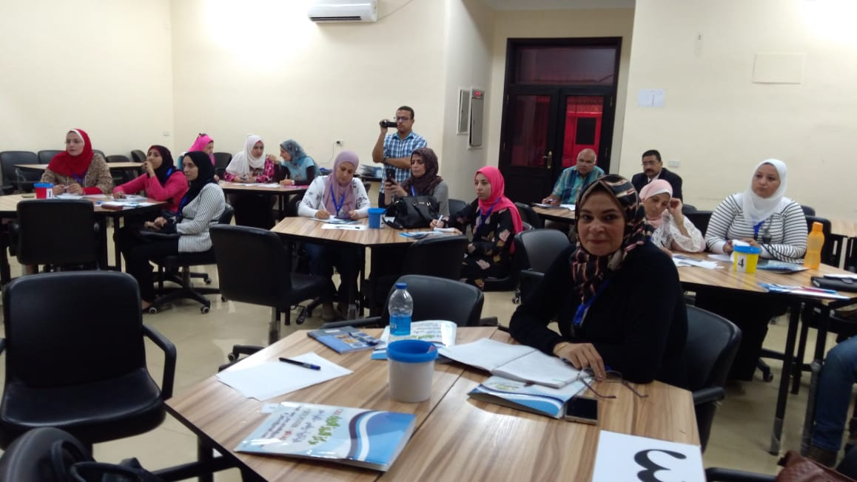
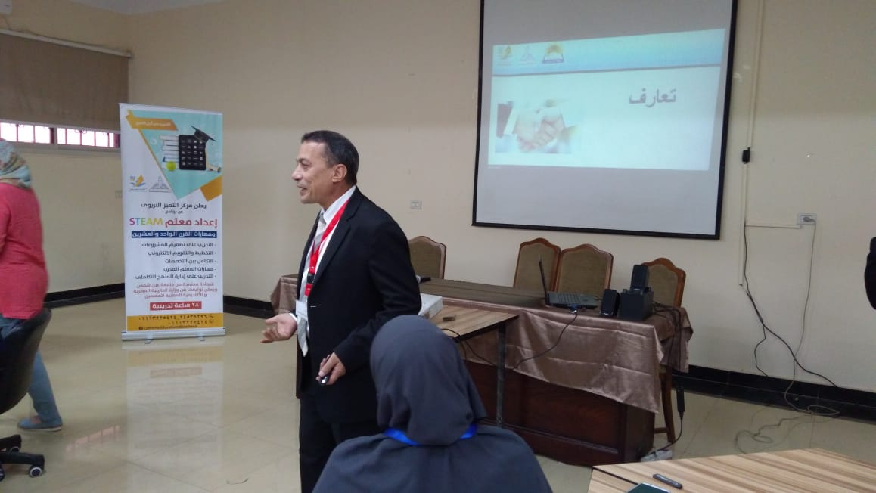
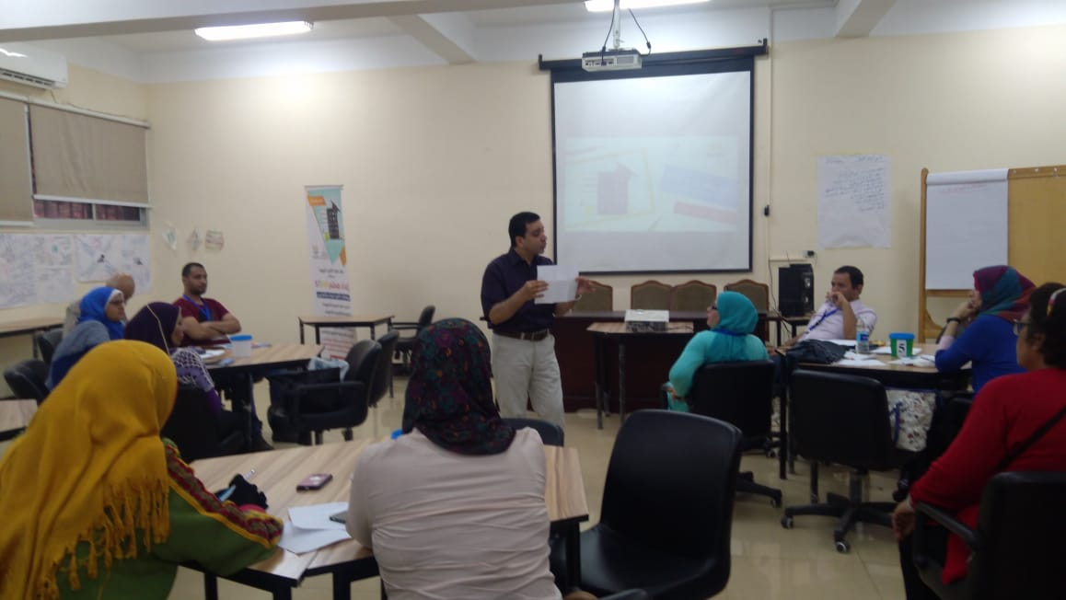

Slide 13
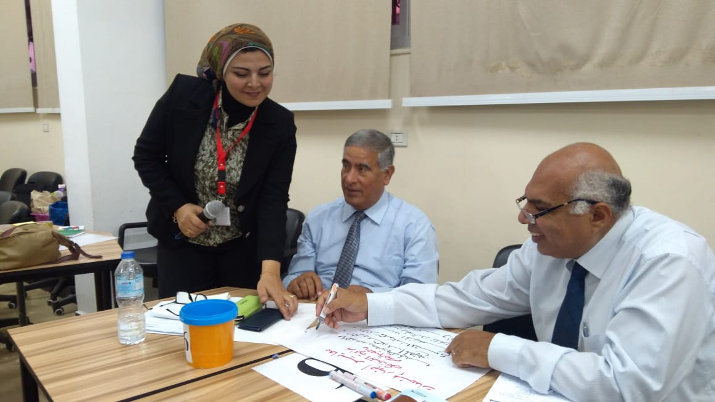
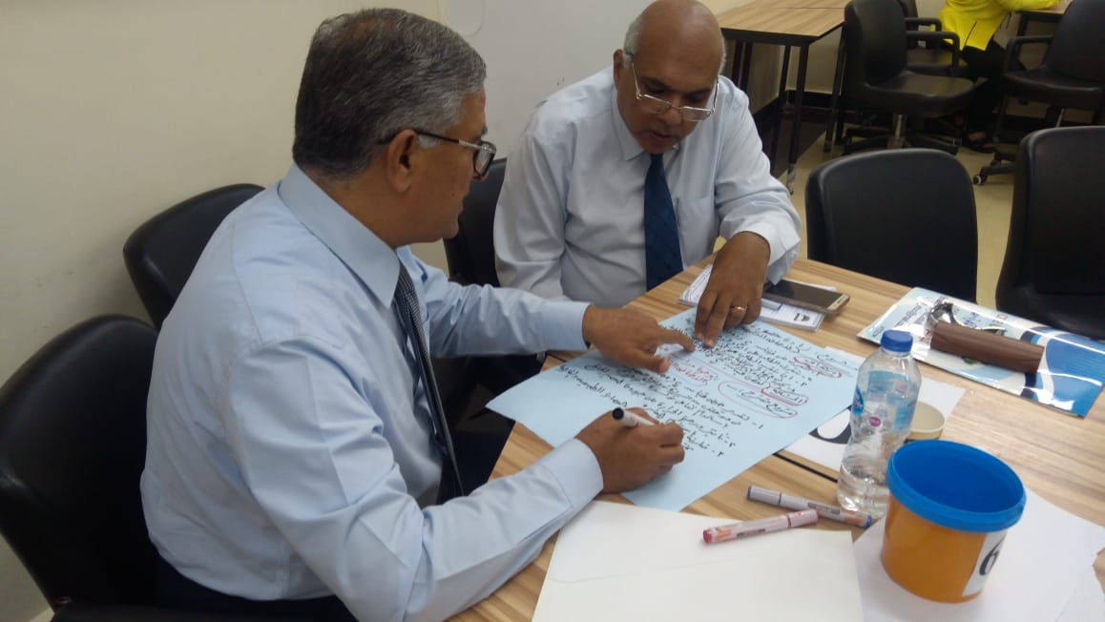
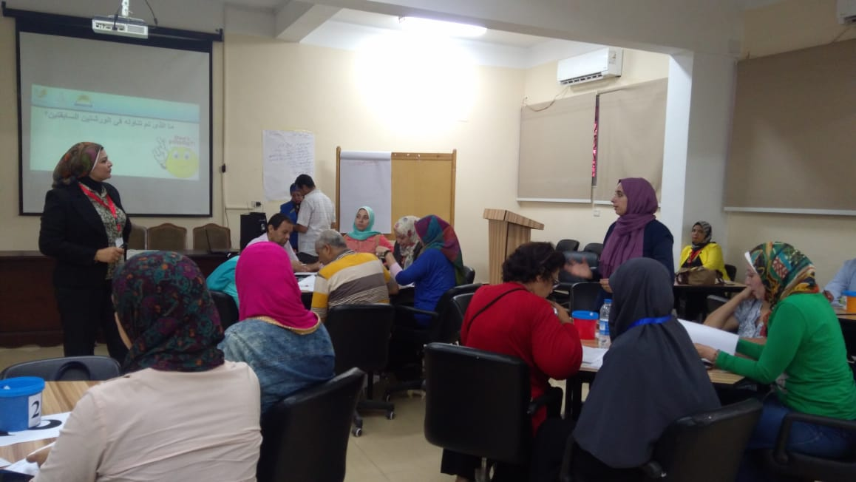
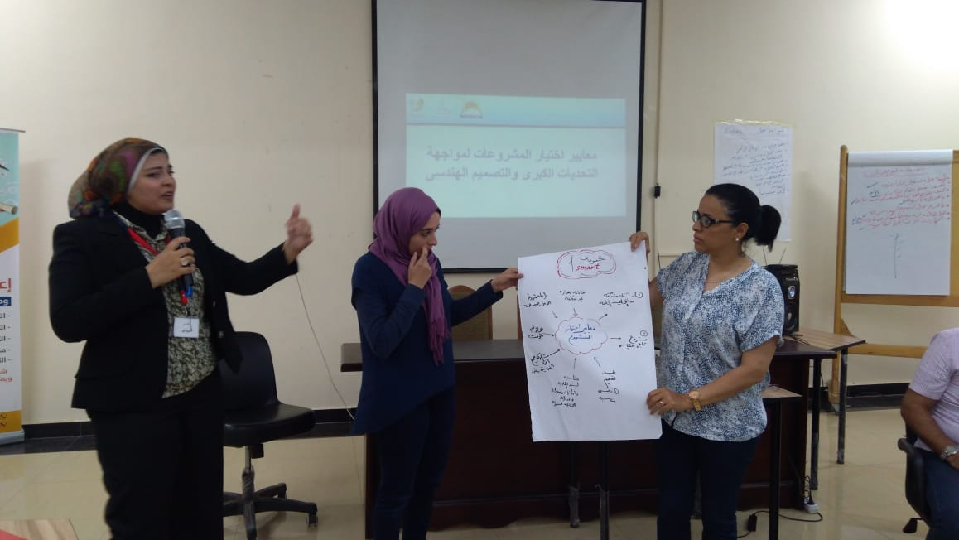
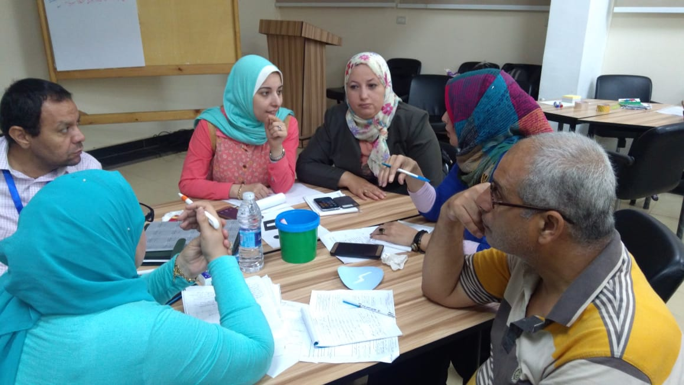
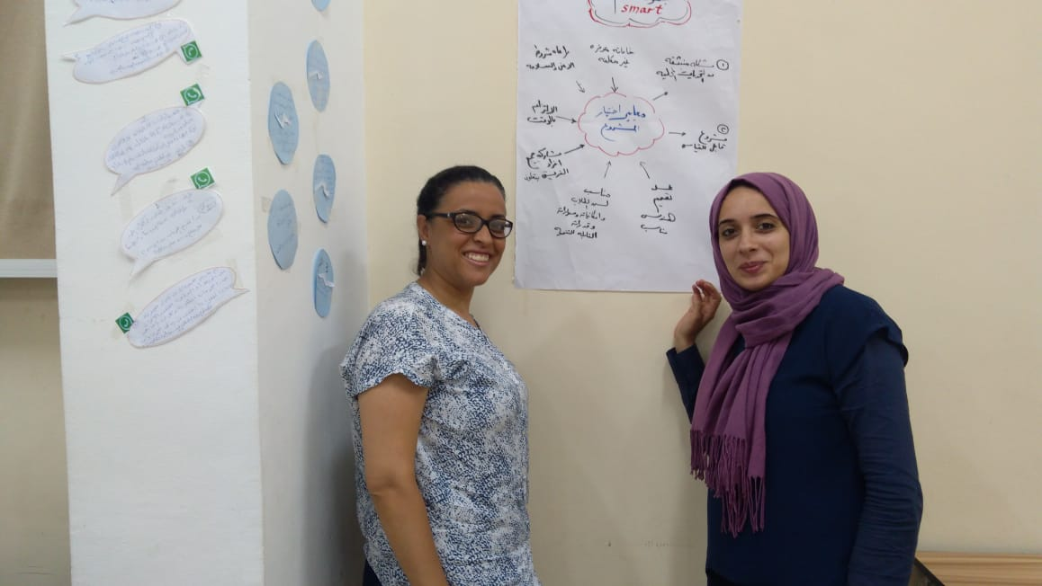

Slide 14
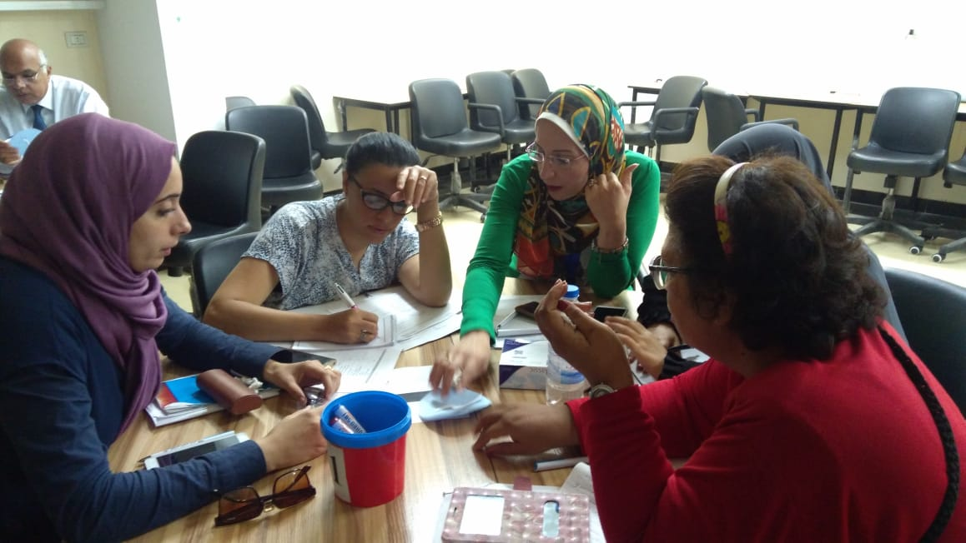
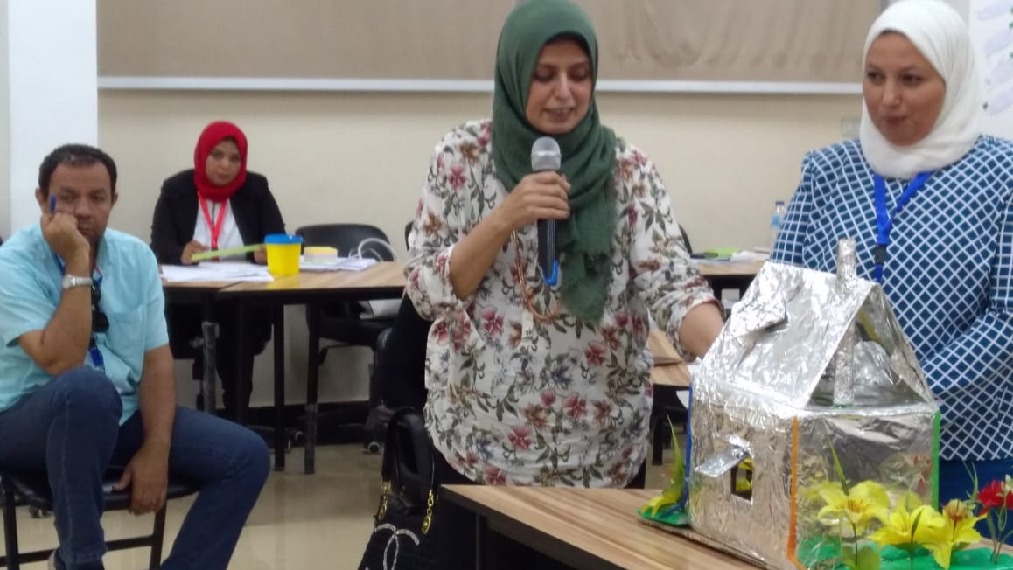
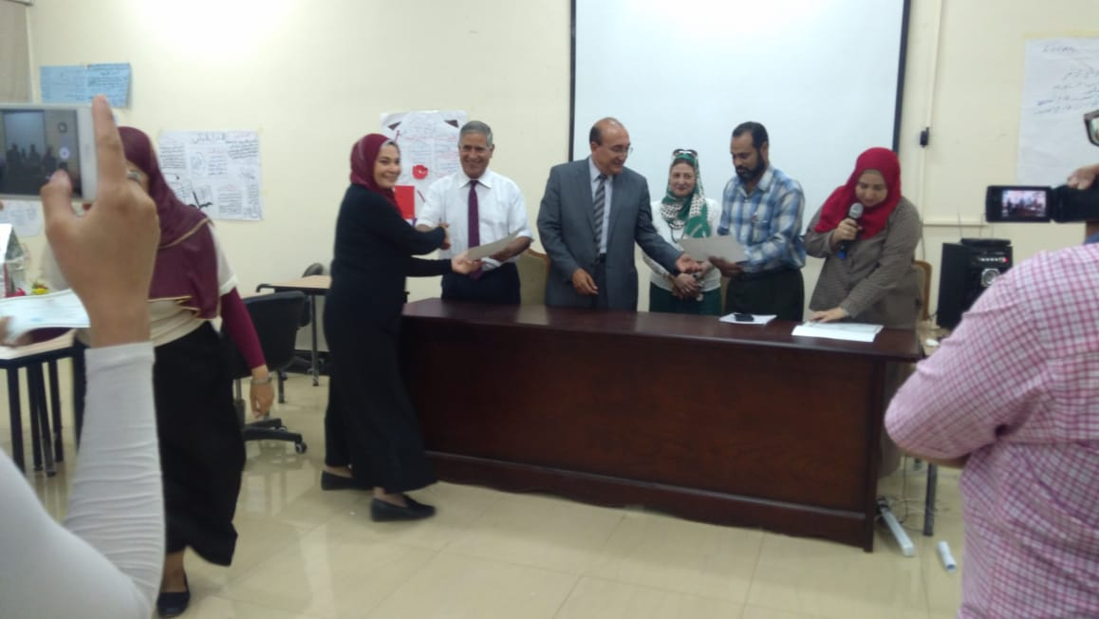
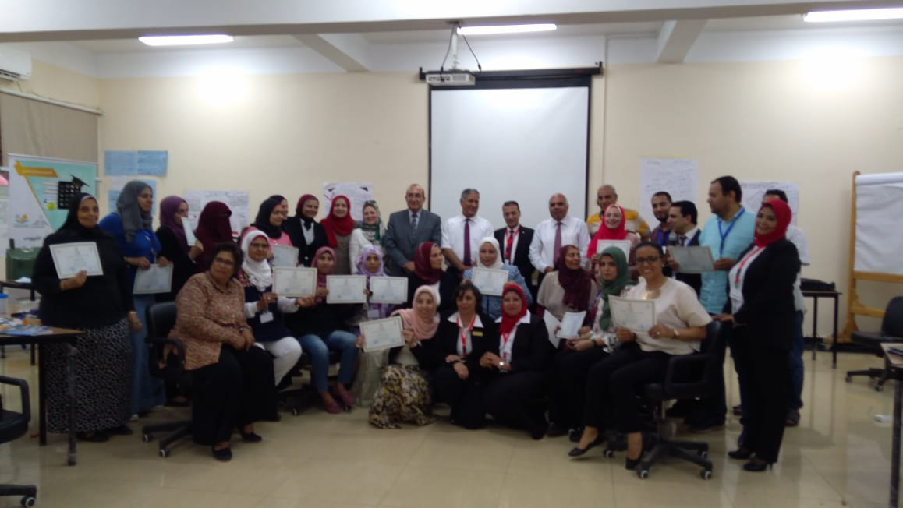
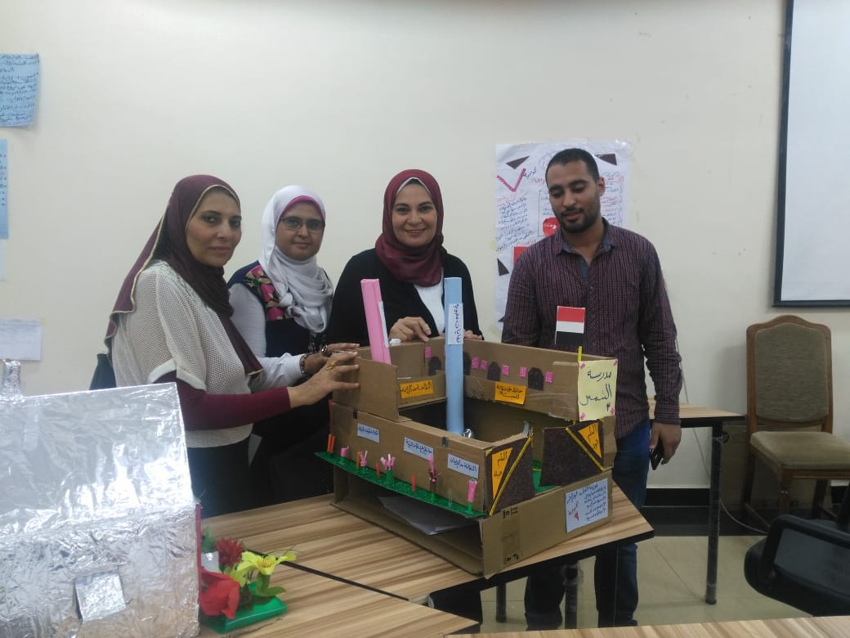
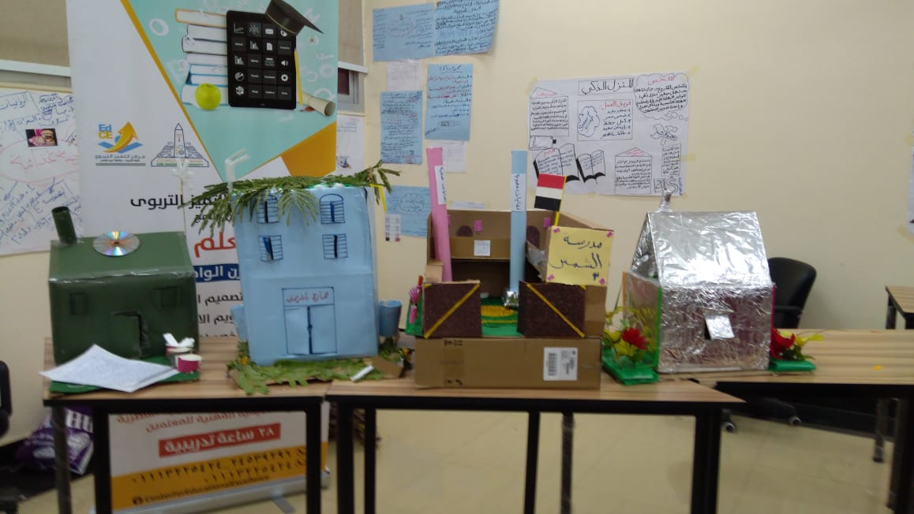
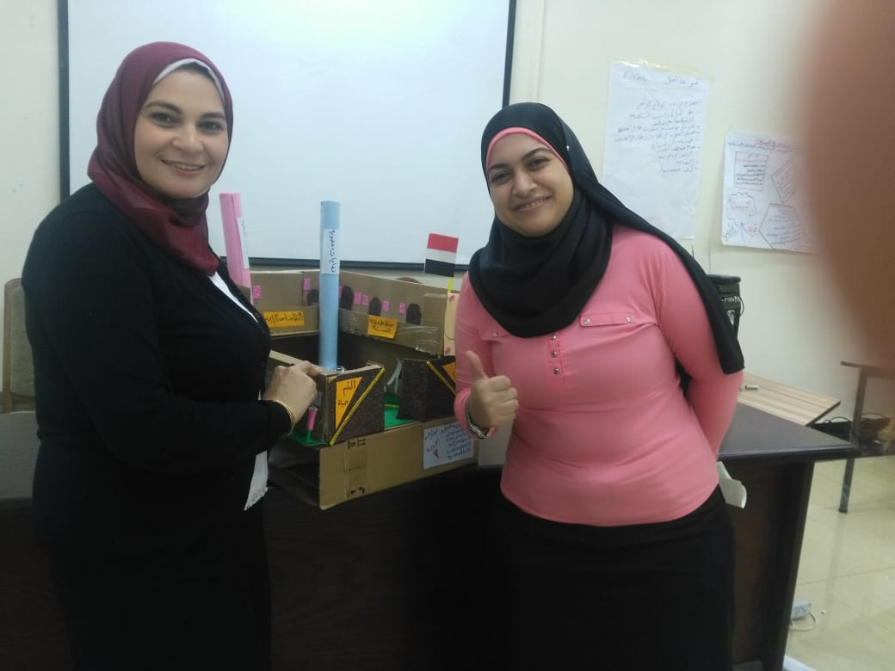

Slide 15

FOE freed the training package in content and practice
Teachers participated with the FOE in training other participants from other schools
Day-1
Day-2
Samples of the produced material

Slide 16

STEAM
Global Citizenship
Sustainable development
Special needs
In Progress
In Progress
In Progress

Slide 17


Leader school
School 1
School 2
School 3
School 4
Draft
Final
For each training package a school will lead the other schools in producing a draft for the training package
The produced draft will be edited many times through face to face workshops and online communication
The final draft produced will be evaluated by an expertise from the project team.

Slide 18


