Slide 1
Project Name:
School and University Partnership for Peer Communities of Learners
(SUP4PCL)
Six^{th} Local Management Meeting
Monday February 4th, 2019
Organized by: The American University in Cairo (AUC), Egypt
Location: Alexandria
This project has been funded with support from the European Commission. This publication [communication] reflects the views only of the author, and the Commission cannot be held responsible for any use which may be made of the information contained therein

Slide 2
School Clusters

Slide 3
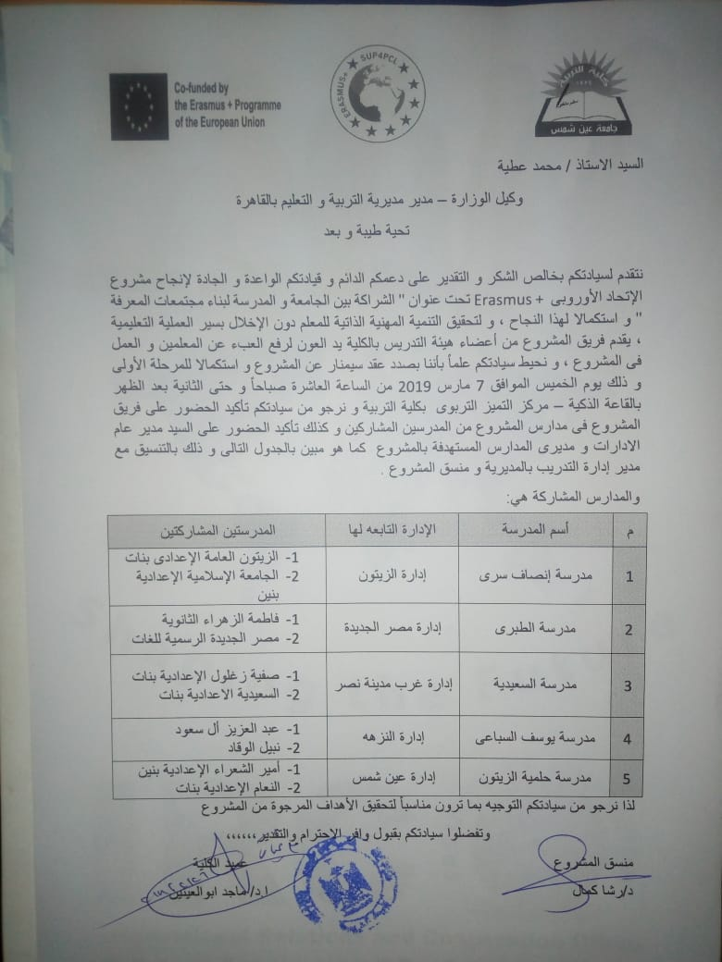
Criteria of clustering & Official approval
Each school selected 2 schools depending on the following criteria (bottom-up)
Reasonably closer to the core school
The school is willing to participate in the project
Eager to exchange ideas with the core school
Eager to improve the quality of its teaching and learning
Having enthusiastic leadership

Slide 4
School clustering Seminar
A seminar will be held at FOE this week (7th March 2019) for launching the activities of school clustering.
The target groups of this seminar are:
Mr. Mohamed Atia, chairman of Directorate of Education in Cairo Governorate.
Prof. Malak Z.
Dean of FOE
The Training unit at Directorate of Education in Cairo Governorate
The 5 core schools participated in the Project
The 10 satellite schools newly joining the project.
15 School principals & Directors of educational departments
FOE team

Slide 5
School clustering Seminar
The proposed Agenda
Time | Activity
10:00-10.30 am | Welcome
10:30-11.00 am | Opening of the project Lab
11:00-11:15 am | Info session about the project (Goals- Themes- Timeline- Outcomes)
11:15-12:30 pm | Experience of the 5 core schools as models (15 min/school)
12:30-01:00 pm | Break
01:00-01:30 pm | Working Groups (Activities of school clustering)
01:30-02:00 pm | Groups Presentations & Discussions
02:00-02:10 pm | Closing & Conclusion

Slide 6
Proposed Lab activities for supporting clustering
A survey will be apply on the teachers of the 15 schools during the seminar of 7 March to detect the most important topics of technology for the participated teachers.
Not important | Neutral | Important | Very important | Suggested topics
 |  |  |  | Using EKB in teaching & Research
 |  |  |  | Advanced tools of Microsoft PowerPoint
 |  |  |  | Using Multimedia in teaching (Image-video-3D models- QR codes)
 |  |  |  | Building and using Infographic in teaching
 |  |  |  | How to create an electronic course
 |  |  |  | Using google or Microsoft forms in electronic assessment and surveys
 |  |  |  | Others (please specify)

Slide 7
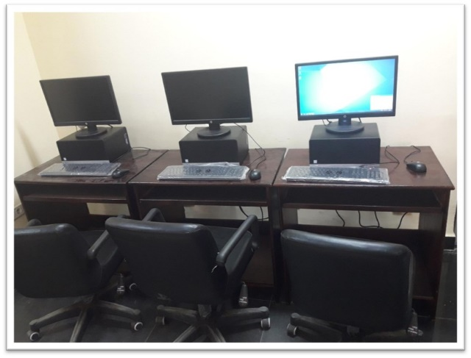
Proposed Lab activities for supporting clustering
A training will be held for each sub-cluster (FOE Mentors + core school+2 satellite schools) on these topics to support the clustering among them
FOE Mentors
Core school
Satalite-1
Satalite-2
Training topics
Project Lab
Sub-cluster

Slide 8


