Slide 1
Project Name:
School and University Partnership for Peer Communities of Learners
(SUP4PCL)
Six^{th} Local Management Meeting
Monday February 4th, 2019
Organized by: The American University in Cairo (AUC), Egypt
Location: Alexandria
This project has been funded with support from the European Commission. This publication [communication] reflects the views only of the author, and the Commission cannot be held responsible for any use which may be made of the information contained therein

Slide 2
Material Development

Slide 3
STEAM
Global Citizenship
Sustainable development
Special needs

Slide 4

Workshop:
Training Package Development
28th November, 2018

Slide 5
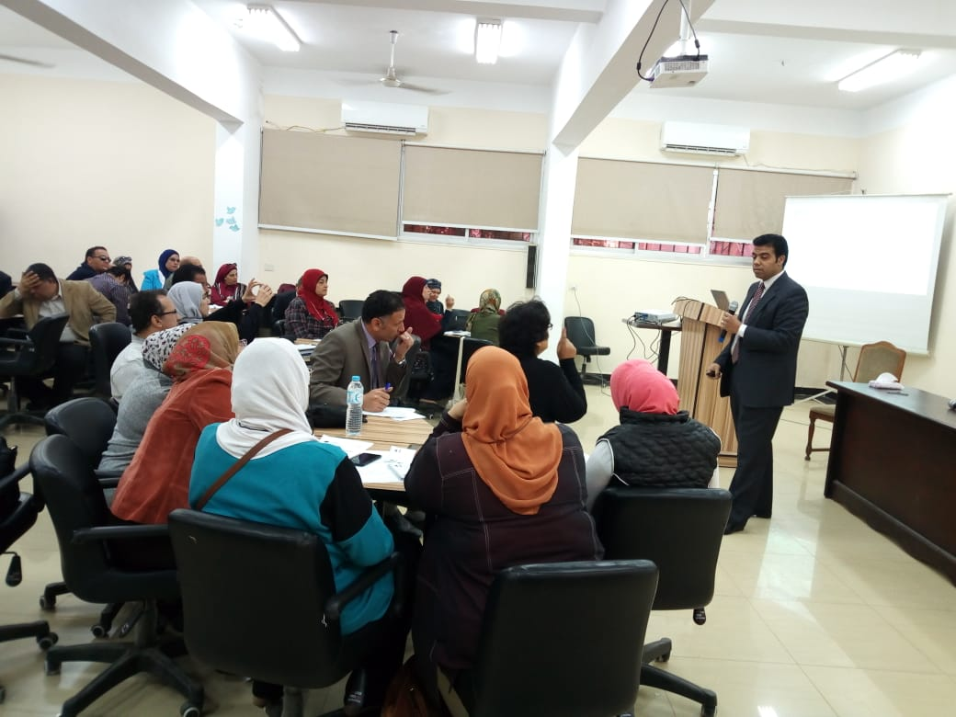
The target groups for this workshop were In-service Teachers participated in SUP4PCL Project and their mentors from FOE.
The trainees were divided into 5 groups according to the themes of the SUP4PCL Project which are: Global Citizenship, STEAM, Sustainable Development, Educational Technology and Special needs.
The methodology of the work during the workshop was as follow: the moderator raised some issues related to the training package development to be discussed among the trainees, then he kept trying to direct them to participate in the discussion in order to share their ideas and experiences relevant to those issues, and then he asked each group to apply what they concluded through the discussion.
The methodology helped the trainees to be more participated in all discussion held on one side, and enabled them to share their experiences and apply all what they learnt in their group cooperatively through their specialization.
Time | Activity
09:00 – 09:15 am | Welcome
09:15-10:15 am | Concept of Training Program Training Program Design.
10:15-12:00 am | Training Package: Concept, Tools and Procedures. Training Package Components
12:00-12:30 pm | Break
12:30-01:30 pm | The process of Training Package Design PAT Criteria for Designing the Training Package.
01:30-02:15 pm | Working Groups
02:15-02:45 pm | Groups Presentations & Discussions
02:45-03:00 pm | Closing & Conclusion

Slide 6
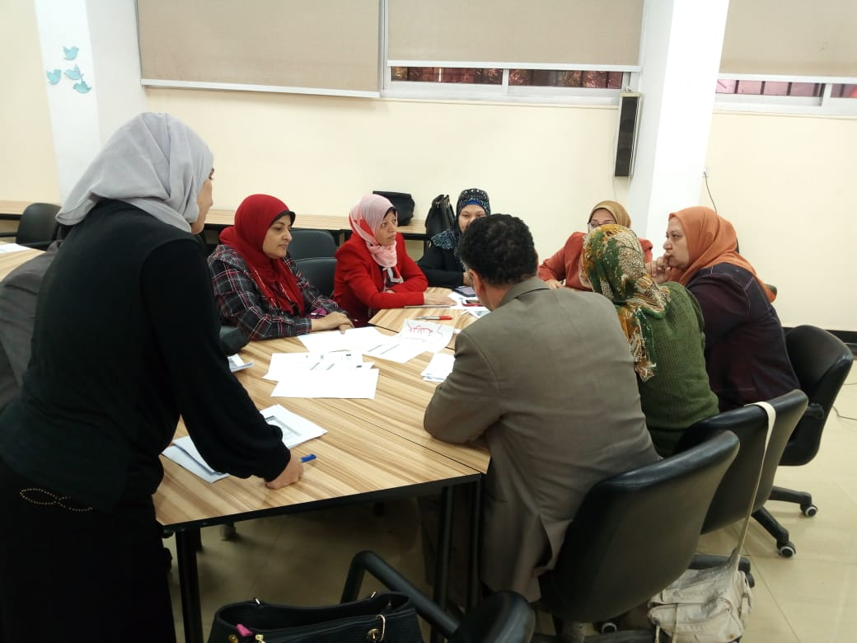
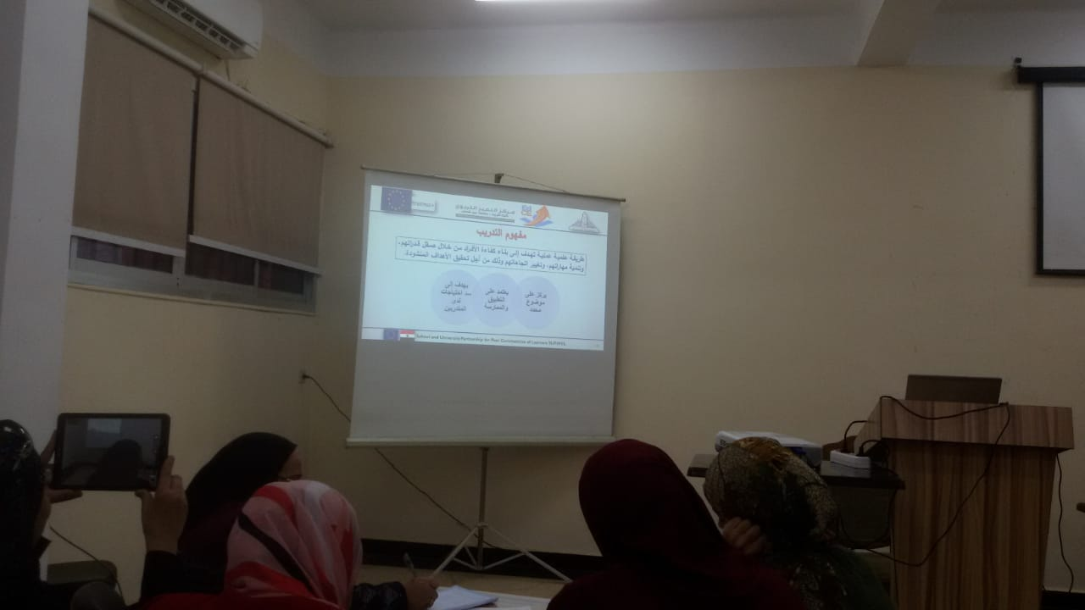
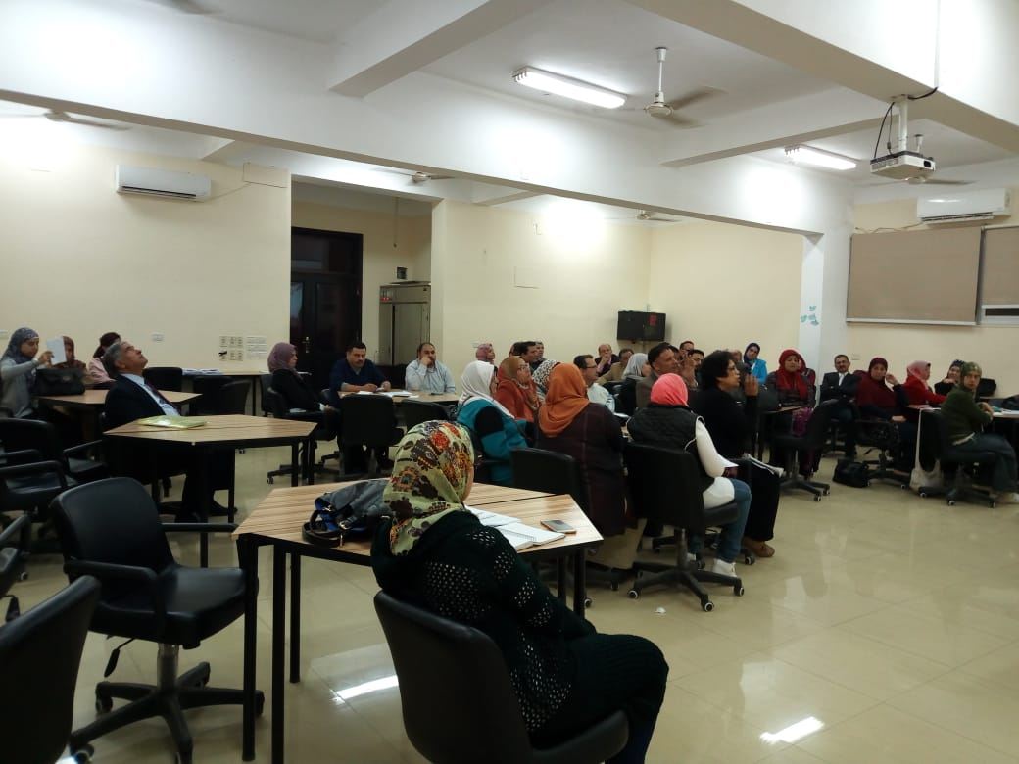
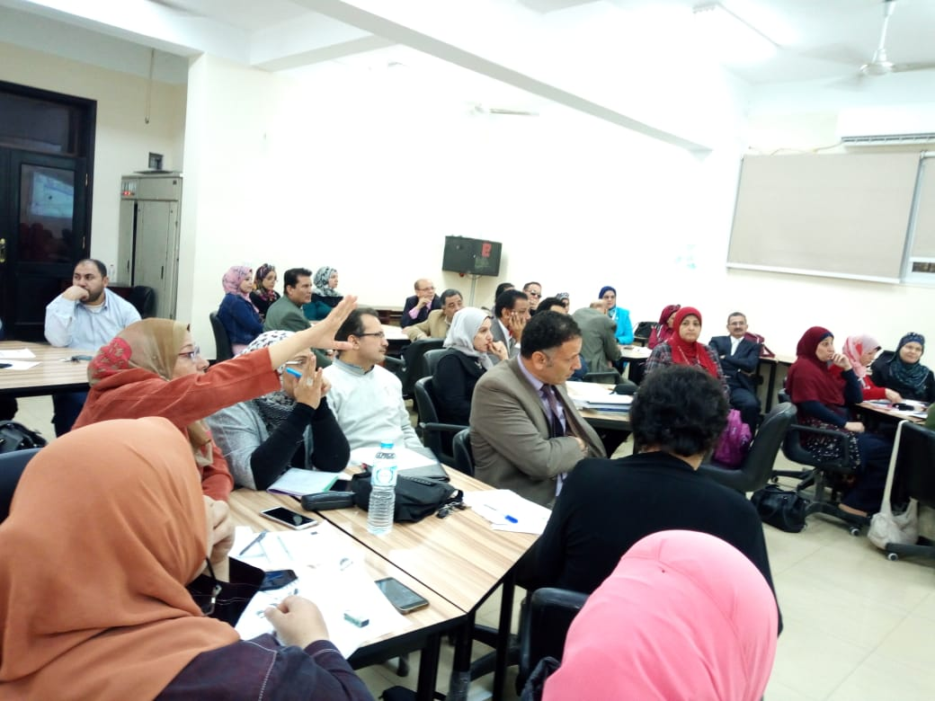

Slide 7
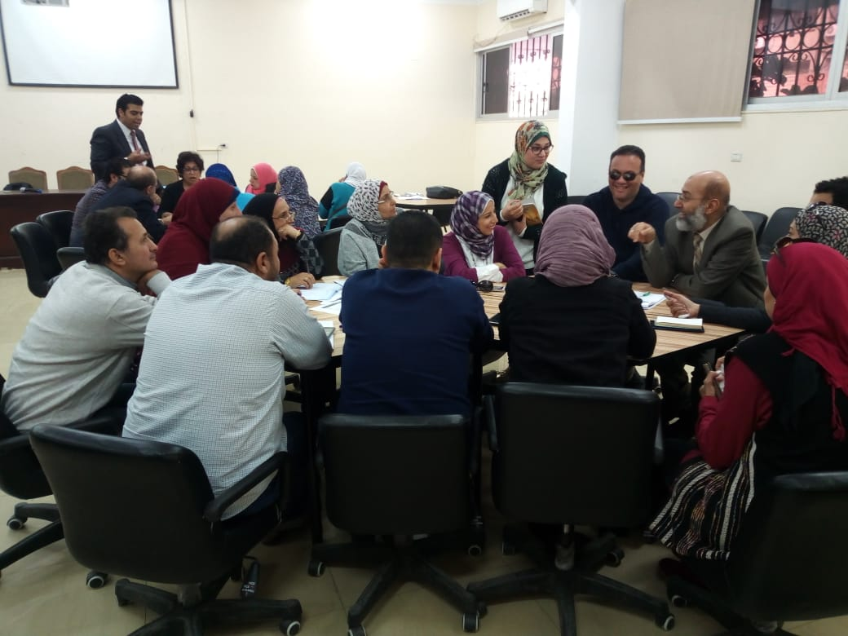
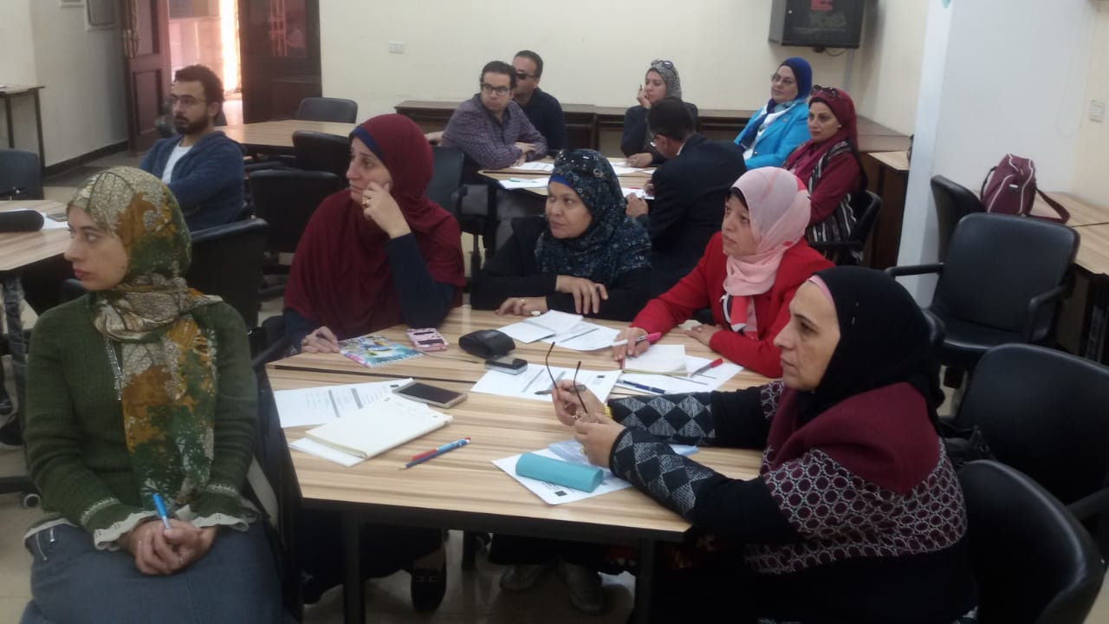
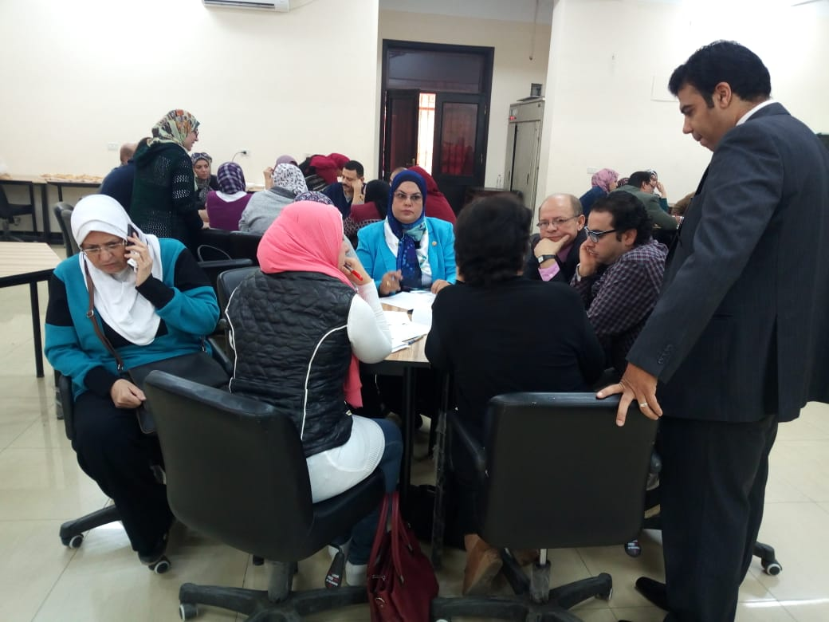
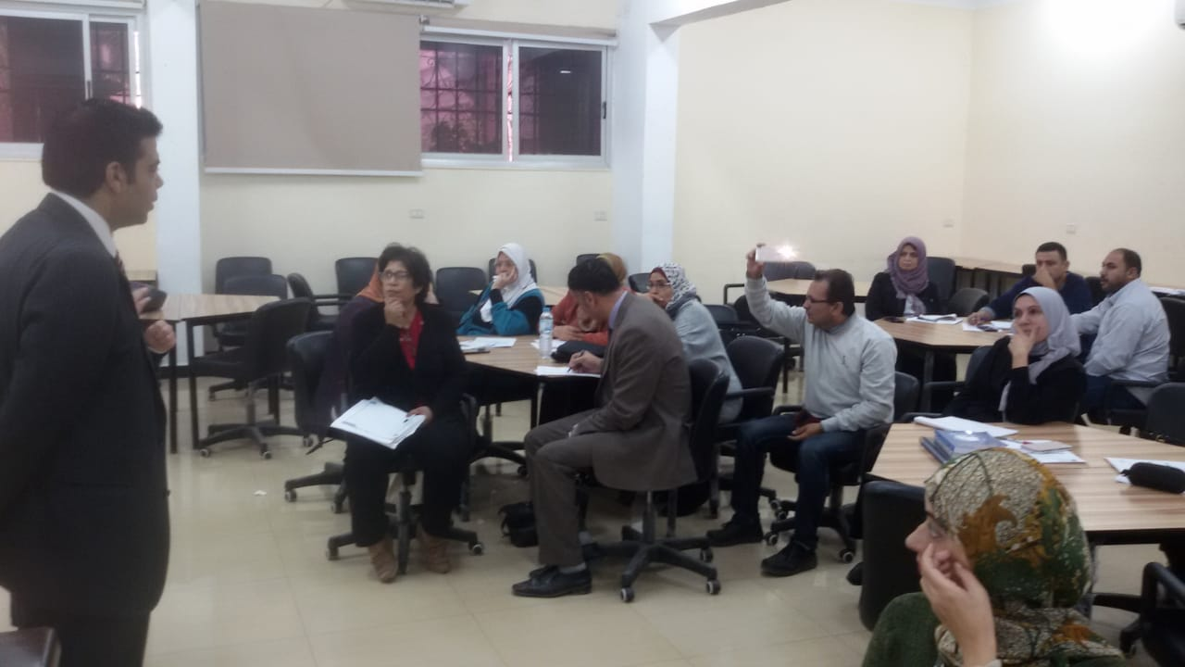

Slide 8
Framework of the training package
Outline
Trainer guide
Trainee guide
Enriching readings
Presentations
Pre and post tests of the whole package
Pre and post tests of each topic
Introduction
Vision & Mission
Philosophy
Components
Main and specific goals
Topics
Target group
Training methods
Duration
Resources and tools
Training Room specifications
Assessment methods
Agenda
Concepts / Terminology

Slide 9



Slide 10

Training package-1:
STEAM

Slide 11

A training entitled: “ Preparation of STEAM teacher and the 21st century skills" for 5 days (30 hours) was held by participation of the training unit in Cairo directorate and 5 Teachers from each core school and their mentors from FOE
This training was sponsored by the center of excellence in education, Ain Shams University.
Through this training the trainees worked together step by step to produce a training package of STEAM.

Slide 12
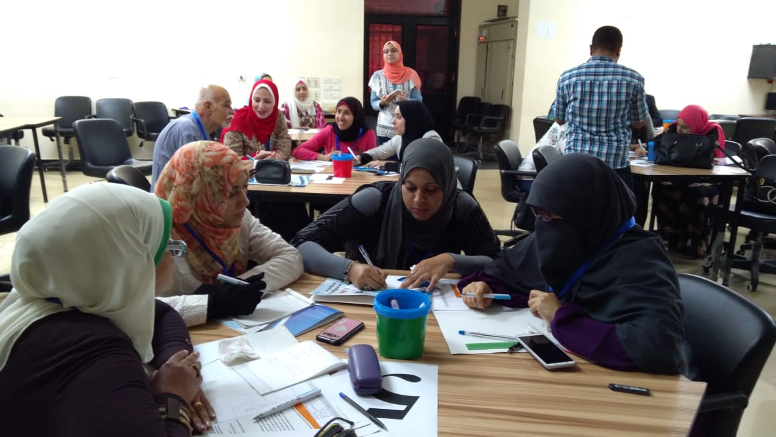
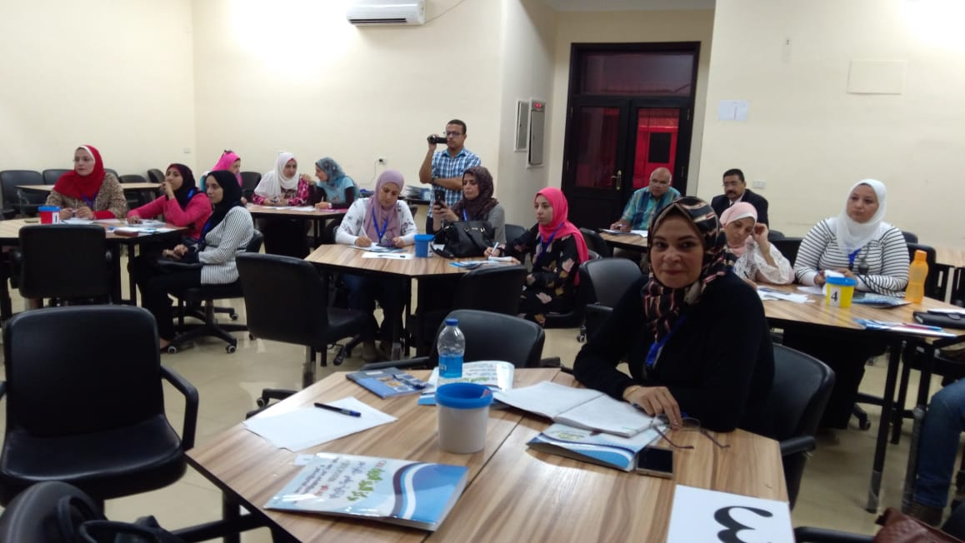
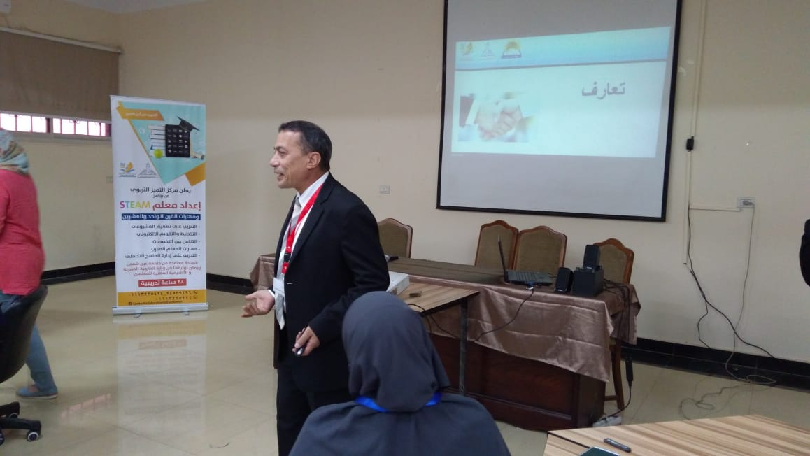
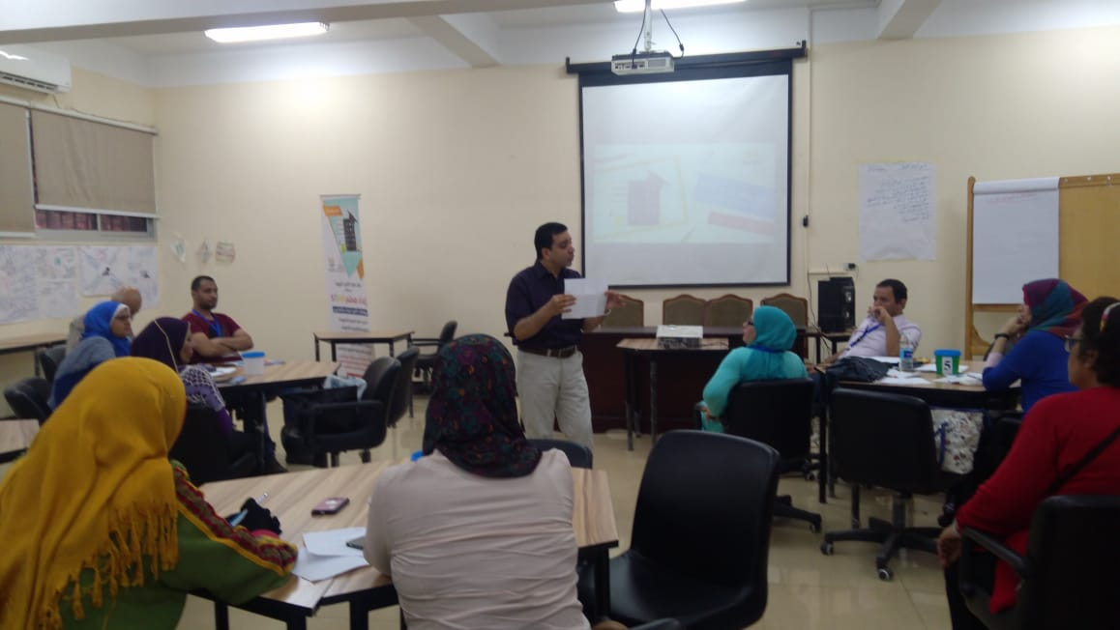

Slide 13
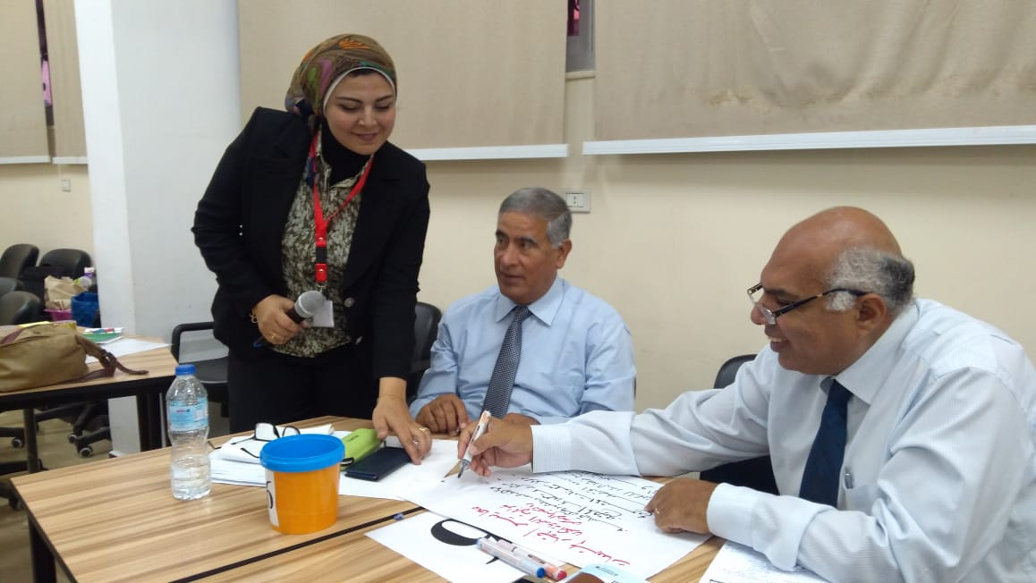
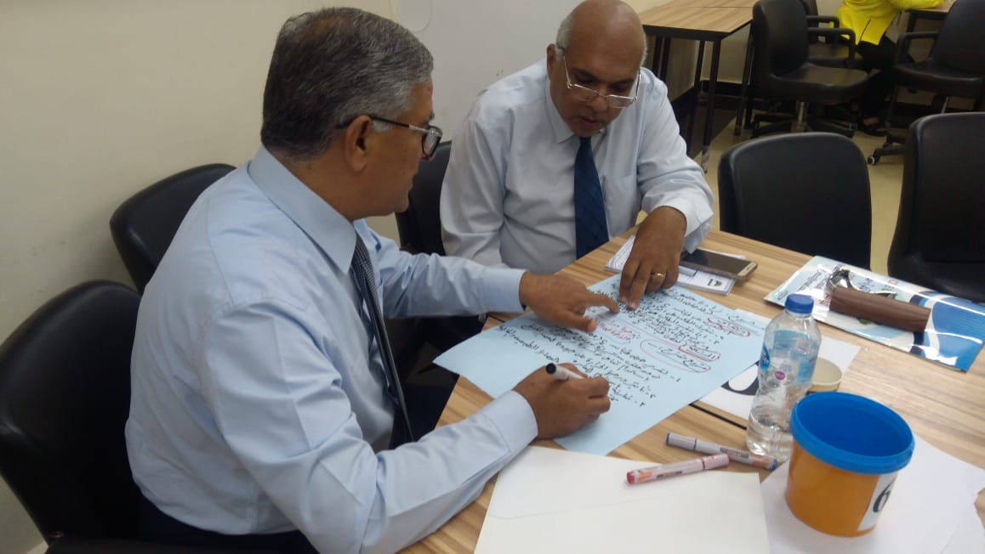
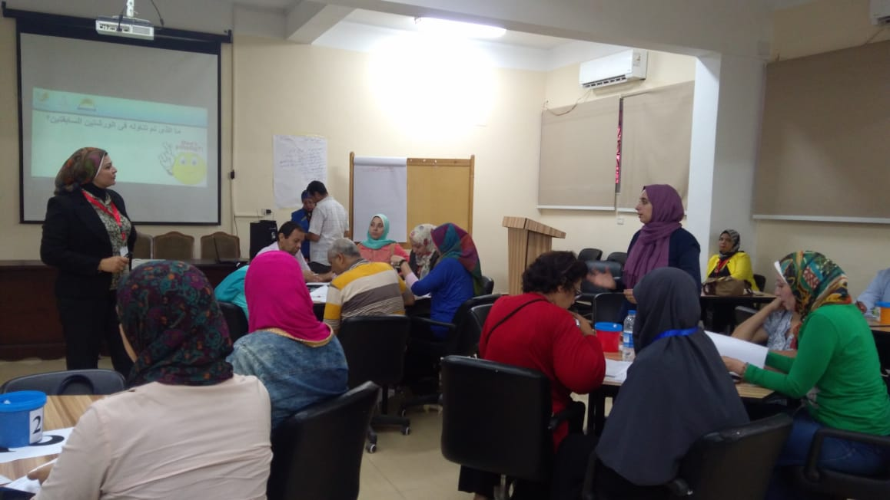
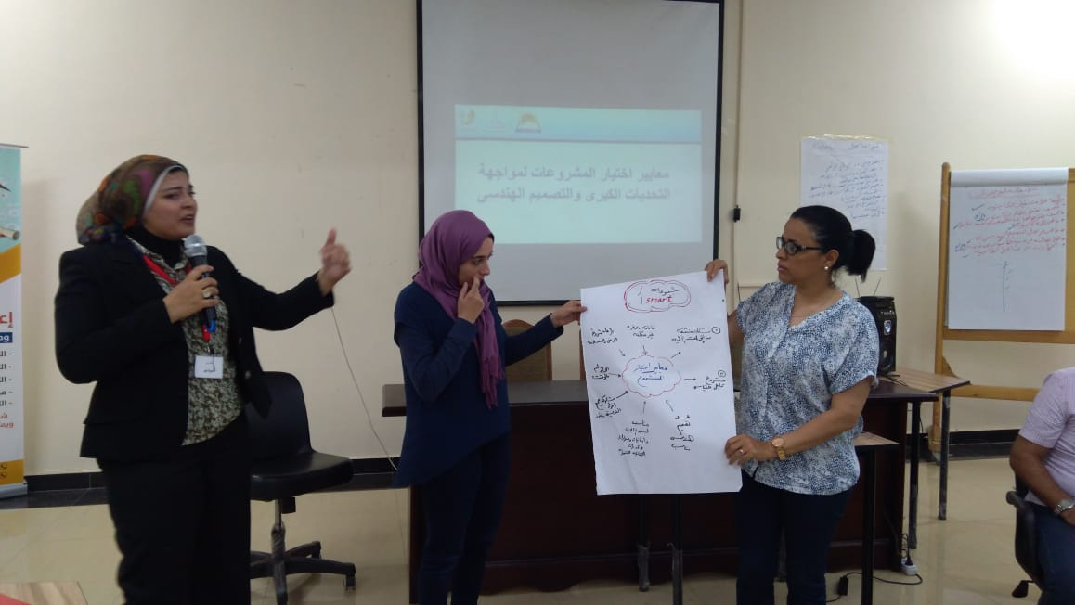
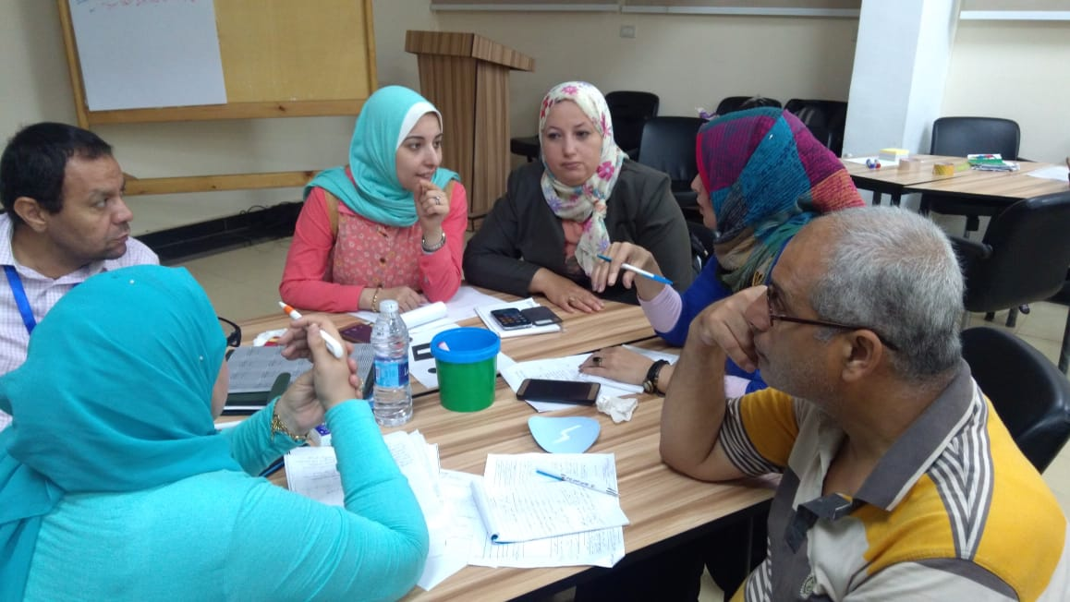
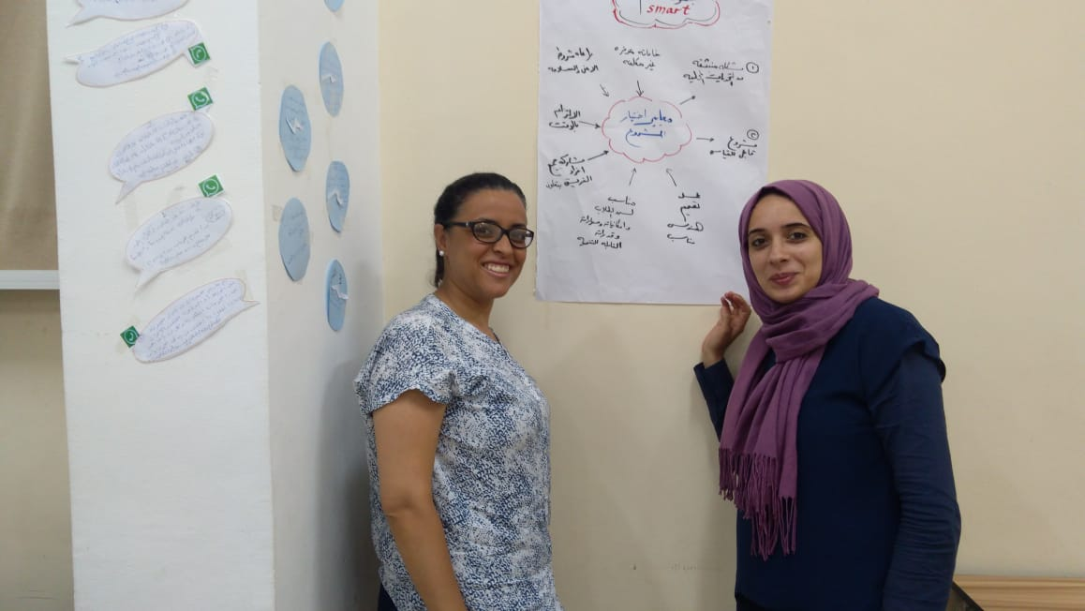

Slide 14
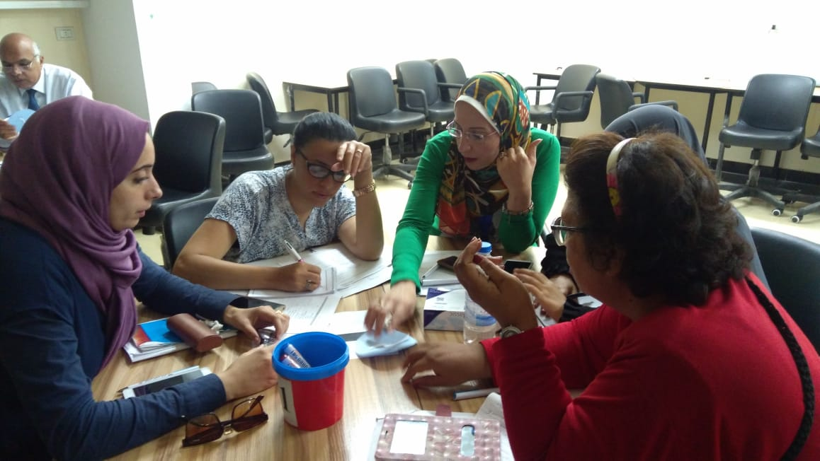
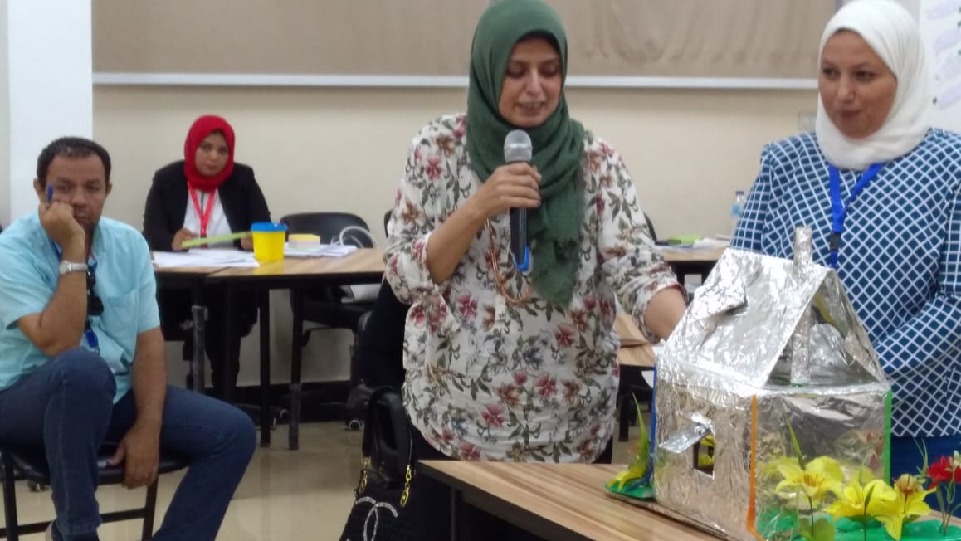
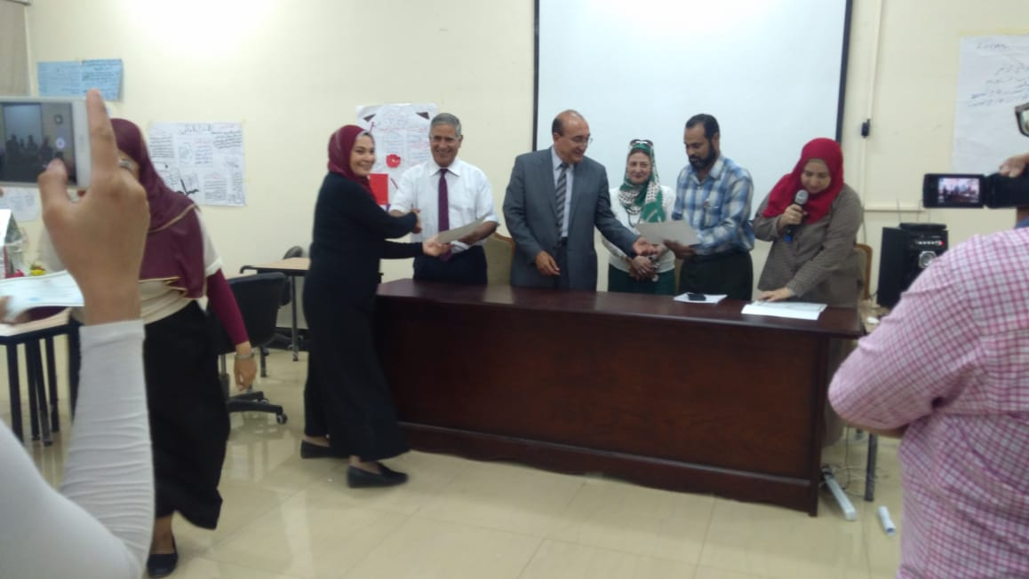
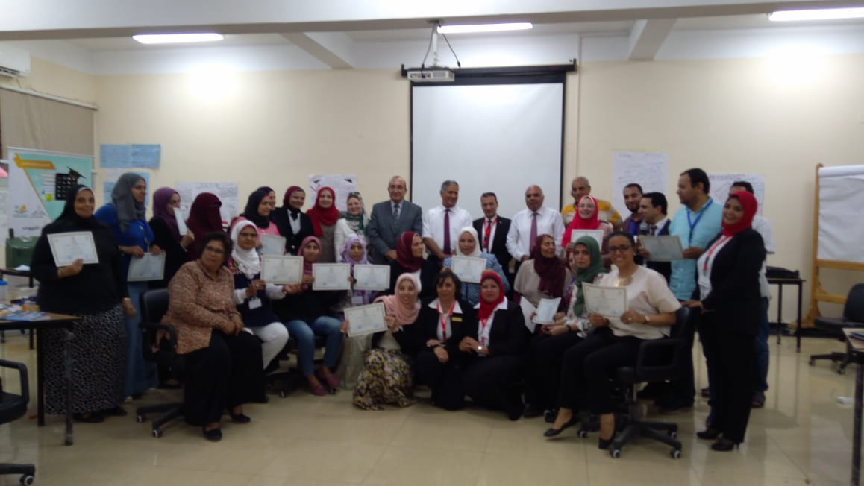
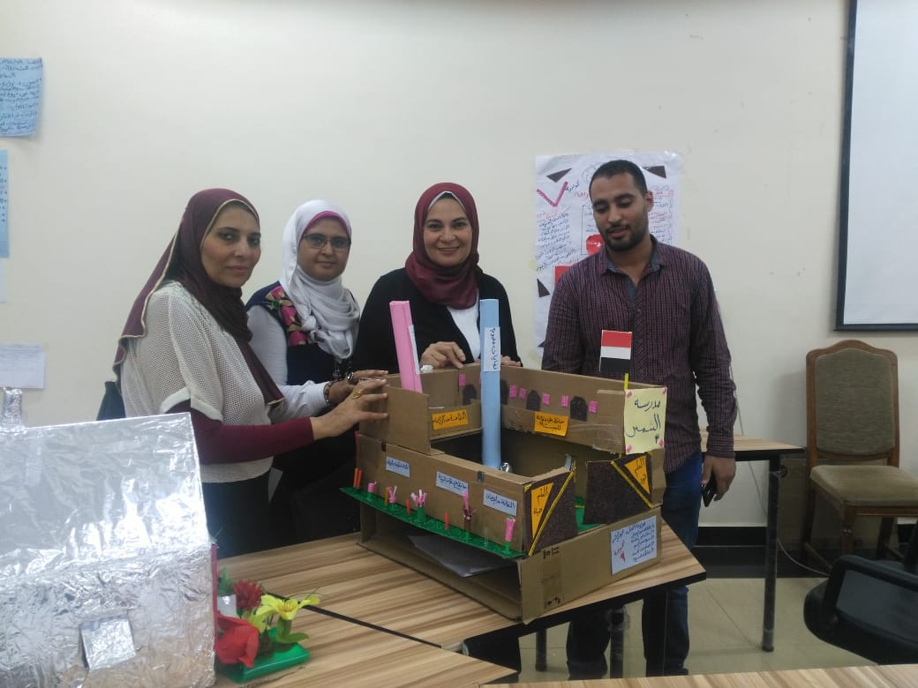
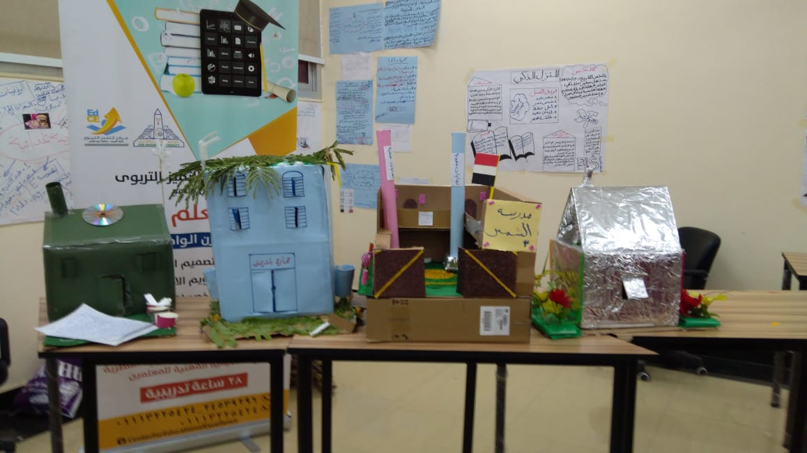
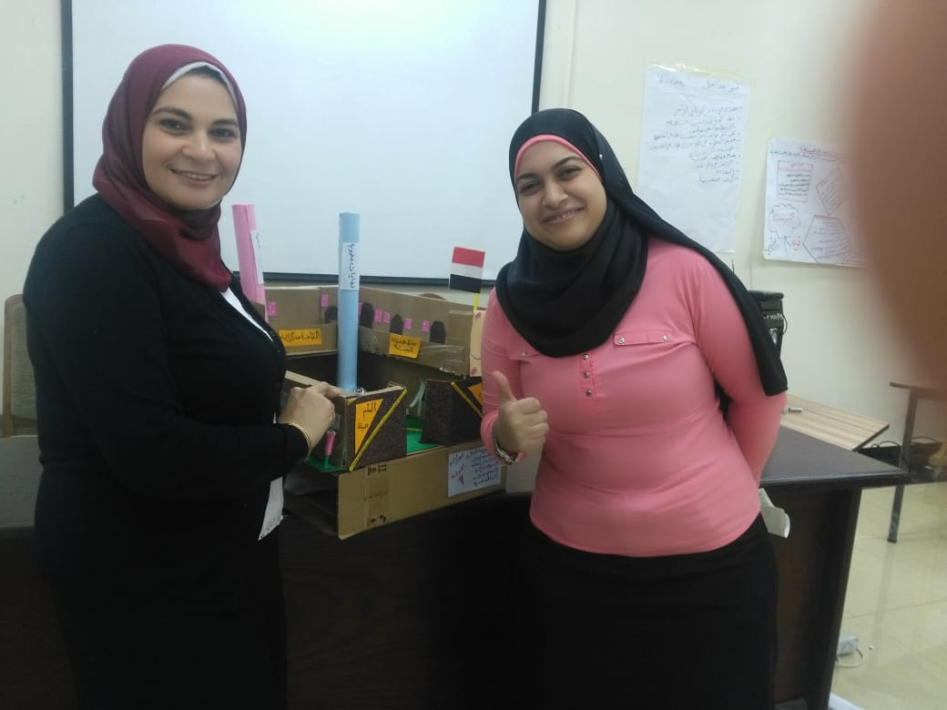

Slide 15

FOE freed the training package in content and practice
Teachers participated with the FOE in training other participants from other schools
Day-1
Day-2
Samples of the produced material

Slide 16

STEAM
Global Citizenship
Sustainable development
Special needs
In Progress
In Progress
In Progress

Slide 17


Leader school
School 1
School 2
School 3
School 4
Draft
Final
For each training package a school will lead the other schools in producing a draft for the training package
The produced draft will be edited many times through face to face workshops and online communication
The final draft produced will be evaluated by an expertise from the project team.

Slide 18
School Clusters

Slide 19
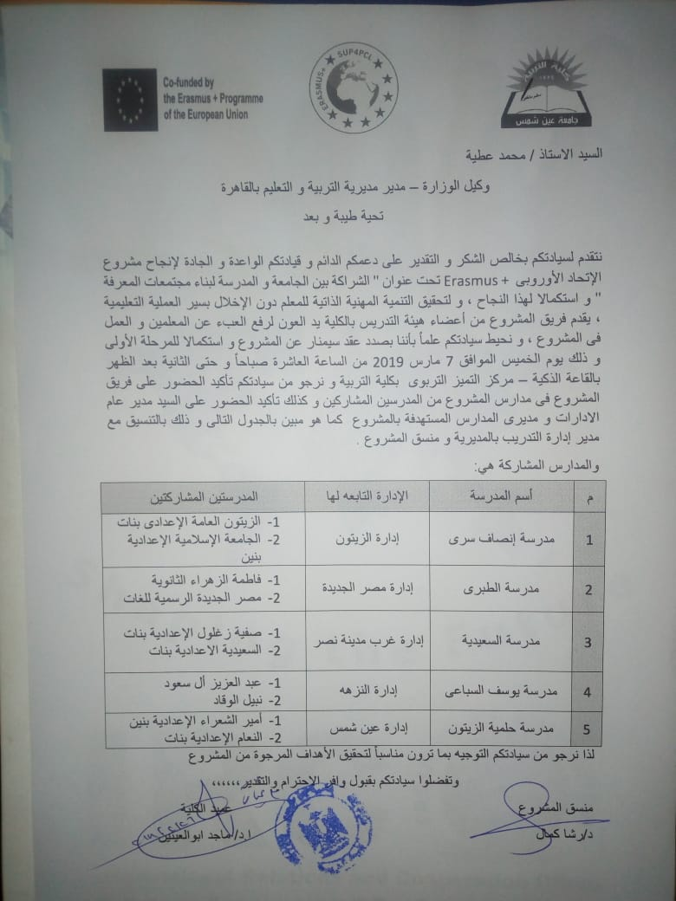
Criteria of clustering & Official approval
Each school selected 2 schools depending on the following criteria (bottom-up)
Reasonably closer to the core school
The school is willing to participate in the project
Eager to exchange ideas with the core school
Eager to improve the quality of its teaching and learning
Having enthusiastic leadership

Slide 20
School clustering Seminar
A seminar will be held at FOE this week (7th March 2019) for launching the activities of school clustering.
The target groups of this seminar are:
Mr. Mohamed Atia, chairman of Directorate of Education in Cairo Governorate.
Prof. Malak Z.
Dean of FOE
The Training unit at Directorate of Education in Cairo Governorate
The 5 core schools participated in the Project
The 10 satellite schools newly joining the project.
15 School principals & Directors of educational departments
FOE team

Slide 21
School clustering Seminar
The proposed Agenda
Time | Activity
10:00-10.30 am | Welcome
10:30-11.00 am | Opening of the project Lab
11:00-11:15 am | Info session about the project (Goals- Themes- Timeline- Outcomes)
11:15-12:30 pm | Experience of the 5 core schools as models (15 min/school)
12:30-01:00 pm | Break
01:00-01:30 pm | Working Groups (Activities of school clustering)
01:30-02:00 pm | Groups Presentations & Discussions
02:00-02:10 pm | Closing & Conclusion

Slide 22
Proposed Lab activities for supporting clustering
A survey will be apply on the teachers of the 15 schools during the seminar of 7 March to detect the most important topics of technology for the participated teachers.
Not important | Neutral | Important | Very important | Suggested topics
 |  |  |  | Using EKB in teaching & Research
 |  |  |  | Advanced tools of Microsoft PowerPoint
 |  |  |  | Using Multimedia in teaching (Image-video-3D models- QR codes)
 |  |  |  | Building and using Infographic in teaching
 |  |  |  | How to create an electronic course
 |  |  |  | Using google or Microsoft forms in electronic assessment and surveys
 |  |  |  | Others (please specify)

Slide 23
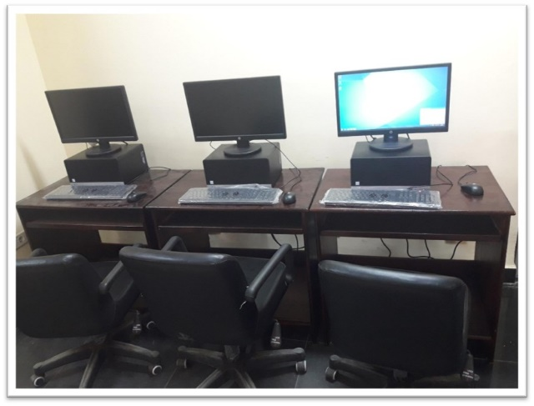
Proposed Lab activities for supporting clustering
A training will be held for each sub-cluster (FOE Mentors + core school+2 satellite schools) on these topics to support the clustering among them
FOE Mentors
Core school
Satalite-1
Satalite-2
Training topics
Project Lab
Sub-cluster

Slide 24
Progress of Research

Slide 25
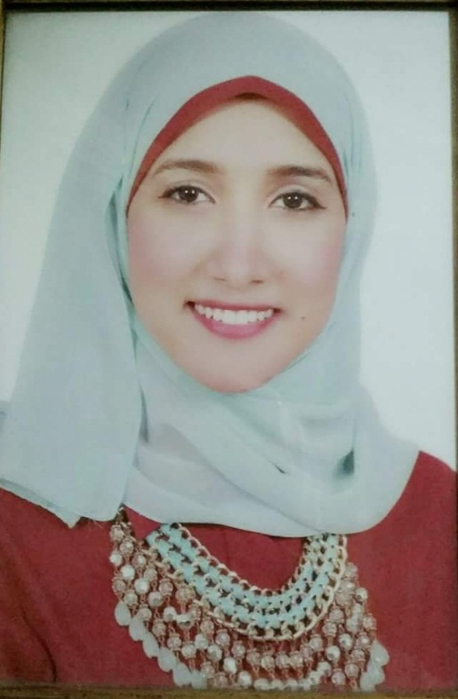
MA Student
Alaa is graduated from faculty of education "English department" at Ain shams University. Her general estimate is very good with honor, May 2015. She is working now as a demonstrator at EFL curriculum and instructions department (faculty of Education –Ain shams University).she also worked as an English instructor at Future University in Egypt (FUE), an English instructor at CEDLT at faculty of education, Ain shams University and an English teacher at St. Fatima Language School in Cairo. She is very interested in Conducting her research about PLC as a new culture of work to improve the communication skills of the English Teachers. This MA will be co supervised between a professor at the EFL Curriculum and Instructions Department ASU and a professor at University of Limerick.
Suggested Title of the Research:
" The Effectiveness of PLC Approach to improve Communication Skills of English Teachers"

Slide 26
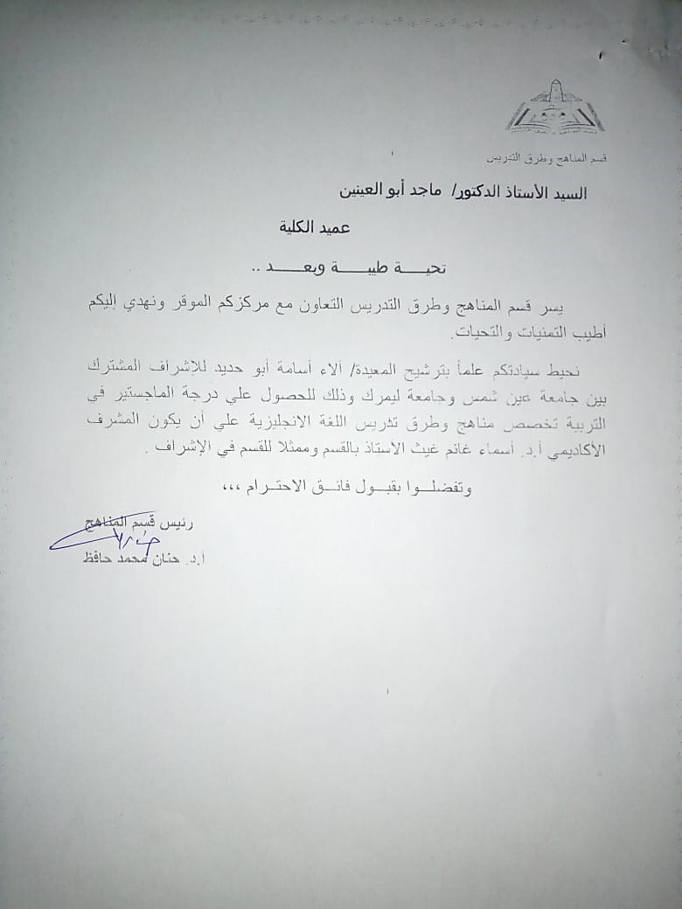

Slide 27

The scientific Magazine of Helmyet El-zaytoun
The idea of this magazine was originated by some teachers participating in the Project.
They discussed this idea through successive meetings by participation of FOE mentors.
A draft for the school magazine was postulated and developed many times until reaching the current final form including:
Structure of the magazine
Editorial board
Criteria of the published articles

Slide 28
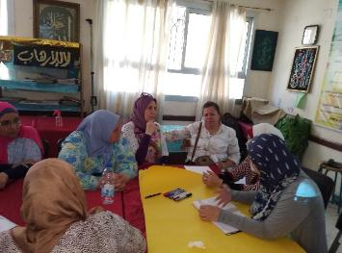
Agreement on the journal cover
Dividing the journal parts into (psycho-social, educational and scientific).
Assigning fixed parts of the journal.
One of them will be titled Helmyet El Zaytoun mail, this part will discuss problems related to teachers and students and how they have been solved.
Another part will be titled I am distinguished in, this part will introduce anyone who has done a remarkable job or provided service to the community or the school. This part is Encouraging and motivating for anyone who has done something distinct.

Slide 29
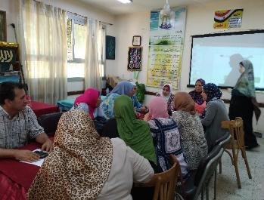
A number of topics were proposed for the first issue:
Questions about the implementation of the tablet system in the new secondary school system.
Chemical industries
How to study languages
A meeting with the top secondary school students
Field trips

Slide 30

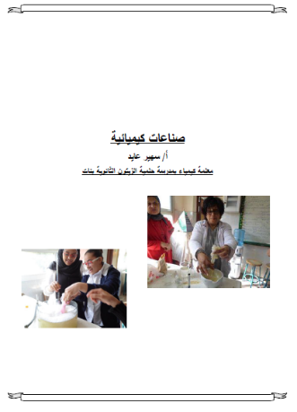

Article-2
Article-1
Introduction

Slide 31
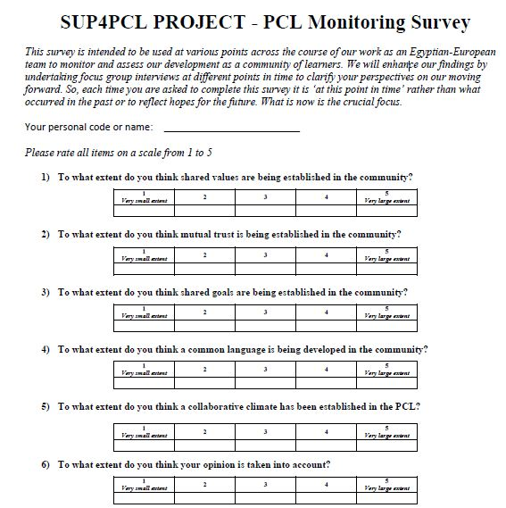
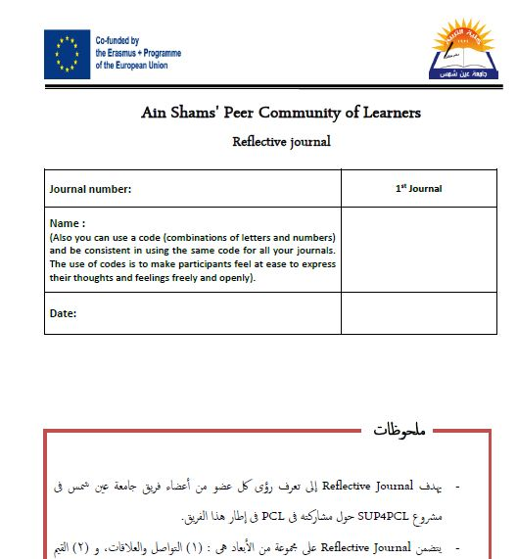
PCL development tools (Printed version)
PCL Monitoring Survey
Reflective Journal Entry

Slide 32
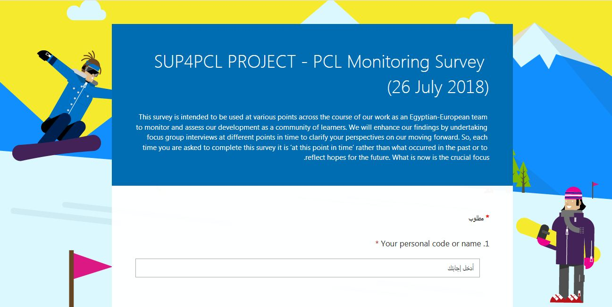
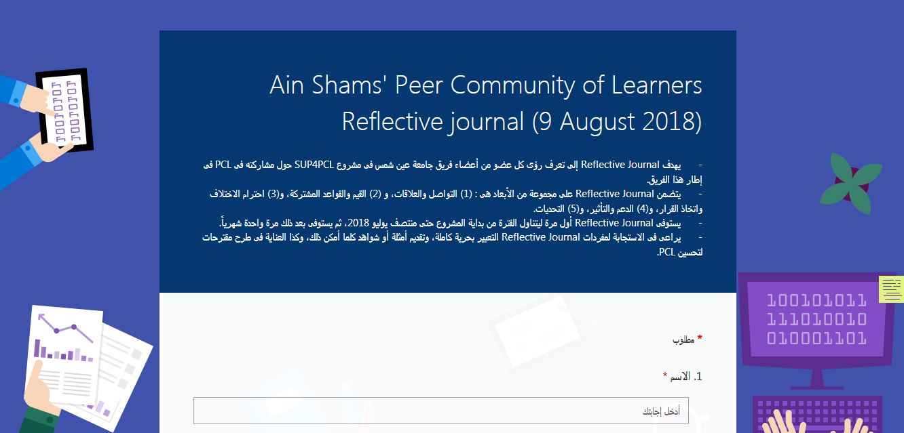
PCL development tools (electronic version)
PCL Monitoring Survey
Reflective Journal Entry

Slide 33
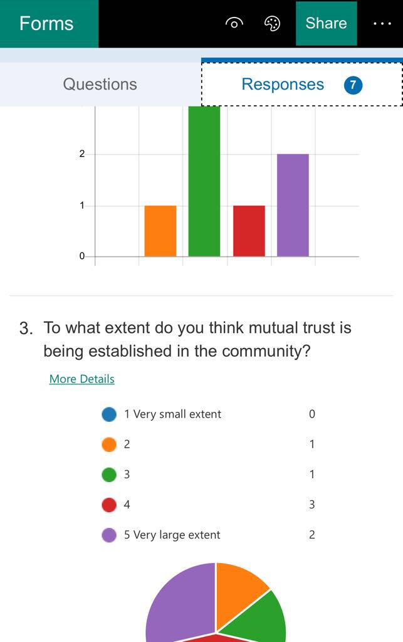
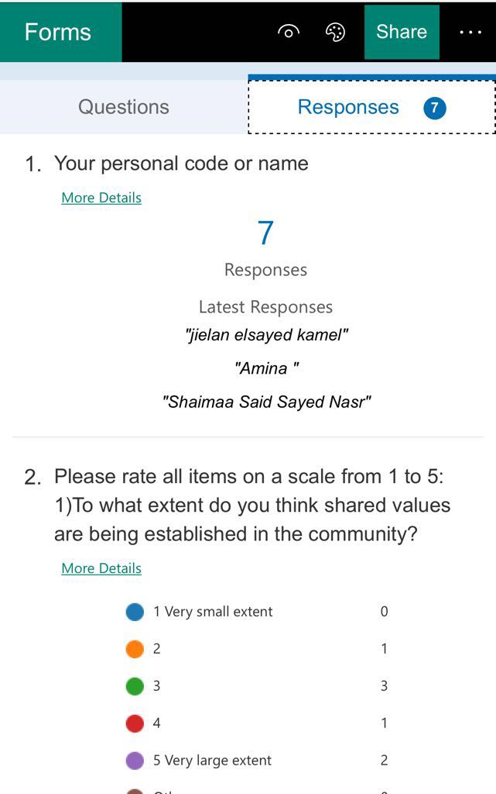
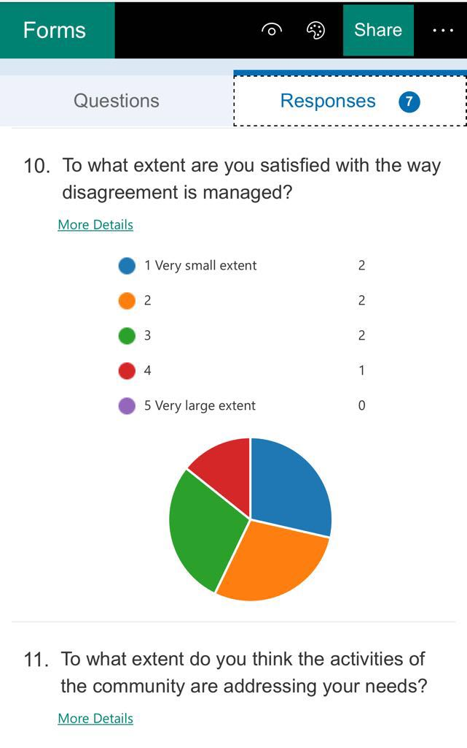
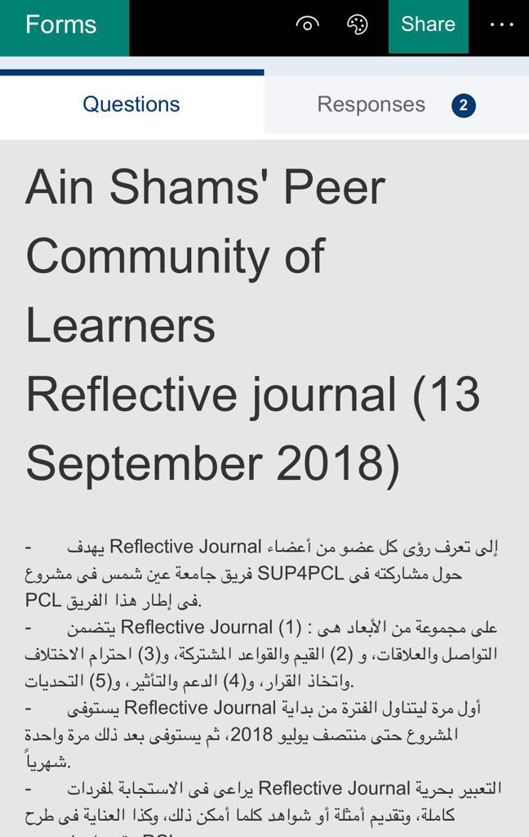
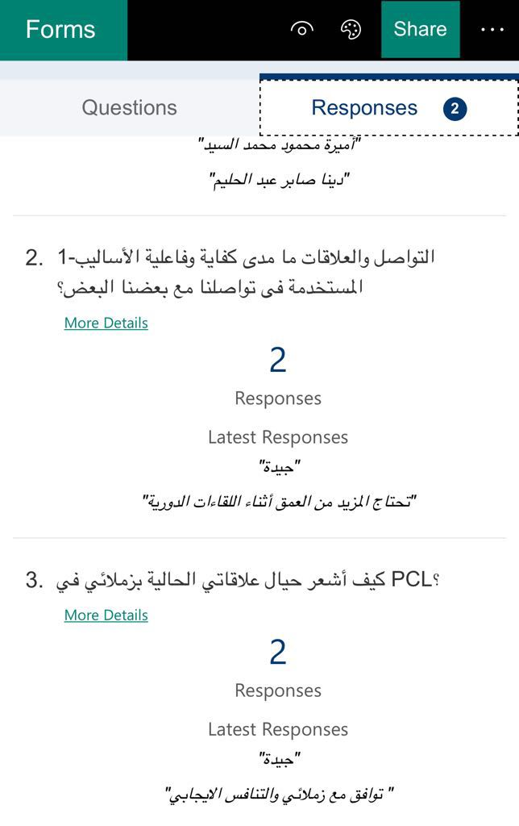
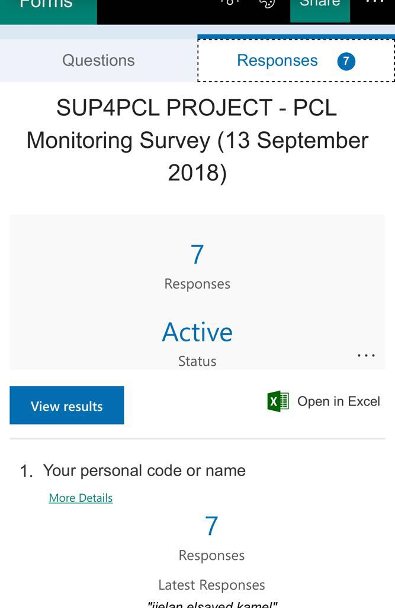
PCL development tool responses

Slide 34


