Slide 1


School and University Partnership for Peer Communities of Learners )SUP4PCL(
الشراكة بين المدرسة والجامعة لبناء مجتمعات الأقران من المتعلمين
Project Number : 573660-EPP-1-2016-1-EG-EPPKA2-CBHE-JP (2016-2516/001-001)
Progress Reporting
Schools Clustering
AU
Alexandria
Sixth Local Management Meeting
4th March 2019

Slide 2
Outline
Communication with Directorate
Schools clustering work at AU in November-December 2018
Schools Clustering work during the second semester February- April 2019
Challenges

Slide 3
1. Communication with Directorate
Slow process
Issues with response levels

Slide 4
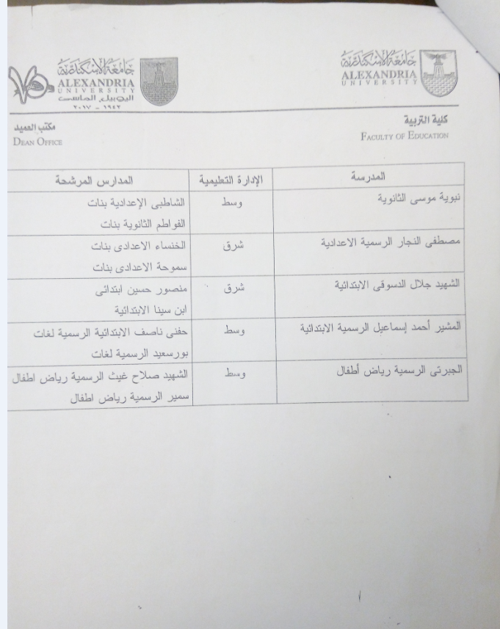
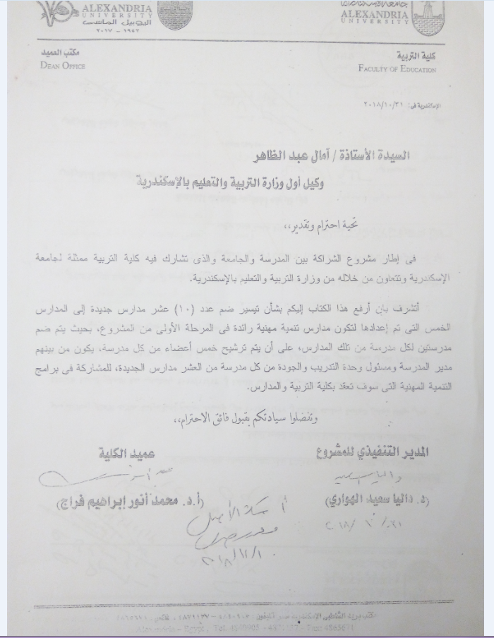
1. Communication with Directorate

Slide 5
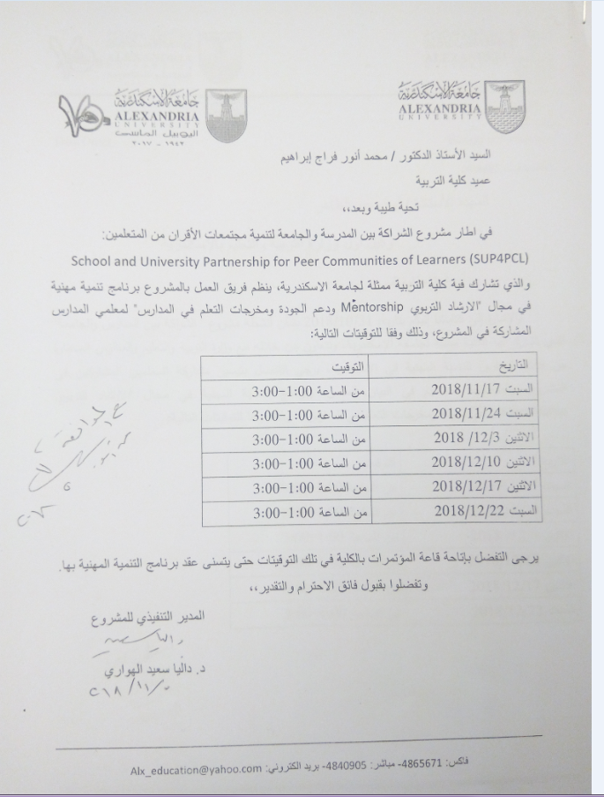
2. Schools clustering work at AU in November-December 2018

Slide 6
2. Schools clustering work at AU in November-December 2018
Schools get to know each other
Orientation to the new schools (project goals, activities and journey)
PD schools mentor the new schools (e.g. introducing key concepts& sharing practices learned)
All 15 schools share experiences, good practices & Challenges
PD schools & new schools engage in discussions to identify how best to collaborate

Slide 7
2. Schools clustering work at AU in November-December 2018: Outcomes
1. Elgabarti & partner school (KG)
Exchange visits among partner schools to better get to know the new curriculum- the needed teaching aids and how to make use of the curriculum activities and teaching aids
Exchange visits to share experiences in training - benefit from the teachers who attended the training for the new curricula
Assign one person to be responsible for planning these exchange visits- this can be planned through the training and quality assurance unit at schools

Slide 8
2. Schools clustering work at AU in November-December 2018: Outcomes
2. ElMosheer Ahmed Esmaeel
Exchange visits to share training materials and experiences (training conducted during Summer)- with a focus on EKB and active learning as well as other topics relevant to the needs of the schools.

Slide 9
2. Schools clustering work at AU in November-December 2018: Outcomes
3. Galal Eldesoky
Plan visits to take place during the mid-term holiday and collaborate to prepare teaching/ learning activities - exchange ideas- conduct classroom observations- plan lessons collaboratively- share training materials- making the training materials available to all schools (a soft copy)- establish a website to be used as a forum to share good practices and exemplary activities among all the 15 schools.

Slide 10
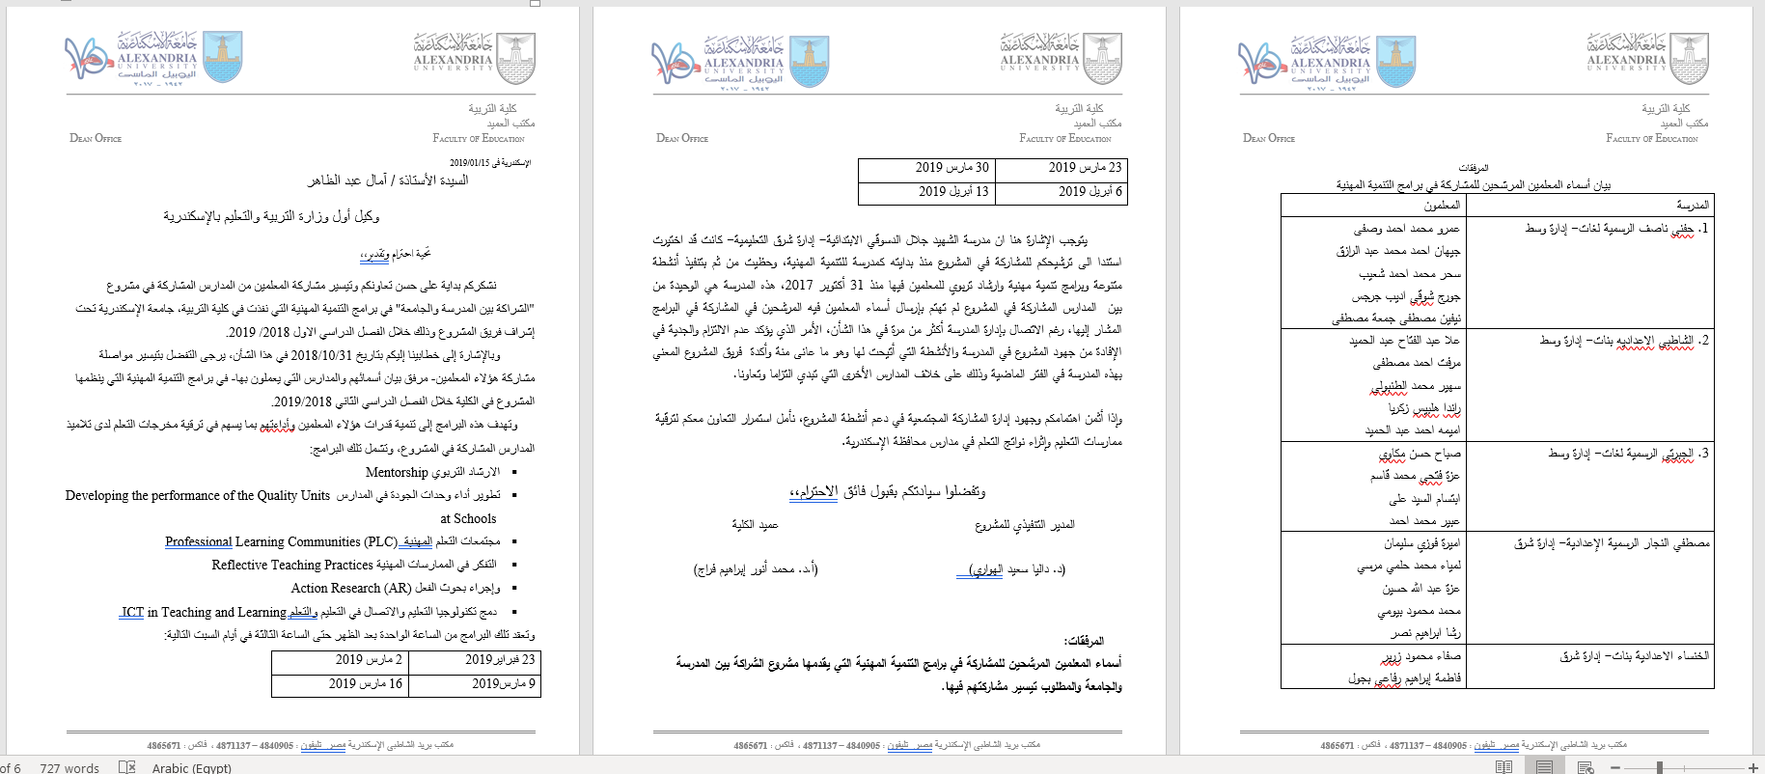
3. Schools Clustering work during the second semester February- April 2019

Slide 11
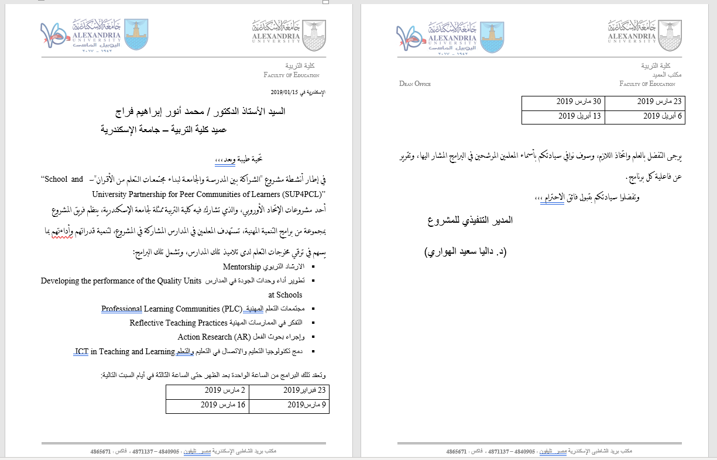
3. Schools Clustering work during the second semester February- April 2019

Slide 12
3. Schools Clustering work during the second semester February- April 2019
Follow up work
Provide uninterrupted time for all 15 schools to work together
Provide Space for schools to work together
Schools hold their PCL meeting at AU
AU team provides support and guidance
AU team supports schools to find common areas they can focus on
AU team provides input about issues raised by schools.

Slide 13

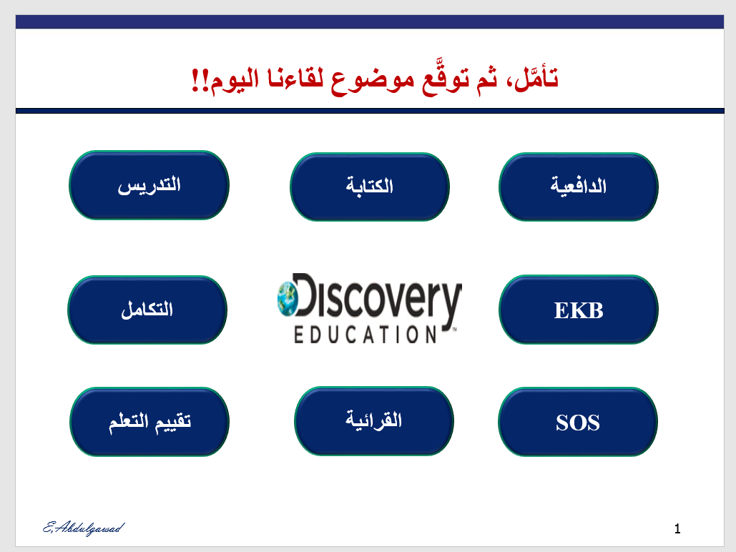
3. Schools Clustering work during the second semester February- April 2019

Slide 14
4. Challenges
The late start
Time and space
Motivation

Slide 15


