Slide 1


School and University Partnership for Peer Communities of Learners )SUP4PCL(
الشراكة بين المدرسة والجامعة لبناء مجتمعات الأقران من المتعلمين
Project Number : 573660-EPP-1-2016-1-EG-EPPKA2-CBHE-JP (2016-2516/001-001)
Progress Reporting
Material Development
AU
Alexandria
Sixth Local Management Meeting
4th March 2019

Slide 2
Outline
Introducing Schools to STEAM, ESD & GC
Sharing example materials (Adapted by AU Team)
Supporting schools develop their materials
Collecting materials
Uploading materials to AU Google Drive
PD Materials developed by AU

Slide 3
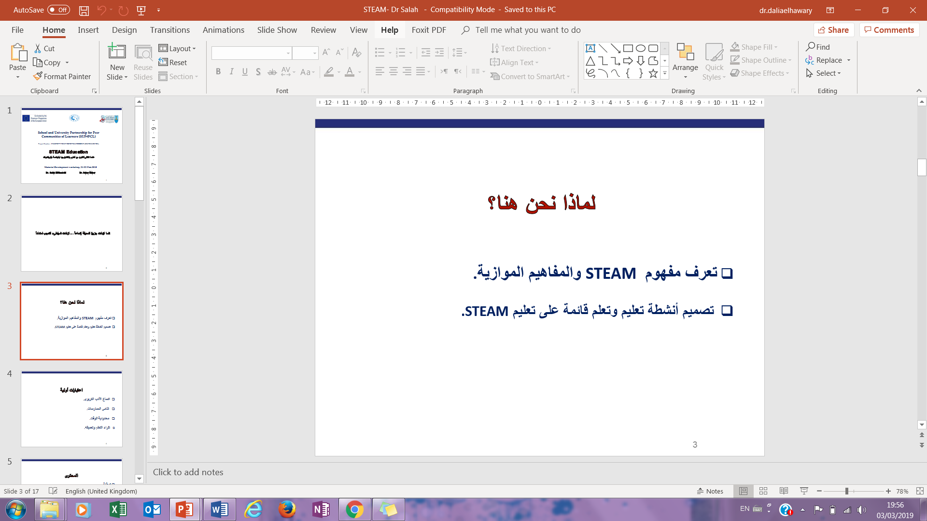
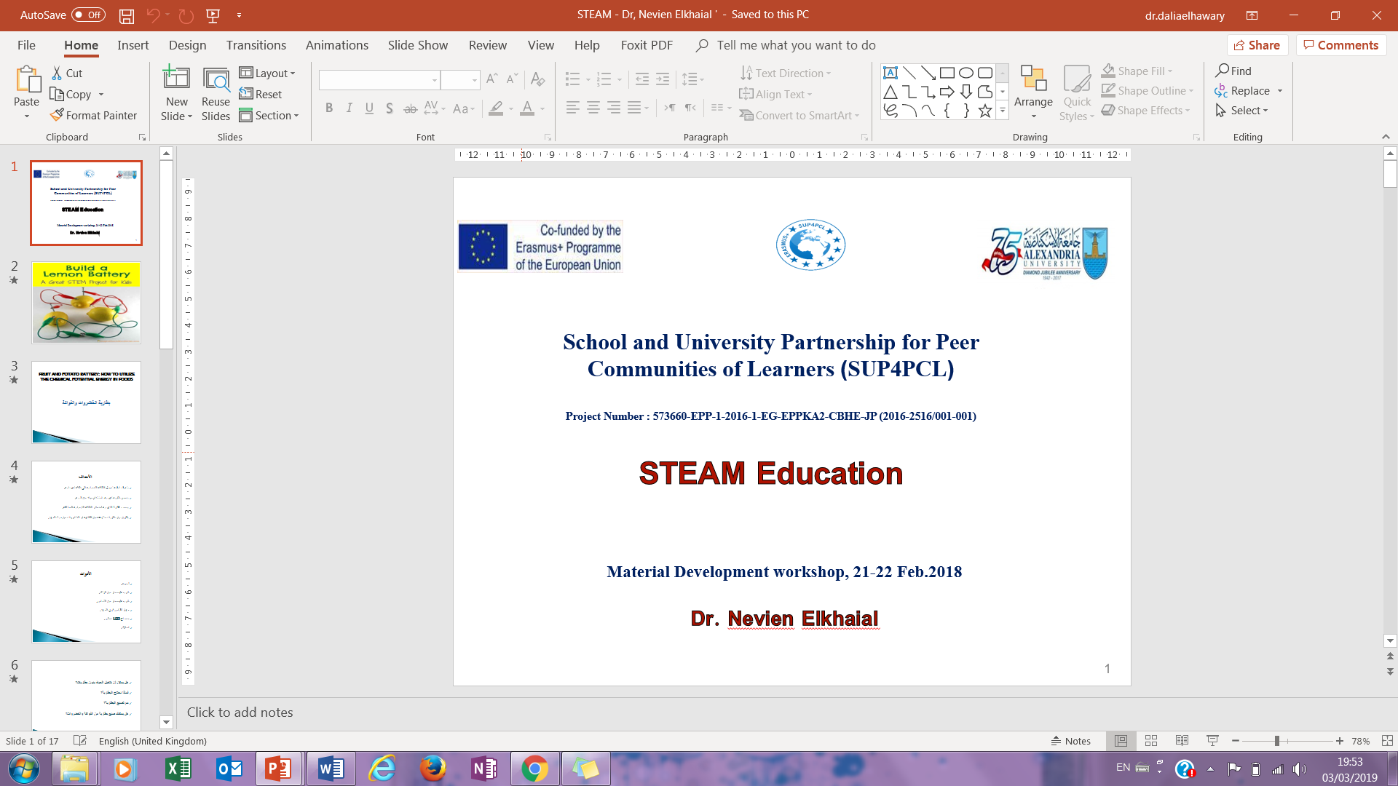
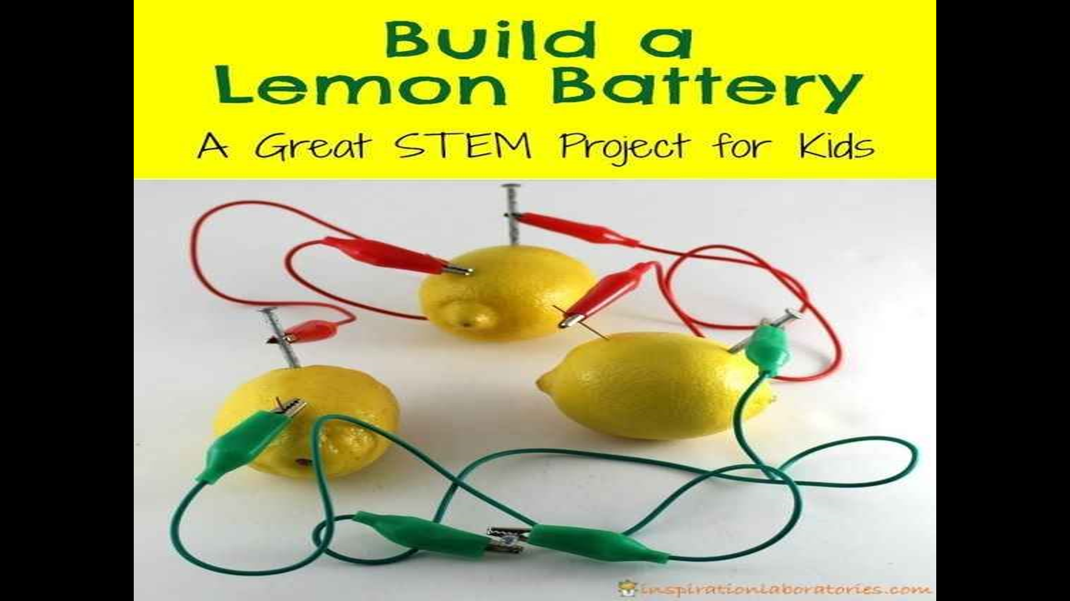
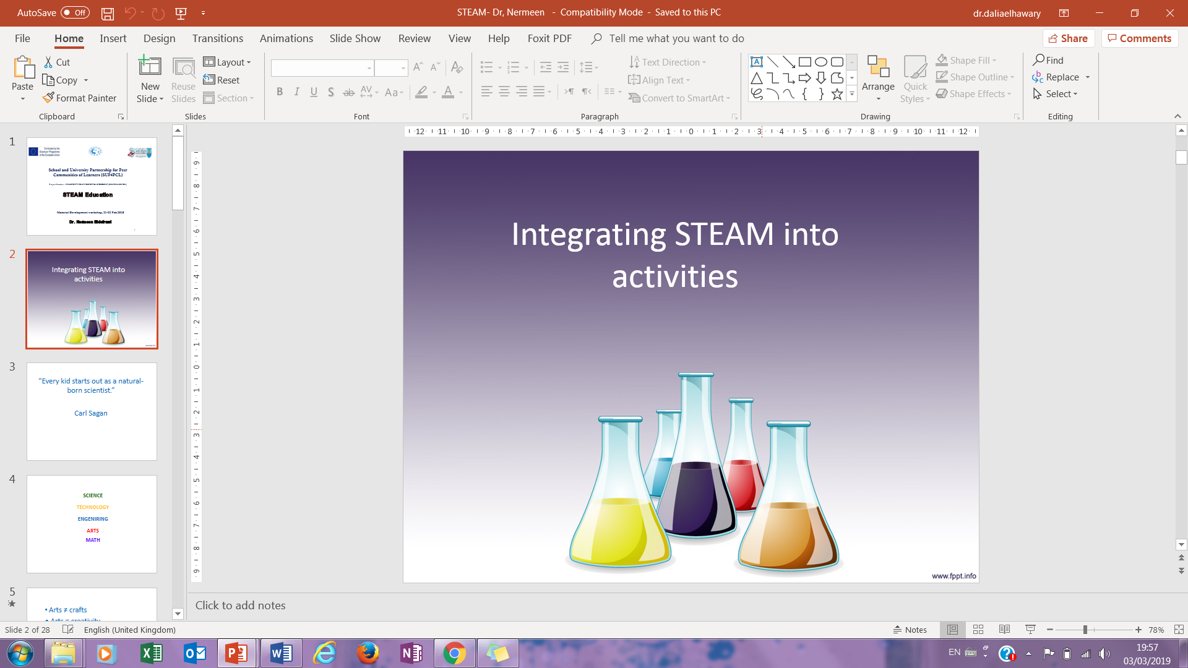
1. Introducing Schools to STEAM

Slide 4
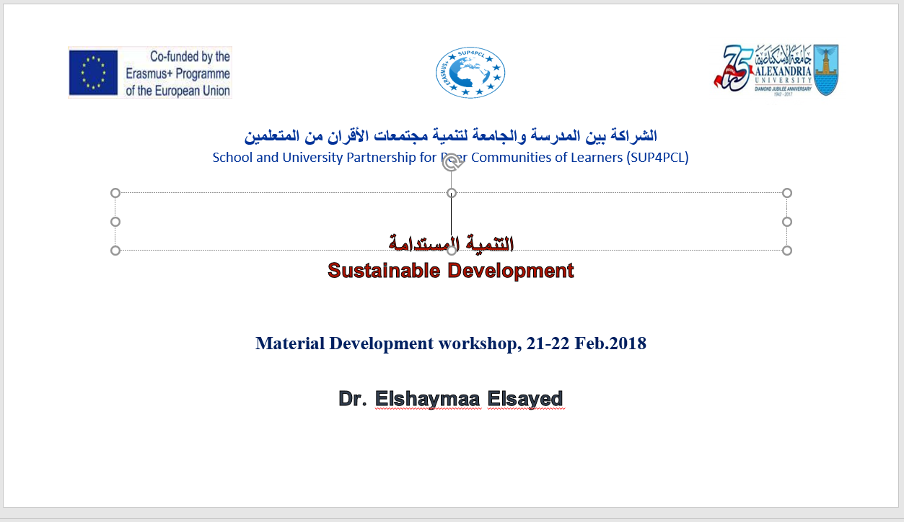
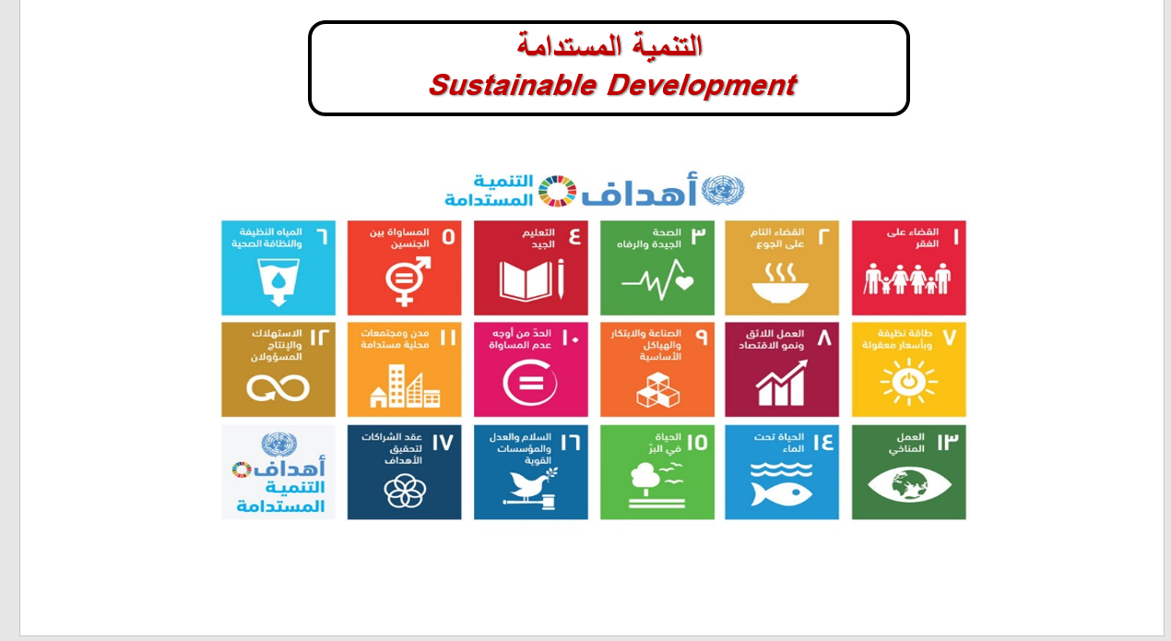
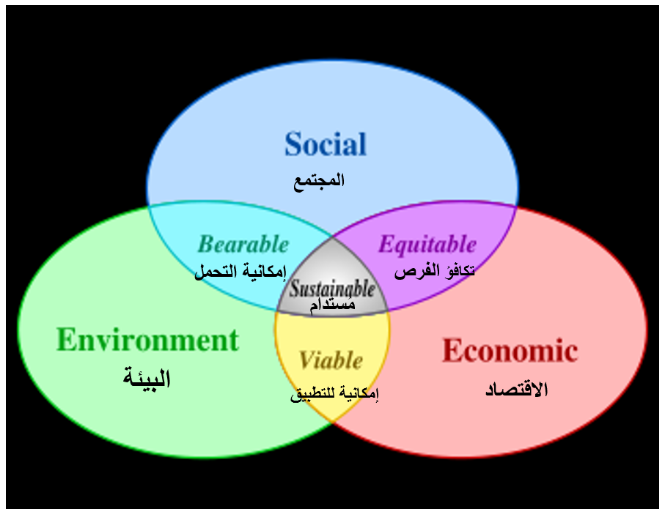
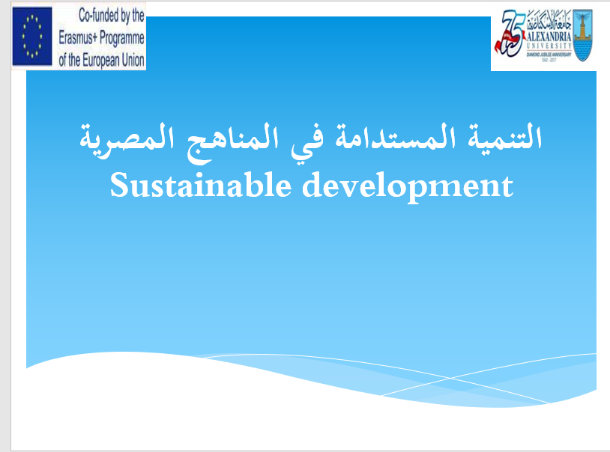
1. Introducing Schools to ESD

Slide 5
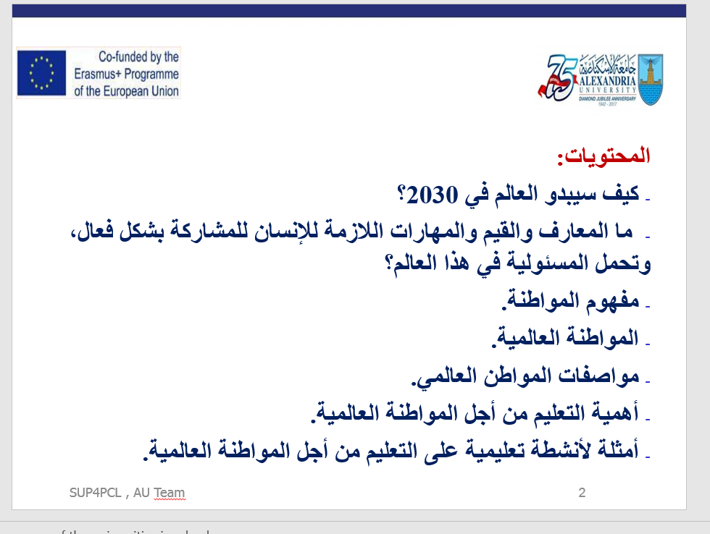
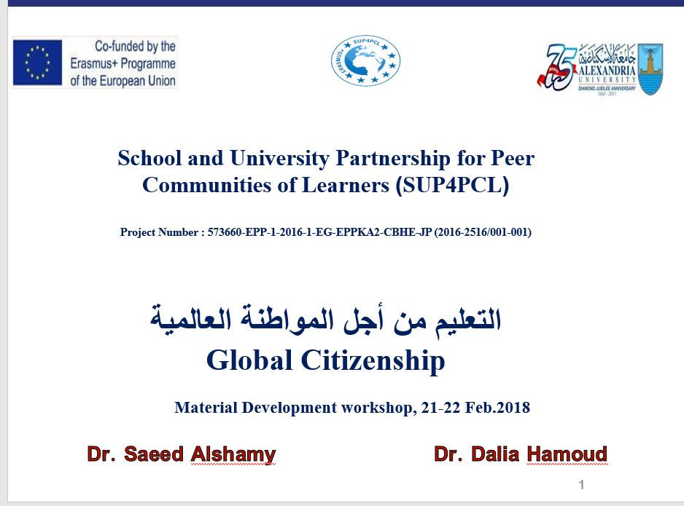
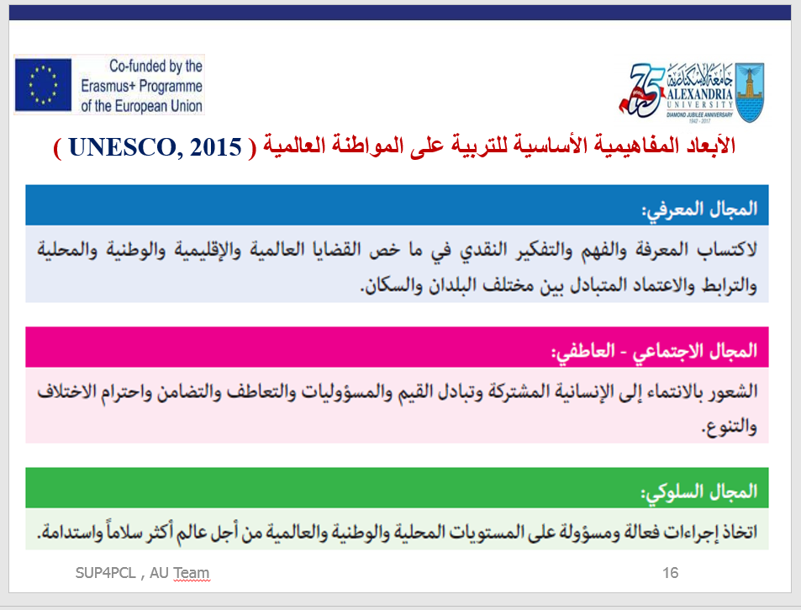
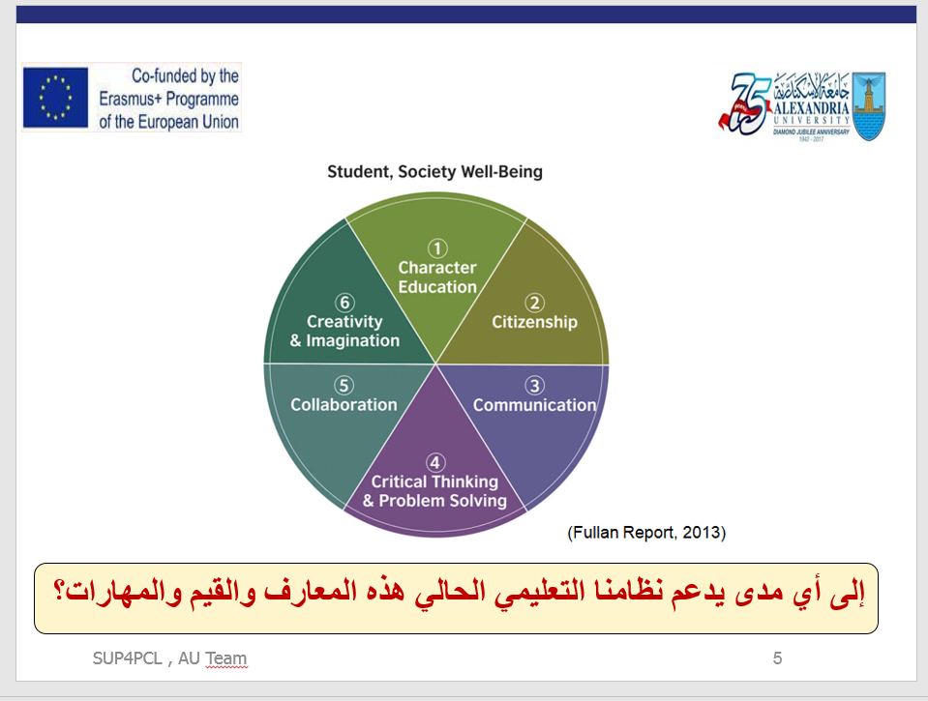
1. Introducing Schools to GC

Slide 6
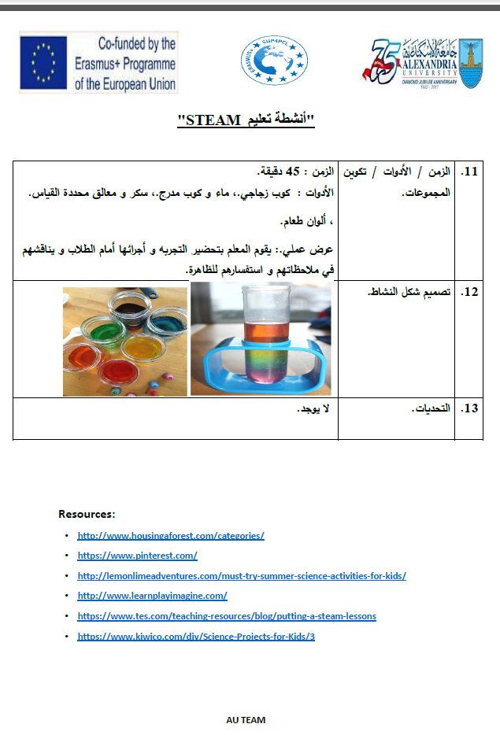
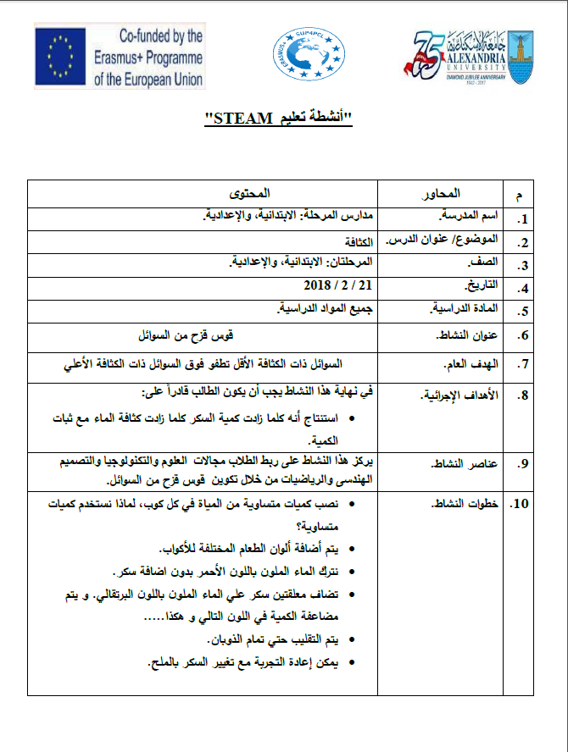
2. Sharing Example Materials: STEAM

Slide 7
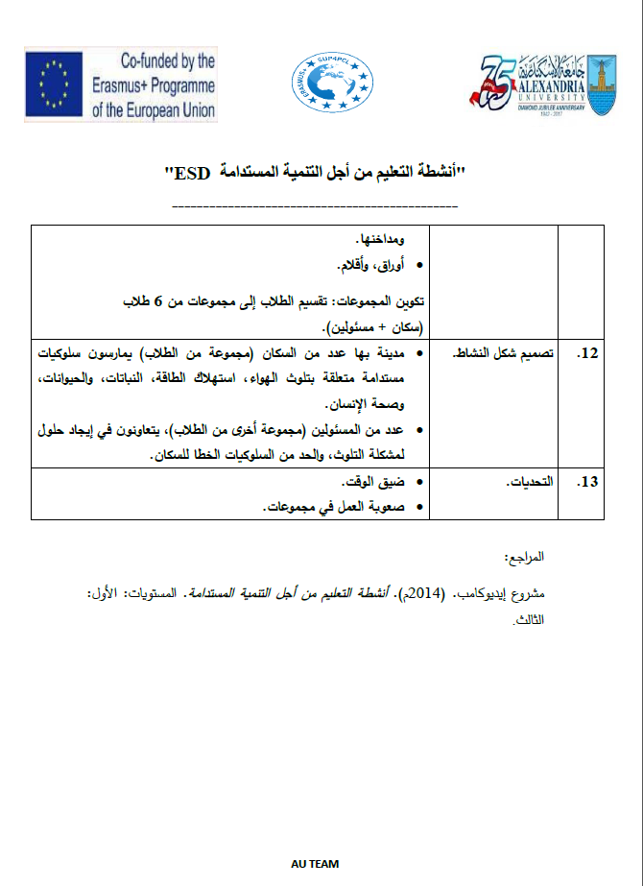
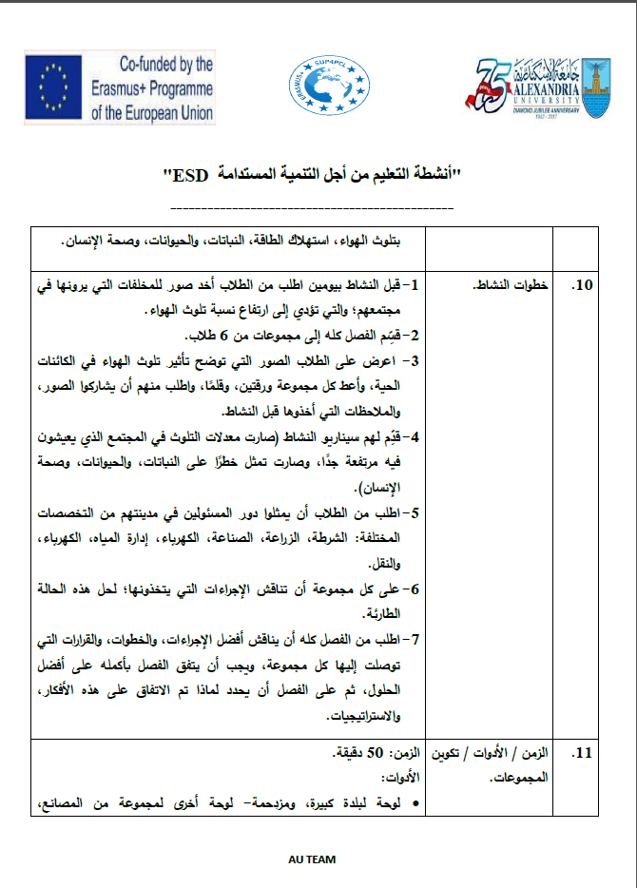
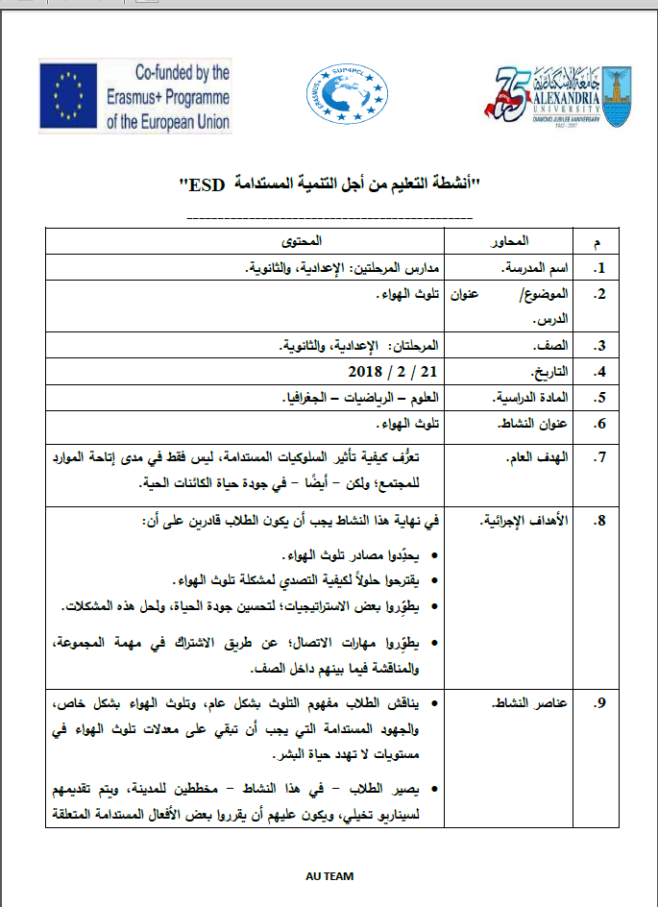
2. Sharing Example Materials: ESD

Slide 8
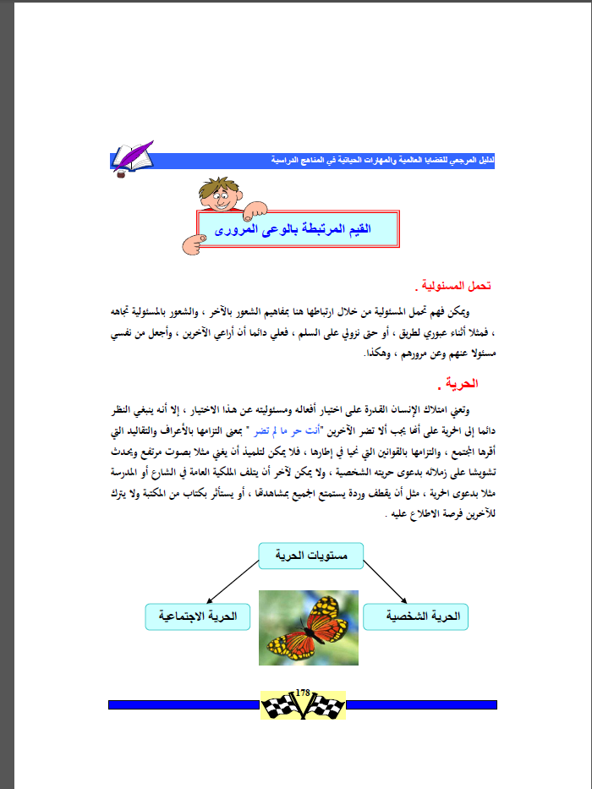
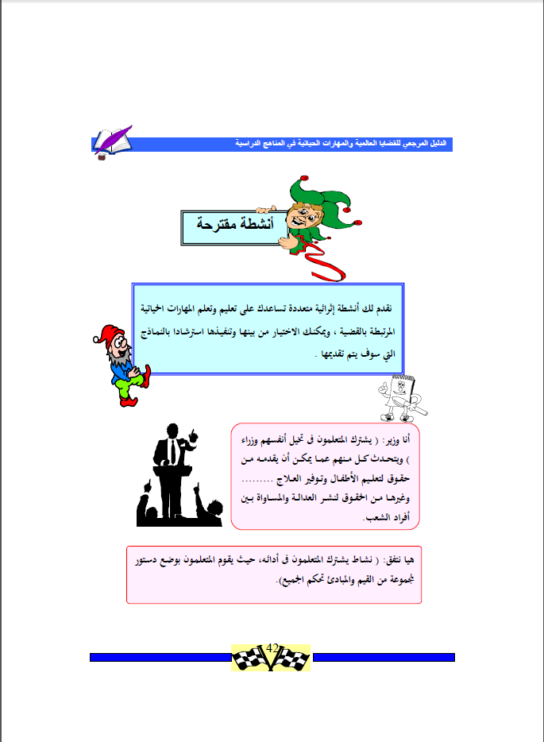
2. Sharing Example Materials: GC

Slide 9
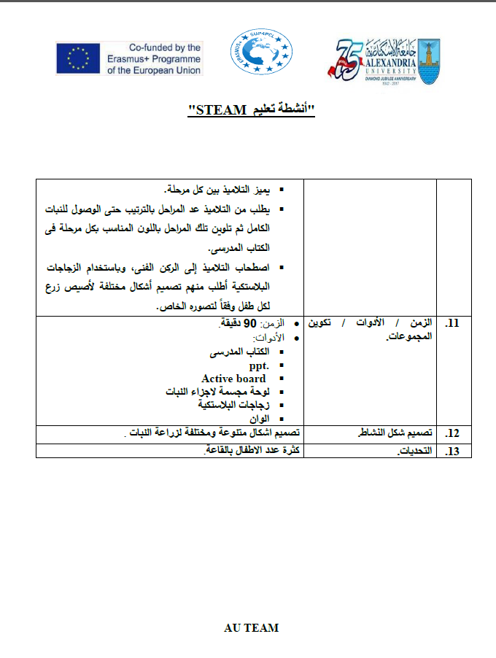
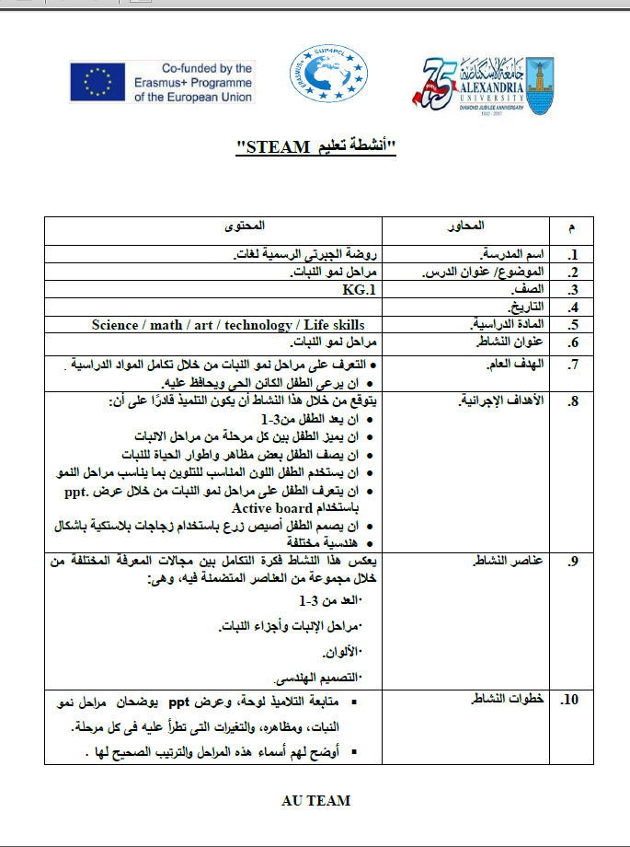
3. Schools Develop their Materials: STEAM

Slide 10
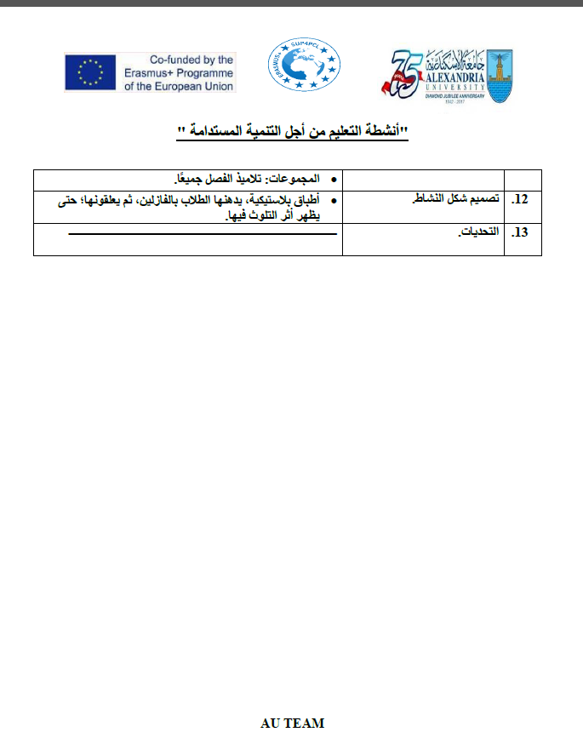
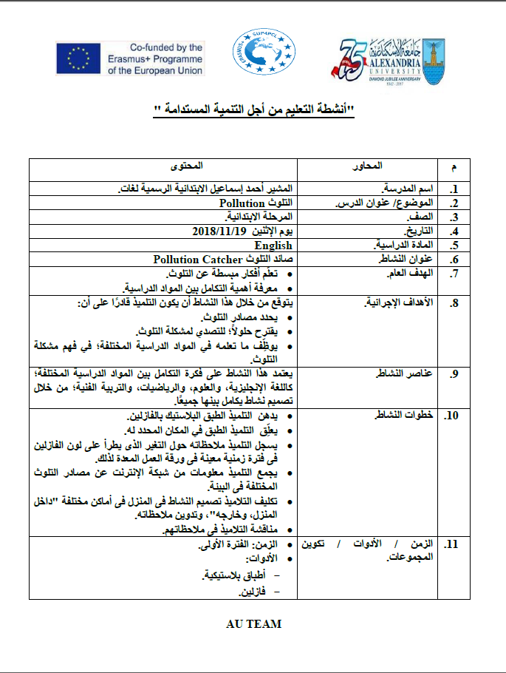
3. Schools Develop their Materials: ESD

Slide 11
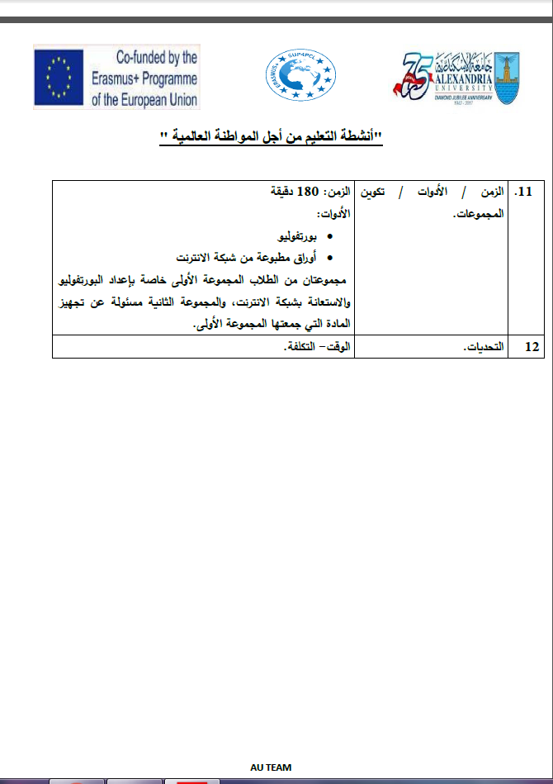
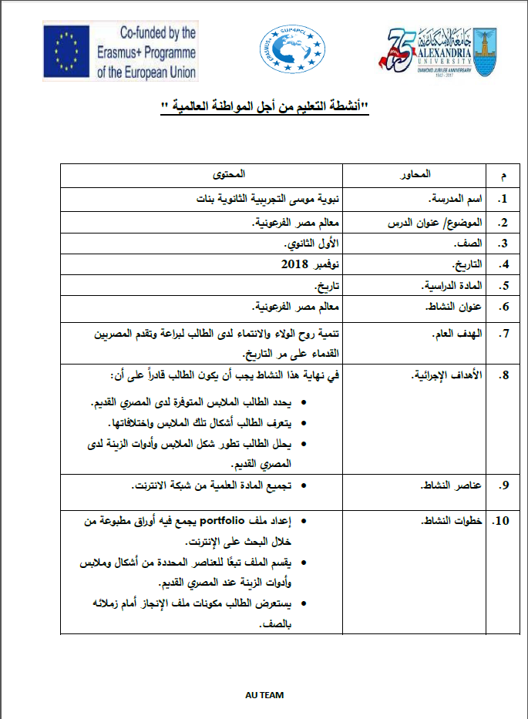
3. Schools Develop their Materials: GC

Slide 12
4. Collecting Materials
Different levels of contributions
Opportunities for providing feedback on activities
AU team collects materials- hard copies
AU team creates soft copies of all materials

Slide 13
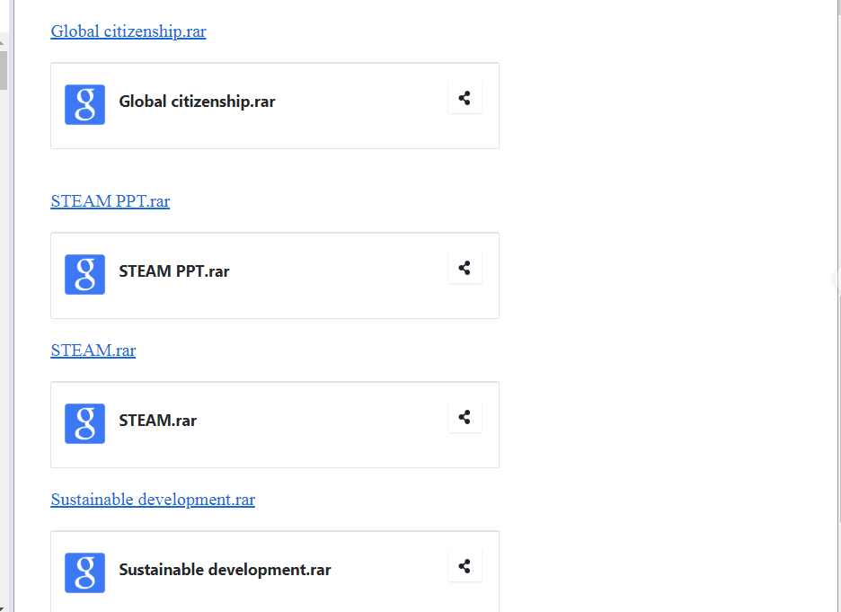
5. Uploading materials to AU Google Drive

Slide 14
6. PD Materials developed by AU
1. STEAM, ESD, GC
2. Teachers’ Roles
3. PCLs
4. Active Learning
5. PD Schools
6. Effective Mentoring
7. Using EKB in Education
8. Strategies for Teaching Thinking Skills
9. SEN
10. Quality Classrooms
11. Lesson Study

Slide 15


