Slide 1

School and University Partnership for Peer Communities of Learners (SUP4PCL)
NEO Advisory Monitoring Visit
Thursday May 2nd , 2019
ASU Team
This project has been funded with support from the European Commission. This publication [communication] reflects the views only of the author, and the Commission cannot be held responsible for any use which may be made of the information contained therein

Slide 2
 | TP1 | TP2 | TP3
Focus | Baseline of Original*5: Demographics Needs Assessment | Original *5: Understand development, successes and challenges Ways forward Baseline with Clusters *10 Demographics Needs Assessment | Consolidating and moving forward Sustainability of PCLs Lessons learned State of cluster PCLs
Approach | Focus Groups Questionnaire Interviews with school management; principal, supervisor, training unit of educational administration | *5 Revisiting focus groups reflective of T1 and development of key themes within the project *10 - T1 repeated with new *10 clusters | - Questionnaires - Reflection Day *5 schools - School PLC Rollercoaster timeline Repeat T2 for new cluster schools *10
Participants | Teachers in schools x5 | Teachers *15 schools | Teachers *15 schools Principals, supervisor, training unit
Deadline | Completed | Before December visit | Reflection Day aligns with T3 FOE & UL First of March for cluster school data collection
Data Analysis | Completed To be revisited to structure T2 Mid November | During December visit; Analysed by End of January | FOE&UL end of march Clusters March 19th
ASU/UL Planning Collaboratively the Project TPs

Slide 3
Visibility and Publicity of the Project

Slide 4
Many activities and events have been done for enhancing the visibility and publicity of the project. As examples of these activities:
Ceremony of launching the project (30 October 2017)
A Seminar entitled: “The Partnership Between University and Schools for Enhancing the Learning Difficulties at the School Curriculum” at the Cairo Educational Directorate (5 Dec 2018)
A Seminar entitled: “the Development of PLC at Limerick PD Schools” for Heads of Departments and professors at ASU (6 Dec 2018)
Having a complete session about the project in FOE international conference (17 Dec 2018)

Slide 5
Many activities and events have been done for enhancing the visibility and publicity of the project. As examples of these activities:
Presenting a ppt about the project in the Graduate Studies Council (30 Dec 2018)
Ceremony of opening the project lab (7 March 2019)
Designing a website for the project at the level of ASU, contains (the project philosophy, goals, themes, team, participating schools, various activities, project lab, contacts,……..etc)
Facebook pages
Articles in media

Slide 6
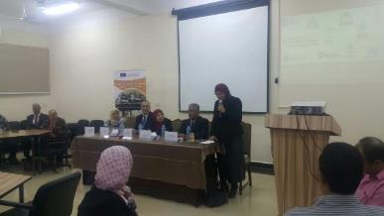
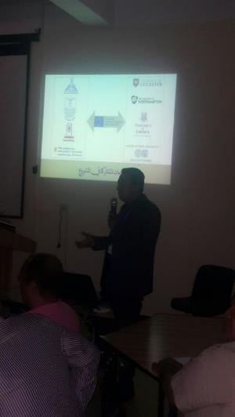
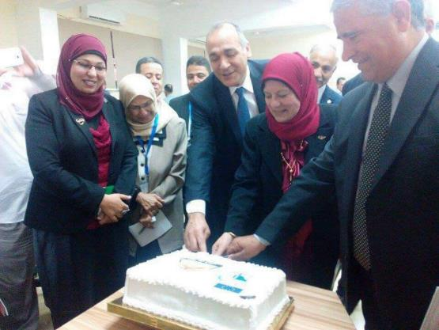
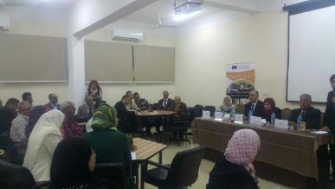
Ceremony of Launching the Project

Slide 7
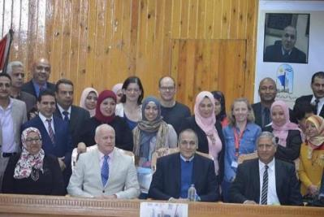
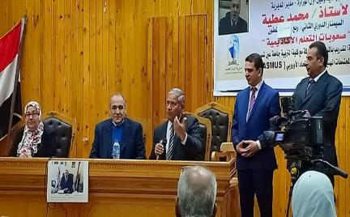
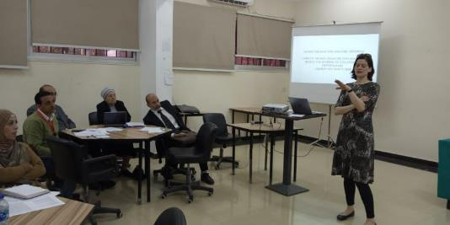
Seminars at Cairo Educational Directorate & FOE
“The Partnership Between University and Schools for Enhancing the Learning Difficulties at the School Curriculum”
“The Development of PLC at Limerick PD Schools”

Slide 8
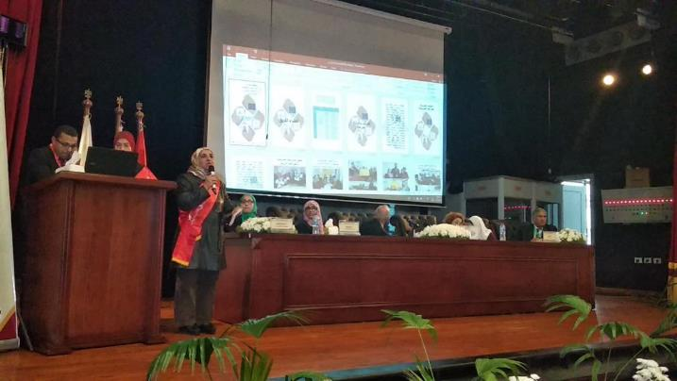
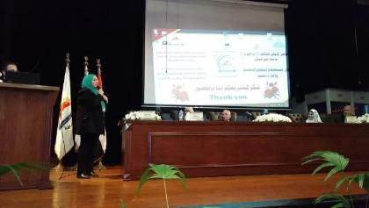
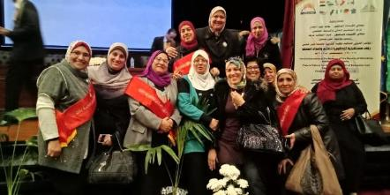
FOE International Conference
ASU PD Schools Teachers Participation

Slide 9
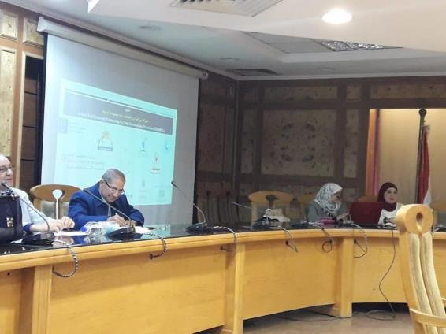
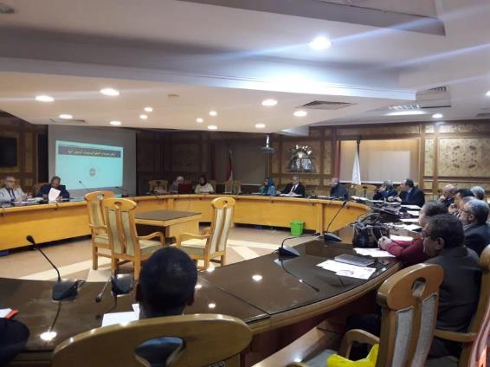
Graduate & Research Regular Council Meeting

Slide 10
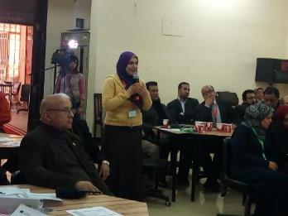
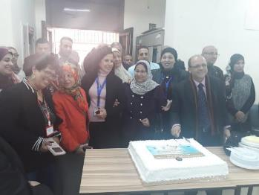
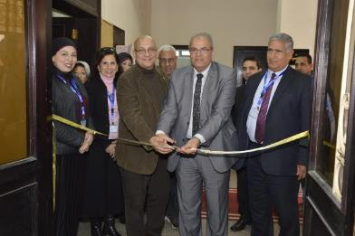
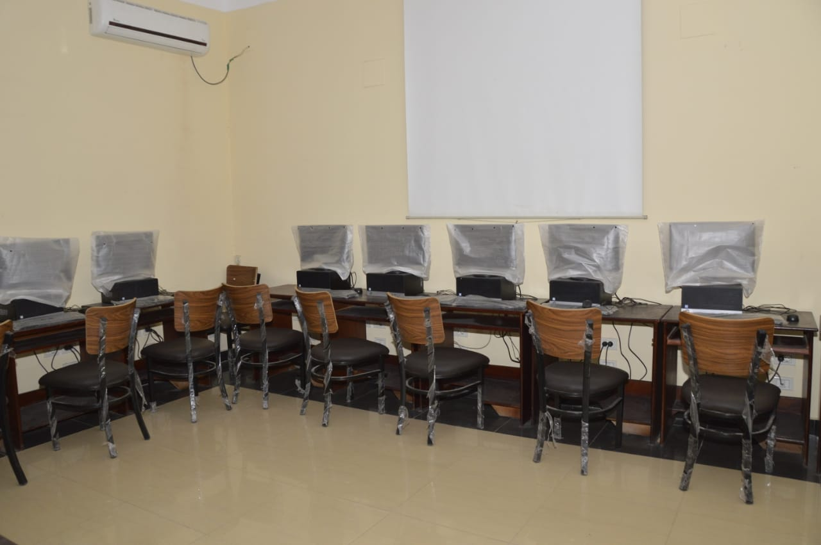
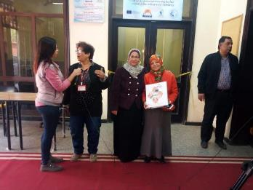
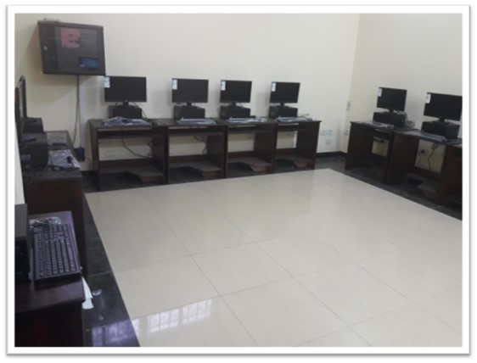
Ceremony of Opening the PD school lab

Slide 11
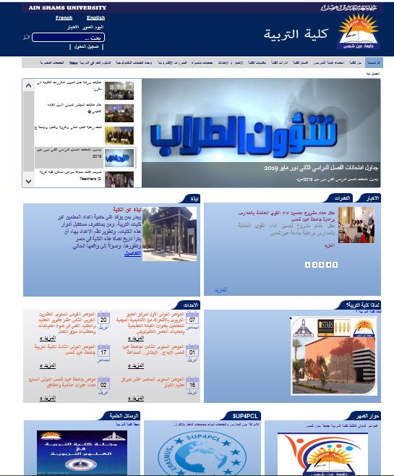
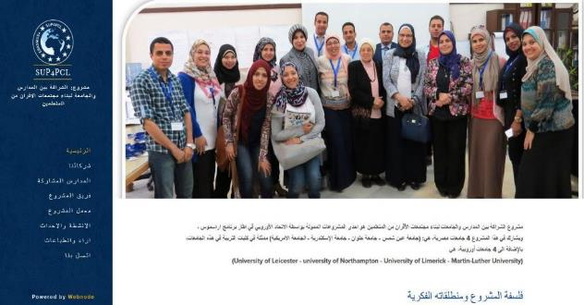
Visibility of the Project Activities Through the FOE Website

Slide 12
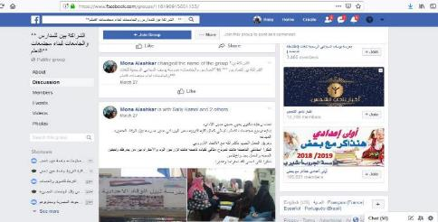
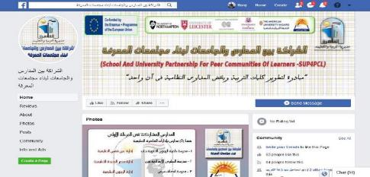
Facebook Groups & pages Created by the Teachers themselves
https://www.facebook.com/groups/118190915601135/
https://www.facebook.com/%D8%A7%D9%84%D8%B4%D8%B1%D8%A7%D9%83%D8%A9-%D8%A8%D9%8A%D9%86-%D8%A7%D9%84%D9%85%D8%AF%D8%A7%D8%B1%D8%B3-%D9%88%D8%A7%D9%84%D8%AC%D8%A7%D9%85%D8%B9%D8%A7%D8%AA-%D9%84%D8%A8%D9%86%D8%A7%D8%A1-%D9%85%D8%AC%D8%AA%D9%85%D8%B9%D8%A7%D8%AA-%D8%A7%D9%84%D9%85%D8%B9%D8%B1%D9%81%D8%A9-892061124291771

Slide 13
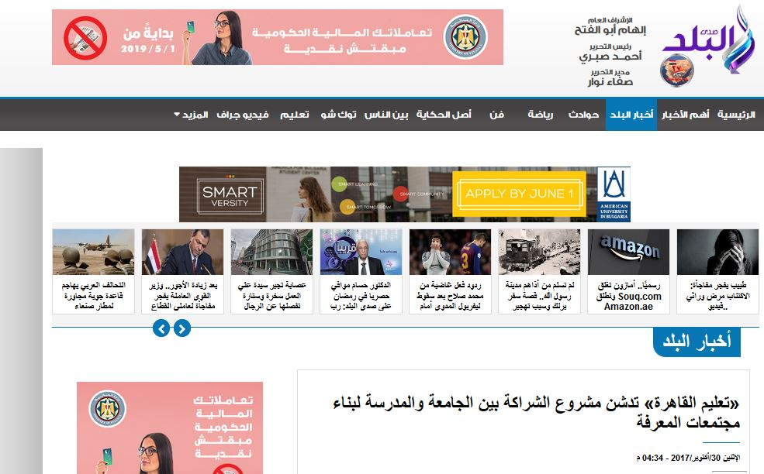
Articles & Media
https://youtu.be/Ll9oQ3PTtWs
https://youtu.be/7irXTCEvWIs
http://www.akhbarak.net/articles/27904404-%D8%A7%D9%84%D9%85%D9%82%D8%A7%D9%84-%D9%85%D9%86-%D8%A7%D9%84%D9%85%D8%B5%D8%AF%D8%B1--%D8%A7%D9%84%D8%B4%D8%B1%D8%A7%D9%83%D8%A9-%D8%A8%D9%8A%D9%86-%D8%A7%D9%84%D8%AC%D8%A7%D9%85%D8%B9%D8%A9
http://edu.asu.edu.eg/news.php?action=show&nid=55950#.XCKljFUzapo
https://www.elwatannews.com/news/details/2835302
https://www.elbalad.news/3007718

Slide 14
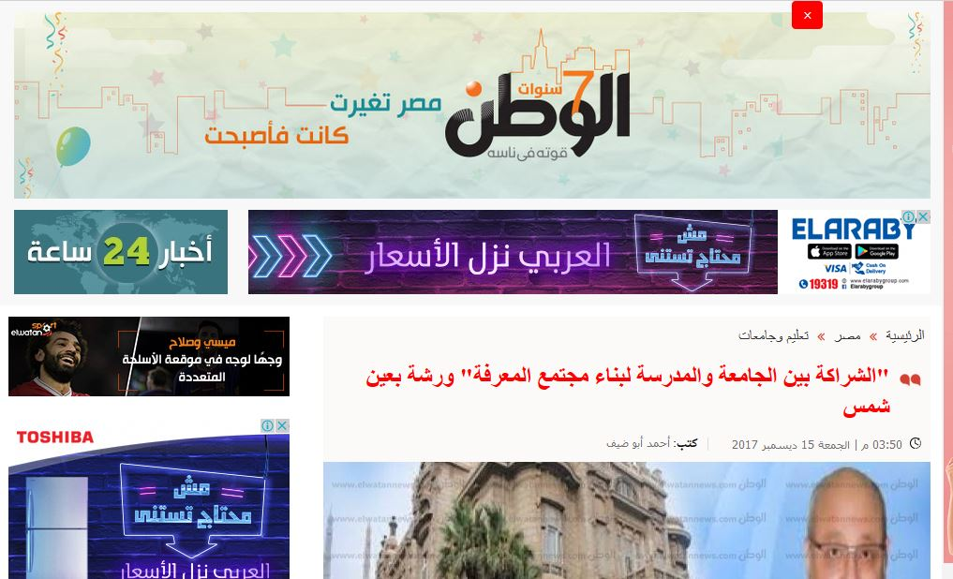
Articles & Media
http://www.arabdream.net/Main/NewsDetails.aspx?PID=35887
http://www.akhbarak.net/news/2017/10/30/12636885/articles/27229929/%D8%AA%D8%B9%D9%84%D9%8A%D9%85-%D8%A7%D9%84%D9%82%D8%A7%D9%87%D8%B1%D8%A9-%D8%AA%D8%AF%D8%B4%D9%86-%D9%85%D8%B4%D8%B1%D9%88%D8%B9-%D8%A7%D9%84%D8%B4%D8%B1%D8%A7%D9%83%D8%A9-%D8%A8%D9%8A%D9%86-%D8%A7%D9%84%D8%AC%D8%A7%D9%85%D8%B9%D8%A9
https://www.elwatannews.com/news/details/2669370
http://edu.asu.edu.eg/news.php?action=show&nid=56109#.XCKotlUzapo

Slide 15
New Learning Environment

Slide 16
At University Level
Most Of The Project Members Have Improved Their Teaching Performance And Adopted New Teaching Methods Using Student Centered Approaches.
They Follow The Style Of Peer Learning And Work To Improve Their Performance Based On The Constructive Criticism And Feedback Of Their Colleagues Of The Same Subject (Lesson Study).

Slide 17
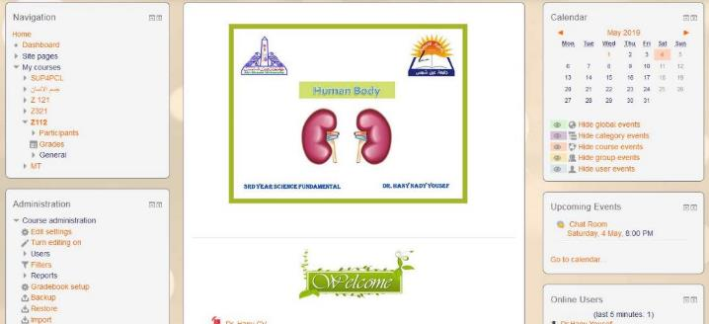
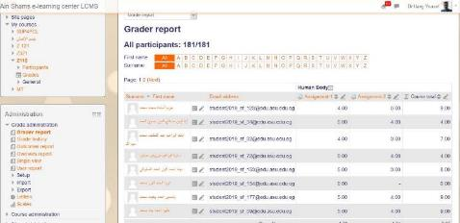
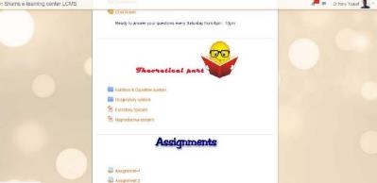
At University Level
Example-1: Dr. Hany Yousef
Dr. Hany Yousef depends of using E-learning approach using the Moodle as a supportive way for his ordinary lecture.
This approach allow the student to collaborate remotely , upload the required assignments online, download their lectures from the electronic platform.

Slide 18
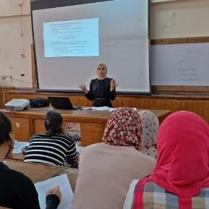
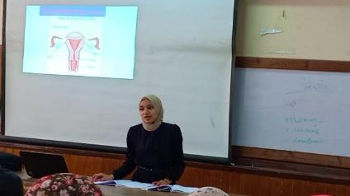
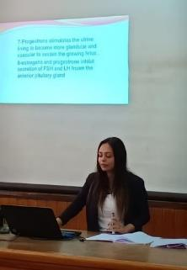
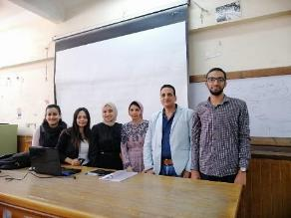
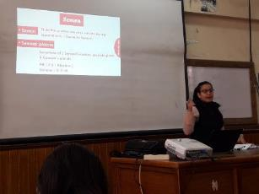
At University Level
Example-1: Dr. Hany Yousef
In addition, Dr. Hany divides the students into groups, each of them is responsible for preparing the topics of one lecture. Each group works collaboratively collecting the data and preparing a ppt and presenting it for their classmates.
At the end of the lecture the presenting group receives feedback from their peers and their teacher.

Slide 19
At University Level
Example-2: Amira Mahmoud El-Sayed
Applying PCL in Micro-teaching sections.
I was asking students to work in teams to make team presentations and thus work together on one goal (a high mark for the whole team). After presenting as a team, student-teachers used to take oral feedback from their peers as well as an oral feedback based on a written evaluation checklist from me. Before having this process done, all student-teachers were given an initial brief orientation on the benefits of getting feedback from peers and on how to give constructive feedback.

Slide 20
At School level
Teaching performance of many of the participating teachers have Been improved due to their participation in the different activities of the project.
Most of them use student centered approaches and new technological teaching methods such as: preparing educational movies, using google classrooms, designing E-books, using the sources of EKB in teaching, preparing electronic forms, preparing infographics, using the multimedia in teaching.
Most of them work collaboratively (integrated subjects) and depend on the peer review approach for improving their teaching performance .

Slide 21
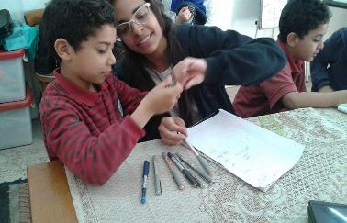
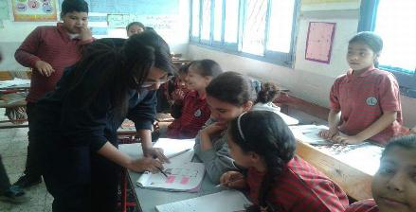
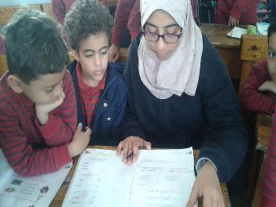
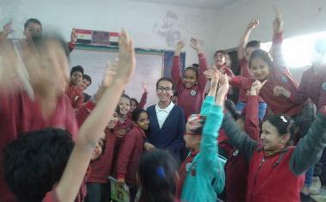
Ex1: learning primary one students the reading and writing Arabic through students in secondary stage from their school (sustainable development)

Slide 22
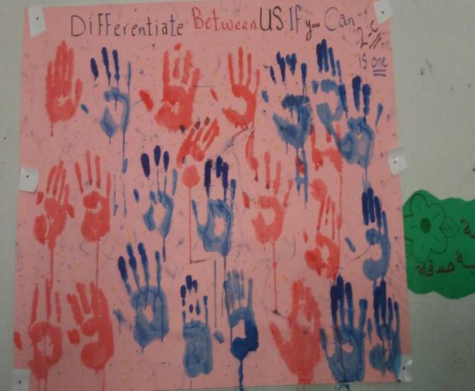
Ex2: Designing this painting with students to illustrate that they are a citizen in class , they are equal , and they have the rights and duties in their class.

Slide 23
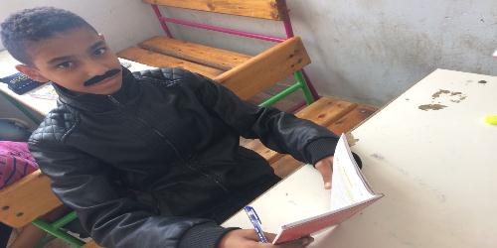
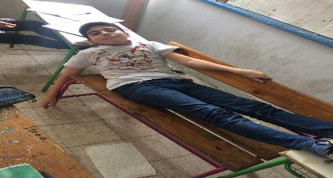
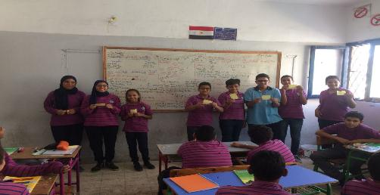
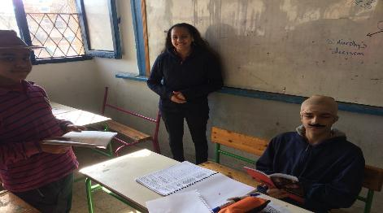
Ex3: Role play about the role of police

Slide 24
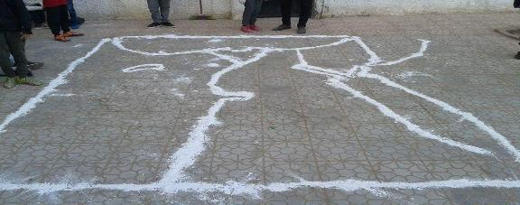
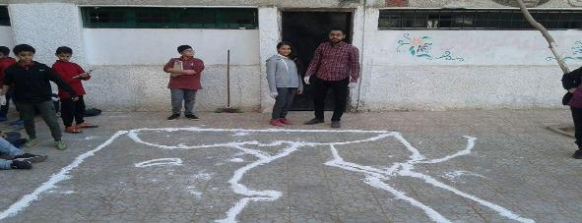
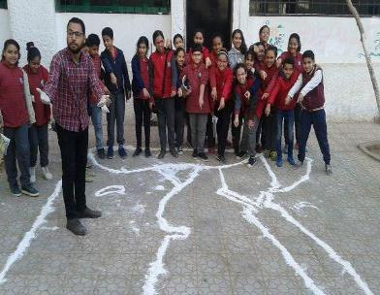
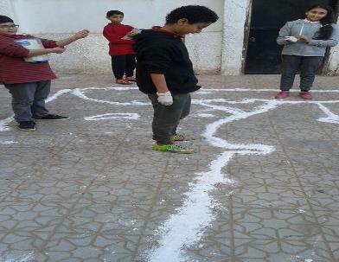
Ex4: Activities through teaching social studies

Slide 25
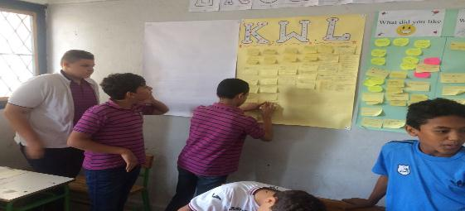
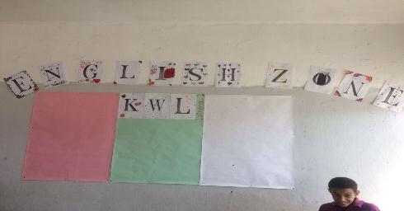
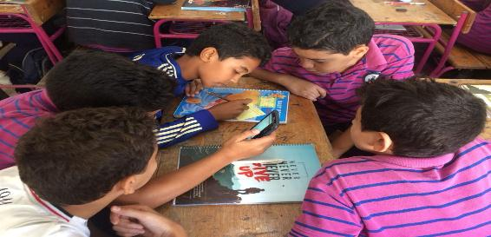
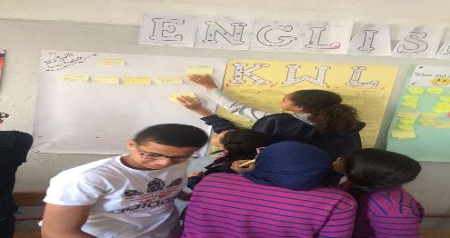
Ex5: KWL (Know, Want to Learn) activity

Slide 26
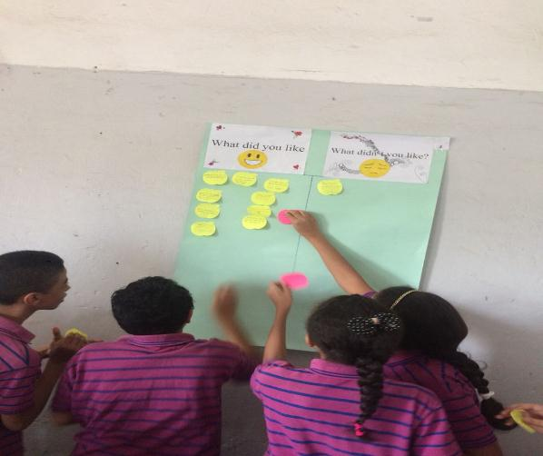

Ex6: Knowledge tree and thinking wall

Slide 27
Training and Mobility Activities

Slide 28
EU/AUC/ASU
Training/ Workshops/ Mentorship
STEM Strand
Professional Learning Communities Strand
School Placement Strand
Professional Development Strand
Technology in Teacher Education Strand
Developmental Education/Education for sustainable development
Workshop on Lesson Study :Introduction to key principles of Lesson Study
Active Blended Learning
Teacher research and enquiry for school improvement: teachers’ perspectives
Professional development of school leaders
Qualitative Research
Mentorship
Data Analysis & Decoding System

Slide 29
ASU/PD Schools Tailored Programs
Program | Topics
An overview of the Themes of the project | STEAM Global citizenship Sustainable development Special needs
Action research training | The concept , importance, Characteristics, and Steps of action research Ethnographic Study of the school. The stages of building the team and defining its roles Strategic plan SWOT analysis Challenges of action research
STEAM training | STEAM philosophy Great challenges Capstone STEAM schools

Slide 30
ASU/PD Schools Tailored Programs
Program | Topics
Training Package Development | Concept of Training Program Training Program Design Training Package: Concept, Tools and Procedures. Training Package Components
Developing the Technological Skills of the Teachers of the PCL (First) | Mastering the use of the program of processing and production of educational videos (Windows Movie Maker-6) and using it in the production of educational videos from the subject of specialization. Mastering the use of the program of producing electronic books and magazines (Flipbook Maker Pro) and using it in the production of an electronic book from the subject of specialization. Mastering the use of educational platforms such as (Google Classroom) and using it in the production of electronic classrooms.

Slide 31
ASU/PD Schools Tailored Programs
Program | Topics
Developing the Technological Skills of the Teachers of the PCL (Second) | Mastering the use of EKB resources in teaching Building Infographic and using it in teaching Building Google Forms as a tool of online quizzes How to be professional in searching for and downloading multimedia such as (Image-video-3D models - QR codes) and using them teaching

Slide 32




An overview of the Themes of the project

Slide 33




Action Research Training

Slide 34




STEAM Training

Slide 35




Training Package Development

Slide 36





Developing the Technological Skills of the Teachers of the PCL (First Patch)

Slide 37





Developing the Technological Skills of the Teachers of the PCL (second patch)

Slide 38


At the school level
A workshop on learning styles, and differentiated teaching by Ms. Soher Ayed at Helmyet El Zaytoun secondary school for girls (18/7/2018)

Slide 39



At the school level
A workshop on active learning by teachers themselves at Helmyet El Zaytoun secondary school for girls (18/7/2018)

Slide 40
Developing the Team Member Skills

Slide 41
IT Skills
At the School Level | At the University Level
E-books making using Flip-book maker Preparing educational movies using Movie maker-6 Electronic platforms using google classrooms Using of EKB resources in teaching Building Infographic and using it in teaching Building Google Forms as a tool of online quizzes How to be professional in searching for and downloading multimedia such as (Image-video-3D models - QR codes) and using them teaching Preparing training packages | Electronic platforms using google classrooms Using Blogs

Slide 42

Ex: Google Classroom

Slide 43
Ex: Designing a movie linking between 2 subjects (Arabic and Math)
https://drive.google.com/file/d/1fqhEiGaDYDeo257DYKczXyLHeafbDW5i/view

Slide 44


Research & Academic Skills
At the School Level | At the University Level
How to prepare a research paper Action research skills | Quantitative research Qualitative research Data analysis (Decoding system) How to write a case study Action research skills
Scientific magazine for Helmyet El Zaytoun secondary school for girls .
Article-1

Slide 45
Behavioral Skills
At the School Level | At the University Level
Culture of documentation Collaborative research skills Lesson study approach Exchange information and best practices Using E-mails for communication Leadership style Using research ethics tools | Culture of documentation Collaborative research skills Lesson study approach Exchange information and best practices Using E-mails for communication Leadership style Using research ethics tools Clarity of instructions on applying research tools

Slide 46

Yossif El Sebeai School | https://eduasuedu-my.sharepoint.com/:f:/g/personal/sup4pcl_edu_asu_edu_eg/El_qYBJhWkRCrVUC3GSWt34BeTtGxDJSLPVrldgZDI1bXQ?e=Z6rsMm
Helmit Elzaiton School | https://eduasuedu-my.sharepoint.com/:f:/g/personal/sup4pcl_edu_asu_edu_eg/ErntfIkUHv1Iv9XQXL4EzqQBtq1Z3OyUvrBqt7K6shHTLg?e=mcm0v2
Ansaf Seri School | https://eduasuedu-my.sharepoint.com/:f:/g/personal/sup4pcl_edu_asu_edu_eg/EmgD8C0brN5Pmx2exS1EF2MBrK8mGckygpIhi0KBoa0mbA?e=XxKdDG
Eltabry School | https://eduasuedu-my.sharepoint.com/:f:/g/personal/sup4pcl_edu_asu_edu_eg/EsZWThkuuSdHnueC7n4_7q4Bz-elBidwSCdHpwN58HejCg?e=TzOrFN
Elsaidia Pre. School | https://eduasuedu-my.sharepoint.com/:f:/g/personal/sup4pcl_edu_asu_edu_eg/EiWjQ2rp_yBAlgZsp-YNcSMBimPz4VnsW4b0ZFJ7gdkR8w?e=P0C3Ap
Ex: Documentation using Drives

Slide 47
Twinning Between ASU/UL

Slide 48


ASU & UL Potential Partnership
  We are on the same page
  The twining universities have the same strategic plan of internationalisation
  We agree on a sustainable collaboration not merely signing an MOU
  Key Action One ( Mobility of students and staff)
  Dual / Joint Degree in Leadership Graduate Program
  Three parties MOU between UL, ASU and Ministry of Education for developing the Educational Leadership style at schools
  We are in the process of having MOU signed between ASU and UL

Slide 49

Opening a Channel of Joint Supervision Between ASU & UL
Alaa is graduated from faculty of education "English department" at Ain shams University. Her general estimate is very good with honor, May 2015. She is working now as a demonstrator at EFL curriculum and instructions department (faculty of Education –Ain shams University).she also worked as an English instructor at Future University in Egypt (FUE), an English instructor at CEDLT at faculty of education, Ain shams University and an English teacher at St. Fatima Language School in Cairo. She is very interested in Conducting her research about PLC as a new culture of work to improve the communication skills of the English Teachers.
Thesis title:
" The Effectiveness of PLC Approach to Improve Communication Skills of English Teachers"
Supervisors
Prof. Asmaa Ghanim Gheith
Professor of EFL instructions and curriculum
Faculty of Education ,Ain shams University.
Dr. Orla McCormack
Lecturer in Education at the School of Education, University of Limerick.

Slide 50
Motivation Towards the Project.

Slide 51




Examples of Student Participation
Example-1: Prof. Said Khalil
Students are participating in designing projects using the STEAM approach as an extra curricula activity.

Slide 52

Some Feedback Of Teachers Towards The Project
Most of the participating teachers and staff are highly motivated towards the project.
Schools out of the clustering schools send requests for joining the project
https://sup4plc.webnode.com/two-columns/

Slide 53





Slide 54
Developing Material.

Slide 55


Depending on collaborative work and lesson study based approach, teachers produced developed materials out of the current school curricula.

Slide 56


Example-1: lesson entitled:
Agricultural environment

Slide 57


Example-2: lesson entitled:
Planets and galaxies

Slide 58
Sustainability Plan

Slide 59


