Slide 1


School and University Partnership for Peer Communities of learners (SUP4PCL)
Project number: 573660-EPP-1-2016-1-EG-EPPKA2-CBHE-JP (2016-2516/001-001
2 nd May 2019
HU Progress

Slide 2



Content
Any activities or initiatives that would have enhanced the visibility and publicity of the project (public meetings, advocacy, media events etc..)
Any changes in curriculum, syllabus, student centered approaches, new modules, new programs, new diplomas, new methodologies , internal and external peer review, feed back and assessment mechanisms.
Description of the various training and mobility activities both international and national (at school and at university).
Impact of the project on enrollment at university and school level as well as career development for participants.
What skills were acquired (IT skills, research skills, behavioral and academic skills.
What change of behavior was depicted
Impact from twinning
Degree of participation, ownership, motivation towards the project.
Level of student participation.

Slide 3
Any activities or initiatives that would have enhanced the visibility and publicity of the project (public meetings, advocacy, media events etc..)

Slide 4
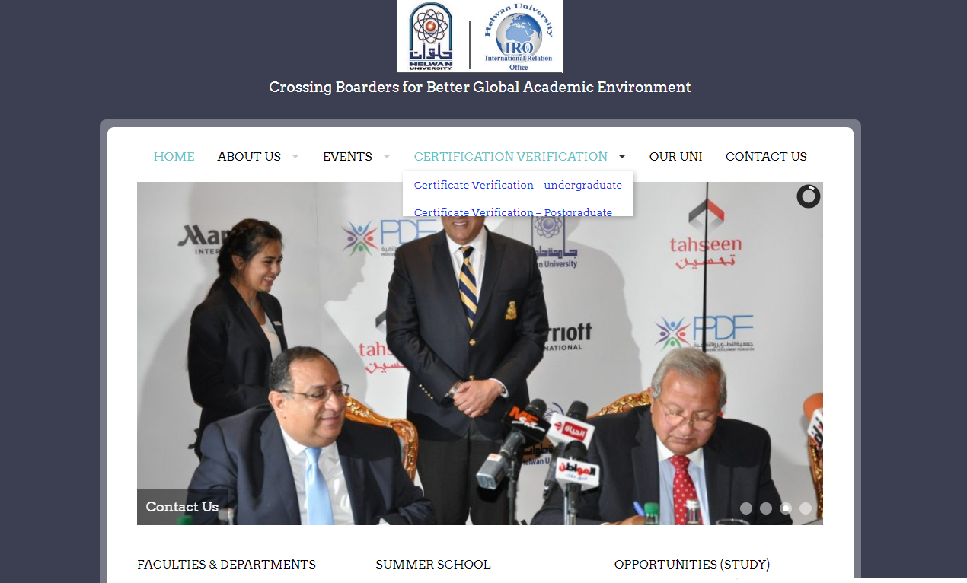
Visibility of the Project on HU website http://www.helwan.edu.eg/English/

Slide 5
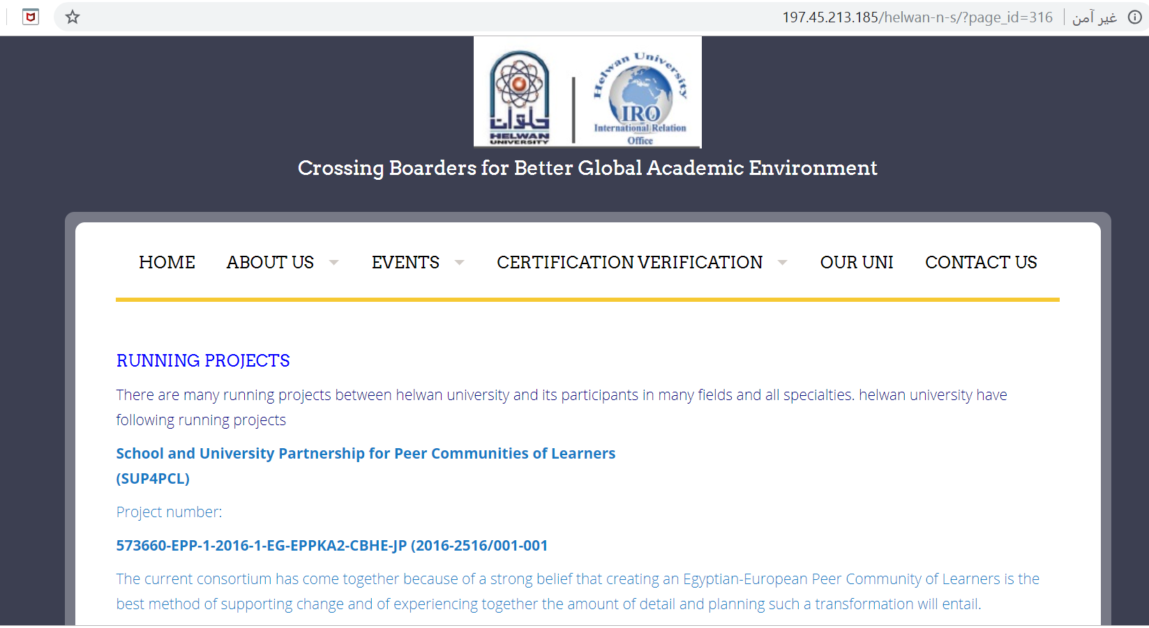
http://197.45.213.185/helwan-n-s/?page_id=316

Slide 6
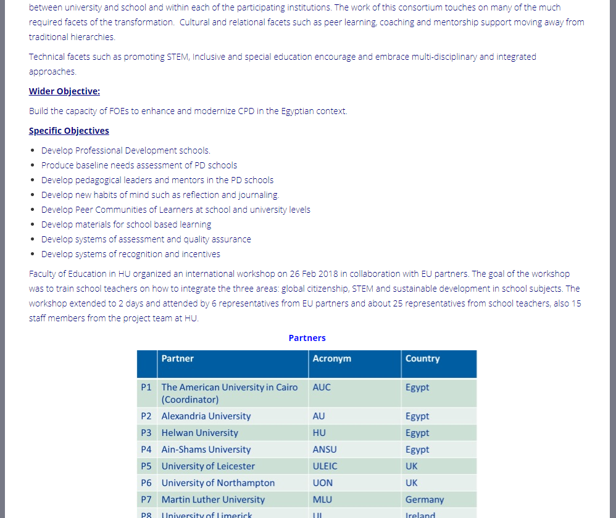
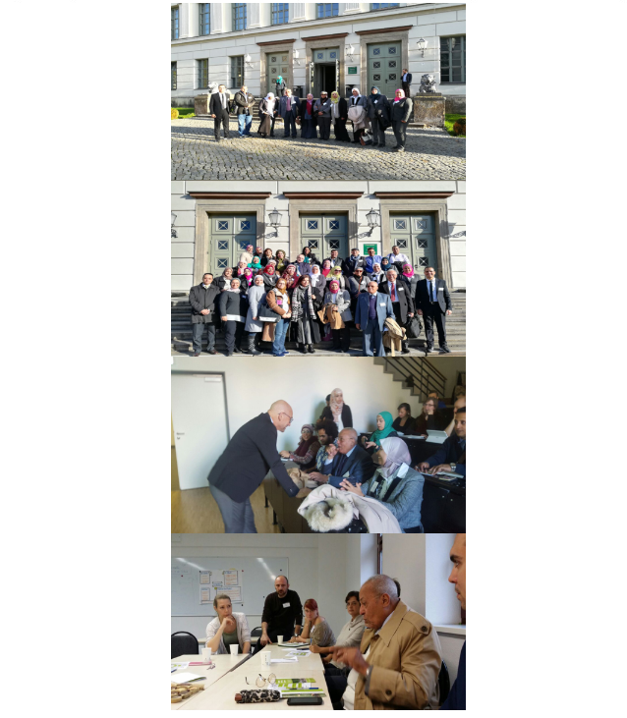

Slide 7
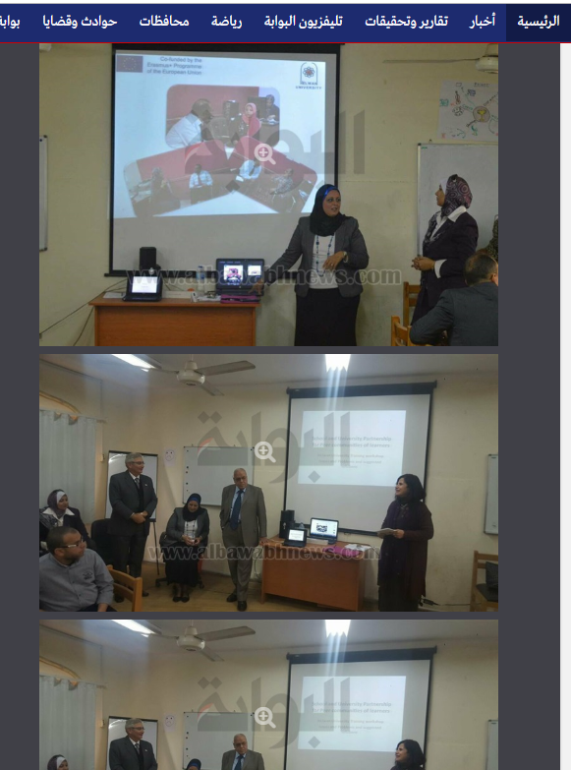
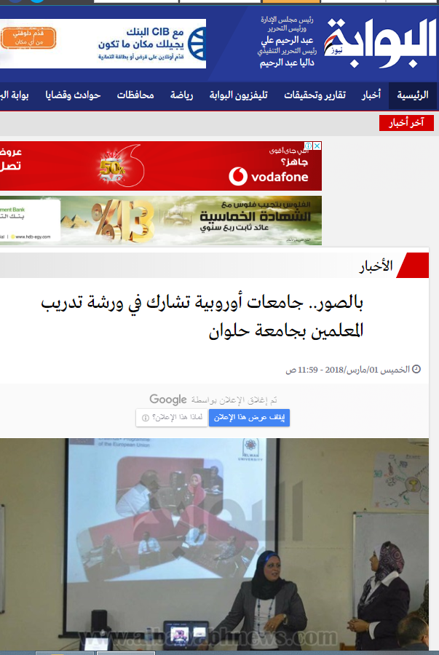
Media Publicity https://www.albawabhnews.com/2968691

Slide 8
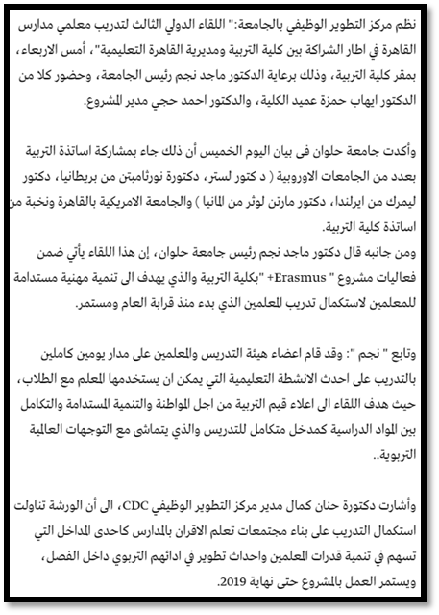
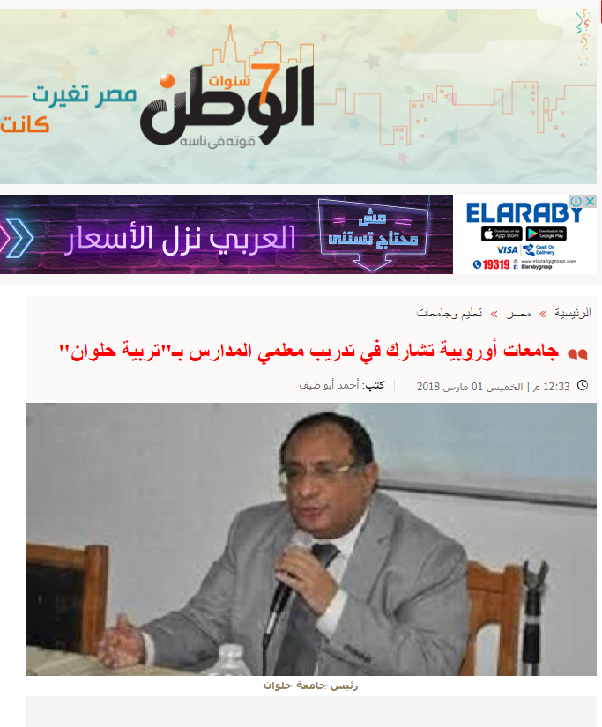
https://m.elwatannews.com/news/details/3120506

Slide 9
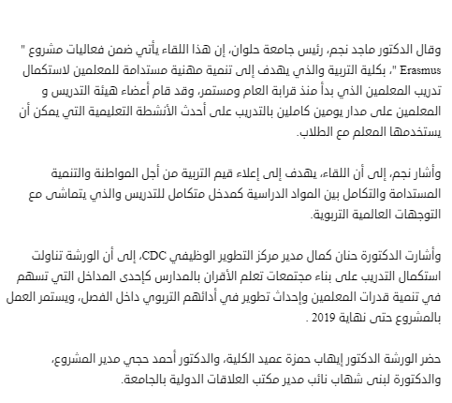
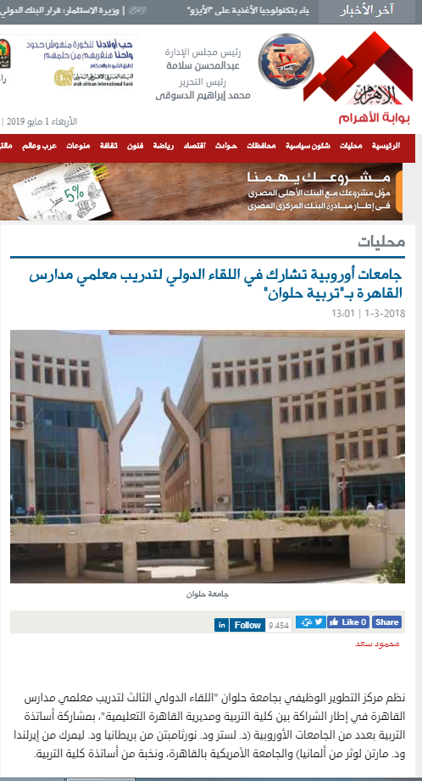
http://gate.ahram.org.eg/News/1834394.aspx

Slide 10
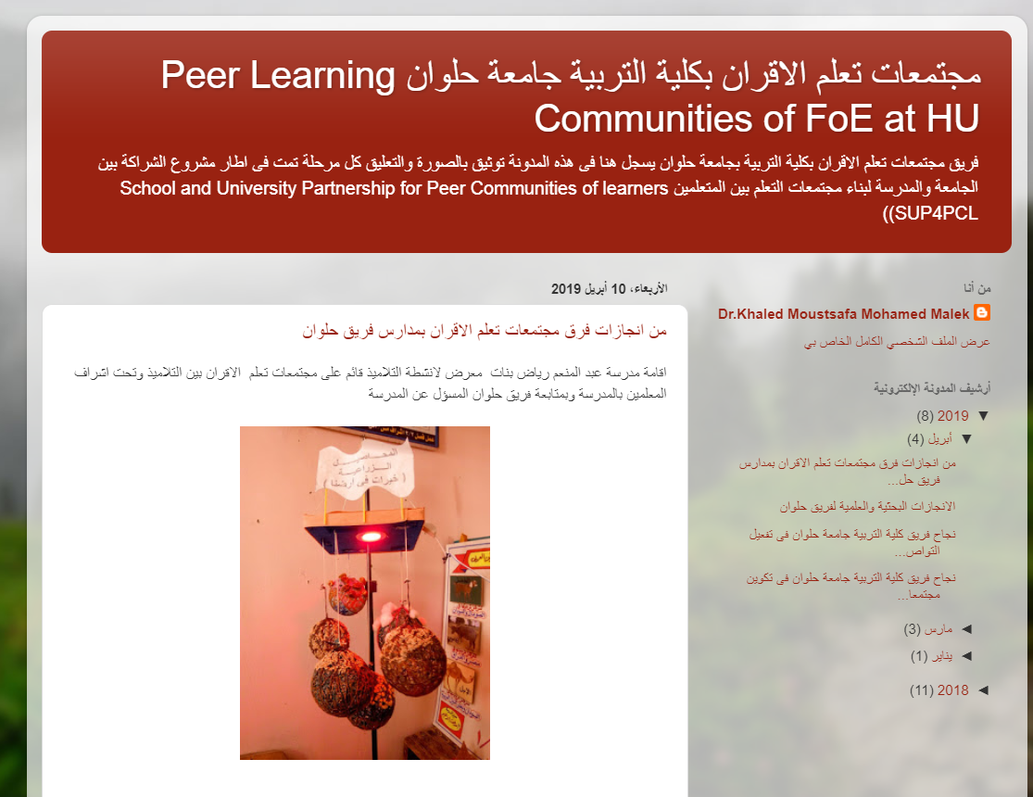
HU Blog
https://helwanpcl.blogspot.com/

Slide 11
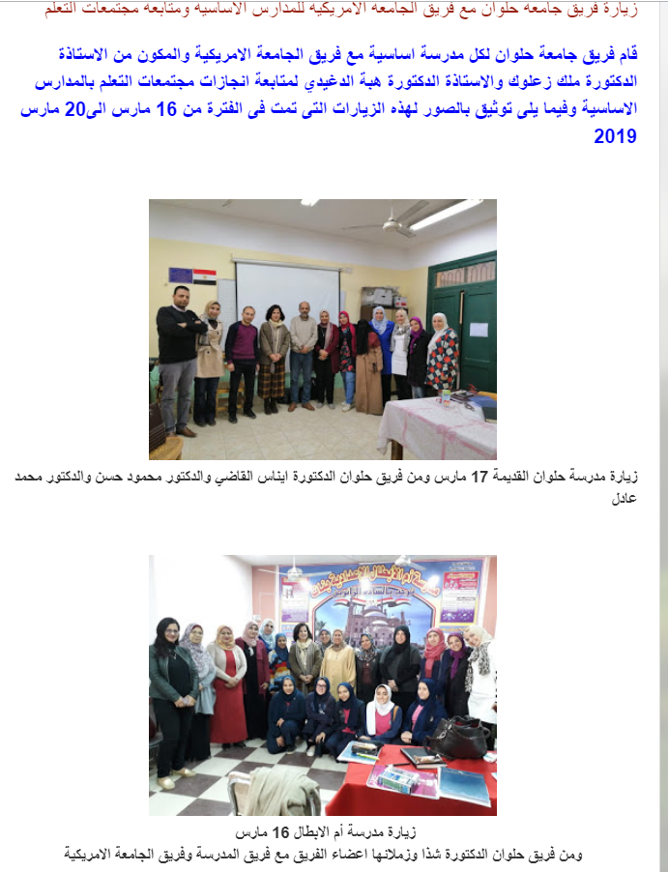

Slide 12
Public Meetings
International seminar with HU community and strategic stakeholders
Target groups:
HU faculty staff.
University students
Researchers
School teachers and principals.
Educational administrative leaders.

Slide 13

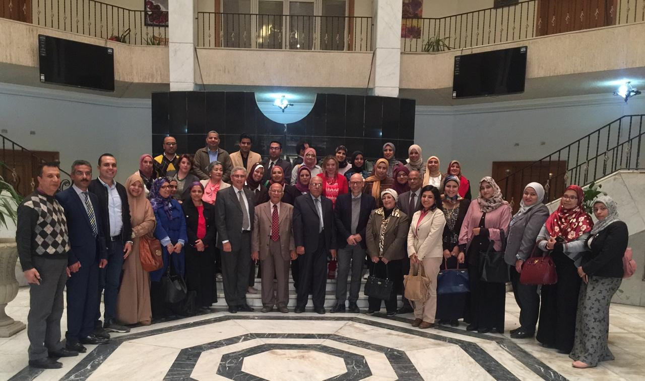

Slide 14
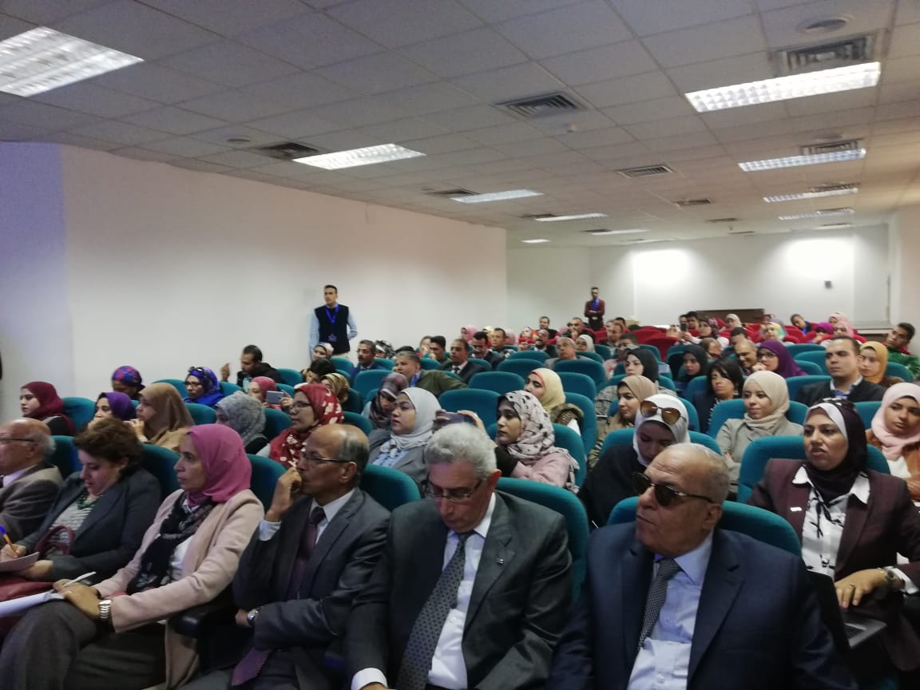
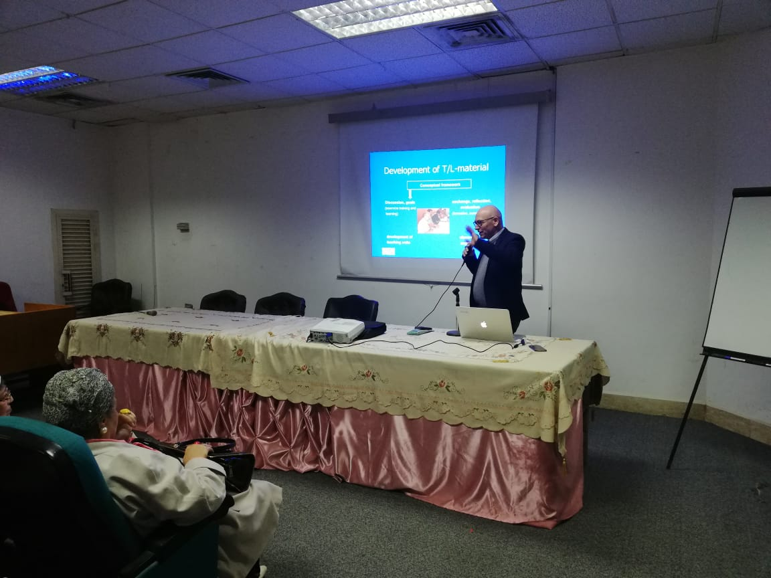

Slide 15
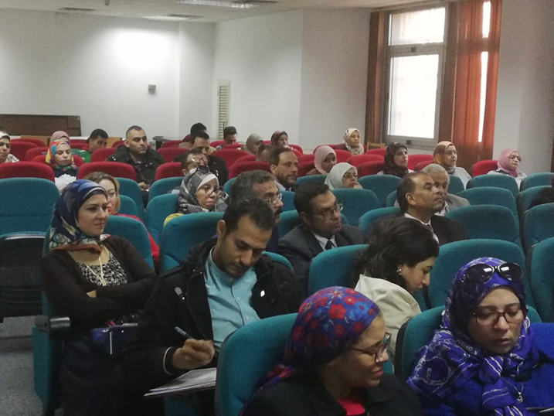
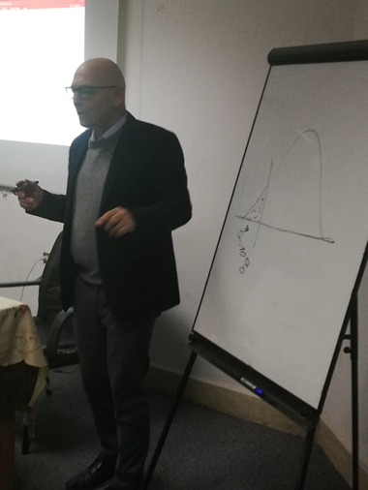

Slide 16
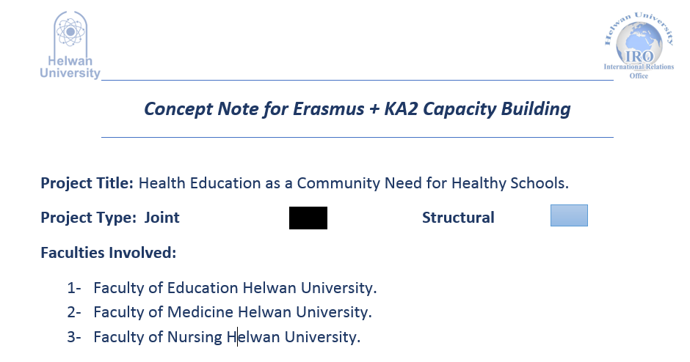
Projects PCLs https://sites.google.com/view/helwanerasmusprojectsfollowup

Slide 17
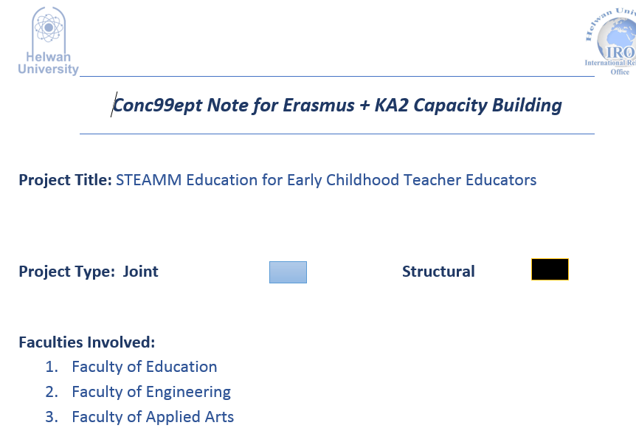

Slide 18
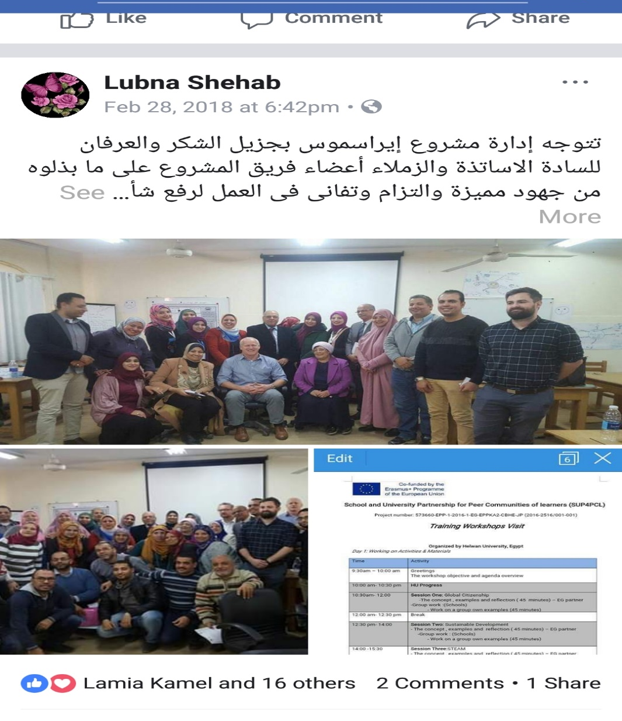
FoE Facebook Page

Slide 19
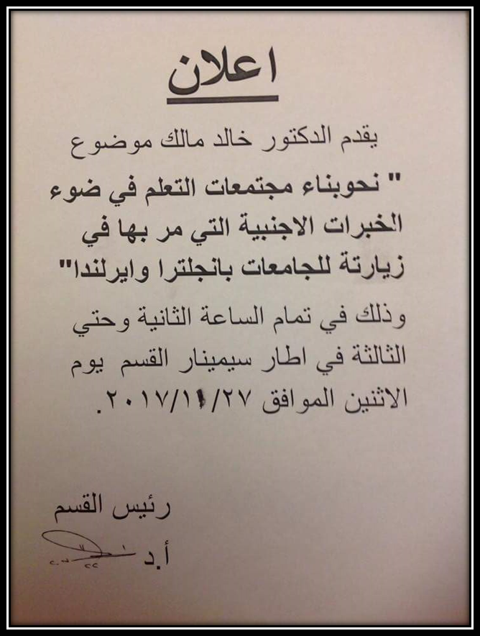
Department Meetings

Slide 20
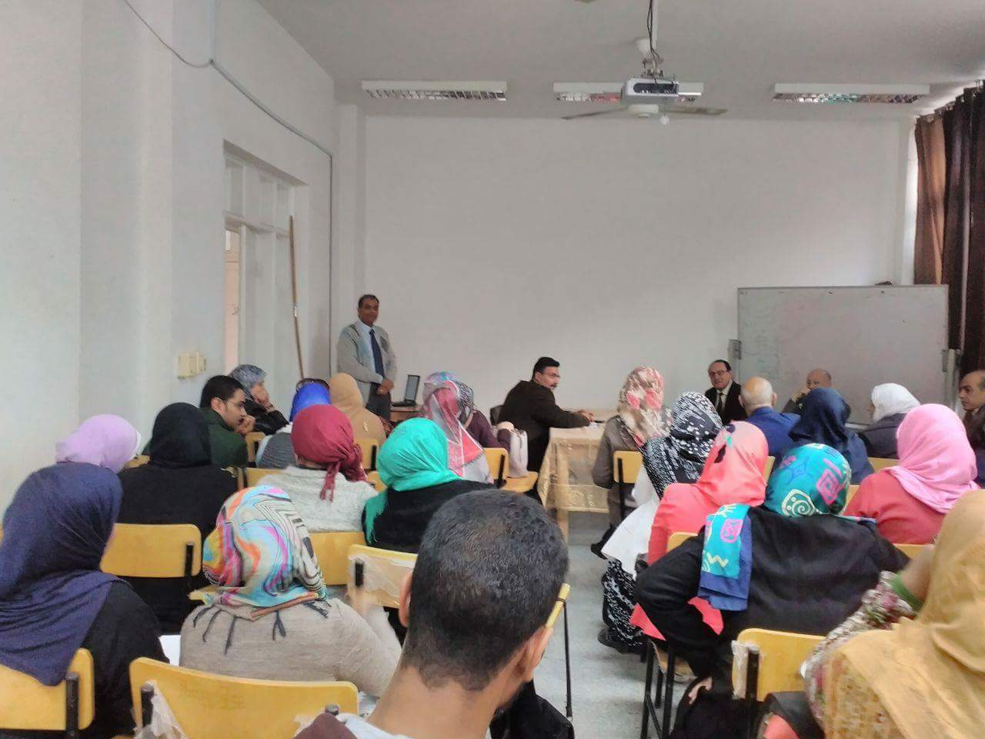

Slide 21
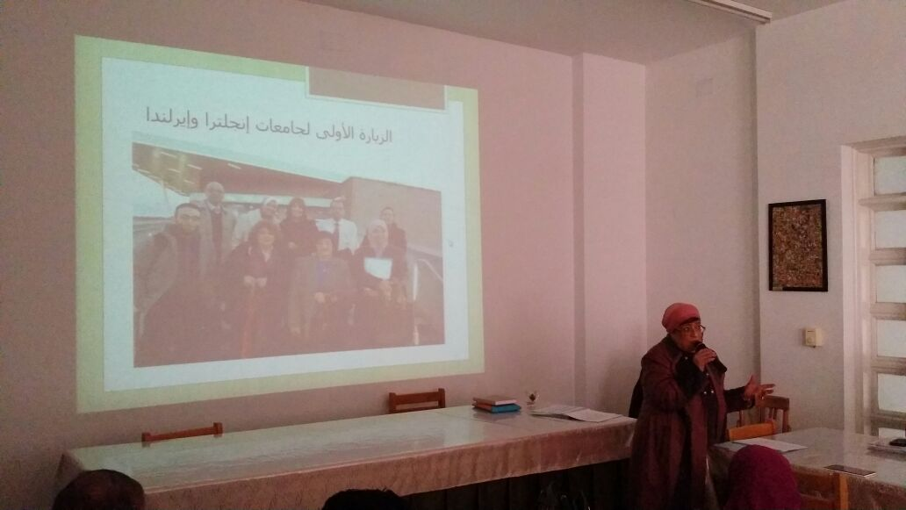
Curricula& Teaching Methodology Department

Slide 22
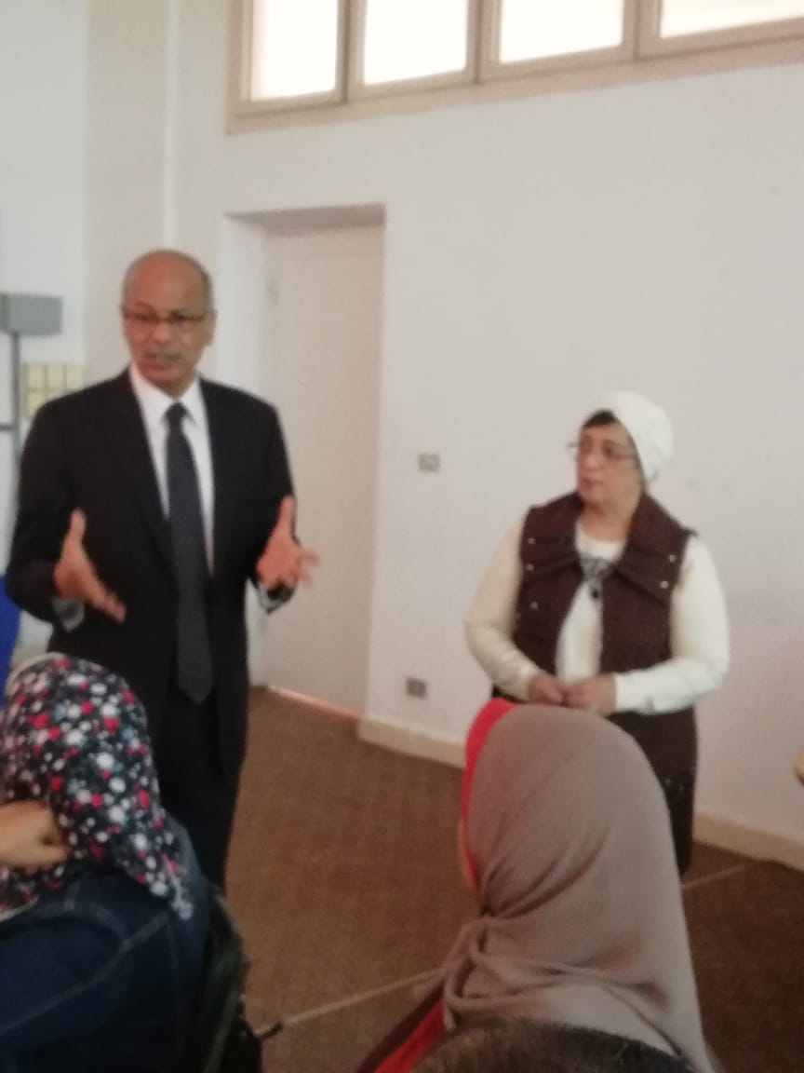
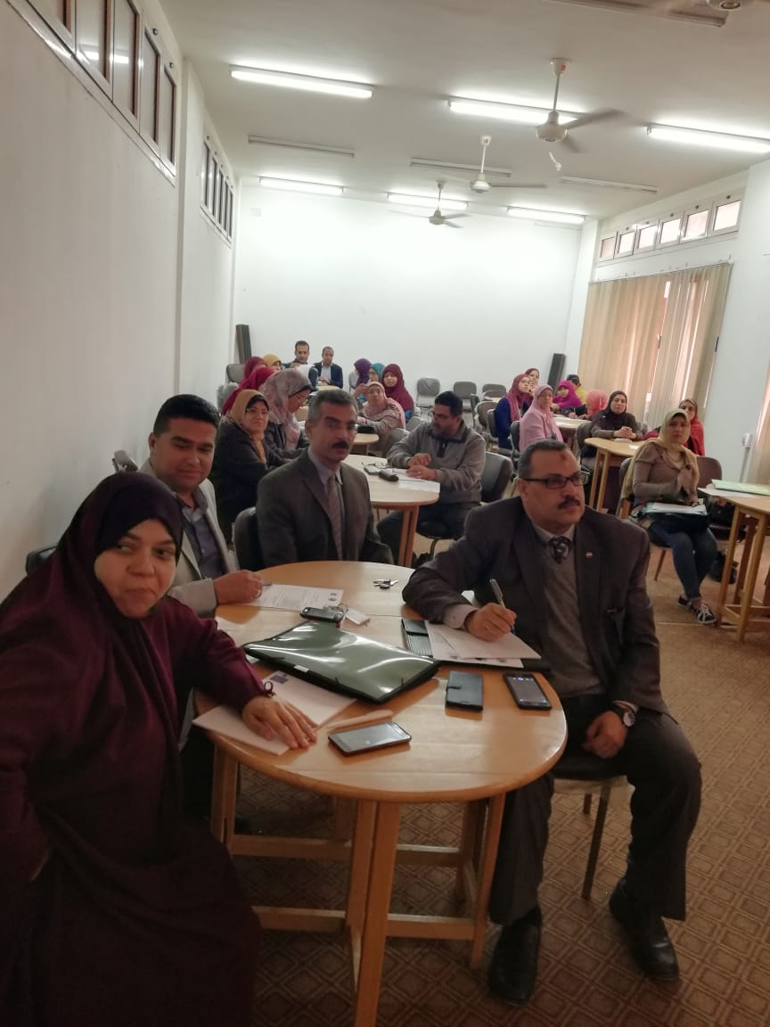
Public Workshops in cooperation with Alumni Unit

Slide 23
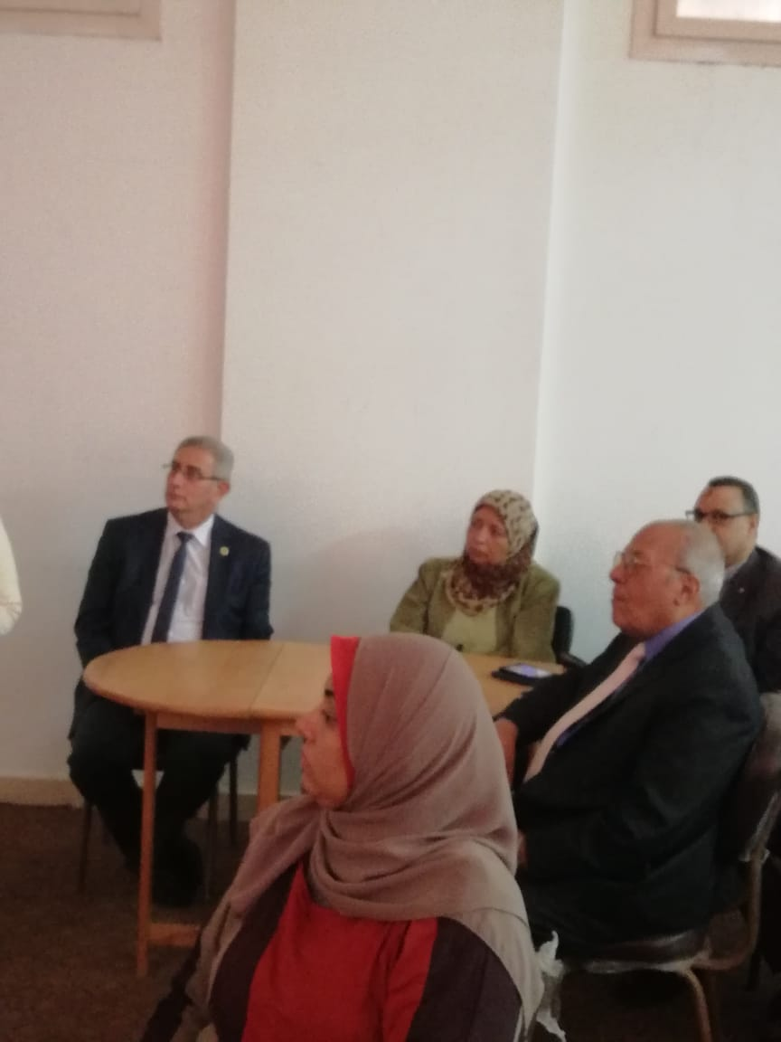
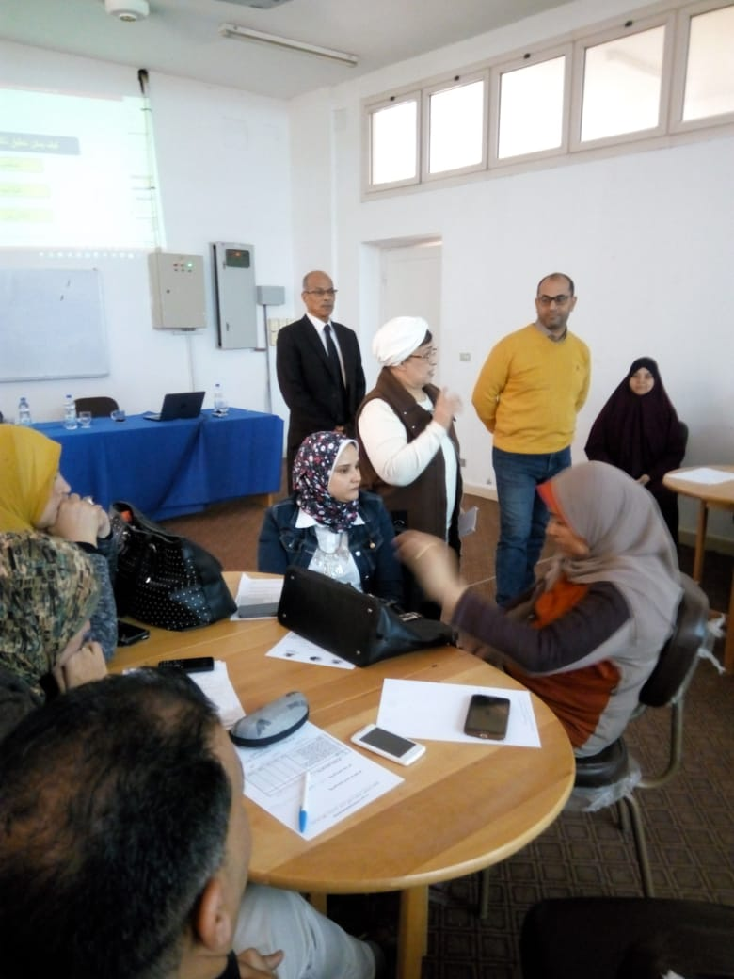

Slide 24
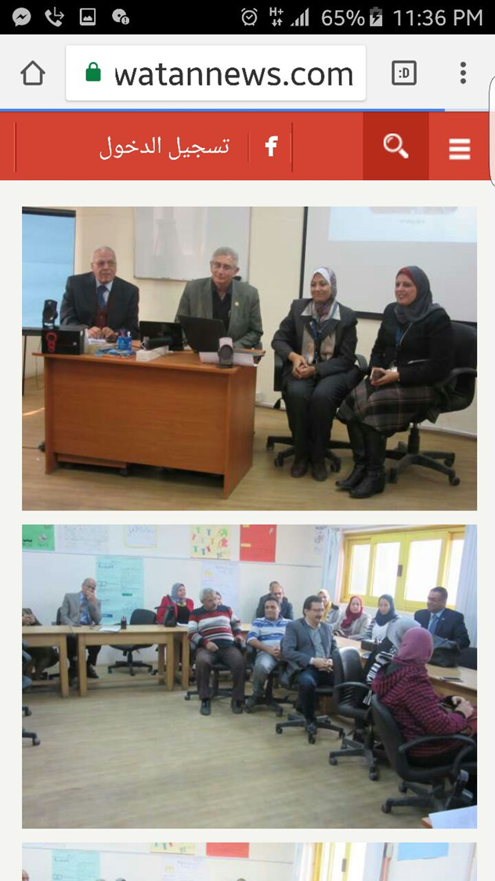
General Seminar about the project for all Departments with the attendance of the Dean.

Slide 25
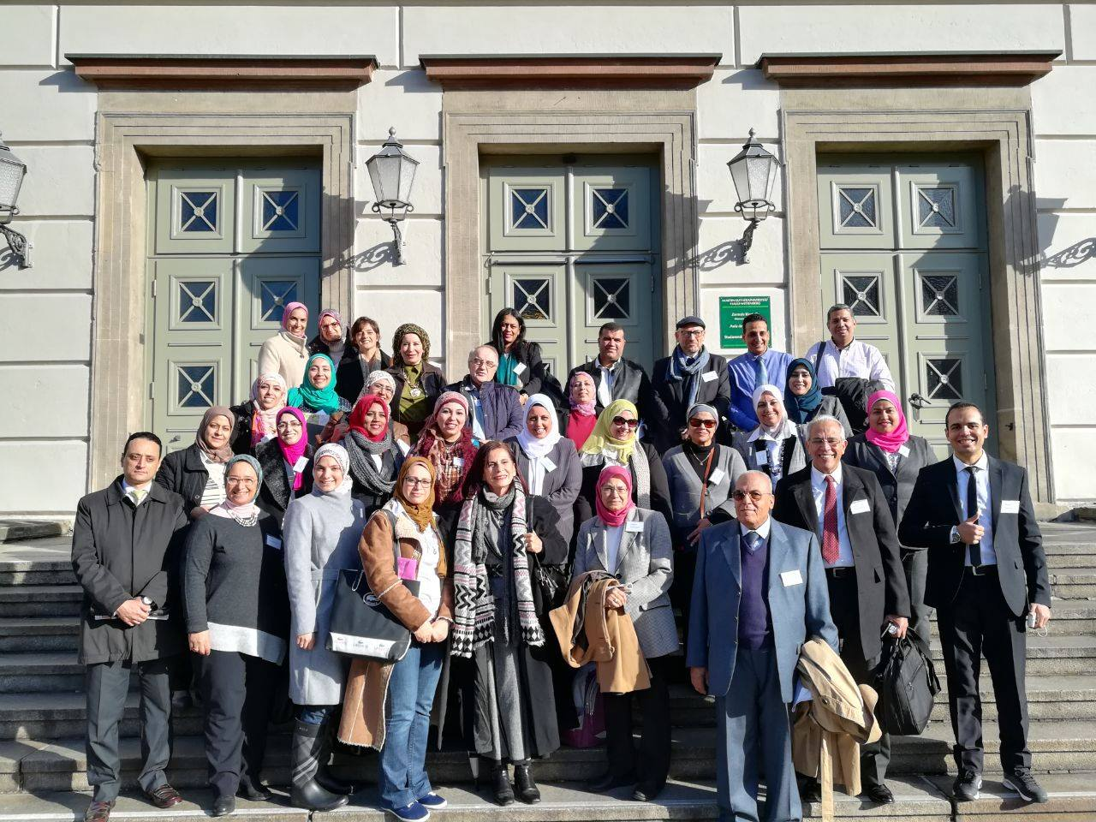
https://www.facebook.com/groups/791388081242477/

Slide 26
Any changes in curriculum, syllabus, student centered approaches, new modules, new programs, new diplomas, new methodologies , internal and external peer review, feed back and assessment mechanisms.

Slide 27
Changes in curriculum and syllabus
Postgraduate course about the development of PCL( PHD).
Undergraduate courses
1- Curriculum development( third year)
2- Practicum( Fourth year).
3- Effective Communication Skills( Credit program in faculty of Engineering)
“ Integration of the three concepts of the project in the development of school curricula and practicum activities”

Slide 28
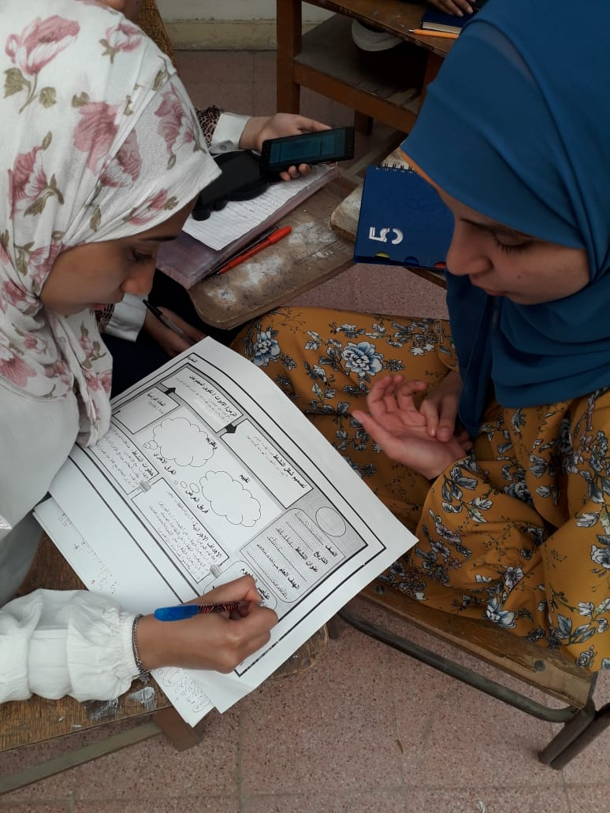
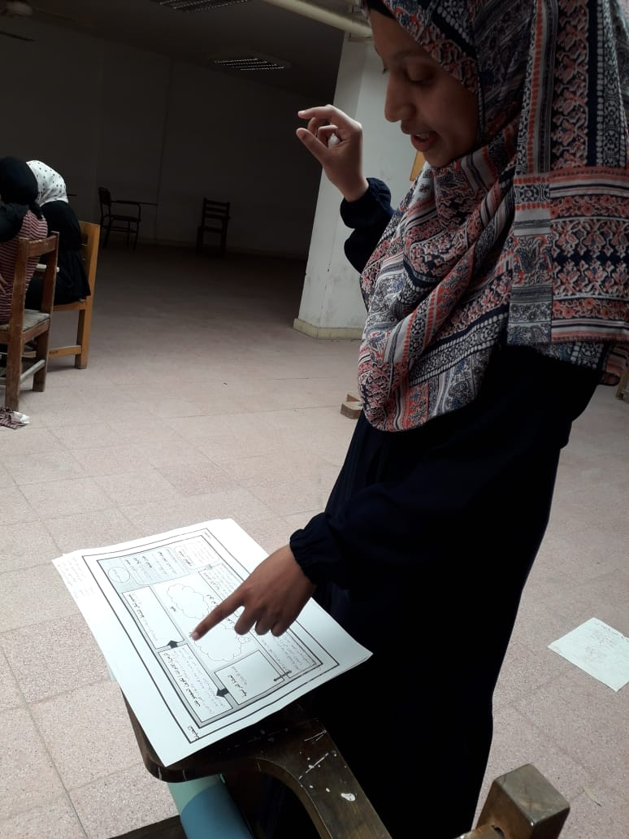
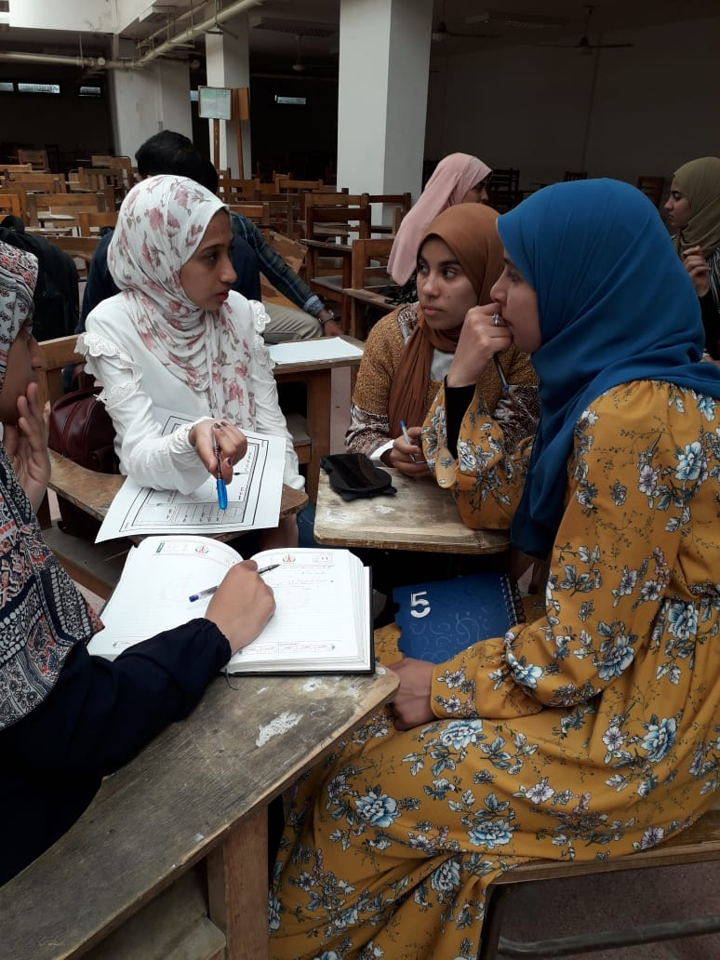

Slide 29
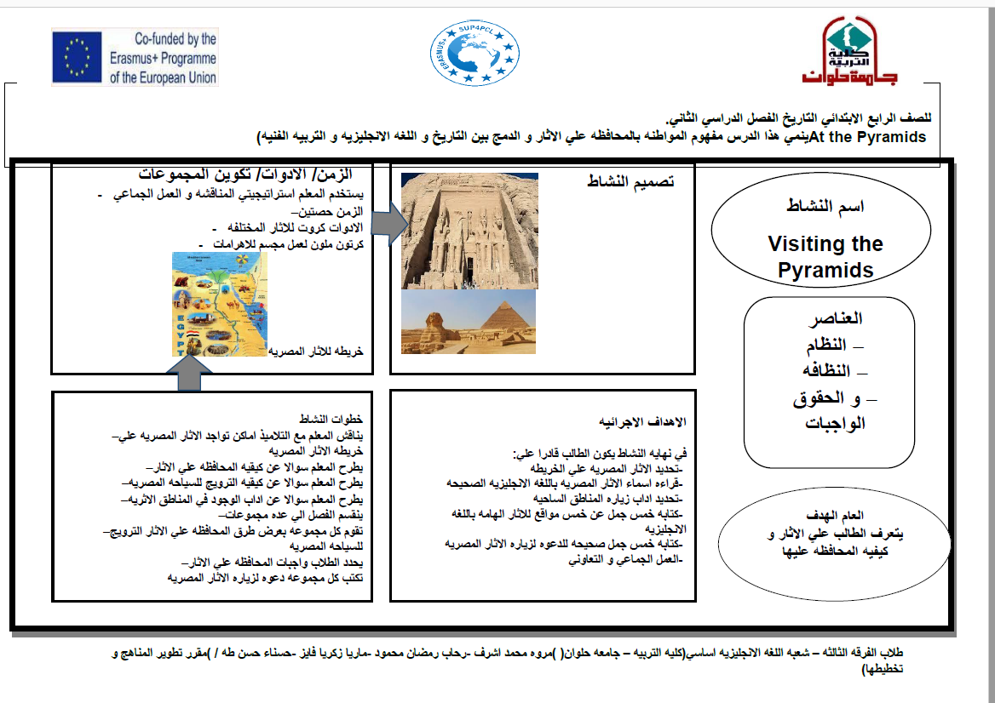

Slide 30
Levels of students participation
Undergraduate students
Postgraduate students.
School students.

Slide 31
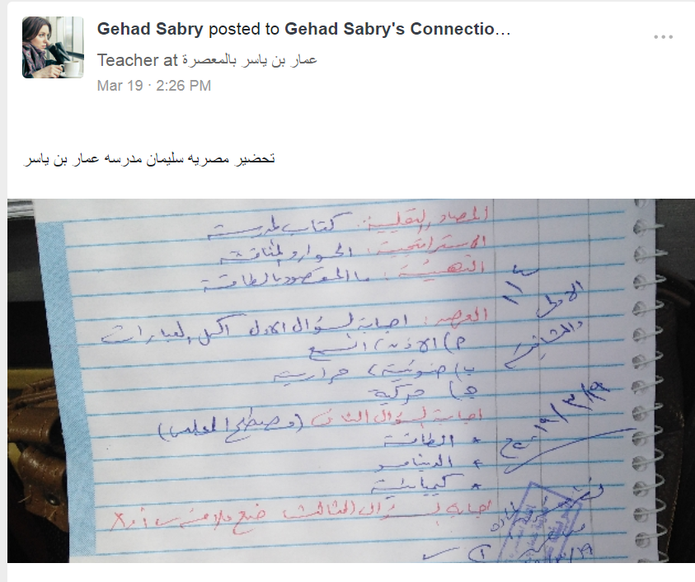
Undergraduate Students

Slide 32
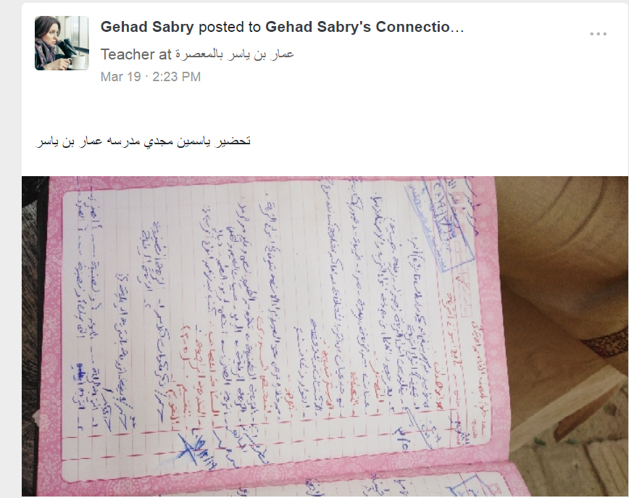

Slide 33
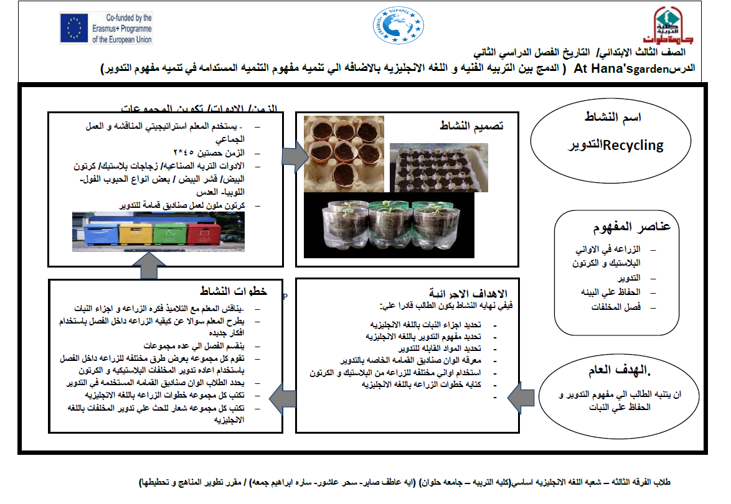

Slide 34
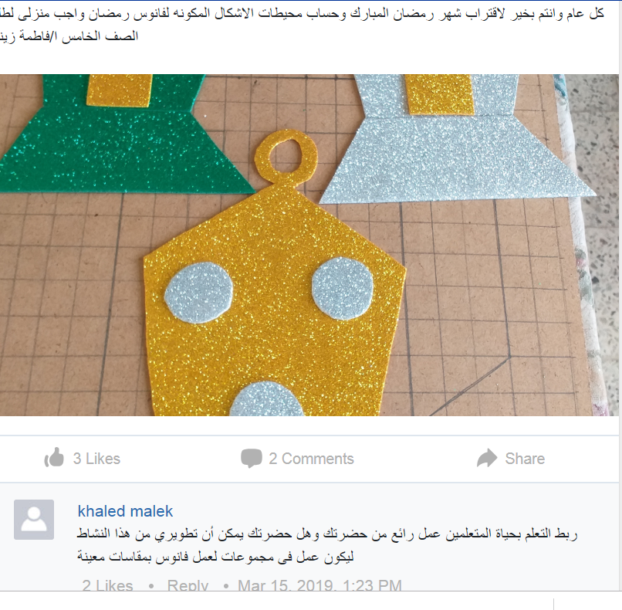

Slide 35
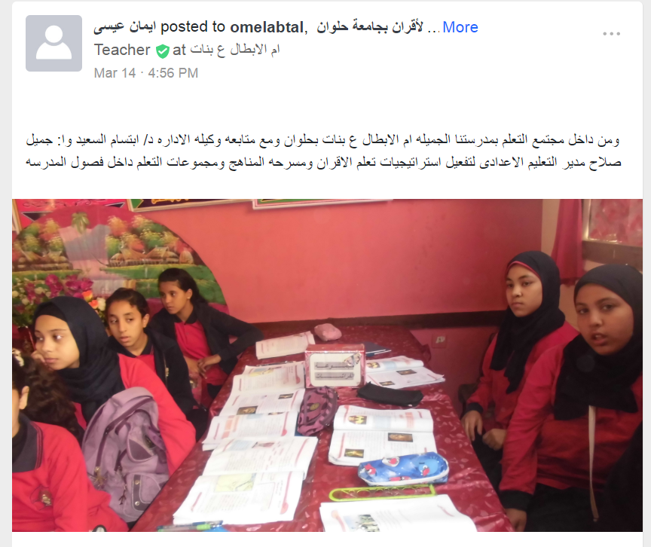
School Students

Slide 36
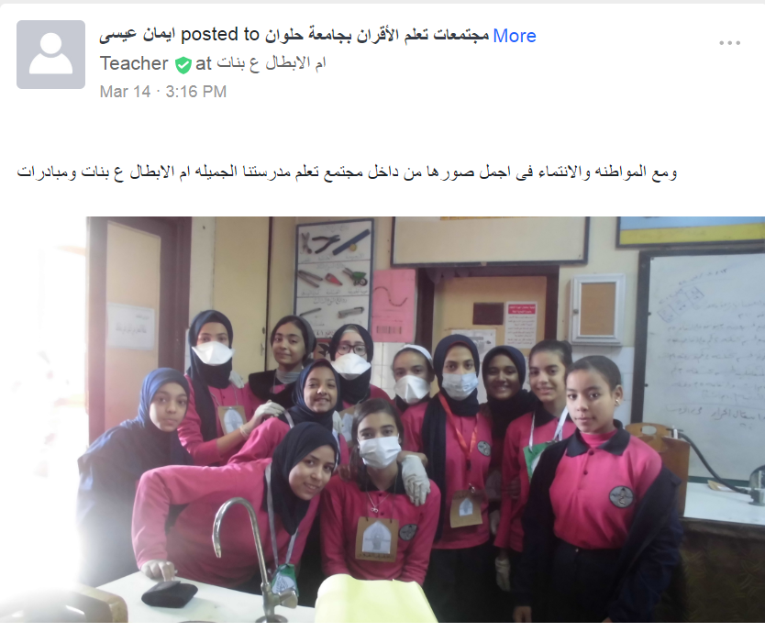

Slide 37
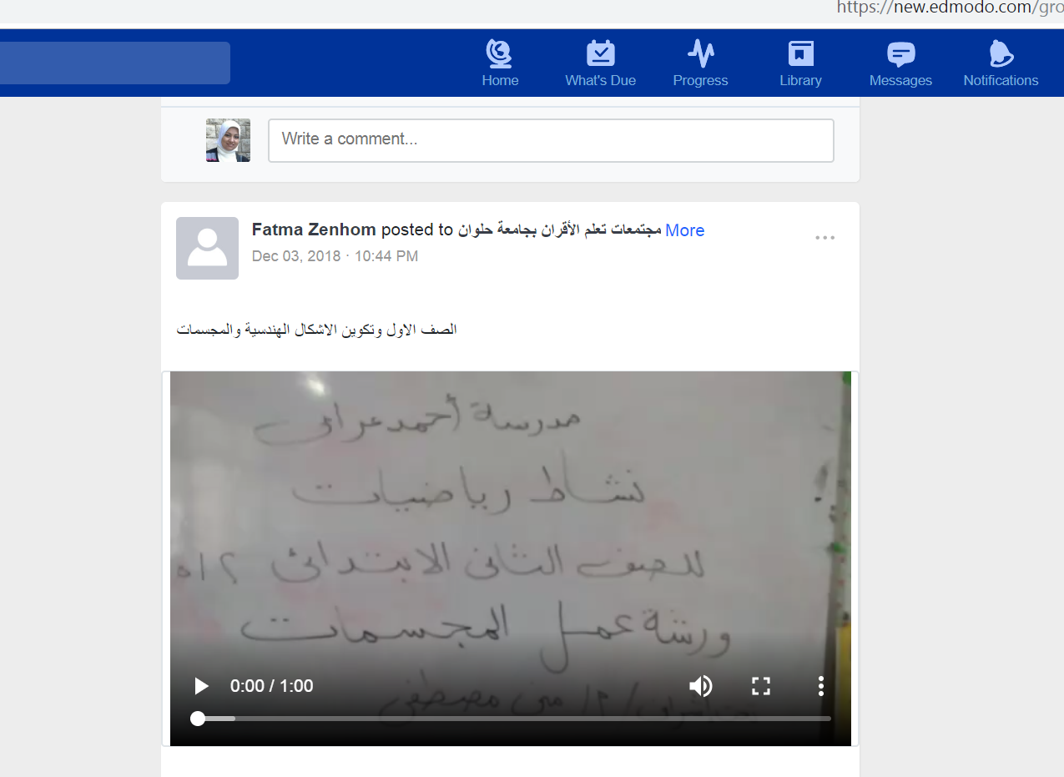
School videos and activities developed by school mentors.

Slide 38
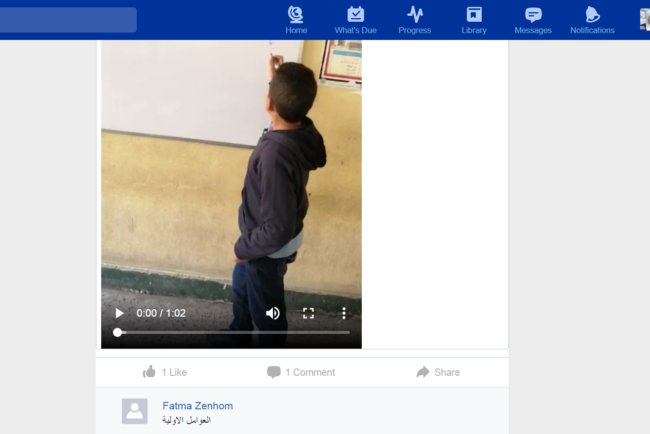
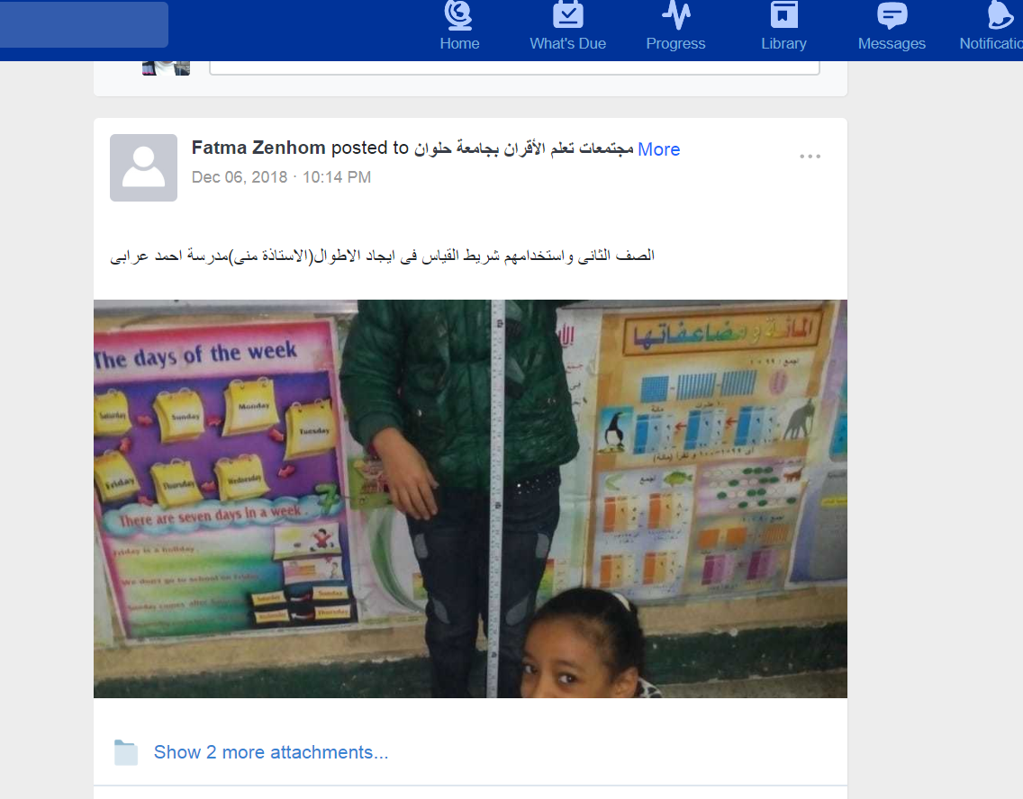

Slide 39
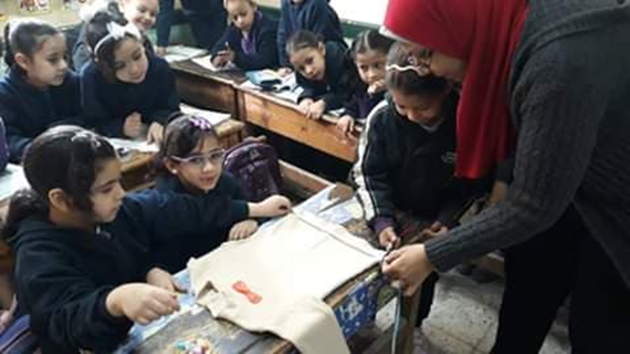
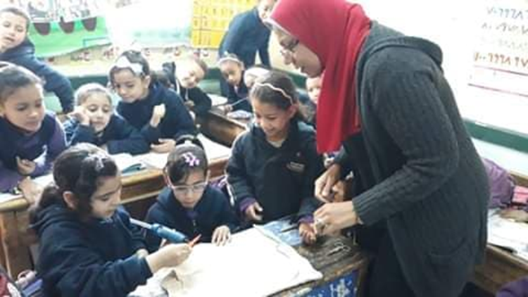
Sustainable Development& Impact on Students
صور توضح نشاط إعادة تدوير المخلفات كأحد السبل للحفاظ على البيئة وتطبيقًا لمفهوم التنمية المستدامة

Slide 40
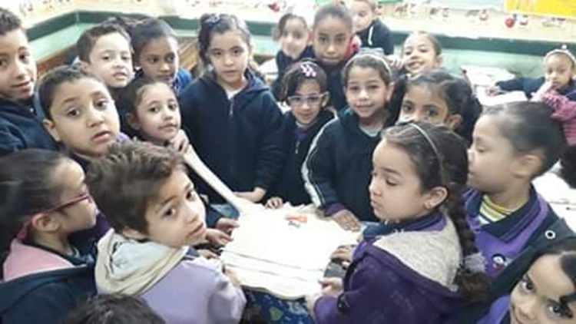

Slide 41
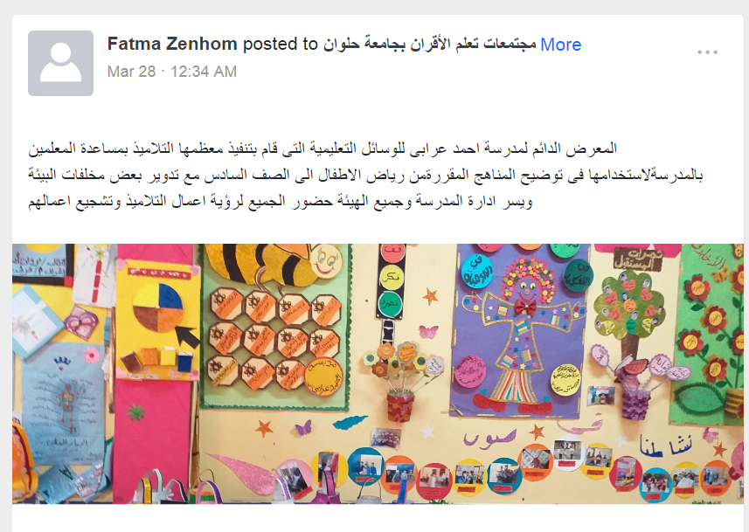
PCL Fair

Slide 42
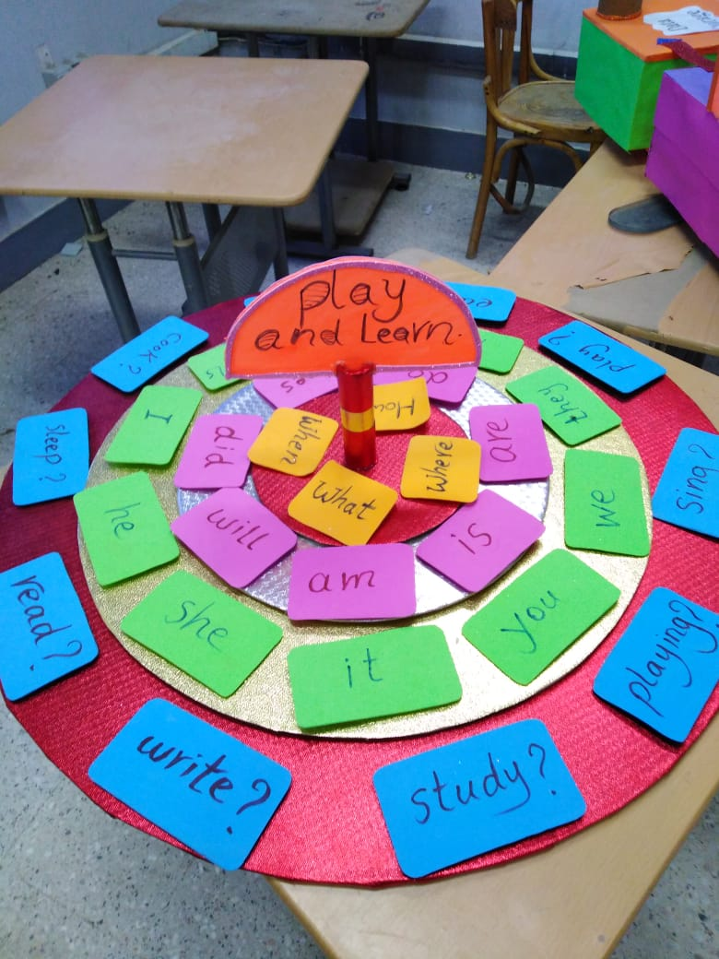
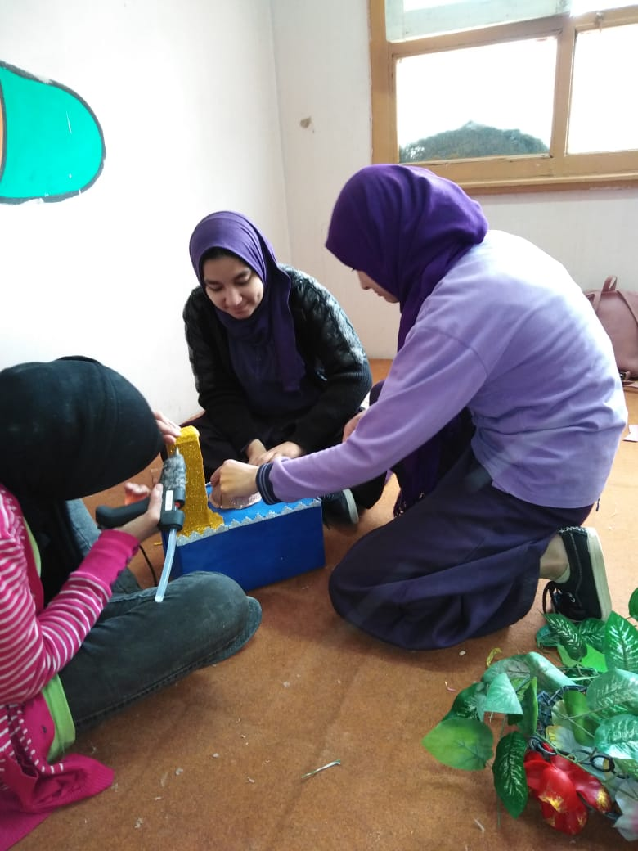

Slide 43
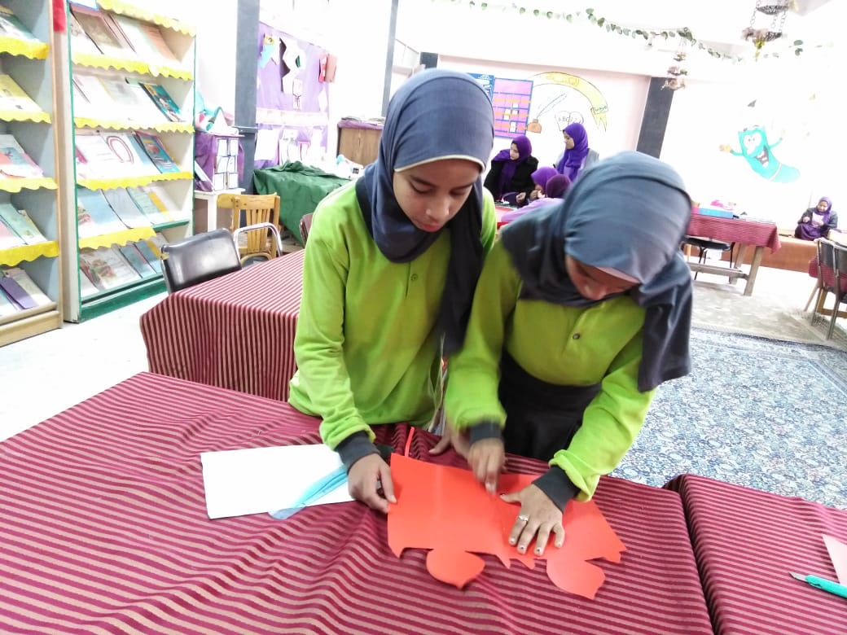
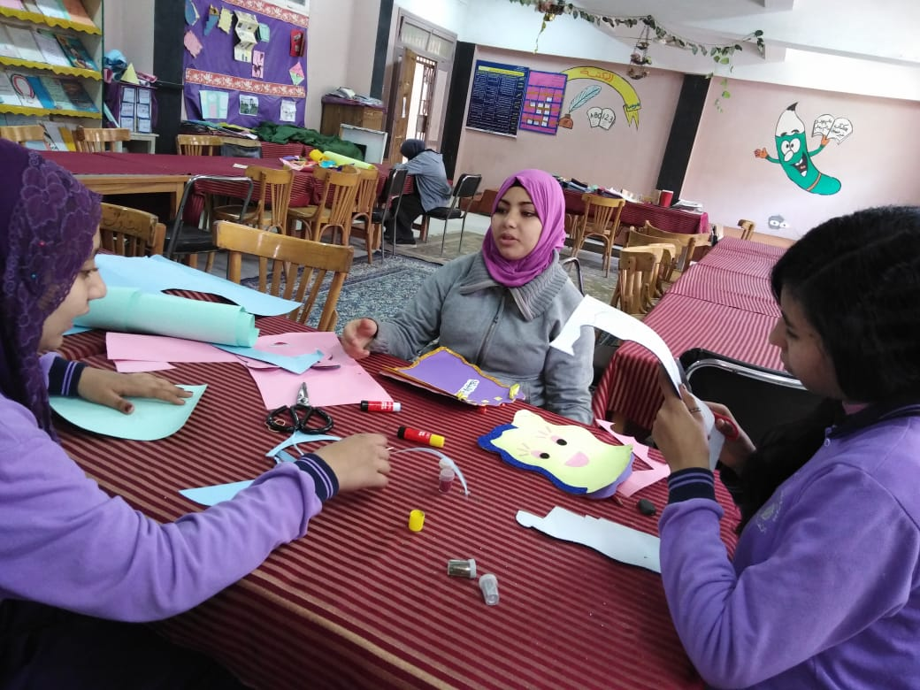
The German Experience

Slide 44

Post graduate students

Slide 45


MA student at Educational Technology Department
https://www.youtube.com/watch?v=FOI-uLvomIc&list=UUg1cIdwjILVAfixfSAHykKQ&index=14

Slide 46


Slide 47


2 PHD researchers
Mr. Ashraf Ahmed Yasser
English Teacher Faculty staff

Slide 48
Feedback and assessment mechanisms.
Edmodo
Web quest.
Web Based virtual text.

Slide 49


Slide 50
Material Development
PCL templates.
Activity design
Documentation
Training materials.
Power point presentations.
Edmodo Library
Online materials.
Web Quest
Text based virtual tour.

Slide 51

PCL Templates
1- Templates for PCL activities

Slide 52

Samples from the PDSs

Slide 53

Together Every one Achieve More " TEAM"

Slide 54


Slide 55

2- Documentation

Slide 56



Slide 57

Training materials
Power point presentations.

Slide 58


Slide 59


Slide 60

Edmodo Library

Slide 61


Slide 62


Slide 63
Online Materials
Web Quest.
Text based virtual tour.

Slide 64

STEAM Web Quest
http://zunal.com/webquest.php?w=393105

Slide 65


Slide 66

Tasks

Slide 67

Process

Slide 68





Slide 69

Evaluation

Slide 70

Teacher Page

Slide 71

Citizenship Text based virtual tour

Slide 72


Slide 73


Slide 74



Slide 75



Slide 76


Slide 77

The role of FOE mentors

Slide 78

Link
https://sites.google.com/site/pclhelwan/

Slide 79

Research proposal writing web quest
https://sites.google.com/site/helwanplcs/

Slide 80


Impact from twinning

Slide 81


MOU

Slide 82


Slide 83


Slide 84


Slide 85


Submission of Erasmus projects KA2

Slide 86


Teaching in diversity by the support of digital media

Slide 87



Mobility exchange for PHD researcher in collaboration with MLU

Slide 88



Mobility activities

Slide 89

Case study Meetings

Slide 90




Slide 92


Knowledge without borders

Slide 93
MLU Case Study Visit
Focus groups.
MLU questionnaire
Data collection.

Slide 94


Slide 95


Slide 96

Policy Makers Meeting

Slide 97


Slide 98

Focus Group

Slide 99
Description of the various training and mobility activities both international and national (at school and at university).

Slide 100

Training Activities
International Training workshop by MLU:
“ Interpretation as a Method”
13- 14 June 2019

Slide 101
Training workshops
EU workshops at HU by EU partners
HU workshops by FoE mentors.
School workshops by FoE mentors at the five main PDSs.
Clustering school workshops by school mentors.

Slide 102

EU workshops at HU by EU partners
Dec. 2017 workshop

Slide 103



Feb 2018

Slide 104


Slide 105


HU workshops by FoE mentors

Slide 106


School workshops by FoE mentors at the five main PDSs.

Slide 107


Clustering school workshops by school mentors.

Slide 108


Slide 109



Slide 110


Teachers & Teachers
Training workshops between teachers
Formal meetings supported by HU
Arabic Language PCL

Slide 111


Math PCL

Slide 112

Activation of the quality and training unit:
Training annual plan 2018/2019

Slide 113


Slide 114
Examples of training programs received during the academic year 2017-2018: Preparing the school schedule electronically. Class management and modern teaching methods. Training on how to sign up to the Egyptian Knowledge Bank.

Slide 115


Project management team & FOE staff.
Monitoring visits
Follow up the impact of our PCL on students during their summer activities in school

Slide 116



Slide 117


AUC Monitoring Visits

Slide 118
Impact of the project on enrollment at university and school level as well as career development for participants.

Slide 119
Career Development for participants
New teaching styles
Projects proposal writing
( for the first time HU community submitted 7 projects for Erasmus KA2)
Use of ICT.
Design interactive activities
Active learning & learning for fun

Slide 120
What skills were acquired (IT skills, research skills, behavioral and academic skills.

Slide 121
FoE team
Monthly meetings
IT skills( Edmodo- Web quest- PPT ……)
Team building skills
Communication skills
Human relationships
Time management.

Slide 122




Slide 123


Slide 124
School Team
IT skills.
Edmodo
Leadership team building.
Quality assurance culture
Research skills.
Design research paper
Teamwork
Knowledge skills( citizenship, Sustainable development, STEAM education)

Slide 125
Degree of participation, ownership, motivation towards the project.

Slide 126
Degree of ownership towards the project
School mentors
Support of university top management and educational directorate
Mentors at the educational administration.
Creativity in teaching styles
Regular upload of activities from school mentors.
Commitment of mentors regarding documentation and feedback on Edmodo.

Slide 127


