Slide 1



School and University Partnership for Peer Communities of Learners (SUP4PCL)
Project number:
573660-EPP-1-2016-1-EG-EPPKA2-CBHE-JP (2016-2516/001-001)
2nd May 2019
AU

Slide 2
AU Activities: Schools
Selecting 5 PD schools (October 2017)
Conducting Schools’ needs assessment (October- December 2017)
Working with the schools to integrate the project’s new culture (on-going)
Developing and delivering tailored PD programmes for the schools (June-September 2018)
Supporting Schools’ Training & Quality Assurance units, mentors, PCLs and inquiry based approaches (on-going)

Slide 3
AU Activities: Schools
Supporting schools to integrate more interactive and collaborative teaching and learning practices (e.g. Material development)
Schools’ Clustering (November 2018)
Schools’ clusters workshops at AU (November 2018- April 2019)
Collecting data for the schools’ case studies (on-going)
Communication & logistics with Directorate in Alexandria (on-going)

Slide 4
Outcomes
Documentation of PD schools’ initial profile and progress (baseline reports & progress reports)
PD programmes delivered in all schools (PD materials)
PD programmes integrated in the schools’ Training & Quality Assurance units work plan for this academic year: 2018/ 2019
Schools’ developed materials

Slide 5
Examples of Materials Developed by AU Team
1. STEAM, ESD, GC
2. Teachers’ Roles
3. PCLs
4. Active Learning
5. PD Schools
6. Effective Mentoring
7. Using EKB in Education
8. Strategies for Teaching Thinking Skills
9. SEN
10. Quality Classrooms
11. Lesson Study

Slide 6
Collecting Materials from Schools
Different levels of contributions
Opportunities for providing feedback on activities
AU team collects materials- hard copies
AU team creates soft copies of all materials

Slide 7
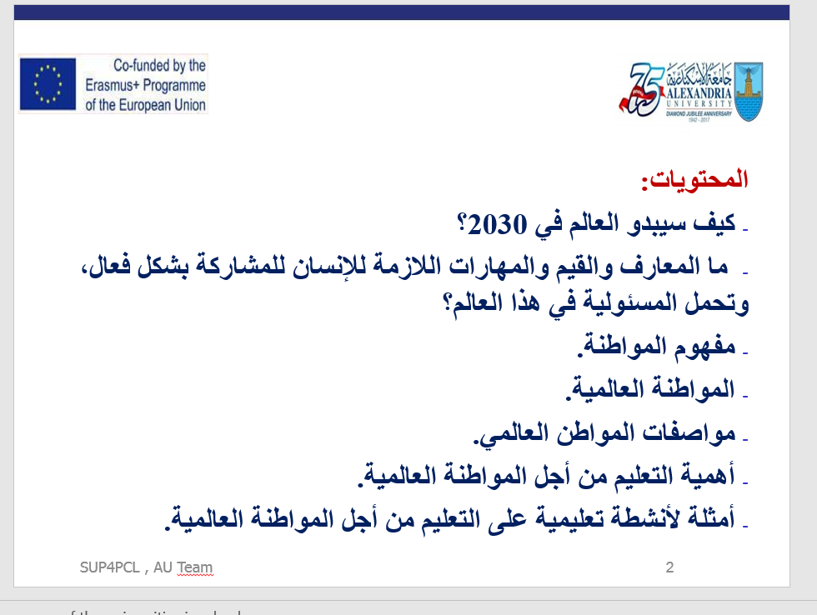

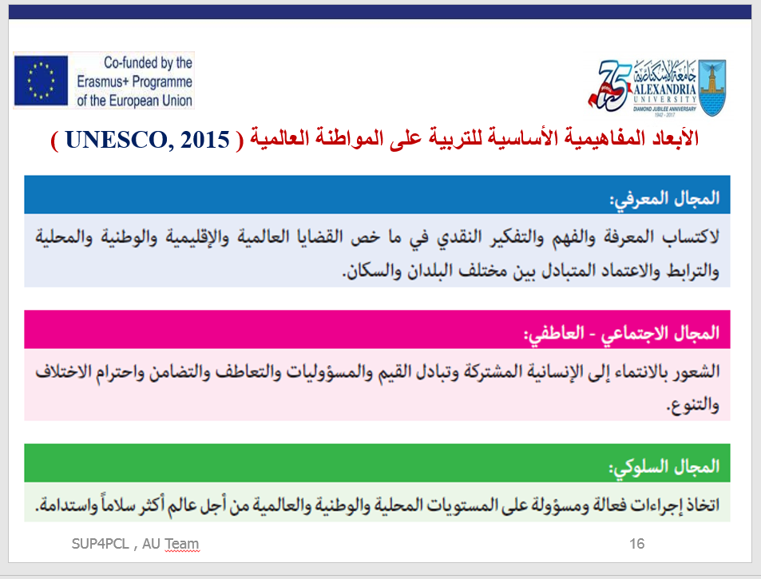
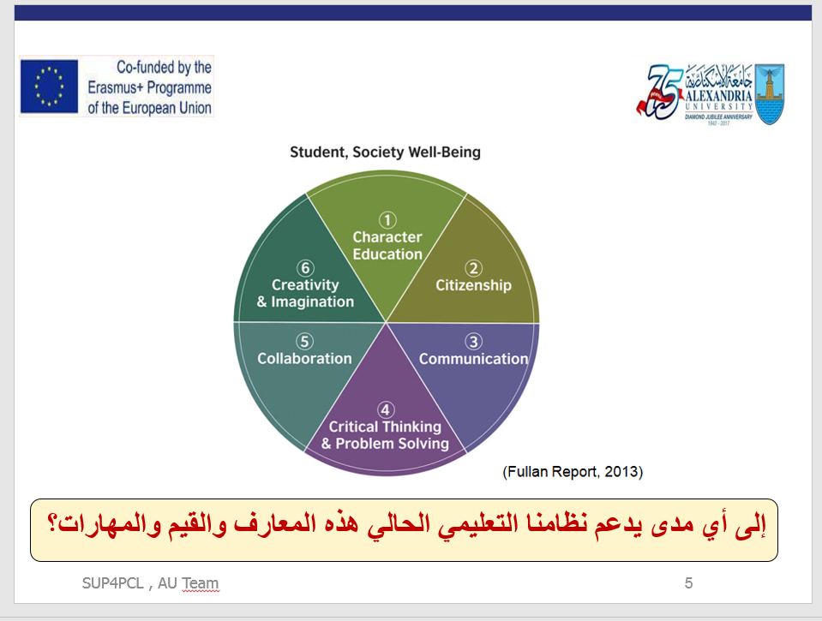
1. Introducing Schools to GC

Slide 8
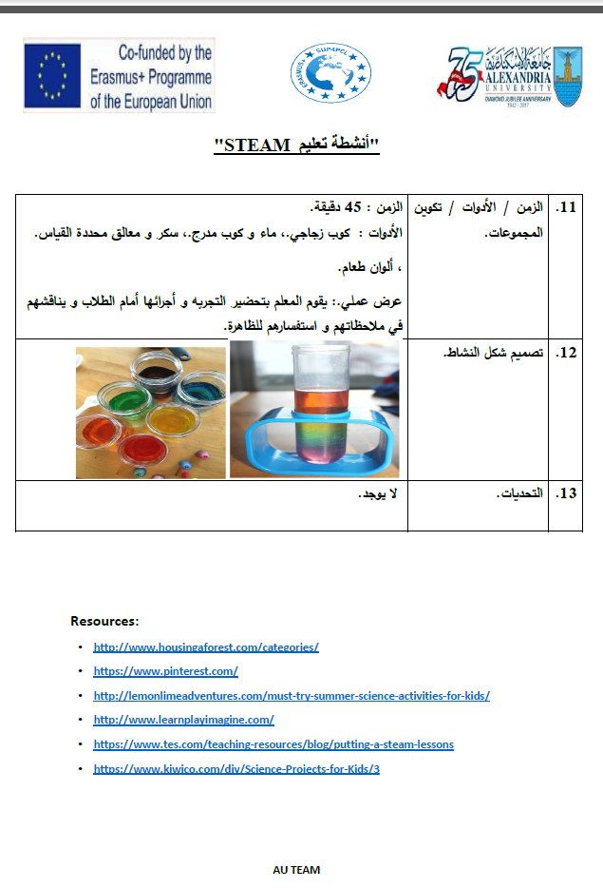
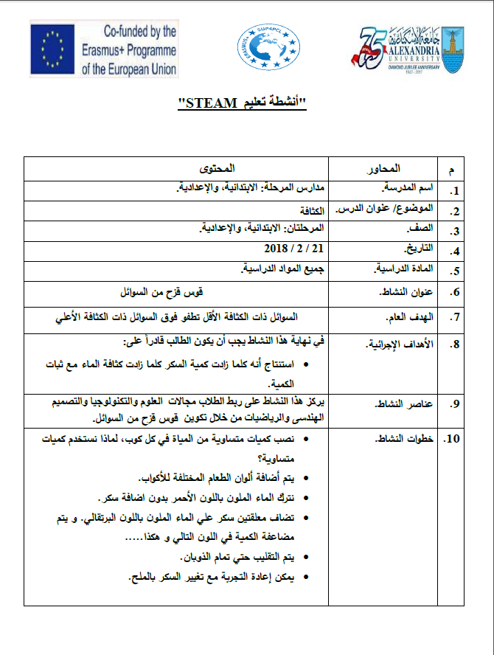
2. Sharing Example Materials: STEAM

Slide 9
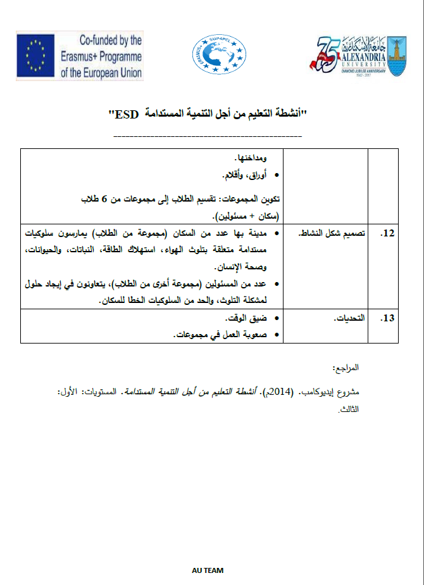
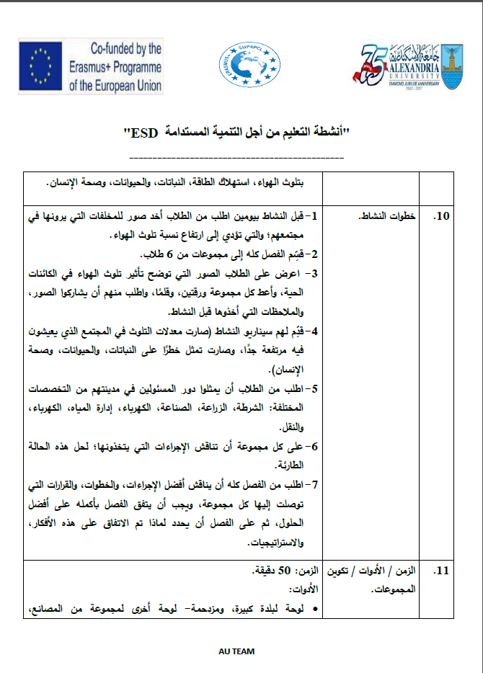
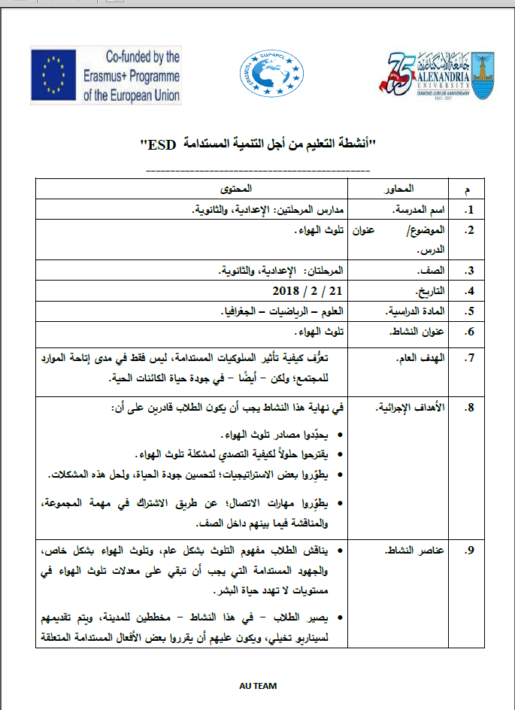
2. Sharing Example Materials: ESD

Slide 10
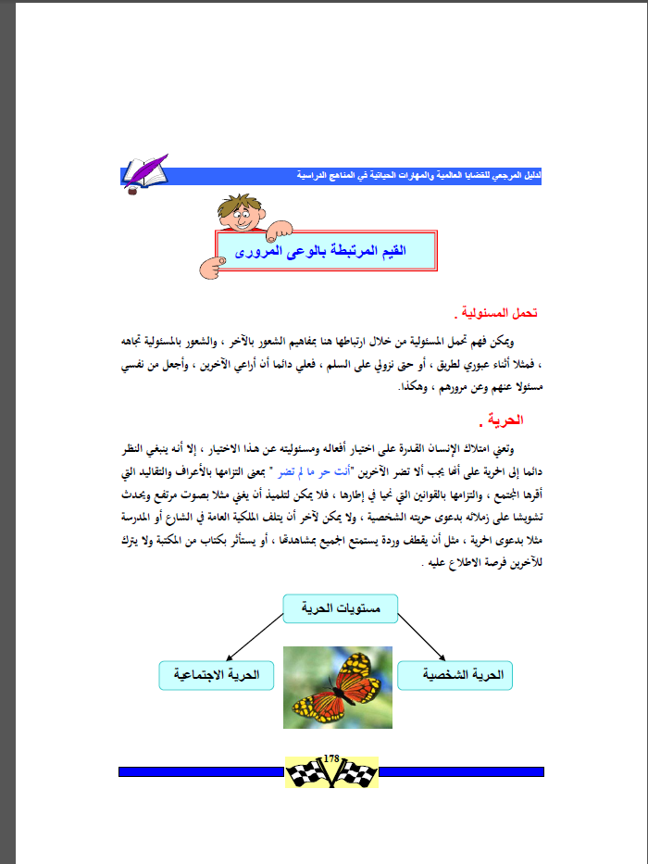
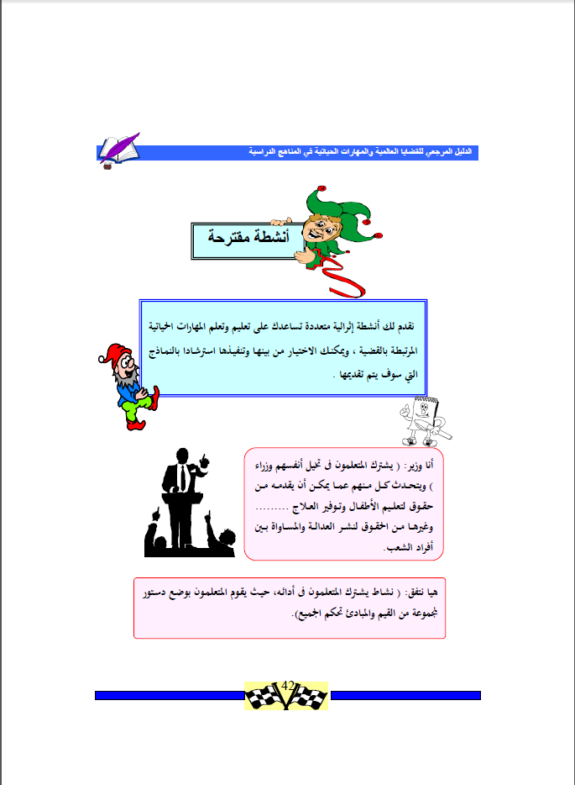
2. Sharing Example Materials: GC

Slide 11
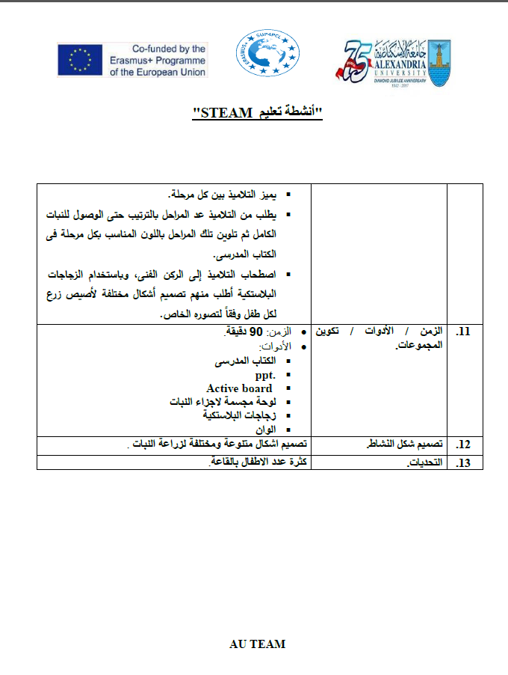
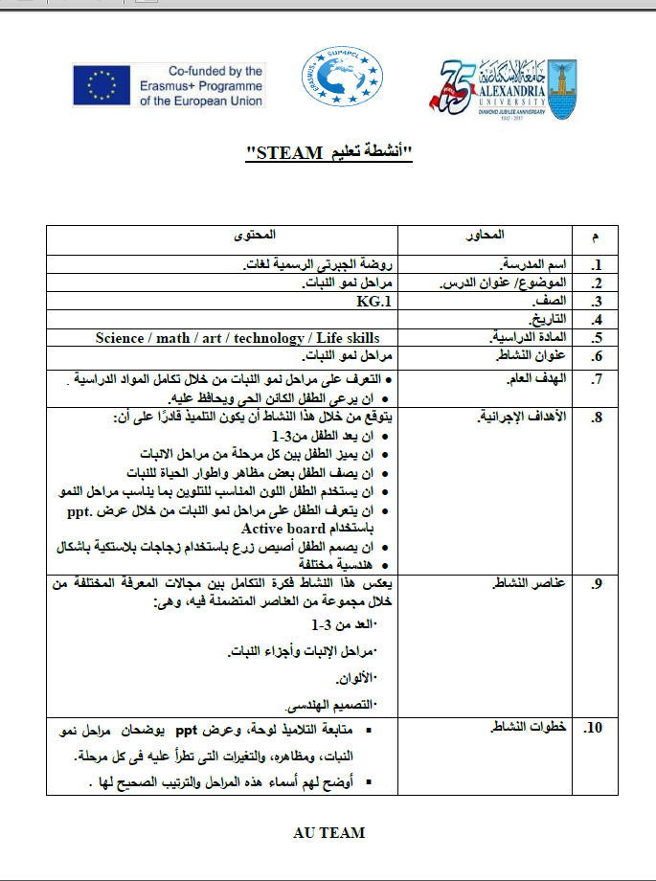
3. Schools Develop their Materials: STEAM

Slide 12
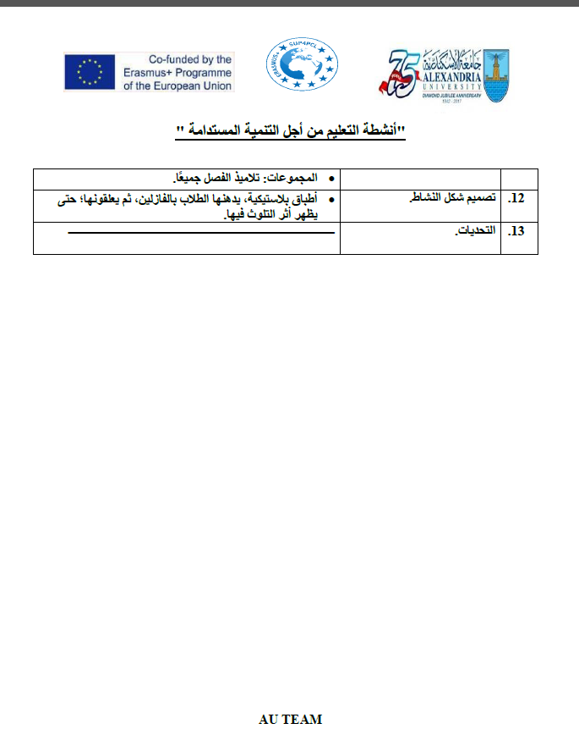
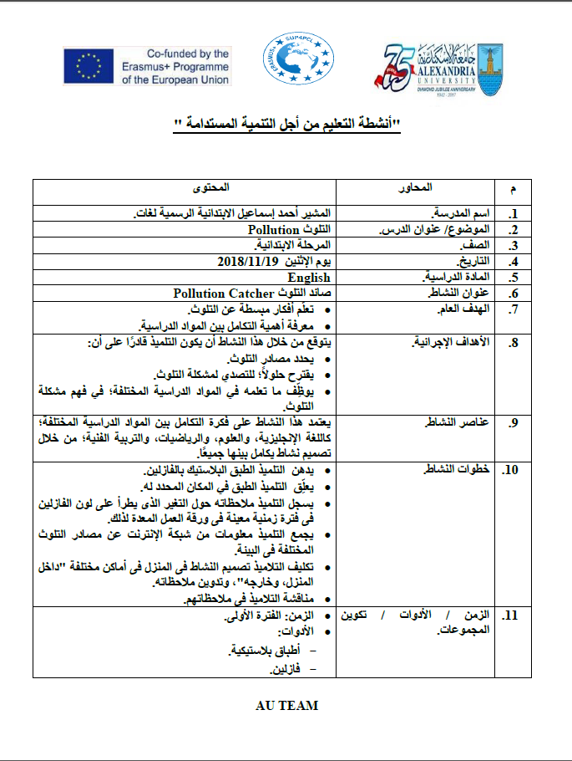
3. Schools Develop their Materials: ESD

Slide 13
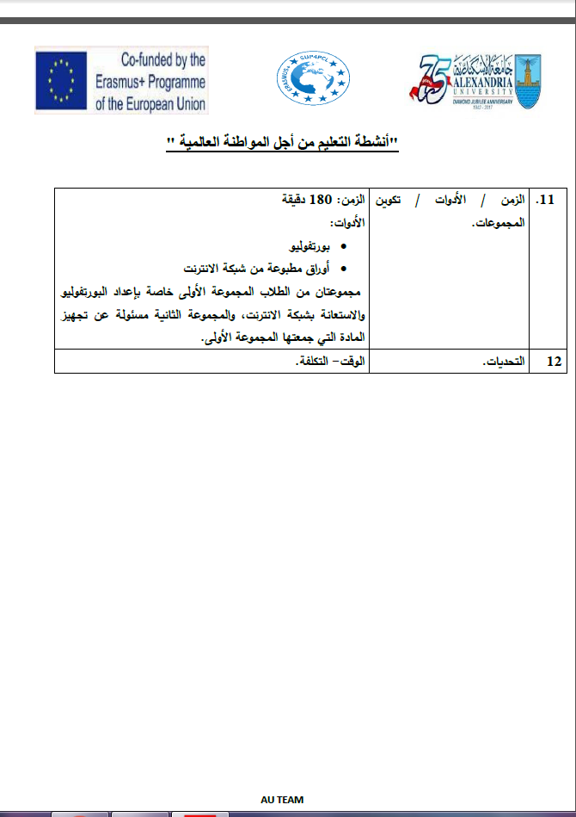
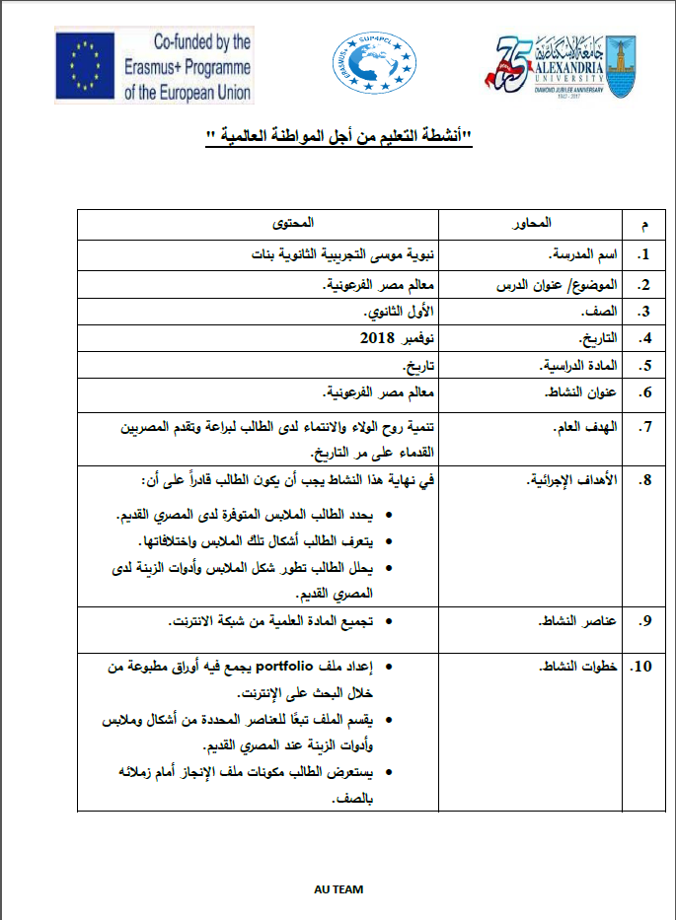
3. Schools Develop their Materials: GC

Slide 14
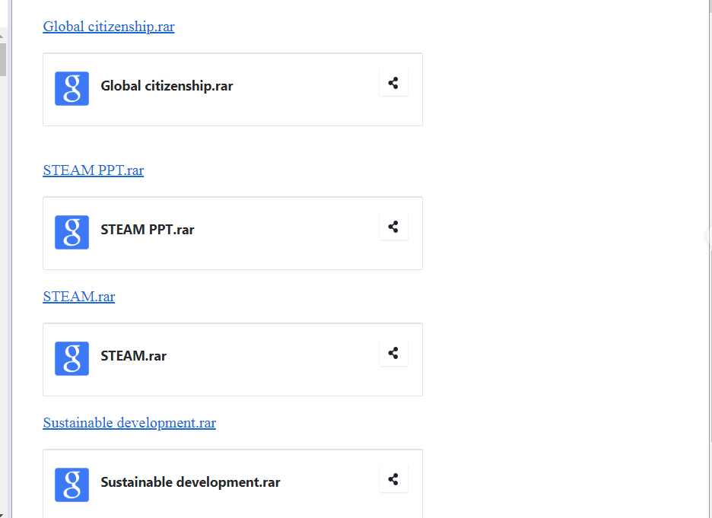
Uploading materials to AU Google Drive

Slide 15
Outcomes
Building capacity of schools’ Training and Quality Assurance units
Building capacity of schools’ mentors (selection- de-selection & re-selection)
Supporting emerging PCLs in schools
Creating Schools’ networks/ clusters
Introducing a different culture for the five PD & their clustering schools
Emergence of collaborative action research projects among schools’ clusters.
Emergence of PCLs across schools.

Slide 16
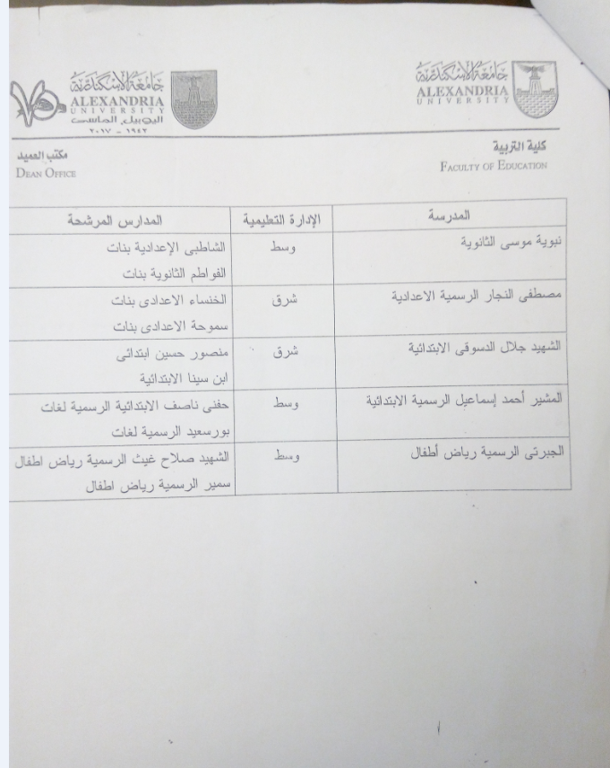
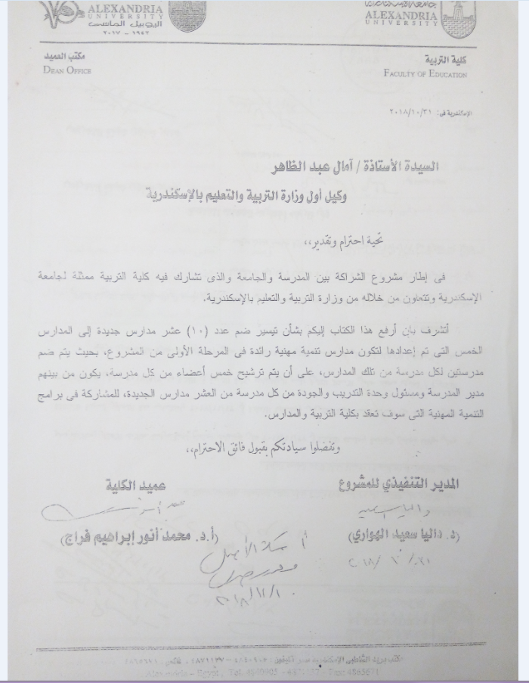
Communication with Directorate

Slide 17
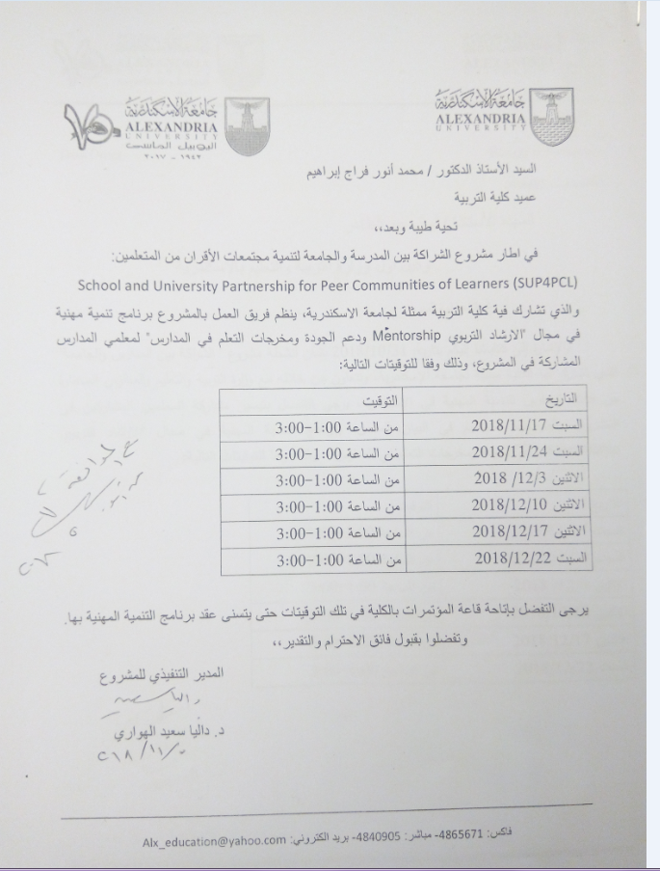
Schools clustering work at AU in November-December 2018

Slide 18
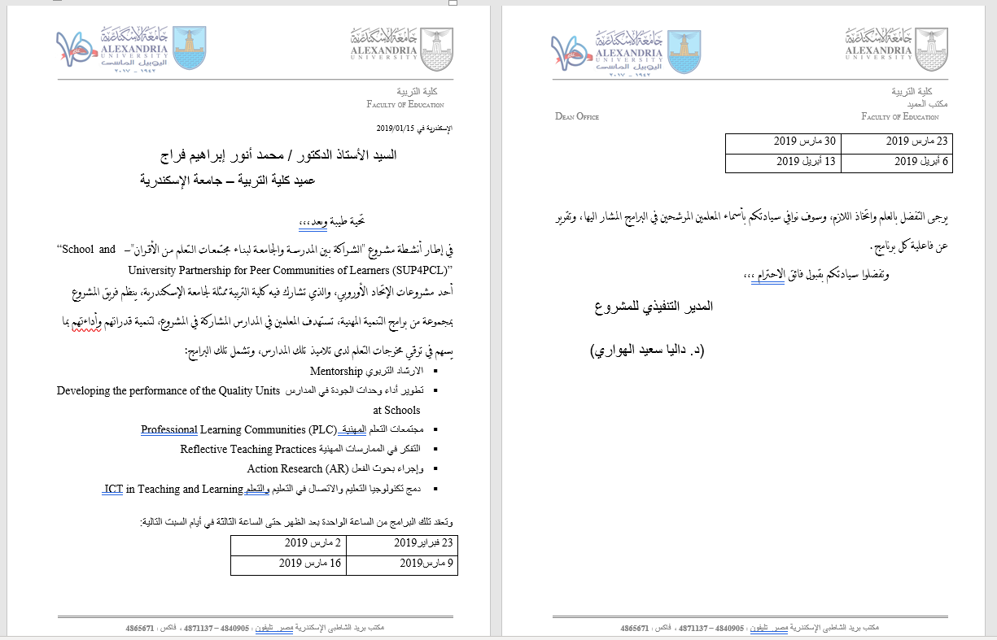
Schools Clustering work during the second semester February- April 2019

Slide 19
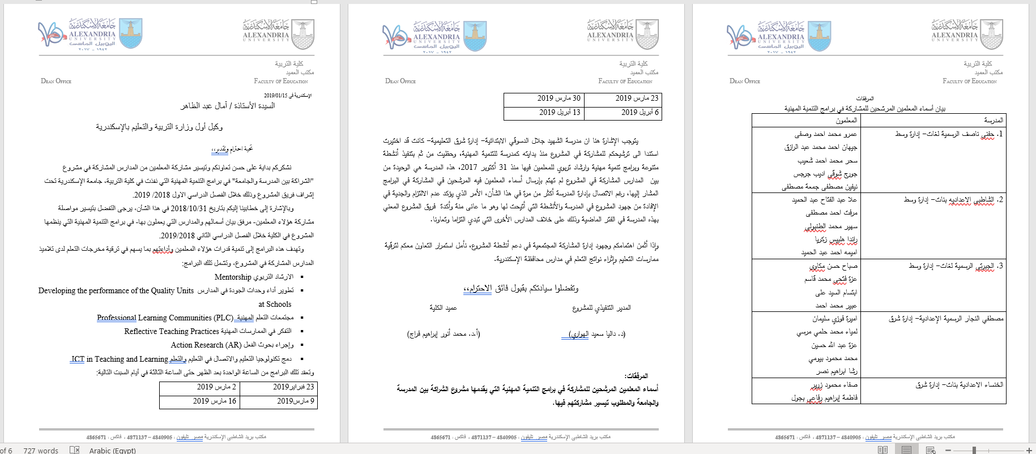
Participants from the 15 Schools

Slide 20
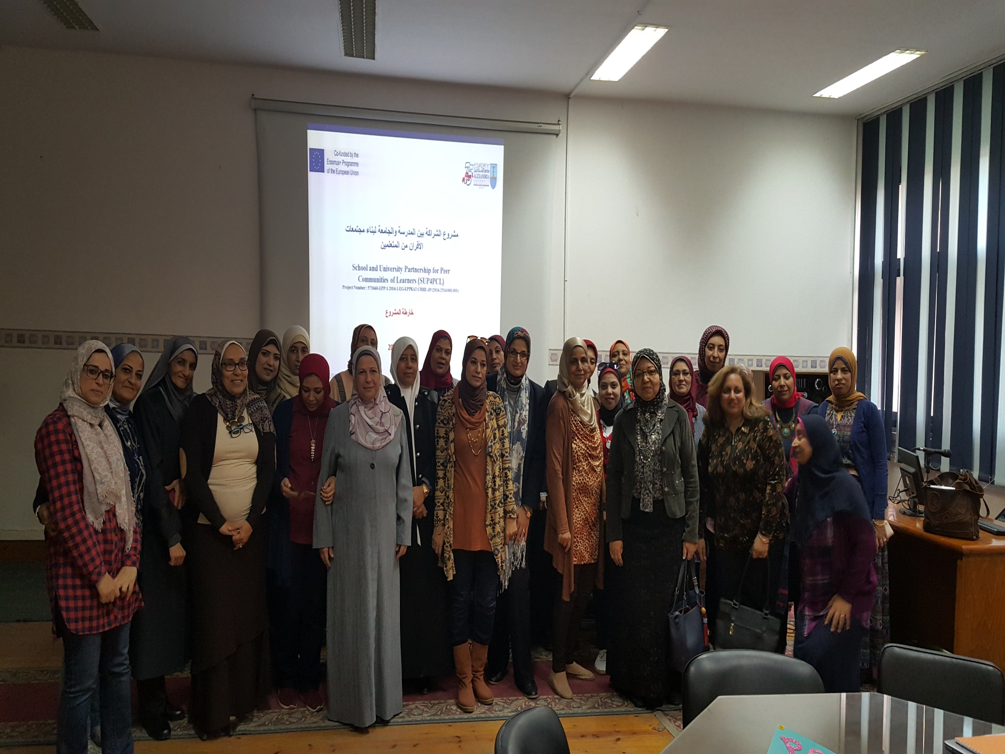

Slide 21
Challenges
Communication with the Directorate in Alexandria
Unavailability of some schools
Concurrent Intensive trainings by the MOE (teachers’ workload- motivation)
Losing some previously selected mentors
The unavailability of teachers/ schools on agreed visits days

Slide 22
AU Activities: AU
Mobility (October-November 2017)
Collaborative workshops with EU partners (April 2017, December 2017& February 2018)
Working with twining University (UoN) (Online monthly meetings, UoN visit in December 2018)
AU team regular meetings
AU developing into a PCL
Mentoring activities among AU team members

Slide 23
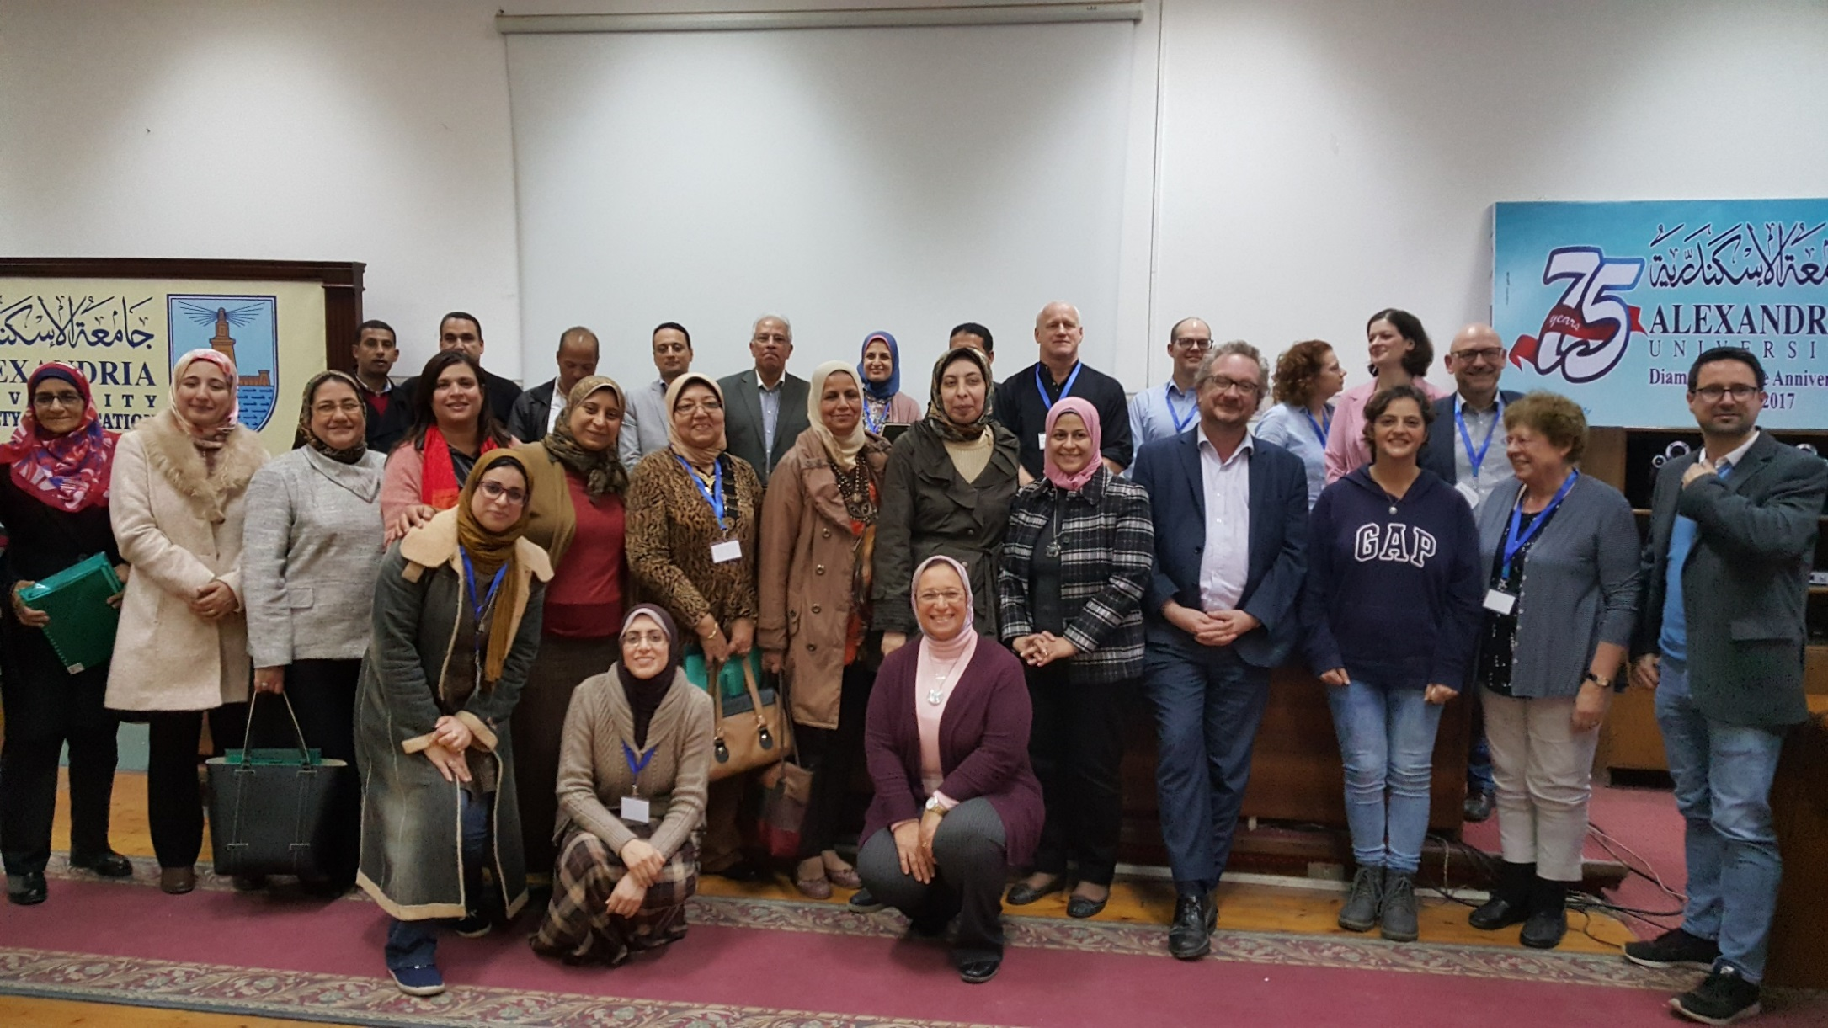

Slide 24
AU Activities: AU
Inquiry based activities (reflection- research)

Slide 25
Overarching Research Questions:
How does the SUP enhance the development of PCLs at school level?
How has the PCL impacted on the transformation of professional learning practice at the school level?
What are some of the tensions between beliefs/values and practice?

Slide 26
Overarching Research Questions:
How does the SUP enhance the development of PCLs at university level?
How has the PCL impacted on the transformation of professional learning practice at the university level?
What are some of the tensions between beliefs/values and practice?

Slide 27
Outcomes
Building capacity of AU team members
Evolution of AU PCL
Evolution of mentorship
Documentation (focus group interviews, reflective journals, PCL’s meetings agendas)
New teaching strategies (English and Math Undergraduate Initial teacher Education programmes)
New topics introduced in undergraduate and postgraduate Initial Teacher Education Programmes (English and) Math

Slide 28
Outcomes
Collaboration among AU team members
New culture introduced
Data collected for researching changes at the school and AU
Initial data analysis conducted
Agreed timeline and framework for writing of the case studies

Slide 29
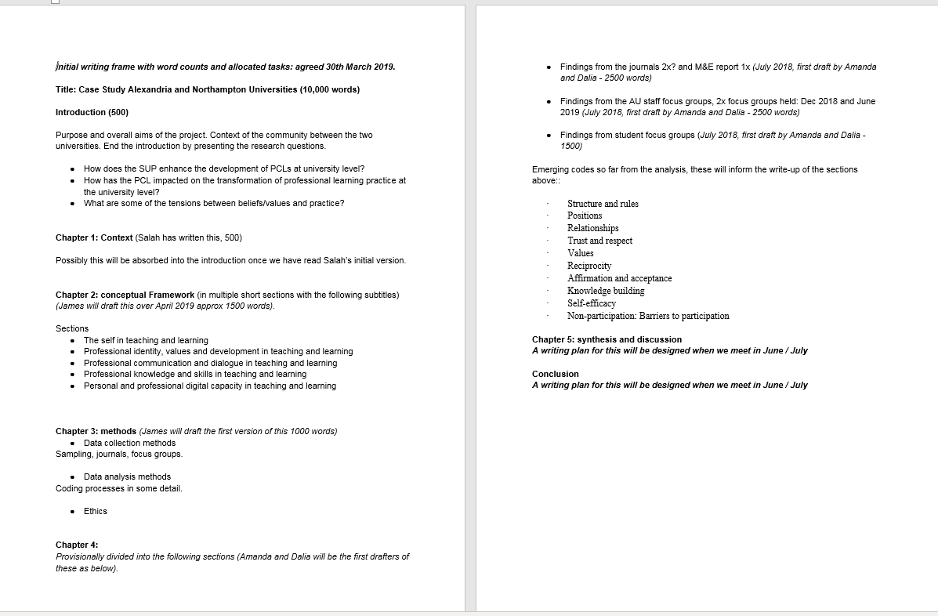

Slide 30
Outcomes
A Fully equipped computer lab ay AU
MoU between AU & UoN (in process)
Online Learning communities (emerging)

Slide 31


Project Dissimination

Slide 32
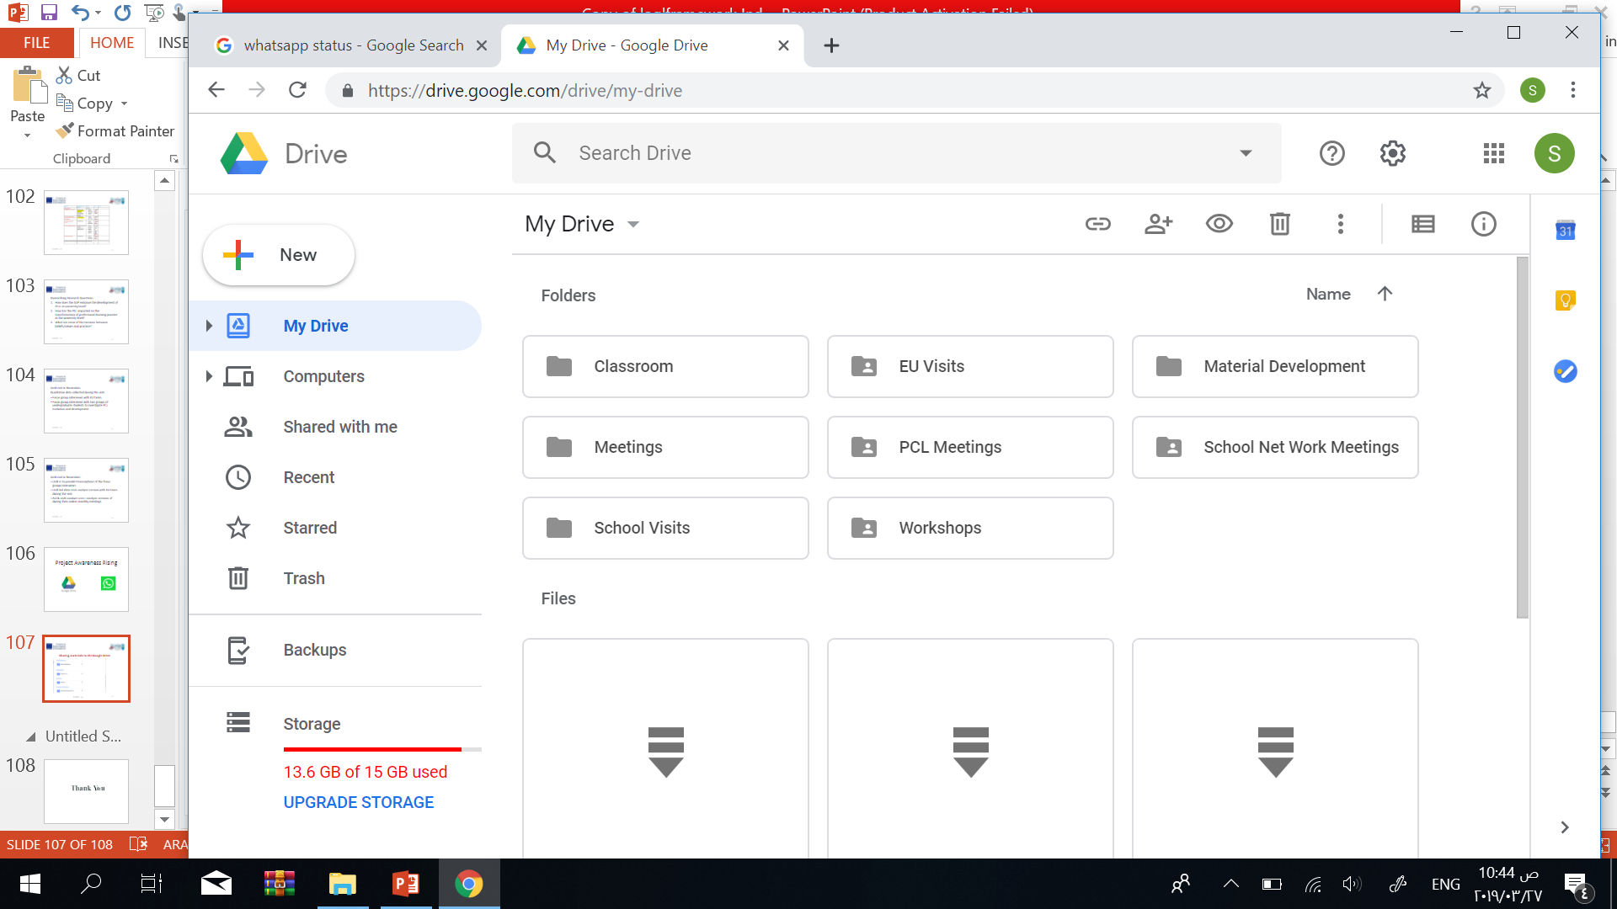
Sharing materials to AU Google Drive
SUP4PCL AU

Slide 33
Challenges
Development of PCL culture
The culture of hierarchy
The weak culture of collaboration
Lack of resources
Workload puts constraints on collaboration
Time and space
Collaboration with the MoE
Research skills
Sustainability
Notes:
The only issues expressed are related to the culture of hierarchy that some members feel that it affects decision making. The weak culture of collaboration and lack of resources at AU represent another challenge. Heavy Workloads is a further challenge that at times puts constraints on collaboration.

Slide 34


