Slide 1


School and University Partnership for Peer Communities of Learners (SUP4PCL)
Project number:
573660-EPP-1-2016-1-EG-EPPKA2-CBHE-JP (2016-2516/001-001)
Introduction to SUP4PCL Website
Advisory Meeting 2nd of May The American University in Cairo
"This project has been funded with support from the European Commission. This presentation reflects the views only of the author, and the Commission cannot be held responsible for any use which may be made of the information contained therein

Slide 2

SUP4PCL Website

Slide 3
Structure of the Website
Home Page
About Us
Partners
Work Packages – WP1: Preparation WP2: Development WP3:Quality Plan WP4: Dissemination and Exploitation WP5: Management
Library
News
Contact
Internal Postal for SUP4PCL Members
Notes:
Clarify developed materials in the workpackage
State that the tools in the templates were validated by the EU

Slide 4
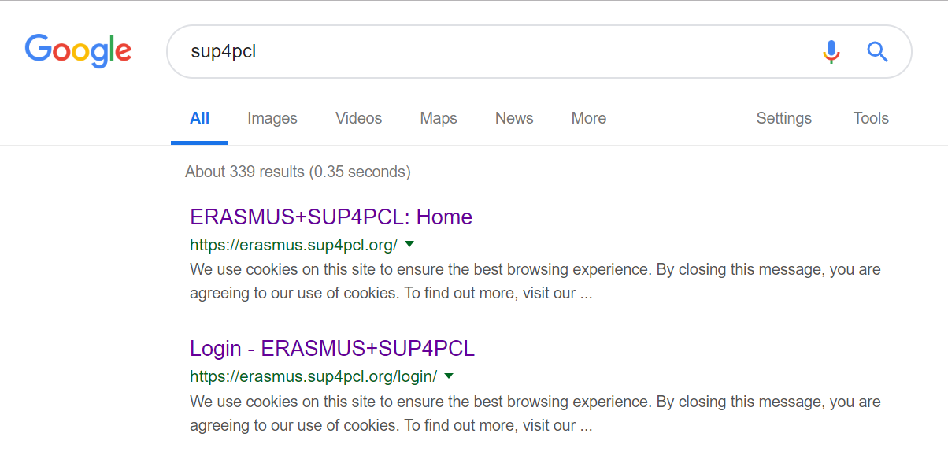
Disseminating the website
AUC has already asked the partners to put the website’s URL in their email signatures.
The URL was shared with all networking schools
All partners are registered on the website and can access the internal part
Notes:
Clarify developed materials in the workpackage
State that the tools in the templates were validated by the EU

Slide 5
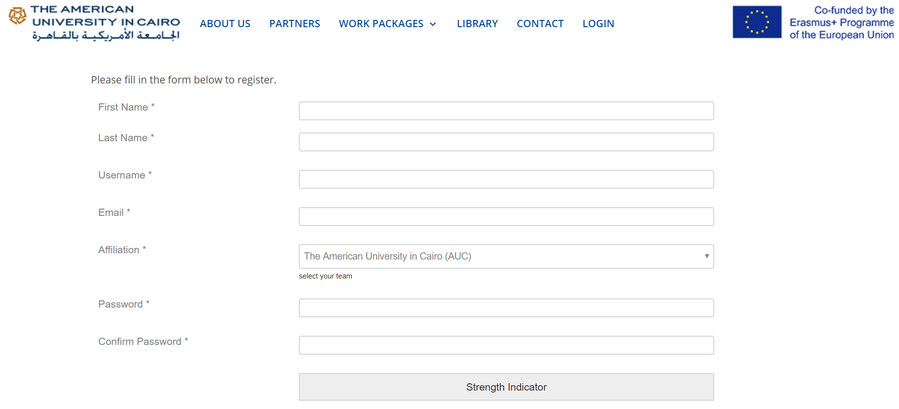
https://erasmus-test.insideout.io/registration/
https://erasmus-test.insideout.io/registration/
Registration
Registration link for the internal part of the website:
https://erasmus-test.insideout.io/registration-2/

Slide 6
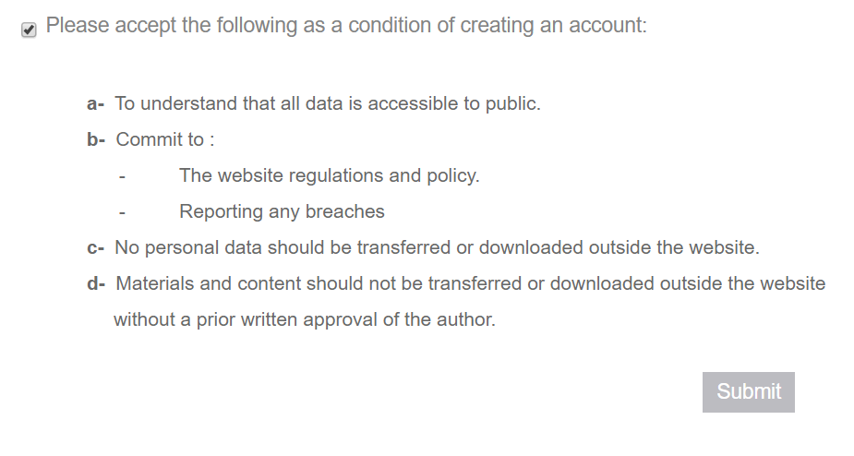
Registration
Privacy Policy abides by GDPR EU regulations:

Slide 7
Objectives of the Website
Global visibility and dissemination of the project’s objectives, partners, work packages and organization
Unified platform that merges all educational platforms used by partners ex: Edmodo, Facebook, Webquest
Easily accessible platform with all the material from management meetings, workshops and circulars
Space for enriched library and developed material
Technological platform for group discussions and posts by partners
News page with all the latest achievements and media coverage
Management and M&E tool
Helps the process of writing case studies
Useful for auditing purposes

Slide 8
Resources on the library
Publishing Forums on PCLs and Mentorship
Egyptian Knowledge Bank
Qualitative Research
Helwan University’s Platforms with Teachers
Useful Articles for International Networks for Teachers مقالات فنية تدعم العلاقات الدولية للمعلمين
Global Citizenship
STEAM
Sustainable Development
Special Educational Needs (SEN)
Mentorship

Slide 9
Roles on the website
Subscribers: They can access the frontend only, they can see private sections of the website, own a personal profile on the portal, can see and post on groups, can send requests to join groups and read articles.
Contributors: They can write, edit, and delete their own unpublished posts, but their content must be reviewed and published by an Admin or Editor. If they want to use specific images, videos, or audio files in the Media Library, they have to ask for assistance.

Slide 10
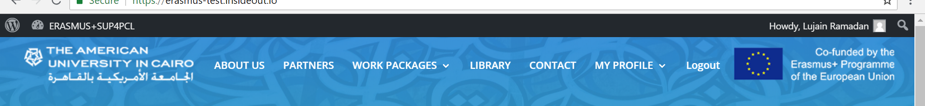
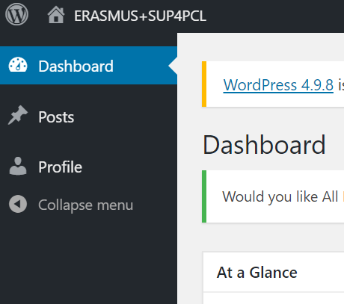
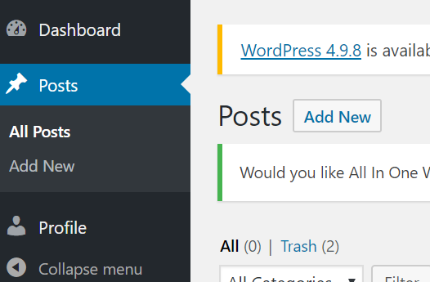
Roles on the website
Dashboard:
New post:
Notes:
- Migrating the website to AUC’s domain. We were planning to migrate to the NEO’s domain, but that will be costly

Slide 11
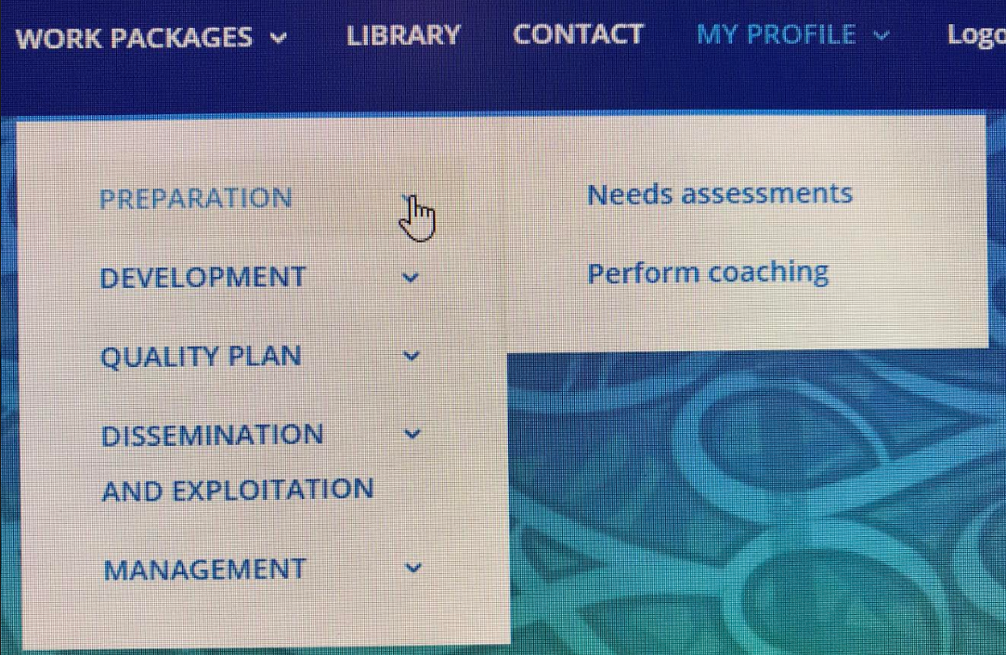
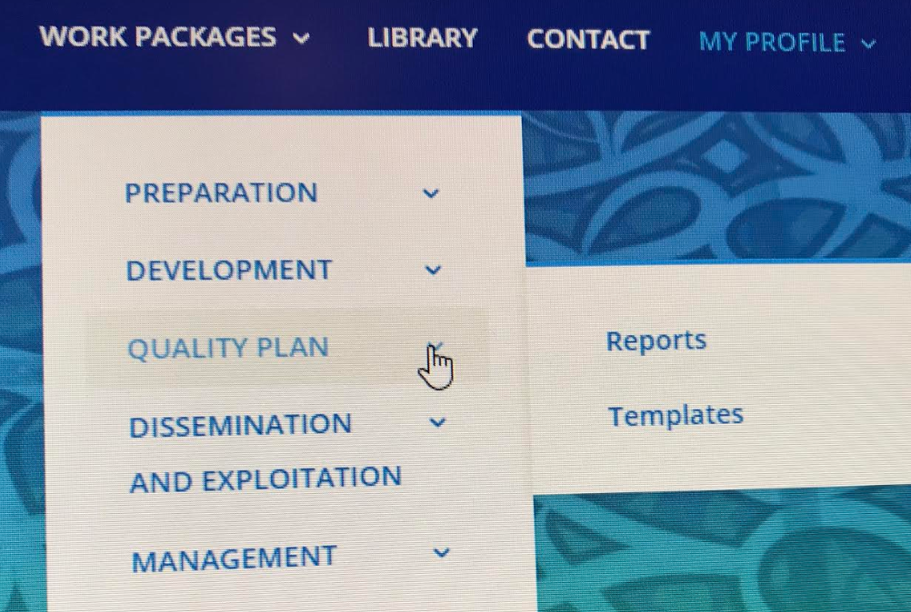
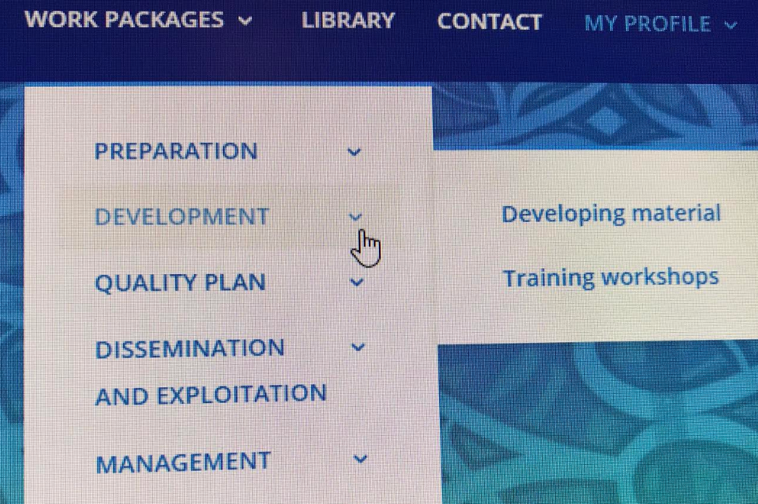
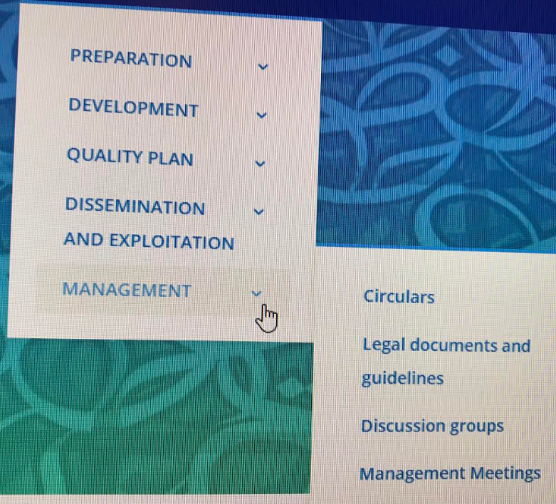
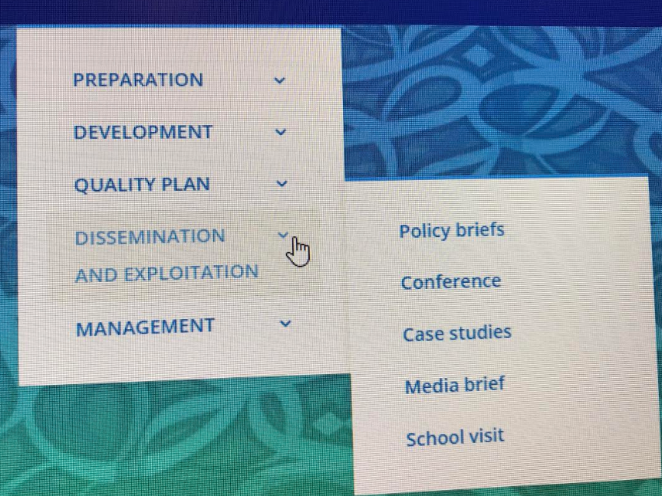
Division of Work Packages

Slide 12
Thank You

